Slide 1
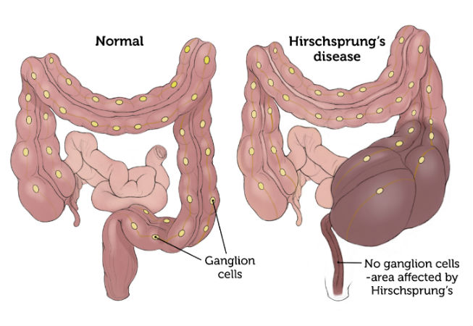
HIRSCHSPRUNG’S DISEASE
Prepared By;
Preya Patel

Slide 2
Alternative Names
Megacolon
Mega rectum
Congenital Aganglionic Megacolon
Hirschsprung's disease

Slide 3
Hirschsprung’s disease
Hirschsprung’s disease is named after the 19th century doctor, Harald Hirschsprung, who first identified it in 1886.
Prior to 1948, the basis of the disease was not understood, and there was no surgical procedure to correct it.

Slide 4
Definition
Hirschsprung disease is an congenital anomaly that results in mechanical obstruction from inadequate motility of part of the intestine .
This condition occurs when the nerves in the intestine (enteric nerves) do not form properly during development before birth (embryonic development).
The incidence is 1 in 5000 live births

Slide 5
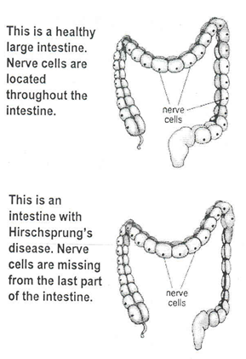

Slide 6
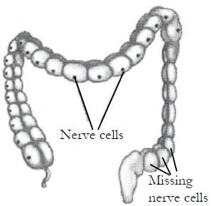

Slide 7
Children with a lack of nerve cells in part of the intestine interrupts the signal from the brain and prevents peristalsis in that segment of the intestine.
Because stool cannot move forward normally, the intestine can become partially or completely obstructed (blocked), and begins to expand to a larger than normal size.

Slide 8
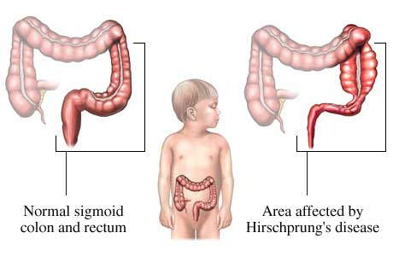

Slide 9
Causes
Genetic mutation (Dominant pattern of inheritance)
Absence of ganglion nerve cells (Aganglia)

Slide 10
Types
There are four main types of Hirschsprung disease, which are defined by the region of the intestine lacking nerve cells.
1. Short-segment disease
2. Long-segment disease
3. Total colonic Aganglionosis
4. Total intestinal Aganglionosis

Slide 11
1. Short segment disease
Nerve cells are missing from only the last segment of the large intestine.
This type is most common, occurring in approximately 80 percent of people with Hirschsprung disease.
For unknown reasons, short-segment disease is four times more common in men than in women.

Slide 12
2. Long segment disease
Long-segment disease occurs when nerve cells are missing from most of the large intestine and is the more severe type.
Long-segment disease is found in approximately 20 percent of people with HD and affects men and women equally

Slide 13
3.Total colonic Aganglionosis
Very rarely, nerve cells are missing from the entire large intestine and sometimes part of the small intestine

Slide 14
4. Total intestinal Aganglionosis
Missing of nerve cells from all of the large and small intestine

Slide 15
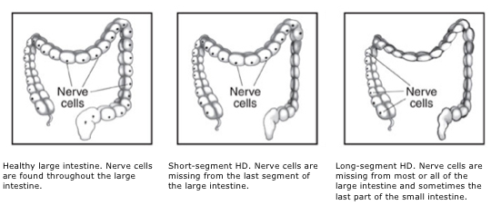

Slide 16
Pathophysiology
Absence of ganglion cells
Lack of enteric nervous system stimulation
Contraction of the abnormal bowel
Lack of peristalsis
Loss of Rectosphincteric reflex
Abdominal distention

Slide 17
Signs & Symptoms
Newborn period
Failure to pass meconium within 24 to 48 hours after birth
Refusal to feed
Bilious vomiting
Abdominal distention
Infancy
Growth failure
Constipation
Abdominal distention
Signs of Enterocolitis (fever, watery diarrhoea)
Childhood
Ribbon like foul smelling stool
Easily palpable fecal mass
undernourished

Slide 18
Diagnostic evaluation
History collection
Physical examination
Abdominal X-ray
Barium enema
Biopsy of the rectum or large intestine
Anorectal manometry

Slide 19
Anorectal manometry
Anorectal manometry is a test performed to evaluate patients with constipation or fecal incontinence.
This test measures
the pressures of the anal sphincter muscles,
the sensation in the rectum,
the neural reflexes that are needed for normal bowel movements.

Slide 20
Treatment
Ostomy procedures include:
Ileostomy
In ileostomy, the entire colon is removed. Stool leaves the body through the end of the small intestine.
Colostomy
The first stage of treatment used to be a reversible colostomy.
In this approach, the healthy end of the large intestine is cut and attached to an opening created on the front of the abdomen.
The contents of the bowel are discharged through the hole in the abdomen and into a bag.
Anorectal myomectomy

Slide 21
Pull through procedure
During a pull-through procedure, a surgeon removes the part of the large intestine that is missing nerve cells and connects the healthy part to the anus.
A surgeon most often does a pull-through procedure soon after diagnosis.

Slide 22
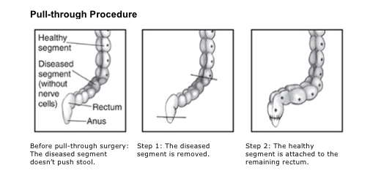

Slide 23
PULL THROUGH PROCEDURES :
The Swenson procedure leaves a small portion of the diseased bowel.
The Duhamel procedure uses a surgical stapler to connect the good and bad bowel.
The Soave procedure leaves the outer wall of the colon unaltered.

Slide 24
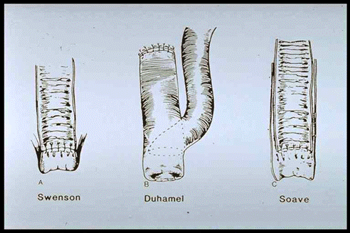

Slide 25
Preoperative care:
Bowel empty with repeated saline enema
Colon irrigation and observe output
NG tube may be inserted to prevent abdominal distention
Rectal tube may be inserted to allow for escape of accumulated fluid and gas
Prepare child and parents for colostomy (temporary)

Slide 26
Postoperative care:
Routine care includes; NPO, IV, NG suctioning.
Frequent abdominal dressing changes
Teach the parents about the importance of colostomy care
Drainage from the colostomy is measured
Perform good skin care (around colostomy)

Slide 27
On-going care
After healing from surgery, child’s bowel movements may become normal.
But surgery doesn’t cure Hirschsprung disease.
Some children will have bowel problems like constipation or fecal incontinence off and on throughout their lives.

Slide 28
Sometimes, these issues occur when babies start eating solid food, when older children add foods that are harder to digest or when children resist going to the bathroom because they are distracted by other activities.
There’s also some risk of enterocolitis, even after surgery.
Persistent diarrhoea, abdominal distention, abdominal pain, and constipation may be symptoms of complications.
It is important to seek medical help to prevent more serious problems.

Slide 29
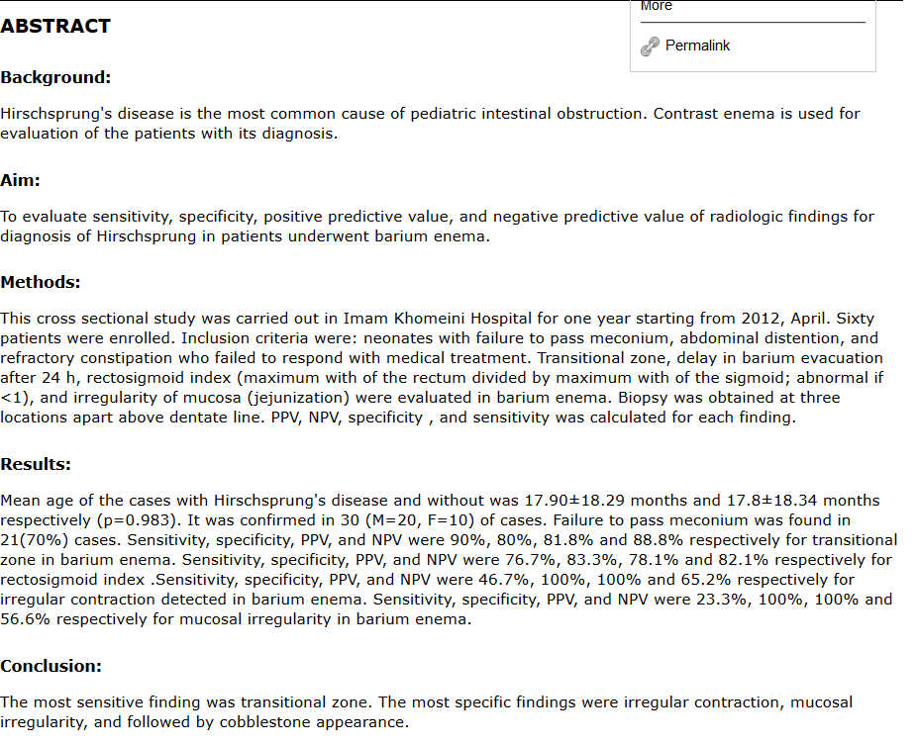

Slide 30
