Slide 1

MODERN TRENDS IN NURSING
Prepared By;
Preya Patel

Slide 2
INTRODUCTION
Trend :- A general development or change in a situation or in the way that people are behaving.
Nursing Trends :- Refers to direction towards which the different nursing events have moved or are moving.
Nursing is the largest health care profession which serves to meet the need of the society particularly the needs related to health.

Slide 3
According to U.S. Bureau of Labor Statistics, there were more than 3 million RNs in the nation in 2019, and employment of registered nurses is projected to grow faster than the average for all professions from 2019 to 2029.

Slide 4
TRENDS
Medical profession is a profession in which frequent advancements occur.
Trends in nursing profession are closely related to those in medical profession.
Now- a days advancements have came in many terms such as; in drug choices investigative choices and other specialized services too.

Slide 5
FACTORS AFFECTING CURRENT NURSING TRENDS
New developments in medicine.
Need for specialization in medicine and nursing.
Opportunities for services and education abroad.
New knowledge and procedures developed through research in science and technology.

Slide 6
TYPES OF NURSING TRENDS
Nursing Education
Nursing Practice
Nursing Administration

Slide 7
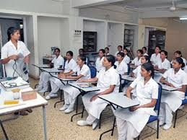
(I) NURSING EDUCATION
Diploma Courses
Auxiliary Nurse Midwife (ANM)
General Nursing and Midwifery (GNM)
BSc. Nursing
Post Basic BSc. Nursing
MSc Nursing
M.Phill
PhD in Nursing

Slide 8
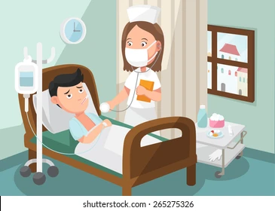
(II) NURSING PRACTICE
Comprehensive nursing care in hospital setting.
Team nursing
Quality care
Self care concept
Palliative nursing care
Health education

Slide 9
Preventive nursing care
Technological aids
Domiciliary care
Progressive patient care

Slide 10
(III) NURSING ADMINISTRATION
What is Administration ?
“ Administration is the organization of human and material resources to achieve desired ends.”
( Pfiffner and Presthus)
1 year Diploma Program in Nursing Administration (DNA).

Slide 11
THANK YOU

