Slide 1
Convulsion
MS Zoya ali Makrani
Nursing Tutor
DEPARTMENT OF MSN
SUMANDEEP nursing COLLEGE

Slide 2
Convulsion/epilepsy/seizures
Sudden alteration in normal brain activity that cause distinct changes in behavior and body function

Slide 3
Types
Partial
Generalized
Status epilapticus

Slide 4
Etiology
Brain injury
Brain tumors
Brain surgery
Cerebral infections
Drug toxicity
Hypoglycemia and hyper glycemia
hypoxia

Slide 5
Hepatic coma
PIH
High fever
Congenital disease
Alcohols with drawl

Slide 6
Phases of major epilapesy
Onset
Tonic
Clonic
Post convulsive phase

Slide 7
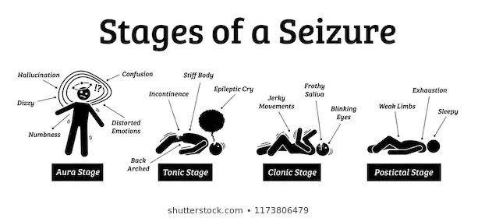


Slide 8
Clinical features
Onset
Aura
Tonic phase
Rigidity of entire body
Jerky muscle movement
Tongue bite
Excessive salivation
Urinary and fecal incontinenece
Unconscious

Slide 9
Clonic phase
Relaxation of all muscles
Deep coma
Noisy breathing
Post convulsive phase
Confusion
Sleepy
c/o headache and muscle pain
Not aware about the episode of seizure

Slide 10
Investigation
EEG
MRI
CT scan
Lumbar puncture
Blood investigations

Slide 11
management
Pharmacological
Lager doses of single epileptic drugs
Anti epileptics
Phenytoin
Carmazapine
Valporic acid
Benzo diazepines

Slide 12
Surgical management
Temporal lobectomy
Sub-pial resection
Resection
Hemispherectomy
Corpus callostomy
Vegal nerve stimulatior implantation

Slide 13
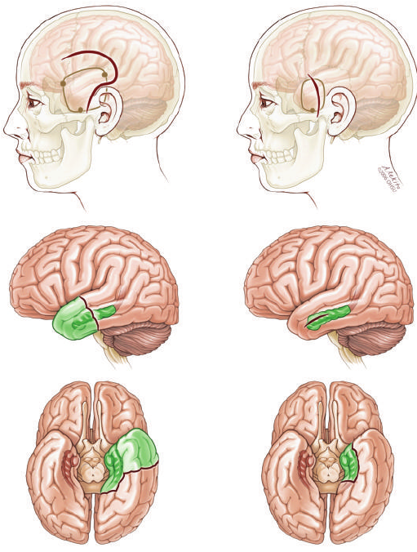

Slide 14
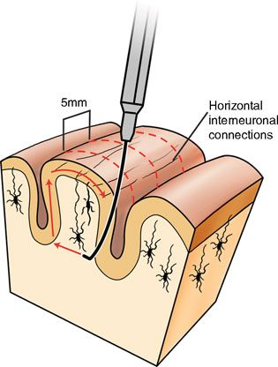

Slide 15
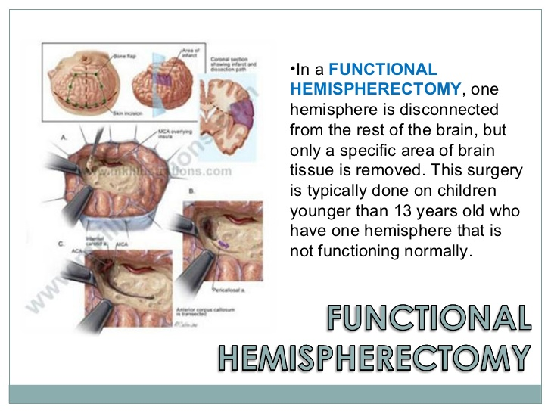

Slide 16
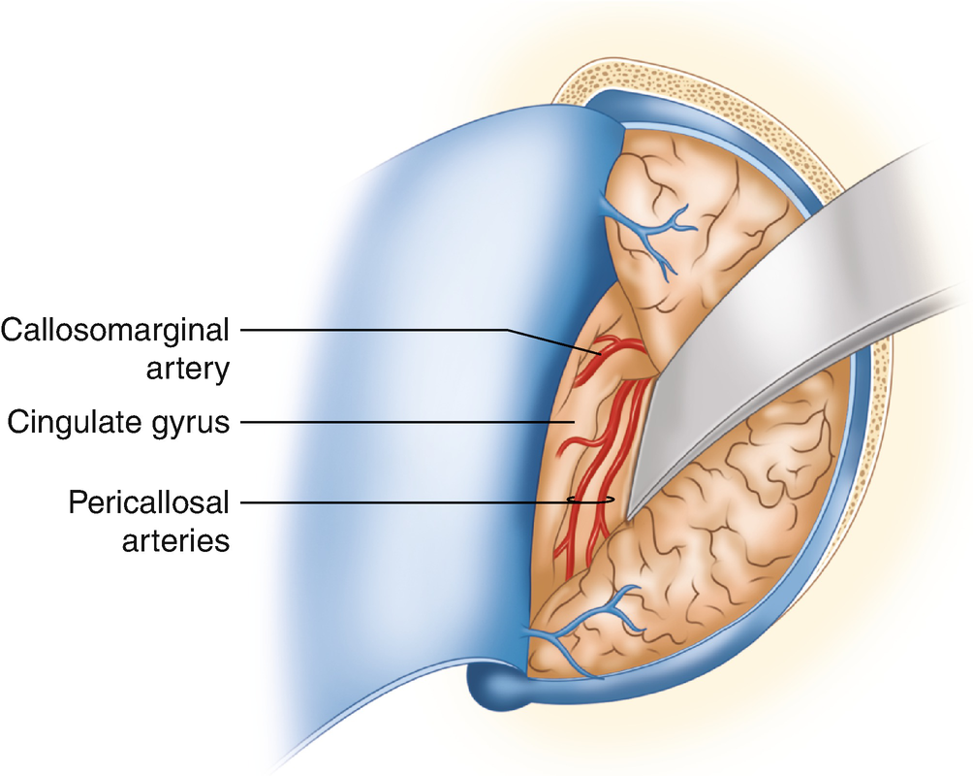

Slide 17
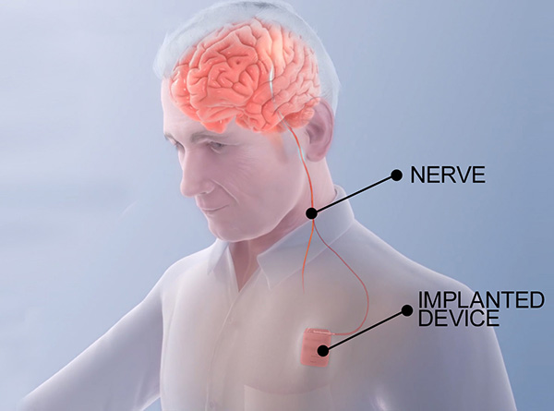

Slide 18
Nursing management
First aid
Lateral position
Removal of ornaments
Loosen cloth
Don’t dive anything by mouth
Don’t try to stop muscle spasm
Shift to hospital immediately
Inform to doctor immidiately

Slide 19
Nursing diagnosis
Ineffective airway clearance related to excessive production of secretion
Risk for injury related to involuntary muscle movement
Ineffective coping related to stress imposed to disease
Fear related to ever present possibility of having seizure

Slide 20
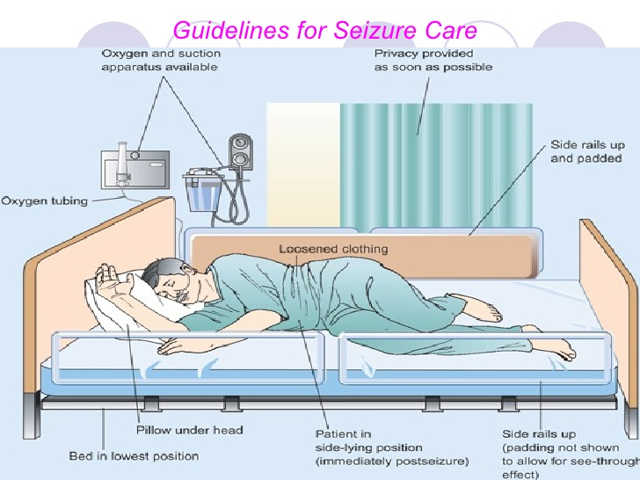

Slide 21


