Slide 1
Intra venous infusions
Presented by :
Ms. Zoya Ali
Nursing Tutor
Department of MSN
Sumandeep Nursing College

Slide 2
Historical background:
In the 1830s, a lethal strain of cholera wracked much of Europe. This type of cholera was called “Russian cholera,” or “blue cholera,” for the dusky cyanotic complexion of its.
Mr. Thomas Latta, implemente d this iv therapy.

Slide 3
Intravenous therapy :
Intravenous therapy or IV therapy is the infusion of liquid substances directly into a vein. The word intravenous simply means "within a vein”.
Iv therapy constitutes the administration of liquid substances directly into a vein and general

Slide 4
Infusion therapy :
Infusion therapy is deﬁned as the parenteral infusion of ﬂuids, electrolytes, blood components, nutrients, or medications to prevent or treat deﬁciencies.
Infusion therapy may be dispensed by I.V., subcutaneous, intraosseous or intrathecal routes of administration.

Slide 5
Blood component therapy:
Common blood components that may be transfused include red blood cells, fresh-frozen plasma, platelets, and clotting factors .

Slide 6
PARENTERAL NUTRITION
Parenteral nutrient solution composition is determined individually to meet each patient’s nutritional needs.
Parenteral solutions include electrolytes, dextrose, amino acids, vitamins, and various trace elements.
These solutions are referred to as total parenteral nutrition (TPN).
here are also solutions referred to as total nutrient admixture (TNA) solutions that provide a nutrient mix that includes electrolytes, dextrose, amino acids, vitamins, trace elements, and fats.

Slide 7
The concentration of nutrients in TPN solutions, IVFEs, and TNA solutions, is determined by I.V. delivery route.
The solutions are less concentrated when they are delivered by a peripheral I.V. route and are more concentrated when delivered by a central I.V. route.

Slide 8
Fluid compartments
EXTRACELLULAR FLUID (ECF) Approximately 80% of extracellular fluid is interstitial, which occupies the microscopic spaces between the cells. 20% is plasma, which is the liquid portion of the blood.
INTRACELLULAR FLUID ( ICF) This is known as cytosol and is fluid.
Substances move around from areas of high concentration to low concentration and a concentration gradient will exist between the two.
They move passively.
Movement is facilitated through process of osmosis or diffusion.

Slide 9
Types of fluid :
1. Colloid
2. Crystalloid

Slide 10
1. Colloid
• Fluids with large molecules which donot pass the cell membranes, when infused remain mainly in the intravascular compartment.
• It expands intravascular volume and draw fluid from extravascular spaces. Eg. Albumin, hemacel, dextran.

Slide 11
2. Crystalloid
• It contains small molecules flowing easily through cell membranes, allowing for transfer from blood stream into cells and body tissues.
• It increases the blood volume in both interstitial and intravascular spaces.
It is further divided into:
a. Isotonic: eg. 0.9% Sodium Chloride, Ringer Lactate,5% dextrose in water.
b.Hypotonic: eg. 0.45% sodium chloride,0.33% Sodium Chloride,o.2% sodium chloride,2.5% dextrose in water.
c.Hypertonic: eg. 3% Sodium Chloride,5% Sodium Chloride.

Slide 12
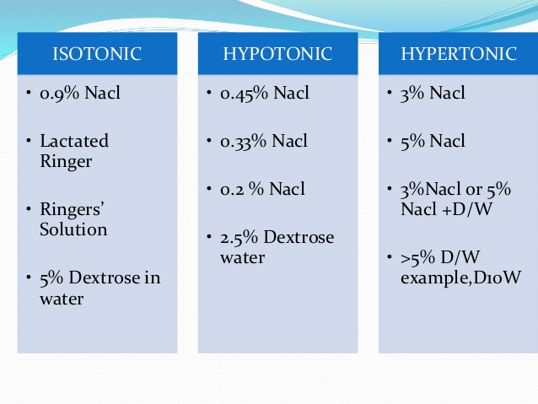

Slide 13
IV ACCESS DEVICES:

Slide 14
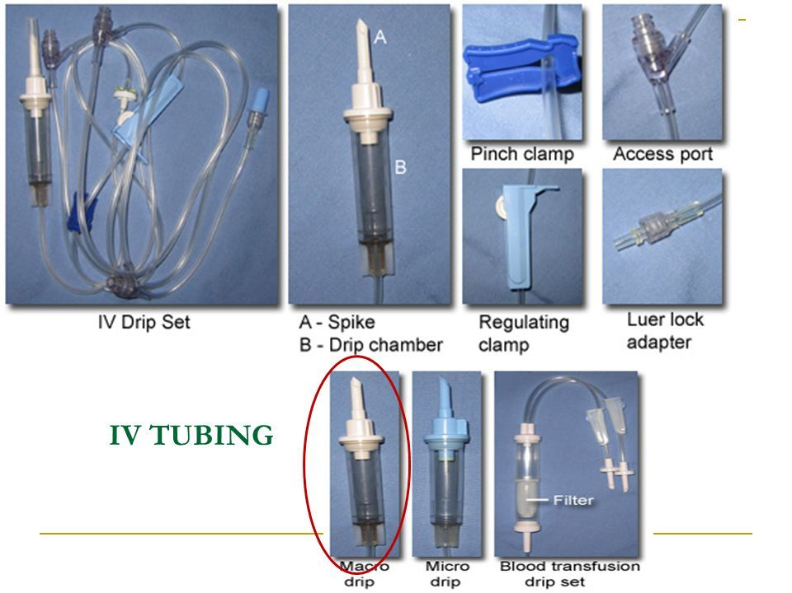
Iv sets

Slide 15
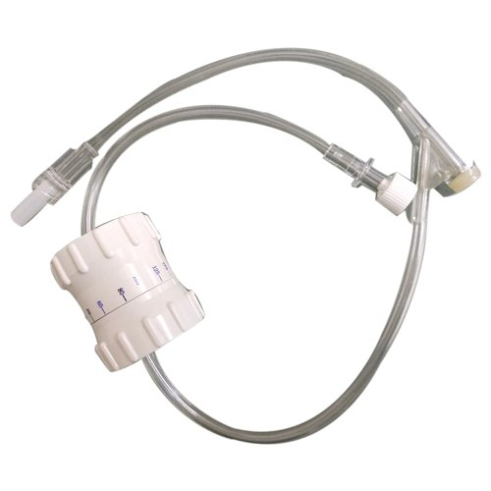
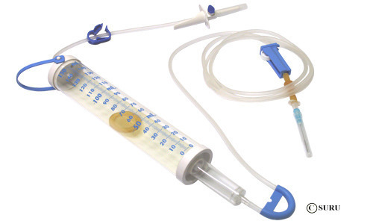
Infusion sets

Slide 16
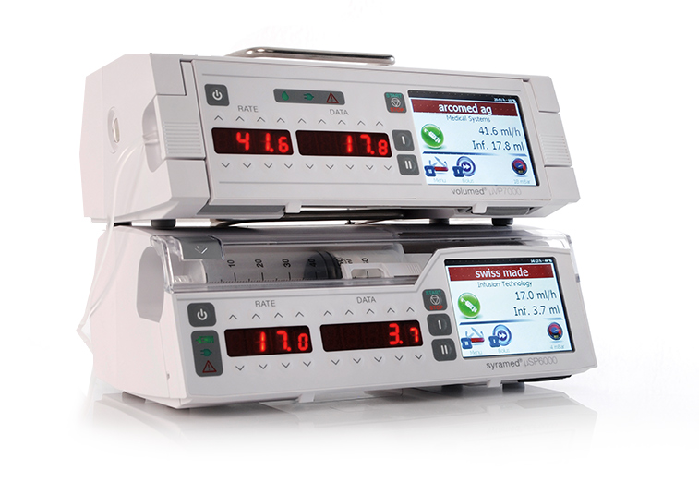
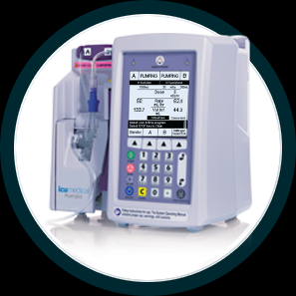
INFUSION PUMPS

Slide 17
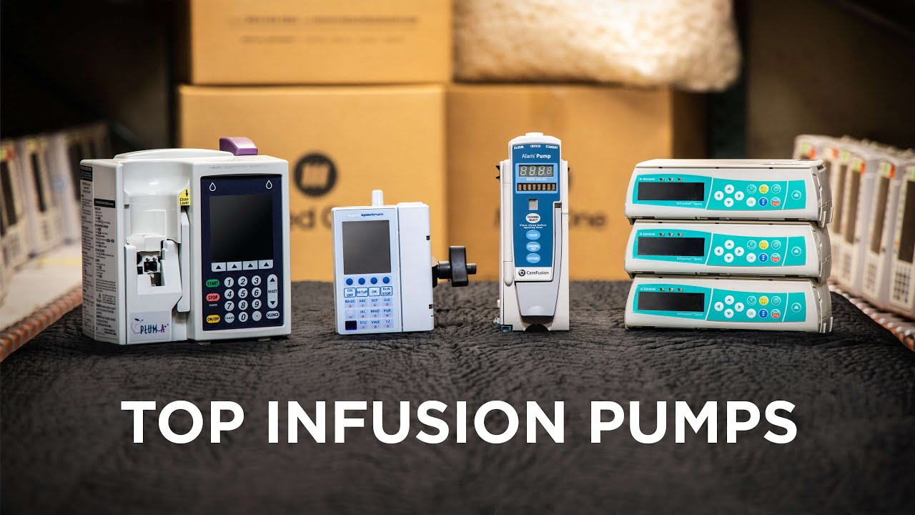

Slide 18
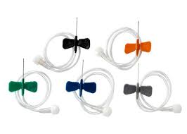
Scalp vein set

Slide 19
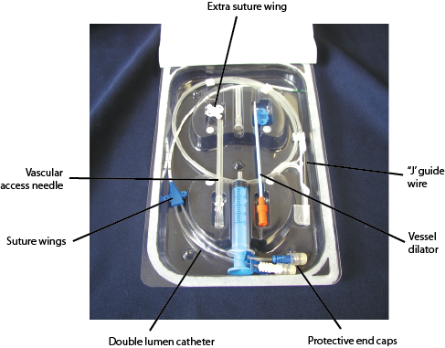
Central venous catheter kit

Slide 20
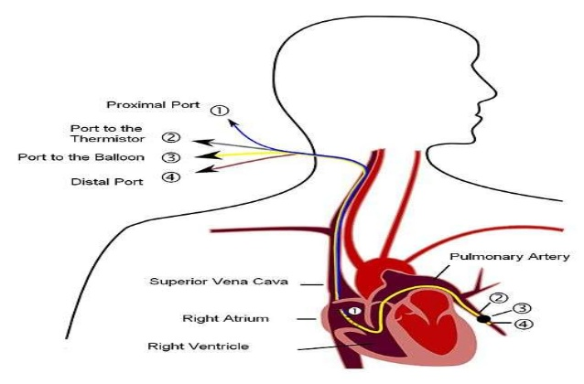

Slide 21
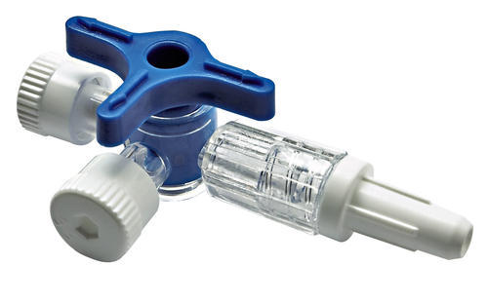
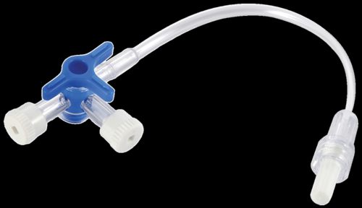
3 WAY STOP COCK

Slide 22
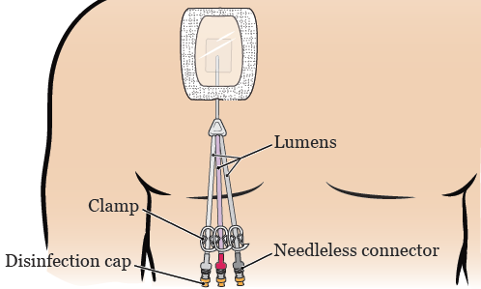
TUNNELED LINES :

Slide 23
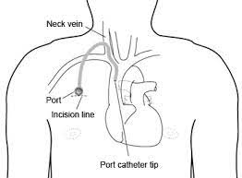
IMPLANTABLE PORTS:
A port (Port-a-Cath or MediPort) is a central venous line that does not have an external connector; instead, it has a small reservoir that is covered with silicone rubber and is implanted under the skin.

Slide 24
VERICOSE VEINS /SCLERO THERAPY:
Sclerotherapy is a procedure used to treat blood vessels vascular malformations and also those of the lymphatic system.
A medicine is injected into the vessels, which makes them shrink.
In adults, sclerotherapy is often used to treat spider veins, smaller varicose veins and hemorrhoids.

Slide 25
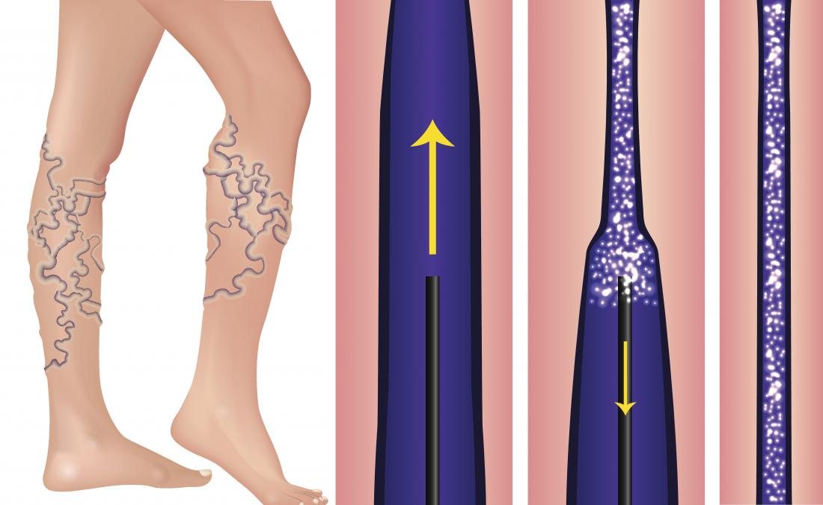

Slide 26
Indications for IV therapy:
◻ To provide Parenteral nutrition
◻ To provide avenue for dialysis/apheresis
◻ To transfuse blood products
◻ Replace fluids and replace imbalances
◻ To provide avenue for hemodynamic monitoring
◻ To provide avenue for diagnostic testing
◻ To administer fluids and medications

Slide 27
Principles of IV therapy:
1. maintenance :
• Fluids are given for compensating ongoing sensible losses.
• It includes urine output, fecal matter, respiration, perspiration.
• Its requirement is higher in children than adults because of higher metabolic rate, more body surface area, higher respiratory rate

Slide 28
¼ NS,1/4 NS+ D5, ½ NS, 1/2NS+D5 are the most commonly used fluid for maintenance.
• Normal range for children is (70-150)ml/hr.

Slide 29
2. replacement
It includes fluid to meet ongoing losses due to medical treatment.Eg. Patient with chest tube drain, umcontrolled vomotong, continue diarrhea,CSF shunt, etc. Ringer lactate, Normal saline are preferred.

Slide 30
Procedure :
Confirm Patient’s Identification
Review Physician’s Order
Explanation about the procedure
Perform Hand Hygiene
Gather Equipments a. Cardex b. Tray containing gloves, syringe with normal saline, marker medicine. c. IV drip fluid d. Buroset
Inspect administration set
Place IV level on the IVF bottle
Hang solution container on the pole.

Slide 31
9. Open IV set aseptically.
10. Fill the drip chamber half.
11. Expel air bubble if any.
12. Connect tubing to catheter and initiate infusion.
13. Infuse as per the rate and amount.
14. Observe for complications like signs of infection, phlebitis, infiltration, kin color changes, fluid and electrolyte overload, etc.
15. Never allow the bottle to get empty completely.
16. Quickly remove the spike from the old IV solution without touching the tip and insert spike into the new intravenous bottle.
17. Document accurately.
18. IV tubing should be changed every 48-72 hours and cannula every 72 hours.

Slide 32
SIDE EFFECTS OF IV THERAPY
infection
Infilteration
Phlebitis and thrombophlebitis
Extravasation
hypersensitivity

Slide 33
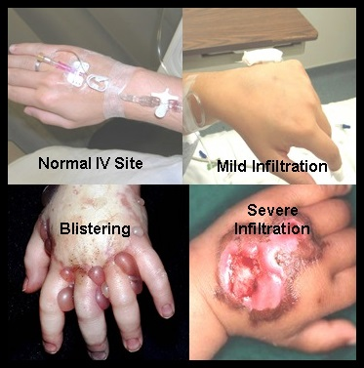
Infilteration
infiltration occurs when I.V. fluid or medications leak into the surrounding tissue. Infiltration can be caused by improper placement or dislodgment of the catheter. Patient movement can cause the catheter to slip out or through the blood vessel lumen.

Slide 34
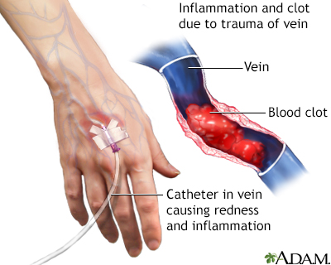
Phlebitis
Phlebitis is inflammation of a vein. It is usually associated with acidic or alkaline solutions or solutions that have a high osmolarity. Phlebitis can also occur as a result of vein trauma during insertion, use of an inappropriate I.V. catheter size for the vein, or prolonged use of the same I.V. site.

Slide 35
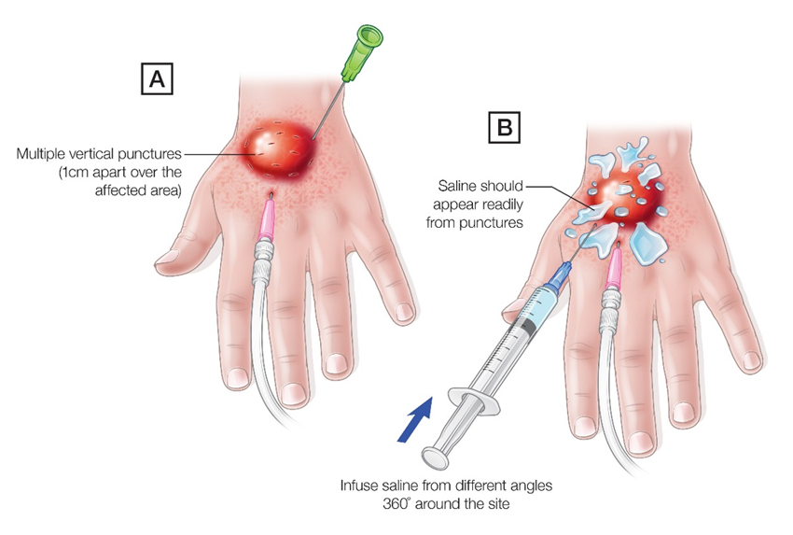
Extravasation :
Extravasation is the leaking of vesicant drugs into surrounding tissue. Extravasation can cause severe local tissue damage, possibly leading to delayed healing, infection, tissue necrosis, disfigurement, loss of function, and even amputation.

Slide 36


