Slide 1
Pulmonary Tuberculosis
PRESENTED BY:
Ms. Zoya Makrani
Nursing Tutor
Department of MSN
Sumandeep Nursing College

Slide 2
definition
TB is an infection disease that primarily affects the lung parenchyma.
It also may be transmitted to other parts of the body, including the meninges, kidneys, bones, and lymph nodes.
The primary infectious agent is M.tuberculosis, is an acid –fast aerobic rod that grows slowly and is sensitive to heat and ultraviolet light.

Slide 3
Statistical data
TB estimated one third of the world’s population and remains the leading cause of death from infectious disease in the world
In 2014, 9.6 million people were sick with TB throughout the world and there were 1.5 million TB related deaths,(CDC/2015d)
According to WHO India is the country with highest burden of TB.
In 2016, about 2.79 million cases of TB were reported in India out of the total incidence of 10.4 million cases globally.
7 countries account for 64% of the total TB cases worldwide, with India leading the count, followed by Indonesia, China, Philipines, Pakistan, Nigeria, and South Africa (TB India report, 2017)

Slide 4
Transmission and risk factors
TB spreads from person to parson by airborne transmission
Close contact with person who has TB
Immunocompromised status
Substance abuse
Institutionalization
Pre existing medical conditions
Living in overcrowded sub standard housing
Being a health care provided performing high-risk activities

Slide 5
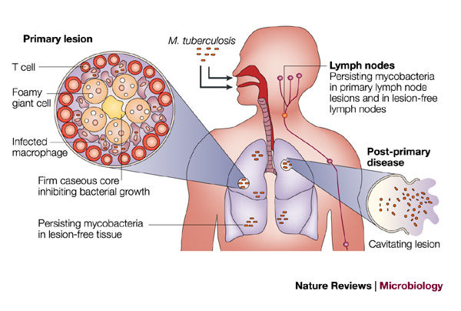
pathophysiology

Slide 6
Clinical manifestations
Low grade fever
Cough
Night sweats
Fatigue
Weight loss
Hemoptysis may also occur
Patients with HIV and extrapulmonary disease are more prevalent

Slide 7
Assessment and diagnostic findings
Once a patient with a positive skin test, blood test or sputum culture must require,
A complete history
Physical examination
Tuberculin skin test
Chest X-ray- lesions in upper lobes
Drug Susceptibility testing
Thorough respiratory examination

Slide 8
Tuberculin skin test
The Mantoux method is used for identification of TB
It is the standardized method
The intracutaneous injection is given only by trained person.
Tuberculin bacillus extract , purified protein derivative (PPD) is injected into the intradermal layer of the inner aspect of the forearm, approximately 4 inches below the elbow.
Tuberculin syringe of 26 or 27 gauze is used.
0.1 ml is injected.
Time, date, antigen name, site ,strength, lot number are recorded.

Slide 9
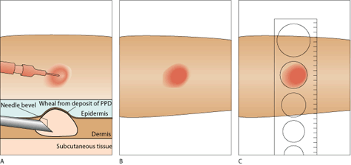
The test result is read after 48 to 72 hours.
Test read after 72 hours tend to underestimate the true size of induration
A delayed localized reaction indicates that the person is sensitive to tuberculin.
A site is inspected for induration, redness and diameter.
A reaction of o to 4 mm diameter is not significant. A reaction of 5mm or greater diameter is considered to be at risk.
A 10 mm or more is usually considered as significant in mildly impaired immunity.

Slide 10
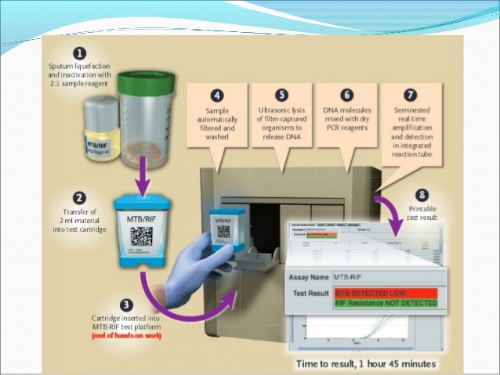
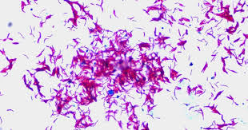
Diagnostic TB tests
According to new national TB plan there are 3 tests.
Sputum smear microscopy
2. Chest X-ray
3. CB-NAAT (cartridge- based nucleic acid amplification test.

Slide 11
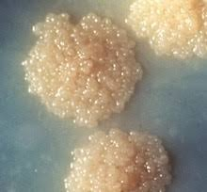
Sputum culture
Sputum specimen is used.
Presence of AFB on smear may indicate the disease but does not conform the disease.
Sputum culture is done to conform.

Slide 12
Medical management
Tb is primarily treated with anti TB agents for 6-12 months. several types of resistance are must considered when planning for effective therapy.
Primary drug resistance :resistance to one of first line anti-TB agents who have not had previous treatment.
Secondary or acquired drug resistance: resistance to one or more anti-TB agents in patients undergoing therapy.
Multidrug resistance: resistance to two agents, isoniazid and rifampin. Patients who are HIV positive,institutionalized or homeless are more at risk.

Slide 13
Medical management:firstline anti-TB drugs
Drug | Dosage
Isoniazid (INH) | 5mg/kg (300mg maximum daily)
Rifampicin | 10mg/kg (600mg maximum daily)
Rifabutin | 5mg/kg (300 mg maximum daily)
Pyrazinamide | 15-30mg/kg (2 g maximum daily)
Rifapentine | 10mg/kg (600 mg twice daily)
Ethambutol | 15-25 mg/kg (1.6 g maximum daily dose)
Combinations INH and rifampin | 150 mg and 300 mg caps

Slide 14
In current TB therapy, first four medicines are used INH,rifampin,pyrazinamide and ethambutol.
Combination medictions such as
INH+rifampin or INH+rifampin+pyrazinamide given twice a week.
Multidrug resistance is difficult to treat. Treatment is guided by sputum culture and sensitivity. Second line drugs such as, aminoglycosides, fluroquinolones, capreomycin, ethionamide, para-aminosalicyclate sodium, and cycloserine.

Slide 15
CDC guidelines 2015
Recommended guidelines for newly diagnosed TB case have two phases:
Initial phase:
Duration-8 weeks
Medication-INH , rifampicin, pyrazinamide, ethambutol, vitamin-B12
Continuation phase
Duration – 4 to 7 month
Medication- INH+rifampin or INH + rifapentine

Slide 16
Nursing management
Promoting airway clearance
Promoting adherence to treatment regimen
Promoting activity and nutrition.
Preventing transmission of TB infection

Slide 17
Promoting airway clearance
Careful removal of secretions.
Increase fluid intake to promote hydration and serve as effective expectorant.
Instruct about correct position to facilitate airway airway drainage.

Slide 18
Promoting adherence to treatment regimen
Advice to take medications before 1 hour of meal or empty stomach.
While taking INH avoid tyramine and histamine in food.
To wear eyeglasses during taking rifampin. Because it changes the colure of contact lenses.
Instruct about regular medication regimen and drug resistance.
Monitor vitals and temperature changes and respiratory status.
In community DOT therapy is prescribed.

Slide 19
Promoting activity and adequate nutrition
Planning of progressive activity schedule focusing on increasing tolerance and muscle strength.
A nutritional plans with small frequent meals and liquid nutritional supplements helps to maintain the calorie requirement.

Slide 20
Preventing transmission of TB infection
Covering of face and mouth while coughing and sneezing, mouth care and personal hygiene maintenance.
Inform to health care department for prevention and control.

