Slide 1
Reproductive Organs
Neethu Jomin

Slide 2
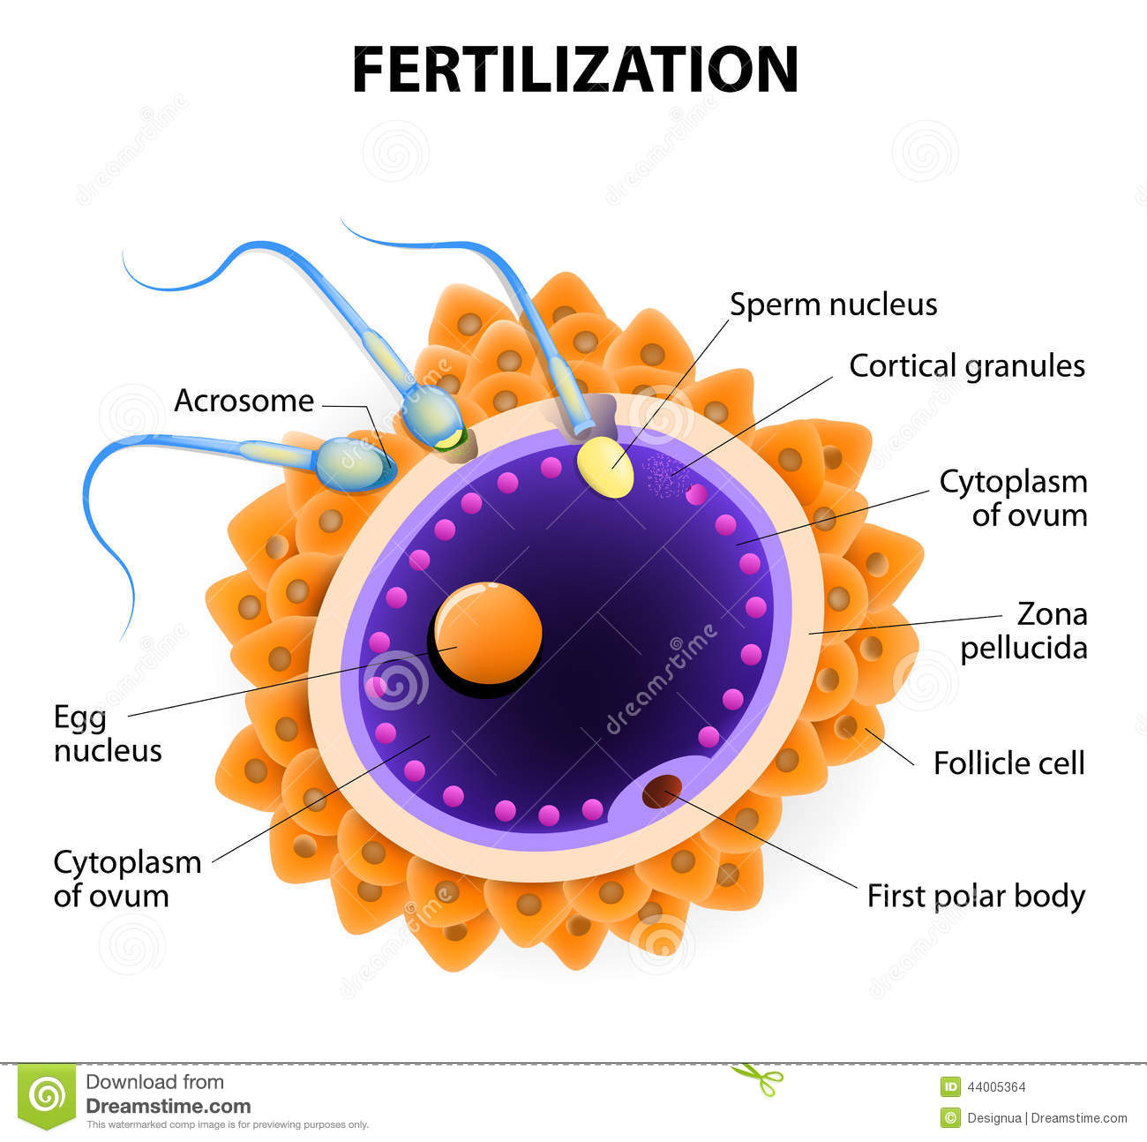
DEFINITION:
Ovum: “A mature female reproductive cell which can give rise to a new life only after fertilization by a male cell”.
Sperm: “A cell that is produced by the male sexual organs and that combines with the female’s ovum in reproduction.”
Fertilization: “it is a process of fusion of the sperm with the mature ovum.”

Slide 3
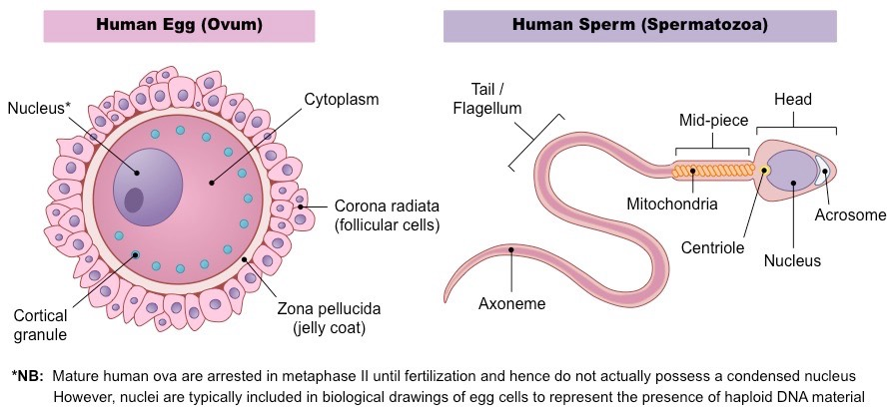

Slide 4
Male Reproductive Organs

Slide 5
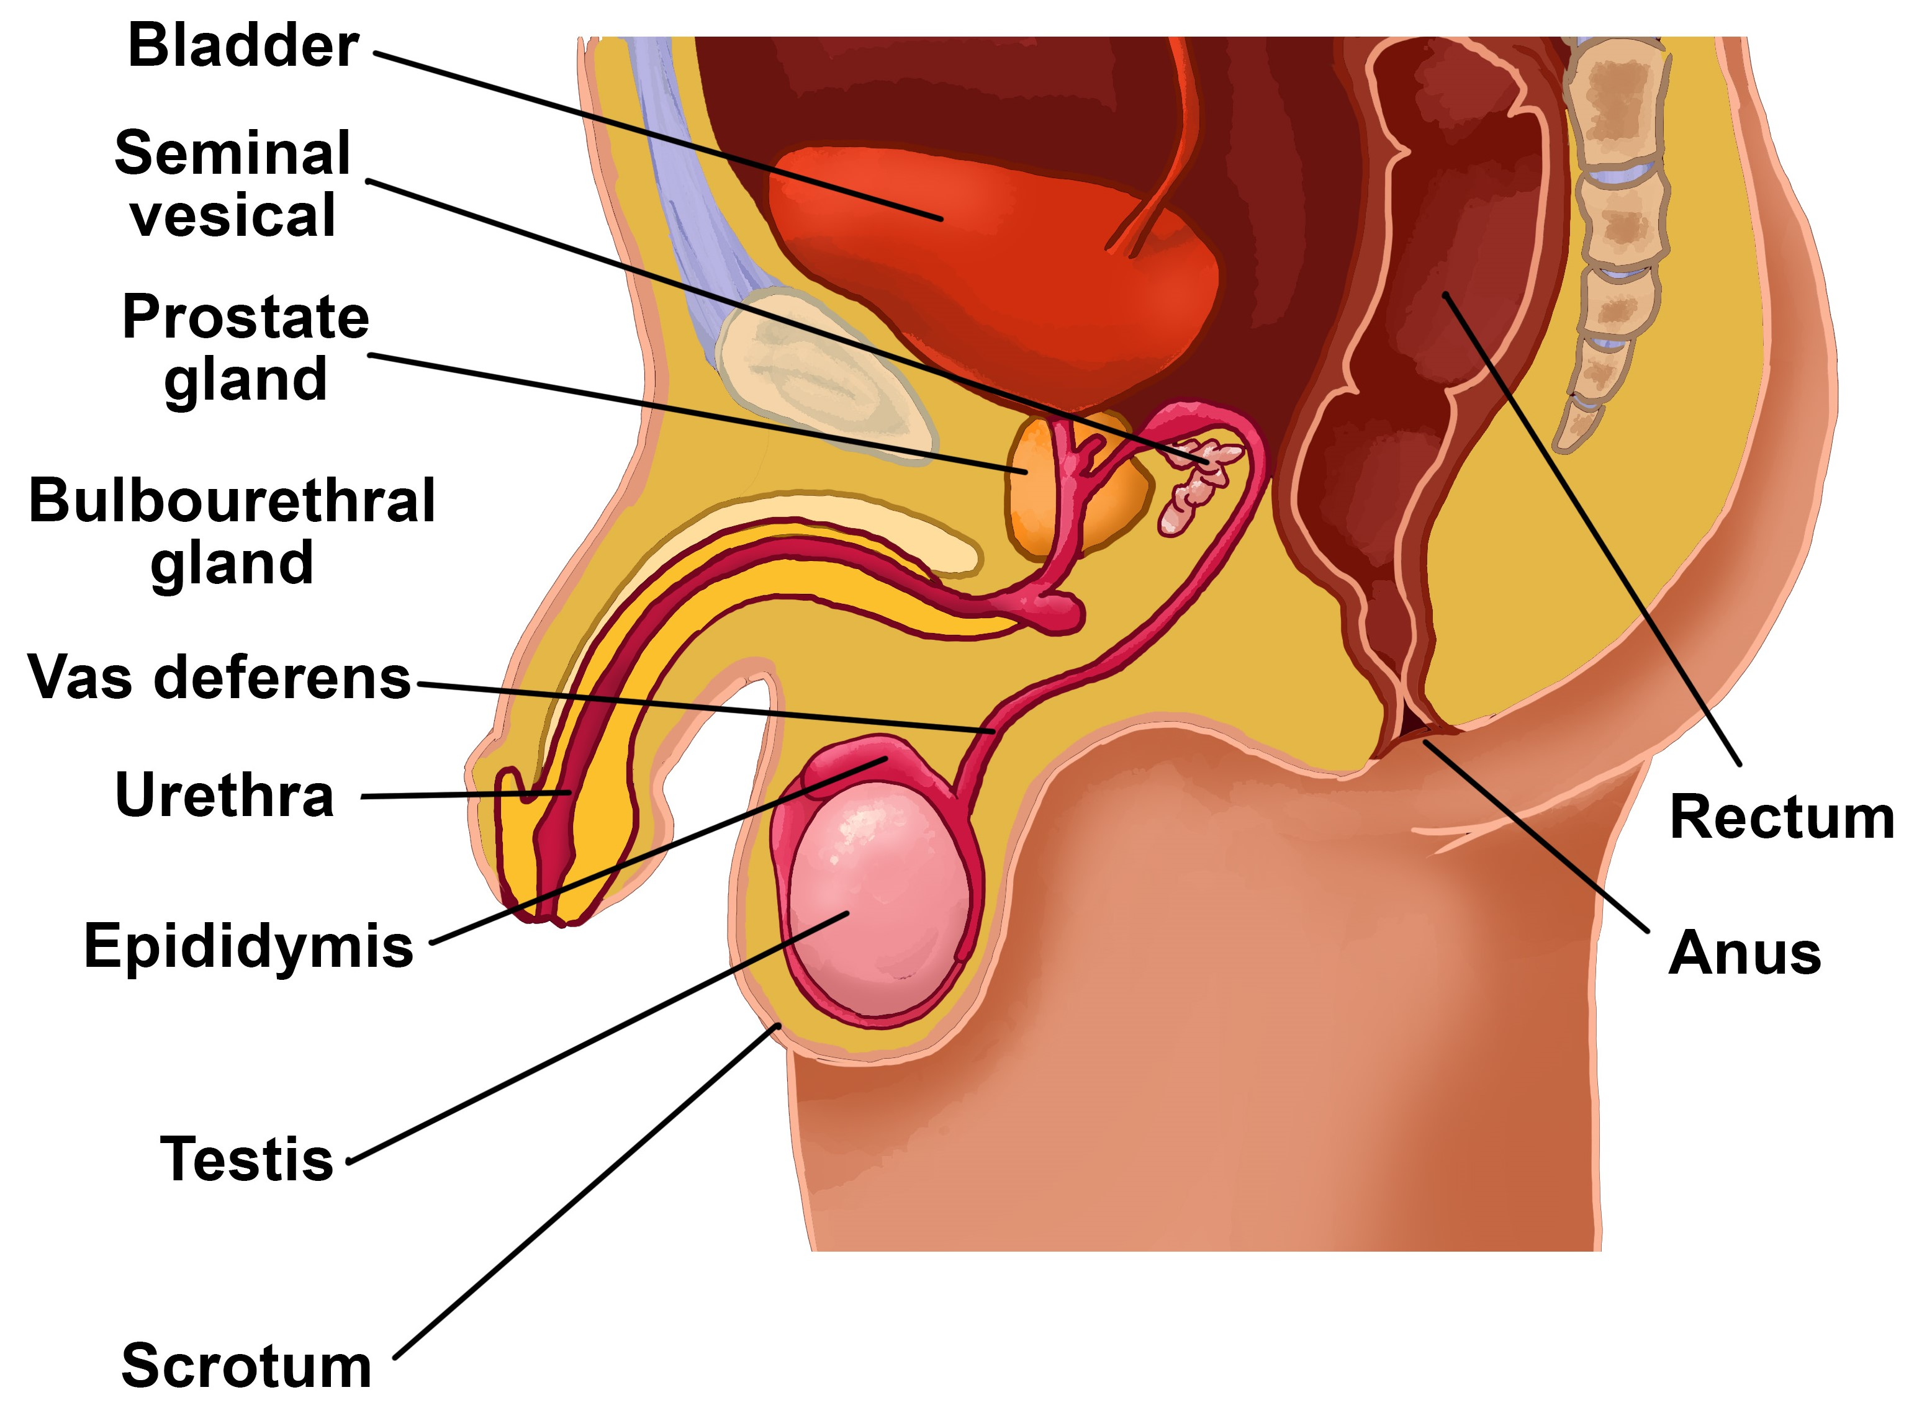

Slide 6
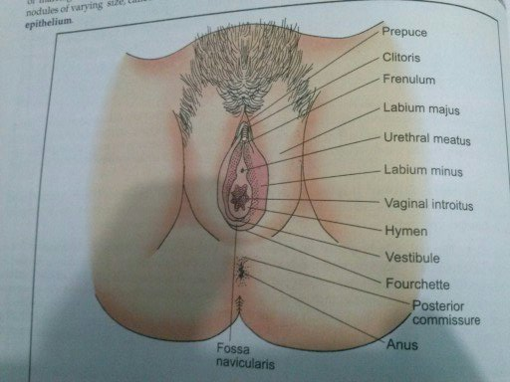
Female Reproductive organs

Slide 7
[o

Slide 8
Vaginal opening and hymen:
Hymen is a membrane that partially cover the vaginal opening
It gets raptured and may bleed during first intercourse
in 90% of women hymen got raptured before intercourse due to cycling, exercise, etc…..

Slide 9
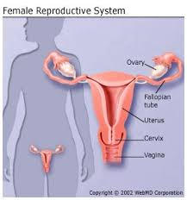
Internal Reproductive organs
Neethu George
2nd yr MSc Nursing

Slide 10
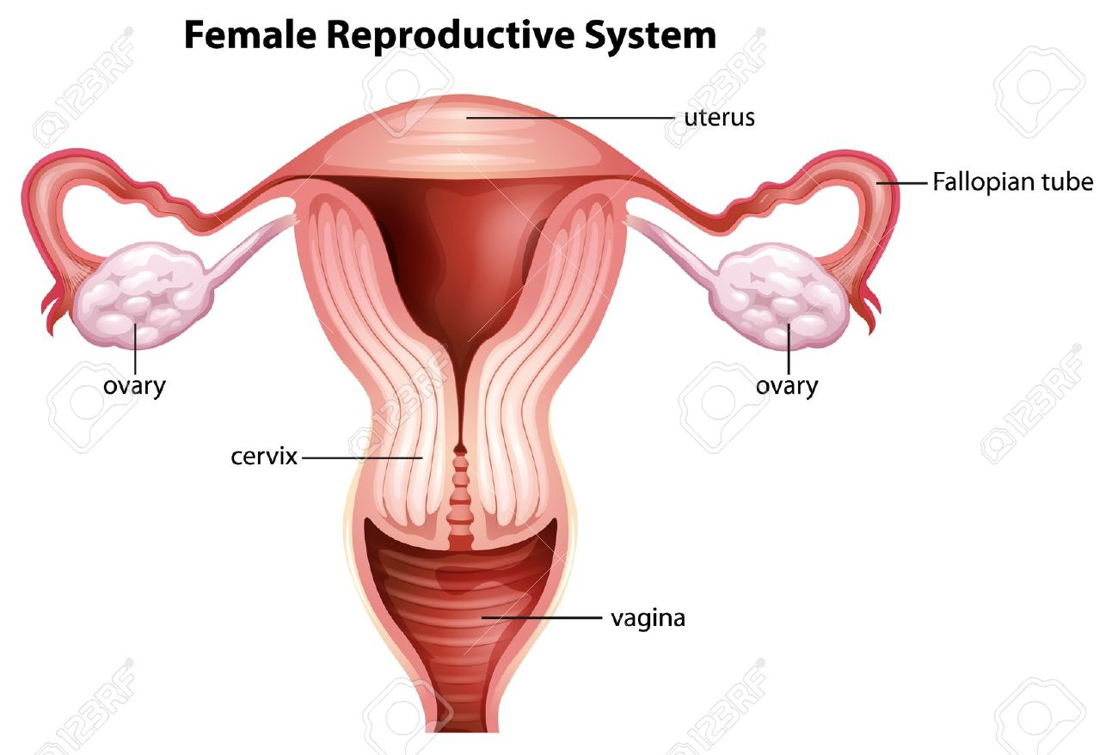
Internal structure consists of:
Vagina
Uterus
Fallopian tubes
Ovaries

Slide 11
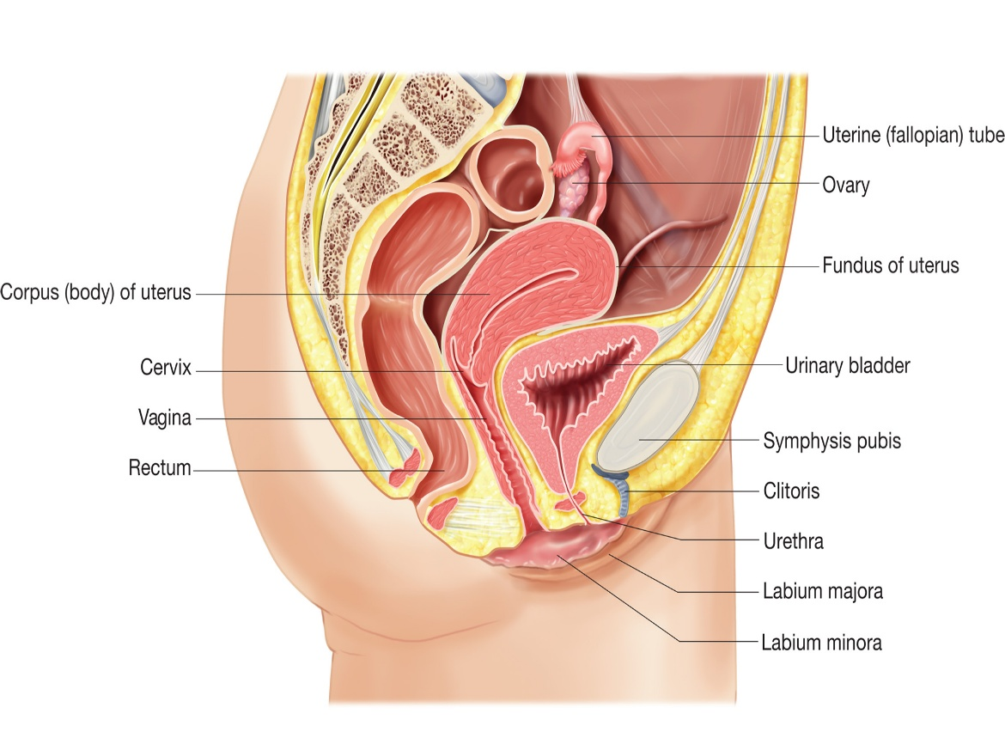

Slide 12
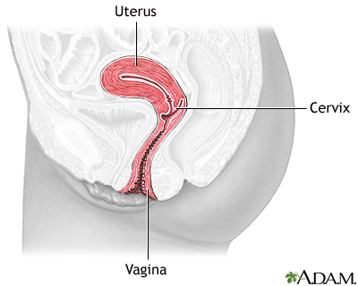
Vagina

Slide 13
Function of the vagina:
– Excretory duct for menstrual blood.
– Coitas canal
– Sperm supplying.
– Birth canal for delivery of baby.

Slide 14
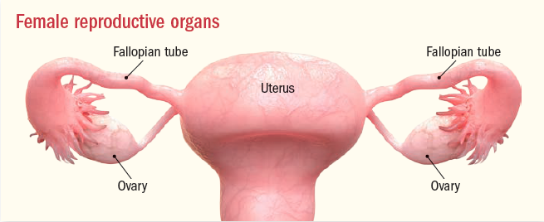
Uterus

Slide 15
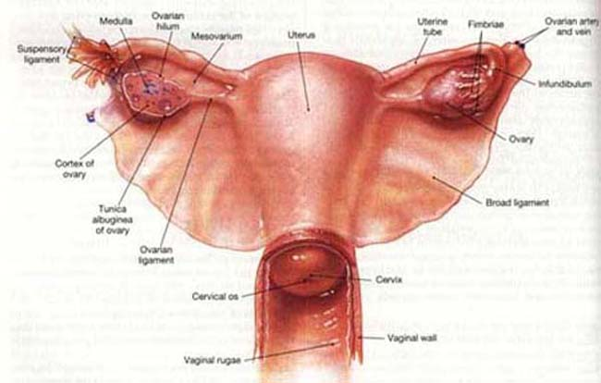
Function of the uterus:
Menstruation
Transmission of sperm to fallopian tube for fertilization
Pregnancy continues
Labour (contraction)

Slide 16
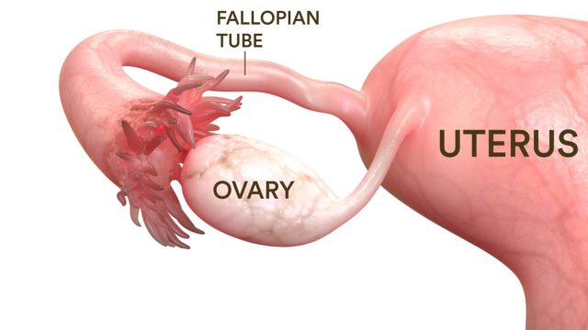
Fallopian Tubes
Function of the uterine tubes:
– Fallopian tubes transports ovum from ovary to uterus

Slide 17
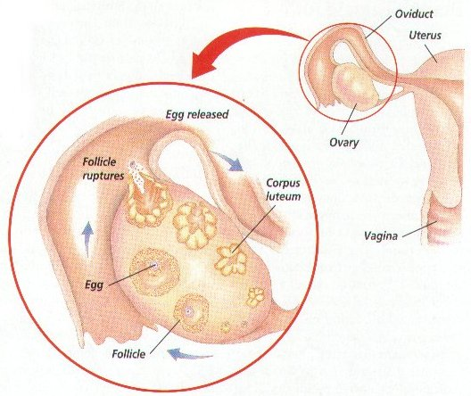
Ovary
Functions of the ovary:
During reproductive period, the ovary discharges mature ovum at each menstrual cycle.
Produces sex hormones – oestrogens and progesterone

Slide 18
Menstrual Cycle
Menstruation, also known as a period or monthly, is the regular discharge of blood and mucosal tissue from the inner lining of the uterus through the vagina.
The first period usually begins between twelve and fifteen years of age
it is 28 days cycle.
Bleeding usually lasts around 4 to 7 days.
Menstruation permanently stops between 45 and 55 years of age.
Periods also stop during pregnancy and typically do not resume during the initial months of breastfeeding

Slide 19
Up to 80% of women report having some symptoms prior to menstruation.
Common signs and symptoms include acne, tender breasts, feeling tired, irritability, and mood changes.
These may interfere with normal life in 20 to 30% of women. In 3 to 8%, symptoms are severe.

Slide 20
Phases of menstural cycle:
Menstrual phase
Proliferative phase
Ovulation
Secretory phase

Slide 21
Menstrual phase:
If ovum is not fertilized , progesterone (hormone) level decreases. Because of this the new layer formed in uterus start to detach .
As a result blood discharge from the vagina follows.
This lasts for about 4-7 days.
The normal amount of blood flow at each menstruation is approximately 60-90ml.

Slide 22
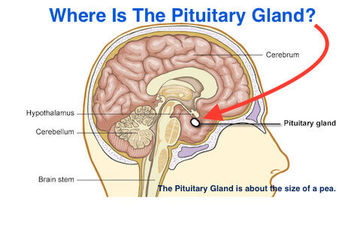
Proliferative phase:
Phase begins at the end of menstruation ,which is about 10 days.
In this time hormone (FSH) released from pituitary gland helps for the maturation of ovum in the ovary..

Slide 23
Ovulation:
Ovulation is a process whereby a mature ovum released from ovary & become available for fertilization (fusion of sperm and ovum)
The ovum remains viable for 12-24 hrs.
After ovulation this phase is completed.
Sperm remains viable for 48 to 72 hrs.
Video

Slide 24
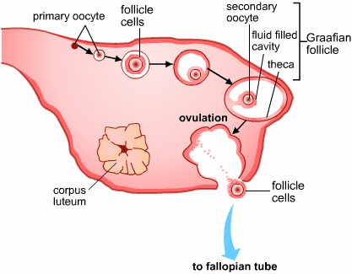
Secretary phase:
This phase begins just after ovulation & lasts for about 2 weeks.
In this phase there is an increase in the secretion of progesterone(hormone)
causes further changes in uterus like increase blood circulation, become thick & spongy for fertilized ovum.

Slide 25
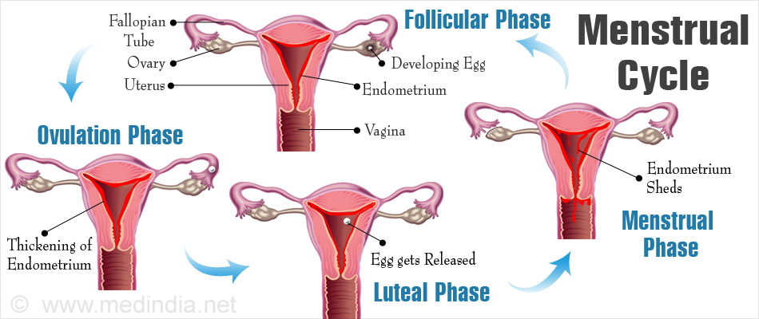

Slide 26
Family planning
The practice of controlling the number of children one has & the intervals between their births, particularly by means of contraception methods or sterilization.
Natural Methods:
Coitus Interruptus
Safe period

Slide 27
Coitus interruptus :
This method is also called as withdrawal method. In this method the penis (male organ) is withdrawn from the vagina before ejaculation (discharge). In this way the semen (a thick, whitish liquid containing sperm) is prevented from entering the uterine cavity and pregnancy does not take place. Since the penis is withdrawn and ejaculations takes place out side the vagina, this method is called as coitus interruptus or the withdrawal method. This method is in use by people since time immemorial

Slide 28
Advantage:
It involves no cost
It does not require any other device
With self control and discipline it can be fairly effective

Slide 29
Disadvantage:
It requires a great deal of self control and the slightest delay in withdrawal of penis may cause failure because even a drop of semen(a thick, whitish liquid containing sperm) which may escape and is sufficient to cause pregnancy.
The semen deposited out side the vagina has the risk of entering in the genital tract
There is thus a failure rate of as high as 25 percent
Couples are often dissatisfied

Slide 30
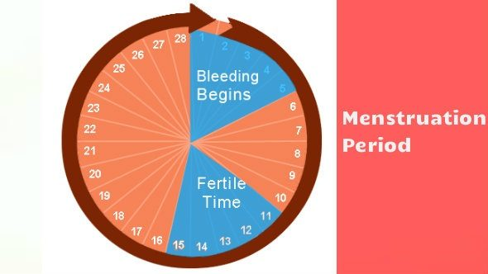
2. Safe Method/ Rhythm method/ Calendar method
This method is based on the process of ovulation and menstruation cycle which helps in determination of the safe period when intercourse can be done and unsafe period when intercourse should be avoided to prevent pregnancy. Ovulation occurs at 12 to 14th day and ovum life span is 12 to 24 hours.

Slide 31
Advantage :
it does not require any man made device
this method is accepted by Roman Catholic Church.

Slide 32
Disadvantage:
The practice of this method requires a great deal of self control between the partners because there is a period of compulsory avoidance of intercourse.
This method is unsuitable for women who have irregular periods
This method is possible for those couple who are educated, can maintain a record of their calender and follow the safe and unsafe period

Slide 33


