Slide 1
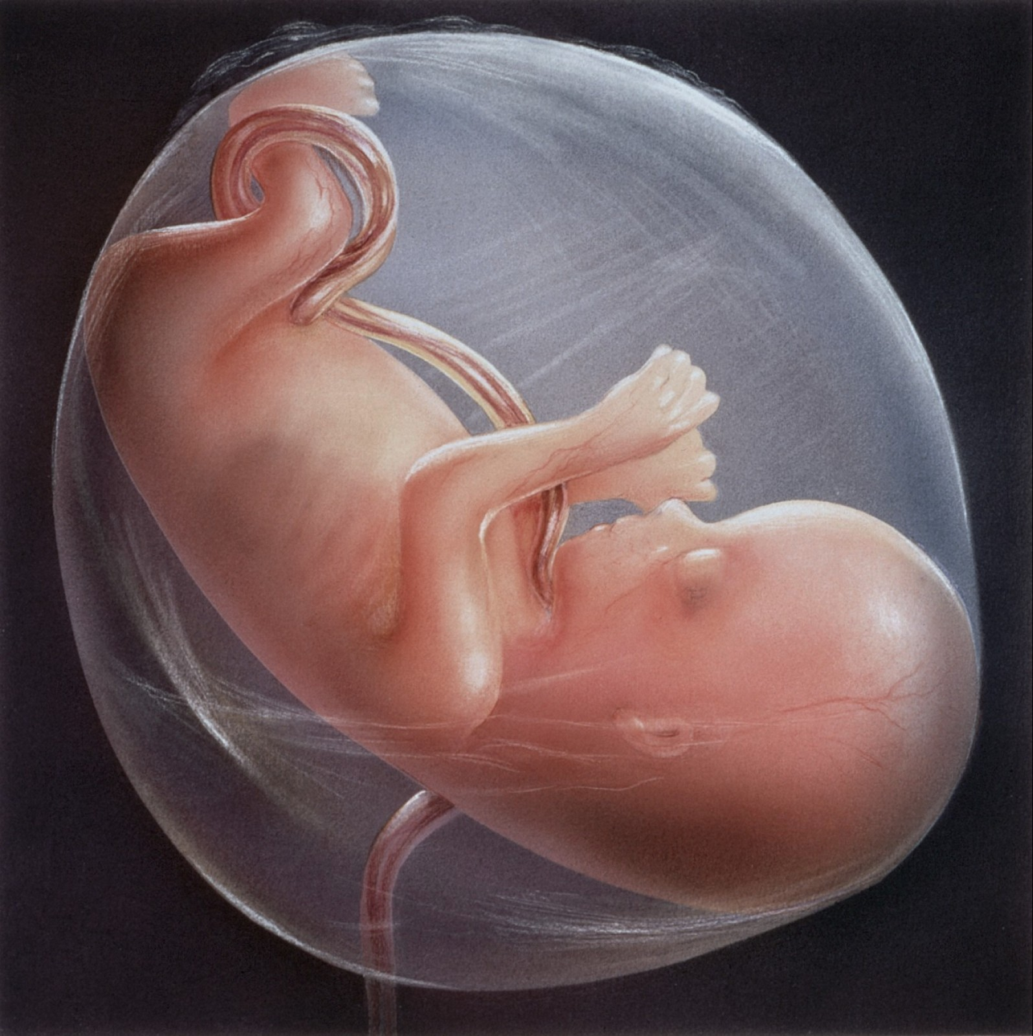
The foetal membranes, amniotic fluid, umbilical cord
MRS NEETHU GEORGE
ASSISTANT PROFESSOR (OBG)

Slide 2
THE FOETAL MEMBRANES
Foetal membranes are of two layers:
Outer Chorion: It forms outer layer of foetal membranes formed out of chorionic leave & ends at placental margin. It is thicker than amnion but friable & shaggy on both sides. It consists of two layers of trophoblastic epithelium lined internally by mesoderm.
Inner Amnion: It is the inner layer of foetal membranes. It is smooth, shiny & slippery that lies in contact with amniotic fluids. It is tough membrane.

Slide 3
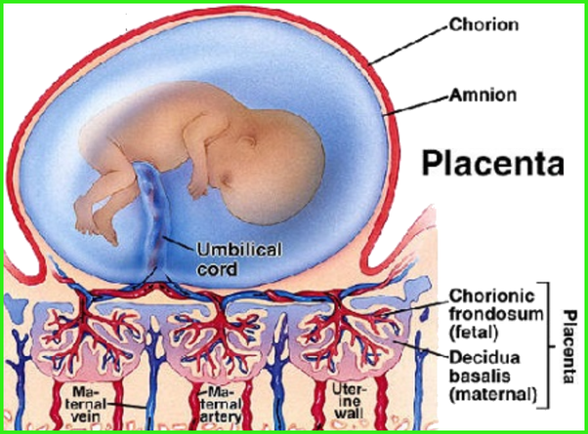

Slide 4
Function of foetal membrane:
Protective for foetus
Form liquor amnii
Prevents infection
Facilitates cervical dilatation
Shows enzymatic activities
Serves as a source of precursor of prostaglandin.

Slide 5
Liquor amnii (amniotic fluid)
The watery alkaline fluid of amniotic sac in which embryo, foetus grow is called amniotic fluid.
Physical Characteristics:
It is clear fluid in early pregnancy.
In mid-pregnancy due to more bile pigments it becomes yellow.
But in late pregnancy it is colourless as billirubin negligible.
It also contains vernix caseosa & desquamated epidermis.

Slide 6
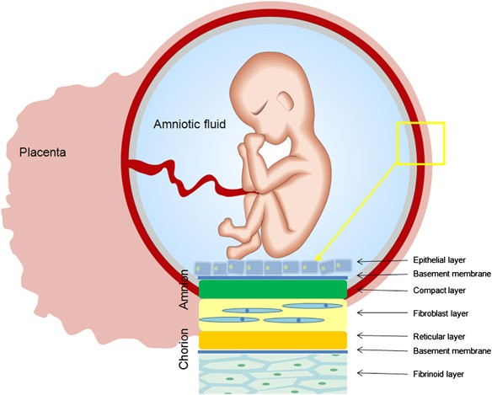

Slide 7
Cont…
Volume:
Amniotic fluid is detected at 8 weeks of pregnancy & its average volume varies. At 38 weeks the amount is 1000 ml, 40 weeks 800 ml & at 43 weeks 200ml.
Composition:
Water 98-99%

Slide 8
Cont…
Organic substances:
Protein 0.25 gm%
Uric acid 4 mg%
Creatinine 1.8 mg%
Glucose 20 mg%
Lipids, phospholipids, billirubin (a trace), hormones (prolactin) vitamins, prostaglandins.
Inorganic substance:
Electrolytes- (sodium, potassium chloride) same as in maternal plasma.
Ph is 7.2
Specific gravity 1008

Slide 9
Cont…
Sources of Amniotic Fluid:
  Foetal urine
  Exudation of umbilical vessels
  Amniotic epithelium
Foetus swallow liquor after 16 weeks 450 ml daily.

Slide 10
Cont…
Functions:
During pregnancy:
  It helps in foetal growth.
  It protects foetus from external injuries.
  Maintains even from external injuries.
  Maintains even temperature for foetus.
  Allows free movements of foetus & prevents adhesions.
  Serves lmmunological, biochemical & hormonal functions.

Slide 11
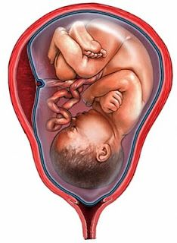
Cont…
During labour:
Helps in dilatation of os.
Protects foetus & placenta from direct pressure from contracting uterus. Fore waters washes the vagina before birth of baby preventing infection of baby & uterine cavity & the hind waters clear the birth passage after the baby is born.

Slide 12
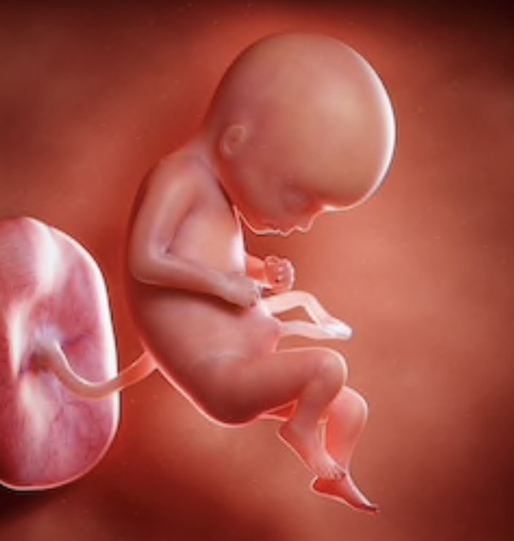
Umbilical cord (funis)
Umbilical cord is a long cord like structure that connects the foetal umbilicus with foetal surface of placenta. It is developed from body stalk of mesodormal cells stretching between embryonic disc & chorion.
Structure of Umbilical Cord At Term:
It is bluish white cord about 50 cm long & 1.5 cm in diameter.
3 blood vessels are embedded in it. 1 umbilical vein & 2 umbilical arteries.

Slide 13
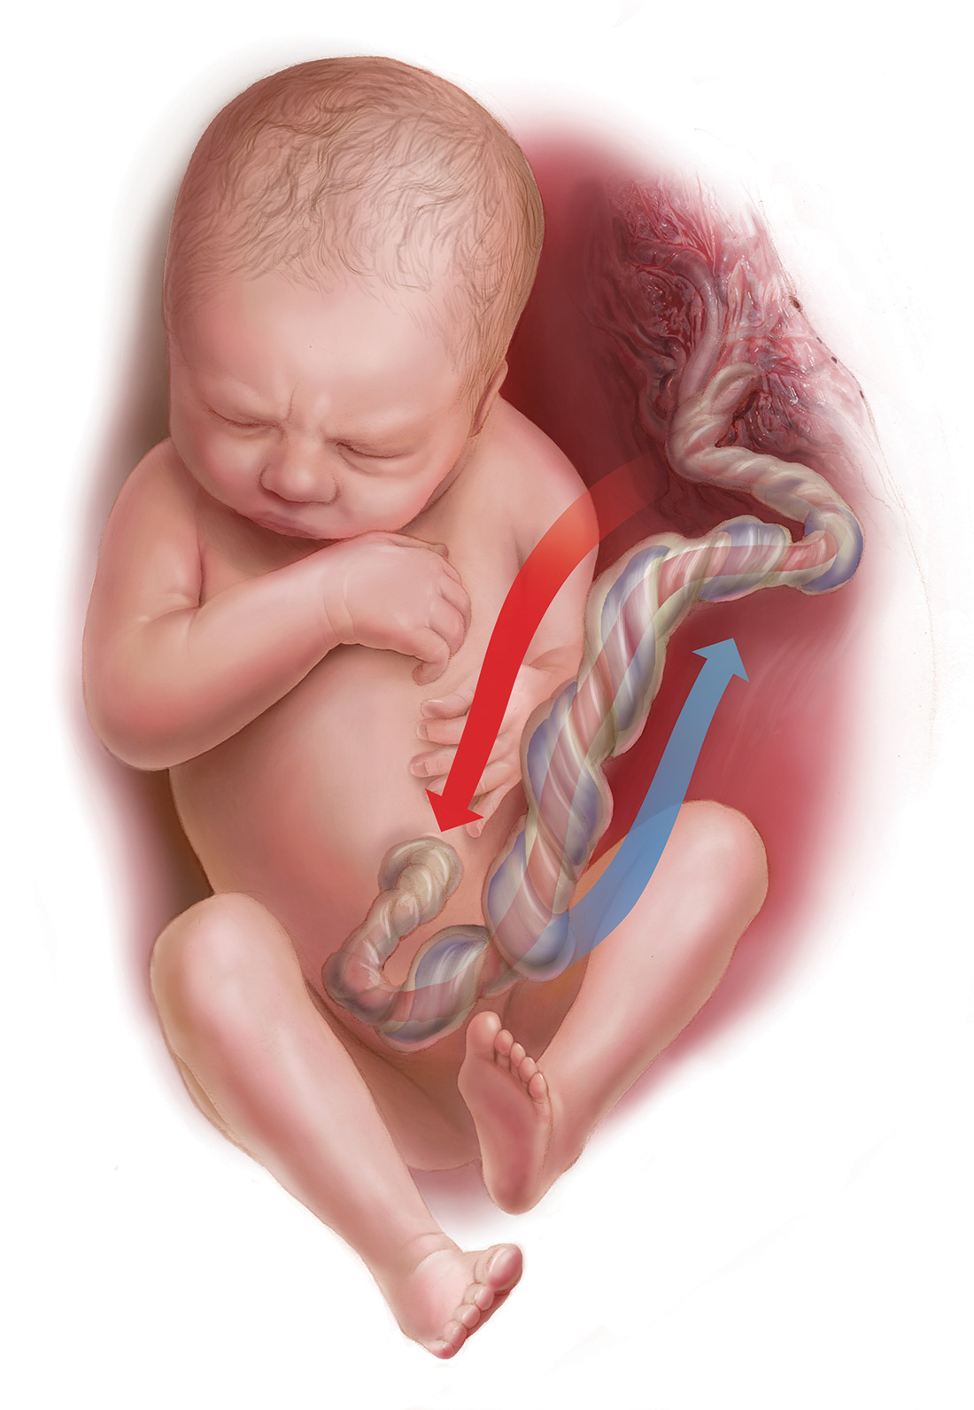

Slide 14
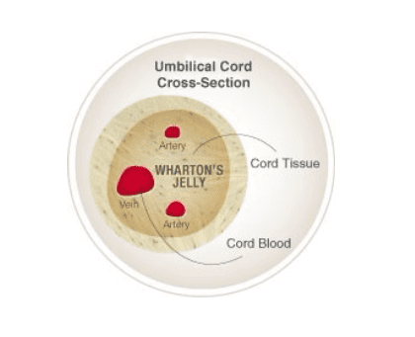
It is twisted spirally from left to right.
There are collection of wharton’s jelly at places.
There are false knots.
Umbilical cord attached foetus to placenta.
It is covered by amnion.
Underneath wharton’s jelly supports the blood vessels.
Remanants of vitelline duct at foetal end of cord & yellow sac as minute yellow body at the site of placenta attachment & allantois at foetal end of cord.

Slide 15
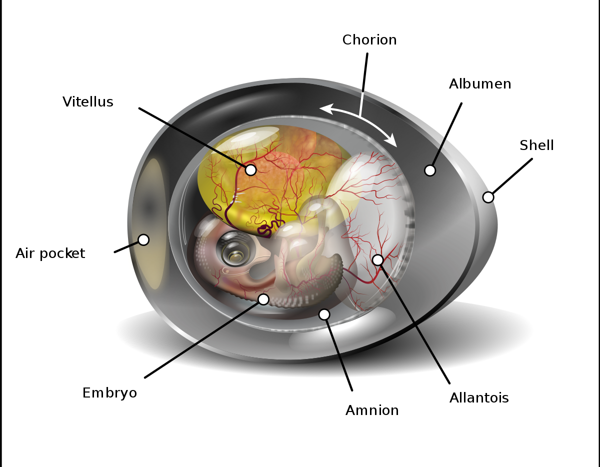

Slide 16
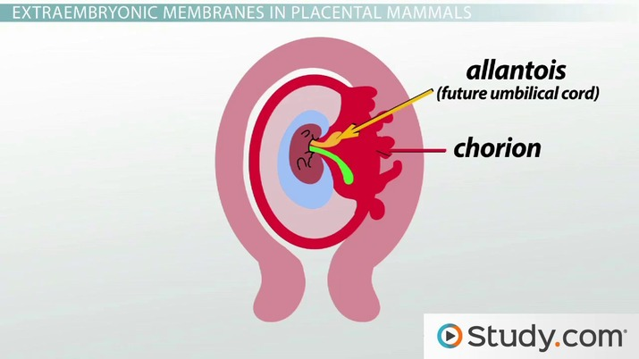

Slide 17
Cont…
Functions:
It is the life line between placenta & foetus supplying oxygen & nutrients for foetus & disposing waste products.
Exchange of fluid & electrolyte between umbilical vessels & amniotic fluid.

Slide 18
Cont…
Abnormality of cord:
Short cord less than 30 cm.
No cord (achordia)
Long cord 100-300 cm long. Long cord may lead to prolapse of the cord before & during labour.
True knots
False knots due to collection of wharton’s jelly.
Loop around the neck, may be once, twice or three times.
Single artery in umbilical cord.

Slide 19
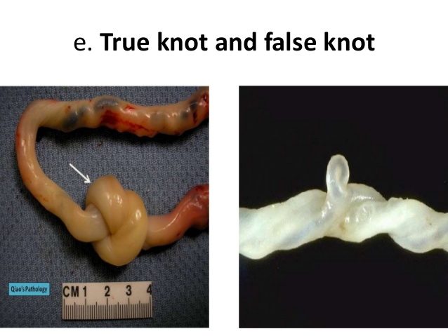

Slide 20


