Slide 1
PLACENTA
MRS. NEETHU GEORGE
ASSISTANT PROFESSOR (OBG)

Slide 2
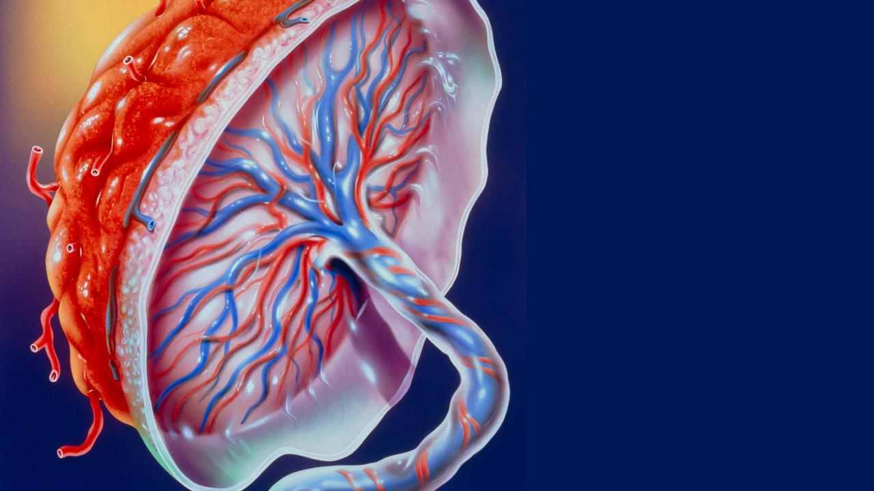
DEFINE:
Placenta is developed from chorionic frondosum & decidua. It begins at 6th week & completed by 12th week.

Slide 3
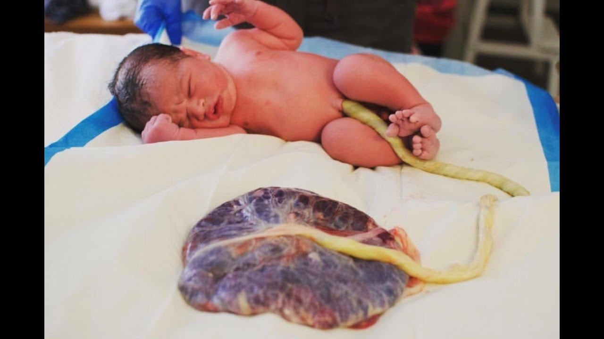

Slide 4
THE PLACENTA AT TERM:
The placenta at term is almost circular disc with a diameter of 15-20 cm.
It is 2.5 cm thick at its centre.
Its weights about 500gm. Of 1/6th of baby’s weight.
It as two surfaces:
Maternal surface: it is rough & spongy. It is red dull colour. It has 15-20 lobes, known as cotyledons, separated from each other by furrow.

Slide 5
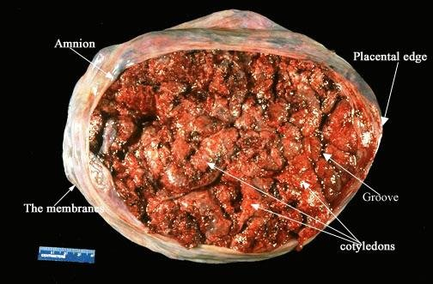

Slide 6
Cont…
Foetal surface: The foetal surface is covered by the smooth & glistening amnion with the umbilical cord attached near to its centre. Branches of the umbilical vessels are visible beneath the amnion as they radiate from the insertion of the cord. The amnion can be peeled off from the underlying chorion except at the insertion of the cord.

Slide 7
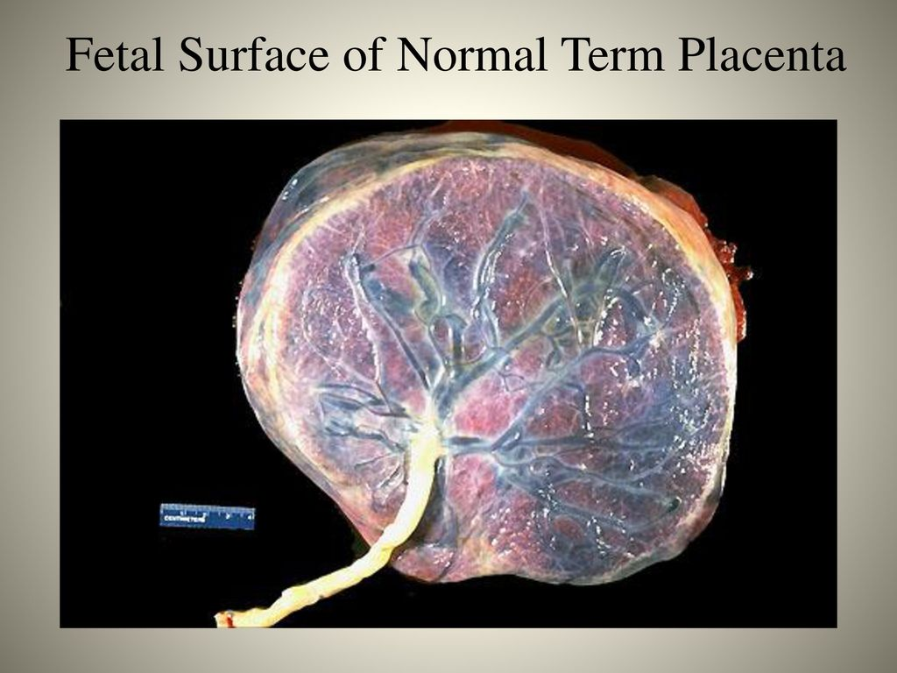

Slide 8
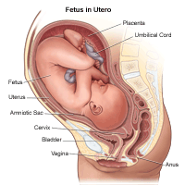
Cont…
Placenta separates after the birth of the baby & the line of separation is through the desidua spongiosum. The placenta is lined internally by the amniotic membrane & chorionic plate, externally by the basal plate & in between these two lies the choriodecidual space containing the stem villi with their branches. The space being filled with maternal blood.

Slide 9
Structures of placenta from foetal to maternal surface:
Amniotic membrane
Chorionic plate
Choriodecidual plate (maternal sinus)
Placenta villi: two types of placenta villi develop as:
Anchoring villi: a few villus get attached to deciduas basalis.
Nutritive villi: majority of chorionic villi, branch freely in the choriodecidual space. Primary villi branch to secondary & tertiary villi. These floats in the maternal sinus & provide nutrition to the foetus.

Slide 10
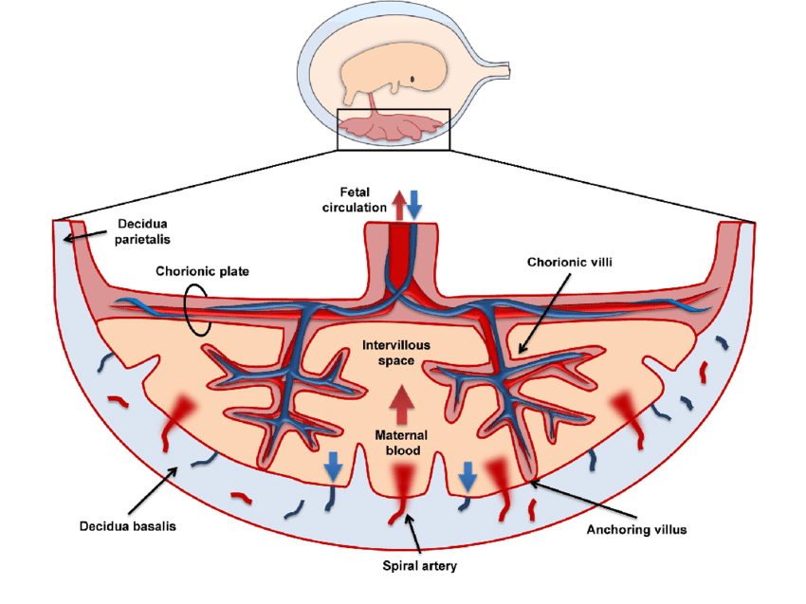

Slide 11
Placental circulation:
It consist of two independent circulation:
Maternal circulation: at term 120 spiral arteries enter maternal sinus. Venous blood is collected by venous channel.
Foetal circulation: through umbilical cord two arteries spirally around umbilical vein carry venous impure blood from foetus to chorionic plate of placenta. Branches of umbilical artery enters to each villus. Single umbilical vein emerging from placenta into umbilical cord carries oxygenated blood.

Slide 12
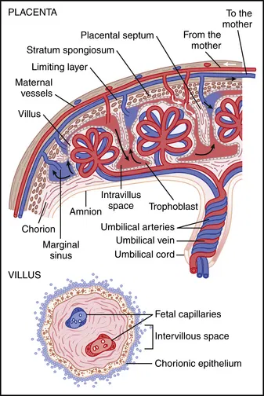

Slide 13
Cont…
Foetal & maternal blood streams flow side by side in opposite direction. Foetal blood has higher oxygen carrying capacity due to red cells carrying foetal haemoglobin.
Placental Aging:
Placenta has limited life span. Near term pregnancy normal placenta shows white infarcts- degenerated villi with deposition of fibrin & calcium. These infracts are more common at placental margin.

Slide 14
Functions of placenta:
Foetal Respiratory Function: by simple diffusion, oxygen goes to foetal circulation from maternal sinus & carbon dioxide diffuses out.
Foetal Alimentary Function: all nutrient such as glucose, aminoacids, lipids, vitamins, minerals, water & electrolytes pass from maternal sinus to foetal circulation.

Slide 15
Cont…
Foetal Excretory Function: placenta acts as a foetal kidney by excreting small amount of placental hormones & steroids hormones.
Foetal Barrier Functions: this prevents large molecular size substance to pass from mother to foetus. Currently this barrier function is considered a myth since many infective organisums, drugs easily cross over to the foetus.

Slide 16
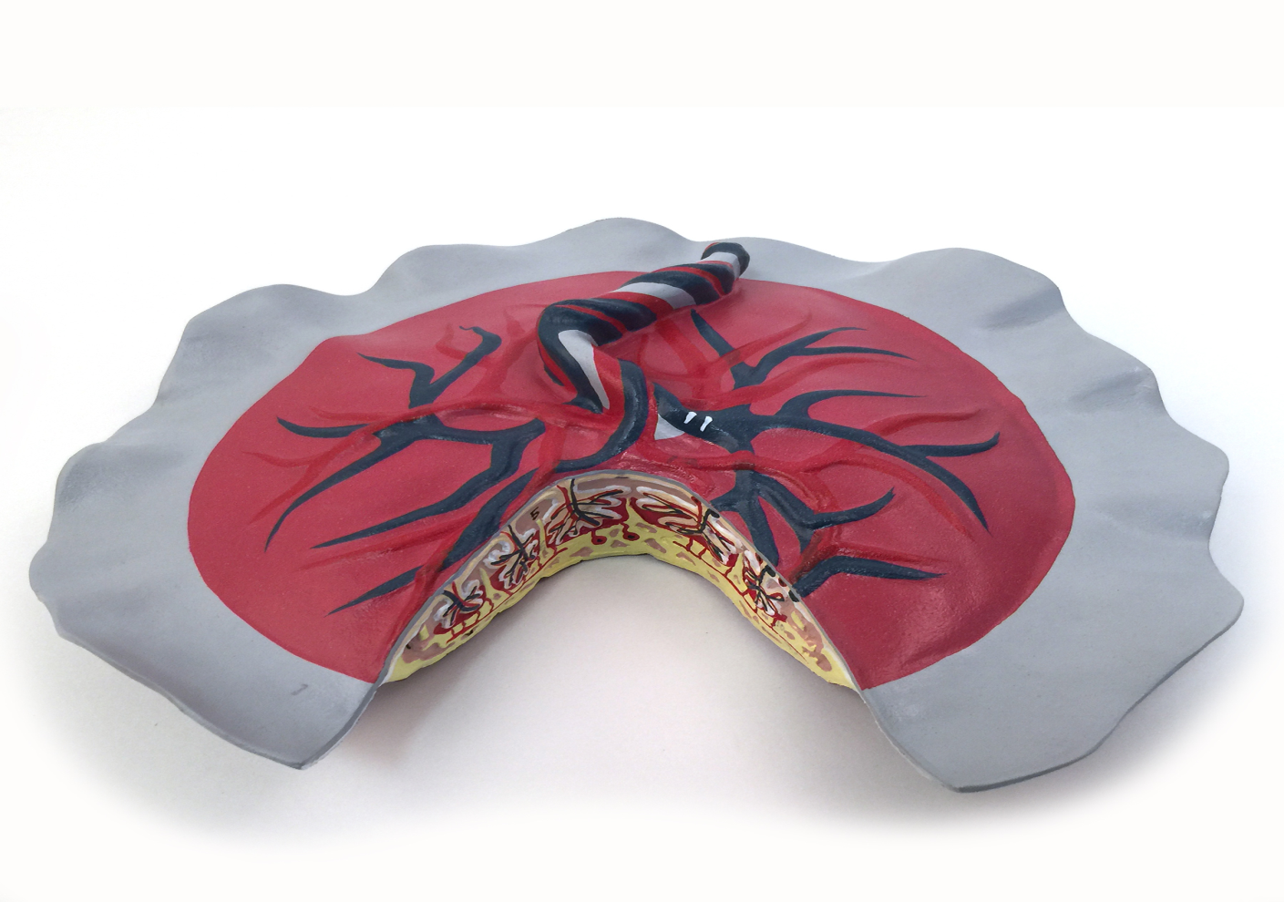
Cont…
Enzyme Function: various enzymes are involved in hormone synthesis & metabolism are elaborated by placenta.
Immunological Function

Slide 17
Abnormalities of placenta
Large placenta:occur in syphilis, diabetes mellitus & in erythroblastosis.
Placenta succenturiata: one or more small accessory lobes lie away from the main mass contining blood vessels. Clinical importances is that it can be retained after the main placenta is expelled producing postpartum haemorrhage.

Slide 18
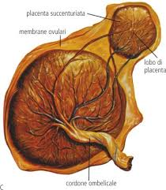
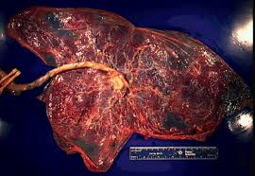

Slide 19
Cont…
Bipartite of tripartite placenta: there are two or three almost equal lobes lying close to each other. Foetal vessels extend from one lobe to other before uniting at umbilical cord. This may cause antepartum haemorrhage & retained placenta.
Battle dore placenta: in this the cord is situated at the very edge of placenta.

Slide 20
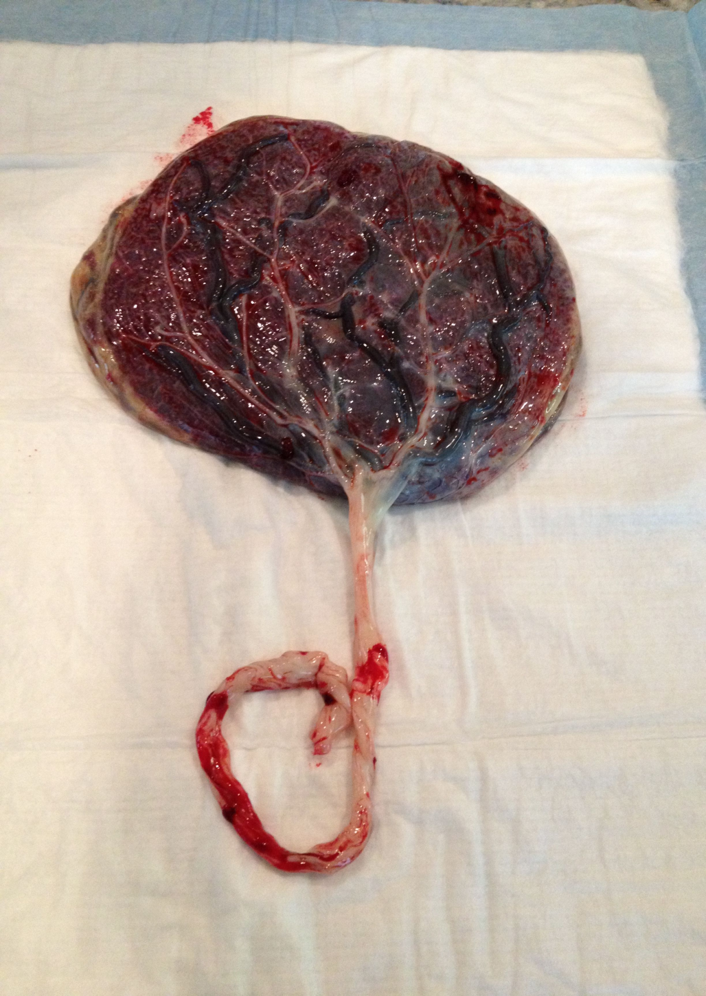
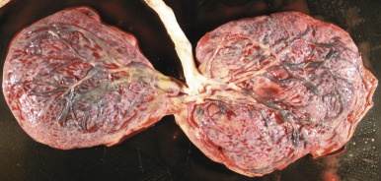

Slide 21


