Slide 1
ABORTION
PRESENTED BY:
MS. HETAL PATEL
NURSING TUTOR, SNC

Slide 2
INTRODUCTION:
The causes of bleeding in early pregnancy are broadly divided into two groups:
Those related to the pregnant state
Those associated with the pregnant state

Slide 3
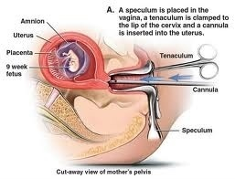
TERMINOLOGIES:
Abortion (miscarriage): Abortion is the expulsion or extraction from its mother of an embryo or fetus weighing 500 gms or less when it is not capable of independent survival (WHO).
Abortus: The expelled embryo or fetus is called abortus.

Slide 4
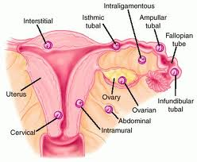
TERMINOLOGIES:
Miscarriage: The term miscarriage is the recommended terminology for spontaneous abortion.
Ectopic pregnancy: It is one where implantation occurs at a site other than the uterine cavity. Sites can include uterine tube, cervix, and the abdomen.

Slide 5
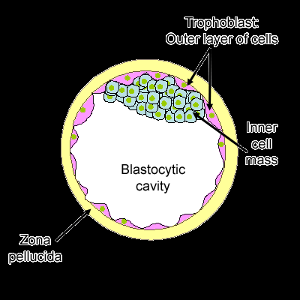
TERMINOLOGIES:
Trophoblast: Outer most layer of blastocyst.

Slide 6
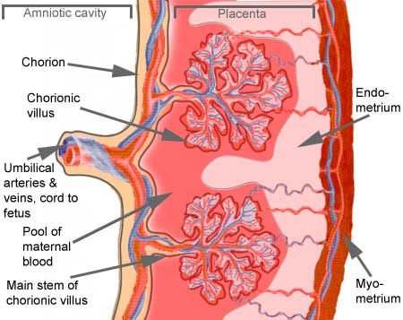
TERMINOLOGIES:
Chorionic villi: The vascular Finger like buds projection from chorion.

Slide 7
TERMINOLOGIES:
Hydatidiform mole: It is a gross malformation of the trophoblast in which the chorionic villi proliferate and become avascular.

Slide 8
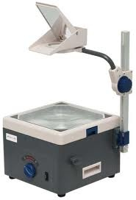
CLASSIFICATION:

Slide 9
ABORTION:
DEFINITION: Abortion is the expulsion or extraction from its mother of an embryo or fetus weighing 500 gms or less when it is not capable of independent survival (WHO). This 500 gm of fetal develop is attained approximately at22 weeks (154 days) of gestation.

Slide 10
ETIOLOGY:
The etiology of miscarriage is often complex and obscure. The following factors (embryonic or parker important:
Genetic
Endocrine and metabolic
Anatomic
Infection

Slide 11
Cont…
Immunological
Blood group incompatibility
Premature rupture of the membranes
Environmental factors

Slide 12
Cont….
Blood group incompatibility: couple with group ‘A’ husband and group ‘O’ wife have higher incidences of abortion.
Premature rupture of membranes
Parental factor: sperm chromosomal anomaly(translocation)
Drugs: e.g. quinine, ergots, severe purgatives

Slide 13
Mechanism of Abortion:
Up to 8 weeks: the ovum surrounded by the villi with the decidual coverings is expelled out intact. .
Sometimes, the external os fails to dilate so that the entire mass is accommodated in the dilated cervical canal and is called cervical abortion.
The gestational sac tends to be expelled complete and the decidua is shed thereafter.

Slide 14
Cont…
After 14 weeks: The placenta is completely formed and the process of abortion is like a miniature labour.
It is more common for the foetus to be expelled but for the placenta to be retained due to firmer attachment to the uterine wall.

Slide 15
THREATENED ABORTION

Slide 16
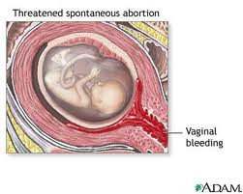
DEFINITION:
It is a clinical entity where the process of miscarriage has started but has not progress to a state from which recovery is impossible.

Slide 17
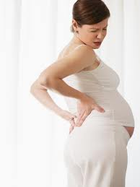
CLINICAL FEATURES:
Vaginal bleeding slight or mild, bright red in color originating from the choriodecidual interface.
Pain is absent or slight.
Cervix is closed.
Pregnancy test is positive.
Ultrasonography shows a living foetus.

Slide 18
INVESTIGATIONS:
Blood - for hemoglobin, haematocrit, ABO and Rh grouping. Blood transfusion may be required if abortion becomes inevitable and anti-D gamma globulin has to be given in Rh negative non-immunized women.

Slide 19
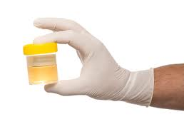
Cont…
Urine for immunological test of pregnancy is not helpful as the test remains positive for a variable period even after the fetal death.

Slide 20
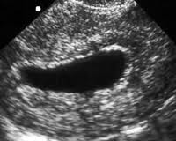
Cont…
Blighted ovum: there is absence of fetal pole in a gestational sac with diameter of 3 cm or more. Uterus is to be evacuated once the diagnosis made
Ultrasonography-diagnosis of blighted ovum.

Slide 21


TREATMENT:
Rest: the patient should be in bed until one week after stoppage of bleeding.
Drugs: Relief of pain may be ensured by diazepam 5 mg tablet or phenobarbitone 30 mg.twice daily.

Slide 22
MANAGEMENT:
The patient is advised to preserve the vulval pads and anything expelled out per vaginam, for inspection.
To report if bleeding and/or pain becomes aggravated.
Routine note of pulse, temperature and vaginal bleeding.

Slide 23
ADVICE ON DECHARGE:
The patient should limit her activities for at least two weeks and avoid heavy work.
Coitus is contraindication during this period, as it may disturb pregnancy by the mechanical effect and the effect of semen prostaglandins on the uterus.
She should be re-examine after one month to assess the growth of fetus.

Slide 24
INEVITABLE ABORTION

Slide 25
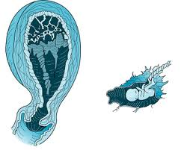
DEFINITION:
It is the clinical type of abortion where the changes have progressed to a state from where continuation of pregnancy is impossible.

Slide 26
CLINICAL FEATURES:
vaginal bleeding-with clots.
pain in the lower abdomen which may colicky in nature in the suprapubic region radiating to the back.

Slide 27
Cont….
Internal os of the cervix is dilated and products of conception may be felt through it.
Rupture of membranes between 12-28 weeks is a sign of the inevitability of abortion

Slide 28
MANAGEMENT:
The principles in the management are:(a) to look after general condition.(b)to accelerate the process of expulsion (c) to maintain strict asepsis

Slide 29
General measures:
Excessive bleeding should be promptly controlled by administering methergin 0.2 mg if the cervix is dilated and the size of the uterus is less than 12 weeks.
The shock is corrected by intravenous fluid therapy and blood transfusion

Slide 30
Active Treatment:
Before 12 weeks:
(1) Dilatation and evacuation followed by curettage of the uterine cavity by blunt curette under general anesthesia (2) Alternatively, suction evacuation followed by curettage done.

Slide 31
Cont…
After 12 weeks: (1) The uterine contraction is accelerated by oxytocin drip (10 units in 500 ml of normal saline) 40-60 drops per minute. If the fetus is expelled and the placenta is retained, it is removed by OVUM forceps, if lying separated.
If the placenta is not separated, digital separation followed by its evacuation is done under G.A.

Slide 32
COMPLETE ABORTION

Slide 33
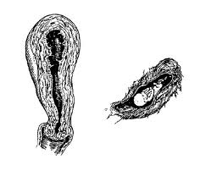
DEFINITION:
When the products of conception are expelled as an masses, it is called complete miscarriage.

Slide 34
CLINICAL FEATURES:
There is history of expulsion of a fleshy mass per vagina followed
(1) Subsidence of abdominal pain.
(2) Vaginal bleeding becomes trace or absent
(3) Internal examinations reveals: (a) Uterus is smaller than the period of amenorrhea and a little firmer (b) Cervical os is close (c) Bleeding is trace.
(4) Examination of the expelled fleshy mass is found complete.

Slide 35
MANAGEMENT:
The effect of blood loss, if any, should be assessed and treated. If there is doubt about complete expulsion of product, uterine curettage should be done.
Transvaginal sonography is useful to see that uterine cavity is empty; other evacuation of uterine curettage should be done.

Slide 36
Cont….
A Rh-negative patient without antibody in her system should be protected Anti-D gamma globulin-50 microgram or 100 microgram intramuscularly in cases of early miscarriage or, miscarriage respectively within 72 hours.
However, Anti-D may not be required in a case with complete miscarriage before 12 weeks gestation where no instrumentation has been done.

Slide 37
INCOMPLETE ABORTION

Slide 38
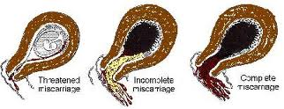
DEFINITION:
When there is entire products of conception are not expelled, instead a part of it is left inside the uterine cavity, it is called incomplete abortion.

Slide 39
CLINICAL FEATURES:
History of expulsion of a fleshy mass per vagina followed by :
1. Continuation of pain in lower abdomen, colicky in nature, although in diminished magnitude.
2. Persistent vaginal bleeding

Slide 40
3. Examination reveal: uterus smaller than the period of amenorrhoea, patulous cervical os. Often admitting one finger, expelled mass is found incomplete.
She should be resuscitated before any active treatment is undertaken.

Slide 41
MANAGEMENT:
In recent cases – the same principles to be followed like that of the inevitable. it is emphasized, patient may be in a state of shock due to blood loss.
Early abortion: dilatation and evacuation under general anesthesia is to be done.
Late abortion: the uterus is evacuated under general anesthesia and the products are removed by ovum forceps or by blunt curette.

Slide 42
MISSED ABORTION (SILENT MISCARRIAGE)

Slide 43
DEFINITION:
When the fetus is dead and retained inside the uterus for a variable period, it is called missed abortion or silent miscarriage or early fetal demise.

Slide 44
CLINICAL FEATURES:
Persistence of brownish vaginal discharge.
Subsidence of pregnancy symptoms.
Retrogression of breast changes.
Cessation of uterine growth which in fact becomes smaller in size.
Non audibility of the fetal heart sound even with Doppler ultrasound if it had been audible before.

Slide 45
Cont…
Cervix feels firm.
Immunological test for pregnancy becomes negative.
Real time Ultrasonography reveals an empty sac early in the pregnancy or the absence of fetal motion or fetal cardiac movements.

Slide 46
COMP LICATIONS:
The complications of the missed miscarriage are those mentioned in intrauterine fetal death.
Disseminated intravascular coagulation (DIC) may occur if the dead conceptus is retained for more than 4 weeks.

Slide 47
INVESTIGATION:
Pregnancy test becomes negative within two weeks from the ovum death, but it may remain positive for a longer period due to persistent living chorionic villi.
Ultrasound shows either a collapsed gestational sac, absent foetal heart movement or foetal movement.

Slide 48
MANAGEMENT:
If the uterus size is less than 12 weeks: Vaginal evacuation can be carried out without delay. This can be done effectively done by suction evacuation or slow dilatation of cervix by laminar tent followed by D&E of the uterus under general anesthesia.
The risk of damage to the uterine walls and brisk rhage during the operation should be kept in mind.

Slide 49
Cont…
Inductuion is done by following methods:
Oxytocin: to start with 10-20 units of oxytocin in 500 ml of normal saline at 30 drops/minute.
Prostaglandins: are more effective than oxytocin in such cases. The methods used are :

Slide 50
Prostaglandin E1 analogue( misoprostol) 200 µg tablet is inserted into the posterior vaginal fornix every 4 hours for a maximum of 5 such.
Intramuscular administration of 15 methyl PGF2α (carboprost tromethamins) 250 µg at three hourly intervals for a maximum of 10 such.

Slide 51
SEPTIC
ABORTION

Slide 52
DEFINITION:
Any abortion associated with clinical evidences of infection of the uterus and its contents, is called septic abortion.

Slide 53
Cont….
Although clinical criteria vary, abortion is usually considered septic when thlll (l) rise of temperature of at least 100.4°F (38°C) for 24 hours or more (2) offensive or purulent vaginal and (3) other evidences of pelvic infection such as lower abdominal pain and tenderness.

Slide 54
CLINICAL FEATURES:
Pyrexia is an important clinical manifestation.
Pain abdomen of varying degrees is almost a constant feature.
A rising pulse rate of 100-120/minute or more is a significant finding than even pyrexia. It indicates spread of infection beyond the uterus.

Slide 55
CLINICAL GRADING:
Grade-I: The infection is localized in the uterus.
Grade-II: The infection spreads beyond the uterus to the parametrium, tubes and ovaries or pelvic peritoneum.

Slide 56
Grade-III: Generalized peritonitis and/ or end toxic shock or jaundice or acute renal failure.
Education, motivation and extension of the facilities are sine-qua-non to get the real benefit out of it.(3) To take antiseptic and aseptic precautions either during internal examination or during operation in spontaneous abortion.

Slide 57
INVESTIGATION:
Routine investigation include: cervical or high vaginal swab is taken prior to internal examination fro culture.
Sensitivity of micro organisms to antibiotics
Smear to gram stain.

Slide 58
Cont…
Hemoglobin test
Urine analysis.
Ultrasonography pelvis and abdomen to detect intrauterine retained products of conception

Slide 59
COMPLICATION:
Immediate:
Hemorrhage related to abortion process.
Injury may occur to the uterus and also to the adjacent structures particularly to gut.
Generalized peritonitis.
Endotoxic shock
Acute renal failure
Thrombophlebitis

Slide 60
Remote:
Chronic pelvic pain and backache
Dyspareunia
Ectopic pregnancy
Secondary infertility due to tubal blockage
depression

Slide 61
MANAGEMENT:
Isolate the patient .
Bed rest in semi-sitting position.
An intravenous line is established for therapy.
In case of shock a central venous pressure (CVP) line to aid in the control of fluid and blood transfusion is added.

Slide 62
Observation for vital signs: pulse, temperature and blood pressure as well as fluid intake and urinary output.
A cervico-vaginal swab is taken for culture (aerobic and anaerobic) and sensitivity,
Antibiotic therapy: Ampicillin or cephalosporin (as a broad spectrum)

Slide 63
Cont…
Gentamycin (for gram -ve organisms) + metronidazole (for anaerobic infection)are given by intravenous route while awaiting the results of the bacteriological culture.
Another regimen to cover the different causative organism is clindamycin + gentamycin

Slide 64
Fluid therapy: e.g. glucose 5% normal saline and/or lactated ringer solutions can be given as long as there is no manifestations of acute renal failure particularly the urinary output is more than 30 ml/hour.

Slide 65
Blood transfusion: is given if CVP is low (normal: 8-12 cm water). It is of importance also to correct anaemia coagulation defects and infection.
Anti-gas gangrene (in Cl.welchii) and antitetanic serum (in Cl. tetani).

Slide 66
Oxytocin infusion: to control bleeding and enhances expulsion of the retained products.
Surgical evacuation of the uterus can be done after 6 hours of commencing IV therapy but may be earlier in case of severe bleeding or deteriorating condition in spite of the previous therapy.

Slide 67
RECURRENT (HABITUAL) ABORTION:

Slide 68
DEFINITION:
It is define as a sequence of Three (two by some authors) or more consecutive spontaneous abortions before 20 weeks.

Slide 69
ETIOLOGY:
Chromosomal abnormalities:
Can be detected in Foetus: e.g. autosomaltrisomy, sex chromosome monosomy (X), and polyploidy.
Parents: e.g. balanced translocation.

Slide 70
Cont…
Uterine abnormalities: Congenital anomalies: e.g. hypoplasia, bicornuate, sepratate and subseptate uterus.
Intrauterine synechiae (Asherman’s syndrome).
Cervical incompetence: whether congenital or acquired.
Uterine myomas.

Slide 71
Cont…
Deficiency of endometrial oestradiol and progesterone receptors: leads to failure of implantation or early abortion.
Divided uterine artery: uterus with two ascending uterine arteries may fail to provide adequate blood flow to the developing placenta and the growing foetus.

Slide 72
Cont…
Infections.
Hormonal.
Hypothyrodism,
Diabetes,
Luteal phase deficiency.

Slide 73
Cont….
Immunological:
Antiphospholipid antibodies: These antibodies cause placental vessels thrombosis resulting in infarction and placental insufficiency.
Systemic lupus erythematosus.

Slide 74
Cont…
Chronic malnutrition,
Chronic anemia,
Chronic cardiac and renal diseases.
Cigarette smoking and alcohol abuse

Slide 75
MANAGEMENT:
Treatment of the cause as:
Anemia and malnutrition,
Diabetes,
Renal diseases.
Infections

Slide 76
Luteal phase defect treated by progesterone or progestogens in the secretary phase and up to 16th week of pregnancy.
Surgical treatment:
Cervical cerclage: Ultrasonography is done before operation to confirm foetal viability, exclude congenital anomalies, measure the internal os.

Slide 77
Cervical cerclage:
It means encircling the cervix at or as near as possible to the internal os by a non-absorbable suture.
The best time for the operation is about 12-14 weeks, so that the placenta is formed and there is no possibility of abortion due to congenital anomalies of the early embryo.

Slide 78
The suture is removed at 38 weeks or if labour started at any time.
Vaginal cerclage( Shirodkar operation):
Two incisions at the reflection of the vaginal wall on the cervix are done anteriorly and posteriorly and bladder is dissected upwards.

Slide 79
Vaginal cerclage( Shirodkar operation):
Two incisions at the reflection of the vaginal wall on the cervix are done anteriorly and posteriorly and bladder is dissected upwards.
Nylon or silk suture or a dacron (mersilene) tape is applied around the internal os under the cervical mucosa.

Slide 80
Mc Donald operation:
It is the commonest operation.
The cervix is surrounded from outside by a nylon or silk purse- string suture.
The suture takes bites of cervical tissue at 3,6,9 and 12 o'clock then tied anteriorly or posteriorly.

Slide 81
Abdominal cerclage:
In case of previous high amputation of the cervix extensive cervical laceration or repeated failure of vaginal cerclage.

Slide 82
The isthmus uteri is encircled by a non-absorbable suture and the patient should be delivered by caesarean section.
Bicornuate uterus: Strassmann operation is done to unify the two corns.

Slide 83
Tompkins's operation:
It involves dissection of the uterine septum.
Hysteroscopic excision of the septum is the preferred management nowadays as it leaves no scar in the uterus and the patient can be delivered vaginally later on in addition to absent abdominal incision and early ambulation.

Slide 84
Asherman's syndrome: Hysteroscopic dissection of the intrauterine adhesions is the preferred management nowadays.
Myomectomy: In case of submucousmyoma which disturb the endometrium and its vasculature affecting implantation and subsequent foetal development. This can be done through hysteroscopy also.

Slide 85
INDUCTION OF ABORTION

Slide 86
Definition
Deliberate termination of pregnancy before the viability of the fetus is called induction of abortion. The induced abortion may be legal or illegal.

Slide 87
MEDICAL TERMINATION OF PREGNANACY
Since legatisation of abortion in india, deliberate induction of abortion by a registered medical practitioner in the interest of mother’s health and life is protected under the MTP act.

Slide 88
The following provisions are laid down:
The conditions are under which a pregnancy can be terminated.
The person or persons who can perform such termination and
The place where such terminations can be performed.

Slide 89
The conditions under which a pregnancy can be terminated under the MTP act, 1971:
There are 5 conditions that have been identified in the Act:
Medical: where continuation of the pregnancy might endanger the mother’s life or cause grave injury to her physical or mental health.

Slide 90
Eugenic: where there is substantial risk of the child being born with the serious handicaps due to physical or mental abnormalities.
Humanitarian: where pregnancy is the result of rape.
Socio-economic: where actual or reasonable foreseeable environments could lead to risk of injury to the health of mother.

Slide 91
Failure to contraceptive devices: the anguish caused by an unwanted pregnancy resulting from a failure of any contraceptive device or method can be presumed to mother.
The written consent of the guardian is necessary before performing abortion in woman under 18 years of age, and in lunatics even if they are older than 18 years.

Slide 92
The person or persons who can perform such termination:
The act provides safeguards to the mother by authorizing only a registerd medical practioner having experience in gynecology and obstretrics to perform abortion where the length of pregnancy does not exceed 12 weeks.
However where the pregnancy exceeds 12 weeks and is not more than 20 weeks the opinion of two registered medical practioner is necessary to terminate the pregnancy.

Slide 93
Where the abortion can be done:
The act stipulates that no termination of pregnancy shall be made at any place other than a hospital established or maintained by government or a place approved for the purpose of this act by govt.

Slide 94
METHODS OF TERMINATION OF PREGNANCY

Slide 95
First trimester ( up to 12 weeks) | Second trimester(13-20 weeks)
Surgical: Manual vacuum aspiration D&C D&E: rapid method, slow method Medical: Mifepristone Mifepristone and Misoprostol Methotrexate and Misoprostol Tamoxifen and Misopristone | Dilatation and evacuation(13-14 weeks) Intra uterine instillation of hyper osmotic solutions Prostaglandins Oxytocin infusion Hysterectomy-abdominal

Slide 96
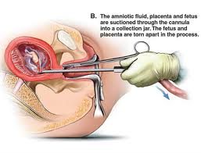
Manual Vacuum Aspiration (MVA):
A procedure used as early as 7 weeks since the last period with minimal cervical dilation. It is performed as an outpatient procedure using a flexible vacuum cannula and a 50 ml plastic syringe.

Slide 97
Advantages: It is quicker, less traumatic and safer than suction evacuation and curettage.. Considered less invasive with only a local anesthesia being used on the cervix.

Slide 98
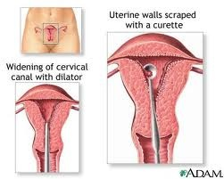
Dilation & Curettage (D & C):
This improvised method consists of a suction machine fitted with a cannula either plastic or metal available in different sizes.

Slide 99
Cont…
Advantages: This procedure is performed under paracervical block anesthesia so no need for general anesthesia. Blood loss is minimal. Less chance of uterine perforation.
Disadvantages: this procedure is not suitable with bigger size uterus of more than 10 weeks as chance of retained products is more. Requires electricity to operate machine.

Slide 100
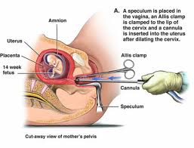
Dilation & Evacuation (D & E):
Rapid method: this can be done as an outdoor procedure with diazepam sedation and paracervical block anesthesia.

Slide 101
Advantages: patient can go home after the sedation effect is over. Chances of sepsis are minimal.
Drawback: A chance of cervical injury is more. Uterus should not be more than 6-8 weeks of pregnancy.

Slide 102
Slow method: slow dilatation of the cervix is achived by inserting laminaria tents-dilators into cervical canal. This is followed by evacuation of the utretus after 12 hours.
Advantages: chance of cervical injury is minimal. Suitable in case of therapeutic indications.
Drawback: hospitalization is required at least for one day. Chances of sepsis.

Slide 103
Medical methods of first trimester abortion:
Mifepristone and Misoprostol:
It acts as an antagonist, blocking the effect of natural progesterone. It is highly successful when used within 50 days of gestation.

Slide 104
Protocol: 600 mg of Mifepristone orally is given on day 1. On day 3 misoprostol(PGE₁) 400 µg orally is given.
Patients remains in the hospital for 4 hours during which expulsion of the conceptus often occur.
Patient is re-examined after 10-14 days.

Slide 105
Methotrexate & Misoprostol (MTX): methotrexate 50 mg/ M² IM (before 56 days of gestation) followed by 7 days later Misoprostol 800 µg vaginally is highly effective.

Slide 106
SECOND TRIMESTER:
Between 13-15 weeks:
Dilatation and evacuation
Prostaglandins
Transcervical extra-amniotic instillation of 0.1% ethacrydine lactate or intra amniotic instillation of hypertonic solution-saline 20%.
Hysterectomy: is less often done these days.

Slide 107
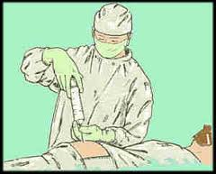
Between 16-20 weeks:
Intra amniotic instillation of hypertonic solution 20% is less commonly used now.
Induction Abortion: a rarely performed surgical procedure where salt water, urea, or potassium chloride is injected into the amniotic sac; prostaglandins are inserted into the vagina and pitocin is injected intravenously.

Slide 108


Slide 109


Slide 110
Assignments
Write down general management of abortion.

Slide 111


