Slide 1
Nursing management
PREPARED BY:
MS. HETAL M. PATEL
NURSING TUTOR, SNC

Slide 2


Slide 3
Supervision
and
management

Slide 4
INTRODUCTION
Supervision is defined as. An art or a process by which designated individual or group of individuals oversee the work of others and establish controls to improve the work as well as the worker.
Supervision is generally termed as an educational process in which a person with better training or more experience takes the responsibility of training a person with less training or less experience, and in this educational process the leadership of the supervisor and the growth of the supervised combine to achieve and maintain progressively the highest level of performance of which the worker is capable.

Slide 5
definition
1.
Supervision has been defined as a co-operative relationship between the leader and one or more person to accomplish a particular job.
2.
according to Jean Barret, supervision is kind of teaching which involves advising, helping, inspiring, leading and liberating.

Slide 6
objectives
1.
To help subordinate to do their job skillful and efficiently.
2.
To promote team work
3.
To bridge the gap between personal goal and organizational goal
To develop subordinates capacity to the fullest extent.
To promote moral and motivation among workers.

Slide 7
PURPOSE
To improve the quality of work/ performance.
Helping the person doing the work and develop the highest possible standard

Slide 8
PRINCIPLES
Supervision should aim at growth in knowledge and improvement of skill of the person.
Supervision should improve the ability in thinking and adjusting to the new situation.
It should help to formulate objects.
Good supervision stimulates their interest and effectors.
No undue pressure for achievement
Autonomy to subordinate preferred
Supervision should have competence

Slide 9
Supervision should have receive training
Decision making is encouraged
Free communication to required
No over burdening to staff
Good leadership by supervisor
Suitable climate for work
Give guidance

Slide 10
COMMON SUPERVISORY METHODS
1.Individual conference
2.Group conference
3.Training sessions
4.Review of records
5.Evaluation sessions
6.Direct observation

Slide 11
PRINCIPLES APPLIED TO NURSING
Supervision should be focused on the attainment of one goal, the giving of a high quality of nursing care.
Strives to make the ward a good learning situation.
Supervision is well planned.
It should posters the ability to think and act herself.
Helps her to attain objectives stimulates interest and effort.
To make pattern for analysis and to analyze continuously her success in reaching the objectives.

Slide 12
WHO IS SUPERVISOR
A supervisor is a person who is primarily incharge of a section & is responsible for both quality & quantity of production, for the efficient performance of the equipment, & for the employees in his charge & their efficiency, training & morale
A supervisor drives authority from the departmental head for getting work done from the workers by using the resources of the enterprises.
He issues instructions to the workers, directs their activities & reports to the department head on the performance of his section.

Slide 13
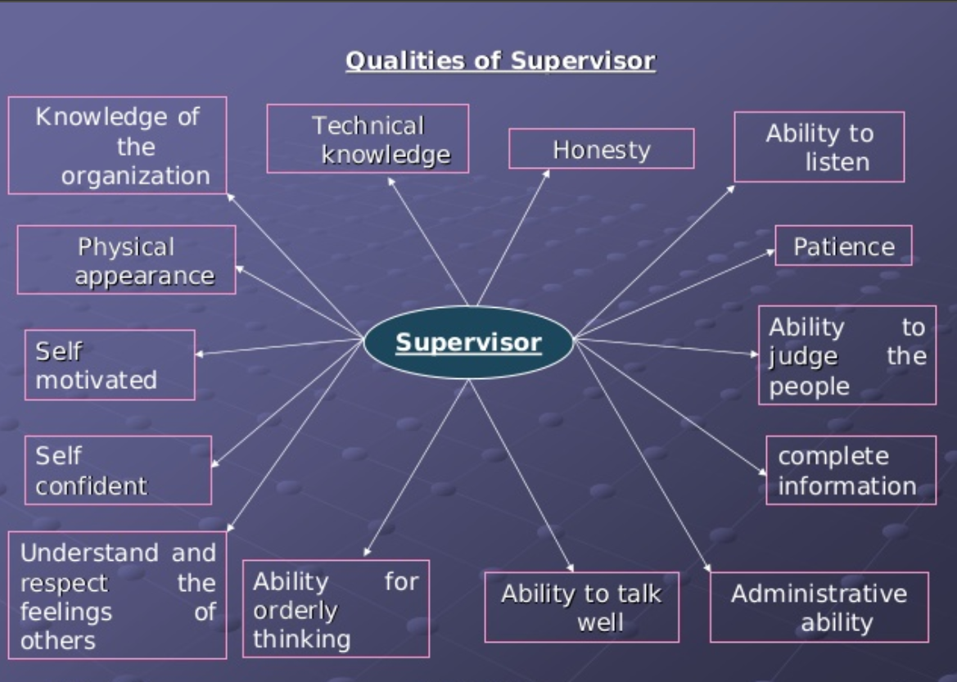

Slide 14




FUNCTIONS OF SUPERVISION

Slide 15
OTHER FUNCTIONS ARE:
Co-ordinates there of subordinates and agents and promote team worker.
Promote social contact with in the team to bring staff together and increases group cohesiveness.
Develops mutual confidence
Raises level of motivation
Develops good IPR
Maintains R & R
Establish control over the subordinates

Slide 16
STEPS IN SUPERVISION
When supervision is needed the spurt has to make plan for supervision by using certain steps to follow.
Defining of the job to be done
Selection and organization of supervisor activities based on available resources.
Anticipation of difficulties
Establishment of criterion for evaluation determining what extent the programme has met problem / objectives acc to plan.

Slide 17
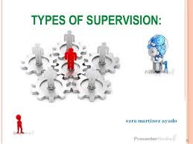

Slide 18
Types of supervision:
Direct supervision
Face to face talk with worker
Indirect supervision
With the help of record and reports of the worker and through written instructions.

Slide 19
Methods of supervision:
Technical vs. creative supervision
Co-operative vs. authoritarian
Scientific vs. institutive
Task oriented vs. employee oriented

Slide 20
TOOLS FOR SUPERVISION
Checklist
Rating scales
Nurses reports
Nursing rounds
Job descriptions
Personnel policies
Staff educations
Problem solving approach

Slide 21
The process of supervision
Stage 1: Preparation for supervision
Stage 2: supervision
Stage 3: Follow up of supervision

Slide 22
THE EFFECTIVENESS OF SUPERVISION DEPENDS ON
Human relations skill
Technical and Managerial knowledge
Leadership position
Improved upward relations
Relief from non-supervisory duties
General and lose supervision

Slide 23
PROBLEMS OF SUPERVISION

Slide 24
PROBLEMS IN NURSING SERVICE

Slide 25
COMMON PROBLEMS IN COMMUNITY HEALTH NURSING SUPERVISION

Slide 26


