Slide 1
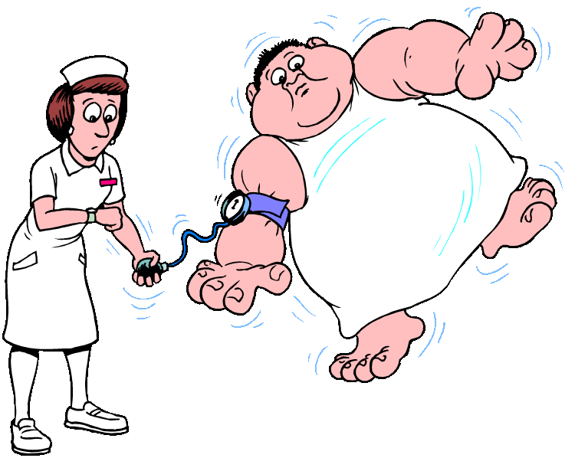
HYPERTENSION
Presented by:-Ms.RIDDHI Patel
CLINICAL INSTRUCTOR
Sumandeep Nursing College

Slide 2
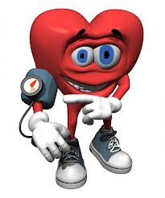
defination
According to the seventh report of the joint National committee on Prevention, Detection, Evaluation and Treatment of high blood pressure (JNC 7) Hypertension is defined as a persistent elevation of the systolic blood pressure at a level of 140mm hg or higher and diastolic blood pressure at a level of 90 mm hg or higher based on the average of two or more accurate blood pressure measurements taken during two or more contact with a health care provider

Slide 3
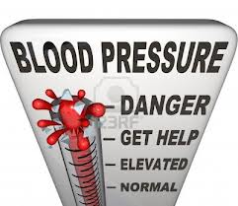
Classification of hypertension
Primary hypertension:-affecting 95% of hypertensive patients. has no identifiable cause
Secondary hypertension:-is a type of hypertension which is caused by an identifiable underlying secondary cause. affecting only 5% of hypertensive patients. It has many different causes including-
Endocrine diseases, Congenital narrowing of the aorta, Renal disease, Neurology disorders, Pregnancy, Medications.

Slide 4
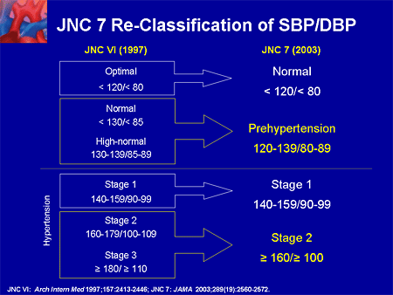

Slide 5
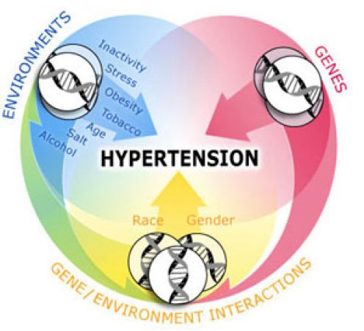
RISK FACTORS FOR HYPERTENSION
Non-modifiable risk factors.
II. Modifiable risk factors

Slide 6
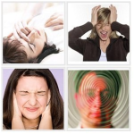
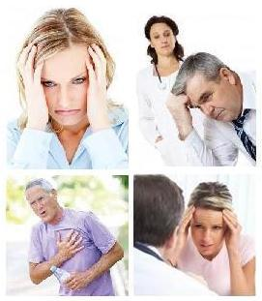
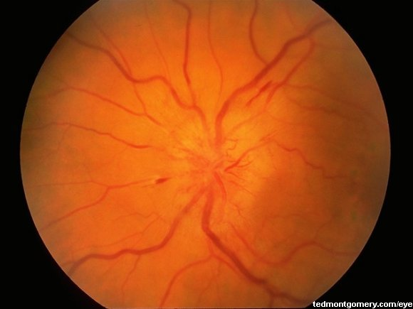
SIGNS AND SYMPTOMS
Severe headaches Fatigue or confusion Dizziness Palpitations Nausea Papilledema (swelling of the optic disc) Problems with vision Chest pains Dyspnea Hematuria

Slide 7
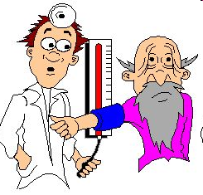
Diagnostic Evaluation
■ History taking Physical examination
■ Laboratory studies
■ OTHER
➢ Chest X Ray
➢ Echocardiogram
➢ UCG (Ultrasound cardiography)
➢ Retina examination
➢ Chest x-ray no longer routinely indicated

Slide 8
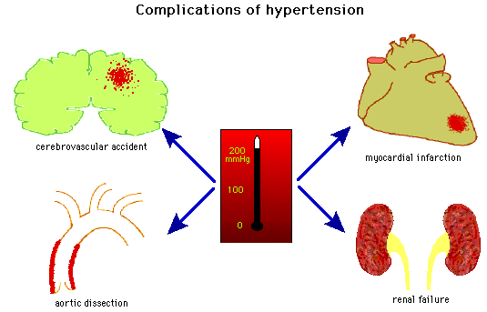
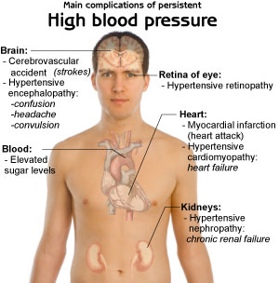
Complications Related to hypertension

Slide 9
MANAGEMENT
Medical management Diuretics ß-Adrenergic receptor blockers (BB) Calcium channel blockers (CCB) ACE inhibitors (ACEI) Alpha adrenergic blockers. Supportive management Life style modification

Slide 10
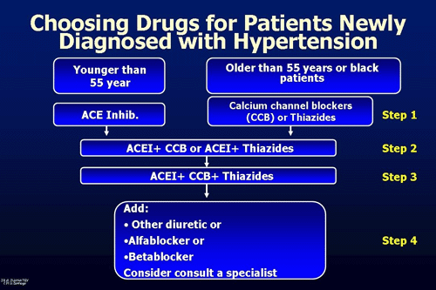

Slide 11
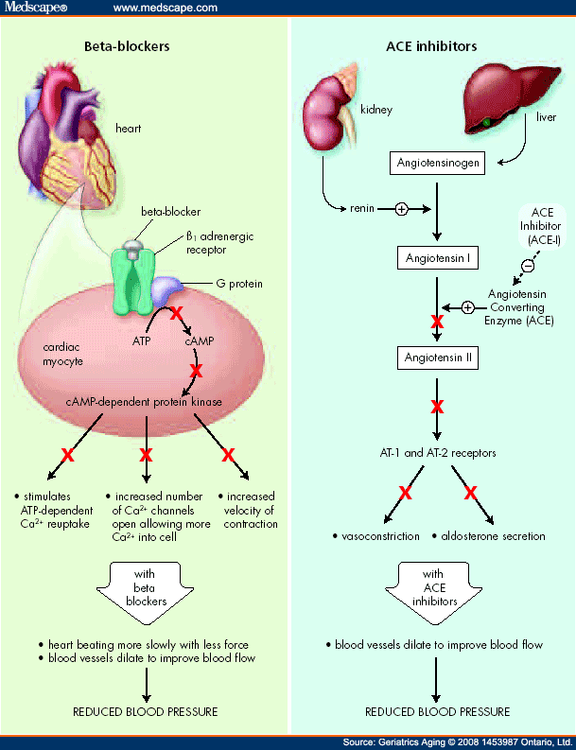

Slide 12
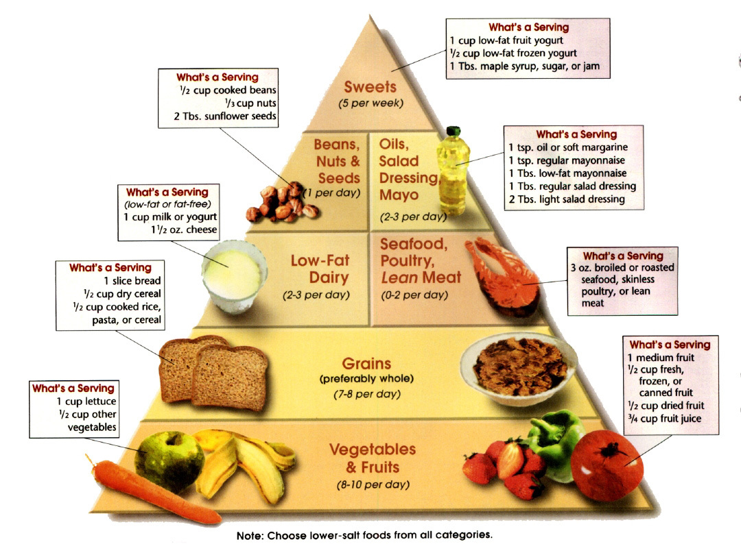
PREVENTION OF HYPERTENSION
Maintaining a Healthy Weight Reduce Salt/Sodium restriction diet Dietary fat modification Physical Exercise Alcohol restriction Caffeine restriction Smoking Cessation Limit Alcohol Consumption Control Diabetes Stress Relieving Techniques Regular blood pressure monitoring

Slide 13


Slide 14
Nurses role in caring of patient with hypertension
Nurses need to emphasize the concept of controlling hypertension Regularly need to Monitor and record the client vital sign and blood pressure. Nurses can encourage the patients to consult a dietitian to help develop a plan for weight loss. Advice client to take sodium restricted diet, less fat intake, increase intake of fruits and vegetables. Advice client to maintain regular physical activity. The patient should be advices to limit alcohol intake and tobacco should be avoided. Stress should be avoided Explain the client about the drug and use of drug at home as per physician. Explain the client about regular follow up and blood pressure monitoring.

Slide 15
HYPOTENSION
Low blood pressure occurs when blood pressure is much lower than normal. This means the heart, brain, and other parts of the body do not get enough blood.
Hypotension is generally considered systolic blood pressure less than 90 millimeters of mercury (mm Hg) or diastolic less than 60 mm Hg.

Slide 16
Types of Hypotension
Hypotension is divided into several different classifications according to when your blood pressure drops.
Orthostatic hypotension is the drop in blood pressure that occurs when you transition from sitting or lying down to standing. It is common in people of all ages. This is what some people refer to as “seeing stars” when they get up. They are most likely experiencing a brief period of dizziness caused by orthostatic hypotension.
2. Postprandial hypotension is the drop of blood pressure occurring directly after eating.

Slide 17
Neurally mediated hypotension
happens after you stand for a long time. According to the National Heart, Lung, and Blood Institute, children get this form of hypotension more often than adults (NHLBI, 2010). Emotionally upsetting events can also cause this drop in blood pressure.
Severe hypotension is related to shock. Shock occurs when your organs do not get the blood and oxygen they need to function properly. Severe hypotension can be life threatening if not treated promptly.

Slide 18
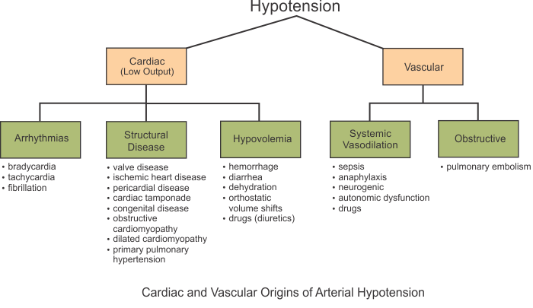

Slide 19
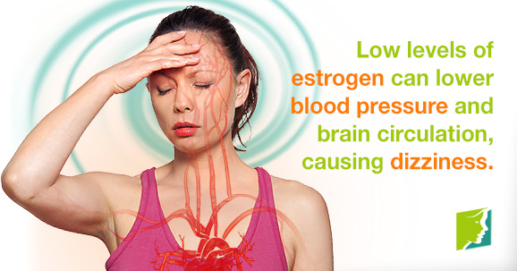

Slide 20
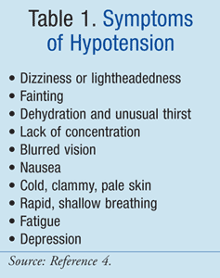
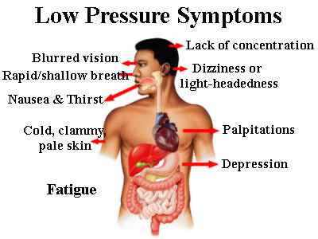

Slide 21
Treatment for Hypotension
Volume resuscitation
Blood pressure support with a vasopressor
Ensure adequate tissue perfusion
Address the underlying problem
Drink plenty of water to avoid hypotension due to dehydration.
Treat orthostatic hypotension with slow, gradual movements.
Instead of standing up quickly, work your way into a sitting or standing position using small movements.
Shock-induced hypotension is the most serious form of the condition. Severe hypotension must be treated immediately. Emergency personnel will give you fluids and possibly blood products to increase your blood pressure and stabilize your vital signs.

Slide 22
Use more salt. Experts usually recommend limiting the amount of salt in your diet because sodium can raise blood pressure, sometimes dramatically. For people with low blood pressure, that can be a good thing.
But because excess sodium can lead to heart failure, especially in older adults, it's important to check with your doctor before increasing the salt in your diet.
Wear compression stockings. The same elastic stockings commonly used to relieve the pain and swelling of varicose veins may help reduce the pooling of blood in your legs.

Slide 23
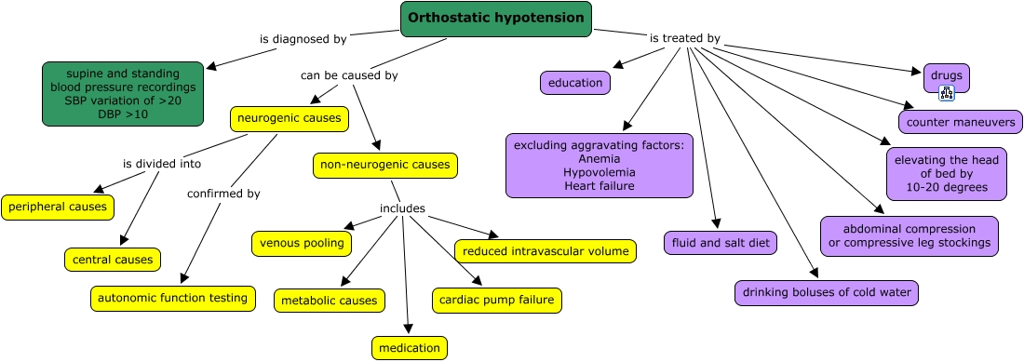

Slide 24


Slide 25
PICO
PATIENT/PROBLEM | INTERVENTION | COMPARISON | OBSERVATION/RESULT
Treatment of Hypertension with Alternative Therapies (THAT) Study: a randomized clinical trial. | (i) A dietary intervention program administered by a dietitian or (ii) a dietary intervention program administered by a doctor of chiropractic in conjunction with chiropractic spinal manipulation. The frequency of treatment for both groups was three times per week for 4 weeks, for a total of 12 visits. Randomized clinical trial Method use in the study. | This randomized clinical trial compared the effects of chiropractic spinal manipulation and diet with diet alone for lowering blood pressure in participants with high-normal blood pressure or stage I hypertension.- | Study groups were comparable at baseline. Changes in potentially confounding covariates did not differ between groups.

Slide 26

Hypertension means…
  Increase blood pressure
  Increase respiratory rate
  Increase pulse
Hypotension means
  Decrease blood pressure
  Decrease respiratory rate
  Decrease pulse
Which of the following etiological factor of Hypertension?
  Age
  Smoking
  Obesity
  All of the above
Which of the following clinical Manifestation of Hypertension?
  Apnea
  Bradycardia
  Nasal Bleeding
Which medicine used to treat Hypertension?
  Antibiotic
  Anti microbial
  Antihypertensive

Slide 27
Key answers:-
A
A
D
C
C

