Slide 1
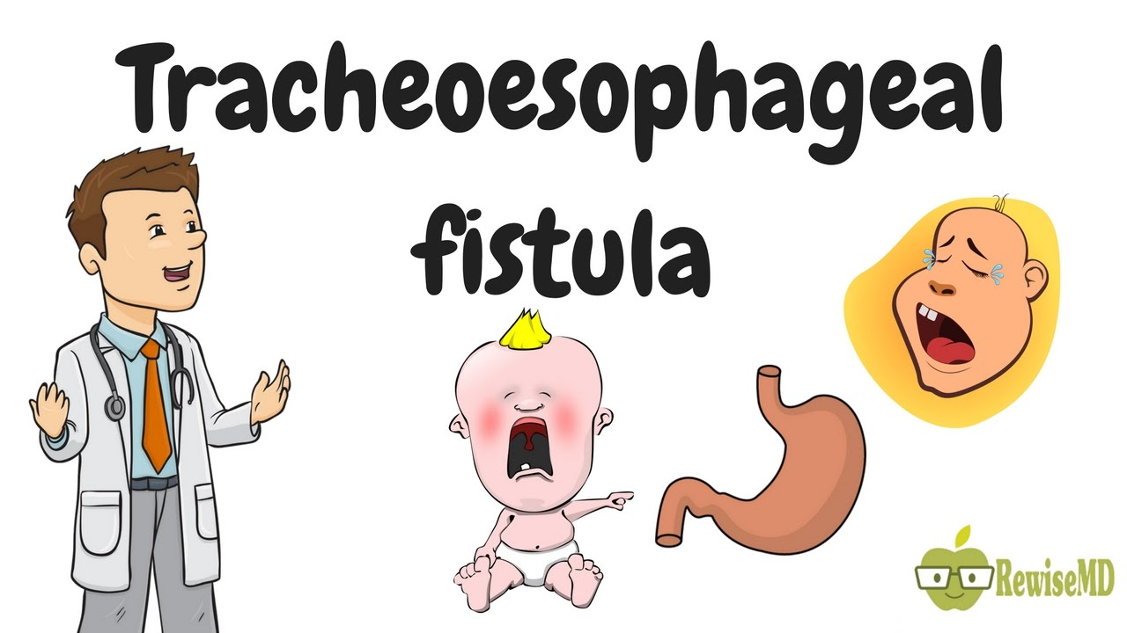
By
Prof. mr Rajesh p joseph
Department of Pediatric Nursing
Sumandeep Nursing college
Sumandeep Vidyapeeth deemed to be university
Piparia, Waghodia, Vadodara

Slide 2
TEF / EA
Tracheoesophageal fistula is an abnormal connection in one or more places between the oesophagus and the trachea
Normally, the oesophagus and the trachea are two separate tubes that are not connected.
Tracheoesophageal fistula is also known as TE fistula or simply TEF.

Slide 3
TE fistula is a birth defect, which is an abnormality that occurs as a fetus is forming in its mother's uterus.
When a baby with a TE fistula swallows, the liquid can pass through the abnormal connection between the oesophagus and the trachea.
When this happens, liquid gets into the baby's lungs.
This can cause pneumonia and other problems.

Slide 4
Esophageal atresia (EA)
is a condition where the oesophagus does not form completely.
This usually means the tube leading down from the mouth and the tube leading up from the stomach do not meet.
Instead, each section of tube has a closed end.
A baby with EA cannot eat or drink by mouth because there is no way for food and liquid to travel from the mouth to the stomach.

Slide 5
Since the esophagus is in two segments, liquid that a baby swallows cannot pass normally through the esophagus and reach the stomach.
Milk and other fluids cannot be digested if the esophagus does not connect to the stomach.
If a TE fistula is also present, liquid that a baby swallows can pass through the connection between the esophagus and the trachea and go into the lungs.

Slide 6
Risk factors
Trisomy 13, 18, or 21
Other digestive tract problems (such as diaphragmatic hernia, duodenal atresia, or imperforate anus)
Heart problems (such as ventricular septal defect, tetralogy of Fallot, or patent ductus arteriosus)
Kidney and urinary tract problems (such as horseshoe or polycystic kidney, absent kidney, or hypospadias)
Muscular or skeletal problems
VACTERL syndrome (which involves Vertebral, Anal, Cardiac, TE fistula, Renal, and Limb abnormalities)

Slide 7
Classification of TEF/EA
Type A (Isolated EA)
Pure atresia (4% to 7%)
Type B
Proximal fistula with distal atresia (1%)
Type C
Proximal atresia with distal fistula (85% to 90%)
Type D
Proximal and distal fistula (3%)
Type E
H-type fistula (2% to 3%)
Tracheoesophageal fistula without oesophageal Artesia

Slide 8
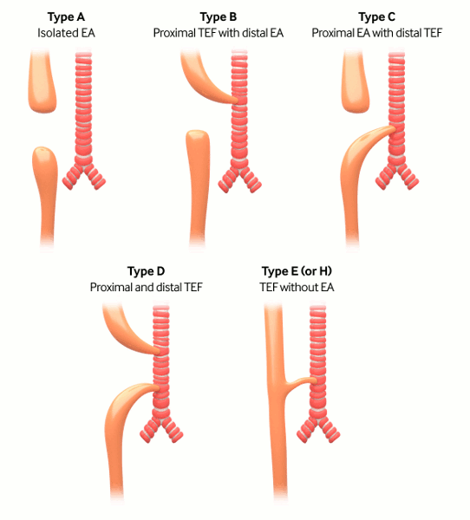

Slide 9
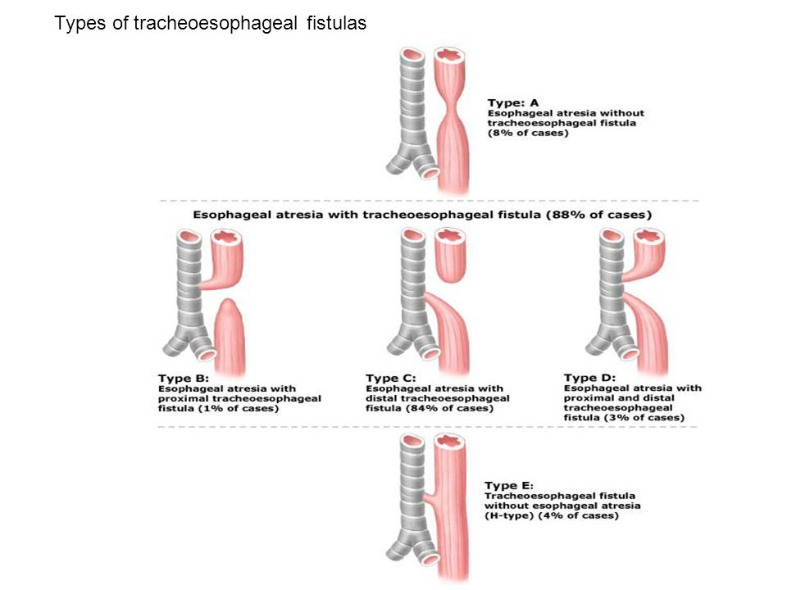

Slide 10
Pathophysiology
As a fetus is growing and developing in its mother's uterus before birth, different organ systems are developing and maturing.
The trachea and the esophagus begin developing as one single tube.
At about four to eight weeks after conception, a wall forms between the fetus' esophagus and trachea to separate them into two distinct tubes.
If this wall does not form properly, TE fistula and/or esophageal atresia can occur.

Slide 11
Signs & Symptoms
Three C’s of TEF
1. Coughing
2. Choking
3. Cyanosis
Excessive Frothy mucus from nose & mouth
Vomiting
Blue color of the skin, especially when the baby is feeding (Apnea)
Increased respiratory distress during feeding

Slide 12
Diagnostic Evaluation
History collection
Physical examination
Ultrasound
Nasogastric tube & X ray
Contrast studies (Barium swallow test or gastrograffin)
Upper GI (gastrointestinal) series

Slide 13
Surgical Management
Most babies with TEF and EA will have surgery soon after they are born.
Some babies who have other associated problems may need to wait a short time before having surgery.
The type of surgery depends on the baby’s condition.
In many cases, surgeons correct the problem with one surgery.
Other times, doctors need to correct the condition in stages.

Slide 14
SURGICAL MANAGEMENT FOR EA
Repair of the EA depends on the distance between the proximal and distal pouch:
1. For short gap EA, primary repair is the preferred approach. (less than 3 cm)
2. For long gap (3 to 4 cm) EA the Foker technique with axial traction or the Kimura advancement with extra-thoracic spit fistula (SF) are surgical options

Slide 15
Foker’s Technique
Allows esophageal lengthening, facilitating end to end anastomosis in long gap esophageal atresia.
After dissection of the upper and lower esophageal pouches, purse string sutures placed, two each on both pouches.
Clips applied at the ends of both the pouches.
Sutures brought out on the posterior chest wall and traction applied
The problem with this technique is that the traction sutures cut through the tissues leading to re-operations.

Slide 16
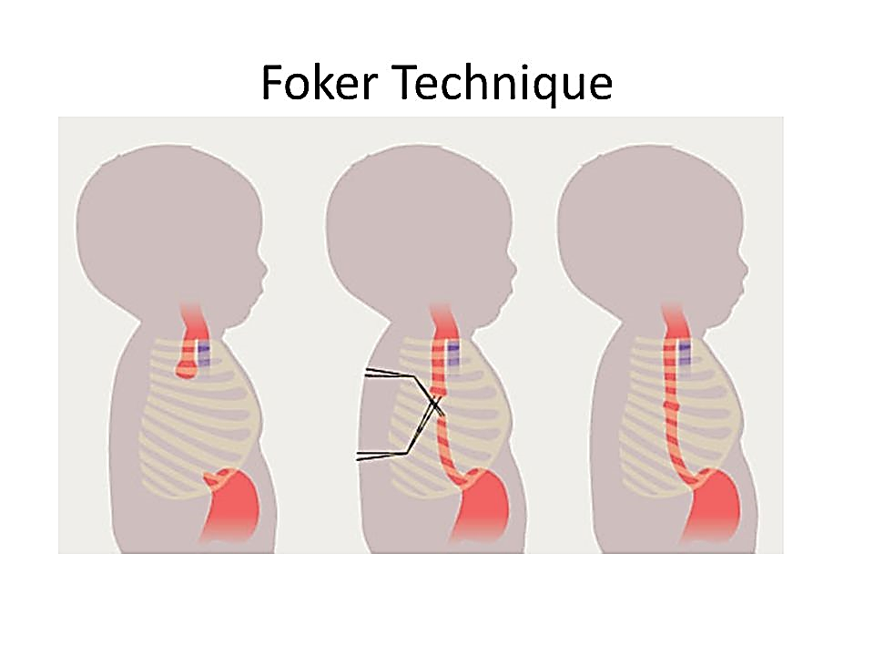

Slide 17
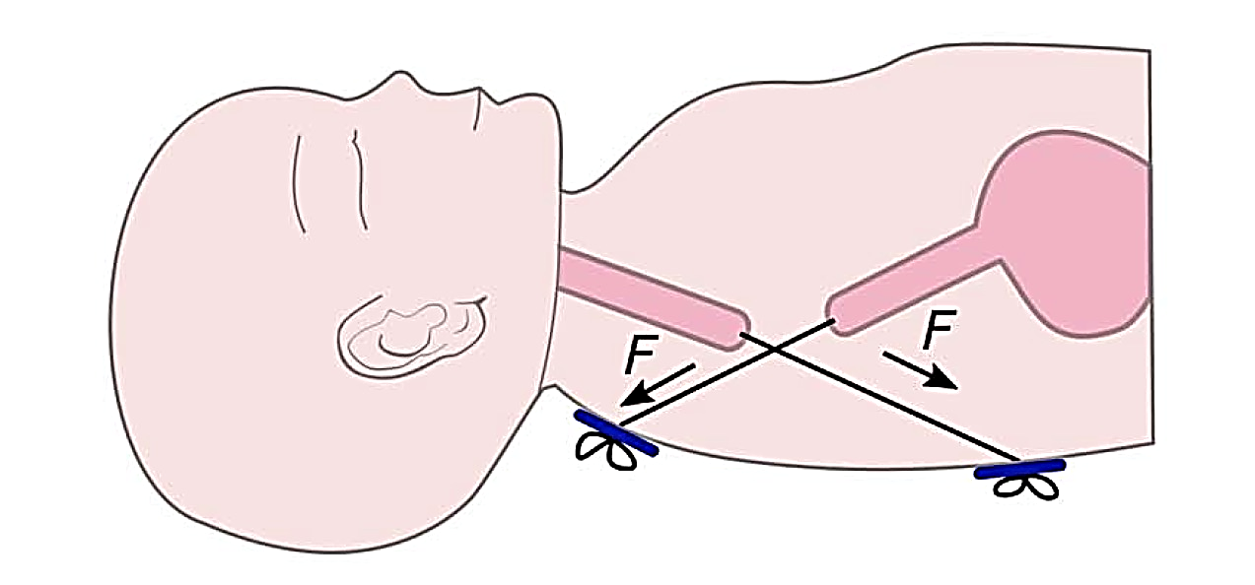

Slide 18
SURGICAL MANAGEMENT OF TEF
Thoracotomy with division and ligation of the TEF and an end to side anastomosis of the oesophagus
Cervical Esophgostomy
Staged procedure
Palliative measures
Gastrostomy
Ligation of the TEF
Provision of constant drainage of the esophageal pouch

Slide 19
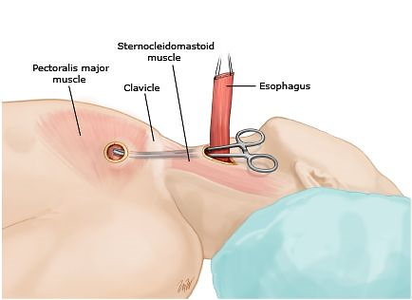
Cervical Esophagostomy

Slide 20
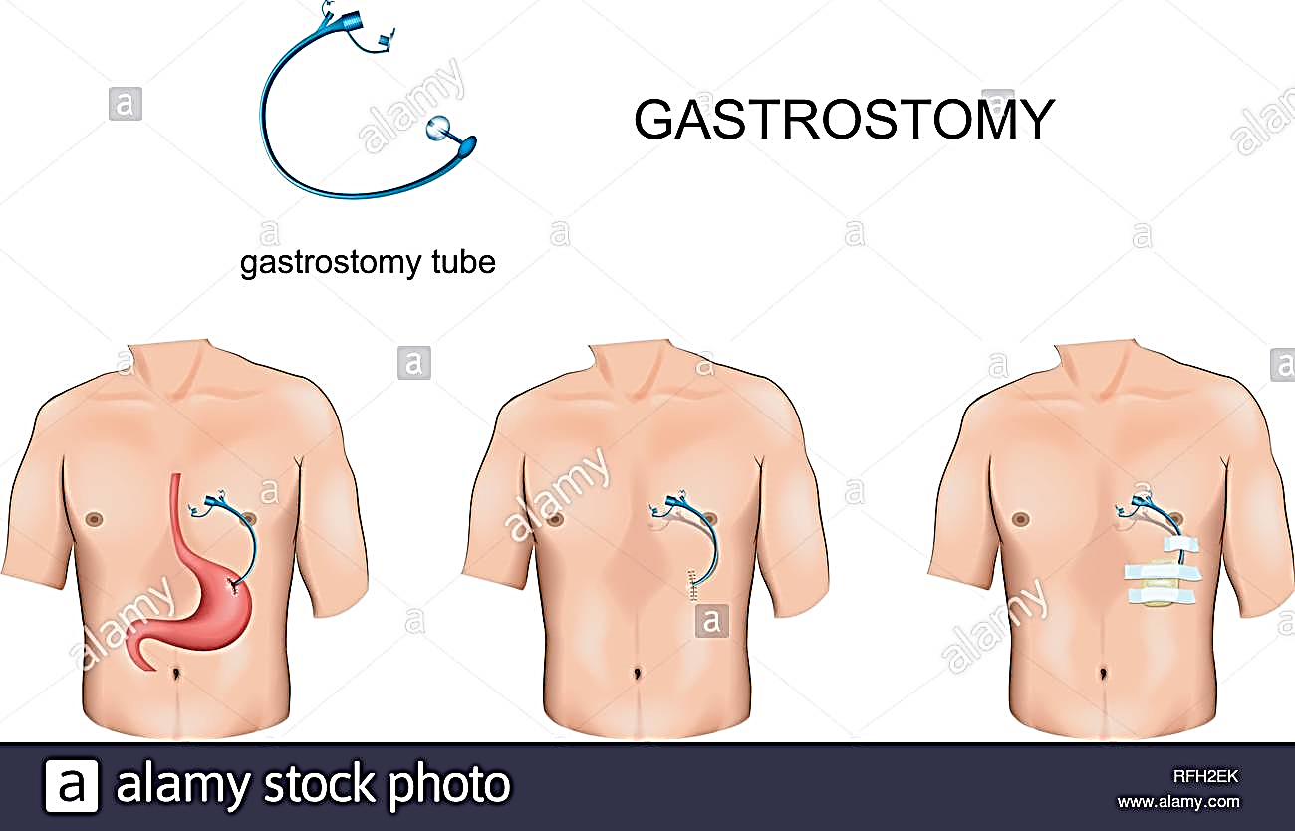

Slide 21
Nutrition & Feeding
About a week after surgery, an imaging study to check the oesophagus repair for leaks will be done .
This is called Esophagram
If there is no leak, baby may be able to start feeding by mouth.
Babies who had a Gastrostomy tube placed early in life will keep using that until they can take all their feedings by mouth.
Some babies need extra feedings from a tube passed through their nose and into their stomach

Slide 22
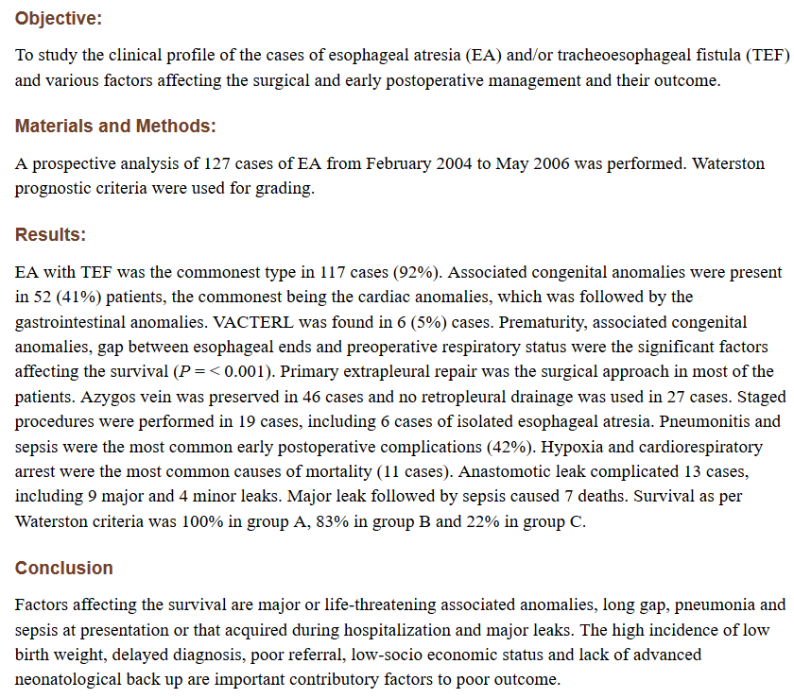

Slide 23
P | I | C | O
Factors affecting the surgical and early post operative management and outcome in TEF | Prospective analysis of 127 cases | No comparison | Factors affecting the survival are major or long gap, life threatening anomalies, pneumonia and sepsis at presentation

Slide 24
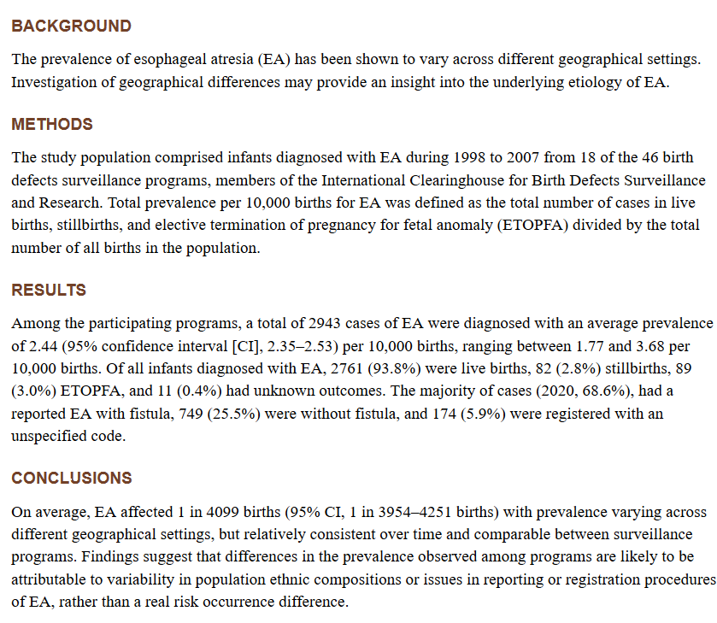

Slide 25
P | I | C | O
Prevalence of Esophageal atresia | Birth defects surveillence programms | No comparison

