Slide 1

Breastfeeding, Feeding Practices and Food Preparation
Prepared by: Ms. Rupal Patel
Assistant Professor
SNC.

Slide 2

INTRODUCTION
"The more we know about human breast milk the more we discover about its value in human nutrition
and development”.

Slide 3
MILK PRODUCTION
A healthy mother may produce about 500-800 ml of milk a day to feed her infant with about 500 kcal /day.

Slide 4
Infant and Young Child Feeding
IYCF is a set of well-known and recommended appropriate feeding practices for newborn and children up to two years of age
Initial Breastfeeding
Exclusive
Breastfeeding
Complementary Feeding
Timely introduction of complementary food (maintaining adequate diet and dietary diversity) beyond six months along with continued breastfeeding
Early initiation of breastfeeding; immediately after birth, preferably within one hour
Exclusive breastfeeding for the first six months of life

Slide 5
Colostrum-First Food
“Liquid gold” is the first gift you give your baby.
Thick and yellow in color, colostrum lasts a few days after the baby is born
Rich in protein, antibodies, vitamins and minerals.

Slide 6

How often to Feed
Your baby needs a minimum of seven to eight feeds in 24 hours, especially in the early weeks after birth.

Slide 7
You know your baby is feeding well when they:
Have at least six soaked cloth nappies in 24 hours after your milk
Have at least one yellow, loose bowel action every day after initial meconium (first bowel action) is passed
Your baby should be back to birth weight by two weeks of age

Slide 8
Stay Together After Birth
Get your position and attachment right
Technique

Slide 9


Slide 10
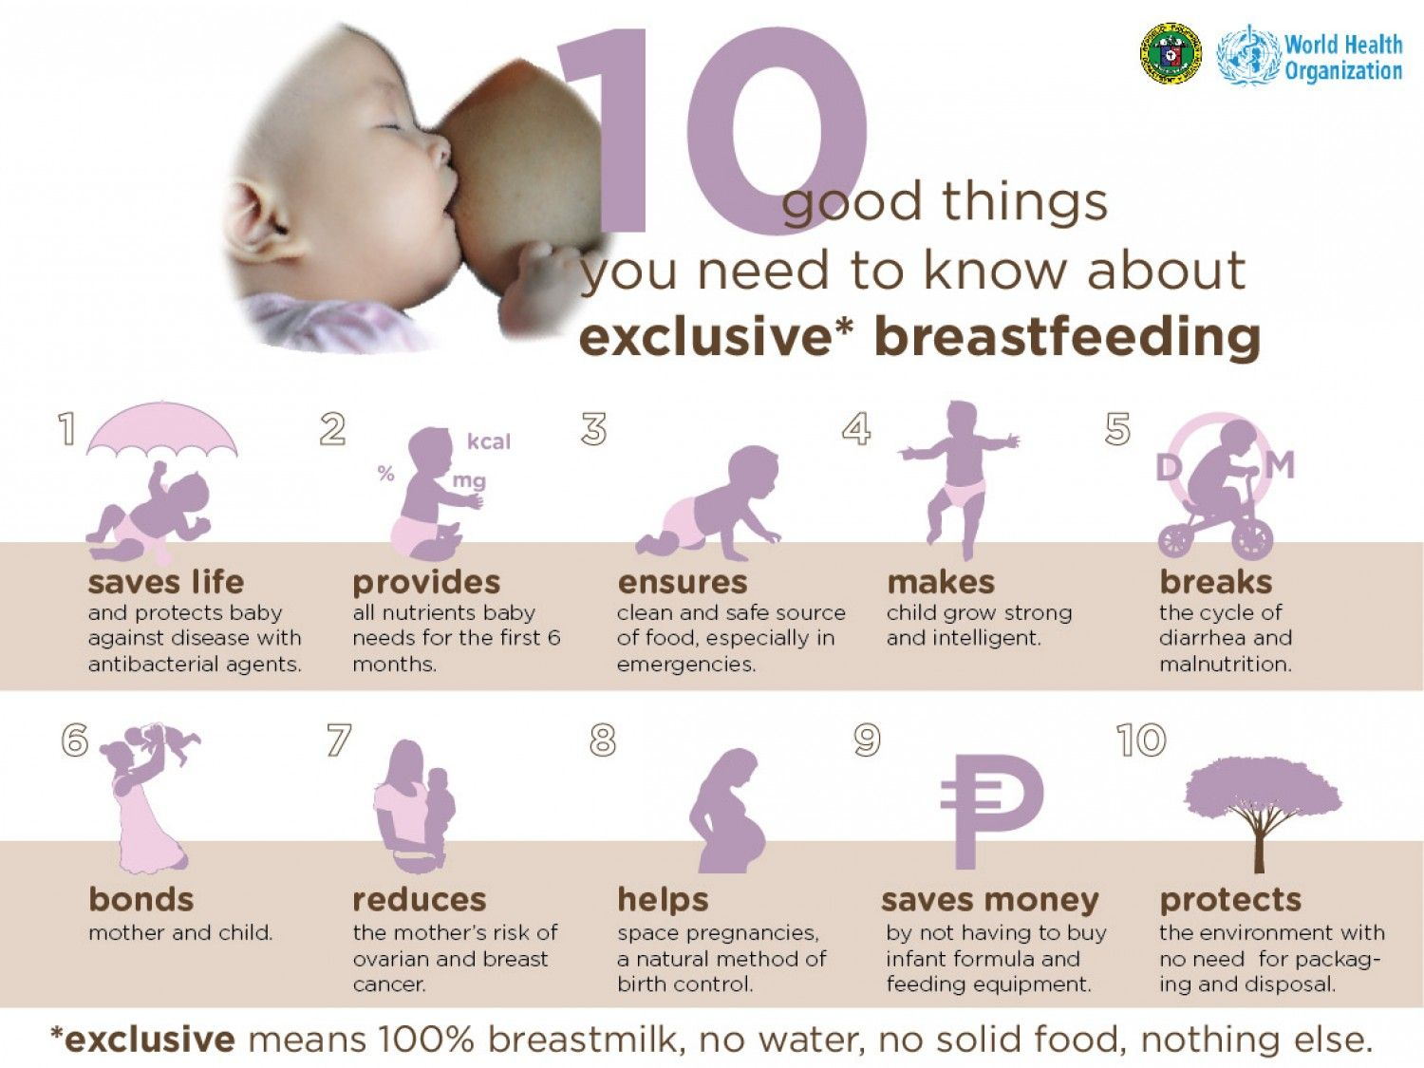
Exclusive Breastfeeding
According to WHO only 56% of Indian mothers practice exclusive breastfeeding for the recommended 6 months

Slide 11
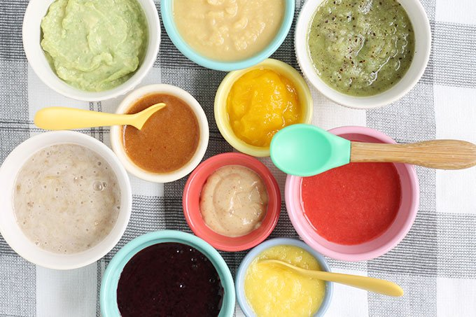
FOOD PREPARATION

Slide 12
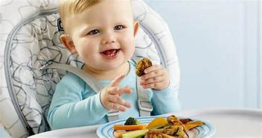
WEANING/BABY FOOD
Weaning plays a major role in determining the nutritional status of a child. Poor weaning practices during infancy and early childhood, resulting in malnutrition, contribute to impairment of cognitive and social development, poor school performance and reduced productivity in later life.

Slide 13
ESSENTIALLY FOLLOW THE SEQUENCE
WEANING | AGE OF CONSUMPTION | REMARK
BREAST FEED | 0 TO 6 MONTH
SEMI LIQUID | AFTER 5 TO 6 MONTH | Easy to digest, smooth for babies stomach
SEMI SOLID | AFTER 8 TO 9 MONTH | Baby now need food with taste of texture
SEMI SOLID | AFTER 10 MONTH | Baby now need food that satisfy his urge to chew
SOLID DIET | 1 TO 2 YEAR | Includes variety of food itmes

Slide 14
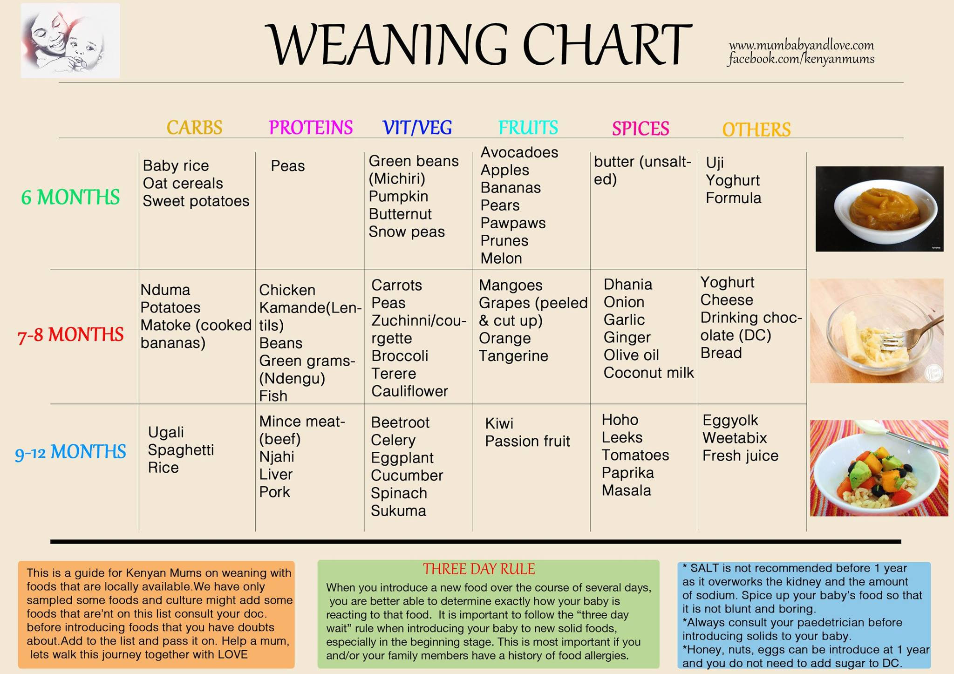

Slide 15
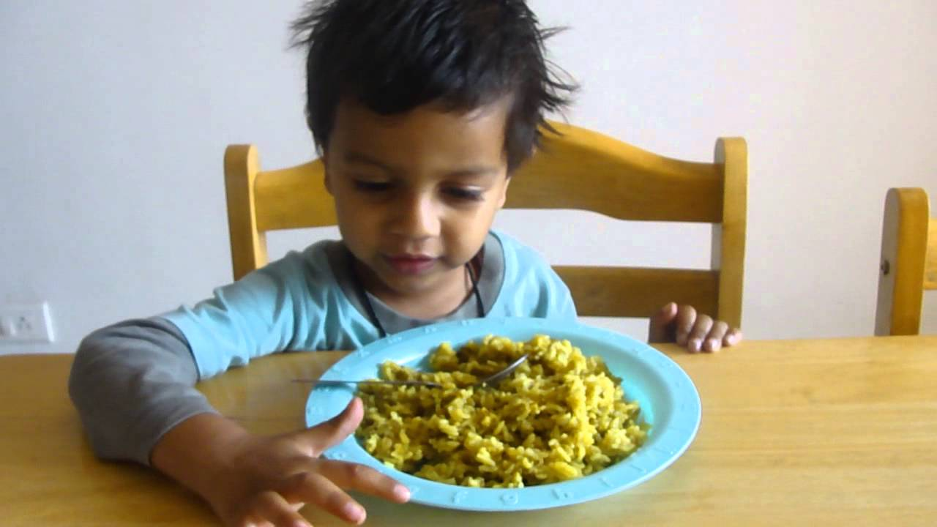
TRADITIONAL FOOD FOR INFANTS
Traditional food are different for different part of country like khichidi , daliya ,sujii, kheer etc.
MODIFIED FAMILY FOOD :
Is one of the effective way of ensuring complementary feed.

Slide 16
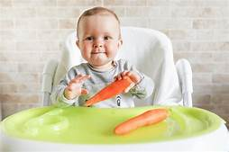
INSTANT INFANT FOOD : Food can be made at home from food grains available in the household. These can be stored and frequently feeding of infant.
PROTECTIVE FOOD :
Green vegetable, carrot etc are important to ensure vitamin A and iron status of the child.

Slide 17
THANK YOU

