Slide 1
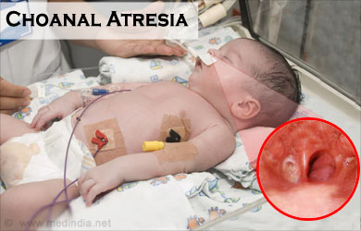

CHOANAL ATRESIA
Ms. Nirali Soni
M.Sc Nursing Tutor

Slide 2
What is Choanal Atresia ?
Choanal atresia is a congenital disorder where the back of the nasal passage(choanal) is blocked, usually by abnormal bony or soft tissue(membranous) due to failed recanalization of the nasal fossae during fetal development.
or simply
Developmental failure of the nasal cavity to communicate with the nasopharynx.

Slide 3
Causes of Choanal Atresia
The cause of choanal atresia is unknown. It is thought to occur when the thin tissue separating the nose and mouth area during fetal development remains after birth.
The condition is the most common nasal abnormality in newborn infants, affecting about 1 in 7,000 live births. Females get this condition about twice as often as males. More than half of affected infants also have other congenital problems.
Choanal atresia is generally diagnosed shortly after birth while the infant is still in the hospital.

Slide 4
Symptoms of Choanal Atresia
Symptoms of choanal atresia will obviously depend on the type of choanal atresia that is affecting the child. Some symptoms of choanal atresia are following:
Noisy and laboured breathing
Difficulty feeding
Cyclic respiratory distress which is only relieved with crying as this allows the baby to breathe orally
Nasal drainage
Breathing failure upon delivery that necessitates resuscitation. (In such a scenario, emergency surgery is necessary)

Slide 5
Diagnosis of Choanal Atresia
Doctors will also suspect choanal atresia in the event of cyanosis during breast feeding, as nasal respiration is essential while feeding. If any symptoms arouse suspicion, whether life threatening or not, health care providers will recommend certain tests to confirm the diagnosis. A physical examination will also suffice at times as it could reveal nasal obstruction. Tests that can help in the diagnosis of choanal atresia include the following:
Sinus X-rays
Nasal Endoscopy
CT Scans

Slide 6
Treatments of Choanal Atresia
The immediate concern is to resuscitate the baby if necessary. An airway may need to be placed so that the infant can breathe. In some cases, intubation or tracheostomy may be needed.
An infant can learn to mouth breathe, which can delay the need for immediate surgery.
Surgery to remove the obstruction cures the problem. Surgery may be delayed if the infant can tolerate mouth breathing. The surgery may be done through the nose (transnasal) or through the mouth (transpalatal).

Slide 7
Prevention of Choanal Atresia
The risk factors of choanal atresia cannot really be avoided, as we still do not have a clear understanding about the causes of the condition. We can do little about genetic factors, which may contribute to the problem. Certain environmental allergens or triggers have also been identified as being possible risk factors in the recent past, and in light of these findings, it would be a good idea to avoid or reduce exposure to the following during pregnancy:
Atrazine, a chemical compound present in certain herbicides
Excessive coffee consumption
Zinc and B-12 supplements
Some anti-infective urinary tract medications

