Slide 1
CHILDHOOD PAEDIATRIC EMERGENCY
Ms. Nirali soni
M.Sc Nursing Tutor

Slide 2
CHILDHOOD PAEDIATRIC EMERGENCY
Outline for Presentation;
Introduction.
Cardiopulmonary Resuscitation (CPR) Pediatric Life Support. Management of Pediatric Emergencies.
Drowning. Burns.
Falls and Injuries.
Ingestion of Foreign Bodies. Poisoning.
Respiratory Distress Syndrome.

Slide 3
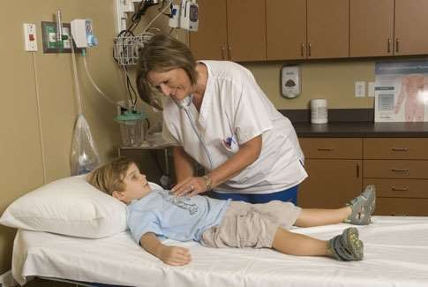
Introduction
The increase in population and change in life style have imposed stress among people resulting in an increase in the mortality and morbidity. These are Higher among the children due to their inadequate organ responses and inability to cope up especially during emergencies. Pediatric emergencies related to respiratory syndrome,drowning,Poisoning,Burns,Falls,Injuries and Ingestion of Foreign Bodies.

Slide 4
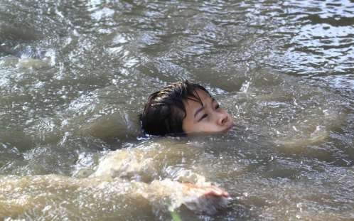
Cardio Pulmonary Resuscitation (CPR)
CPR consists of measures for establishing and maintaining Airway, Initiate Breathing and Providing Adequate Circulation for Tissue Perfusion. Failure of Circulation for more than 3-4 minutes can lead to irreversible cerebral damage, therefore CPR must begin Quickly.
Common Causes of CR arrest Includes; Airway Obstruction.
Lower Respiratory Tract Infections.
Drowning.
Anaphylaxis. Serious Infections. Cardiac Conditions.

Slide 5
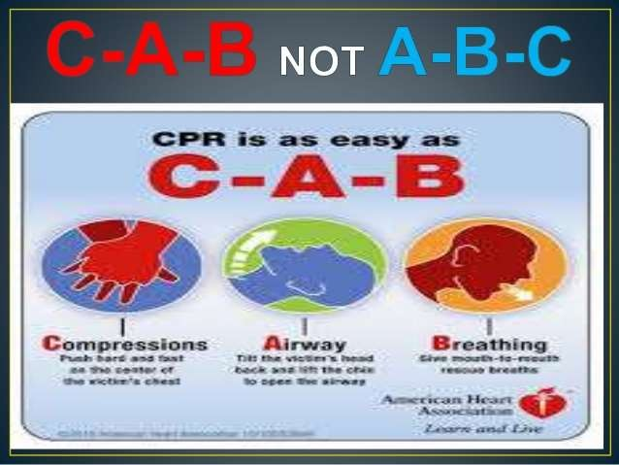


Slide 6
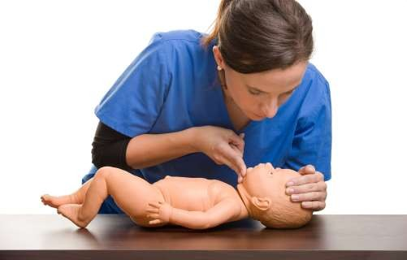
Initiation of CPR
A child who is unresponsive should be immediately placed in supine position. Cardiac status can be assessed by palpating the central pulses like carotid or brachial pulses. Opening the airway and rescue breathing or both may be all that is required.
Airway
Place the patient supine on a firm surface with his head at level or slightly lower than the level of heart. Immediately, clear the airway and start rescue breathing. Oral cavity should be cleared of all secretions.

Slide 7
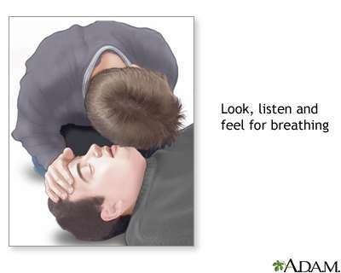
Cont…
Breathing
If after opening the airway child is still not breathing or have gasping respiration, rescue breathing should be started. If Chest wall does not rise,
airway obstruction due to inflammatory swelling, mucous plug or foreign body should be suspected. A self inflating bag and mask can be used for administering positive pressure ventilation, if available.

Slide 8
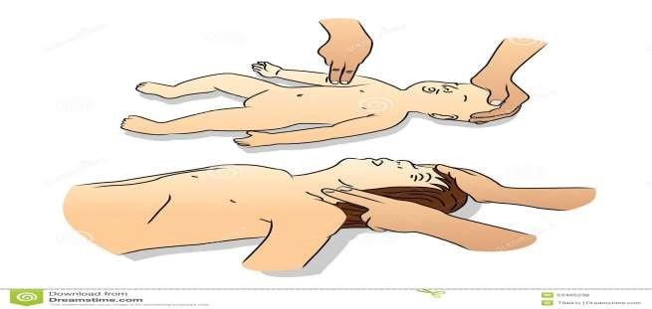
Cont…..
Circulation.
If Central Pulses (Femoral in infants and carotid in children) are not palpable, begin chest compression without losing any time. In children over 8 years may use “Adult” two hand method of chest compresson.The depth of compression
should be ½ to 1” in Infants, 1 to 1.5” in younger and 1.5 to 2” in older children.

Slide 9
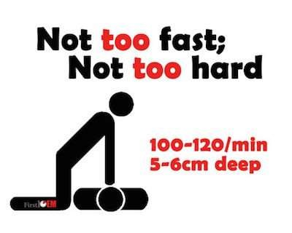
Synchronizing Chest Compression and Breathing
The Rate of Compression should be about 100 in Infants and 80 in Older Children. After every 5 compressions one breath should be delivered during recovery phase of 5th compression. Every few minutes the CPR can be stopped to see if spontaneous pulse has returned.

Slide 10
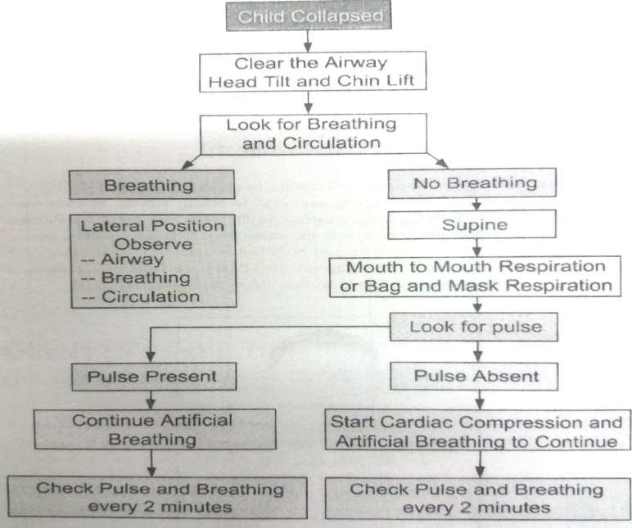
Algorithm for Cardiopulmonary Resuscitation

Slide 11
Other Measures
Endotracheal Intubation Facilitates better ventilation and effective tracheal suction. Intubation Protects airway from aspiration and enables administration of medication.
Oxygenation to prevent Hypoxia.
Establish IV line immediately to give fluids and drugs.
Sodabicard 1 ml/kg diluted in same amount of distilled water can be given IV slow to treat acidosis.
Hypotensive, Normal Saline dose of 20 ml/kg given to expand IV Volume.
Adrenaline
It increase blood pressure and improving perfusion. Adrenaline 0.1 ml/kg of 1 : 10,000 solution should be given IV initially.

Slide 12
Management of Pediatric Emergencies
Young Children are more prone to emergency due to Intense activity, insatiable curiosity and immaturity have more Accidents.e.g.Scalds, Falls, Poisoning , Household Solutions. Accidents can be prevented by parents to a great extends.

Slide 13
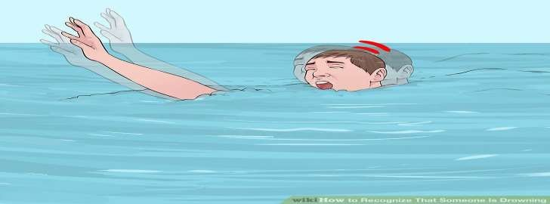
Drowning
Drowning is a cause of accidental death in children Accidental drowning may occur because children do not have adequate protective supervision. It may be defined as submersion incident leading to death within the first 24 hrs.
Near Drowning
It is a submersion incident in which the individual survives for more than 24 hrs ,irrespective of the eventual outcome.

Slide 14
Causes
Most Childhood drowning occur in fresh water, bathtubs, Swimming Pools,Ponds,Large Buckets, Washing Machine, Toilets and Tanks.
In Adolescents drowning occurs Lake and Rivers.
Causes of Hypoxemia in Drowning
Laryngeal Spasm
Pulmonary Shunting through Non ventilated Alveoli. Collapse of Alveoli.
Fluid in Alveoli and Pulmonary Edema. Decreased Lung Compliance.
Complications- Aspiration Pneumonitis, Altered Alveolar Capillary Membrane, Formation of Protein rich exudates and infection.

Slide 15
Pathophysiology
Reaction to Submersion.
Panic
Frantic
Struggling
An Attempt to hold the Breath.
Gasping
Vomit and Aspirate Vomits
Laryngeal Spasm
Unconsciousness
Pathophysiology
Effects occurs as a Consequence of Hypoxemia
Aspiration and Failure of other Organs.
Death is either due to Immediate asphyxia following Laryngeal spasm, Aspiration of Fluid or Due to late Complication.

Slide 16
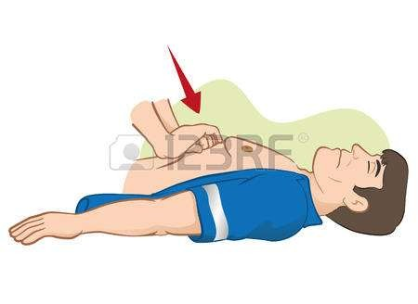
Management
Emergency Care: Mouth to Mouth Ventilation Start Immediately. Oxygen Should be given as soon as possible.
Cardiac Massage: Effective External Cardiac Massage 80 – 100 Compression/
Min in Children.100 – 120 compression/min in infant. Maximum Ventilatory And circulatory support should be continued and transport the patient to Hospital.

Slide 17
Management in the Hospital
Clear the Airway and Oxygen at the rate of 8 – 10 litre /Min.
Provide Mechanical Ventilatory Support if required. Stomach content should be Aspirated.
Monitor the Circulatory Status with Frequent BP Measurement. Obtain Blood Sample for Investigation.
Arterial Blood Gas Analysis (ABG) and Ph should be Monitored.
Insertion of CVP (Central Venous Pressure) for status of blood Volume. Keep IV Line Open.
Administer drug as Per Order.
Chest X-ray to determine Foreign Bodies. Insert foley Catheter

Slide 18
Cont…
Near Drowning Children admitted to the Hospital Should be kept under Observation and Treated for at least 24 to 48 hrs periods which includes;
Bed Rest
If Patient Unconscious then Give Care as Per Unconscious Care. Change Position frequently.
Make Continuous Observation and Assessment of Child. Administer Medication and Treatment as per Plan.
Provide emotional support to child and parents.

Slide 19
Supportive Treatment
Quick Warming and Administration of IV fluid to maintain renal output. Treatment of Comatose patient to prevent Brain Edema.
Maintain a state of hypothermia.
Head elevated to about 60 degree and should be kept in a dark and quiet area.
Prevention
Awareness of the danger and depth of Water.
Parents and Caretakers should never leave the child unattended. Keep the bathroom doors and lid on toilet closed.
Fence around swimming pool and lock gate.

Slide 20
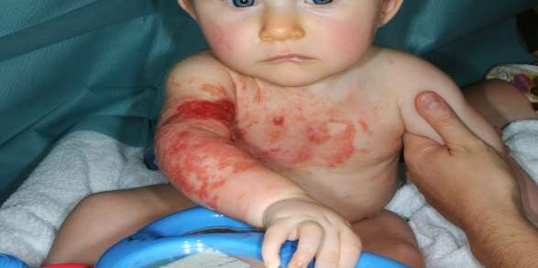
Burns
“A Burn occurs when there is injury to the tissues of the body caused by heat, chemicals, electric current or radiation.” Major Burns are one of the most
Serious accidents of childhood. Immediate mortality associated with extensive burn is very high.

Slide 21
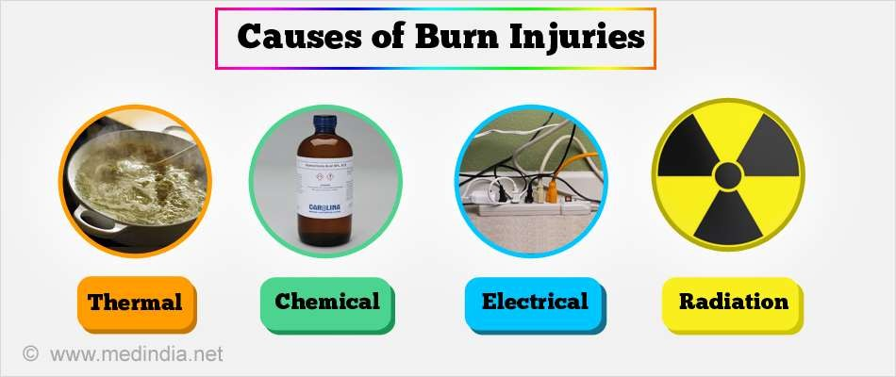
Causes of Burns
Burns can be Caused due to Various Reasons; Scald Injury From Moist Heat.
Flame Injury. Electrical Injury.
Chemical Injury and Contact Injury. Radiation Injury.

Slide 22
Pathophysiology of Burns
Burns
Increased Vascular Permeability
Edema
Reduced intra vascular volume
Reduced Blood Volume
Increased Hematocrit
Increased Viscosity
Increased Peripheral Vascular Resistance
Burns shock

Slide 23
Estimation of Depth of Burn Injury
A thermal injury is described as partial thickness or full thickness depending on the depth and severity of tissue damage.
First Degree
Burns affecting the epidermal layer is characterized by erythema due to vascular response in the sub papillary vessels.
Second Degree
Burns which involve from one half to seven eights of the dermal layer. It is subdivided into partial thickness (Superficial Layers with Blisters) and deep partial thickness (Destroy the entire thickness of the epidermis)
Third Degree
Full thickness involves all the epidermis and dermis.

Slide 24
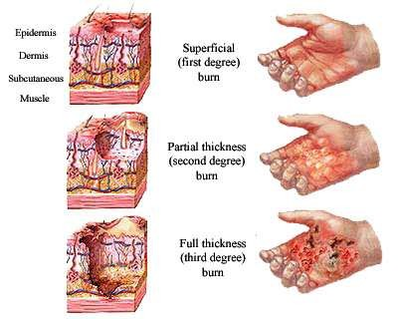

Slide 25
Classifications of Burns
The Burns are classified on the basis of extent (Size) and Depth.
Minor Burns
Second degree burns of less than 10 % of body surface area or third degree burns of less than 2 % of body surface area.
Moderate Burns
Second degree burns affecting 10-25% of body surface area or third degree burn of less than 10 % of body surface area.
Major Burns
Second degree burns exceeding 25% of body surface area or third degree burns of face,hands,feet or over 10% of other body surface area.

Slide 26
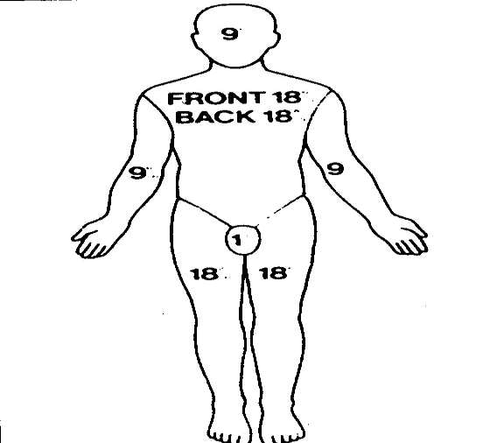
Estimation of Burn Area
The estimation of the extent of burn area expressed as the percentage of the surface area of the skin burnt to the Total Body Surface Area (TBSA) is Important.

Slide 27
Management
Emergency First Aid.
Stop, Drop and Roll techniques for extinguishing flame. Once Flame Extinguished cool water should be poured over.
Saturated Clothing, Towel or Blankets should be replaced with clean dry linen to prevent excessive heat loss.
Chemical burn lavage for 30 minutes.
Electrical shock or burn injury should be monitored for cardiac irregularities. Protection of the Burn Area.
Burns area should be covered with clean dry cloth or dressing to prevent contamination with infection agents and exposure to the air.
Transportation to a Medical Facility
Assessment should be done quickly and ensure adequacy of the Airway,
Breathing and Circulation.

Slide 28
Emotional Support to the Parents
Minor Burns
Partial thickness injuries less than 10-15 % burn in children. It involves burn of face,feet,perineum or hands and can be treated at home.
Major Burns
15% in Children require Admission. Assess Airway, Breathing and Circulation.
Administer O2 by Mask for the 24 hrs. Keep Child NBM.
Intravenous therapy is Indicated.
Take Blood for Blood Investigation. Catheterization and Record Urine Output hrly.
Pass a nasogastric tube and connect drainage for aspiration of water.

Slide 29
Cont…
Watch for gastric dilation. Monitor Vital Signs.
Clean the Burn Area with betadine or Antiseptic Solution and Apply Silver Sulphadiazine.
Give Injection of Tetanus Toxoid 0.5 ml I.M.
Give Injection Crystalline Penicillin 50,000 units/kg body weight after test dose.
Administer Conservative dose of Analgesics.

Slide 30
Cont…..
Provide Local Treatment (Two Methods have been used (Closed Method) and Open (Exposure) Method.)
Exposure Method
The Principles of this method includes Dryness, Coolness and exposure to light of the burnt surface conditions. Exposure method is especially useful for burns of face, buttocks and perineal regions.
Closed Method
In this burns area are covered with dressing but local application of various local antibacterial creams and solution for absorption of exudate is done.

Slide 31
Fluid Requirement
B rooke’s Formula
Estimate the Accurate / Approximate weight of the patient.
First 24 Hours.
Colloids 0.5 ml/kg/percent burn physiological saline 1.5ml/kg/percent burn.
Second 24 Hours.
Colloids 0.25 ml/kg/percent burn physiological saline 0.75 ml/kg/percent burn. Ascorbic Acid, Vitamin B complex and folates are important for wound healing.

Slide 32
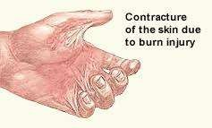
Complication
Shock
Respiratory Tract Injury
Nosocomial Infection
Gastro Duodenal Hemorrhage. Bone and Joint Abnormalities. Thrombophlebitis.
Delayed Complication
Post Burn Scars Contractures
Marjolin’s Ulcer (Burn Scar Carcinoma)

Slide 33

Fall and Injuries
Falls: Falls are most common in infants after the age of four month when they can roll over, sit and stand alone and more independently by crawling,creepng and crushing.
Injuries:
Injuries most prevalence in school age children reflect their developmental stage. Most injuries occur in or near the home or school.

Slide 34

Causes
In School Age Children Motor Vehicle Accidents Riding Bike or Minibike. Riding on school bus.
Sports Injuries or Games Playing with Animals
Falls
Fire Arms Eye Injuries

Slide 35
Prevention of Injury
Always raise crib rails to their full height when the child is unattended.
Never leave an infant of any age on a raised surface that does not have protective side rails.
Never Carry an infant in an area where the floor is slippery. Do not leave an infant unattended in a walker.
Close off with a door or fence the top and bottom of any stairways.
Keep stairs free of object to prevent falls when carrying an infant. Keep low windows securely screened and locked.
Educate the child regarding proper use of seat belts while travelling.
Maintain discipline while travelling in vehicle.
Insist on wearing safety apparel.
Educate the child for traffic rules and traffic Signal. Supervise at playground.

Slide 36
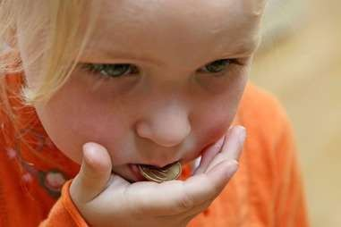
Ingestion of Foreign Bodies
Aspiration of foreign bodies can occur at any age but is most common in older infants and children in the ages group of 1 to 3 years. Example: Peanuts, Seeds, Nuts, Popcorn, Bengalgram and other Vegetable, Small Pieces etc.. are inserted.
A sharp or irritating object produces irritation and edema, latex balloons are especially hazardous, object such as safety pins, parts of broken toys, beads, button and coin. An object of sufficient size obstructing a passage can produce various changes including atelectasis, Emphysema, Inflammation and Abscess.

Slide 37
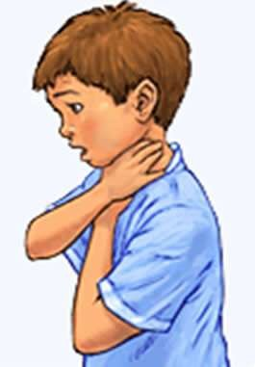





Clinical Manifestation

Slide 38
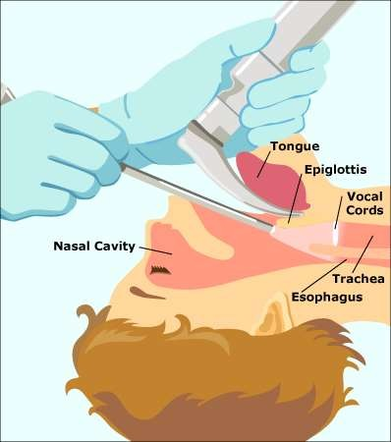
Treatment
Laryngoscopic or Bronchoscopic removal of foreign body. If the object is lodged in the larynx,Tracheostomy may be necessary to maintain respiration.
After Removing Foreign body the child is placed in a high humidity atmosphere.
Antibiotics may be administered to prevent secondary infection. Observation of Child for further signs is necessary.

Slide 39
Nursing Management of Child with Ingestion of Foreign Body
Recognize the sign of foreign body aspiration and implement immediate measure to relieve the obstruction.
Immediate removal of foreign body. Prevent local tissue inflammation. Prevent Secondary Infection, and treat with appropriate antibiotics.
Place child in an atmosphere of high humidity.
Educate parents, baby care takers about emergency Procedure.
Prevention
Keeping small objects out of reach of infants and young children. Adults should not set a negative things like pins into their mouth. Educate the parents about hazards of Aspiration.

Slide 40
Poisoning
Definition:
A Poison is any substance that when ingested, inhaled or absorbed even in relatively small amounts can cause damage to a structure or disturbance of body function by its chemical action.
Poisoning is a common medical emergency in childhood. In children under 5 years of age essentially all poisoning are accidental. Nearly
75% of all poisoning episodes involve ingestion of substance which are nontoxic or have mild toxicity.

Slide 41
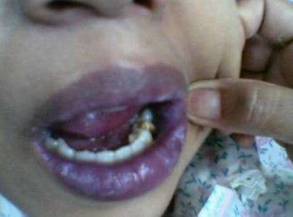
Common Clinical Manifestation
Gastrointestinal Disturbance : Nausea, Vomiting, Abdominal Pain and Diarrhea.
Respiratory and Circulatory Symptoms : Possible Unexplained Cyanosis, Shock and Collapse.
Central Nervous System: Lethargy, Sudden Loss of Consciousness and Convulsions,Dizziness,Stupor and Coma.

Slide 42
Management for Poisoning and Overdose
The Following data should be obtained at the time of initial contact
Phone Number.
Address.
Evaluation of Severity.
Weight and Age.
Time of Ingestion.
Past Medical History.
Type of Exposure.
Amount of Exposure.
Route of Exposure.

Slide 43
Primary Assessment and Interventions
Maintain an Open Airway
Attain Control of the Airway, Ventilation and Oxygenation.
Subsequent Assessment
Identify the Poison.(Product Taken – Where, why,when,howmuch,who witnessed and time of ingestion)
Continue the Focused Assessment.
Obtain blood and urine tests for toxicology screening. Monitor neurologic status. Monitor the Vital signs.
Monitor fluid and electrolyte imbalance.

Slide 44
Cont…
A) Supportive Care
Initiate IV Access.
Administer Oxygen for Respiratory Depression.
Monitor and Treat Shock.
Prevent Aspiration of Gastric Contents by Positioning, Use of oropharyngeal Airway and Suctioning.
Give Supportive Care to maintain vital organ.
Insert an Indwelling urinary catheter to monitor renal function.
Support the patient having seizures. Seizures may occurs from oxygen deprivation.
Monitor and treat Complications.
Psychiatric Evaluations.

Slide 45
Cont…..
B) Minimizing Absorption.
Primary Method:
Administration of oral activated charcoal absorbs the poison on the surface of its particles and allows it to pass with the stool. Multiple doses may be administered.
Activated charcoal is usually mixed in tap water to make a slurry.
Secondary Method:
This procedure done only if the patient is conscious and has a good eye reflex. It is more effective within 30 minutes of ingestion of poison.
Syrup of Ipecac – 30 ml by mouth followed by 2 glasses of water adult dose.
15 ml between age group of 1 to 12 Years.
Gastric Lavage . Hemodialysis.

Slide 46
Cont….
C) Providing an Antidote.
An antidote is a chemical or physiologic antagonist that will neutralize the poison.
Administer the specific antidote as early as possible to reverse or diminish effects of the toxin.
Prevention
Prevent Poisoning by effective storage in a locked cabinet and handling of dangerous substance.
Toxic substance never be stored with food containers.
Advise the parents to label poisonous substance with stickers.

Slide 47
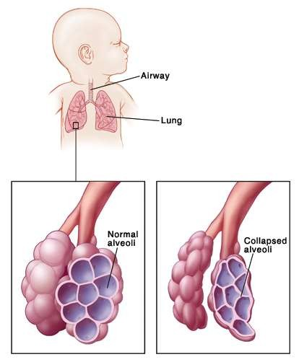
Respiratory Distress Syndrome
It is defined as respiratory rate over 60 /min and/or use of accessory muscles of respiration. This often accompanied by grunting, retraction of the intercostals muscles. Central Cyanosis, lethargy and Poor Feeding may also appear.

Slide 48
Causes
Airway Obstruction
Nasal or Nasopharyngeal : Choanal Atresia, Nasal Edema. Oral Cavity : Macroglossia,Micrognathia.
Neck : Congenital Goiter, Cystic Hygroma
Larynx : Web, Stenosis, Cord paralysis,Laryngomalacia. Trachea : Tracheamalacia, Tracheo-esophageal Fistula.
Lung Parenchymal Disorders
Aspiration Syndromes : Liquor,Meconium,Blood. Air Leak : Pneumothorax, Pneumomedistinum.
Pneumonia
Pulmonary Hemorrhage. Transient Tachypnea of Newborn.

Slide 49
Cont…
Congenital Malformation. Diaphragmatic Hernia.
Metabolic Cause : Acidosis, Hypothermia, hypoglycemia. Birth Asphyxia.
Non Pulmonary Causes: Cardiac (congenital Heart disease, MI),Neurologic (Asphyxia, Intracranial Bleeding) Metabolic Hypoglycemia, Acidosis hypothermia.
Respiratory Distress or Hyaline Membrane Disease (HMD) : It Caused due to decrease surfactant Production in the lungs.
Aspiration Syndrome : The commonest is the Meconium Aspiration Syndrome.Postnatally milk can be aspirated in babies with cleft palate and regurgitation problem.

Slide 50
Cont….
Pneumonia : (Congenital and Postnatal Pneumonia) : Preterm babies may develop pneumonia as a consequence of septicemia, Aspiration of feeds and Respiratory Failure. Pneumonia may be due to aspiration (Tracheo esophageal fistula ) Gastro Esophageal Reflux or may be of bacterial or viral etiology.
Pneumothorax : Air leaks are seen more common in ventilated babies or when aggressive resuscitation is done for birth.

Slide 51
Clinical Presentation
Signs usually develops before the neonate is 6 hours old and persist beyond 24 hours.
Progressive worsening until day 2-3 and onset of recovery by 72 hours. Respiratory rate above 60/min.
Grunting Expiration.
Indrawing of the chest, intercostals spaces and lower ribs. Cyanosis without oxygen.

Slide 52
Management
Respiratory
Prevent hypoxia and acidosis.
Prevent worsening atelectasis, edema. Minimize barotraumas and hyperoxia.
Supportive Management
Optimize fluid and nutrition management. Perfusion, Infection, Temperature control.

Slide 53
Cont….
Maintain warmth- cold stress will mimic other causes of distress. Monitor blood glucose levels- assure they are normal.
Provide enough oxygen to keep the baby pink.
Body Temperature that is too high or too low will increase metabolic demands.
Servo controlled warmers are very helpful.
Start fluids at 80 ml/kg/day 10% glucose solution. Smaller babies may need more fluid.

Slide 54


