Slide 1

SUBJECT: CHLD HEALTH NURSING
PREPARED BY:
SEVAK CHANDANI J

Slide 2
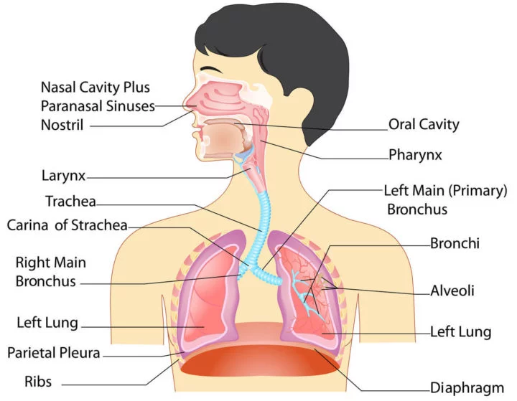

Slide 3
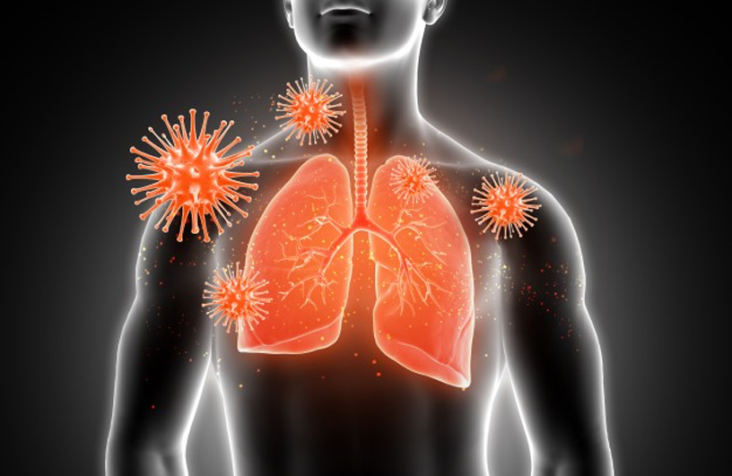
ACUTE RESPIRATORY INFECTIONS (ARI)

Slide 4
Definition:
An acute infection of any part of the respiratory tract and related structures
causes inflammation of respiratory tract anywhere from nose to alveoli with a wide range of combinations of symptoms and signs
includes all infections of less than 30 days duration, except the infection of the ear lasting less than 14 days.

Slide 5

CLASSIFICATION
site of infections of respiratory tract
anatomical involvement of lung
severity of infections
Bronchopneumonia
Loberpneumonia
Pneumonitis
2 months to 5 years of age
Infant less than two months of age

Slide 6

causative organisms
Bacteria
Virus
Mycoplasma
Fungal
Protozoa
Rickettsia
Miscellaneous

Slide 7
Clinical Manifestations
The clinical features of ARI depend upon
  Age of the children,
  Site and severity of infections,
  Causative organism,
  General health and associated medical conditions.
Notes:
Ahjheukhyiuyhulkk.klk

Slide 8
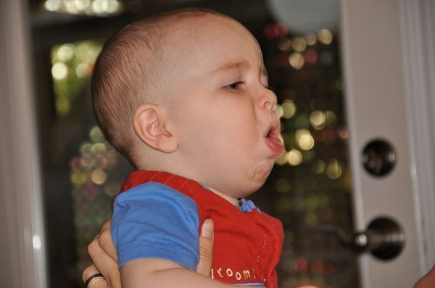
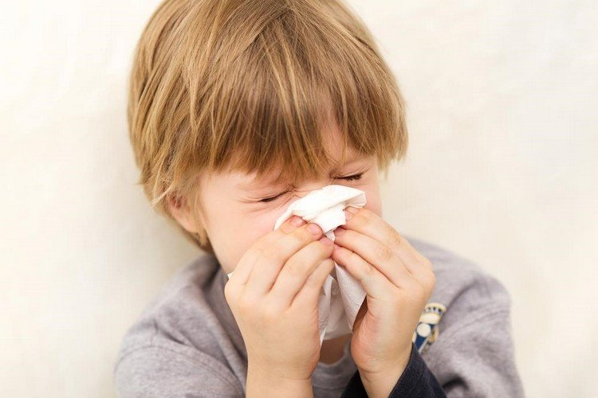
Upper respiratory infections may present as
Dry cough with postnasal discharge,
Purulent nasal discharge and
Inflammation of tonsils, Pharynx and glands

Slide 9
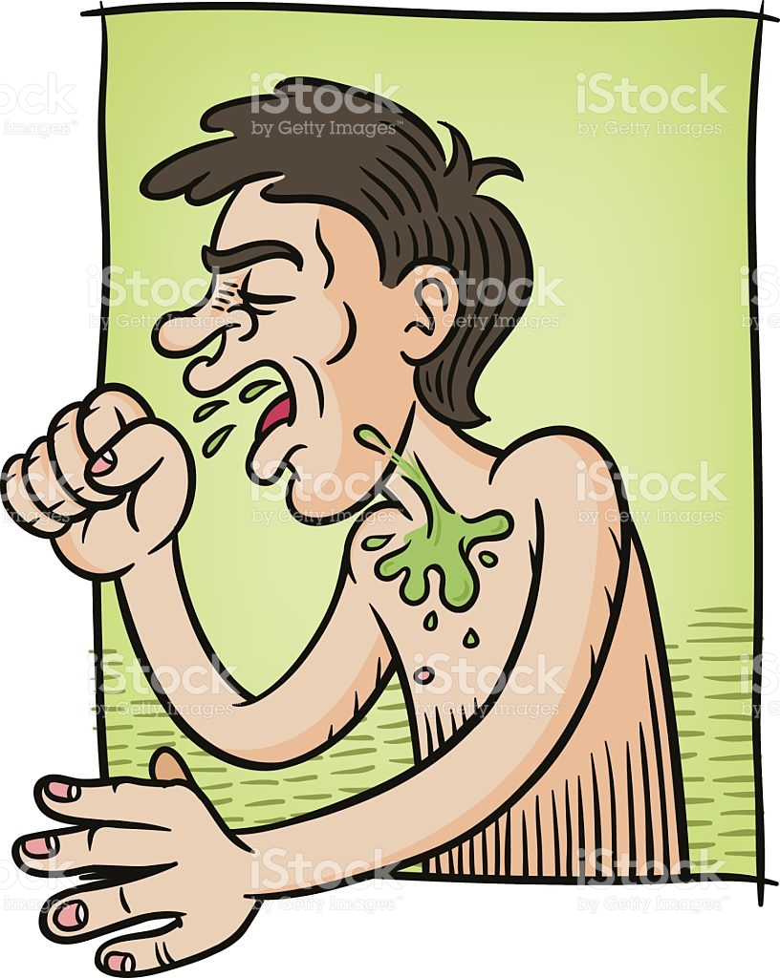

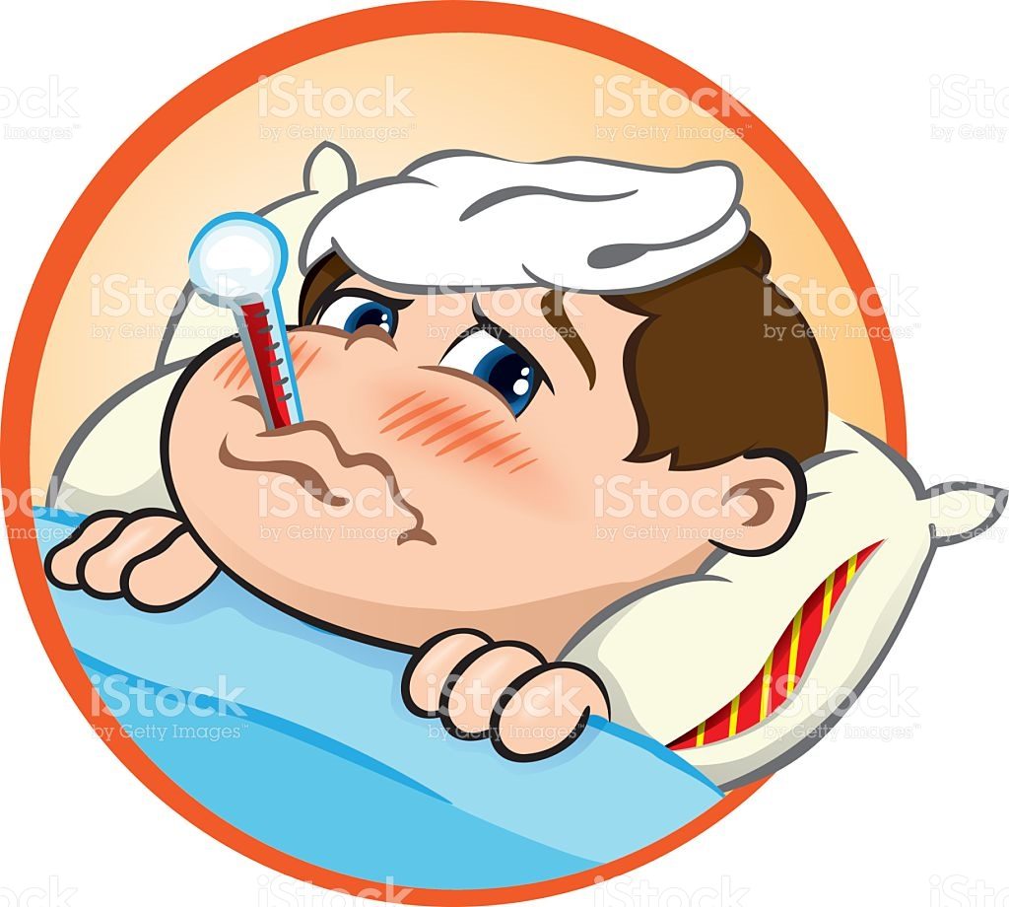
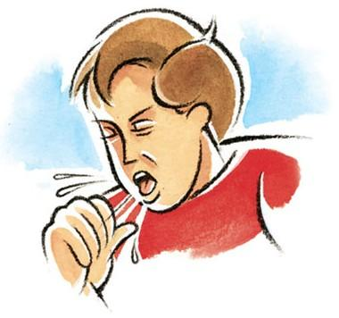

Acute bronchitis usually present with
Fever,
Dry cough (worst at night),
Wheezing and mild constitutional symptoms.
Cough becomes productive after 5 days
tachypnea
On auscultation bronchi and coarse crepitation are found.

Slide 10
Acute bronchiolitis is manifested as
severe dyspnea and prostration
Mild Cough
Mild to moderate fever
Air hunger
Flaring of alae nasi and cyanosis
Chest retraction
Wheezing
Dehydration
Respiratory acidosis

Slide 11
Chest retraction,
Wheezing,
Dehydration and
Respiratory acidosis
Crepitation and Diminished breath sound are detected on auscultation.

Slide 12
Diagnostic Measures
Careful examination of clinical features
details history taking
Auscultation of chest sound
Only in complicated cases blood for TC, DC, ESR and chest X-ray can be done.

Slide 13
Complications
Pleural effusion,
Emphysema,
Atelectasis,
Empyema,
Lung abscess,
Bronchiectasis, Pyopneumothorox
Pneumatocele
Otitis media,
Chronic sinusitis,
Pericarditis,
Congestive cardiac failure,
Respiratory failure and paralytic ileus may also develop.
Metastatic spread may cause meningitis, septic arthritis and oesteomyelitis

Slide 14


Management

Slide 15

The effective antibiotic therapy is given with
Co-trimoxazole and Amoxiciine
Penicillin,
Ampicillin,
Cloxacillin,
Gentamicin,
Amoxycillin,
Chloramphenicol,
Erythromycin or cephalosporin
cefotaxime or ceftriaxone
Bronchodilators like deriphyllin or salbutamol may be needed.

Slide 16
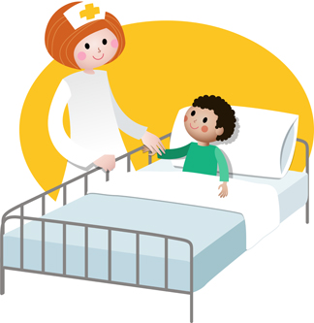
Supportive Measures???
Nursing Management???

Slide 17
Nursing Diagnosis
Nursing Interventions

Slide 18
Preventive Measures of ARI
Good hygienic practices
Isolation of the infected patients
Maintenance of warm, well ventilated environment.
Special protection during weather variation
Appropriate handling and disposal of respiratory secretions
Avoiding synthetic clothing and exposure of skin.
Avoiding harmful practices
Use of home remedies for cough and cold
Maintenance of nutritional status
Immunization
Regular health check up

Slide 19


