Slide 1
WORM INFESTATIONS
Prepared by,
Chandani Sevak

Slide 2
DEFINITION:
“Worm infestation is basically harboring of worm inside the gut.”
One of the leading causes of stomach ache in children is intestinal infection which is mostly caused by intestinal parasites such as worms.

Slide 3
COMMON CAUSES:
coming in contact with an infected surface such as soil containing eggs or germs at a playground or touching pets infected with worms
When the food is undercooked or even when properly cooked, the food is handled by contaminated hands or utensils.
Penetration of the skin of the feet.
Consuming infected food or water
Improper hygiene
Inadequate hand washing

Slide 4
GENERAL SIGNS AND SYMPTOMS OF WORM INFESTATIONS :
Stomach pain and watery diarrhoea usually start 1 to 2 weeks after infection.
About half the people who are infected also lose weight.
The illness lasts 2 to 6 weeks, or longer in people who are sick with another disease.
Tiredness, malaise, Nausea, vomiting, Weight loss, Irregular bowel movement, diarrhoea, abdominal pain and distension.
In hookworm infestation, itchy rash on the feet.In pin worm infestation, itch around the anus.

Slide 5
TYPES OF WORM INFESTATION:
There are different types of intestinal worms that can cause worm infections, but the most common are
  tapeworms,
  roundworms,
  pinworms or threadworms and
  hookworms.

Slide 6
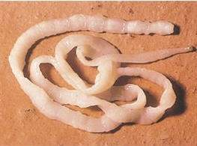
TAPEWORM:
Tapeworm infestation is the infection of the digestive tract by adult parasitic flatworms called cestodes or tapeworms.
Adult tapeworms can measure upto 50 feet long and can survive as long as 20 years.
Even while being treated for certain tapeworm infections, re-infection can result from infesting tapeworm eggs shed by the adult worm into the stool as a result of insufficient personal hygiene.

Slide 7
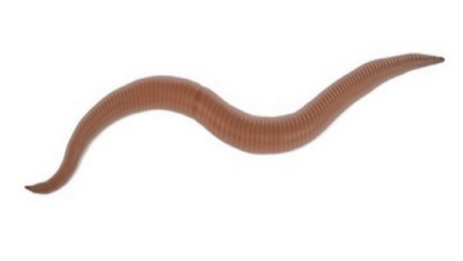
ROUNDWORMS:
Roundworm or nematodes, are a group of invertebrates with long, round bodies.
Roundworms can be 1 millimeter to 1 meter long, and infestations are more likely to occur in warmer climates than in colder locations.
The severity of illnesses caused by parasitic roundworms ranges from, mild to life threatening.

Slide 8
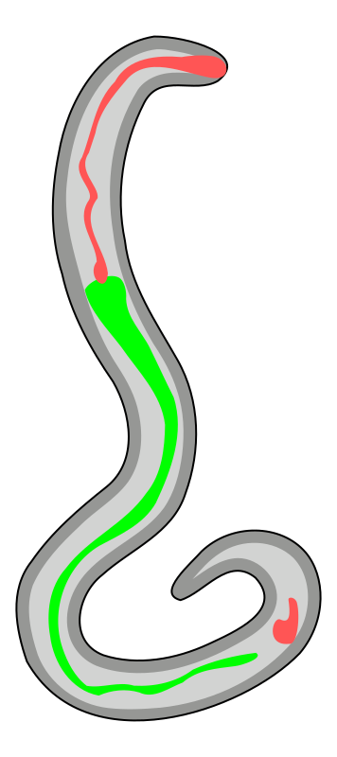
HOOKWORM:
The hook worm is a parasitic nematode that lives in the small intestine of its host, which may be a mammal such as a dog, cat, or humans.
This bend forms a definitive hook shape at the anterior end for which hookworms are named.
Hookworm is a leading cause of maternal and child morbidity in the developing countries of the tropics and subtropics.

Slide 9

THREADWORMS:
Threadworms also known as Enterobios Vermicularis are small worm parasites that infect the intestines of humans.
They are thin, white and look like pieces of thread.
The adult female worm is 8-13 mm long and the adult male is 2-5 mm long.
They live for upto 6 weeks.

Slide 10
Management:
The most common medications that are used to treat worm infections are Albendazole, mebendazole and piperazine.
In rare cases, mebendazole can cause abdominal pain or diarrhoea, particularly if the threadworm infection is severe.
Mebendazole and piperazine are 90%-100% effective at killing the threadworms, but don’t kill the eggs.

Slide 11
Prevention:
Washing hands.
It is important to treat the whole house to prevent reinfection.
Cleaning hands and under nails with a nail brush.
Discourage nail biting/finger sucking.
Wash bed linen, if possible wear clean pyjamas every night and avoid sharing towels and flannels.
Vaccum and damp dust bedrooms and bathrooms.
Wash anus as soon as you get up in the morning, to wash off any lingering eggs laid the previous night.

Slide 12
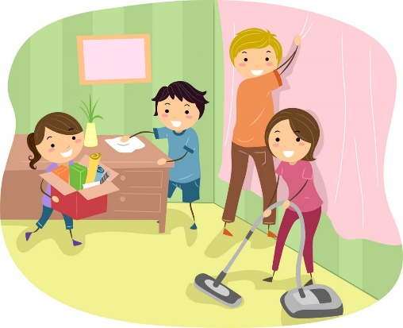

Slide 13
Wear close fitting knickers or pants at night under pyjamas, so that if urge to scratch persists there is a cloth barrier between anus and fingers, so hopefully eggs will not get undernails.
Avoid shaking any material, like sheets, which may have eggs on.
Keep your finger nails short, wear cotton gloves at night if you scratch.
Make sure children don’t suck their thumb.
Wash your hands frequently and scrub under your fingernails, particularly before eating or preparing food, after going to the toilet and before and after changing a nappy.

Slide 14

THANK YOU

