Slide 1
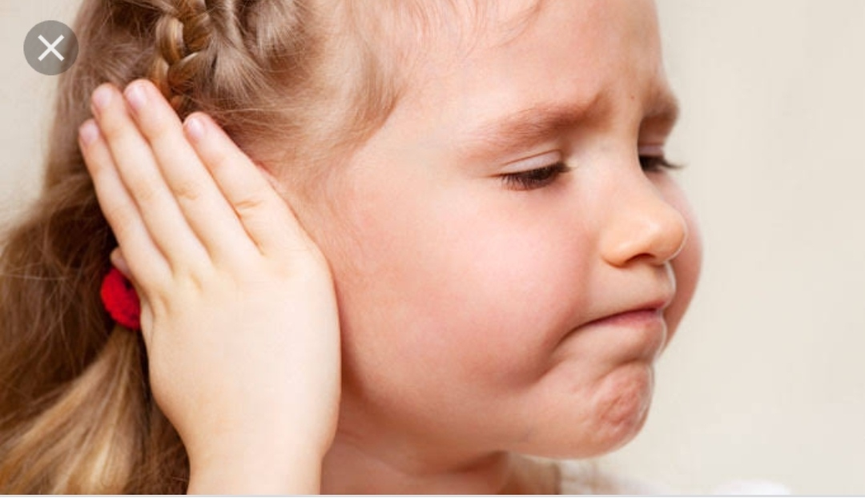
Otitis media
BY
KHUSHBU PATEL
CLINICAL INSTRUCTOR
SNC

Slide 2
INTRODUCTION
It is the inflamation of middle ear.
It is very common in infancy &early childhood.
Usually associated with URTI.
Infection from pharynx can easily spread through the eustachian tube to the middle ear & mastoid antrum causing otitis media& mastoditis.

Slide 3
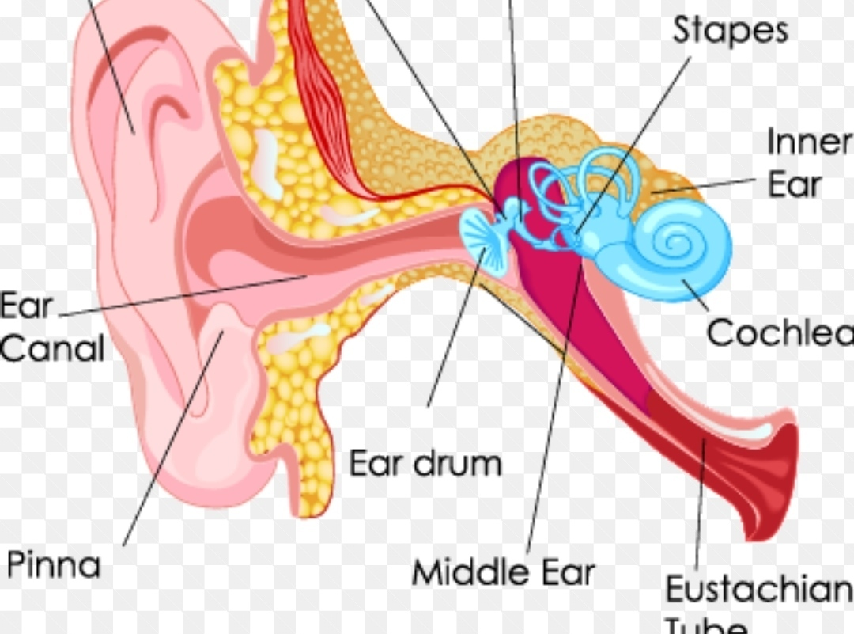
Middle ear

Slide 4
Children are more prone….
(A)
Short wide & horizontal eustachian tube.
(B)
URTI
(C)
Congestion of gums during eruption teeth.

Slide 5
Thease condition promote spread of infection through the eustachian tube to the middle ear.
Risk factors
Exposure to cigaratte smoking
Over crowding
Bottle feeding
Allergic rhinitis
Claft palate
Down syndrome

Slide 6
Types of OM
1. Acute otitis media
2. otitis media with effusion
3.chronic supporative otitis media

Slide 7
Acute otitis media
Usually associated with URI & following measles & rubella.
Etiology
Streptococcus pneumaniae
Hemophilus influenza

Slide 8
Sign & symptoms
Pain
Discomfort
Irritation
Restlessness
Continuous crying
Fever
Discharge
Hearing impairment

Slide 9
Diagnostic evaluation
Ear examination
Culture
managment
Antibiotics: amoxycillin
erytromycin for 10 to 15 days.

Slide 10
Surgical managment
Tympanocentesis
Tympanotomy
Drain collection

Slide 11
Otitis media with effusion
Associated with AOM
Child with OME may have effusion without pain & fever.
EFFUSION: purulent, infactions, allergic liquid.

Slide 12
Sign & symptoms
Mild to modrate loss of hearing.
Feeling of ear blockage
Management
Surgical: myringotomy
tympanostomy

Slide 13
Chronic suppurative otitis media
It is complication of AOM
Active CSOM: manisfested as perforation of tympanic membrane with otorrhea,hearing loss.
Inactive CSOM: hearing loss

Slide 14
Complications
Mastoiditis
Absess formation in mastoid & nack
Inner ear infection
Sensory hearing loss
Facial palsy
Meningitis
Intracranial absess

Slide 15
PICO
P | I | C | O
Child with otitis media | Antibacterial therapy | placebo | Antibacterial drug is more efactive to treat the middle ear infection

Slide 16
Thank you !!!!

