Slide 1
Uppar Respiratory Tract Infection
BY
Khushbu patel
clinical instructor
SNC

Slide 2
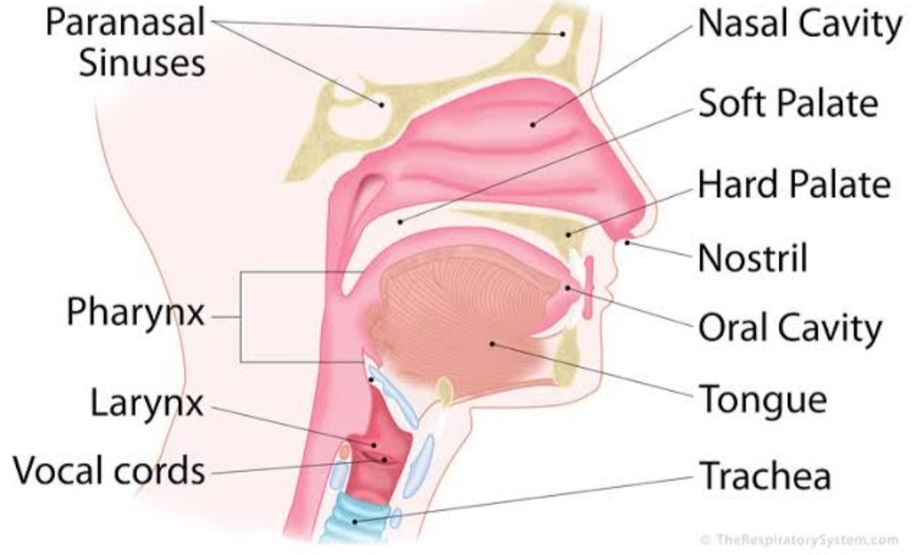
UPPER RESPIRATORY TRACT
Pharynx
Larynx
Upper part of trachea

Slide 3
Its include……
Acute viral Nasopharyngitis
Acute pharyngitis
Toncilitis
Influenza
Otitis media

Slide 4
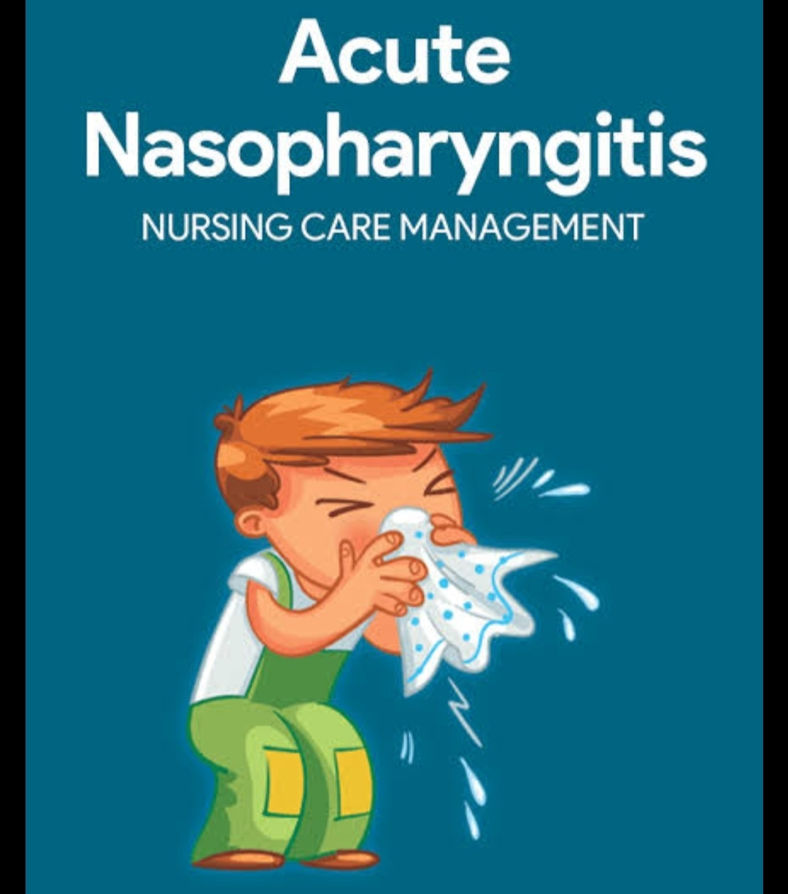
Acute Viral Nasopharyngitis

Slide 5
Definition
Its comonly known as cold. Caracterized by swelling of nasal septum,running nose &coughing.

Slide 6
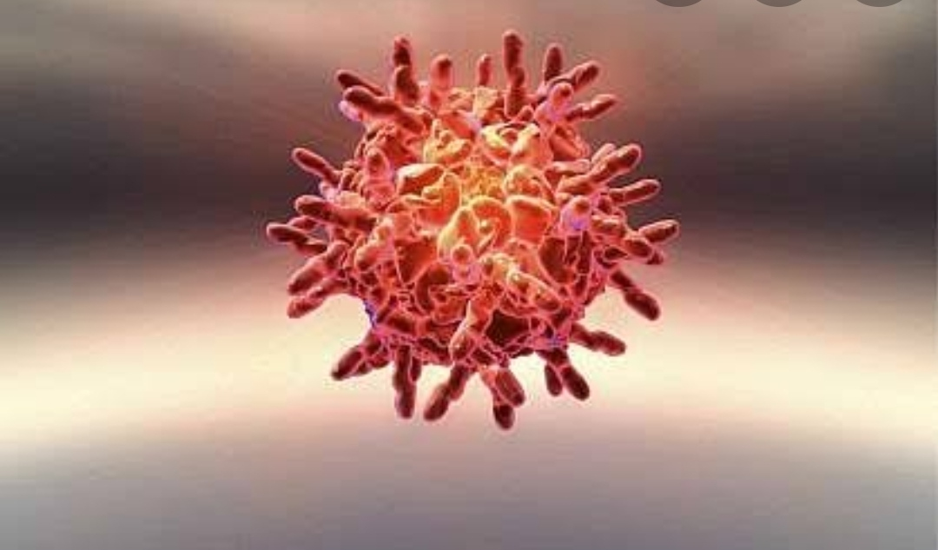
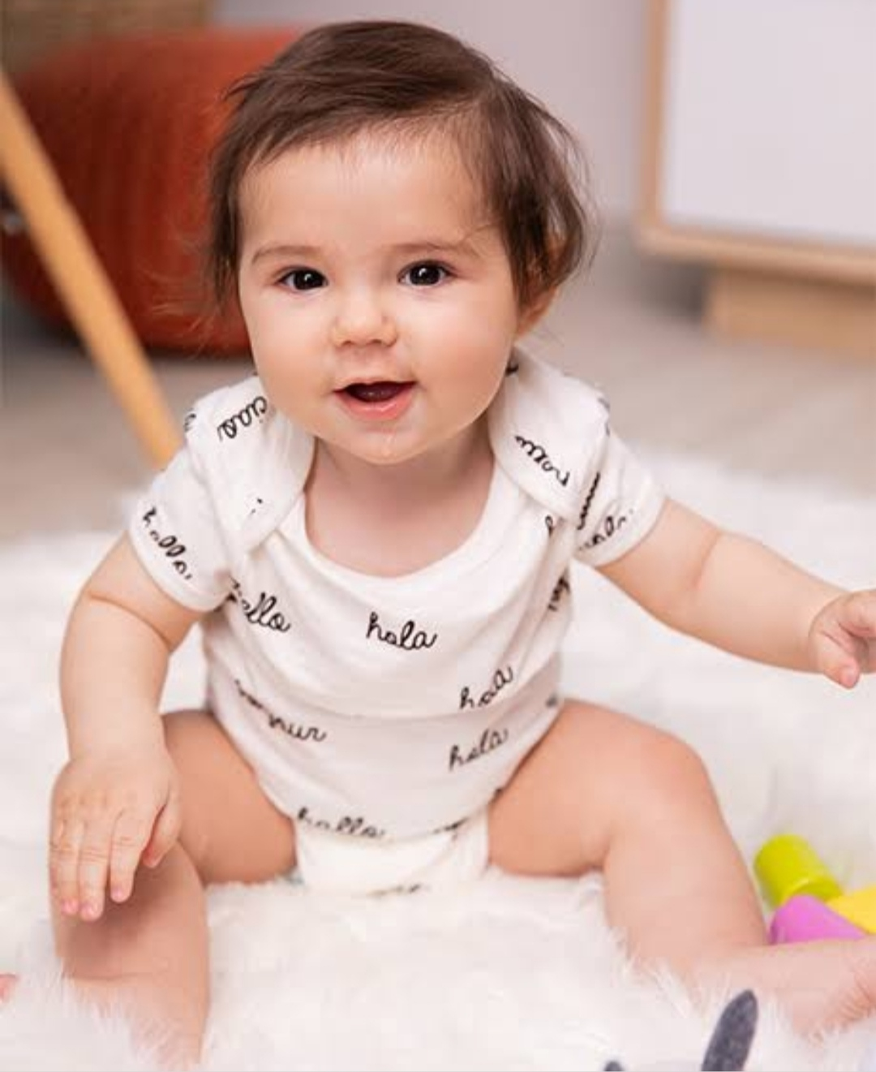
Etiology
Rhinovirus
RSV
Adenovirus
Entero virus
Influenza virus
Risk factor
age;-infents
Seassional variations

Slide 7
Sign & SYMPTOMS
Fever
Poor feeding &anorexia
Nasal blocage
Nasal discharge
Irriteted lips & surroundings
Cough
Sore throat

Slide 8
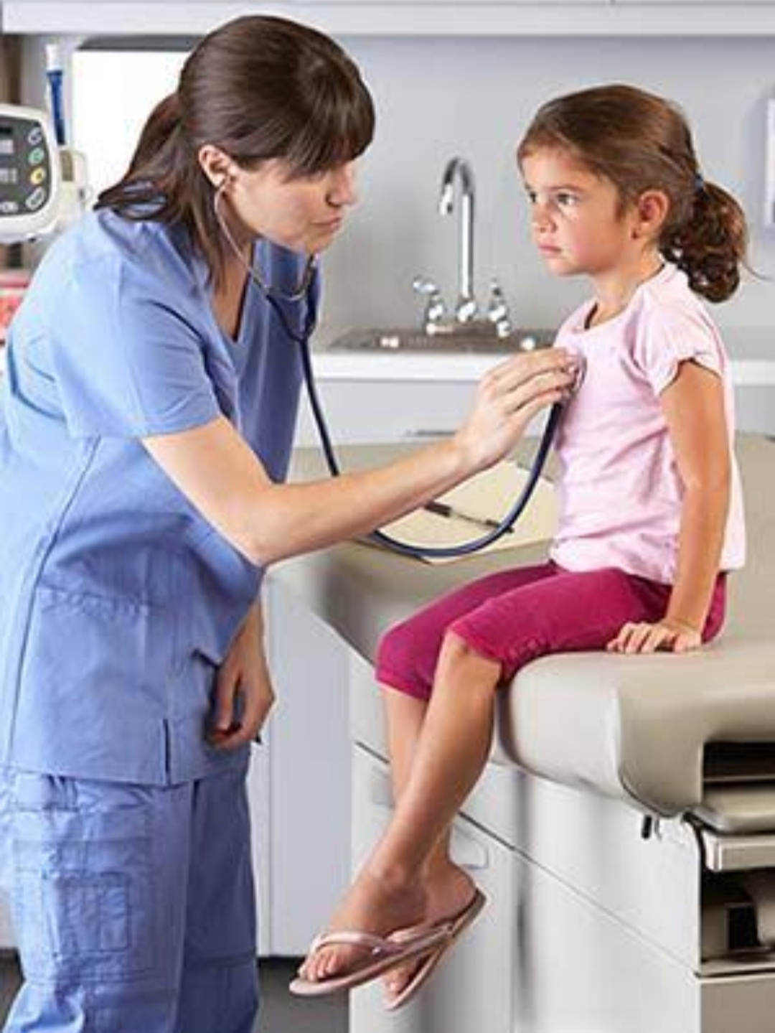
Diagnostic evaluation
Physical examination

Slide 9
Theraputic Management
Children with nasopheringitis can manage at home.
Rest
Antipyuratic
Increace oral fluid
Provide humidified environment
Couph suppresant

Slide 10
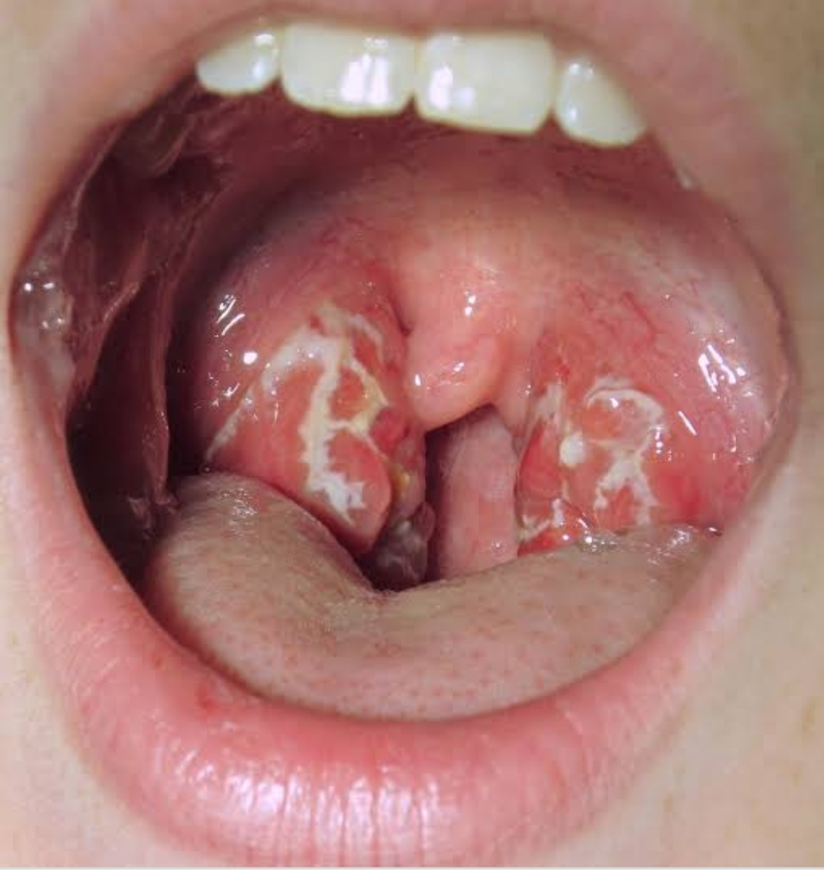
Acute pharyngitis

Slide 11
Defination
It is defined as inflamation of phaynx,which affect joint,heart,central nervous system &kidney.
Etiology
Group A bita hemolytic streptococcus

Slide 12
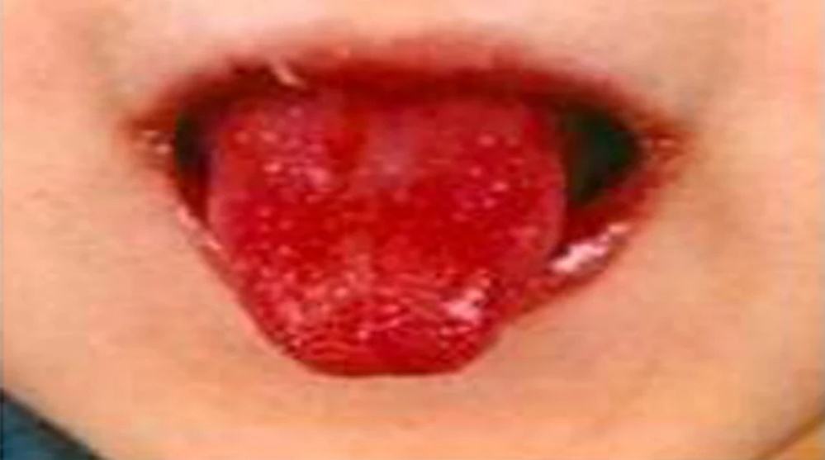
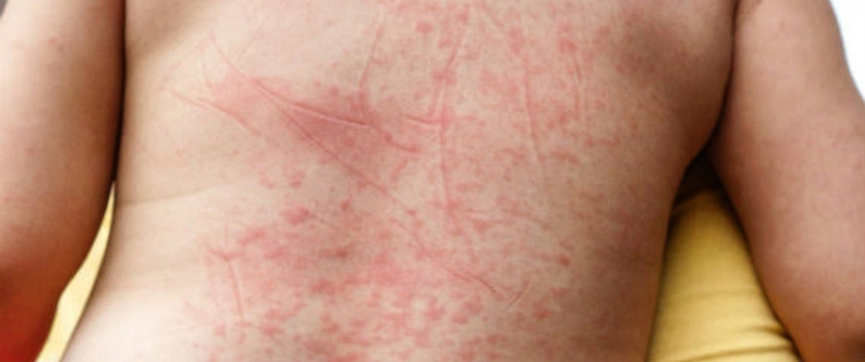
Sign & symptoms
Headache
Fever
Irritation
Sore throat
Abdominal pain
Strabarry toungue
Sand peper rash

Slide 13
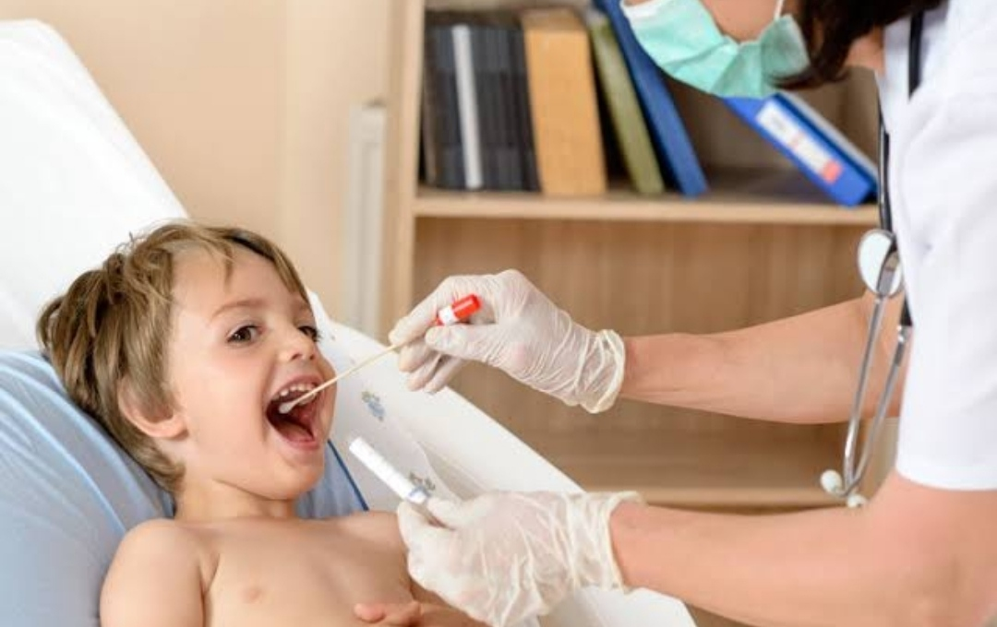
Diagnostic eveluation
Rapid antigen detection test
Throat culture

Slide 14
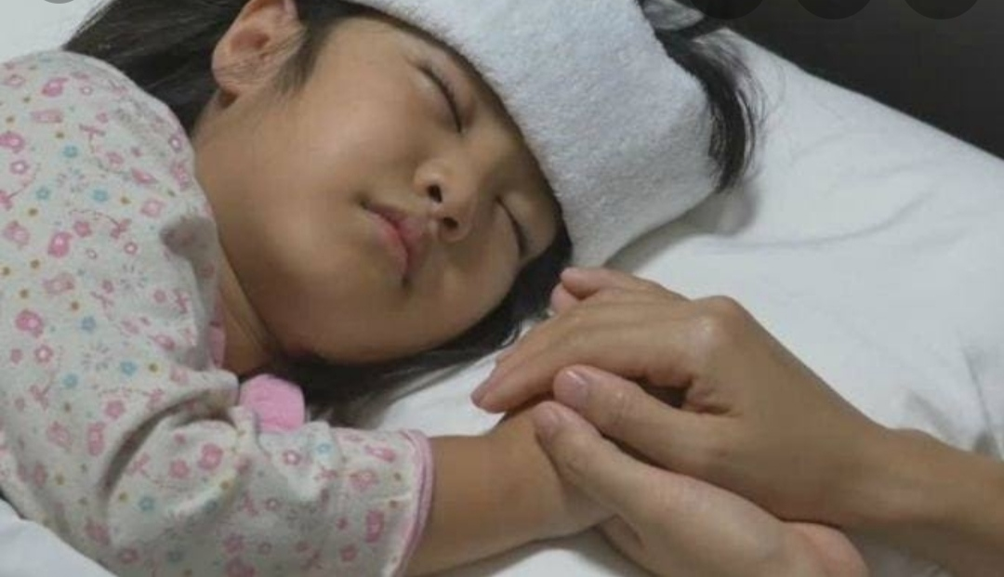
managment
Oral penicillin
Nursing management
Cold warm compress
Saline gargles
Steam inhalation

Slide 15
TONSILITIS

Slide 16
INTRODUCTION
location: Tonsils are located in the pharyneal cavvity.
role: They filter &protect the respiratory tracts from invasion of pathogenic organism.
size: they are varies in size. Children have larger than adult.

Slide 17
Defination
It is defined as inflamation of tonsils.
Etiology
It occur with pharyngitis.its very common condition.
Causative agent:viral or bacterial.

Slide 18
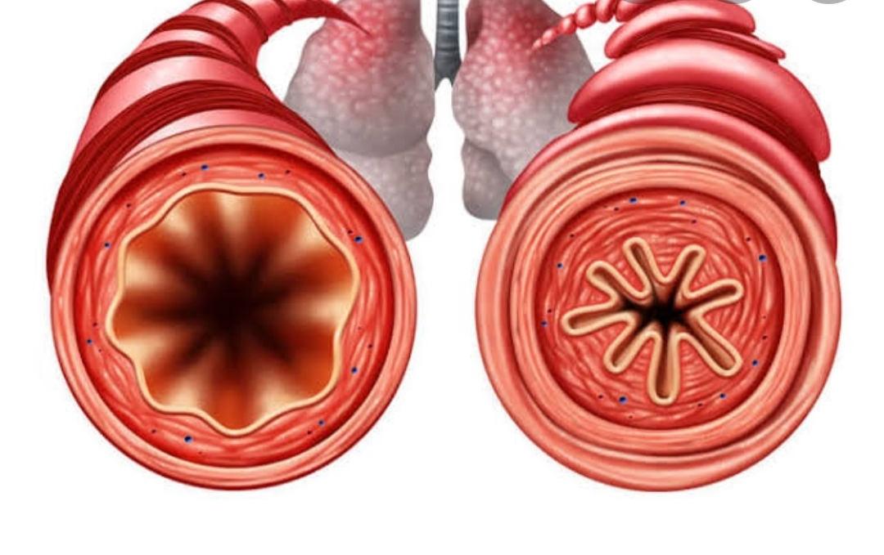
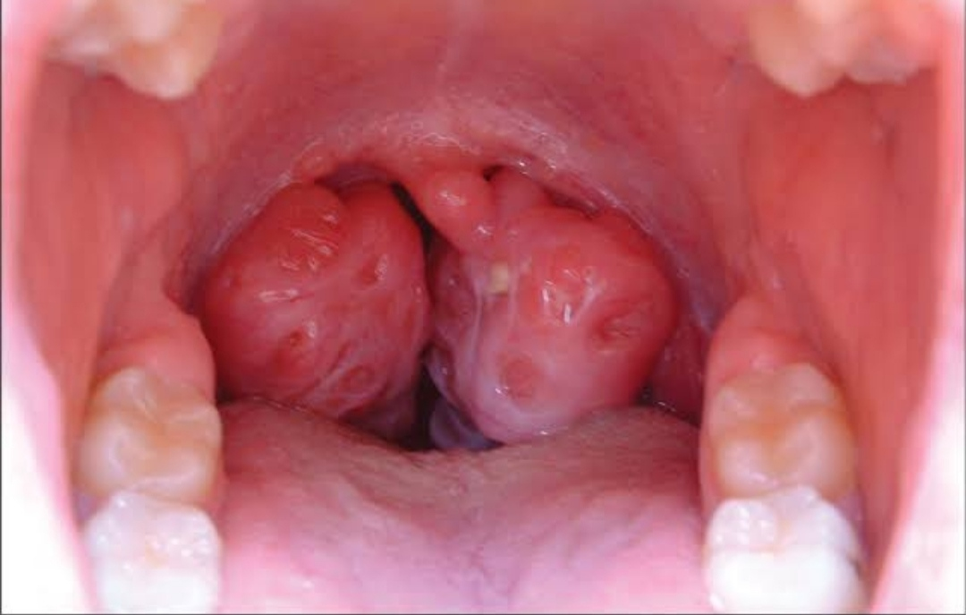
Sign & symptoms
Edema obstructive airway

Slide 19
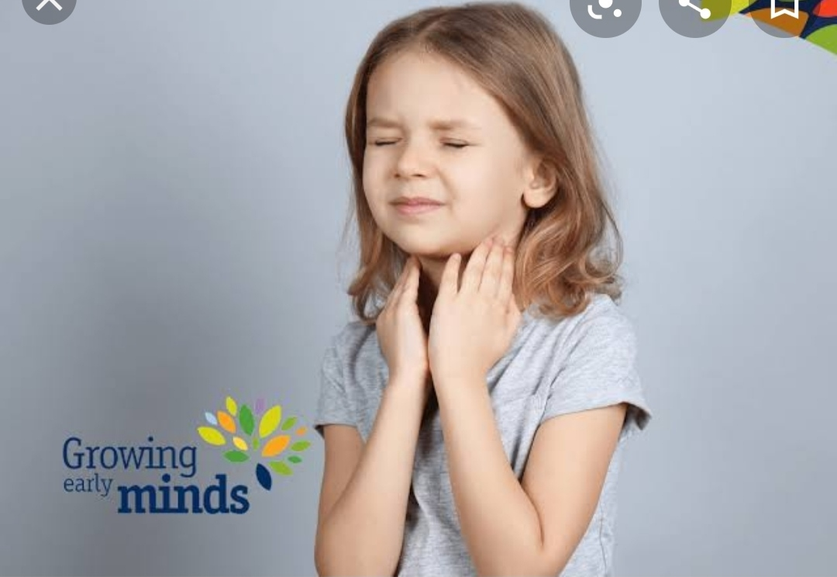
Difficulty in swallowing
Difficulty in swalloing & breathing

Slide 20
Theraputic managment
Antibiotics can given.

Slide 21
PICO
P | I | C | O
Child with URTI | Complementry and alternative medicine for prevention and treatment of upper respiratory tract infection. | Herbal madicine. | A combination of echinacea,propolis abd ascorbic asid decrease nasal secretions.

Slide 22


