Slide 1
WEANING
PREPARED BY,
MS KHUSHBU PATEL
CLINICAL INSTRUCTOR
SNC

Slide 2
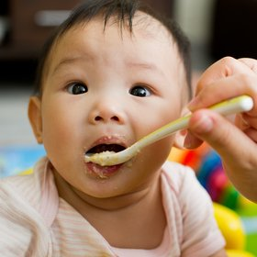
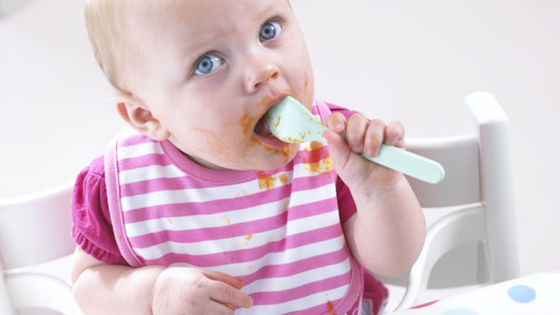
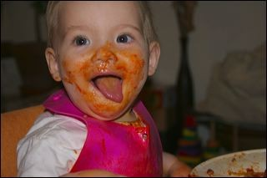

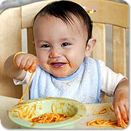
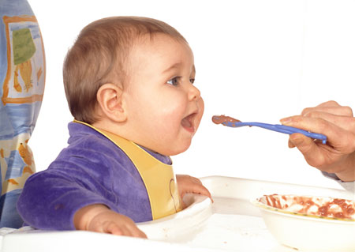

Slide 3
WEANING
Process of introducing semi-liquid to semi-solid foods along with breast milk.
Weaning is the process in which an infant is taken out from the breast milk to a mixed diet.

Slide 4

Weaning is a process through which a baby's dependency on mother's milk is slowly reducing.

Slide 5
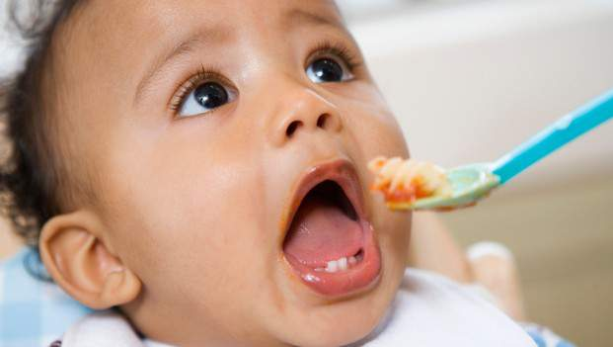
When to start weaning?
At 6 months of age ( WHO reco.)
Complementary feeding initiated and
Supplementary to breast milk started.
Breast milk output 600-700 ml/d (healthy mother)

Slide 6
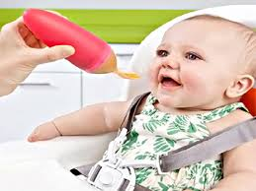
Why start weaning at 6 months?
Breast milk sufficient for the growth of the baby only till 6 months of age.
Breast milk output starts to decline thereafter but baby’s physical + mental development continues at a very fast pace till the end of 2 years.
Weaning latest by 6 months - failing which will lead to malnutrition.

Slide 7
The rate of increase in length and weight declines but still the child is growing in size. Other activities like learning to turn, crawl, standing with support, walking, running / vocabulary/ teething/ learning to eat by himself/ grasp etc etc.
Food contain complex form of nutrients. Child is ready to digest these complex CHO, Protein and fats by 6 months of age. Enzymes to digest complex nutrients are fully activated now.

Slide 8
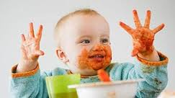
Critical/ crucial period - each month is different till one year of age.
Weaning at proper time
Transition from liquid to solids - gradual
Frequency from 10 feeds per day (breast feeding) to 6-7 feeds per day - gradual
Amount of food to be offered at a time eg; when the child is small---- can manage small amount of feeds each time ----- frequency is high
Once the critical stage of learning a particular behavior is over, it is difficult to teach that behavior at a later stage.

Slide 9


Points to be considered while introducing weaning foods:
Introduce only one food at a time.
Allow the infant to become familiar with the food before trying to give another.
Give very small amounts of any new food at the beginning.
Use a very thin consistency when starting solid foods.
Variety in choice of foods is important.
Give freshly prepared food.
End
Previous
Next

Slide 10
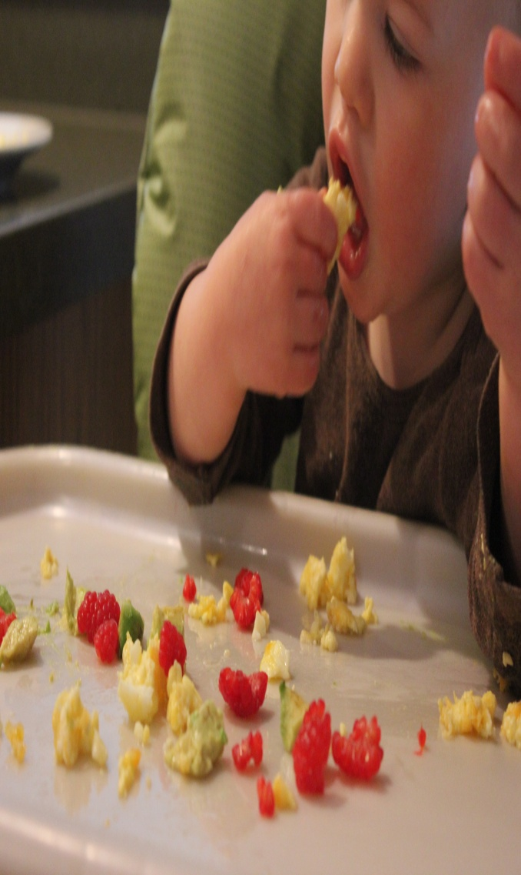
How to initiate weaning and progress
Essentially follow the sequence :
Breast feeds (0-6 months)
Semi-liquid (after 5-6 months)
Semi-solid (after 8-9 months)
solid (after 10 months)
Solid diet including variety of food items (1-1.2 yrs).

Slide 11
Till 5-6 months child is given breast feeds on demand
10 times over 24 hours.
From 6- 8 months As the child grows, his requirements
increase and he starts to accept larger
volume and thicker consistency at a
time
feed him 7-8 times/d
From 9- 12 months normally eats 6-7 times per day
By 12 - 15 months child eats at least 6 times per day.
By 18 months child’s eating schedule of 5-6 times
/day gets fixed

Slide 12
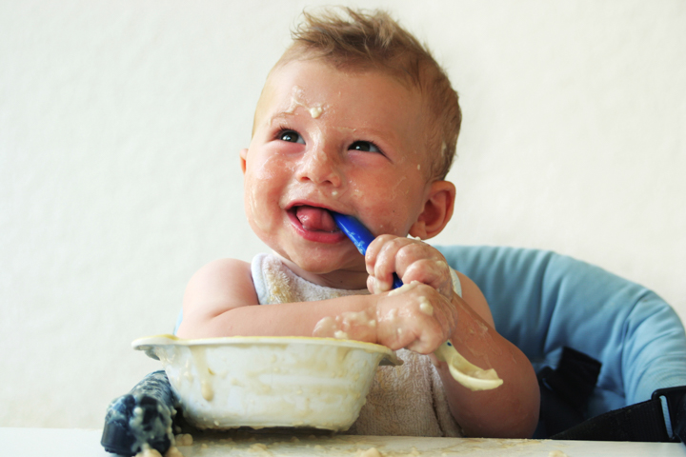
How to initiate weaning and progress
Volume:
Children have little capacity due to their smaller surface
area. Initially accepts small amount but as he increases in
size, accepts larger volume.
Till 5-6 months - Few spoons to 30ml at a time
From 6- 7 months - 50-75 ml/g
From 7-8 months - 75 - 100 ml/g
From 9- 12 months - 100 - 150 ml/g

Slide 13
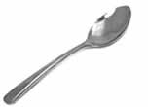
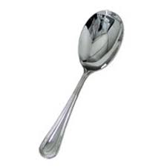
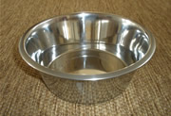
Rice based weaning food and instant mixes
Weaning Process
Standard weights and measures
1 tea spoon = 5 g
1 table spoon = 15 g
1 katori = 240 g
End
Previous
Next

Slide 14
What to feed?

Slide 15
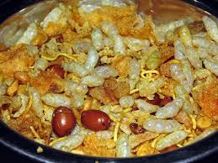
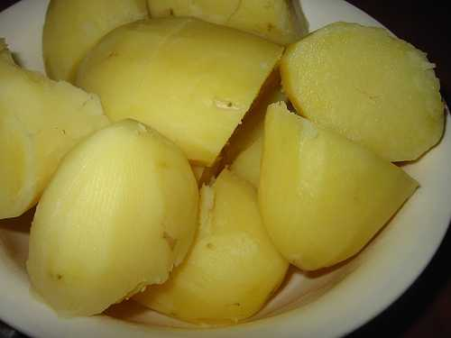
From 6-7 months
Introduce (along with BF)
Fresh milk
mashed banana/ custard
Powdered murmura/ riceflakes
in milk+sugar+fat
Khichri (Liquid consistency)
Washed moong dal + rice + fat
biscuit/ bread/Suji in milk
+sugar+fat
Boiled mashed potato/ halwa

Slide 16
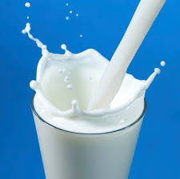
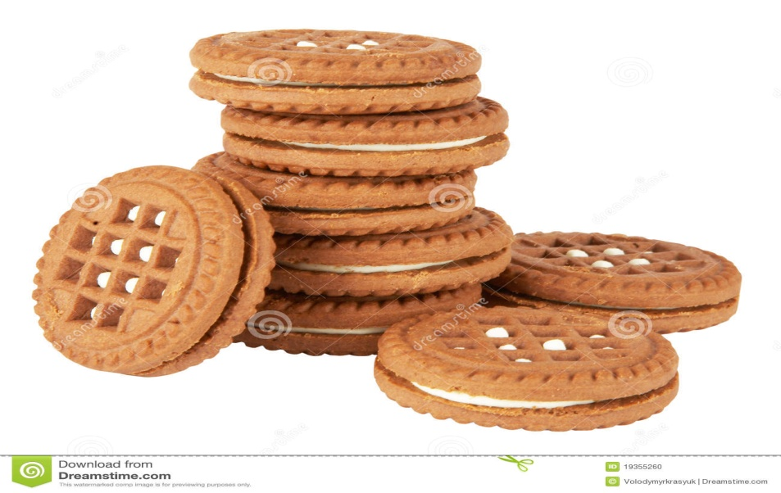
From 8-9 months
Continue breast feeds
Fresh milk (includes curd)
Banana OR any other
seasonal fruit
Suji/sago/Dalia in milk
+sugar+fat
Khichri (semisolid consistency)
(dal + rice + fat) OR rice-dal
Biscuit/ bread in milk
+sugar+fat
Potato+ vegetable

Slide 17
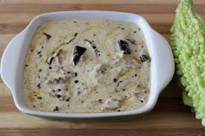
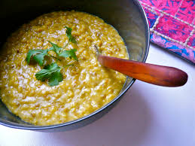
From 10 - 12 months
Continue breast feeds
Fresh milk (includes curd)
Banana OR any other
seasonal fruit
Suji/sago/Dalia/sevian in milk
Khichri (semisolid consistency)
(dal + rice + fat) OR rice-dal
Biscuit/ bread/chapati/ paratha
(by 1 year)
Potato + any other vegetable
Curd/ paneer/ groundnut/Egg

Slide 18
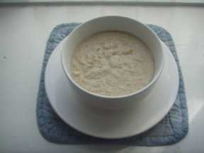
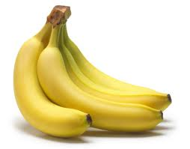
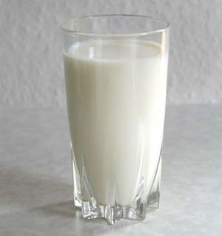
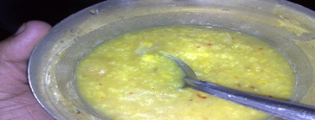
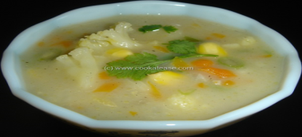
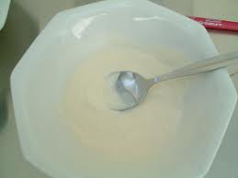
Rice based weaning food and instant mixes
Weaning Process
Feeding schedule for a 6-9 months old infant
Morning | Rice flour(porridge) ½ katori
10 o’clock | Milk(125ml) with1 banana
Noon | Khichdi ½ katori
2 o’clock | Vegetable soup 4 tablespoon
4 o’clock | Milk 125ml
Night | Khichadi ½ katori
End
Previous
Next

Slide 19
Things to remember
Nutrition Plan
Develop the baby’s taste buds gradually.
Easy to digest - consistency
Well-balanced diet
Convenient: Easy to prepare & affordable
Hygienic - use katori-spoon
Patience to feed
Availability of food items - nothing is hard and fast

Slide 20
Likes and dislikes of the child - nothing is a must. Allow your child to dislike certain foods.
No restriction on the volume - nothing is too much for the child
Introduce one food at a time
Food fads - hot and cold foods/ light and heavy foods
Food fads - fats and sweets - not to be restricted
Artificial milk formulas/ commercial formulas - not recommended

Slide 21
Faulty feeding and malnutrition
Feeding on artificial milk formulas - reconstituting wrongly.
Feeding on diluted fresh milk
Breast feeding for a long time
Delayed weaning
Feeding via dirty feeding bottles
working mothers/ non-working mothers

Slide 22

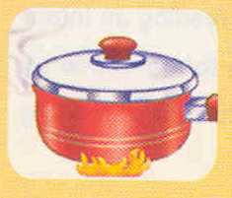
Preparation of feed
Wash hands before preparing baby’s feed.
Boil drinking water or milk for 5 minutes. Leave it till it will lukewarm.

Slide 23
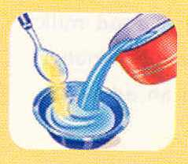
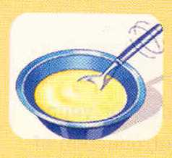
Preparation of feed
Pour the feed in bowl let it to be little cool. Check it’s temp. by hands.
Feed baby with a clean spoon

Slide 24
NUTRITIONAL REQUIREMENTS
Carbohydrates
Proteins
Lipids
Vitamins
Minerals

Slide 25
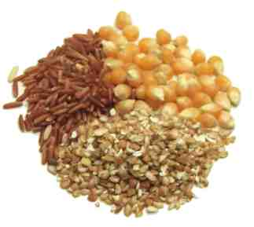
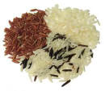
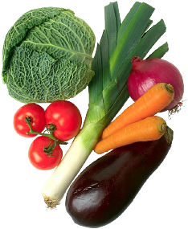
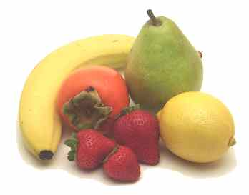
CARBOHYDRATES

Slide 26
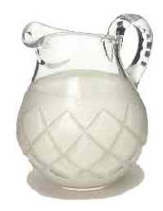
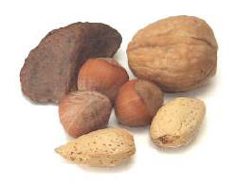




PROTEIN

Slide 27
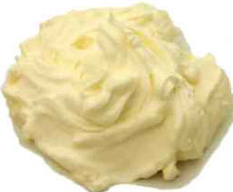
LIPIDS

Slide 28





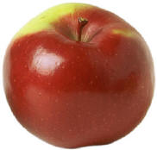

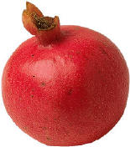


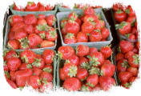

VITAMIN-A

Slide 29
PICO on ifact of weaning diet
P | I | C | O
Infants(0-6 month) | Massed fruits,vegetables, dalwater, juice, breast milk | Exclusive breast feeding | Infant who have a Massed fruits,vegetables, dalwater, juice, breast milk have a higher growth by 1.5 than who had only breast feed.

Slide 30

ANY QUERIES?

Slide 31


