Slide 1
ASSESSMENT CARDIOVASCULAR
SYSTEM
By:Sonal Patel
SNC

Slide 2
TERMINOLOGY
APICAL IMPULSE (also called point of maximum impulse [PMI]): impulse normally palpated at the fifth intercostal space, left midclavicular line; caused by contraction of the left ventricle
CARDIAC CATHETERIZATION: an invasive procedure used to measure cardiac chamber pressures and assess patency of the coronary arteries
CONTRACTILITY: ability of the cardiac muscle to shorten in response to an electrical impulse.
PULSE PRESSURE:-The difference between the systolic and the diastolic pressures is called the pulse pressure.

Slide 3
CARDIAC STRESS TEST: (TMT) a test used to evaluate the functioning of the heart during a period of increased oxygen demand
DEPOLARIZATION: electrical activation of a cell caused by the influx of sodium into the cell while potassium exits the cell.
REPOLARIZATION: return of the cell to resting state, caused by re-entry of potassium into the cell while sodium exits the cell
CARDIAC OUTPUT: amount of blood pumped by each ventricle in liters per minute; normal cardiac output is 5 L per minute in the resting adult heart
stroke volume: amount of blood ejected from the ventricle per heartbeat; normal stroke volume is 70 mL in the resting heart

Slide 4
SINOATRIAL (SA) NODE: primary pacemaker of the heart, located in the right atrium
DIASTOLE: period of ventricular relaxation resulting in ventricular filling
SYSTOLE: period of ventricular contraction resulting in ejection of blood from the ventricles into the pulmonary artery and aorta
HEMODYNAMIC MONITORING: use of monitoring devices to measure cardiovascular function.
POSTURAL (ORTHOSTATIC) HYPOTENSION: a significant drop in blood pressure (usually 10 mm Hg systolic or more) after an upright posture is assumed
PRELOAD: degree of stretch of the cardiac muscle fibers at the end of diastole
AFTERLOAD: the amount of resistance to ejection of blood from the ventricle

Slide 5
VALVES OF THE HEART
Each area corresponds to one of the hearts 4 valves.
  AORTIC AREA - 2nd ICS to right of sternum (closure of the aortic valve loudest here).
  PULMONIC AREA - 2nd ICS to left of sternum (closure of the pulmonic valve loudest here).
  TRICUSPID - 5th ICS left of sternal border (closure of tricuspid valve).
  Mitral - 5th ICS left of the sternum just medial to MCL (closure of mitral valve). When cardiac output is increased as in anemia, anxiety, HTN, fever, the impulse may have greater force - inspect for lift or heave.

Slide 6
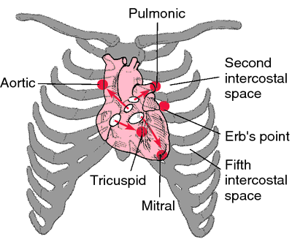

Slide 7
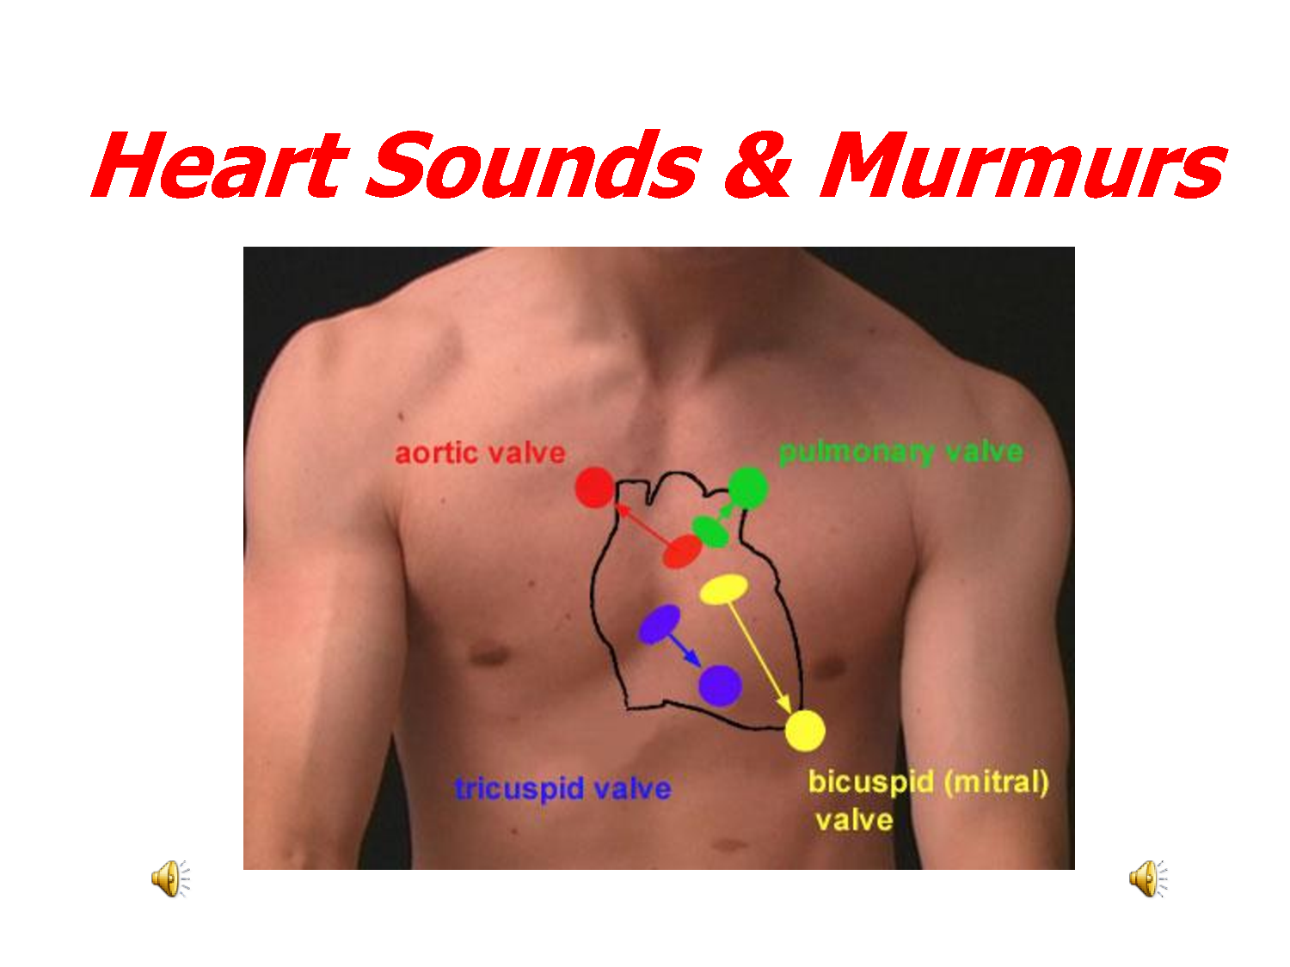
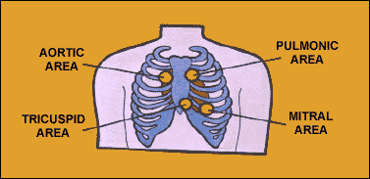

Slide 8
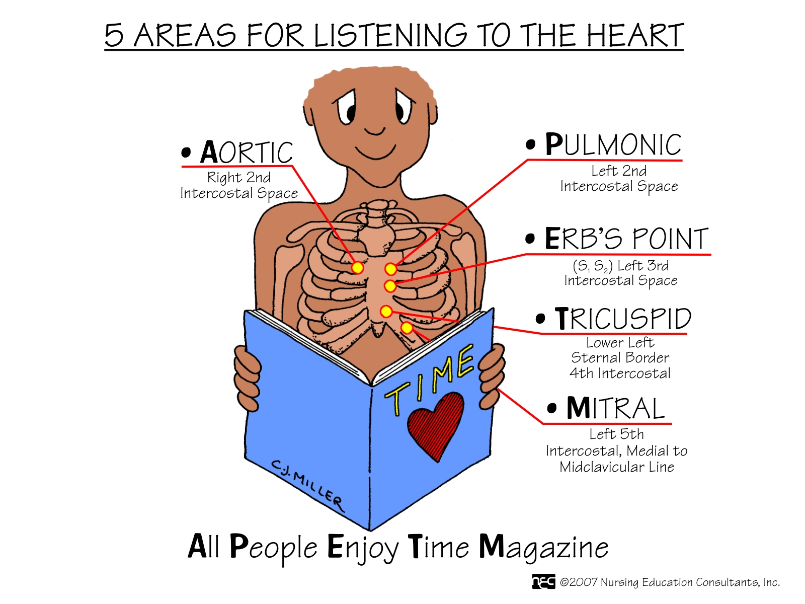

Slide 9

NORMAL HEART SOUNDS
The first heart sound - systolic S1:
  Signals the closure of AV valves and the beginning of systole.
  Consists of mitral M1 and tricuspid T1 components.
  Is loudest at the apex

Slide 10
The second heart sound - diastolic S2:
  Signals the closure of semilunar valves and the end of systole.
  Consists of aortic A2 and pulmonic P2 components.
  Is loudest at the base.
S1 & S2 correspond respectively to the familiar "lub dub" often used to describe the sounds.

Slide 11
Other Heart Sounds
Extra Heart Sounds:
  S3
    is the result of vibrations produced during ventricular filling.
    It can be thought of as a sound which is generated when the ventricle is forced to dilate beyond its normal range because the atrium has overloaded volume. As seen in congestive heart failure, which is the most common cause of a S3.
    is normally heard only in some children and young adults, but it is considered abnormal in older individuals.

Slide 12
  S4
Low frequency sound in late diastole
Caused by the atrial kick into a noncompliant ventricle
    is caused by the recoil of vibrations between the atria and ventricles following atrial contraction, at the end of diastole.
    is rarely heard as a normal heart sound; usually it is considered indicative of further cardiac evaluation.

Slide 13
Other Heart Sounds
Murmurs:
  are produced by vibrations within the heart chambers or in the major arteries from the back and turbulent flow of blood.
  are classified as:
    1. Innocent, occurring in individuals with no anatomic or physiologic abnormality.
    2. Functional, occurring in individuals with no anatomic cardiac defect but with a physiologic abnormality such as anemia.
    3. Organic, occurring in individuals with a cardiac defect with or without a physiologic abnormality.

Slide 14

Blood flow through a structure normally closed during systole (mitral or tricuspid valves). Regurgitation
Blood flow through a valve normally open in systole but abnormally narrowed (e.g. aortic or pulmonary). Stenosis
Increased blood flow through a normal valve High flow states like… pregnancy, fever, anemia, hypothyroidism
Due to structural cardiac abnormality and increased flow
  ventricular septal defect
  atrial septal defect
  mitral regurgitation

Slide 15
Pericardial friction rubs are scratchy, high-pitched grating sounds, similar to pleural friction rubs,

Slide 16


Systolic vs. Diastolic
systole
S1 S2
diastole

Slide 17
Gallops
systole
S1 S2
S4 S3
diastole

Slide 18
The conduction system of the heart consists of four structures:
1. The sinoatrial (SA) node, located within the rig atrial wall near the opening of the superior vena cava
2. The atrioventricular (AV) node, also located within the right atrium but near the lower end of the septum
3. The atrioventricular bundle (bundle of His), which extends from the atrioventricular node along each side of the interventricular septum
4. Purkinje fibers, which extend from the atrioventricular bundle into the walls of the ventricles. The electric impulses from this conduction system can be recorded on an electrocardiogram.

Slide 19
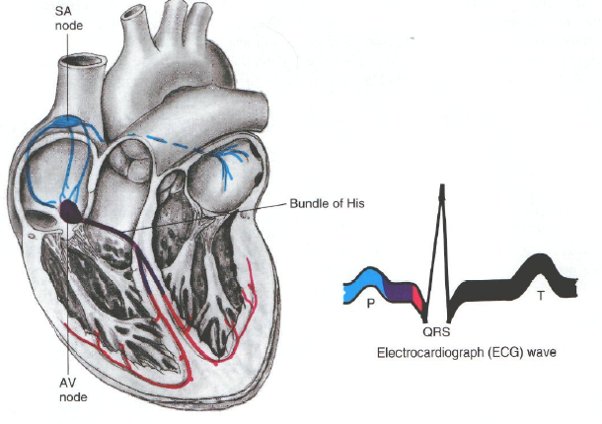
Conduction System

Slide 20
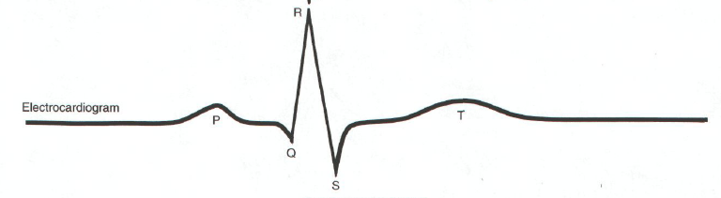
Electrocardiography (ECG)
records the electrical impulses generated from the heart muscle and provides a graphic illustration of the summation of these impulses and their sequence and magnitude.

Slide 21
The ECG waves
P wave represents the electric activity associated with the sinoatrial node and the spread of the impulse over the atria. It is a wave of depolarization.
QRS complex (wave) is composed of three separate waves: the Q wave, the R wave, and the S wave. They are all caused by currents generated when the ventricles depolarize before their contraction.
P-R interval is measured from the beginning of the P wave to the beginning of the QRS complex.. This interval represents intervalning of atrial depolarization to the beginning of ventricular depolarization.

Slide 22
The ECG waves
The T wave represents repolarization of the ventricles.
The S-T segment is normally an isoelectric (flat) line that connects the end of the S wave to the beginning of the T wave.
The T-P interval represents atrial and ventricular polarization in anticipation of the next cardiac cycle.

Slide 23
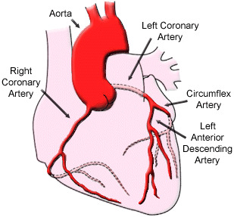
Coronary Circulation

Slide 24
History taking and physical examination
Detail history of client
Personal and family history
Diet history
Socioeconomic status – ability to purchase proper foods, medicines. Employment and its effects on health?
Cigarette smoking : # packs /day and also # years smoked PACK YEARS

Slide 25
Physical Activity/Inactivity – 30 minutes daily of moderate exercise recommended on most days
Obesity – associated with HTN, hyperlipidemia, and diabetes and all contribute to CV disease.
Current Health Problems – describe health concerns.

Slide 26
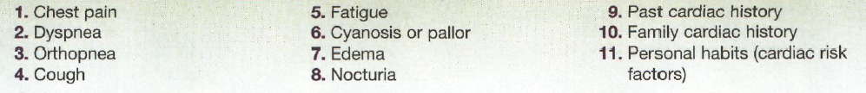
Subjective data

Slide 27
Chest pain:
Onset, location, character, aggravating and/or relieving factors
Character: crashing, burning, vise-like.
Associated symptoms: sweating, pale skin, shortness of breath, nausea or vomiting,

Slide 28
Subjective data
Dyspnea:
  Cause, onset, duration, affection by position,
  Paroxysmal nocturnal dyspnea (PND)
  Does shortness of breath interfere with activities of daily living?
Orthopnea:
  Is the need to assume a more upright position to breathe.
  Note the exact number of pillows used.

Slide 29
Subjective data
Hemoptysis is often a
pulmonary problem,
but also occurs with
mitral stenosis
Cough: duration, frequency, type, coughing up sputum (color, odor, blood, aggravating and/or relieving factors.
Fatigue: onset, relation to time of day?
Cyanosis or pallor: occurs with myocardial infarction or low cardiac output.

Slide 30
Subjective data
Edema:
  Swelling of legs
  Onset, recent change, relation to time of day, relieving factors, associated symptoms.
Nocturia:

Slide 31
Inspection
Skin colour (cyanosis, pallor) and condition
Any obvious bulging on anterior thorax at the left
Edema
Orhtopnea

Slide 32
Palpation
Palpate the apical impulse (the point of maximal impulse, or PMI):
  Location: (usually 5th ICS) at left MCL,
  Size: normally 1 cm × 2 cm,,
  Duration: short, normally occupies only first half of systole.
  Ask the client “to exhale then hold it” or turn him to the left side.

Slide 33
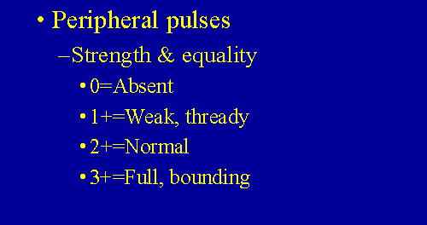
Palpation

Slide 34
Palpation
Palpate across the precardium for:
  Other pulsations,
  palpable vibration due to strong heart murmur
  Pericardial friction rubs are scratchy, high-pitched grating sounds, similar to pleural friction rubs, except that they are not affected by changes in respiration.
  S1 and S2.

Slide 35
Percussion
Is used to estimate approximately heart borders and configuration.
Recently is displaced by the chest x-ray or EchoCG.
Helps to detect heart enlargement

Slide 36
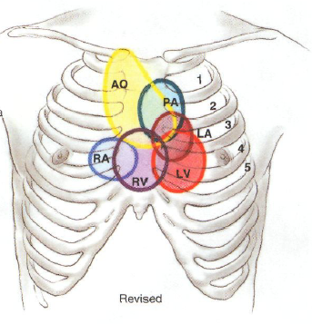
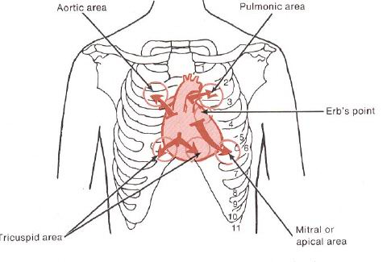
Auscultation

Slide 37
Auscultation
use the following routing:
  Note the rate
  the rhythm
  Identify S1 and S2
  Listen for extra heart sounds
  Listen for murmurs

Slide 38
Auscultation (cont.)
Rhythm:
Regular
Irregular:
  Synus arrythmia – common variation. Rate ↑ on inspiration and ↓ on expiration.
  Regularly irregular
  Irregularly irregular – no pattern to the sounds, beats come rapidly and at random intervals.
  Pulse deficit – occurs with atrial fibrillation, heart failure, detects weak heart contractions.

Slide 39
Auscultation (cont.)
Identify S1 and S2
  Location and amplitude,
  Correlation with peripheral pulses, PMI
  Correlation with ECG waves
  “Lub” or “dup”
Give description of origin.
Listen to sounds separately: accentuation, split (fixed, paradoxical).

Slide 40
Auscultation (cont.)
Extra heart sounds:
  S3: normal, pathological (ventricular gallop)
  S4: atrial gallop
Listen for murmurs:
  Characteristics: timing, loudness, pitch, pattern, quality, location, radiation, posture

Slide 41
1. The amount of blood pumped by each ventricle in liters per minute is called as:-
Cardiac output
Stroke volume
Cardiac volume
Lung volume
2. The area near to 2nd Inter costal space to left of sternum represent the:-
  TRICUSPID area
  Mitral area
  Pulmonic area
  Aortic area

Slide 42
3. The second heart sound s2 is Signals :-
  the closure of semilunar valve
  The closure of aortic valve
  The Closer of the pulmonary valve
  The closer of the AV valve
  4. the ventricles depolarize represent in ECG is :-
  P wave
  QRS complex (wave)
  P-R interval
  T wave

Slide 43
5. The arteries which supply blood to heart is known as:-
Coronary arteries
Renal arteries
Thoracic arteries
Femoral arteries

Slide 44
Thanks

