Slide 1
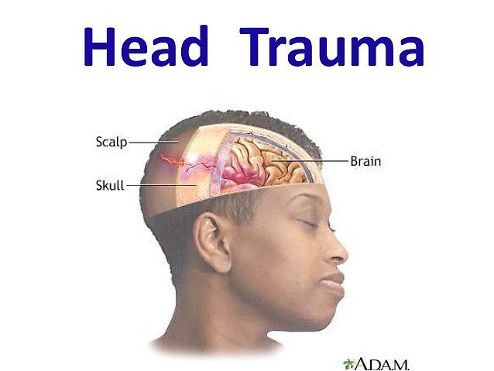

Slide 2
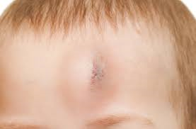
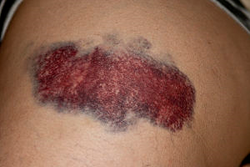
DEFINITION
A head injury is any sort of injury to brain, skull, or scalp.
This can range from a mild bump or bruise to a traumatic brain injury.

Slide 3
CLASSIFICATION
According to Glassgow coma scale (GCS) head injury is classified into:
Mild : GCS 13 – 15 with loss of consciousness to 15 mts
Moderate : GCS 9 – 10with loss of consciousness for up to 6hrs
Severe : GCS 3 – 8 with loss of consciousness greater than 6hrs

Slide 4
CAUSES
Head injuries caused by a blow to the head are usually associated with:
Motor vehicle accidents
Falls
Physical assaults
Sports-related accidents
Violence and abuse
Falls by recreational activities – biking, skating

Slide 5
TYPES OF HEAD INJURY
Scalp injury : Head injuries may be either closed or open.
A closed head injury is any injury that doesn’t break your skull.
An open (penetrating) head injury is one in which something breaks your scalp and skull and enters your brain.
2. Skull injury : A head injury may cause a minor headache skull fracture, which may or may not be associated with injury to the brain. Some patients may have linear or depressed skull fracture.

Slide 6
Skull fracture : A skull fracture is a break in the bone surrounding the brain and other structures within the skull.
Linear skull fracture : A common injury, especially in children. A linear skull fracture is a simple break in the skull that follows a relatively straight line. It can occur after seemingly minor head injuries (falls, blows, or from motor vehicle accidents).

Slide 7
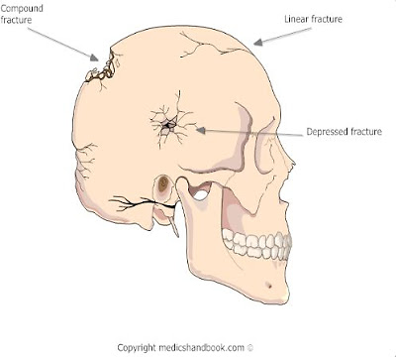
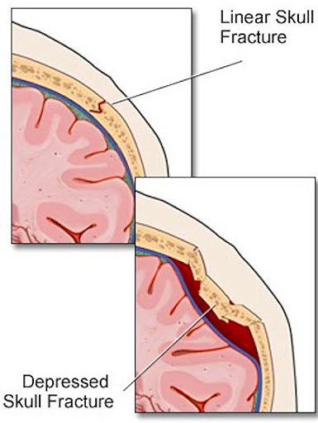

Slide 8
Depressed skull fracture : These are common after forceful impact by blunt objects-most commonly hammers, these injuries causes dents in the skull bone.
If the depth of a depressed fracture is at least equal to the thickness of the surrounding skull bone (1/4-1/2inch).
Surgery is often required to elevate the bony pieces.

Slide 9
Basilar skull fracture : A fracture of the bones that forms the base of the skull and results from severe blunt injury of significant trauma.
A basilar skull fracture commonly connects to the sinus cavities.
This connection may allow fluid or air entry into the inside of the skull and may cause infection.

Slide 10
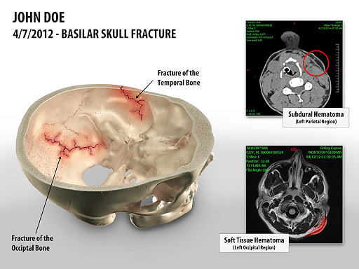

Slide 11
4. Concussion : A concussion is an injury to the head area that may cause instant loss of awareness or alertness for a few minutes up to a few hours after the traumatic event.
5. Intracranial hematoma (ICH) : There are several types of ICH, or blood clots, in or around the brain. The different types are classified by their location in the brain. These can range from mild head injuries to quite serious and potentially life-threatening injuries.

Slide 12
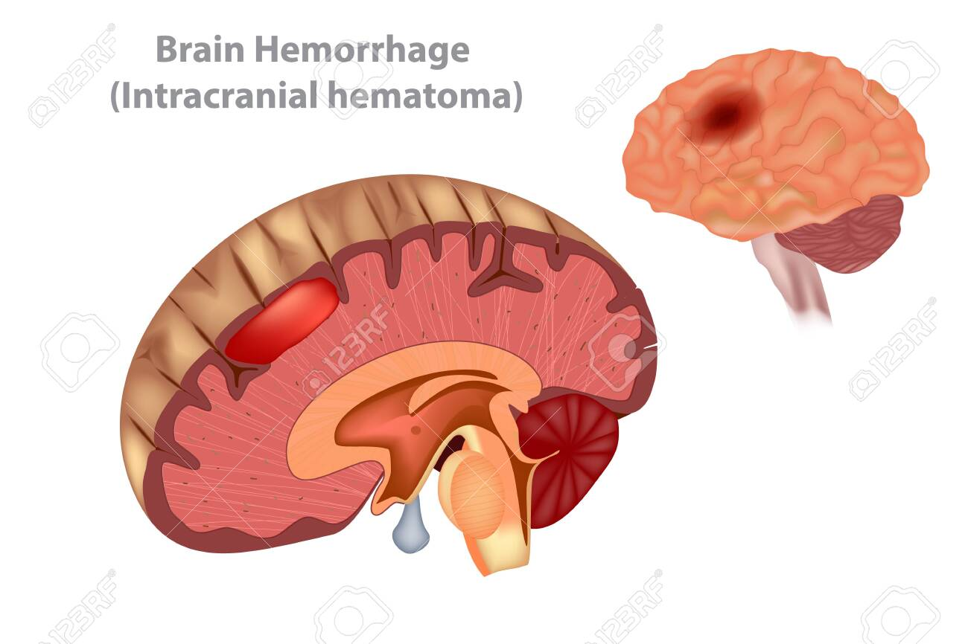
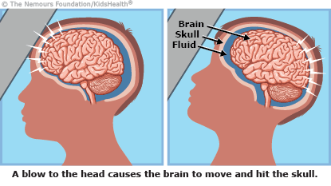
Concussion

Slide 13
a. Epidural hematoma : Epidural hematomas occur when a blood clot forms underneath the skull, but on top of the dura, the tough covering that surrounds the brain.
They usually come from a tear in an artery that runs just under the skull
Epidural hematomas are usually associated with a skull fracture.
b. Subdural hematoma. Subdural hematomas occur when a blood clot forms underneath the skull and underneath the dura, but outside of the brain.
These can form from a tear in the veins that go from the brain to the dura, or from a cut on the brain itself.

Slide 14
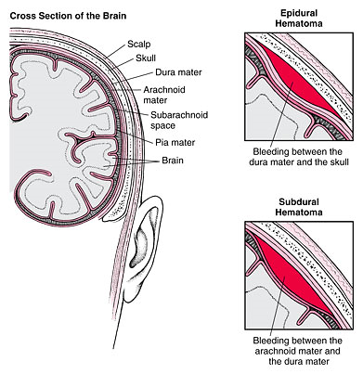

Slide 15
c. Contusion or intracerebral hematoma. A contusion is a bruise to the brain itself.
A contusion causes bleeding and swelling inside of the brain around the area where the head was struck.
Contusions may occur with skull fractures or other blood clots such as a subdural or epidural hematoma.
Bleeding that occurs inside the brain itself (also called intraparenchymal hemorrhage) can sometimes occur spontaneously.
When trauma is not the cause, high blood pressure in older adults, bleeding disorders in either children or adults, or the use of medications that cause blood thinning.

Slide 16
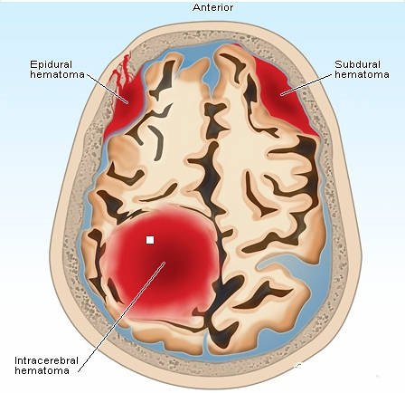
Contusion or intracerebral hematoma

Slide 17
Diffuse axonal injury (DAI). These injuries are fairly common and are usually caused by shaking of the brain back and forth, which can happen in car accidents, from falls or shaken baby syndrome.
In DAI, the patient is usually in a coma for a prolonged period of time, with injury to many different parts of the brain.

Slide 18
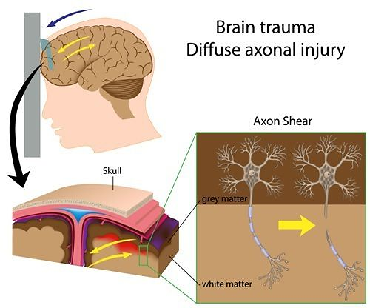

Slide 19
Signs and symptoms
Mild head injury:
Raised, swollen area from a bump or a bruise
Small, superficial (shallow) cut in the scalp
Headache
Sensitivity to noise and light
Irritability
Confusion
Lightheadedness and/or dizziness
Problems with balance
Nausea
Problems with memory and/or concentration
Change in sleep patterns
Blurred vision

Slide 20
Moderate to severe head injury (requires immediate medical attention)--symptoms may include any of the above plus:
Loss of consciousness
Severe headache that does not go away
Repeated nausea and vomiting
Loss of short-term memory, such as difficulty remembering the events that led right up to and through the traumatic event
Slurred speech
Difficulty with walking
Weakness in one side or area of the body
Sweating
Pale skin color
Seizures or convulsions

Slide 21
Diagnostic evaluation
Medical history
Physical examination
Neurological examination
Computed tomography scan (also called a CT or CAT scan)
Blood tests
X-ray
Electroencephalogram (EEG). A procedure that records the brain's continuous, electrical activity by
means of electrodes attached to the scalp
Magnetic resonance imaging (MRI). A diagnostic procedure that uses a combination of large magnets,
radiofrequencies, and a computer to produce detailed images of organs and structures within the body.
Glasgow Coma Scale (GCS). The GCS is a 15-point test that assesses your mental status

Slide 22
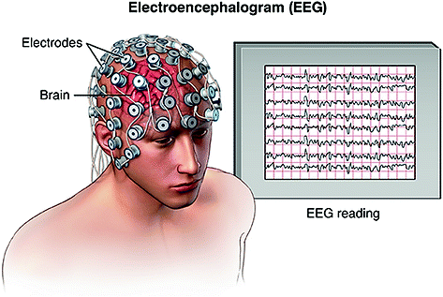
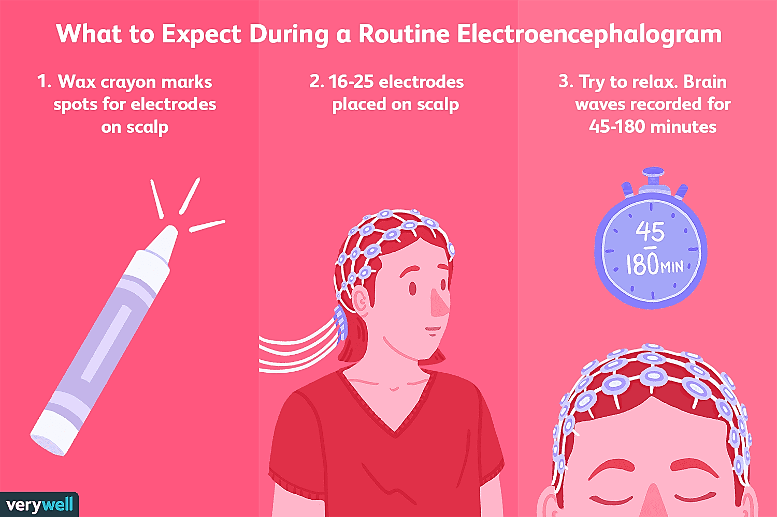

Slide 23
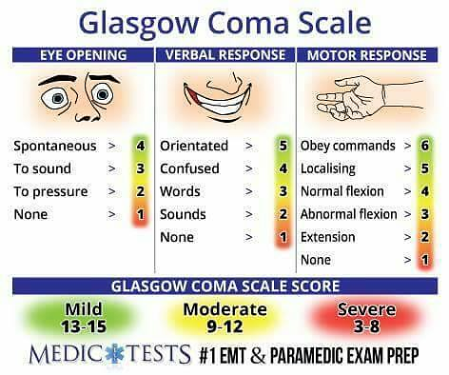

Slide 24
Treatment
Depending on the severity of the injury, treatment may include:
Ice
Rest
Topical antibiotic ointment and adhesive bandage
Observation
Immediate medical attention
Stitches
Hospitalization for observation
Moderate sedation or assistance with breathing that would require being placed on a breathing machine, or mechanical ventilator or respirator
Surgery

Slide 25
Self care management
Minor head injuries may be cared for at home
Bleeding under the scalp may cause large bruises at the site of injury. Using ice immediately after the trauma may help decrease the size.
Do not apply ice directly to the skin. Ice should be applied 20 – 30 minutes at a time. It can be repeated every 2 – 4 hrs
Use a light wash cloth to wrap the ice in it.
The person should not be alone or driving or operating machinery should be restricted for 24 hrs

Slide 26
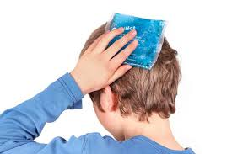


Slide 27
Medical management
Management of increased ICP:
Maintaining adequate oxygenation
Administering osmotic diuretics e.g Mannitol
Drainage of CSF
Elevation of head of the bed
Complete bed rest
Administering high dose barbiturate therapy
Glucocorticoid, dexamethasone to reduce the cerebral edema
2. Antibiotic therapy:
Administration of antibiotics is required to prevent infection with open skull fracture and penetrating wound.

Slide 28
3. Antiepileptic therapy : medication to prevent or treat seizures that occur from the head injury. Phenytoin most often used to control seizures.
4. Supportive measures :
Ventilatory support
Vasopressors may be required to maintain blood pressure
Seizures prevention
Fluid and electrolyte maintenance
Nutritional support
Pain and anxiety management

Slide 29
Surgical management
Removing clotted blood (hematomas). Bleeding outside or within the brain can result in a collection of clotted blood (hematoma) that puts pressure on the brain and damages brain tissue.
Repairing skull fractures. Surgery may be needed to repair severe skull fractures or to remove pieces of skull in the brain.
Bleeding in the brain. Head injuries that cause bleeding in the brain may need surgery to stop the bleeding.
Opening a window in the skull. Surgery may be used to relieve pressure inside the skull by draining accumulated cerebral spinal fluid or creating a window in the skull that provides more room for swollen tissues.

Slide 30
General Head Injury Prevention Tips
.
Wear a seatbelt every time you drive or ride in a motor vehicle.
Never drive while under the influence of drugs or alcohol or ride as a passenger with anybody else who is under the influence.
Supervise younger children at all times, and do not let them use sporting equipment or play sports unsuitable for their age.
Wear appropriate clothing for the sport.
Do not wear any clothing that can interfere with your vision.
Do not participate in sports when you are ill or very tired.
Obey all traffic signals, and be aware of drivers when cycling or skateboarding

Slide 31
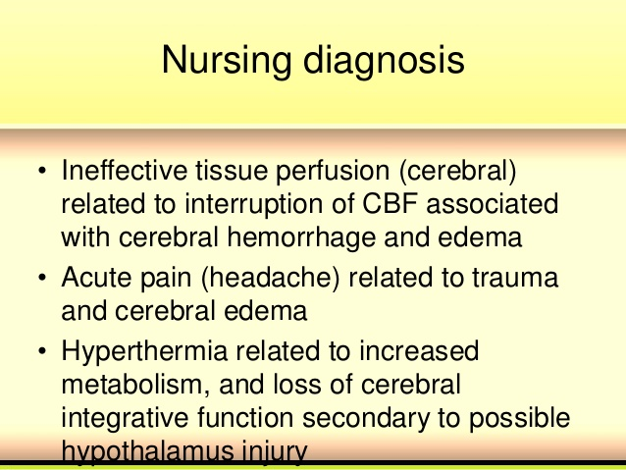

Slide 32
