Slide 1
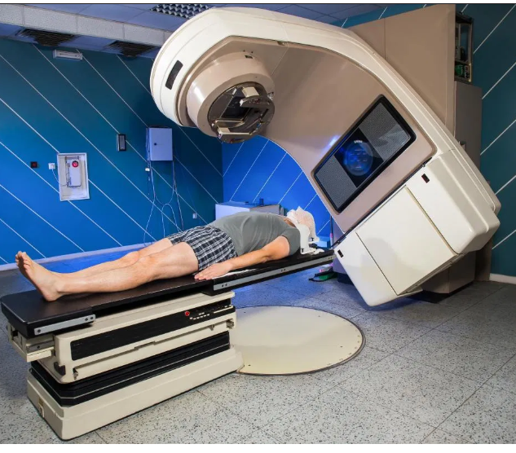
RADIATION THERAPY
PREPARED BY:
BINDHU MOL G
CLINICAL INSTRUCTOR
SUMANDEEP NURSING COLLEGE

Slide 2
Radiation therapy
Radiation therapy is a type of cancer treatment that uses beams of intense energy to kill cancer cells.
Radiation therapy most often uses X-rays, but protons or other types of energy also can be used.
Radiation therapy uses high-dose radiation to kill cancerous cells.
Also, a doctor may recommend using radiation to shrink a tumor before surgery or reduce tumor-related symptoms.

Slide 3
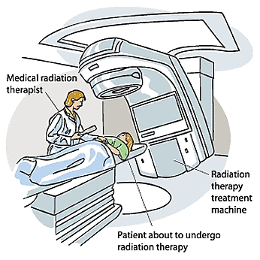

Slide 4
Types of radiation therapy
External beam radiation therapy
This is the most common type. It involves an external machine emitting a beam of radiation that targets the treatment area.
Different forms are available, depending on the need. High-energy beams, for example, can target cancer that is deeper within the body.
For example, if cancer in lung, will have radiation only to chest, not to whole body.

Slide 5
Internal Radiation Therapy
Internal radiation therapy is a treatment in which a source of radiation is put inside the body. The radiation source can be solid or liquid.
Internal radiation therapy with a solid source is called brachytherapy. In this type of treatment, seeds, ribbons, or capsules that contain a radiation source are placed in body, in or near the tumor.
Like external beam radiation therapy, brachytherapy is a local treatment and treats only a specific part of body.
With brachytherapy, the radiation source in body will give off radiation for a while

Slide 6
Internal radiation therapy with a liquid source is called systemic therapy. Systemic means that the treatment travels in the blood to tissues throughout the body, seeking out and killing cancer cells. receive systemic radiation therapy by swallowing, through a vein via an IV line, or through an injection.
With systemic radiation, body fluids, such as urine, sweat, and saliva, will give off radiation for a while.

Slide 7
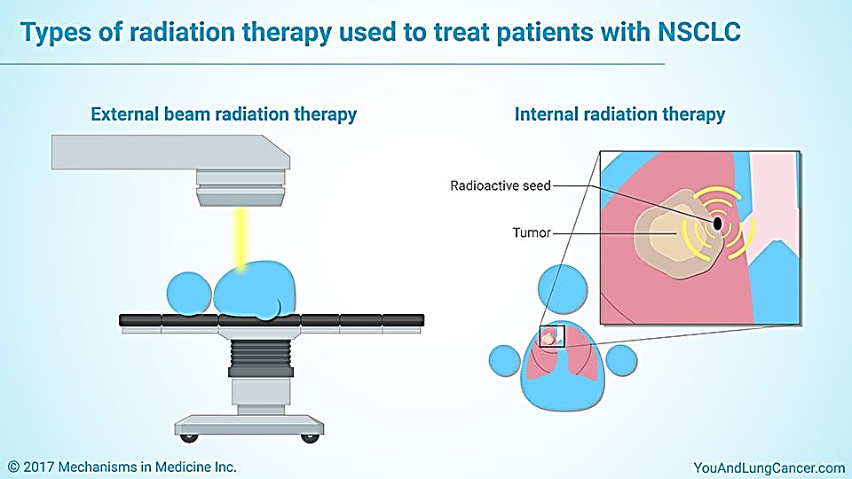

Slide 8
Radiation is combined with surgery
Before surgery, to shrink the size of the cancer so it can be removed by surgery and be less likely to return.
During surgery, so that it goes straight to the cancer without passing through the skin. Radiation therapy used this way is called intraoperative radiation. With this technique, doctors can more easily protect nearby normal tissues from radiation.
After surgery to kill any cancer cells that remain.

Slide 9
Side effects
Short term side effects vary, depending on the part of the body receiving radiation.
They can include:
fatigue
hair loss
diarrhea
skin changes
nausea and vomiting

Slide 10
Long term side effects
Long term side effects also depend on the treatment site. They include:
heart or lung problems, if radiation affects the chest
thyroid problems, leading to hormonal changes, if radiation affects the neck area
lymphedema, which involves lymph fluid building up and causing pain
hormonal changes, including a possibility of early menopause, from radiation in the pelvic area

Slide 11
Aftercare
After receiving external treatment, a person can go home and continue with their daily routine.
However, they may experience:
tiredness
sensitivity around the treatment site
emotional distress

Slide 12
To help manage these effects, it is important to:
get plenty of rest
eat healthy food
talk to friends and family about any side effects
follow instructions, which may involve skin care, from the treatment team
avoid spending time in the sun, due to a risk of photosensitivity

