Slide 1
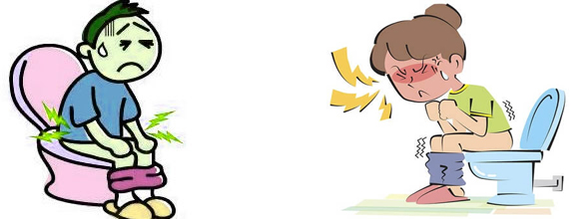
DIARRHOEA
PREPARED BY
MS.BINDHU MOL G
CLINICAL INSTRUCTOR
SUMANDEEP NURSING COLLEGE

Slide 2
DEFINITION
Diarrhea is loose, watery stools (bowel movements).
loose stools three or more times in one day.

Slide 3
TYPES
Acute diarrhea
is diarrhea that lasts a short time.
It is a common problem. It usually lasts about one or two days,
Chronic diarrhea
diarrhea that lasts at least four weeks -- can be a symptom of a chronic disease.
Chronic diarrhea symptoms may be continual, or they may come and go.

Slide 4
CAUSES
Bacteria from contaminated food or water
Rotavirus is the most common cause of acute diarrhea in children.
Parasites through contaminated food or water
Medicines such as antibiotics, cancer drugs, and antacids.
Food intolerances e.g lactose intolerance.
Diseases that affect the stomach, small intestine, or colon, such as Crohn's disease
Problems with how the colon functions, such as irritable bowel syndrome

Slide 5
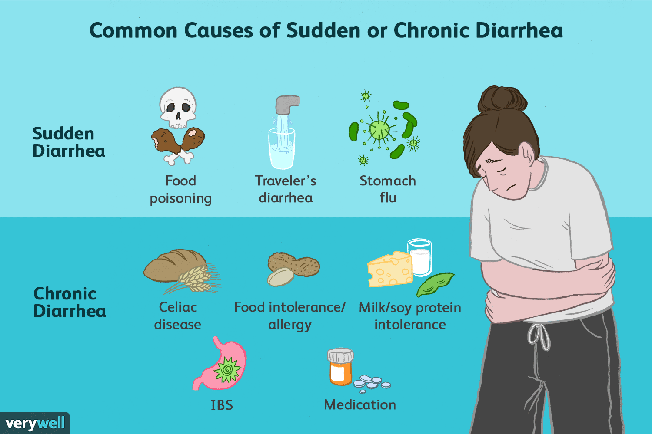

Slide 6
CLINICAL MANIFESTATIONS
Cramps or pain in the abdomen
An urgent need to use the bathroom
Loss of bowel control
fever, chills, and bloody stools.
Diarrhea can cause dehydration
Stools containing blood or pus.

Slide 7
DIAGNOSTIC EVALUATION
Physical examination
Ask about any medicines taken
Test stool or blood to look for bacteria, parasites,
or other signs of disease or infection

Slide 8
Management
Anti-diarrhoeal medication
Loperamide, or Imodium, is an antimotility drug that reduces stool passage
Bismuth subsalicylate, for example, Pepto-Bismol, reduces diarrheal stool output in adults and children
Antibiotics
Antibiotics are only used to treat diarrhea caused by a bacterial infection.
Diet
Sip on clear, still liquids such as fruit juice without added sugar
After each loose stool, replace lost fluids with at least one cup of liquid
Consume high-potassium foods and liquids, such as diluted fruit juices, potatoes without the skin

Slide 9
Dehydration management
Fluids can be replaced by simply drinking more fluids, or they can be received intravenously in severe cases. Children and older people are more vulnerable to dehydration
Oral rehydration solution or salts (ORS) refers to water that contains salt and glucose. It is absorbed by the small intestine to replace the water and electrolytes lost in the stool
Zinc supplementation may reduce the severity and duration of diarrhea in children

Slide 10
Prevention
Use only bottled or purified water for drinking, making ice cubes, and brushing teeth
use boiled tap water, or use iodine tablets
Make sure that the cooked food is fully cooked and served hot
Avoid unwashed or unpeeled raw fruits and vegetables

