Slide 1
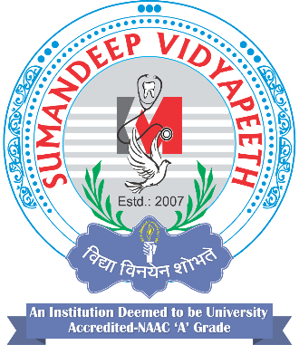
Department of pharmacy svdu
Subject: PD 503 Clinical Pharmacokinetics And Therapeutic Drug Monitoring
Topic: IV to Oral Conversion
Presented By: Dr. Sarvajeet Khare

Slide 2
Introduction
IV to oral(PO) conversion is basically switching to oral (PO) therapy to continue treatment after an already adequate course of intravenous (IV) therapy has been administered.
The term "anti-infective conversion" describes the practice of converting intravenous anti-infection therapy to an alternative oral formulation.

Slide 3
The ideal route of administration for any medication is one that achieves serum concentrations sufficient to produce the desired effect without producing undesired effects. In the past, patients were switched to oral (PO) therapy to continue treatment after an already adequate course of intravenous (IV) therapy was administered.

Slide 4
The Myth!
1. Infectious diseases need intravenous treatment and conversion to oral therapy should be used sparingly. Oral antimicrobials are not equivalent to intravenous therapy.
Answer: Newer antimicrobials are available with equivalent intravenous and oral bioavailability. The literature has shown that IV to PO therapy conversion is efficacious, convenient, cost-effective, and safe in carefully selected patients.
2. The oral antimicrobial must be the same medication or from the same medication class as the intravenous agent.
Answer: The selected oral agent should cover the same or similar spectrum of activity, similar tissue penetration, and should be effective against the isolated or suspected organism(s).

Slide 5
As conversion therapy was based on empirical observations rather than on clinical studies or outcomes, there was concern that oral therapy was less effective.
In addition, until recently, no clinical trials were available to support the conversion from the intravenous route to oral administration.
Current forces that are accelerating the conversion from intravenous to oral therapy include rising health care costs, limited health care resources, efforts to shorten hospital stays, and demands by patients for cost-effective, safer, and more convenient treatments.

Slide 6
Clinical trials have been conducted that demonstrate the efficacy and safety of IV:PO conversion, and several studies have addressed the economic impact of conversion.
Cost savings may be achieved through lowering direct acquisition costs, eliminating the need for ancillary supplies, reducing pharmacy and nursing time, and shortening the length of hospital stay.
Direct benefits to the patient include eliminating adverse events associated with IV therapy, increasing patient comfort and mobility, facilitating a more active role for the patient in his or her treatment, and increasing the possibility of earlier discharge. Improved quality of patient care and the potential for significant and meaningful cost savings make IV:PO conversion a desirable treatment option.

Slide 7
Types of IV to PO Conversions
There are three types of IV to PO therapy conversions as mentioned below:
Sequential Therapy
Switch Therapy
Step-down Therapy

Slide 8
Sequential Therapy
Sequential therapy refers to the act of replacing a parenteral version of a medication with its oral counterpart (same drug molecule and same dose as they are found to be therapeutically equivalent).
An example is the conversion of famotidine 20 mg IV to famotidine 20 mg PO.

Slide 9
Switch Therapy
Switch therapy is used to describe a conversion from an IV medication to the PO equivalent that may be within the same class and have the level of potency, but is a different compound.
An example is the conversion of IV pantoprazole to rapidly dissolving lansoprazole tablets or omeprazole capsules.

Slide 10
Step-down Therapy
Step-down therapy refers to converting from an injectable medication to an oral agent in another class or to a different medication within the same class where the frequency, dose, and the spectrum of activity (in the case of antibiotics) may not be exactly the same.
Converting from ampicillin/sulbactam 3 g IV q 6 hr to amoxicillin/clavulanate 875 mg PO q 12 hr is an example of step-down therapy.

Slide 12
General Pharmacokinetic and Pharmacodynamics Issues during transition( IV:PO)
An ideal oral medication :
Should possess properties that result in minimal disruption to the treatment course.
Should have recognized activity toward the infection/ condition being treated
Oral use should be supported by clinical trials.
To improve patient compliance, the medication should be available in dosage forms that do not limit the patient’s ability to tolerate the medication. Ingesting large tablets or capsules or having to take multiple doses per day is not desirable.
Finally, the medication should be well-absorbed and exhibit good bioavailability

Slide 13
Selection of patients for the conversion program:
The criteria used to determine whether or not the patient is eligible for PO therapy vary, but they generally encompass four key areas:
1. Intact and functioning gastrointestinal tract
2. Improving clinical status
3. Does not meet any exclusion criteria

Slide 14
Inclusion Criteria for Conversion Therapy
Completion of at least 48- 72 hrs of IV therapy in case of antibiotics
Functioning GIT
Afebrile conditions (body temperature: <100.4 F for at least 24 hrs or < 99.6 F for 8-24 hrs)
WBC count < 15,000 cells/ mm³ and decreasing towards normalcy
Clinical improvement
Stable blood pressure and heart rate for CV treatment and not be actively seizing for anti-convulsant therapy

Slide 15
Exclusion Criteria for Conversion Therapy
Patients who cannot use oral route (risk of aspiration, need for complete bowel rest, gastrointestinal obstruction, preoperative/postoperative fast)
Patients with an unreliable response to oral medication (severe nausea/vomiting, continuous nasogastric suction, mal absorption syndrome, motility disorder of the gastrointestinal tract, unresponsive to previous oral therapy, short bowel syndrome)
Patients whose disease state or infection does not permit conversion (e.g. High-risk neutropenia, meningitis, endocarditis)

Slide 16
Suggested Criteria for Selection of Low-Risk Patients With Chemotherapy-Induced Fever and Neutropenia
Anticipated duration of neutropenia < 1 week
Solid tumor malignancy
No comorbidities (clinically stable)
Adequate oral intake
Family support/caregiver
Ability to adhere to instructions
Malignancy responding to current therapy
Absolute neutrophil count nadir >/= 10 days after chemotherapy

Slide 17
The conversion from parenteral to oral anti-infective is described to occur in one of four scenarios :
Scenario 1 involves the use of the same drug in an oral dosage form, if it has excellent bioavailability and assures concentrations consistent with the IV formulation.
Scenario 2 involves the same drug with a reduction in achievable systemic drug concentration.
For IV anti-infectives that lack an oral counterpart, an oral agent from a different class with similar spectrum of activity and good absorption is indicated (scenario 3).
Scenario 4 involves conversion to a different drug with relatively limited absorption. This is the least desirable option for the clinician.

Slide 18
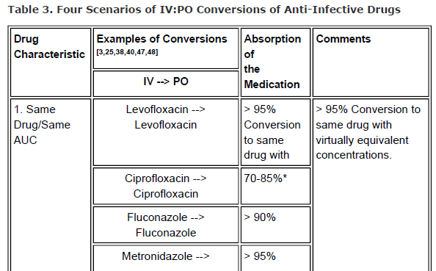
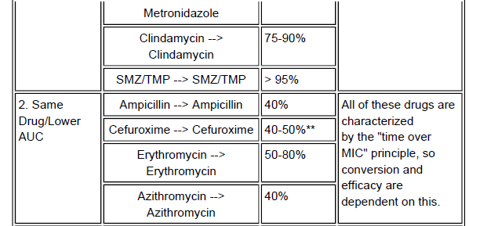

Slide 19
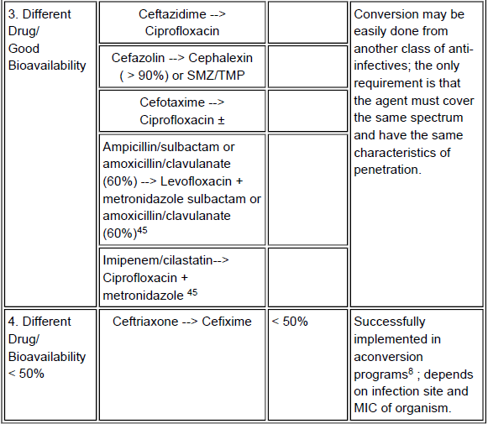

Slide 20
Advantages
Increase in patient convenience, comfort and mobility
Cost effectiveness
Reduces IV related complications
May help in maintaining a steady state plasma level better than an IV bolus in case of a drug with a short t_{1/2}

Slide 21
Conclusion
Intravenous to oral therapy conversion represents a cost-effective strategy that also minimizes intravenous therapy complications and facilitates earlier hospital discharge. IV: PO may be done as soon as the patient’s condition allows for. Implementation of IV: PO conversion can have a substantial impact of reducing hospital expenditures without compromising clinical outcomes and comfort of the patient.

Slide 22
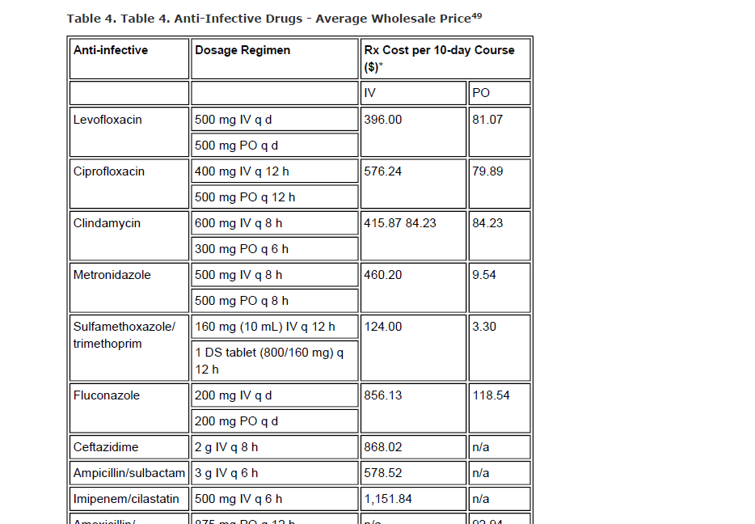

Slide 23
THANK YOU

