Slide 1

DEPARTMENT OF PHARMACY SVDU
Year: Pharm. D 4th year
Subject : PD401 Pharmacotherapeutics iii
Topic: Alcoholic Liver disease
Presented by: DR. HEMRAJ SINGH RAJPUT

Slide 2
Chronic and excessive alcohol ingestion is one of the major causes of liver disease.
The pathology of alcoholic liver disease consists of three major lesions, with the progressive injury rarely existing in a pure form:
  Fatty liver
  Alcoholic hepatitis
  Cirrhosis
Fatty liver is present in >90% of daily as well as binge drinkers.
A much smaller percentage of heavy drinker will progress to alcoholic hepatitis, thought to be a precursor to cirrhosis.
Although alcohol is considered a direct hepatotoxic, only between 10 to 20 % of alcoholics will develop alcoholic hepatitis.

Slide 3
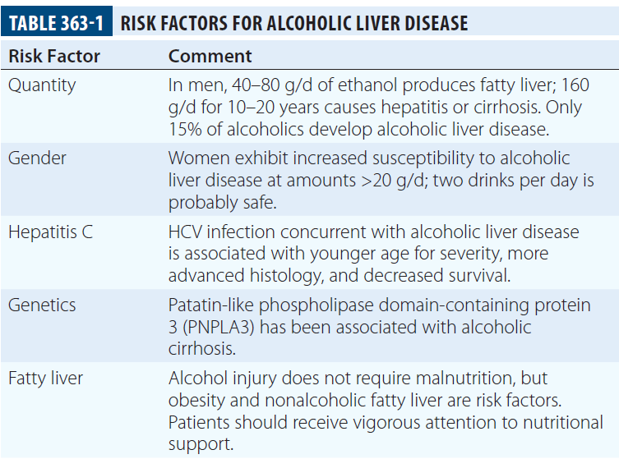
Etiopathogenesis
Quantity and duration of alcohol intake are the most important risk factors involved in the development of alcoholic liver disease

Slide 4
The pathogenesis of alcoholic liver injury is unclear.
The present conceptual foundation is that alcohol acts as a direct hepatotoxin and that malnutrition does not have a major role. Ingestion of alcohol initiates an inflammatory cascade by its metabolism to acetaldehyde, resulting in a variety of metabolic responses. Steatosis from lipogenesis, fatty acid synthesis, and depression of fatty acid oxidation appears secondary to effects on sterol regulatory transcription factor and peroxisome proliferator-activated receptor α (PPAR-α).
Intestinal derived endotoxin initiates a pathogenic process through toll-like receptor 4 and tumor necrosis factor α (TNF-α) that facilitates hepatocyte apoptosis and necrosis.

Slide 5
The cell injury and endotoxin release initiated by ethanol and its metabolites also activate innate and adaptive immunity pathways releasing proinflammatory cytokines (e.g., TNF-α), chemokines, and proliferation of T and B cells.
The production of toxic protein-aldehyde adducts, generation of reducing equivalents, and oxidative stress also contribute to the liver injury.
Hepatocyte injury and impaired regeneration following chronic alcohol ingestion are ultimately associated with stellate cell activation and collagen production, which are key events in fibrogenesis.
The resulting fibrosis from continuing alcohol use determines the architectural derangement of the liver and associated pathophysiology

Slide 6
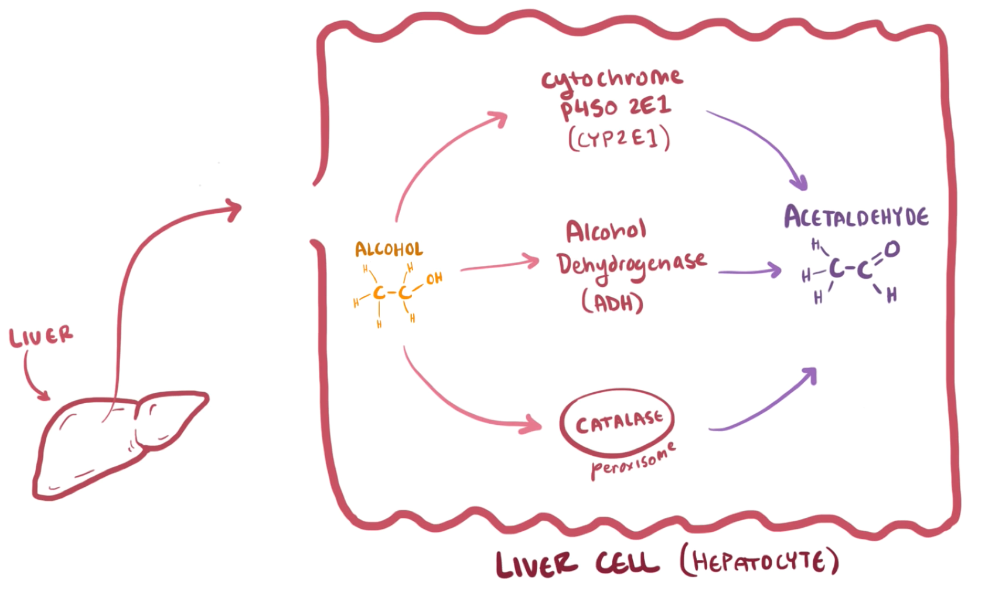

Slide 7
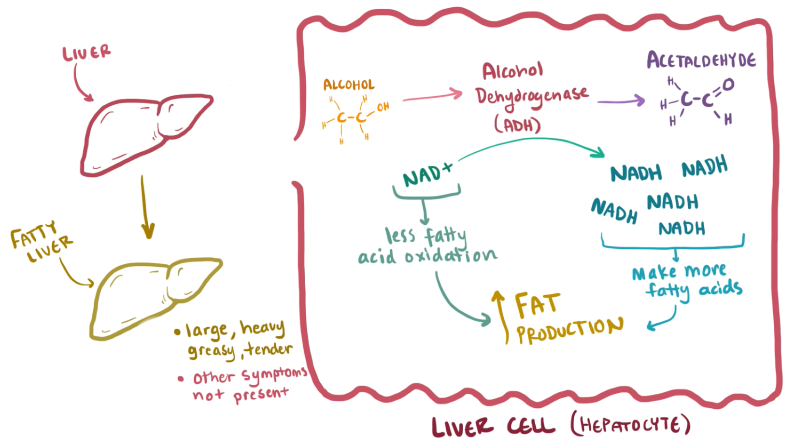

Slide 8
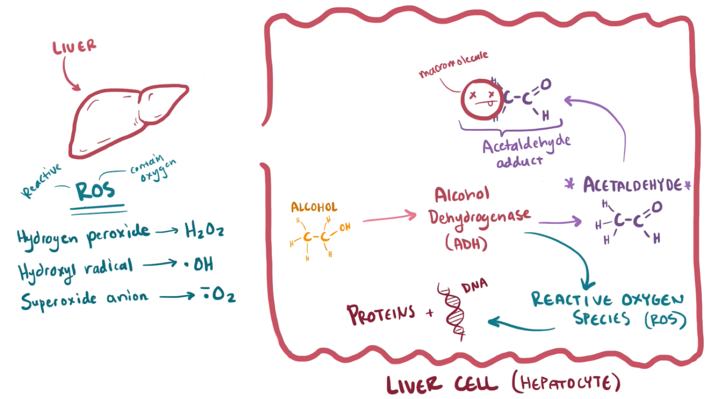

Slide 9
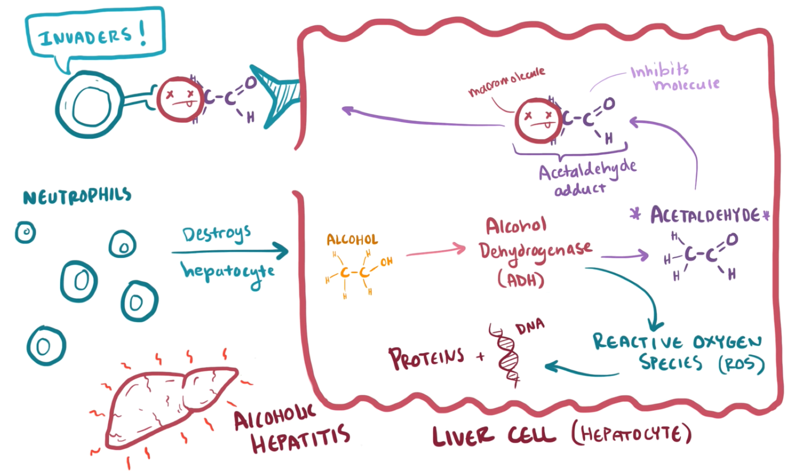

Slide 10
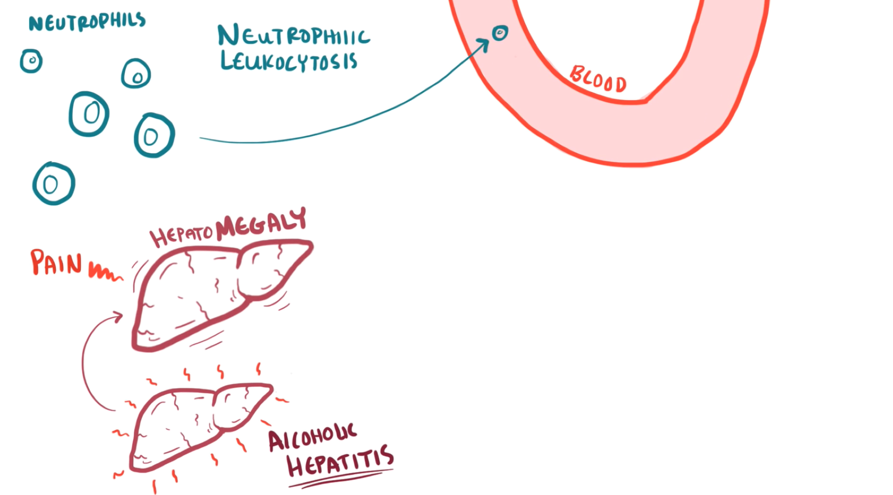

Slide 11
CLINICAL FEATURES
The clinical manifestations of alcoholic fatty liver are subtle and characteristically detected as a consequence of the patient’s visit for a seemingly unrelated matter.
Previously unsuspected hepatomegaly is often the only clinical finding.
Occasionally, patients with fatty liver will present with right upper quadrant discomfort, nausea, and, rarely, jaundice.
Alcoholic hepatitis is associated with a wide gamut of clinical features. Fever, spider nevi, jaundice, and abdominal pain simulating an acute abdomen represent the extreme end of the spectrum, while many patients will be entirely asymptomatic.
Portal hypertension, ascites, or variceal bleeding can occur in the absence of cirrhosis.

Slide 12
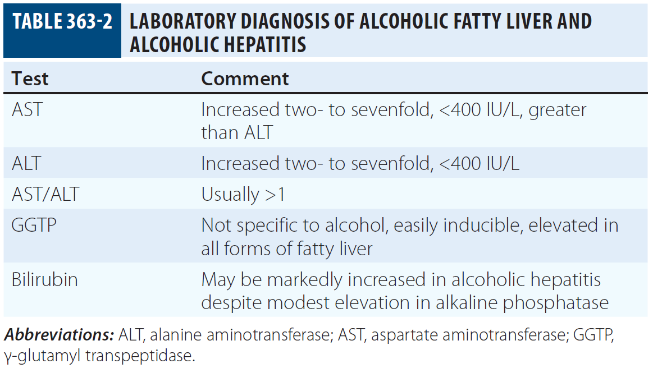
LABORATORY FEATURES

Slide 13
PROGNOSIS
Critically ill patients with alcoholic hepatitis have short-term (30-day) mortality rates >50%. severe alcoholic hepatitis is heralded by coagulopathy (prothrombin time increased >5 s), anemia, serum albumin concentrations <25 g/l (2.5 mg/dl), serum bilirubin levels >137 μmol/l (8 mg/dl), renal failure, and ascites.
A discriminant function calculated as 4.6 X (the prolongation of the prothrombin time above control [seconds]) + serum bilirubin (mg/dL) can identify patients with a poor prognosis (discriminant function >32).
A Model for End-Stage Liver Disease (MELD) score ≥21 also is associated with significant mortality in alcoholic hepatitis.
The presence of ascites, variceal hemorrhage, deep encephalopathy, or hepatorenal syndrome predicts a dismal prognosis.

Slide 14
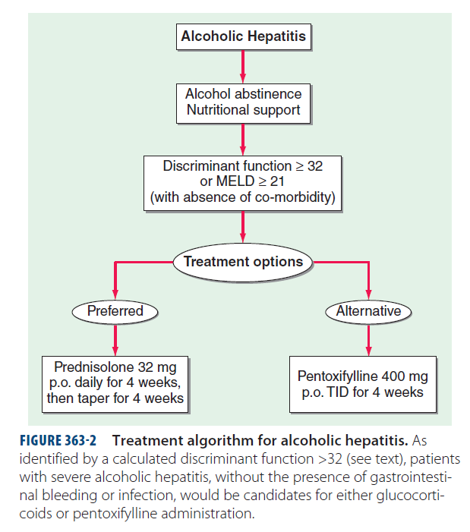
TREATMENT

