Slide 1

DEPARTMENT OF PHARMACY SVDU
YEAR: PHARM. D 1ST YEAR
SUBJECT: PD101 HUMAN ANATOMY AND PHARMACY
TOPIC: ANEMIAS
PRESENTED BY: dr. Anju john

Slide 2
ANEMIAS are a group od disease characterized by a decrease in hemoglobin (Hb) or red blood cells (RBCs), resulting in decreased oxygen-carrying capacity of blood.
PATHOPHYSIOLOGY
Anemias can be classified on the basis of RBC morphology, etiology, or pathophysiology.
Morphologic classifications are based on cell size.
Macrocytic cells are larger than normal and are associated with deficiencies of vitamin B12 or folate.
Microcytic cells are smaller than normal and are associated with iron deficiency.
whereas Normocytic anemia may be associated with recent blood loss or chronic disease.
Iron-deficiency anemia can be caused by inadequate dietary intake, inadequate GI absorption, increased iron demand (e.g., pregnancy), blood loss, and chronic diseases.

Slide 3
Vitamin B12- and folate-deficiency anemias can be caused by inadequate dietary intake, decreased absorption, and inadequate utilization.
Deficiency of intrinsic factor can cause decreased absorption of vitamin B12 (i.e., pernicious anemia). Folate-deficiency anemia can be caused by hyperutilization due to pregnancy, hemolytic anemia, myelofibrosis, malignancy, chronic inflammatory disorders, long-term dialysis, or growth spurt.
Drugs can cause anemia by reducing absorption of folate (e.g., phenytoin) or by interfering with corresponding metabolic pathways (e.g., methotrexate).
Anemia of chronic disease is a hypoproliferative anemia associated with chronic infectious or inflammatory processes, tissue injury, or conditions that release proinflammatory cytokines. The pathogenesis is based on shortened RBC survival, impaired marrow response, and disturbance of iron metabolism.
In anemia of critical illness, the mechanism for RBC replenishment and homeostasis is altered by, for example, blood loss or cytokines, which can blunt the erythropoietic response and inhibit RBC production.

Slide 4
Age-related reductions in bone marrow reserve can render the elderly patient more susceptible to anemia that is caused by multiple minor and often unrecognized diseases (e.g., nutritional deficiencies) that negatively affect erythropoiesis.
Anemias in children are often due to a primary hematologic abnormality. The risk of iron-deficiency anemia is increased by rapid growth spurts and dietary deficiency.
Hemolytic anemia results from decreased RBC survival time due to destruction in the spleen or circulation. The most common etiologies are RBC membrane defects (e.g., hereditary spherocytosis), altered Hb solubility or stability (e.g., sickle cell anemia and thalassemias), and changes in intracellular metabolism (e.g., glucose-6-phosphate dehydrogenase deficiency). Some drugs cause direct oxidative damage to RBCs.

Slide 5
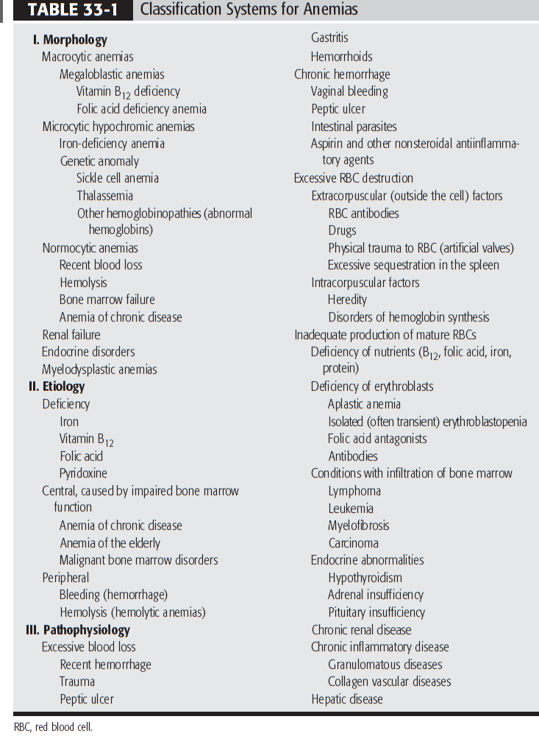

Slide 6
CLINICAL PRESENTATION
Signs and symptoms depend on the rate of development and the age and cardiovascular status of the patient. Acute-onset anemia is characterized by cardiorespiratory symptoms such as tachycardia, lightheadedness, and breathlessness. Chronic anemia is characterized by weakness, fatigue, headache, vertigo, faintness, cold sensitivity, pallor, and loss of skin tone.
Iron-deficiency anemia is characterized by glossal pain, smooth tongue, reduced salivary flow, pica (compulsive eating of nonfood items), and pagophagia (compulsive eating of ice). These symptoms are not usually seen until the Hb concentration is less than 9 g/Dl.
Vitamin B12 - and folate-deficiency anemias are characterized by pallor, icterus, and gastric mucosal atrophy. Vitamin B12 anemia is distinguished by neuropsychiatric abnormalities (e.g., numbness, paresthesias, irritability), which are absent in patients with folate-deficiency anemia.

Slide 7
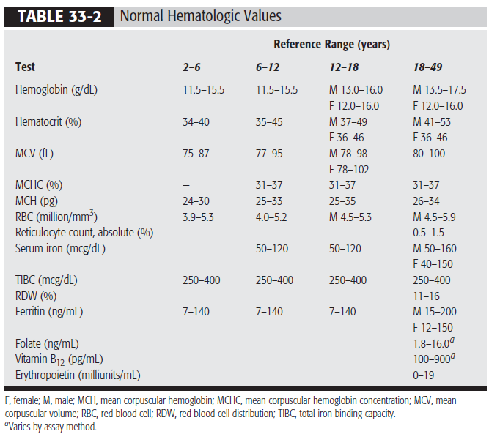
DIAGNOSIS

Slide 8
Rapid diagnosis is essential because anemia is often a sign of underlying pathology.
Initial evaluation of anemia involves a complete blood cell count (Table 33-2), reticulocyte index, and examination of the stool for occult blood.
The earliest and most sensitive laboratory change for iron-deficiency anemia is decreased serum ferritin (storage iron), which should be interpreted in conjunction with decreased transferrin saturation and increased total ironbinding capacity (TIBC). Hb, hematocrit, and RBC indices usually remain normal until later stages of iron-deficiency anemia.
Macrocytic anemias are characterized by increased mean corpuscular volume (110 to 140 fL). One of the earliest and most specific indications of macrocytic anemia is hypersegmented polymorphonuclear leukocytes on the peripheral blood smear. Vitamin B12 and folate concentrations can be measured to differentiate between the two deficiency anemias. A vitamin B12 value of less than 150 pg/mL, together with appropriate peripheral smear and clinical symptoms, is diagnostic of vitamin B12-deficiency anemia. A decreased RBC folate concentration (less than 150 ng/mL) appears to be a better indicator of folate-deficiency anemia than a decreased serum folate concentration (less than 3 ng/mL

Slide 9
Diagnosis of anemia of chronic disease is usually one of exclusion, with consideration of coexisting iron and folate deficiencies. Serum iron is usually decreased but, unlike iron-deficiency anemia, serum ferritin is normal or increased and TIBC is decreased. The bone marrow reveals an abundance of iron; the peripheral smear reveals normocytic anemia.
Laboratory findings of anemia of critical illness disease are similar to those of anemia of chronic disease.
Elderly patients with symptoms of anemia should undergo a complete blood cell count with peripheral smear and reticulocyte count, and other laboratory studies as needed to determine the etiology of anemia.
Diagnosis of anemia in pediatric populations requires the use of age- and sex-adjusted norms for laboratory values.
Hemolytic anemias tend to be normocytic and normochromic and to have increased levels of reticulocytes, lactic dehydrogenase, and indirect bilirubin.

Slide 10
DESIRED OUTCOME
The ultimate goals of treatment in the anemic patient are to alleviate signs and symptoms, correct the underlying etiology (e.g., restore substrates needed for RBC production), and prevent recurrence of anemia.
TREATMENT
IRON-DEFICIENCY ANEMIA
Oral iron therapy with soluble ferrous iron salts, which are not enteric coated and not slow- or sustained-release, is recommended at a daily dosage of 200 mg elemental iron in two or three divided doses.
Diet plays a significant role because iron is poorly absorbed from vegetables, grain products, dairy products, and eggs; iron is best absorbed from meat, fish, and poultry. Administration of iron therapy with a meal decreases absorption by more than 50% but may be needed to improve tolerability.

Slide 11
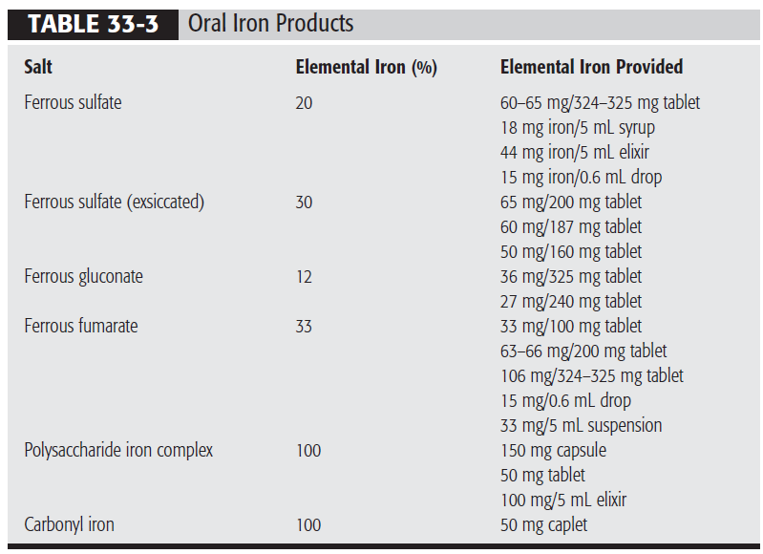

Slide 12
Parenteral iron may be required for patients with iron malabsorption, intolerance of oral iron therapy, or noncompliance. Parenteral administration, however, does not hasten the onset of hematologic response. The replacement dose depends on etiology of anemia and Hb concentration.
Available parenteral iron preparations have similar efficacy but different pharmacologic, pharmacokinetic, and safety profiles. The newer products, sodium ferric gluconate and iron sucrose , appear to be better tolerated than iron dextran.

Slide 13
VITAMIN B 12 -DEFICIENCY ANEMIA
Oral vitamin B12 supplementation appears to be as effective as parenteral, even in patients with pernicious anemia, because the alternate vitamin B 12 absorption pathway is independent of intrinsic factor. Oral cobalamin is initiated at 1 to 2 mg daily for 1 to 2 weeks, followed by 1 mg daily.
Parenteral therapy is more rapid acting than oral therapy and should be used if neurologic symptoms are present. A popular regimen is cyanocobalamin 1,000 mcg daily for 1 week, then weekly for 1 month, and then monthly. When symptoms resolve, daily oral administration can be initiated.
Adverse events are rare with vitamin B12 therapy.

Slide 14
FOLATE-DEFICIENCY ANEMIA
Oral folate 1 mg daily for 4 months is usually sufficient for treatment of folate-deficiency anemia, unless the etiology cannot be corrected. If malabsorption is present, the daily dose should be increased to 5 mg.
ANEMIA OF CHRONIC DISEASE
Treatment of anemia of chronic disease is less specific than that of other anemias and should focus on correcting reversible causes. Iron therapy is not effective when inflammation is present. RBC transfusions are effective but should be limited to episodes of inadequate oxygen transport and Hb of 8 to 10 g/dL..
Epoetin alfa can be considered, especially if cardiovascular status is compromised, but the response can be impaired in patients with anemia of chronic disease (off-label use). The initial dosage is 50 to 100 units/kg three times weekly. If Hb does not increase after 6 to 8 weeks, the dosage can be increased to 150 units/kg three times weekly.

Slide 15
Epoetin alfa is usually well tolerated. The hypertension seen in patients with end-stage kidney disease is less common in patients with acquired immune deficiency syndrome.
OTHER TYPES OF ANEMIAS
Patients with other types of anemias require appropriate supplementation depending on the etiology of anemia.
In patients with anemia of critical illness, parenteral iron is often utilized but is associated with a theoretical risk of infection. Routine use of epoetin alfa or RBC transfusions is not supported by clinical studies.
Anemia of prematurity is usually treated with RBC transfusions. The use of epoetin alfa is controversial.
In the pediatric population, the daily dose of elemental iron, administered as iron sulfate, is 3 mg/kg for infants and 6 mg/kg for older children for 4 weeks. If response is seen, iron should be continued for 2 to 3 months to replace storage iron pools. The dose and schedule of vitamin B12 should be titrated according to clinical and laboratory response. The daily dose of folate is 1 to 3 mg.

Slide 16
Treatment of hemolytic anemia should focus on correcting the underlying cause. There is no specific therapy for glucose-6-phosphate dehydrogenase deficiency, so treatment consists of avoiding oxidant medications and chemicals. Steroids, other immunosuppressants, and even splenectomy can be indicated to reduce RBC destruction.
EVALUATION OF THERAPEUTIC OUTCOMES
In iron-deficiency anemia, iron therapy should cause reticulocytosis in 5 to 7 days and raise Hb by 2 to 4 g/dL every 3 weeks. The patient should be reevaluated if reticulocytosis does not occur or if Hb does not increase by 2 g/dL within 3 weeks. Iron therapy is continued until iron stores are replenished, which usually requires at least 3 to 6 months.

Slide 17
In megaloblastic anemia, signs and symptoms usually improve within a few days after starting vitamin B12 or folate therapy. Neurologic symptoms can take longer to improve or can be irreversible, but they should not progress during therapy. Reticulocytosis should occur within 2 to 5 days. A week after starting vitamin B12 therapy, Hb should rise and leukocyte and platelet counts should normalize. Hematocrit should rise 2 weeks after starting folate therapy.
In anemia of chronic disease, reticulocytosis should occur a few days after starting epoetin alfa therapy. Iron, TIBC, transferring saturation, or ferritin levels should be monitored at baseline and periodically because iron depletion is a major reason for treatment failure. The optimal form and schedule of iron supplementation are unknown. If clinical response does not occur by 8 weeks, epoetin alfa should be discontinued.

Slide 18
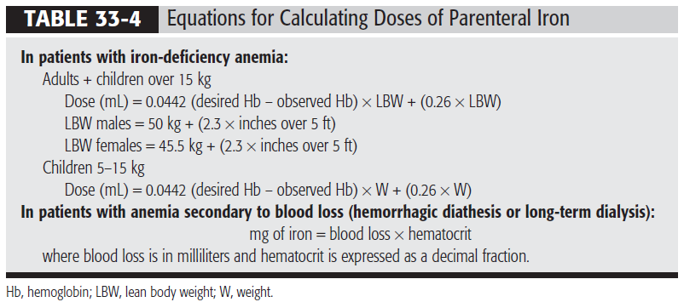

Slide 19
