Slide 1
ANTI TUBERCULAR AGENTS
6th Semester B.Pharm
Medicinal Chemistry- III
By: Mr. Dillip Dash

Slide 2
Anti Tubercular Agents
They are used for the treatment of tuberculosis. Tuberculosis is a bacterial generated disease caused by mycobacterium tuberculosis.
Drug Classification
They are classified into two types
  First line drugs- low toxicity, high efficacy
  Second line drugs- High toxicity, low efficacy

Slide 3
DRUG CLASSIFICATION
FIRST LINE DRUGS
1. Pyrazinamide
2. Rifampicin
3. Isoniazid
4. Ethambutol
5. Streptomycine
6. Rifabutin
SECOND LINE DRUGS
1. Thiacetazone
2. Ethionamide
3. Amikacine
4. Kanamycine
5. Capreomycin
6. Cycloserine
7. Para Amino salicylic Acid

Slide 4
PYARAZINAMIDE
Pyarazinamide diffuses into the mycobacterium tuberculosis cell. It converts to the active form Pyrazinoic acid in presence of enzyme Amidase. Pyrazinoic acid inhibits the enzyme fatty acid synthase which is required for the synthesis of fatty acid in the bacteria. Pyrazinoic acid also damages the membrane potential and interferes with energy production which is necessary for the survival of M. tuberculosis in an acidic side of infection.

Slide 5
ISONIAZID
It is effective against gram –ve bacteria. The main action of isoniazid is the inhibition of biosynthesis of mycolic acid, which is an important constituent of the mycobacterial cell wall. Isoniazid also interfere with certain intracellular mycobacterial enzyme, thereby interfere with bacterial DNA and RNA synthesis.

Slide 6
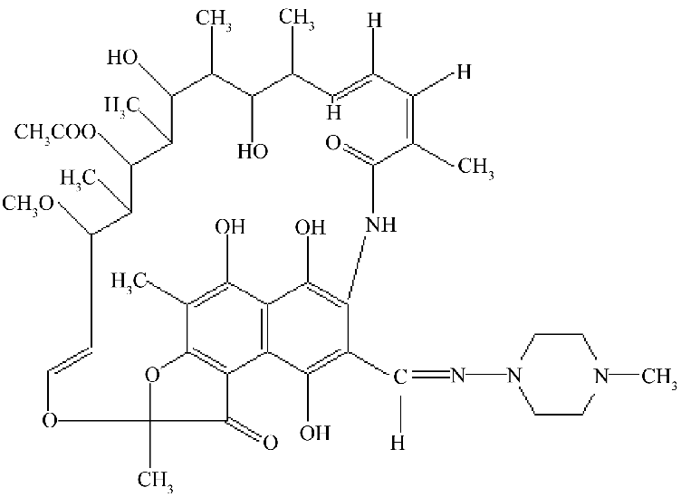
RIFAMPICIN
Rifampicine is structurally related to complex macro cyclic antibiotics. Rifampicine is a broad spectrum antibiotic active against both gram +ve and gram –ve bacteria. Rifampicine is a bactriocidal. It inhibits the DNA dependent RNA polymerase enzyme; thereby interfere with the synthesis of RNA.

Slide 7
ETHAMBUTOL
It is a bacteriostatic against actively growing tuberculosis bacteria. It works by obstructing the formation of cell wall. Mycolic acid attached to the Arbinogalactan to form mycolyl- Arbinogalactan peptidoglycan complex in the cell wall. This complex gives the strength and rigidity to the cell wall. Ethambutol inhibit the enzyme Arbinosyl transferase, thereby the synthesis of Arbinogalactan inhibited. By inhibition of the Arbinogalactan synthesis leads to inhibit the formation of complex by which the damage of cell wall occurs.

Slide 8
STREPTOMYCINE
Discussed in Antibiotics.

Slide 9
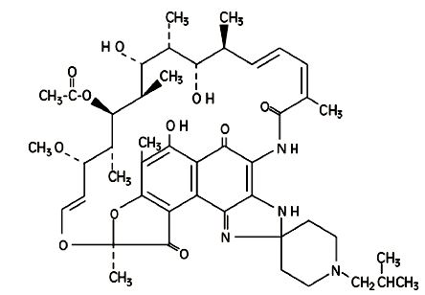
RIFABUTIN
It is an antibiotic used to treat tuberculosis. It is typically used for those who can’t tolerate rifampicin such as people with HIV.

Slide 10
Second line drugs

Slide 11
Ethionamide
Ethionamide specifically used along with other antitubercular agent to treat multi drug resistance TB. Ethionamide is structural analogue to isoniazid. It is a prodrug which is activated by the EthA in mycobacterium tuberculosis. It inhibits InhA, an enzyme involved in mycolic acid biosynthesis by which it interfere with the cell wall synthesis.
Notes:
InhA, a target of the antituberculous drug isoniazid, is involved in a mycobacterial fatty acid elongation system

Slide 12
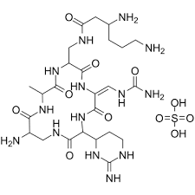
CAPRIOMYCIN
It is a antitubercular antibiotic which is interfere with the protein synthesis in mycobacterium tuberculosis by binding with 70s ribosomal sub unit.

Slide 13
PARA AMINO SALICYLIC ACID
This is a weak antitubercular drug. It is used in the combination with streptomycin and isonizid to treat multi drug resistance TB. It is structurally related to PABA and inhibits the DHFR enzyme and interfere with DNA synthesis in mycobacterium TB.

Slide 14
CYCLO SERINE
Cyclo serine is a antitubercular antibiotic interfere with the cell wall synthesis of mycobacterium tuberculosis. It inhibits to enzymes D-Alanine Recemase and D-Alanine Ligase
D-alanine is a impotant component of peptide glycan portion of the mycobacterial cell wall. Mycobacterium is capable of utilizing natural occurring L-alanine and converting L-alanine to D-alanine by the enzyme D-alanine recemase.

Slide 15
D-alanine couples with itself to form a D-alanine-D-alanine complex under the influence of D-alanine ligase. This complex is incorporated into the peptido glycan strand and gives rigidity to the cell wall. Cyclo serine inhibits the enzyme recemase ana ligase by which it interfere with the cell wall synthesis of mycobacterium.

