Slide 1
APPLICATIONS OF RADIOPHARMACEUTICALS
B.Pharmacy 1st semester pharmaceutical inorganic chemistry
PREPARED BY
Mr. Shivkant Patel
Assistant Professor
Department of Pharmacy,
Sumandeep Vidyapeeth Deemed to be University, Vadodara

Slide 2
Nuclear Pharmacy
WHERE DO WE START?
X Rays discovered in 1895
Artificial radioactivity discovered in 1934
First clinical use of radioactivity 1937
Radioactive iodine used succesfully to treat cancer 1946
Widespread use of nuclear medicine 1950

Slide 3
Radiopharmaceuticals
Pharmaceuticals are the substances used to diagnose, treat and prevent diseases.
Radiopharmaceuticals are the radioactive pharmaceuticals used in nuclear medicine.
These drugs are made up of two components-
A radioactive isotope and a carrier molecule.

Slide 4
Applications
Radioisotopes are used in medicine in four different ways
∆Diagnostic
∆Therapeutic
∆Research
∆Sterilization

Slide 5
Diagnostic radiopharmaceuticals
DEFINITION:
Examples:
Biliary tract blockage—Technetium Tc
Bone diseases—Sodium Fluoride F 18, Technetium Tc
Heart disease—Ammonia N 13,
Kidney diseases—Iodohippurate Sodium I 123,
Red blood cell diseases—Sodium Chromate Cr 51

Slide 6
Brain scan

Slide 7
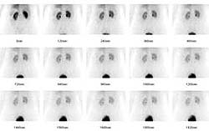
Kidney- Sodium iodohippurate

Slide 8
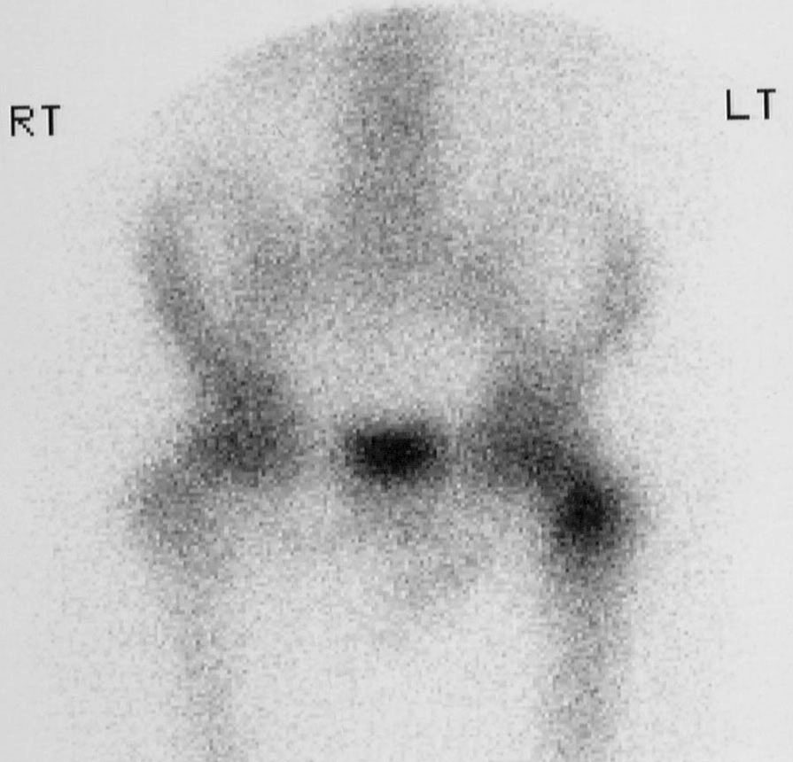
Bone scan

Slide 9
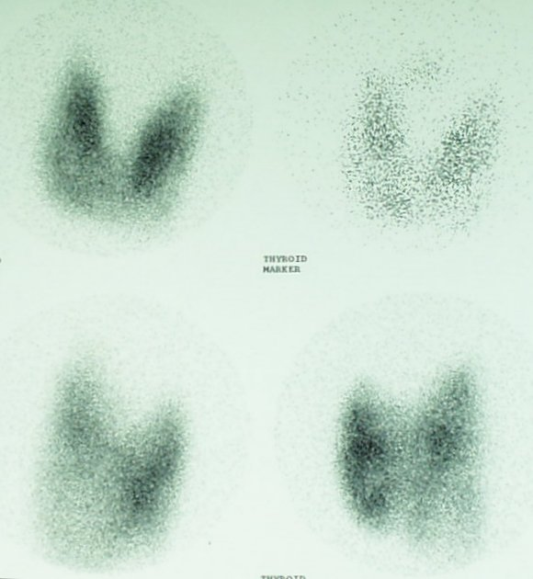
Thyroid gland scan

Slide 10
MRI scan

Slide 11
Examples:
Brain tumors diagnosis:using I 131
Diagnosis of helicobacter pylori: C14

Slide 12
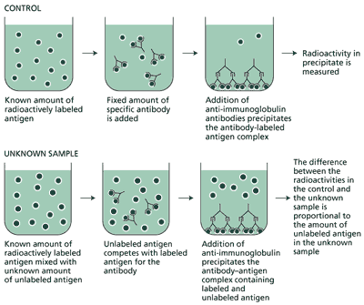
Radio immuno assay

Slide 13
Therapeutic radiopharmaceuticals
DEFINITION: molecules used to deliver their ionic radiations in therapeutic doses to the diseased sites.
AIM : Destroy diseased tissues without destroying healthy tissues.
Divisions of therapy:
∆External
∆Internal

Slide 14
External therapy
α- radiations : poorly penetrating
β-radiations : weakly penetrating . Used for surface treatment of disorders. ex:eyes
γ- radiations : highly penetrating . Used for deep seated tumors.

Slide 15
Internal therapy
Administration:
Example:
Chromic phosphate P 32 suspension:
Chromic phosphate suspended in 30% dextrose solution is given in the form of injection for the treatment of malignant carcinoma of ovary.
I 131 is used to destroy thyroid cells in case of thyrotoxicosis.

Slide 16
Research
Used as tracers for studying biochemical processes.
Examples:C14, H 3, radio isotopes of Na,Mg,Ca,Cu etc.

Slide 17
Sterilisation:
Used to sterilise pharmaceuticals in their final packed containers and surgical instruments in hospitals.Thermolabile substances like vitamins, hormones, antibiotics etc can be safely sterilised.
Example:Co 60, Cesium 137

Slide 18
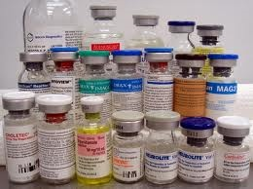

Slide 19
Radiopharmaceutical preparations
Fludeoxyglucose (18F) injection:
Description: Fludeoxyglucose (18F) injection (18F-FDG) is a colourless or slightly yellow and sterile solution.
Radionuclide production: 18F is a radioisotope of fluorine and may be prepared by proton
irradiation of 18O deuteron irradiation of 20Ne or alpha irradiation of 16O and processed in a
manner that 18F obtained is carrier free.

Slide 20
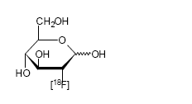
Graphic formula

Slide 21
Category: Diagnostic radiopharmaceutical for liver diseases.
Chemical name. 2-[18F] fluoro-2-deoxy-D-glucopyranose (2-[18F] fluoro-2- deoxy –Dglucose
The radioactive half life of 18F is 109.8 minutes

Slide 22
Sodium Iodide (131 I ) capsules
Description. White or coloured gelatine capsule contained in a sealed secondary container
The radioactive half-life of
131I is 8.06 days.

Slide 23
production: Complies with 131I production and general conditions in radiopharmaceutical preparation. Iodine-131 may be obtained by neutron irradiation of tellurium or by extraction from uranium fission products.
Radiopharmaceutical formulation: The content of 131I is not less than 90.0% and not more than 110.0% of the stated content on the label at the reference date and hour. The method of manufacture is such that the specific activity used is not less than 185MBq of iodine-131 per mg of iodine for diagnostic capsules and 185MBq of iodine-131 per microgram of iodine for therapeutic capsules.
Category: Diagnostic and therapeutic radiopharmaceutical

Slide 24
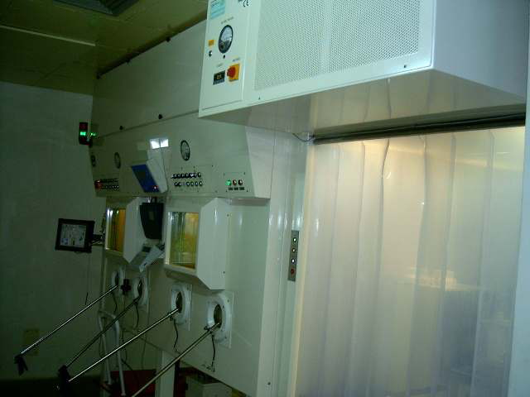
Tc 99 generator

Slide 25
Sodium Phosphate (32P ) injection
Description: A clear, colourless sterile solution containing radioactive disodium and monosodium (32P) orthophosphate made isotonic to blood with sodium chloride.
Radionuclide production: 32P is radioactive isotope of phosphorous and may be produced by neutron irradiation of sulfur. The radioactive half-life of 32P is 14.3 days
Category: Therapeutic radiopharmaceutical.

Slide 26
PHAMACOPOEIAL PRERERATIONS:
Fludeoxyglucose (18F) injection.
Gallium Citrate (67Ga) injection
Sodium Phosphate (32P) injection
Strontium Chloride (89Sr) injection
Technetium (99mTc) labelled Red Blood Cells injection
Technetium (99mTc) Sulphur Colloid injection

Slide 27

THANKS

