Slide 1
ASTHMA MANAGEMENT
Dr. Rajesh Maheshwari
Professor Department of Pharmacy
Sumandeep Vidyapeeth Deemed to be University

Slide 2
Magnitude of the Problem
15- 20 million asthmatics in India.
A recent study conducted in Delhi established asthma prevalence to be 12% in schoolchildren.
Significant cause of school/work absence.
Health care expenditures very high.
Morbidity and mortality are on the rise.
JAPI 2002; Vol 50: 462.

Slide 3
The Treatment Gap in Asthma
Patients are not detected
Do not seek medical attention
No access to health service
Missed diagnosis (bronchitis, LRTI)

Slide 4
Current Understanding of Asthma
A chronic inflammatory disorder of the airway
Infiltration of mast cells, eosinophils and lymphocytes
Airway hyperresponsiveness
Recurrent episodes of wheezing, coughing and shortness of breath
Widespread, variable and often reversible airflow limitation

Slide 5

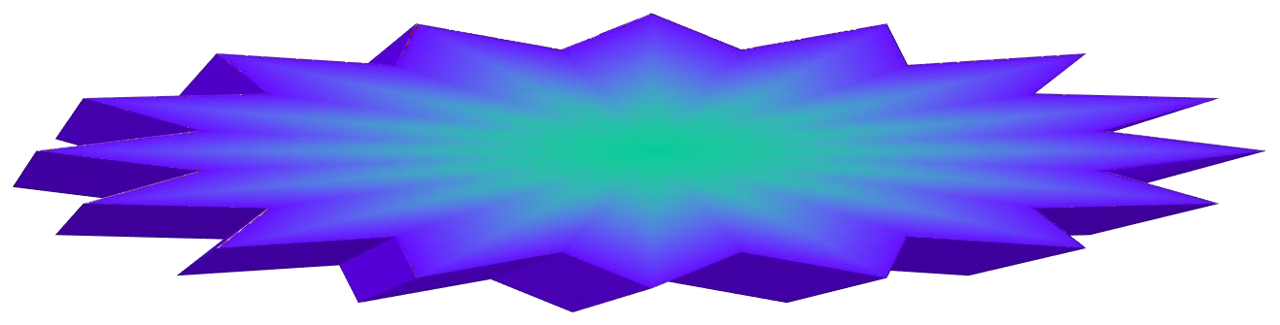

The Underlying Mechanism
Risk Factors (for development of asthma)
INFLAMMATION
Airway Hyperresponsiveness
Airflow Limitation
Symptoms- (shortness of breath, cough, wheeze)
Risk Factors (for exacerbations)

Slide 6
Risk Factors that Lead to Asthma Development
Predisposing Factors
Atopy
Causal Factors
Indoor Allergens
  Domestic mites
  Animal Allergens
  Cockroach Allergens
  Fungi
Outdoor Allergens
  Pollens
  Fungi
Occupational Sensitizers
Contributing Factors
Respiratory infections
Small size at birth
Diet
Air pollution
  Outdoor pollutants
  Indoor pollutants
Smoking
  Passive Smoking
  Active Smoking

Slide 7
Symptoms
Attack or recurrent episodes of wheezing
Cough or wheeze after physical activity
Breathing problem during a particular season
Chest tightness after exposure of airborne allergen or irritant

Slide 8
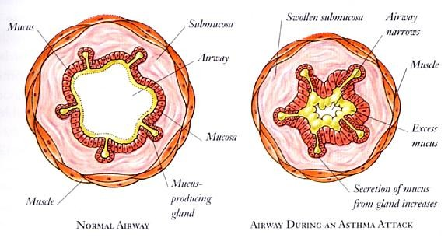
Asthma: Pathological changes

Slide 9
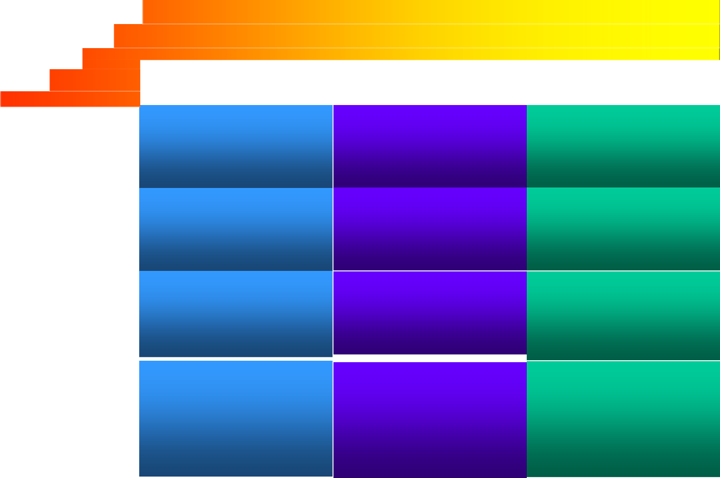
Classification of Asthma Severity
CLASSIFY SEVERITY
Clinical Features Before Treatment
Symptoms
Nighttime Symptoms
PEF
STEP 4
Severe
Persistent
Continuous Limited physical activity
<60% predicted
Variability >30%
Frequent
STEP 3
Moderate Persistent
Daily
Use β2-agonist daily Attacks affect activity
>60%-<80%
predicted
Variability >30%
>1 time week
STEP 2
Mild Persistent
>1 time a week but
<1 time a day
>2 times a month
>80% predicted
Variability 20-30%
STEP 1
Intermittent
< 1 time a week Asymptomatic and normal PEF between attacks
>80% predicted
Variability <20%
<2 times a month
The presence of one of the features of severity is sufficient to place a patient in that category.
Global Initiative for Asthma (GINA) WHO/NHLBI, 2002

Slide 10
Types of asthma
Exercise-induced asthma:
NSAIDS-sensitive asthma-e.g., aspirin or ibuprofen
Nocturnal asthma: asthma symptom seen at night. It occur bet midnight & 8 a.m.
Occupational asthma:

Slide 11
T lymphocytes in asthma
antigen
Epithelial cell
Dendric cell (antigen presenting)
Il-4
Th2 Lym
Th0 Lym
Il-5
His Il TNF
Il-4
eosinophill
Mast cell
IgE
B-Lym

Slide 12
Airway obstruction in asthma is due to com. Of factors
Spasm of airway smooth muscle
Edema of airway mucosa
Increase mucus secretion
Cellular(easinophil & lymphocytes) in filtration of airway wall
Injury of airway epithelium

Slide 13
Bronchoconstriction:
(1)- Early asthmatic reaction:
inhalation of allergen sol by patient with allergic asthma cause Bronchoconstriction
After this allergen challenge, there is rapid decline in FEV1 in 1 sec that
begins within 15 sec & subside within the first hr. & recover by B-agonist. (2)-Late asthmatic response:
Usually occurs 6-24 hrs after
exposure of allergen
This late decline in FEV1 may less severe than EAR, but more Prolonged,
EAR
FEV1
LAR
time

Slide 14
DIAGNOSIS OF ASTHMA
History and patterns of symptoms
Physical examination
Measurements of lung function

Slide 15
PATIENT HISTORY
Has the patient had an attack or recurrent episodes of wheezing?
Does the patient have a troublesome cough, worse particularly at night, or on awakening?
Does the patient cough after physical activity (eg. Playing)?
Does the patient have breathing problems during a particular season (or change of season)?

Slide 16
Do the patient’s colds ‘go to the chest’ or take more than 10 days to resolve?
Does the patient use any medication (e.g. bronchodilator) when symptoms occur? Is there a response?
If the patient answers “YES” to any of the above questions, suspect asthma.

Slide 17
Physical Examination
Wheeze -
Usually heard without a stethoscope
Dyspnoea -
Rhonchi heard with a stethoscope Use of accessory muscles
Remember -
Absence of symptoms at the time of examination does not exclude the diagnosis of asthma

Slide 18
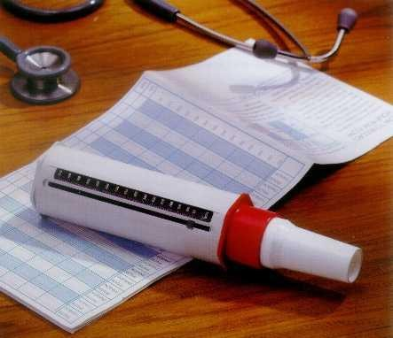
Diagnostic testing
Diagnosis of asthma can be confirmed by demonstrating the presence of reversible airway obstruction using Peak flow meter.

Slide 19
Goals to Be Achieved in Asthma Control
Achieve and maintain control of symptoms
Prevent asthma episodes or attacks
Minimal use of reliever medication
No emergency visits to doctors or hospitals
Maintain normal activity levels, including exercise
Maintain pulmonary function as close to normal as possible
Minimal (or no) adverse effects from medicine

Slide 20
Tool Kit for Achieving Management Goals
Relievers
Preventers
Peak Flow meter
Patient education

Slide 21
What Are Relievers?
Rescue medications
Quick relief of symptoms
Used during acute attacks
Action lasts 4-6 hrs

Slide 22
RELIEVERS
Short acting β₂ agonists
Salbutamol
Levosalbutamol , Terbutaline and Bambuterol
Anti-cholinergics
Ipratropium bromide
Xanthines
Theophylline, Aminophyllin
Adrenaline injections

Slide 23
What are Preventers?
Anti-inflammatory.
Prevent future attacks/ take time to act (1-3 hrs)
Long term control of asthma
Prevent airway remodelling
Only for regular use (whether well or not well)

Slide 24
PREVENTERS
Corticosteroids
Prednisolone, Betamethasone Beclomethasone, Budesonide Fluticasone
Anti-leukotrienes
Montelukast, Zafirlukast
Xanthines Theophylline SR
Long acting β₂ agonists Bambuterol, Salmeterol
Formoterol
Mast cell stabilisers Sodium cromoglycate
COMBINATIONS
Salmeterol/Fluticasone Formoterol/Budesonide Salbutamol/Beclomethasone

Slide 25
Reliever
Reliever (also known as rescue medication)
Bronchodilator (beta₂ agonist)
Quickly relieves symptoms (within 2-3 minutes)
Not for regular use

Slide 26
Salbutamol sulphate:
M/A: it is B-adrenergic stimulant which has highly selective action on receptor in bronchial muscle resulting in bronchi dilation.
Side effects: mild tremor, headache, hypokalaemia and muscle crams:
Market pre: asthalin inh / Rotacaps /Respules/ Tab 4-8 mg.
Levosalbutamol sulphate: Market pre: levolin ½ mg tab.
Bambuterol Hcl: Prod rug of terbutaline

Slide 27
Precaution :
In impaired renal function, dose should be halved Market pre:Bambudil tab/sy.
Formoterol fumarate:
Market pre:foracort inh/Rotacaps
Salmeterol xinafoate:
Market pre: serobid inh/ Rotacaps

Slide 28
Anti-cholinergic:
Ipratropium bromide:
M/A: it is muscarinic receptor antagonist, by binding to M receptor in bronchial smooth muscle & it inhibit Bronchoconstriction effect of Ach.
Side effect: headaeche, nausea, dryness of mouth,tachycardia,palpitation.
Market pre: ipravet inh/ Rotacaps/ respules.
Tiotropium bromide:
Market pre: Tiova inh/ Rotacaps.

Slide 29
Xanthine drugs:
(1)Theophyllin anhydrous:
m/a-it increase C Amp which leads to decrease Ca then relaxation
Side effect: anorexia,nausea,vommiting,insomnia, arrthmias,seizures
Market pre: Theobid 200/300, Theoday 400/sy Mast cell- stabiliser:
Sod chromoglycate:
It prevent the release of chemical mediiator from mast cell & reduce bronchial hyperreactivity.

Slide 30
Side effect: mild throat irritation,coughing,bad taste,nausea.
Market pre: cromal 5 inh.
LT receptor antagonist:
Zafirlukast, ipralukast,montelukast and cinalukast: m/a: prevent leukotrine from interacting with their receptor.
Side effect:dyspepsia,abdominalpain,rash,dizziness, headache
Market pre: montair 5/10 tab, romilast,telekast

Slide 31
Corticosteroids:
m/a: for anti-inflammatory action. They decrease Formation of cytokines in particular Th2 cytokines that Activate easinophil & which are responsible for promoting the production of IgE.
(1)Prednisolone sod phosphate:
Side effect: fluid & electrolyte disturbance, K loss, HT, peptic ulcer, pancreatis, vertigo, glaucoma
Market pre: predon tab/sy, wysolone, omnacortil

Slide 32
Baclomethasone dipropianate:
Side effect: candiasis of mouth & throat Market pre: Beclate inh/ Rotcaps
Betamethasone: same above
Budesonide
Side effect: throat irritation, cataract, glucoma. Market pre: Budecort inh / Rotacaps.
Fluticasone propionate
Market pre: Flohale inh/ Rotacaps. H1 receptor antahonist: Loratidine:

Slide 33
Rescue Medication
SALBUTAMOL INHALER
100 mcg:
1 or 2 puffs as necessary
LEVOSALBUTAMOL INHALER
50 mcg :
1 or 2 puffs as necessary

Slide 34
Ideal combination
Formoterol ( fast relief and sustained relief ) +
Budesonide ( twice or even once daily use )
Dose: 1- 4 puffs ( OD/BD ) Another combination
Salmeterol + Fluticasone

Slide 35
Formoterol + Budesonide combination
the „flexible‟ preventer
Quickly gains control
Asthma worsening
Asthma signs
Maintains control
Maintains control
Reduce to lowest adequate
dose that maintains control
1x2
1x2
2x2
2x2
1x1
Time

Slide 36
All Asthma Drugs Should Ideally Be Taken Through The Inhaled Route.

Slide 37
Why inhalation therapy?
Oral
Slow onset of action
Large dosage used
Greater side effects Not useful in acute symptoms
Inhaled route
Rapid onset of action
Less amount of drug used
Better tolerated
Treatment of choice in acute symptoms

Slide 38
Aerosol delivery systems currently available
Metered dose inhalers
Dry powder inhalers (Rotahaler)
Spacers / Holding chambers

Slide 39
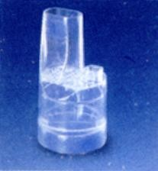
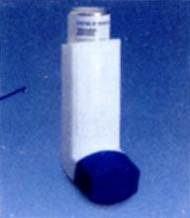
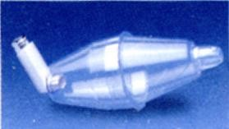
Inhalation devices you can use
Dry Powder Inhaler
Metered Dose inhaler
Spacer

Slide 40
Advantages of Spacer
No co-ordination required
No cold - freon effect
Reduced oropharyngeal deposition
Increased drug deposition in the lungs

Slide 41
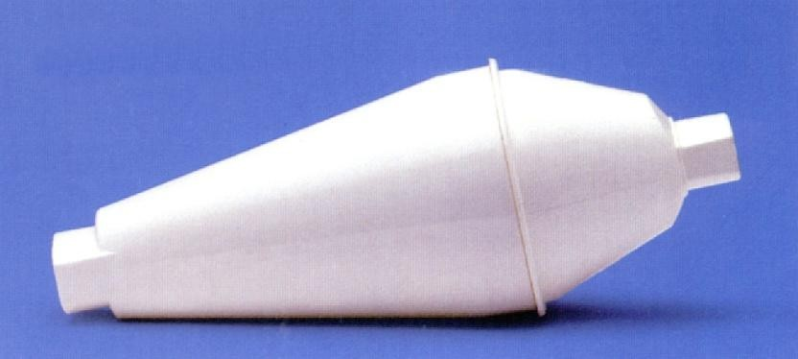
The Zerostat advantage
Non - static spacer made up of polyamide material
Increased respirable fraction → Increased deposition of drug in the airways
Increased aerosol half - life → Plenty of time for the patient to inhale after actuation of the drug
No valve → No dead space → Less wastage of the drug
Small, portable, easy to carry → Child friendly

Slide 42
Rotahaler - The dry powder advantage
Overcomes hand-lung coordination problems that are encountered with MDIs.
Can be easily used by children, elderly and arthritic patients.
Can take multiple inhalations if the entire drug has not been inhaled in one inhalation.

Slide 43
Age-wise selection of inhaler devices
< 3 years – MDI + Spacer + Mask or nebulisers
3 – 5 years – MDI + Spacer + Mask or Rotahaler
5 – 8 years – Rotahaler or MDI + Spacer
> 8 years – Rotahaler or MDI + Spacer

Slide 44
Patient Education in the Clinic
Explain nature of the disease (i.e.
inflammation)
Explain action of prescribed drugs
Stress need for regular, long-term therapy
Allay fears and concerns
Peak flow reading
Treatment diary / booklet

Slide 45
Key Messages
Asthma is a common disorder
It can happen to anybody
It is not caused by supernatural forces
Asthma is not contagious
It produces recurrent attacks of cough with or without wheeze
Between attacks people with asthma lead normal lives as anyone else
In most cases there is some history of allergy in the family.

Slide 46
Key Messages
Asthma can be effectively controlled, although it cannot be cured.
Effective asthma management programs include education, objective measures of lung function, environmental control, and pharmacologic therapy.
A stepwise approach to pharmacologic therapy is recommended. The aim is to accomplish the goals of therapy with the least possible medication.

