Slide 1
Cancer Chemotherapy
Dr.R.Balaraman.FAMS, FIPS
Dept of Pharmacy
Sumandeep Vidyapeet Deemed to be University
Piparia
Baroda

Slide 2
Cancer is a disease characterised by uncontrolled multiplication and spread of abnormal forms of the body's own cells. It is one of the major causes of death in the developed nations: one in three people will be diagnosed with cancer during their lifetime, and in 2001 (for example) 270000 new cases were reported in the UK. Cancer is also responsible for approximately one-quarter of all deaths in the UK, with lung and bowel cancer comprising the largest category, closely followed by breast and prostate cancer. At first sight, incidence figures for the past 100 years or so give the impression that the disease is increasing in developed countries, but cancer is largely a disease of later life, and with advances in public health and medical science many more people now live to an age where they are more liable to contract cancer.

Slide 3
The terms cancer, malignant neoplasm (neoplasm simply means 'new growth') and malignant tumour are synonymous. Both benign and malignant tumours manifest uncontrolled proliferation, but the latter are distinguished by their capacity for dedifferentiation, their invasiveness and their ability to metastasise (spread to other parts of the body). In this chapter, we shall be concerned only with the therapy of malignant neoplasia or cancer. The appearance of these abnormal characteristics reflects altered patterns of gene expression in the cancer cells, resulting from genetic mutations.

Slide 4
There are three main approaches to treating established cancer-surgical excision, irradiation and chemotherapy-and the relative value of each of these approaches depends on the type of tumour and the stage of its development. Chemotherapy may be used on its own or as an adjunct to other forms of therapy. Other approaches to cancer treatment, based, for example, on our increasing knowledge of the pathobiology of cancer, are being pursued (see below) and are beginning to produce results of real value.

Slide 5
Chemotherapy of cancer, as compared with that of bacterial disease, presents a difficult problem. In biochemical terms, micro- organisms are both quantitatively and qualitatively different from human cells but cancer cells and normal cells are so similar in most respects that it is more difficult to find general, exploitable, biochemical differences between them.

Slide 6
THE PATHOGENESIS OF CANCER
To understand the action and drawbacks of current anticancer agents and to appreciate the therapeutic hurdles that must be surmounted by putative new drugs, it is important to consider in more detail the pathobiology of this disease.
Cancer cells manifest, to varying degrees, four characteristics that distinguish them from normal cells. These are:

Slide 7
uncontrolled proliferation
dedifferentiation and loss of function
invasiveness
metastasis.
THE GENESIS OF A CANCER CELL
A normal cell turns into a cancer cell because of one or more mutations in its DNA, which can be acquired or inherited. A good example is breast cancer; women who inherit a single defective copy of either of the tumour suppressor genes BRCA1 and BRCA2 (see below) have a significantly increased risk of developing breast cancer. However, carcinogenesis is a complex multistage process, usually involving more than one genetic change as well as other, epigenetic factors (hormonal, cocarcinogen and tumour promoter effects, etc.) that do not themselves produce cancer but which increase the likelihood that the genetic mutation(s) will result eventually result in cancer.

Slide 8
There are two main categories of genetic change that are important. The activation of proto-oncogenes to oncogenes. Proto-oncogenes are genes that normally control cell division, apoptosis and differentiation, but which can be converted to oncogenes that induce malignant change by viral or carcinogen action.
The inactivation of tumour suppressor genes. Normal cells contain genes that have the ability to suppress malignant change-termed tumour suppressor genes (antioncogenes)-and there is now good evidence that mutations of these genes are involved in many different cancers. The loss of function of tumour suppressor genes can be the critical event in carcinogenesis

Slide 9

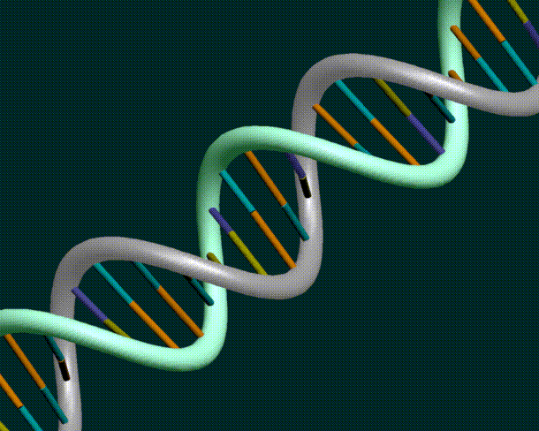
P53 Molecular Policeman

Slide 10
The Cell Cycle
cycle is an ordered series of events consisting of several sequential phases: G₁, S, G₂ and M .M is the phase of mitosis
S is the phase of DNA synthesis
G₁ is the gap between the mitosis that gave rise to the cell and the S phase; during G₁, the cell is preparing for DNA synthesis
G₂ is the gap between S phase and the mitosis that will give rise to two daughter cells; during G₂, the cell is preparing for the mitotic division into two daughter cells.

Slide 11
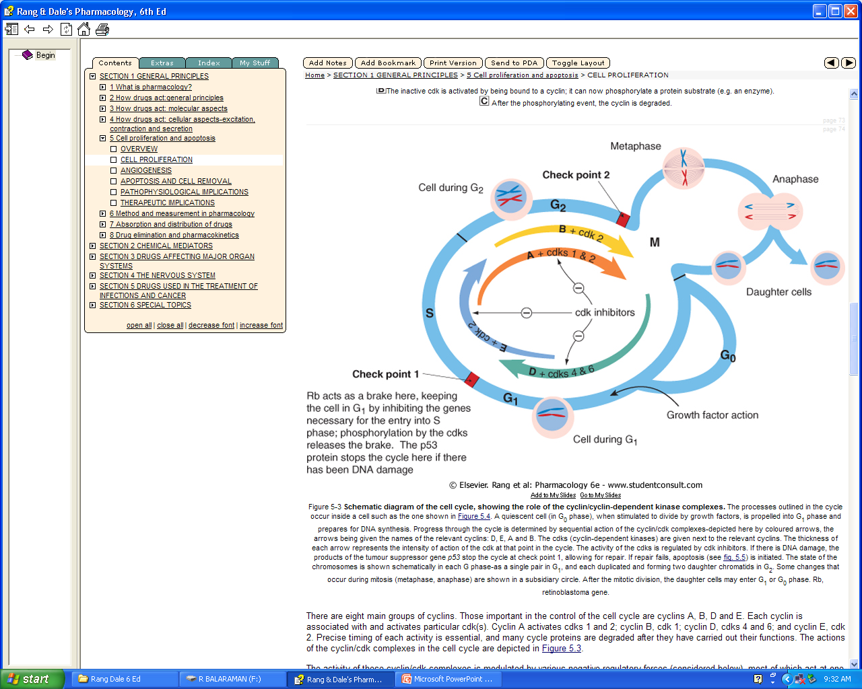

Slide 13
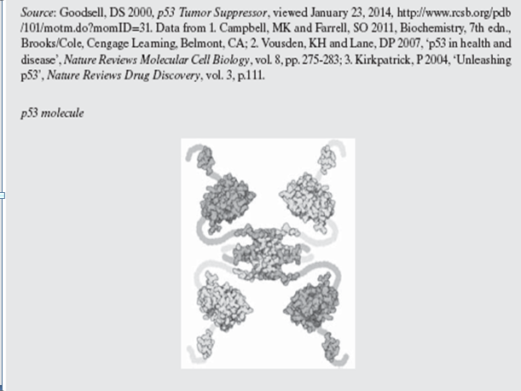

Slide 14
CELL PROLIFERATION
None Cell proliferation is involved in many physiological and pathological processes including growth, healing, repair, hypertrophy, hyperplasia and the development of tumours. Angiogenesis (the development of new blood vessels) necessarily occurs during many of these processes. The cell cycle . The term cell cycle refers to the sequence of events that take place within a cell as it tools up for division. The phases of the cell cycle are
G₁-preparation for DNAsynthesis
S-DNA synthesis
G₂-preparation for division
M-mitosis-division into two daughter cells.
Growth factor action stimulates a quiescent cell-said to be in G₀ (G nought)-to divide, i.e. to start on G₁ phase.
In G₀ phase, a hypophosphorylated protein, coded for by the Rb gene, holds the cycle in check by inhibiting expression of critical factors necessary for DNA replication.
Progress through the cycle is controlled by specific kinases (cyclin-dependent kinases, cdks) that are activated by binding to proteins termed cyclins.
Four main cyclin/cdk complexes involving cyclins D, E, A and B drive the cycle; the first complex, cyclin D/cdk, releases the Rb protein-mediated inhibition.
Various families of proteins act as cdk inhibitors. Important is protein p21, which is expressed when DNA damage causes transcription of gene p53. The p21 protein stops the cycle at check point 1.

Slide 15
THE SPECIAL CHARACTERISTICS OF CANCER CELLS UNCONTROLLED PROLIFERATION
Some healthy cells (such as neurons) have little or no capacity to divide and proliferate, whereas others, in the bone marrow and the epithelium of the gastrointestinal tract for example, have the property of continuous rapid division. Some cancer cells multiply slowly (e.g. those in plasma cell tumours) and some much more rapidly (e.g. the cells of Burkitt's lymphoma). It is therefore not generally true that cancer cells proliferate faster than normal cells. The significant issue is that cancer cells have escaped from the mechanisms that normally regulate cell division and tissue growth. It is this, rather than their rate of proliferation, that distinguishes them from normal cells. Body What are the changes that lead to the uncontrolled proliferation of tumour cells? Inactivation of tumour suppressor genes or transformation of proto-oncogenes into oncogenes can confer autonomy of growth on a cell and thus result in uncontrolled proliferation by producing changes in several cellular systems , including:

Slide 16
growth factors, their receptors and signalling pathways
the cell cycle transducers, for example cyclins, cyclin-dependent kinases (cdks) or the cdk inhibitors
the apoptotic machinery that normally disposes of abnormal cells
telomerase expression
local blood vessels, resulting from tumour-directed angiogenesis.

Slide 17
Telomere

Slide 18
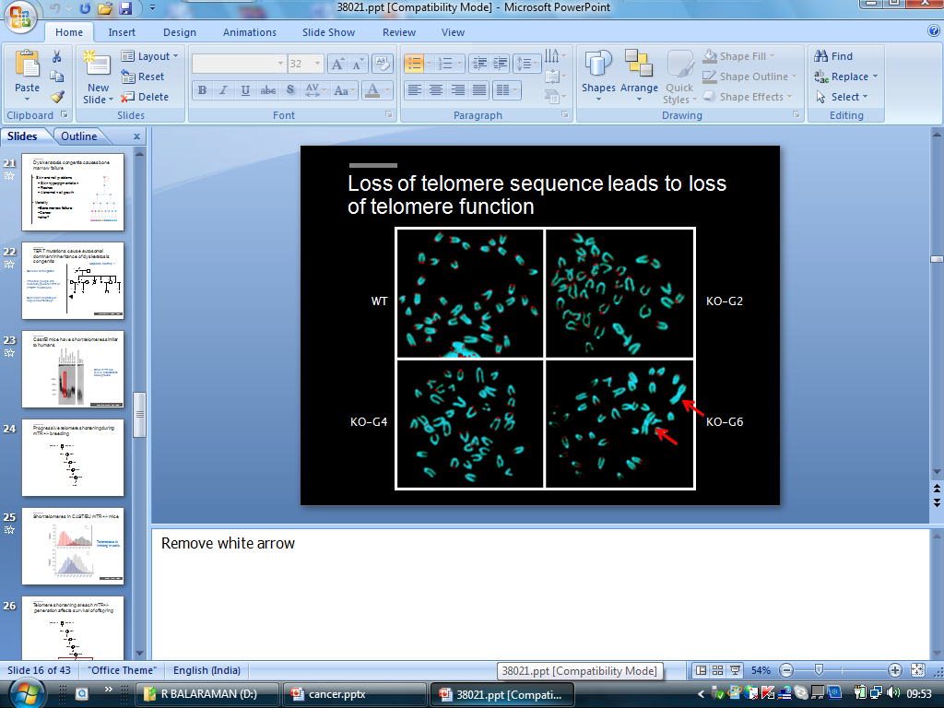

Slide 19
Potentially all the genes coding for the above components could be regarded as oncogenes or tumour suppressor genes although not all are equally prone to malignant transformation. It should be understood that malignant transformation of several components is needed for the development of cancer

Slide 20
Apoptosis and the genesis of a cancer cell Body:
Apoptosis is programmed cell death and genetic mutations in the antiapoptotic genes are usually a prerequisite for cancer; indeed, resistance to apoptosis is a hallmark of the disease. It can be brought about by inactivation of proapoptotic factors or by activation of antiapoptotic factors.
Telomerase expression :
Telomeres are specialised structures that cap the ends of chromosomes-like the small metal tubes on the end of shoelaces-protecting them from degradation, rearrangement and fusion with other chromosomes. Put simply, DNA polymerase cannot easily duplicate the last few nucleotides at the ends of DNA, and telomeres prevent loss of the 'end' genes. With each round of cell division, a portion of the telomere is eroded, so that eventually it becomes non-functional. At this point, DNA replication ceases and the cell becomes senescent. Rapidly dividing cells, such as stem cells and those of the bone marrow, the germline, and the epithelium of the gastrointestinal tract, express telomerase, an enzyme that maintains and stabilises telomeres. While it is absent from most fully differentiated somatic cells, about 95% of late-stage malignant tumours do express the enzyme, and it is this that may confer 'immortality' on cancer cells.

Slide 21
The control of tumour-related blood vessels Body.
The factors described above lead to the uncontrolled proliferation of individual cancer cells, but we also need to consider factors that influence the total tumour mass. The actual growth of a solid tumour depends absolutely on the development of its own blood supply. Tumours 1-2 mm in diameter can obtain nutrients by diffusion, but any further expansion requires angiogenesis, the development of new blood vessels .Angiogenesis occurs in response to growth factors produced by the growing tumor.

Slide 22
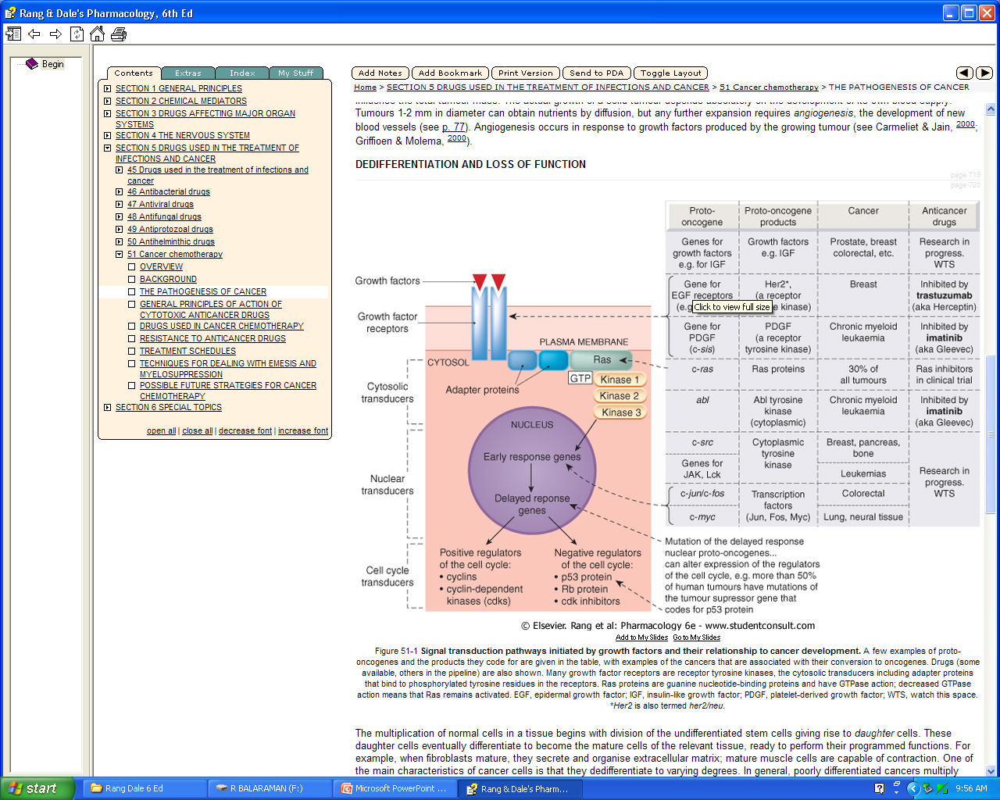

Slide 23
INVASIVENESS Body
Normal cells are not found outside their 'designated' tissue of origin; for example, liver cells are not found in the bladder and pancreatic cells are not found in the testis. This is because, during differentiation and tissue or organ growth, normal cells develop certain spatial relationships with respect to each other. These relationships are maintained by various tissue-specific survival factors that prevent apoptosis In this way, any cells that escape accidentally lose these survival signals and die. Consequently, although the cells of the normal mucosal epithelium of the rectum proliferate continuously as the lining is shed, they remain as a lining epithelium. A cancer of the rectal mucosa, by comparison, invades other tissues forming the rectum and may even invade the tissues of other pelvic organs. Cancer cells have not only lost, through mutation, the restraints that act on normal cells, but they also secrete enzymes (e.g. metalloproteinases; ) that break down the extracellular matrix, enabling them to move around.

Slide 24
METASTASES :Metastases are secondary tumours formed by cells that have been released from the initial or primary tumour and have reached other sites through blood vessels or lymphatics, or as a result of being shed into body cavities. Metastases are the principal cause of mortality and morbidity in most cancers and constitute a major problem for cancer therapy.

Slide 25
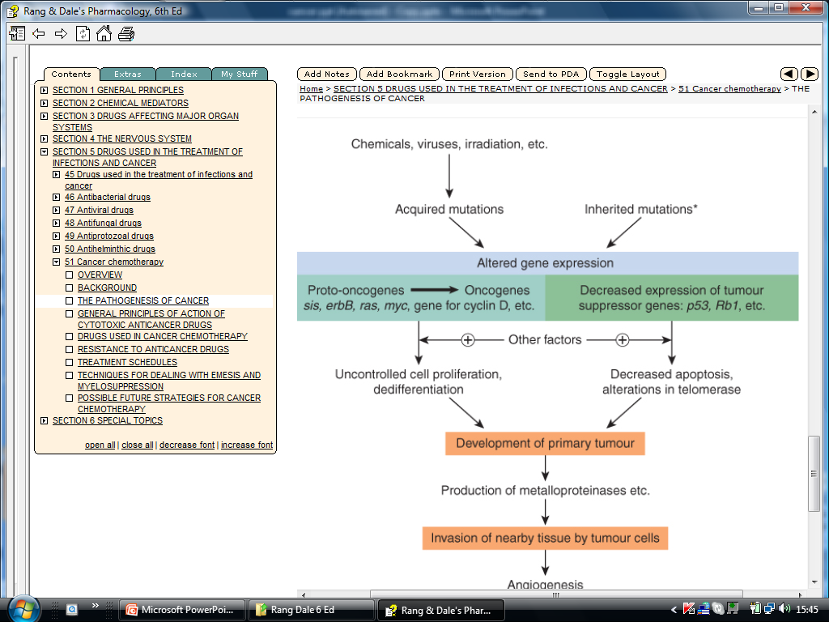
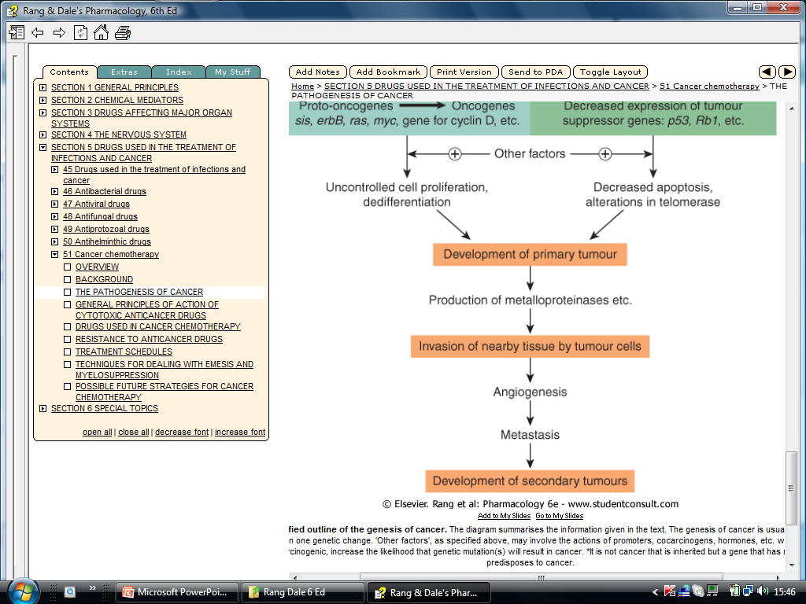

Slide 26
Secondary tumours occur more frequently in some tissues than in others. For example, metastases of mammary cancers are often found in lung, bone and brain. The reason for this is that breast cancer cells express chemokine receptors such as CXR4 on their surfaces, and chemokines that recognise these receptors are expressed at high level in these tissues but not in others (e.g. kidney), facilitating the selective accumulation of cells at these sites.

Slide 27
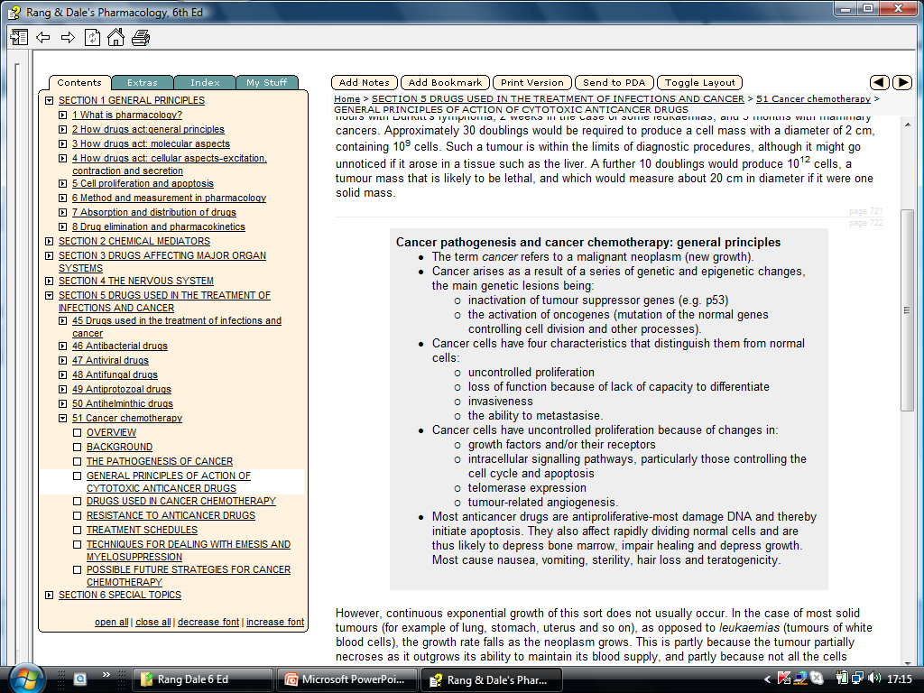

Slide 28
However, continuous exponential growth of this sort does not usually occur. In the case of most solid tumours (for example of lung, stomach, uterus and so on), as opposed to leukaemias (tumours of white blood cells), the growth rate falls as the neoplasm grows. This is partly because the tumour partially necroses as it outgrows its ability to maintain its blood supply, and partly because not all the cells proliferate continuously. The cells of a solid tumour can be considered as belonging to three compartments:
compartment A consists of dividing cells, possibly being continuously in cell cycle
compartment B consists of resting cells (G₀ phase) which, although not dividing, are potentially able to do so
compartment C consists of cells that are no longer able to divide but which contribute to the tumour volume.
None Essentially, only cells in compartment A, which may form as little as 5% of some solid tumours, are susceptible to the main current cytotoxic drugs, as is explained below. The cells in compartment C do not constitute a problem, but it is the existence of compartment B that makes cancer chemotherapy difficult, because these cells are not very sensitive to cytotoxic drugs and are liable to re-enter compartment A following chemotherapy.

Slide 29
Most current anticancer drugs, particularly those that are 'cytotoxic', affect only one characteristic aspect of cancer cell biology-cell division-but have no specific inhibitory effect on invasiveness, the loss of differentiation, or the tendency to metastasise. In many cases, the antiproliferative action results from an action during S phase of the cell cycle, and the resultant damage to DNA initiates apoptosis . Furthermore, because their main target is cell division, they will affect all rapidly dividing normal tissues, and thus they are likely to produce, to a greater or lesser extent, the following general toxic effects: bone marrow toxicity (myelosuppression) with decreased leucocyte production and thus decreased resistance to infection
impaired wound healing
loss of hair (alopecia)
damage to gastrointestinal epithelium
depression of growth in children
sterility
teratogenicity.

Slide 30
DRUGS USED IN CANCER CHEMOTHERAPY The main anticancer drugs can be divided into the following general categories.
Cytotoxic drugs. The mechanism of action of these drugs is discussed more fully below and summarised in they include:
alkylating agents and related compounds, which act by forming covalent bonds with DNA and thus impeding replication
antimetabolites, which block or subvert one or more of the metabolic pathways involved in DNA synthesis
cytotoxic antibiotics, i.e. substances of microbial origin that prevent mammalian cell division
plant derivatives (vinca alkaloids, taxanes, campothecins) -most of these specifically affect microtubule function and hence the formation of the mitotic spindle.
Hormones, of which the most important are steroids, namely glucocorticoids, oestrogens and androgens, as well as drugs that suppress hormone secretion or antagonise hormone action.
Miscellaneous agents that do not fit into the above categories. This group includes a number of recently developed drugs designed to affect specific tumour-related targets.

Slide 31
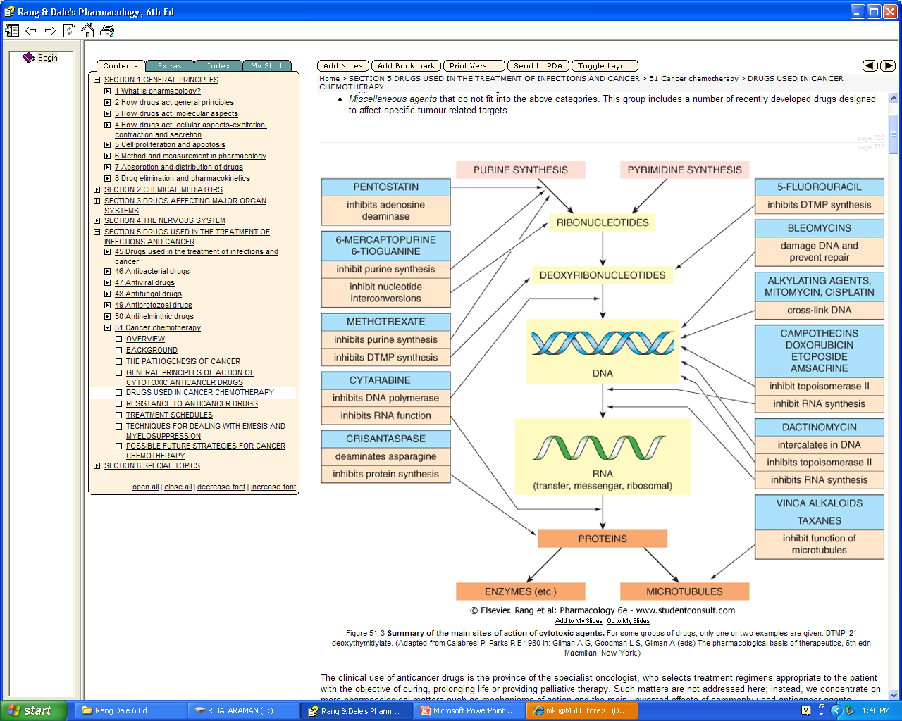

Slide 32
Alkylating Agents
As a class, the alkylating agents exert their cytotoxic effects via transfer of their alkyl groups to various cellular constituents. Alkylations of DNA within the nucleus probably represent the major interactions that lead to cell death. However, these drugs react chemically with sulfhydryl, amino, hydroxyl, carboxyl, and phosphate groups of other cellular nucleophiles as well. The general mechanism of action of these drugs involves intramolecular cyclization to form an ethyleneimonium ion that may directly or through formation of a carbonium ion transfer an alkyl group to a cellular constituent. In addition to alkylation, a secondary mechanism that occurs with nitrosoureas involves carbamoylation of lysine residues of proteins through formation of isocyanates.The major site of alkylation within DNA is the N7 position of guanine
However, other bases are also alkylated to lesser degrees, including N1 and N3 of adenine, N3 of cytosine, and O6 of guanine, as well as phosphate atoms and proteins associated with DNA. These interactions can occur on a single strand or on both strands of DNA through cross-linking, as most major alkylating agents are bifunctional, with two reactive groups. Alkylation of guanine can result in miscoding through abnormal base pairing with thymine or in depurination by excision of guanine residues. The latter effect leads to DNA strand breakage through scission of the sugar-phosphate backbone of DNA. Cross-linking of DNA appears to be of major importance to the cytotoxic action of alkylating agents, and replicating cells are most susceptible to these drugs. Thus, although alkylating agents are not cell cycle-specific, cells are most susceptible to alkylation in late G₁ and S phases of the cell cycle and express block in G₂.

Slide 33
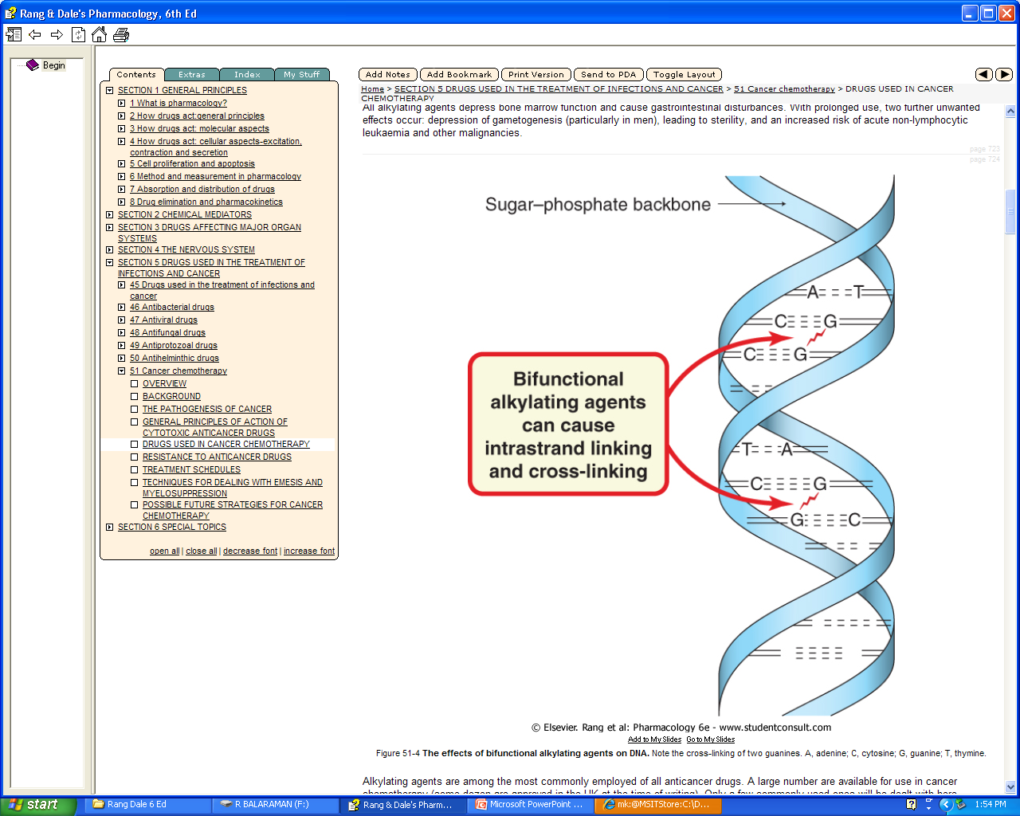

Slide 34
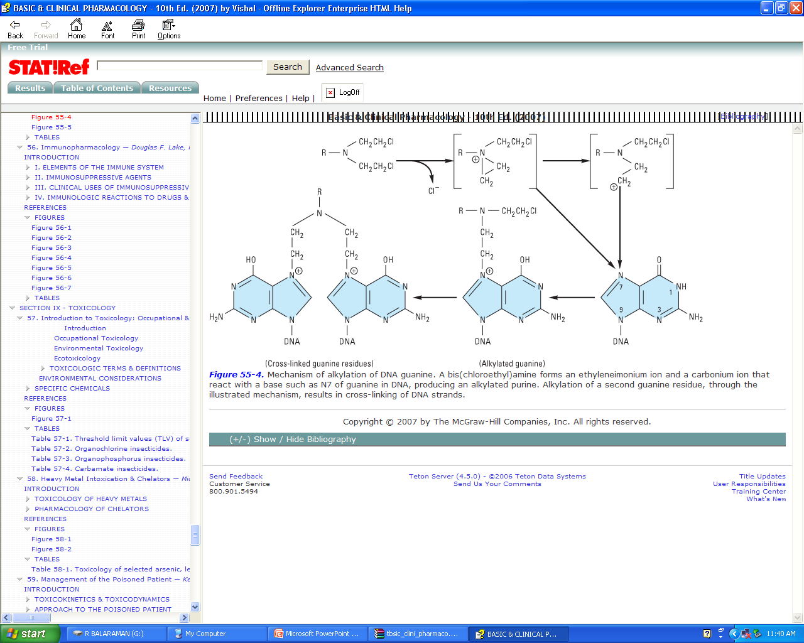

Slide 35
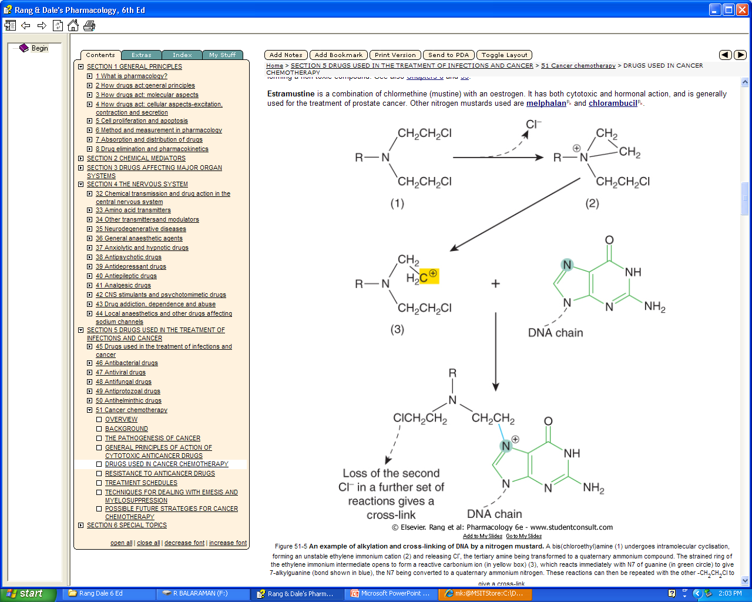

Slide 36
Alkylating agents are among the most commonly employed of all anticancer drugs. A large number are available for use in cancer chemotherapy (some dozen are approved in the UK at the time of writing). Only a few commonly used ones will be dealt with here.
Nitrogen mustards: Nitrogen mustards are related to the 'mustard gas' used during the First World War; their basic formula (R-N-bis-(2-chloroethyl)) is shown in Figure . In the body, each 2-chloroethyl side-chain undergoes an intramolecular cyclisation with the release of a Cl⁻. The highly reactive ethylene immonium derivative so formed can interact with DNA and other molecules. Cyclophosphamide is probably the most commonly used alkylating agent. It is inactive until metabolised in the liver by the P450 mixed function oxidases . It has a pronounced effect on lymphocytes and can also be used as an immunosuppressant . It is usually given orally or by intravenous injection but may also be given intramuscularly. Important toxic effects are nausea and vomiting, bone marrow depression and haemorrhagic cystitis. This last effect (which also occurs with the related drug ifosfamide) is caused by the metabolite acrolein and can be ameliorated by increasing fluid intake and administering compounds that are sulfhydryl donors, such as N-acetylcysteine or mesna (sodium-2-mercaptoethane sulfonate). These agents interact specifically with acrolein, forming a non-toxic compound. Estramustine is a combination of chlormethine (mustine) with an oestrogen. It has both cytotoxic and hormonal action, and is generally used for the treatment of prostate cancer. Other nitrogen mustards used are melphalan and chlorambucil

Slide 37
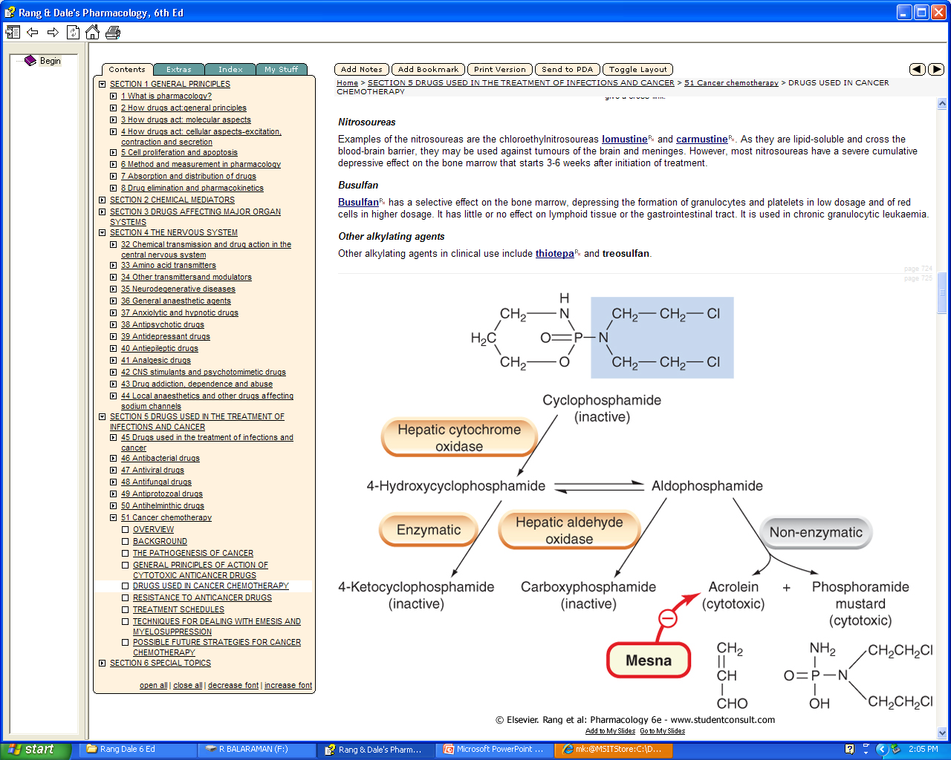

Slide 38
Anticancer drugs: alkylating agents and related compounds :
Alkylating agents have groups that form covalent bonds with cell substituents; a carbonium ion is the reactive intermediate. Most have two alkylating groups and can cross-link two nucleophilic sites such as the N7 of guanine in DNA. Cross-linking can cause defective replication through pairing of alkylguanine and thymine, leading to substitution of AT for GC, or it can cause excision of guanine and chain breakage.
Their principal effect occurs during DNA synthesis and the resulting damage triggers apoptosis.
Unwanted effects include myelosuppression, sterility and risk of non-lymphocytic leukaemia.
The main alkylating agents are:
  nitrogen mustards, for example cyclophosphamide, which is activated to give aldophosphamide, then converted to phosphoramide mustard (the cytotoxic molecule) and acrolein (which causes bladder damage that can be ameliorated by mesna). Cyclophosphamide myelosuppression affects particularly the lymphocytes.
  nitrosoureas, for example lomustine, may act on non-dividing cells, can cross the blood-brain barrier, and cause delayed, cumulative myelotoxicity.
Cisplatin causes intrastrand linking in DNA. It has low myelotoxicity but causes severe nausea and vomiting, and can be nephrotoxic. It has revolutionised the treatment of germ cell tumours.

Slide 39
Platinum compounds
Cisplatin is a water-soluble planar coordination complex containing a central platinum atom surrounded by two chlorine atoms and two ammonia groups. Its action is analogous to that of the alkylating agents. When it enters the cell, Cl⁻ dissociates, leaving a reactive complex that reacts with water and then interacts with DNA. It causes intrastrand cross-linking, probably between N7 and O6 of adjacent guanine molecules, which results in local denaturation of DNA.
Cisplatin has revolutionised the treatment of solid tumours of the testes and ovary. Therapeutically, it is given by slow intravenous injection or infusion. It is seriously nephrotoxic, and strict regimens of hydration and diuresis must be instituted. It has low myelotoxicity but causes very severe nausea and vomiting. The 5-HT₃ receptor antagonists (e.g. ondansetron; ) are very effective in preventing this and have transformed cisplatin-based chemotherapy. Tinnitus and hearing loss in the high-frequency range may occur, as may peripheral neuropathies, hyperuricaemia and anaphylactic reactions.
Carboplatin is a derivative of cisplatin. Because it causes less nephrotoxicity, neurotoxicity, ototoxicity, nausea and vomiting than cisplatin (although it is more myelotoxic), it is sometimes given on an outpatient basis.
Oxaliplatin is another platinum-containing compound with a restricted application.
Dacarbazine, a prodrug, is activated in the liver, and the resulting compound is subsequently cleaved in the target cell to release an alkylating derivative. Unwanted effects include myelotoxicity and severe nausea and vomiting. Temozolimide is a related compound with a restricted usage (malignant glioma

Slide 40
Folate antagonists :
The main folate antagonist is methotrexate, one of the most widely used antimetabolites in cancer chemotherapy. Folates are essential for the synthesis of purine nucleotides and thymidylate, which in turn are essential for DNA synthesis and cell division. The main action of the folate antagonists is to interfere with thymidylate synthesis. In structure, folates consist of three elements: a pteridine ring, p-aminobenzoic acid and glutamic acid Folates are actively taken up into cells, where they are converted to polyglutamates. In order to act as coenzymes, folates must be reduced to tetrahydrofolate (FH₄). This two-step reaction is catalysed by dihydrofolate reductase, which converts the substrate first to dihydrofolate (FH₂), then to FH₄ FH₄ functions as an essential cofactor carrying the methyl groups necessary for the transformation of 2´-deoxyuridylate (DUMP) to the 2´-deoxythymidylate (DTMP) required for the synthesis of DNA and purines. During the formation of DTMP from DUMP, FH₄ is converted back to FH₂, enabling the cycle to repeat. Methotrexate has a higher affinity than FH₂ for dihydrofolate reductase and thus inhibits the enzyme , depleting intracellular FH₄. The binding of methotrexate to dihydrofolate reductase involves an additional bond not present when FH₂ binds. The reaction most sensitive to FH₄ depletion is DTMP formation

Slide 41
Methotrexate is usually given orally but can also be given intramuscularly, intravenously or intrathecally. The drug has low lipid solubility and thus does not readily cross the blood-brain barrier. It is, however, actively taken up into cells by the folate transport system and is metabolised to polyglutamate derivatives, which are retained in the cell for weeks (or even months in some cases) in the absence of extracellular drug. Resistance to methotrexate may develop in tumour cells by a variety of mechanisms
Unwanted effects include depression of the bone marrow and damage to the epithelium of the gastrointestinal tract. Pneumonitis can occur. In addition, when high-dose regimens are used, there may be nephrotoxicity caused by precipitation of the drug or a metabolite in the renal tubules. High-dose regimens (doses 10 times greater than the standard doses), sometimes used in patients with methotrexate resistance, must be followed by 'rescue' with folinic acid (a form of FH₄).

Slide 42
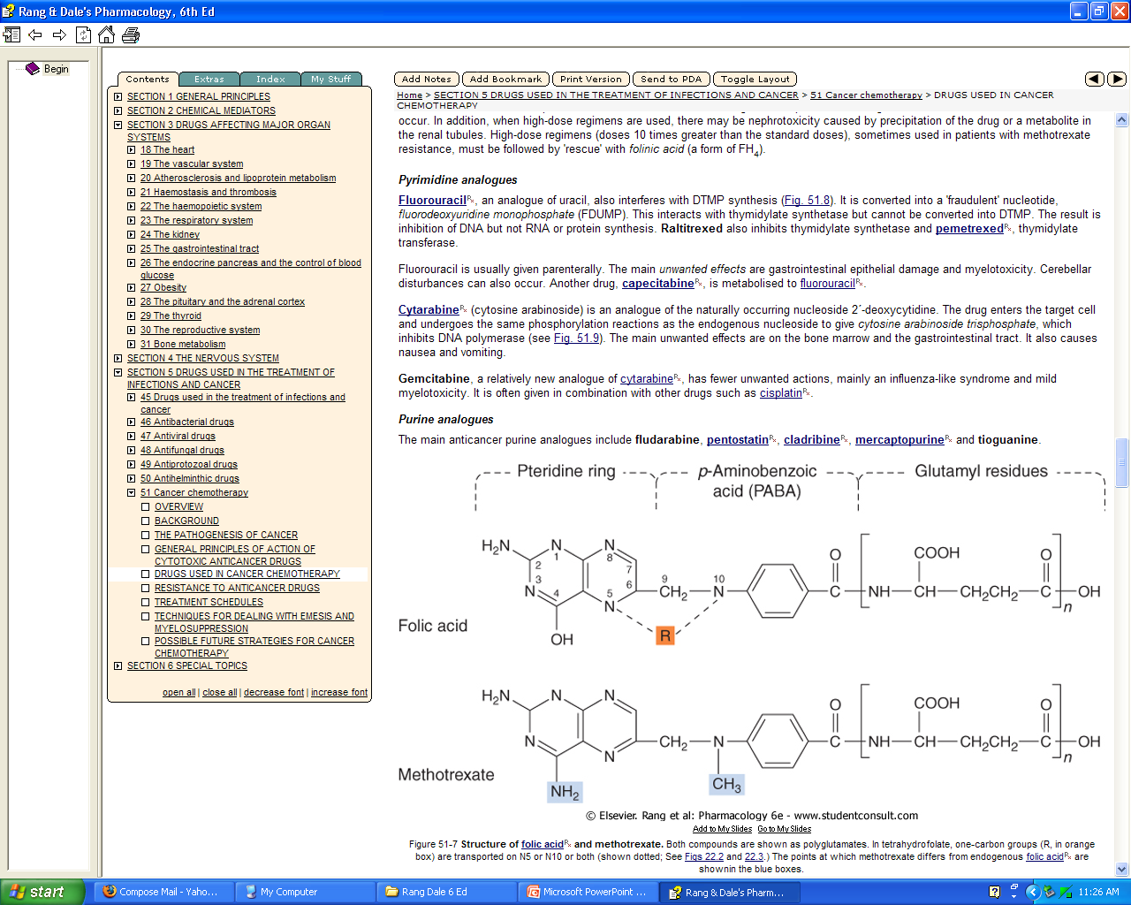

Slide 43
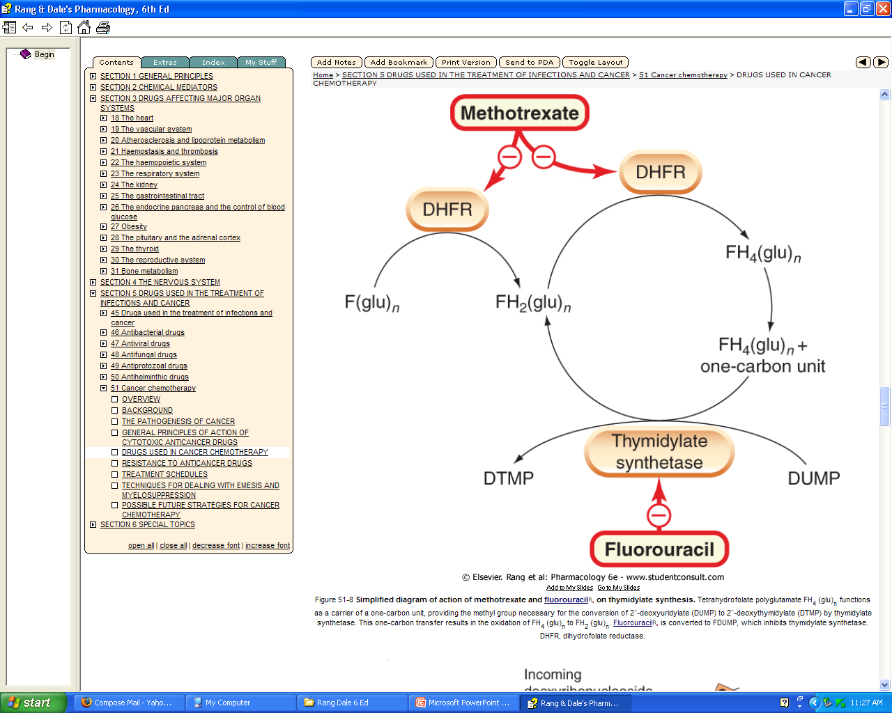

Slide 44
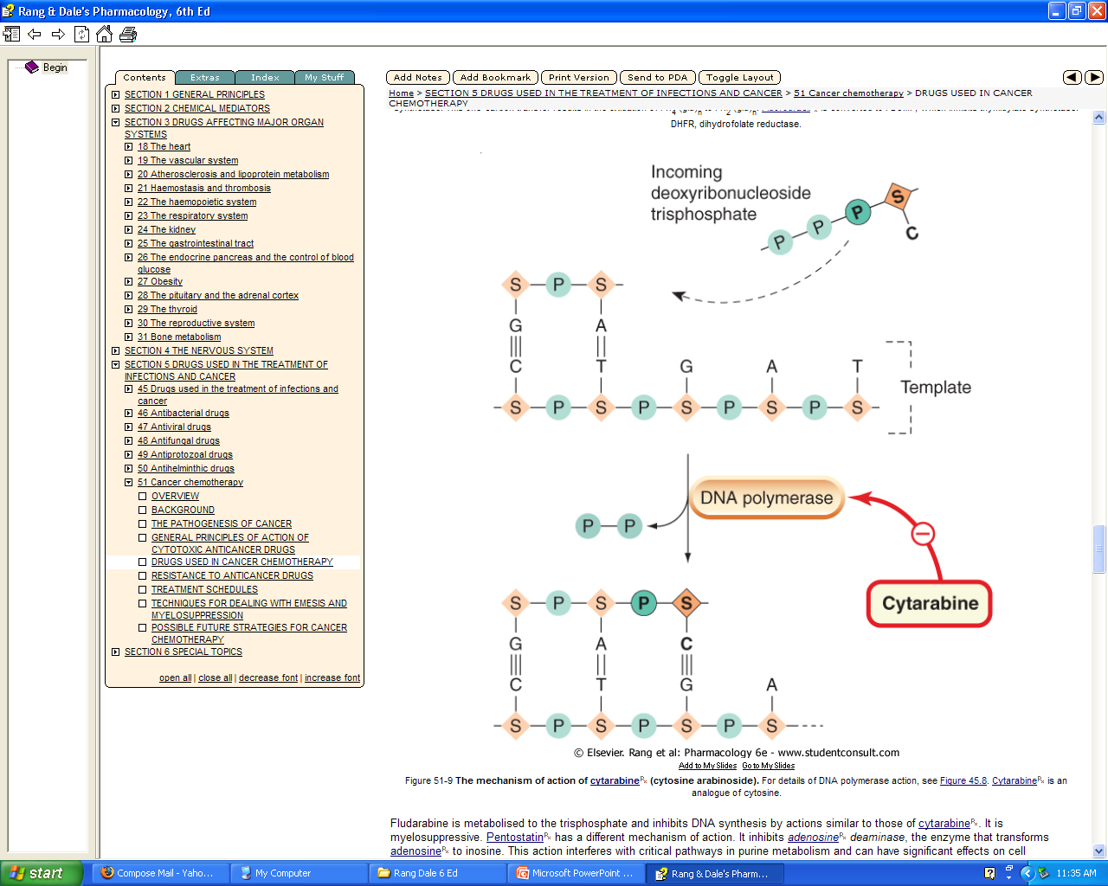

Slide 45
ANTIMETABOLITES:
Folate The main folate antagonist is methotrexate, one of the most widely used anantagonists timetabolites in cancer chemotherapy. Folates are essential for the synthesis of purine nucleotides and thymidylate, which in turn are essential for DNA synthesis and cell division .The main action of the folate antagonists is to interfere with thymidylate synthesis. In structure, folates consist of three elements: a pteridine ring, p-aminobenzoic acid and glutamic acid .Folates are actively taken up into cells, where they are converted to polyglutamates. In order to act as coenzymes, folates must be reduced to tetrahydrofolate (FH₄). This two-step reaction is catalysed by dihydrofolate reductase, which converts the substrate first to dihydrofolate (FH₂), then to FH₄ .FH₄ functions as an essential cofactor carrying the methyl groups necessary for the transformation of 2´-deoxyuridylate (DUMP) to the 2´-deoxythymidylate (DTMP) required for the synthesis of DNA and purines. During the formation of DTMP from DUMP, FH₄ is converted back to FH₂, enabling the cycle to repeat. Methotrexate has a higher affinity than FH₂ for dihydrofolate reductase and thus inhibits the enzyme .depleting intracellular FH₄. The binding of methotrexate to dihydrofolate reductase involves an additional bond not present when FH₂ binds. The reaction most sensitive to FH₄ depletion is DTMP formation

Slide 46
Methotrexate is usually given orally but can also be given intramuscularly, intravenously or intrathecally. The drug has low lipid solubility and thus does not readily cross the blood-brain barrier. It is, however, actively taken up into cells by the folate transport system and is metabolised to polyglutamate derivatives, which are retained in the cell for weeks (or even months in some cases) in the absence of extracellular drug. Resistance to methotrexate may develop in tumour cells by a variety of mechanisms .Unwanted effects include depression of the bone marrow and damage to the epithelium of the gastrointestinal tract. Pneumonitis can occur. In addition, when high-dose regimens are used, there may be nephrotoxicity caused by precipitation of the drug or a metabolite in the renal tubules. High-dose regimens (doses 10 times greater than the standard doses), sometimes used in patients with methotrexate resistance, must be followed by 'rescue' with folinic acid (a form of FH₄).

Slide 47
Pyrimidine analogues
Fluorouracil, an analogue of uracil, also interferes with DTMP synthesis. It is converted into a 'fraudulent' nucleotide, fluorodeoxyuridine monophosphate (FDUMP). This interacts with thymidylate synthetase but cannot be converted into DTMP. The result is inhibition of DNA but not RNA or protein synthesis. Raltitrexed also inhibits thymidylate synthetase and pemetrexed, thymidylate transferase. Fluorouracil is usually given parenterally. The main unwanted effects are gastrointestinal epithelial damage and myelotoxicity. Cerebellar disturbances can also occur. Another drug, capecitabine, is metabolised to fluorouracil. Cytarabine (cytosine arabinoside) is an analogue of the naturally occurring nucleoside 2´-deoxycytidine. The drug enters the target cell and undergoes the same phosphorylation reactions as the endogenous nucleoside to give cytosine arabinoside trisphosphate, which inhibits DNA polymerase The main unwanted effects are on the bone marrow and the gastrointestinal tract. It also causes nausea and vomiting. Gemcitabine, a relatively new analogue of cytarabine, has fewer unwanted actions, mainly an influenza-like syndrome and mild myelotoxicity. It is often given in combination with other drugs such as cisplatin.

Slide 48
Purine analogues
The main anticancer purine analogues include fludarabine, pentostatin, cladribine, mercaptopurine and tioguanine .Fludarabine is metabolised to the trisphosphate and inhibits DNA synthesis by actions similar to those of cytarabine. It is myelosuppressive. Pentostatin has a different mechanism of action. It inhibits adenosine deaminase, the enzyme that transforms adenosine to inosine. This action interferes with critical pathways in purine metabolism and can have significant effects on cell proliferation. Cladribine, mercaptopurine and tioguanine are used mainly in the treatment of leukaemia
Anticancer drugs: antimetabolites
Antimetabolites block or subvert pathways of DNA synthesis. Folate antagonists. Methotrexate inhibits dihydrofolate reductase, preventing generation of tetrahydrofolate interfering with thymidylate synthesis. Methotrexate is taken up into cells by the folate carrier and, like folate, is converted to the polyglutamate form. Normal cells affected by high doses can be 'rescued' by folinic acid. Unwanted effects are myelosuppression and possible nephrotoxicity.
Pyrimidine analogues. Fluorouracil is converted to a 'fraudulent' nucleotide and inhibits thymidylate synthesis. Cytarabine in its trisphosphate form inhibits DNA polymerase. They are potent myelosuppressives.
Purine analogues. Mercaptopurine is converted into fraudulent nucleotide. Fludarabine in its trisphosphate form inhibits DNA polymerase and is myelosuppressive. Pentostatin inhibits adenosine deaminase-a critical pathway in purine metabolism

Slide 49
CYTOTOXIC ANTIBIOTICS (ANTHRACYCLINES)
This is a widely used group of drugs that mainly produce their effects through direct action on DNA. As a rule, they should not be given together with radiotherapy, as the cumulative burden of toxicity is very high. The anthracyclines The main anticancer anthracycline antibiotic is doxorubicin. Other related compounds include idarubicin, daunorubicin, epirubicin, aclarubicin, and mitoxantrone (mitozantrone). Doxorubicin has several cytotoxic actions. It binds to DNA and inhibits both DNA and RNA synthesis, but its main cytotoxic action appears to be mediated through an effect on topoisomerase II .the activity of which is markedly increased in proliferating cells. The significance of the enzyme lies in the fact that, during replication of the DNA helix, reversible swivelling needs to take place around the replication fork in order to prevent the daughter DNA molecule becoming inextricably entangled during mitotic segregation. The 'swivel' is produced by topoisomerase II, which nicks both DNA strands and subsequently reseals the breaks. Doxorubicin intercalates in the DNA, and its effect is, in essence, to stabilise the DNA-topoisomerase II complex after the strands have been nicked, thus halting the process at this point.

Slide 50
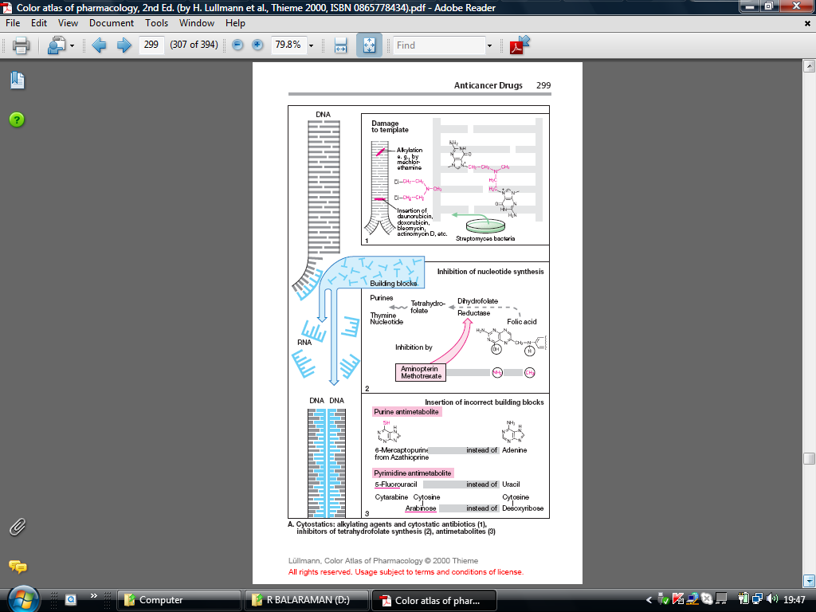

Slide 51
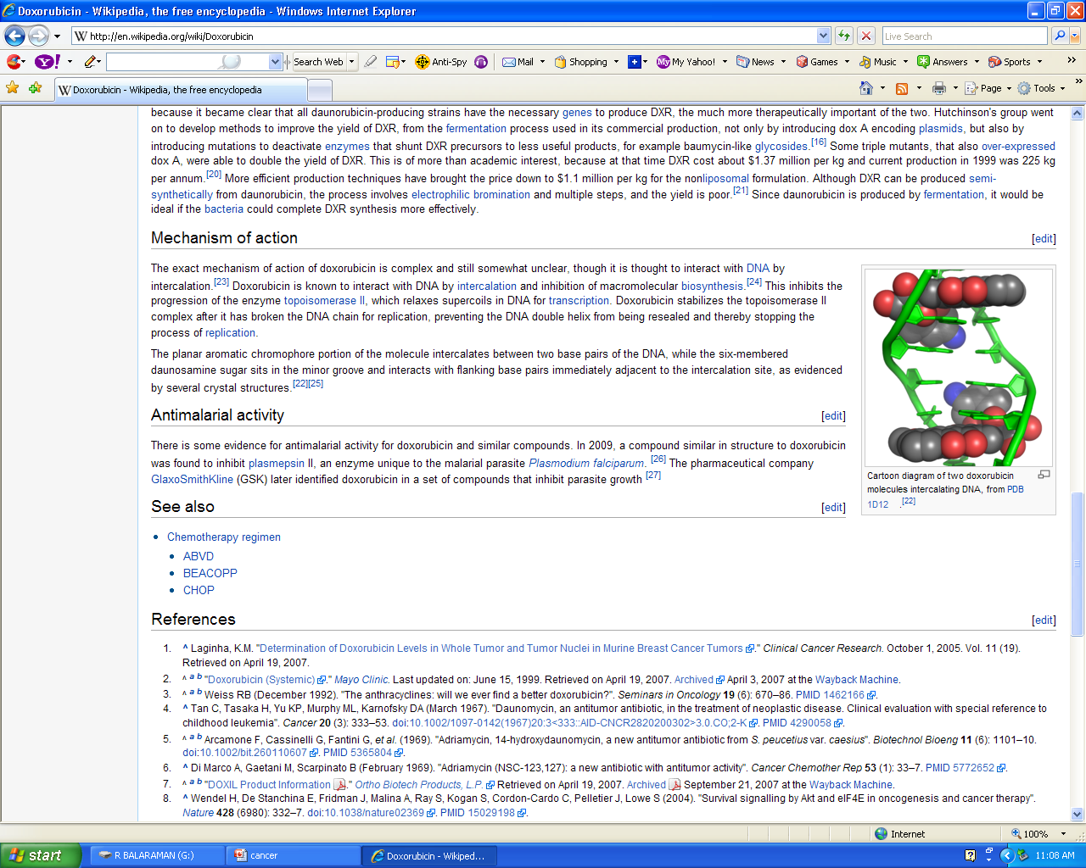

Slide 52
In the clinical setting, anthracyclines are administered via the intravenous route . The anthracyclines are metabolized extensively in the liver, with reduction and hydrolysis of the ring substituents. The hydroxylated metabolite is an active species, whereas the aglycone is inactive. Up to 50% of drug is eliminated in the feces via biliary excretion, and dose reduction is required in the setting of liver dysfunction. Although anthracyclines are usually administered on an every-3-week schedule, alternative schedules such as low-dose weekly or 72-96 hour continuous infusions have been shown to yield equivalent clinical efficacy with reduced overall toxicity.
Doxorubicin is one of the most important anticancer drugs, with major clinical activity in cancers of the breast, endometrium, ovary, testicle, thyroid, stomach, bladder, liver, and lung; in soft tissue sarcomas; and in several childhood cancers, including neuroblastoma, Ewing's sarcoma, osteosarcoma, and rhabdomyosarcoma. It is also widely used in hematologic malignancies, including acute lymphoblastic leukemia, multiple myeloma, and Hodgkin's and non-Hodgkin's lymphomas. It is generally used in combination with other anticancer agents (eg, cyclophosphamide, cisplatin, and 5-FU), and responses and remission duration tend to be improved with combination regimens as opposed to single-agent therapy. Daunorubicin has a far narrower spectrum of activity than doxorubicin. Daunorubicin has been mainly used for the treatment of acute myeloid leukemia, although there has been a shift in clinical practice toward using idarubicin, an analog of daunorubicin. Its efficacy in solid tumors appears to be limited.
Idarubicin is a semisynthetic anthracycline glycoside analog of daunorubicin, and it is approved for use in combination with cytarabine for induction therapy of acute myeloid leukemia. When combined with cytarabine, idarubicin appears to be more active than daunorubicin in producing complete remissions and in improving survival in patients with acute myelogenous leukemia.
Epirubicin is a doxorubicin analog whose mechanism of action is identical to that of all other anthracyclines. It was initially approved for use as a component of adjuvant therapy of early-stage, node-positive breast cancer but is also used for the treatment of metastatic breast cancer and gastric cancer.

Slide 53
Toxicity of ANTHRACYCLINES
The main dose-limiting toxicity of all anthracyclines is myelosuppression, with neutropenia more commonly observed than thrombocytopenia. In some cases, mucositis is dose-limiting. Two forms of cardiotoxicity are observed. The acute form occurs within the first 2-3 days and presents as arrhythmias and conduction abnormalities, other electrocardiographic changes, pericarditis, and myocarditis. This form is usually transient and in most cases is asymptomatic. The chronic form results in a dose-dependent, dilated cardiomyopathy associated with heart failure. The chronic cardiac toxicity appears to result from increased production of free radicals within the myocardium. This effect is rarely seen at total doxorubicin dosages below 500-550 mg/m². Use of lower weekly doses or continuous infusions of doxorubicin appear to reduce the incidence of cardiac toxicity. In addition, treatment with the iron-chelating agent dexrazoxane (ICRF-187) is currently approved to prevent or reduce anthracycline-induced cardiotoxicity in women with metastatic breast cancer who have received a total cumulative dose of doxorubicin of 300 mg/m². The anthracyclines can produce a "radiation recall reaction," with erythema and desquamation of the skin observed at sites of prior radiation therapy.

Slide 54
MITOXANTRONE
Mitoxantrone (dihydroxyanthracenedione, DHAD) is an anthracene compound whose structure resembles the anthracycline ring. It binds to DNA to produce strand breakage and inhibits both DNA and RNA synthesis. It is currently used for treatment of advanced, hormone-refractory prostate cancer and low-grade non-Hodgkin's lymphoma. It is also indicated in breast cancer as well as in pediatric and adult acute myeloid leukemias. The plasma half-life of mitoxantrone in patients is approximately 75 hours, and it is predominantly excreted via the hepatobiliary route in feces. Myelosuppression with leukopenia is the dose-limiting toxicity, and mild nausea and vomiting, mucositis, and alopecia also occur. Although the drug is thought to be less cardiotoxic than doxorubicin, both acute and chronic cardiac toxicity are reported. A blue discoloration of the fingernails, sclera, and urine can be observed up to 1-2 days after drug therapy.

Slide 55
DACTINOMYCIN
Dactinomycin is an antitumor antibiotic isolated from a Streptomyces organism. It binds tightly to double-stranded DNA through intercalation between adjacent guanine-cytosine base pairs and inhibits all forms of DNA-dependent RNA synthesis, with ribosomal RNA formation being most sensitive to drug action.
Dactinomycin is mainly used to treat pediatric tumors such as Wilms' tumor, rhabdomyosarcoma, and Ewing's sarcoma, but it also has activity against germ cell tumors and gestational trophoblastic disease. As with the anthracyclines, dactinomycin can induce a radiation recall reaction for other toxicities.
MITOMYCIN
Mitomycin (mitomycin C) is an antibiotic isolated from Streptomyces caespitosus. It is an alkylating agent that undergoes metabolic activation through an enzyme-mediated reduction to generate an alkylating agent that cross-links DNA. Hypoxic tumor stem cells of solid tumors exist in an environment conducive to reductive reactions and are more sensitive to the cytotoxic actions of mitomycin than normal cells and oxygenated tumor cells. It is active in all phases of the cell cycle, and is the best available drug for use in combination with radiation therapy to attack hypoxic tumor cells. Its main clinical use is in the treatment of squamous cell cancer of the anus in combination with 5-FU and radiation therapy. In addition, it is used in combination chemotherapy for squamous cell carcinoma of the cervix and for breast, gastric, and pancreatic cancer. One special application of mitomycin has been in the intravesical treatment of superficial bladder cancer.
The common toxicities are outlined in The hemolytic-uremic syndrome, manifested as microangiopathic hemolytic anemia, thrombocytopenia, and renal failure, as well as occasional instances of interstitial pneumonitis

Slide 56
BLEOMYCIN
Bleomycin is a small peptide that contains a DNA-binding region and an iron-binding domain at opposite ends of the molecule. It acts by binding to DNA, which results in single-strand and double-strand breaks following free radical formation, and inhibition of DNA biosynthesis. The fragmentation of DNA is due to oxidation of a DNA-bleomycin-Fe(II) complex and leads to chromosomal aberrations. Bleomycin is a cell cycle-specific drug that causes accumulation of cells in the G₂ phase of the cell cycle.
Bleomycin is indicated for the treatment of Hodgkin's and non-Hodgkin's lymphomas, germ cell tumor, head and neck cancer, and squamous cell cancer of the skin, cervix, and vulva. In addition, it can be used as a sclerosing agent for malignant pleural effusions and ascites. One advantage of this agent is that it can be given subcutaneously, intramuscularly, or intravenously .Peak blood levels of bleomycin after intramuscular injection appear within 30-60 minutes. Intravenous injection of similar dosages yields higher peak concentrations and a terminal half-life of about 2.5 hours. Elimination of bleomycin is mainly via renal excretion; dose modification is recommended in the setting of renal dysfunction.
Pulmonary toxicity is dose-limiting for bleomycin and usually presents as pneumonitis with cough, dyspnea, dry inspiratory crackles on physical examination, and infiltrates on chest x-ray. The incidence of pulmonary toxicity is increased in patients older than 70 years of age, in those who receive cumulative doses greater than 400 units, in those with underlying pulmonary disease, and in those who have received prior mediastinal or chest irradiation. In rare cases, pulmonary toxicity can be fatal.

Slide 57
PLANT DERIVATIVES
Several naturally occurring substances exert potent cytotoxic effects and have earned a place in the arsenal of anticancer drugs on that basis.
VINCA ALKALOIDS The vinca alkaloids are derived from the Madagascar periwinkle. The principal members of the group are vincristine, vinblastine and vindesine. Vinorelbine is a semisynthetic vinca alkaloid with similar properties that is mainly used in breast cancer. The drugs bind to tubulin and inhibit its polymerisation into microtubules, preventing spindle formation in dividing cells and causing arrest at metaphase. Their effects become manifest only during mitosis. They also inhibit other cellular activities that involve the microtubules, such as leucocyte phagocytosis and chemotaxis, as well as axonal transport in neurons. The vinca alkaloids are relatively non-toxic. Vincristine has very mild myelosuppressive activity but causes paraesthesias (sensory changes), abdominal pain and muscle weakness fairly frequently. Vinblastine is less neurotoxic but causes leucopenia, while vindesine has both moderate myelotoxicity and neurotoxicity. All members of the group can cause reversible alopecia

Slide 58
Taxanes
Paclitaxel and docetaxel are derived from a naturally occurring compound found in the bark of the yew tree. They act on microtubules, stabilising them (in effect 'freezing' them) in the polymerised state, achieving a similar effect to that of the vinca alkaloids. Paclitaxel is given by intravenous infusion and docetaxel by mouth. Both have a place in the treatment of breast cancer, and paclitaxel, given with carboplatin, is the treatment of choice for ovarian cancer. Unwanted effects, which can be serious, include bone marrow suppression and cumulative neurotoxicity. Resistant fluid retention (particularly oedema of the legs) can occur with docetaxel. Hypersensitivity to both compounds is liable to occur and requires pretreatment with corticosteroids and antihistamines.

Slide 59
Etoposide is derived from mandrake root. Its mode of action is not clearly known, but it may act by inhibiting mitochondrial function and nucleoside transport, as well as having an effect on topoisomerase II similar to that seen with doxorubicin (see above). Unwanted effects include nausea and vomiting, myelosuppression and hair loss.
Campothecins: The campothecins irinotecan and topotecan, isolated from the stem of the tree Camptotheca acuminata, bind to and inhibit topoisomerase I, high levels of which occur throughout the cell cycle. Diarrhoea and reversible bone marrow depression occur but, in general, these alkaloids have fewer unwanted effects than most other anticancer agents.

Slide 60
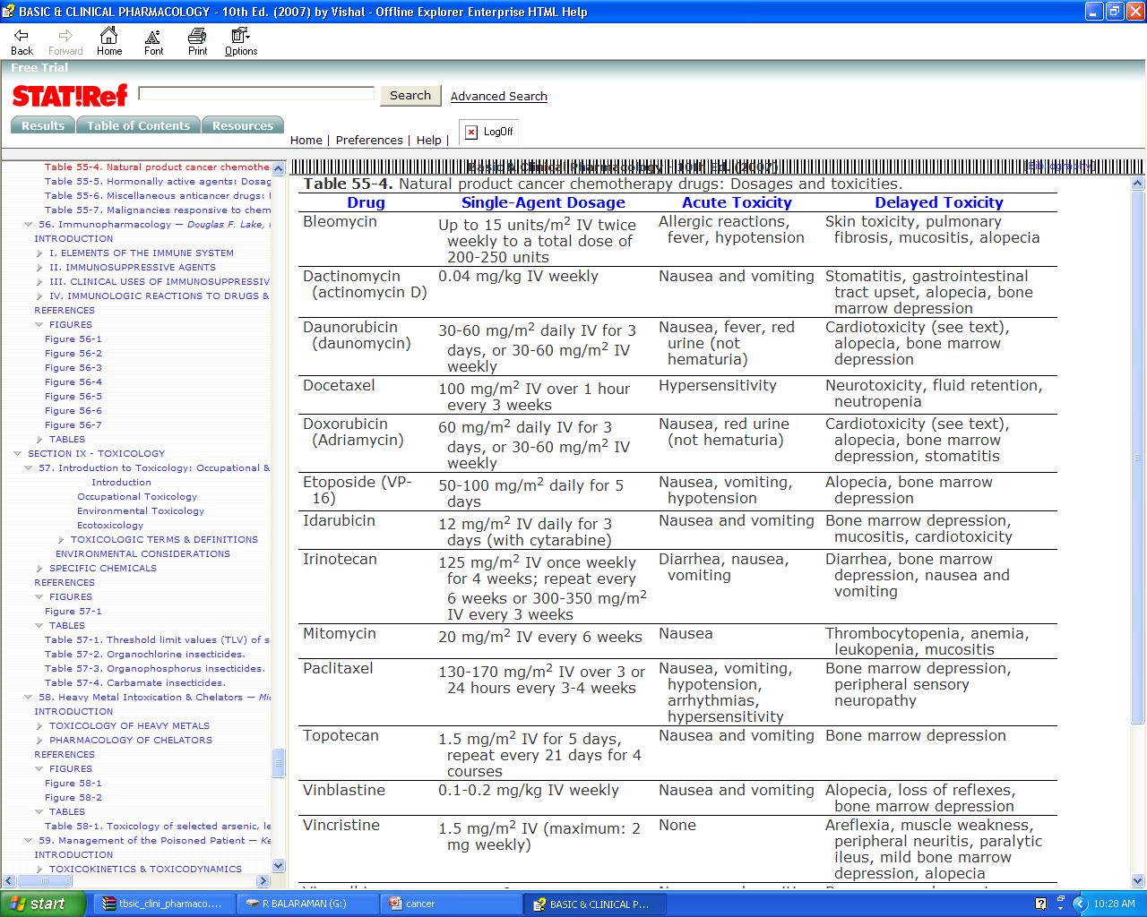

Slide 61
  HORMONAl AGENTS
  ESTROGEN&ANDROGENINHIBITORS
  The antiestrogen tamoxifen has proved to be extremely useful for the treatment of both early-stage and metastatic breast cancer. It is also approved as a chemopreventive agent in women at high risk for breast cancer. In addition, this hormonal agent has activity in endometrial cancer. Tamoxifen functions as a competitive partial agonist-inhibitor of estrogen and binds to the estrogen receptors of estrogen-sensitive tumors. However, tamoxifen has a tenfold lower affinity for the estrogen receptor (ER) than does estradiol, indicating the importance of ablation of endogenous estrogen for optimal antiestrogen effect. In addition to its direct antiestrogen effects on tumor cells, tamoxifen also suppresses serum levels of insulin-like growth factor-1 and up-regulates local production transforming growth factor-beta (TGF-b).
  Tamoxifen is given orally and is rapidly and completely absorbed. High plasma levels of tamoxifen are obtained within 4-6 hours after oral administration, and the agent has a much longer biologic half-life than estradiol¾on the order of 7-14 days. It is extensively metabolized by the liver P450 system, and the main metabolites also possess antitumor activity similar to that of the parent drug. Tamoxifen is well tolerated, and its side effects are generally quite mild (Flutamide and bicalutamide are nonsteroidal antiandrogen agents that bind to the androgen receptor and inhibit androgen effects. They are administered orally and are rapidly and completely absorbed. At present they are used in combination with radiation therapy for the treatment of early-stage prostate cancer and in the setting of metastatic prostate cancer.

Slide 62
GONADOTROPIN-RELEASINGHORMONEAGONISTS
Leuprolide and goserelin are synthetic peptide analogs of naturally occurring gonadotropin-releasing hormone (GnRH, LHRH). When given as depot preparations, these agents lead to a transient release of follicle-stimulating hormone (FSH) and luteinizing hormone (LH) followed by marked inhibition of the release of these gonadotropins. In men, this results in castration levels of testosterone after 2-4 weeks of therapy.
Leuprolide and goserelin are indicated in the treatment of advanced prostate cancer and more recently, these agents have been incorporated as part of neoadjuvant therapy of early-stage prostate cancer. Leuprolide and goserelin are now formulated in long-acting depot forms, which allows for administration at monthly or longer intervals. The main adverse effects include hot flushes, impotence, and gynecomastia

Slide 63
AROMATASEINHIBITORS
Aminoglutethimide is a nonsteroidal inhibitor of corticosteroid synthesis at the first step involving the conversion of cholesterol to pregnenolone Aminoglutethimide also inhibits the extra-adrenal synthesis of estrone and estradiol. Aside from its direct effects on adrenal steroidogenesis, aminoglutethimide is an inhibitor of an aromatase enzyme that converts the adrenal androgen androstenedione to estrone .This aromatization of an androgenic precursor into an estrogen occurs in body fat. Since estrogens promote the growth of breast cancer, estrogen synthesis in adipose tissue can be important in breast cancer growth in postmenopausal women.
Aminoglutethimide is primarily used in the treatment of metastatic breast cancer in women whose tumors express significant levels of estrogen or progesterone receptors. It also has activity in hormone-dependent, advanced prostate cancer. Aminoglutethimide is normally administered with hydrocortisone to prevent symptoms of adrenal insufficiency. Hydrocortisone is preferable to dexamethasone because the latter agent accelerates the rate of catabolism of aminoglutethimide.

Slide 64
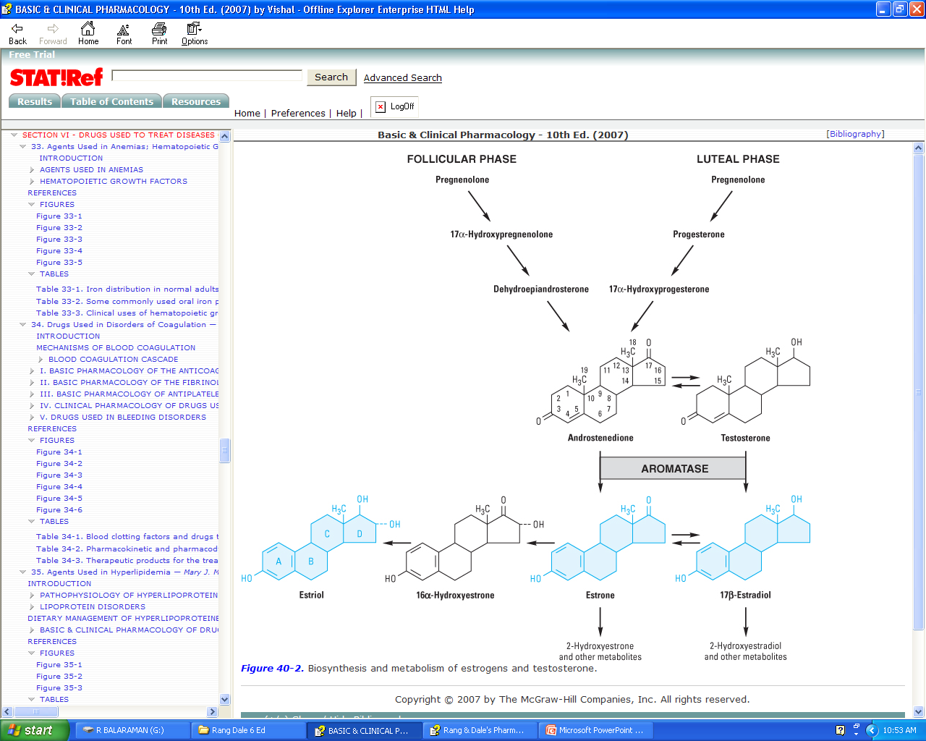

Slide 65
Anastrozole is a selective nonsteroidal inhibitor of aromatase that has no inhibitory effect on adrenal glucocorticoid or mineralocorticoid synthesis. It is presently approved for first-line treatment of postmenopausal women with metastatic breast cancer that is ER-positive, for treatment of postmenopausal women with metastatic breast cancer that is ER-positive and has progressed while on tamoxifen therapy, and as adjuvant therapy of postmenopausal women with hormone-positive, early-stage breast cancer. Letrozole is a nonsteroidal competitive inhibitor of aromatase that is significantly more potent than aminoglutethimide and acts in the same way as anastrozole. It is also indicated for first-line treatment of postmenopausal women with hormone receptor-positive metastatic breast cancer and for second-line treatment of postmenopausal women with advanced breast cancer after progression on tamoxifen therapy. Exemestane is a steroid hormonal suicide inhibitor that binds to and irreversibly inactivates aromatase. There appears to be a lack of cross-resistance between exemestane and nonsteroidal aromatase inhibitors. This agent is indicated for the treatment of advanced breast cancer in postmenopausal women whose disease has progressed on tamoxifen therapy. Each of these aromatase inhibitors exhibits a similar side effect profile

Slide 66
Glucocorticoids Glucocorticoids such as prednisolone and dexamethasone have marked inhibitory effects on lymphocyte proliferation used in the treatment of leukaemias and lymphomas. Their ability to lower raised intracranial pressure, and to mitigate some of the side effects of anticancer drugs, makes them useful as supportive therapy when treating other cancers, as well as in palliative care.

Slide 67
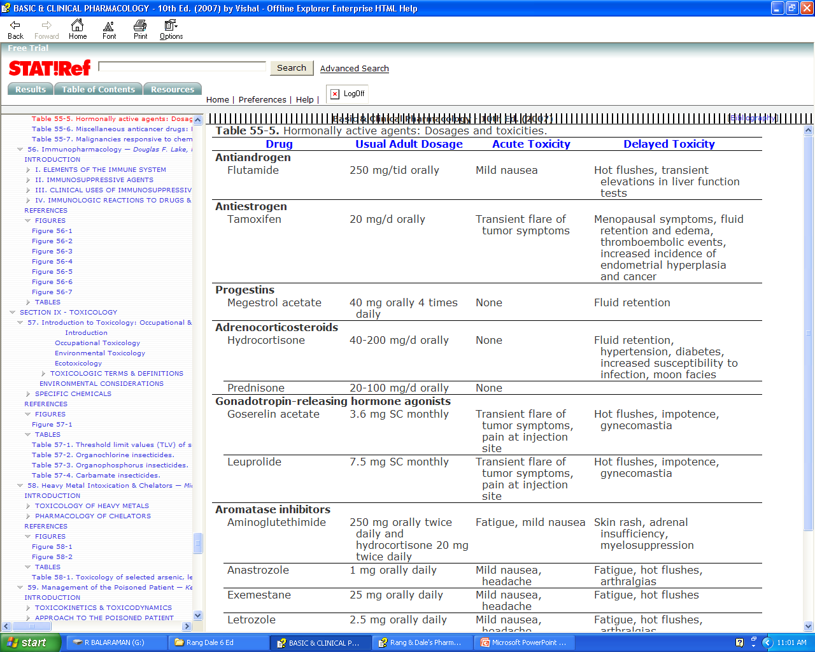

Slide 68
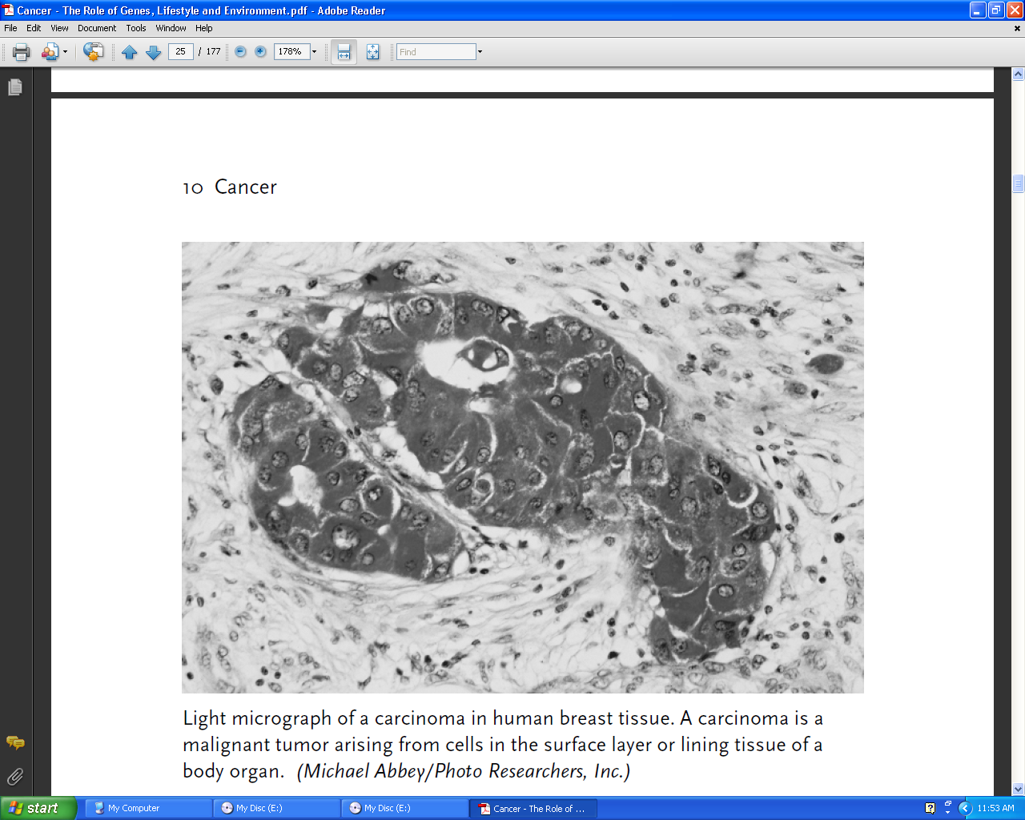

Slide 69
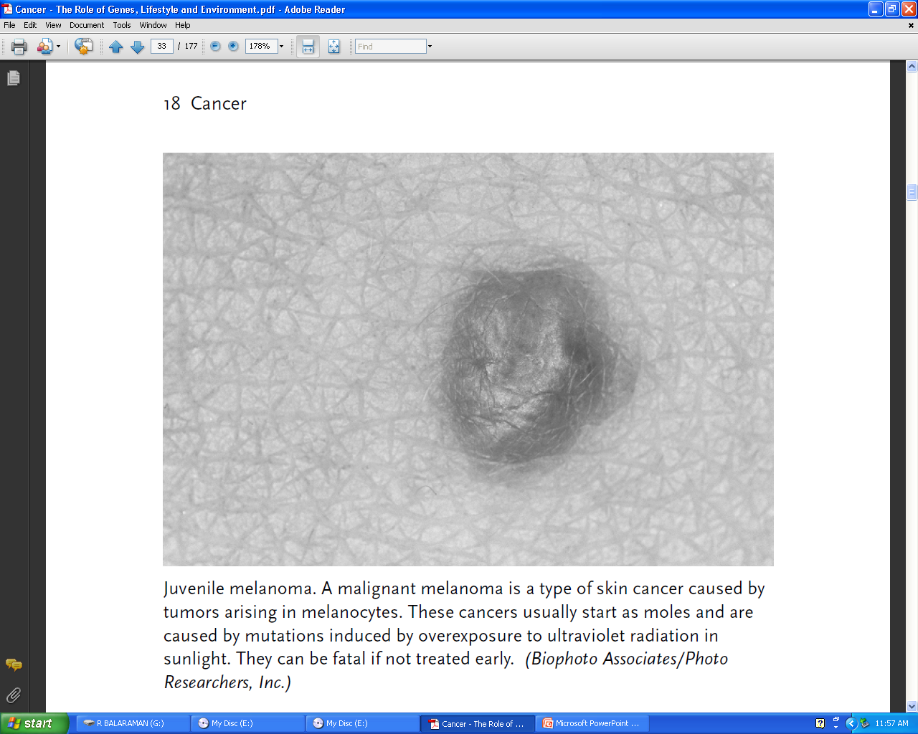

Slide 70
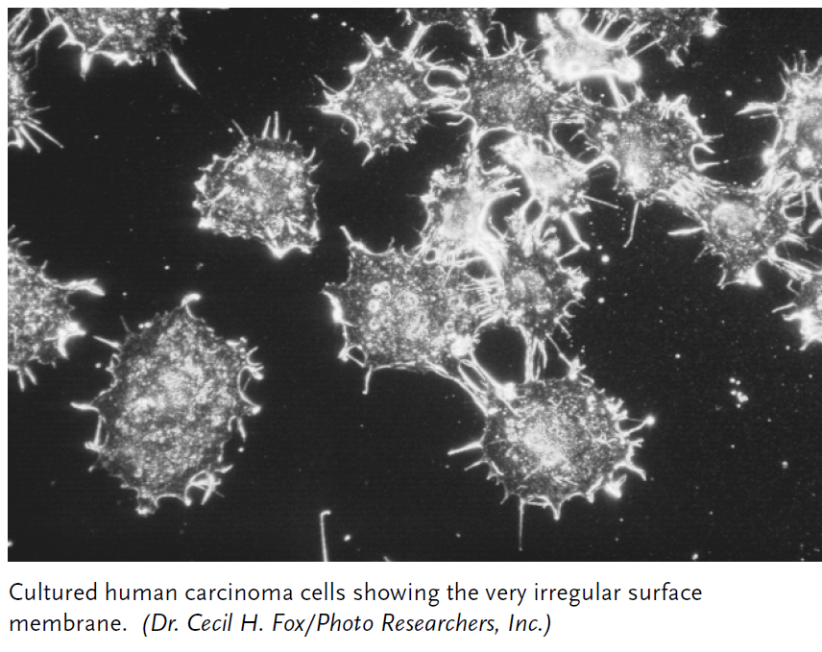

Slide 71
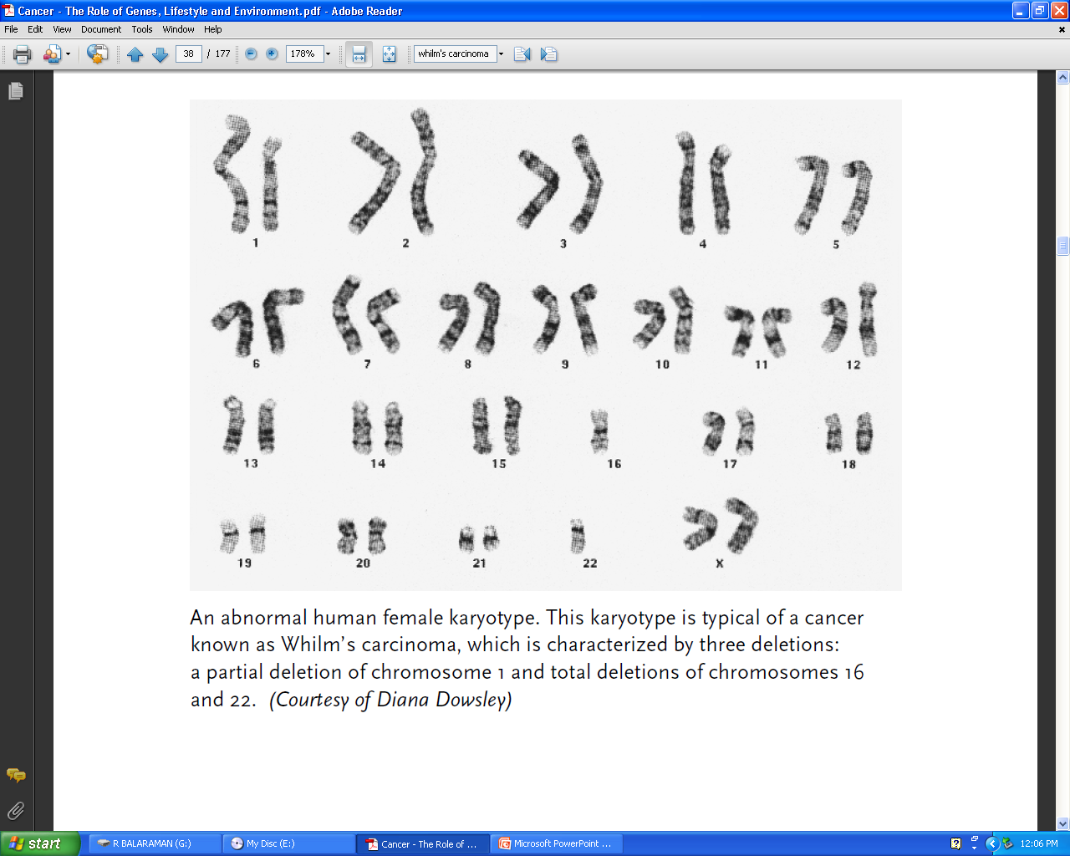

Slide 72
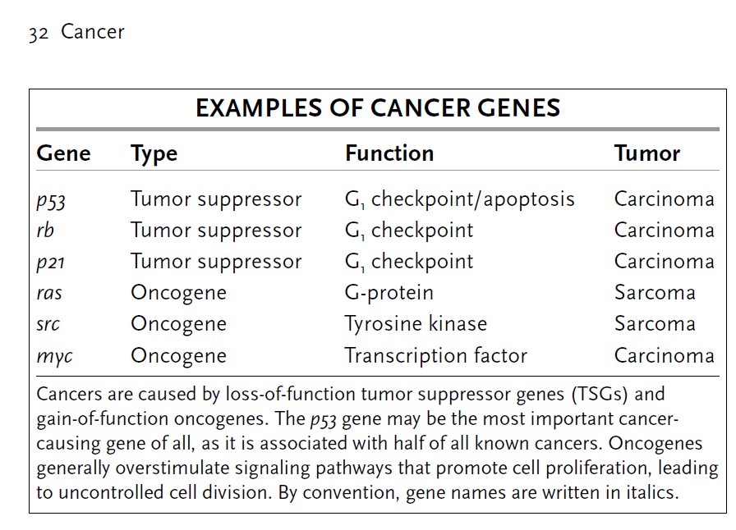

Slide 73
Monoclonal Antibodies In Treatment Of Cancers
In case of cancerous cells, monoclonal antibodies may act directly or indirectly. They
may target growth factor receptors, thus antagonizing ligand receptor interactions or they may
target cell-surface antigens to induce apoptotic signalling . Conversely, they may also target
cells of the immune system to minister effector cells and thus provide additional anti-tumor
immunity . Trastuzumab relies upon induction of T-cell responses against HER2 for its role in
HER2-positive breast cancer . Tumor cells present several antigens. Monoclonal antibodies
against such antigens have been so far clinically efficacious. This has been observed in HER2-
positive breast cancer, B-cell lymphomas, colorectal, head & neck and lung cancers .
Rituximab and alemtuzumab are the currently available monoclonal antibody therapies for B-cell
cancers. A few others are under different phases of clinical trials. Rituximab was the first
monoclonal antibody to be approved by the FDA for the treatment of a human cancer, CD20+
non-Hodgkin’s lymphoma. Since then several efforts have been made, with and without success,
to bring in newer monoclonal antibodies for the treatment of B-cell cancers and to amalgamate
monoclonal antibody therapy with conventional therapy .

Slide 74
Though it is not found to be superior to chlorambucil and prednisoloneagainst indolent lymphomas, it certainly improves the response when added to therapy. Not only that, addition of rituximab to chemotherapeutic regimens also prolonged survival . In case of elderly patients suffering from diffuse large-B-cell lymphoma, addition of rituximab to CHOPregimen prolonged event-free & overall survival

Slide 75
Trastuzumab is a humanized antibody, derived from a murine monoclonal antibody, 4D5.The clinical response of patients suffering from HER2 positive breast cancer correlated with that of HER2 overexpression. When the anthracycline regimen was combined with that of trastuzumab as adjuvant, the response has been found to be increased. However because of the risk of myocardial dysfunction, it is not recommended in combination with anthracyclines .With more than 20% of esophagogastric cancer patients being HER2 positive, the addition of trastuzumab to standard chemotherapy (5-FU + cisplatin OR cisplatin + docetaxel) resulted in a reduction in the risk of dying (19).

Slide 76
