Slide 1
An overview on Modern Drug Discovery Process
(3rd year Pharm D)
Prepared by:
Ashish Shah
(M.Pharm, Ph. D*)
Assistant Professor
Department of Pharmacy,
Sumandeep Vidyapeeth

Slide 2
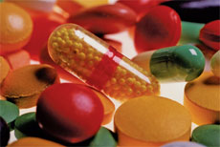

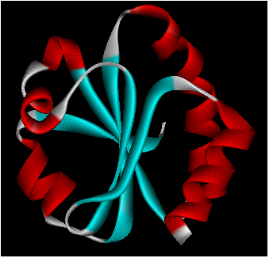
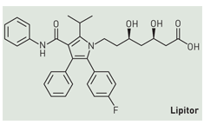
Drug Design & Discovery
Drugs:
Targets
Natural sources
Synthetic sources

Slide 3
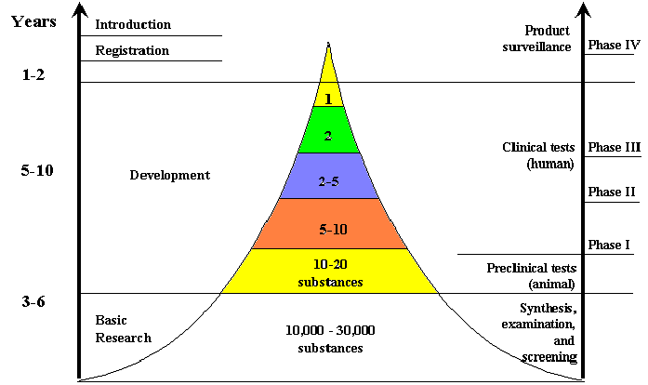

Discovering and Developing the
‘One Drug’

Slide 4
History of Drug Discovery
1909 - First rational drug design.
Goal: safer syphilis treatment than Atoxyl.
Paul Erhlich and Sacachiro Hata wanted to maximize toxicity to pathogen and minimize toxicity to human (therapeutic index).
They found Salvarsan (which was replaced by penicillin in the 1940’s)
1960 - First successful attempt to relate chemical structure to biological action quantitatively (QSAR = Quantitative structure-activity relationships). Hansch and Fujita

Slide 5
History of Drug Discovery
Mid to late 20th century
understand disease states, biological structures, processes,
drug transport, distribution, metabolism.
Medicinal chemists use this knowledge to modify chemical structure to influence a drug’s activity, stability, etc.
procaine = local anaesthetic; Procainamide = antirhythmic

Slide 6
Approaches to drug discovery
  Serendipity (luck)
  Chemical Modification
  Screening
  Rational

Slide 7
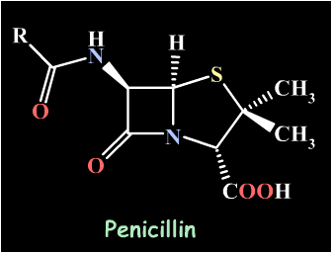
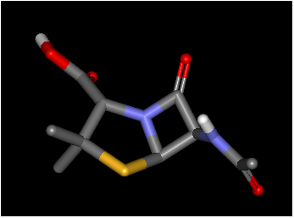
Serendipity “Chance favors the prepared mind”
1928 Fleming studied Staph, but contamination of plates with airborne mold. Noticed bacteria were lysed in the area of mold. A mold product inhibited the growth of bacteria: the antibiotic penicillin

Slide 8
Chemical Modifications
(A) Homolog Approach: Homologs of a lead prepared
(B) Molecular Disconnection /Simplification
(C) Molecular Addition
(D) Isosteric Replacements

Slide 9
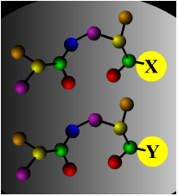
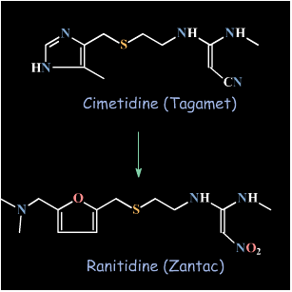
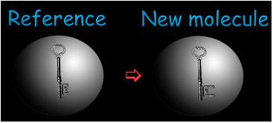
Chemical Modification
Traditional method.
An analog of a known, active compound is synthesized with a minor modification, that will lead to improved Biological Activity.
Advantage and Limitation: End up with something very similar to what you start with.

Slide 10
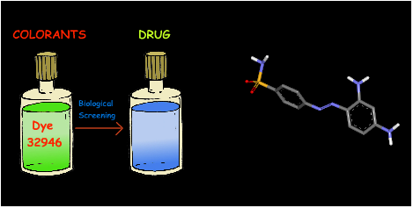
Screening
Testing a random and large number of different molecules for biological activity reveals leads. Innovations have led to the automation of synthesis (combinatorial synthesis) and testing (high-throughput screening).
Example: Prontosil is derived from a dye that exhibited antibacterial properties.

Slide 11
Irrational, based on serendipity & Intuition
Trial & error approach
Time consuming with low through output
No de novo design, mostly “Me Too Approach”

Slide 12
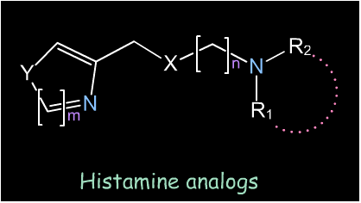
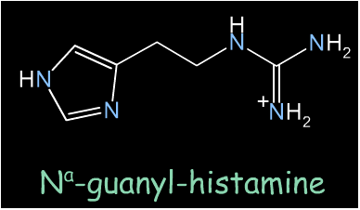
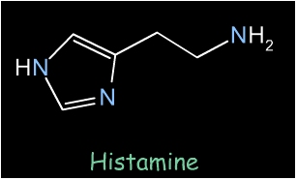
Rational Drug Design - Cimetadine (Tagamet)
Starts with a validated biological target and ends up with a drug that optimally interacts with the target and triggers the desired biological action.
Problem: histamine triggers release of stomach acid. Want a histamine antagonist to prevent stomach acid release by histamine = VALIDATED BIOLOGICAL TARGET.
Histamine analogs were synthesized with systematically varied structures (chemical modification), and SCREENED. N-guanyl-histamine showed some antagonist properties = LEAD compound.

Slide 13
First generation Rational approach in Drug design
In 1970s the medicinal chemists considered molecules as topological entities in 2 dimension (2D) with associated chemical properties.
QSAR concept became quite popular. It was implemented in computers and constituted first generation rational approach to drug design

Slide 14
2nd generation rational drug design
The acceptance by medicinal chemists of molecular modeling was favored by the fact that the QSAR was now supplemented by 3D visualization.
The “lock and key” complementarily is actually supported by 3D model. Computer aided molecular design (CAMD) is expected to contribute to intelligent lead

Slide 15
Evolutionary drug designing
Ancient times: Natural products with biological activities used as drugs.
Chemical Era: Synthetic organic compounds
Rationalizing design process: SAR & Computational Chemistry based Drugs
Biochemical era: To elucidate biochemical pathways and macromolecular structures as target as well as drug.

Slide 16
Modern Drug Discovery Process

Slide 17



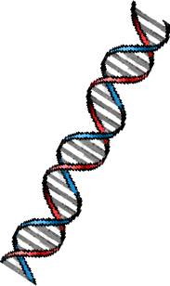
Target selection &
validation
Discovery
Development
Target
-receptor; -ion channel; -transporter;
-enzyme; - signalling molecule
Drug Candidate
safety testing
Studies of
Disease Mechanisms
  Lead Search
-Develop assays (use of automation)
-Chemical diversity
-Highly iterative process
Human Studies
Phases I,II, III
Molecular Studies
Animal Studies
- relevant species
- transgenic KO/KI mice
- conditional KOs
- agonists/antagonists
- antibodies
- antisense
- RNAi
Drug Approval
and Registration
Lead optimization
-selectivity
-efficacy in animal models
-tolerability: AEs mechanism-
based or structure-based?
-pharmacokinetics
-highly iterative process

Slide 18
Target Selection & Validation
Define the unmet medical need (disease)
Understand the molecular mechanism of the disease
Identify a therapeutic target in that pathway (e.g gene, key enzyme, receptor, ion-channel, nuclear receptor)
Demonstrate that target is relevant to disease mechanism using genetics, animal models, lead compounds, antibodies, RNAi, etc.
Notes:
Here is what we are trying to achieve (refer to slide).
Note that you can comment on:
We conduct basic animal health research in RY, but our animal health care products are marketed by Merial, a joint venture between Merck and Rhone- Poulenc (note that RP is now known as Aventis (RP merged with Hoechst).
Outcomes research is when we attempt to prove that our compounds not only cause important chemical effects in the body (such as reduced blood pressure or reduced cholesterol), but that these effects lead to reduced morbidity and mortality over time. The Zocor 4S study is an example.
The research budget for MRL is $2.4 billion this year.

Slide 19
Development
Pre-Clinical
Process R&D
Chem Eng. R&D
Manufacturing
Pharmacology
Safety Assessment
Toxicology
Drug Metabolism
(ADME)
Pharmaceutical R&D
Formulation
Bio Process R&D
Clinical Investigator
& patient
Regulatory Affairs
Project Planning & Management
Marketing
Clinical Pharmacology
Clinical Research
Statistics & Epidemiology
Data Coordination
Research Information Systems
Information Services
Clinical

Slide 20
Clinical Trials
Continued
Advisory
Committee
Regulatory
Review Team
Reviews,
comments, and
discussions
APPROVAL
PROCESS
(Ex. FDA)
Submit to
Regulatory Agencies
Drug Co./Regulatory
liaison activities
New Drug
Application
(NDA)
APPROVAL
Worldwide Marketing Authorization (WMA) in other countries

Slide 21
Discovery
Develop an assay to evaluate activity of compounds on the target
- in vitro (e.g. enzyme assay)
- in vivo (animal model or pharmacodynamic assay)
Identify a lead compound
  screen collection of compounds (“compound library”)
  compound from published literature
  screen Natural Products
  structure-based design (“rational drug design”)
Optimize to give a “proof-of-concept” molecule—one that shows efficacy in an animal disease model
Optimize to give drug-like properties—pharmacokinetics, metabolism, off-target activities
Safety assessment, Preclinical Candidate!!!
Notes:
Here is what we are trying to achieve (refer to slide).
Note that you can comment on:
We conduct basic animal health research in RY, but our animal health care products are marketed by Merial, a joint venture between Merck and Rhone- Poulenc (note that RP is now known as Aventis (RP merged with Hoechst).
Outcomes research is when we attempt to prove that our compounds not only cause important chemical effects in the body (such as reduced blood pressure or reduced cholesterol), but that these effects lead to reduced morbidity and mortality over time. The Zocor 4S study is an example.
The research budget for MRL is $2.4 billion this year.

Slide 22
Drug Discovery—Convergence of Disciplines
Synthetic
Chemistry
Combinatorial
Chemistry
Patent Law
Modelling
Novel
Molecule
Intellectual Property
Physiology
Information
Technology
Design
Structural
Activity
Biochemistry
Physiology
Safety
Pharmaco-
dynamics
Physiology
Metabolism
Pharmacology
Safety
Assessment
Immunology
In Vivo activity
Pharmacokinetic
Properties
DMPK
Pharmacology
Behavior
Pathology
Enzymology
Physiology
Physical
Chemistry
Physiology

Slide 23
Impact of Structural Bioinformatics on Drug Discovery
Fig 1 & 2
Fauman et al.
Speeds up key steps in DD process by combining aspects of bioinformatics, structural biology, and structure-based drug design

Slide 24

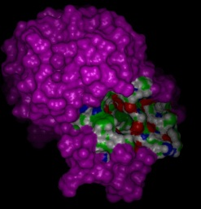
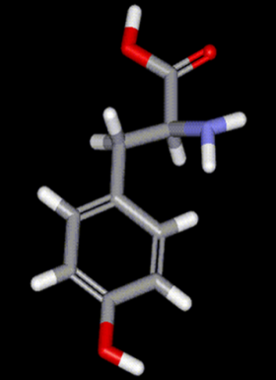
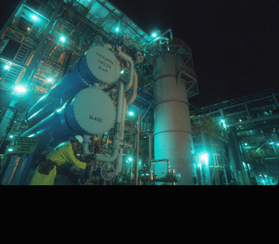
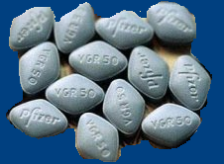
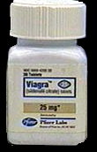

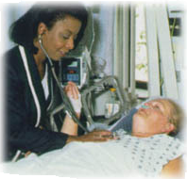
Drug Discovery & Development
Identify disease
Drug Design
Molecular Modeling
Virtual Screening
Find a drug effective
against disease protein
(2-5 years)
Isolate protein
involved in
disease (2-5 years)
Scale-up
Preclinical testing
(1-3 years)
Human clinical trials
(2-10 years)
File IND
Formulation
File NDA
FDA approval
(2-3 years)

Slide 25


Technologies Used in Drug Discovery process
GENOMICS, PROTEOMICS & BIOPHARM.
Potentially producing many more targets
and “personalized” targets
HIGH THROUGHPUT SCREENING
Identify disease
Screening up to 100,000 compounds a
day for activity against a target protein
VIRTUAL SCREENING
Using a computer to
predict activity
Isolate protein
COMBINATORIAL CHEMISTRY
Rapidly producing vast numbers
of compounds
Find drug
MOLECULAR MODELING
Computer graphics & models help improve activity
Preclinical testing
IN VITRO & IN SILICO ADME MODELS
Tissue and computer models begin to replace animal testing

Slide 26
Steps involved in drug designing
Target identification
Target validation
Lead identification
Lead optimization
Docking
Pre clinical trials
Clinical trails

Slide 27
Target identification
A target is a molecule(namely a protein) which is present within an organism.
  The approaches of identifying targets include protein expression, protein biochemistry, structure function studies, study of biochemical pathways.
There are now several other methods to identify specific molecular targets like high throughput sequencing analysis, positional cloning, generation of cDNA libraries with ESTs and database mining by sequence homology.
It is important to determine whether the novel targets are actually relevant to the physiology of the disease.

Slide 28
Target validation
As there are a plethora of new potential therapeutic drug targets that are being discovered, selection and validation of novel molecular targets has become important.
  It needs to be confirmed that the targets identified will affect an appropriate biological response.
  Targeted gene disruption (TGD) is a term that refers to several different methods of target validation.

Slide 29
Lead identification
A lead is a compound(usually a small organic molecule) that demonstrates a desired biological activity on a validated molecular target.
To be termed as a lead, the compound must exceed a specific potency threshold against the target.
The compounds used as potential leads can be from many sources. The most important sources of leads is libraries of molecules like peptide libraries, natural compounds libraries etc.

Slide 30
Some of the technologies used in the lead identification
Virtual screening
Chemoinformatics
Pharmacophore mapping
Quantitative structure activity relationship QSAR
High throughput docking
NMR – based screening
Chemical genetics

Slide 31
Lead optimization
Once a lead compound is established in the identification process, we need to optimize the desirable traits of the lead
To be considered for further development , lead should be amenable for chemistry optimization.

Slide 32
Docking
Docking refers to the ability to position a ligand in the active or a designated site of a protein and calculate the specific binding affinities.
Docking algorithms can be used to find ligands and binding conformations at a receptor site close to experimentally determined structures.
Docking algorithms are also used to identify multiple proteins to which a small molecule can bind. Some of the docking programs are GOLD (Genetic Optimization for Ligand Docking), AUTODOCK, LUDI, HEX etc.

Slide 33
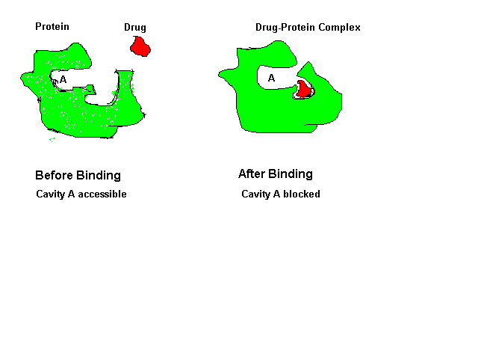
Mechanism of drug action:

Slide 34
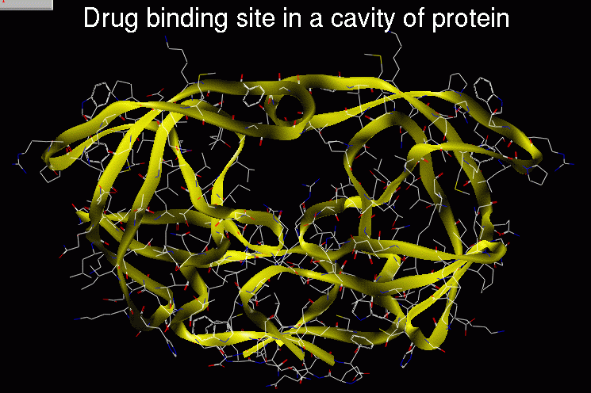
Mechanism of drug binding:

Slide 35
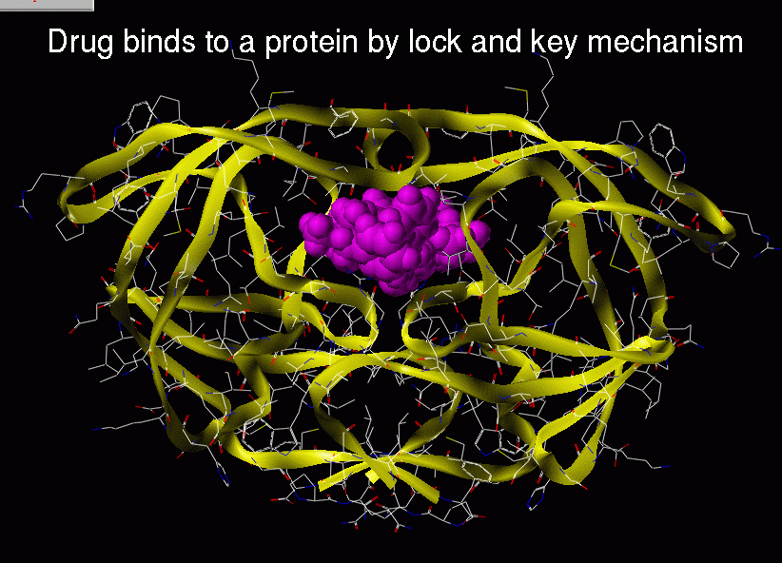
Ligand binding mechanism

Slide 36
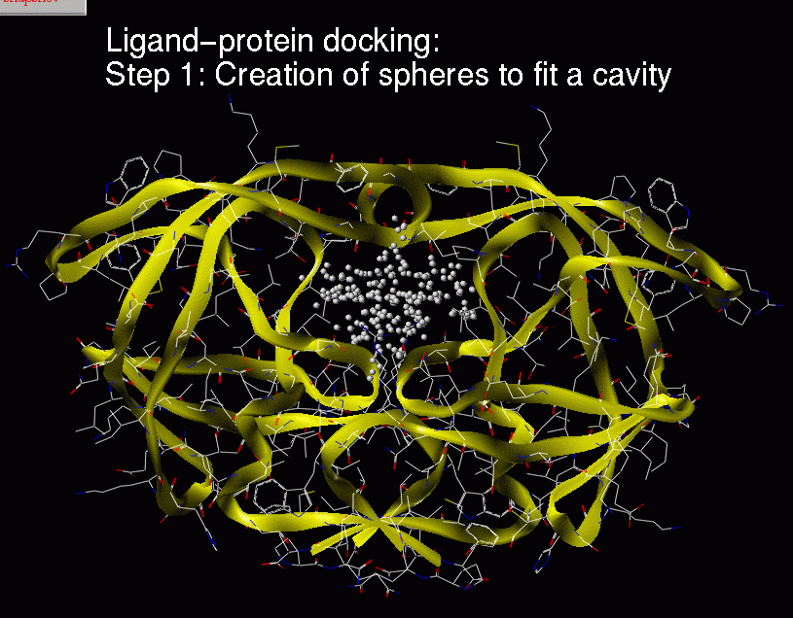
.

Slide 37
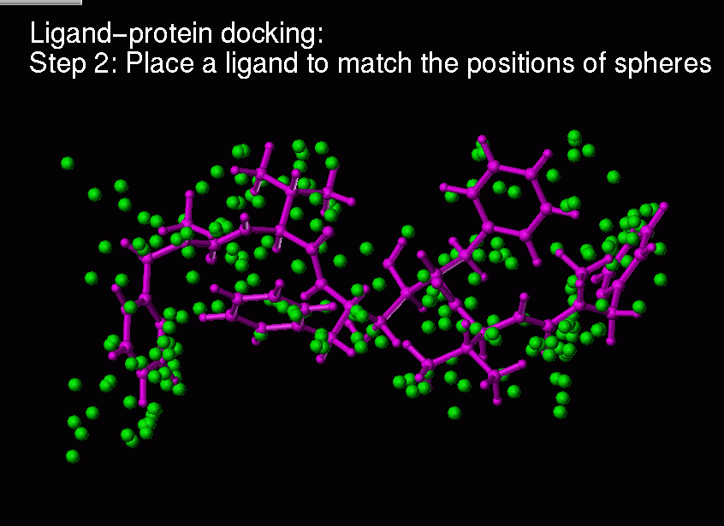
.

Slide 38
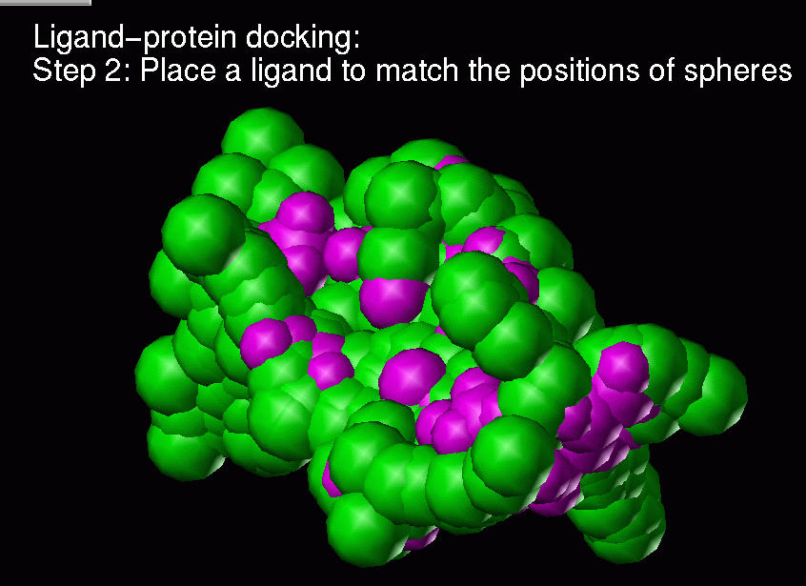
.

Slide 39
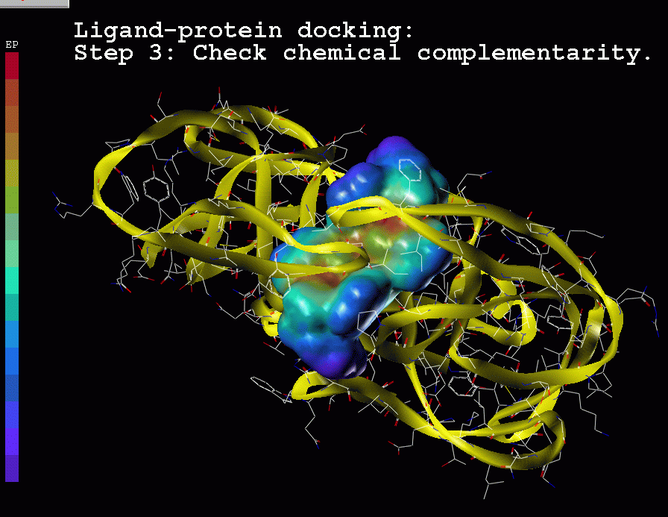
.

Slide 40

“Docking” compounds into proteins computationally

Slide 41
Pre clinical trails
It is the study of how a drug molecule interacts with its molecular target.
Pharmacological techniques are employed to study receptor binding, functional effects, dose responses etc.
ADMET characteristics are very important at this stage.
Absorption:- Compounds are delivered by a range of routes in the body. From the site of initial delivery compounds will be absorbed in specific patterns
Distribution:- Once absorbed compounds is distributed throughout the body, is determined by a route of administration and formulation.

Slide 42
Metabolism:- Compounds are metabolized or modified biologically as the body aims to clear them. Liver is the most significant metabolic organ of an organism.
Excretion:- Compounds and their metabolites are eliminated from the body via urinary, exhalation etc.
Toxicology:- Majority of potent drugs has side effects limiting the safe dose which can be used in man. Toxicological predictions mostly pertain to the identification of structural features of drug molecules likely to confer toxicological properties.

Slide 43
Clinical trails
Before a drug is approved, clinical trials have to be followed. It has distinct phases:
Phase 0-> micro dosing of candidate to determine distribution related information
Phase 1-> first stage testing in humans.
Phase 2-> access how well the drug works.
Phase 3-> multicenter trials on large patient groups.
Phase 4-> involves safety surveillance and ongoing technical support of a drug after receiving permission to be sold.

Slide 44
Success Stories:
HIV-1 Protease Inhibitors:
  Inverase (Hoffman-LaRoche, 1995)
  Norvir (Abbot, 1996)
  Crixivan (Merck, 1996)
  Viracept (Agouron, 1997)
        Drug discovery today 2, 261-272 (1997)

