Slide 1

DEPARTMENT OF PHARMACY SVDU
YEAR: PHARM. D 4TH YEAR
SUBJECT: PD 408 PHARMACOTHERPEUTICS I & II
TOPIC: DRUG INDUCED LIVER DISEASE
PRESENTED BY: DR. MAHEK MISTRY

Slide 2
PATTERNS OF DRUG INDUCED LIVER DISEASE
Hepatocellular injury
Hepatocellular injury is characterized by significant elevations in the aminotransferases in serum which usually precede elevations in total bilirubin levels and alkaline phosphatase levels.
Most injuries occur within 1 year of initiating the offending agent. Hepatocellular injury can lead to fulminant hepatitis with a corresponding 20% survival rate with supportive care. For those patients who present with the combination of hepatocellular injury and jaundice, there is a 10% mortality rate.
Acarbose, allopurinol, fluoxetine, and losartan are capable of causing hepatocellular injury.
Hepatocellular injuries can be further subdivided as Centrolobular necrosis, steatohepatitis (steatonecrosis), phospholipidosis, and generalized hepatocellular necrosis.

Slide 3
CENTRILOBULAR NECROSIS
Centrolobular necrosis is often a dose-related, predictable reaction secondary to drugs such as acetaminophen; however, it also can be associated with idiosyncratic reactions, such as those caused by the anesthetic halothane.
Also called direct or metabolite-related hepatotoxicity, centrolobular necrosis is usually the result of the production of a toxic metabolite.
The damage spreads outward from the middle of a lobe of the liver.
Patients suffering from centrolobular necrosis tend to present in one of two ways, depending on the extent of necrosis. Mild drug reactions, involving only small amounts of parenchymal liver tissue, may be detected as asymptomatic elevations in the serum aminotransferases.

Slide 4
Patients suffering from centrolobular necrosis tend to present in one of two ways, depending on the extent of necrosis.
Mild drug reactions, involving only small amounts of parenchymal liver tissue, may be detected as asymptomatic elevations in the serum aminotransferases.
If the reaction is diagnosed at this stage, most of these patients will recover with minimal cirrhosis and thus minimal chronic liver impairment.
More severe forms of centrolobular necrosis are accompanied by nausea, vomiting, upper abdominal pain, and jaundice.
When taken in overdose, acetaminophen becomes bioactivated to a toxic intermediate known as Nacetyl- p-benzoquinone imine (NAPQI)
NAPQI is very reactive, with a high affinity for sulfhydryl groups. The amino acid glutathione provides a ready source of available sulfhydryl groups within the hepatocyte.

Slide 5
When the liver’s glutathione stores are depleted and there are no longer sulfhydryl groups available to detoxify this metabolite, it begins to react directly with the hepatocyte.
Replenishing the liver’s sulfhydryl capacity through the administration of Nacetylcysteine early after ingestion of the overdose halts this process.
During the first hours after ingestion, some patients report mild symptoms of nausea and vomiting, but no elevations of the commonly measured liver enzymes are seen. Not for 40 to 50 hours after ingestion do serum elevations in the liver enzymes begin.
Reye’s syndrome is an aggressive form of toxic hepatitis often associated with aspirin use in children. Valproate toxicity can also present in this pattern.
Early in the process of Reye’s syndrome, mitochondrial dysfunction leads to the depletion of acyl-coenzyme A and carnitine.

Slide 6
Fatty acids accumulate and gluconeogenesis is impaired, resulting in hypoglycemia.
A concurrent disruption of the urea cycle occurs, leading to a decrease in the removal of ammonia and a slowing of protein use.
A threefold rise in the blood ammonia level and an increase in the prothrombin time are common findings. In advanced stages of Reye’s syndrome, many patients develop intracranial hypertension that can be life-threatening and refractory to therapy.

Slide 7
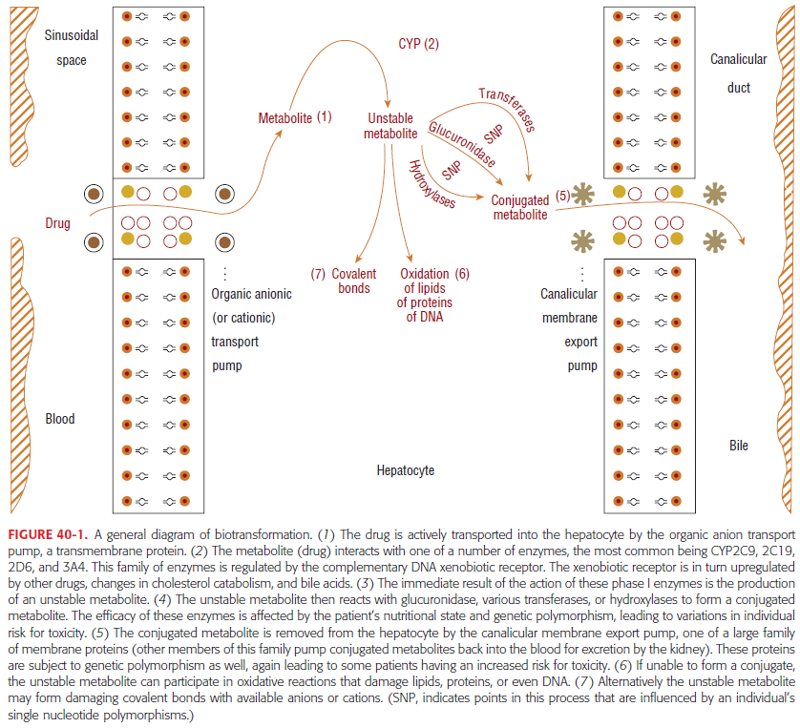

Slide 8
STEATOHEPATITIS
Steatohepatitis (also known as steatonecrosis) is a specialized type of acute necrosis resulting from the accumulation of fatty acids in the hepatocyte.
Drugs or their metabolites that cause steatonecrosis do so by affecting fatty-acid oxidation within the mitochondria of the hepatocyte.
Hepatic vesicles become engorged with fatty acids, eventually disrupting the homeostasis of the hepatocyte.
The liver biopsy is marked by a massive infiltration by polymorphonuclear leukocytes, degeneration of the hepatocytes, and the presence of Mallory bodies.
Alcohol is the drug that most commonly produces steatonecrotic changes in the liver. When alcohol is converted into acetaldehyde, the synthesis of fatty acids is increased

Slide 9
When the hepatocyte has become completely engorged with microvesicular fat, it often breaks open, spilling into the blood.
If enough hepatocytes break open, an inflammatory response begins.
If the offending agent is withdrawn before significant numbers of hepatocytes become necrotic, the process is completely reversible without long-term sequelae.
In nonalcoholic steatohepatitis, the same end point is often achieved through oxidation of lipid peroxidases.
Tetracycline produces steatohepatitis and steatosis. The lesions are characterized by large vesicles of fat found diffused throughout the liver.
The development of this reaction is related to the high concentrations achieved when tetracycline is given intravenously and in doses greater than 1.5 g/day.

Slide 10
The mortality of tetracycline steatohepatitis is high (70% to 80%), and those who do survive often develop cirrhosis.
Sodium valproate also can produce steatonecrosis through the process of bioactivation. Cytochrome P450 converts valproate to delta-4-valproic acid, a potent inducer of microvesicular fat accumulation.
Patients experiencing steatohepatitis may present with abdominal fullness or pain as their only complaint.
Patients with more severe steatonecrosis will present with all the symptoms characteristic of alcoholic hepatitis such as nausea, vomiting, steatorrhea, abdominal pain, pruritus, and fatigue.

Slide 11
PHOSPHOLIPIDOSIS
Phospholipidosis is the accumulation of phospholipids instead of fatty acids. The phospholipids usually engorge the lysosomal bodies of the hepatocyte.
Amiodarone is associated with this reaction. Patients treated with amiodarone who develop overt hepatic disease tend to have received higher doses of the drug.
These patients also have higher amiodarone–to–N-desethyl-amiodarone ratios, indicating a greater accumulation of the parent compound.
Amiodarone and its major metabolite N-desethyl-amiodarone remain in the liver of all patients for several months after therapy is stopped.
Usually the phospholipidosis develops in patients treated for more than 1 year. The patient can present with either elevated aminotransferases or hepatomegaly; jaundice is rare.

Slide 12
GENERALIZED HEPATOCELLULAR NECROSIS
Generalized hepatocellular necrosis mimics the changes associated with the more common viral hepatitis. The onset of symptoms is usually delayed as much as a week or more after exposure to toxin. Bioactivation is often important for toxic hepatitis to develop, but may not be the immediate cause of damage.
Many drugs that are associated with toxic hepatitis produce metabolites that are not inherently toxic to the liver. Instead, they act as haptens, binding to specific cell proteins and inducing an autoimmune reaction.
The rate of bioactivation can vary between males and females and between individuals of the same sex.
The cytochrome P450 (CYP450) system tends to metabolize lipophilic substrates that are actively pumped into the hepatocyte by an organic anion (or cation) transporting protein.

Slide 13
The CYP450 subspecies 2C, 2D, 3A, and 4A are regulated by the highly inducible xenobiotic receptor on complementary DNA.
The receptor is found in the liver, and to a lesser extent in the cells lining the intestinal tract, and is responsible for cholesterol catabolism and bile acid homeostasis.
The activity of this receptor is subject to genetic polymorphism as well. This results in a wide variation in the sensitivity of the population to generalized hepatocellular necrosis and other forms of hepatic damage.
The long-term administration of isoniazid can lead to hepatic dysfunction in 10% to 20% of those receiving the drug. Yet severe toxic hepatitis develops in only 1% or less of this population.
The N-acetyltransferase 2 (NAT2) genotype appears to play a role in determining a patient’s relative risk.

Slide 14
In one study, patients with the slow-type NAT2 genotype had a 28-fold greater risk of developing serum aminotransferase elevations than did patients with the fast type NAT2 genotype.
Isoniazid is metabolized by several pathways, acetylation being the major pathway. It is acetylated to acetylisoniazid, which, in turn, is hydrolyzed to acetylhydrazine.
The acetylhydrazine, and to a lesser extent the acetylisoniazid, are directly toxic to the cellular proteins in the hepatocyte, but rapid acetylators also detoxify acetylhydrazine very rapidly, converting it to diacetylhydrazine (a nontoxic metabolite.
Isoniazid simultaneously is an example of the potential predictability of drug-induced liver disease based on single nucleotide polymorphism and a lesson in the limitations of our current understanding. There are definite links to NAT2 genotype and toxicity.

Slide 15
The risk for this reaction is also influenced heavily by the age of the patient, with older patients having a much higher risk than younger patients. In fact, age may be more important than genotype.
Ketoconazole produces generalized hepatocellular necrosis or milder forms of hepatic dysfunction in 1% to 2% of patients treated for fungal infections.
This reaction is fatal in high numbers of patients who are infected with the human immunodeficiency virus.
The onset is usually early in therapy, although it can be delayed until several months into therapy.
In immune-compromised patients in whom ketoconazole is used for long periods of time, special care should be taken to watch for changes in liver function.

Slide 16
TOXIC CIRRHOSIS
The scarring effect of hepatitis in the liver leads to the development of cirrhosis. Some drugs tend to cause such a mild case of hepatitis that it may not be detected.
Mild hepatitis can be easily mistaken for a more routine generalized viral infection. If the offending drug or agent is not discontinued, this damage will continue to progress.
The patient eventually presents not with hepatitis, but with cirrhosis. Methotrexate causes periportal fibrosis in most patients who experience hepatotoxicity.
The lesion results from the action of a bioactivated metabolite produced by CYP450.
This process occurs most commonly in patients treated for psoriasis and arthritis.

Slide 17
The extent of damage can be reduced or controlled by increasing the dosage interval to once weekly or by routine use of folic acid supplements.
Vitamin A is normally stored in liver cells, and causes significant hypertrophy and fibrosis when taken for long periods in high doses.
Hepatomegaly is a common finding, along with ascites and portal hypertension.
In patients with vitamin A toxicity, gingivitis and dry skin are also very common. This is accelerated by ethanol, which competes with retinol for aldehyde dehydrogenase.

Slide 18
COLESTATIC INJURY
A second pattern of hepatic damage is an injury that primarily involves the bile canalicular system and is know as cholestatic injury.
In cholestatic disease, disturbance of the subcellular actin filaments around the canaliculi prevents the movement of bile through the canalicular system.
The inability of the liver to remove bile causes intrahepatic accumulation of toxic bile acids and excretion products.
Although rare, some patients develop progressive destruction of the cholangiocytes leading to the vanishing bile duct syndrome.
Drug-induced cholestasis can occur as an acute disorder (e.g., cholestasis with or without hepatitis and cholestasis with bile duct injury) or as a chronic disorder (e.g., vanishing bile duct syndrome, sclerosing cholangitis, and cholelithiasis.

Slide 19
However, the most common form of drug-induced cholestasis is cholestasis with hepatitis. Most patients with this acute disorder present with nausea, malaise, jaundice, and pruritus.
Elevations in serum alkaline phosphatase levels are more prominent and usually precede the elevations of other liver enzymes in serum.
On histologic examination, portal inflammation and hepatocyte necrosis are noted.
Although the antipsychotic drug chlorpromazine appears to be the prototype drug for this disorder, other medications are associated with other forms of cholestatic injury, such as erythromycin estolate, amoxicillinclavulanic acid, and carbamazepine.
Cholestatic injury, also known as cholestatic jaundice or cholestasis, can be classified by the area of the bile canalicular or ductal system that is impaired.

Slide 20
Canalicular cholestasis is often associated with long-term high-dose estrogen therapy. Clinically, these patients are often asymptomatic and present with mild to moderate elevations of serum bilirubin
An intravenous form of vitamin E, α- tocopherol acetate, causes cholestatic jaundice, primarily involving the canalicular duct in premature infants. The incidence of this reaction in those receiving this formulation was high (>10%) and the mortality even higher (>50%)
The administration of total parenteral nutrition for periods greater than 1 week induces cholestatic changes and nonspecific enzyme elevations in some patients.
Patients with low serum albumin concentrations may be at greater risk than patients with normal serum albumin concentrations.
This reaction also has been reported to occur rarely with sulfonamides, sulfonylureas, erythromycin estolate and ethylsuccinate, captopril, lisinopril, and other phenothiazines.

Slide 21
MIXED HEPATOCELLULAR AND CHOLESTATIC INJURY
The final pattern of hepatic damage is a combining of the previous two patterns.
This presentation can be the result of three different processes. In some patients, an injury may begin as hepatocellular (or cholestatic) and simply spread so rapidly that by the time the patient presents for diagnosis and treatment, all areas of the liver are affected.
In other patients, the underlying mechanism of damage is such that cells are injured regardless of their anatomical location or primary metabolic role.
LIVER VASCULAR DISORDERS
Focal lesions in hepatic venules, sinusoids, and portal veins occur with various drugs.
The most commonly associated drugs are the cytotoxic agents used to treat cancer, the pyrrolizidine alkaloids, and the sex hormones.
A centralized necrosis often follows and can result in cirrhosis. Azathioprine and herbal teas that contain comfrey (a source of pyrrolizidine alkaloids) are associated with the development of venoocclusive disease

Slide 22
The exact incidence is rare and may be dose related.
Peliosis hepatitis is a rare type of hepatic vascular lesion that can be seen as both an acute and a chronic disease.
The liver develops large, blood-filled lacunae (space or cavity) within the parenchyma. Rupture of the lacunae can lead to severe peritoneal hemorrhage.
Peliosis hepatitis is associated with exposure of the liver to androgens, estrogens, tamoxifen, azathioprine, and danazol.
Androgens with a methyl alkylation at the 17-carbon position of the testosterone structure are the most frequently reported agents that cause peliosis hepatitis, usually after at least 6 months of therapy.

Slide 23
MECHANISM OF DRUG-INDUCED LIVER DISEASE
STIMULATION OF AUTOIMMUNITY
Autoimmune injuries involve antibody mediated cytotoxicity or direct cellular toxicity.
This type of injury occurs when enzymedrug adducts migrate to the cell surface and form neoantigens.
The neoantigens serve as targets for cytolytic attack by T cells.
The injury may be exacerbated by the recruitment of inflammatory cells. Halothane, sulfamethoxazole, carbamazepine, and nevirapine are associated with autoimmune injuries.
Stimulation of autoimmunity is often associated with some stage of all fulminant presentations. It is the primary cause of injury in idiosyncratic reactions.
Dantrolene, isoniazid, phenytoin, nitrofurantoin, and trazodone are associated with a type of autoimmune-mediated disease in the liver called chronic active hepatitis.

Slide 24
Dantrolene, isoniazid, phenytoin, nitrofurantoin, and trazodone are associated with a type of autoimmune-mediated disease in the liver called chronic active hepatitis.
Patients experience periods of symptomatic hepatitis followed by periods of convalescence, only to repeat the experience months later.
It is a progressive disease with a high mortality rate and is more common in females than males. Antinuclear antibodies appear in most patients.
These drugs appear to form antiorganelle antibodies.21 The exact identification of a causative agent is sometimes difficult as diagnosis requires multiple episodes occurring long after exposure to the offending drug.
IDIOSYNCRATIC REACTIONS
Idiosyncratic drug-related hepatotoxicity is rare and usually occurs in a small proportion of individuals. These adverse reactions are often categorized into allergic and nonallergic reactions. The allergic reactions are characterized by fever, rash, and eosinophilia.
They are usually dose-related and have a short latency period (<1 month). Upon reexposure to the offending agent, the patient will experience rapid recurrence of hepatotoxicity. Studies show that minocycline, nitrofurantoin, and phenytoin can cause allergic reactions

Slide 25
Unlike the allergic reactions, the nonallergic idiosyncratic reactions are devoid of the hypersensitivity features and usually have a long latency period (several months). These patients often have normal liver function tests for 6 months or longer and then suddenly develop hepatotoxicity. Dependent on the medication, the incident can be independent of dose or dose-related. Amiodarone, isoniazid, and ketoconazole are associated with nonallergic drugrelated hepatotoxicity.

