Slide 1
2020
Biopharmaceutics
By:
Piyushkumar K Sadhu
Assistant Professor
Sumandeep Vidyapeeth
An Institution Deemed to be University
Vadodara.

Slide 2
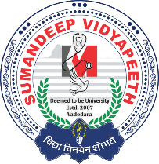
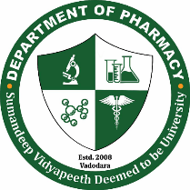
What is Biopharmaceutics?
Most effective in a DRUG DEVELOPMENT
role
Pharmaceutics
&
Bios
Bioavailability
Drug disposition
ADME
Bioavailability
Drug disposition
Absorption
Distribution
Excretion
Metabolism
Notes:
Study of factors influencing the rate and amount of drug that reaches to the systemic circulation and the use of this information to optimize the therapeutic efficiency of the drug product.

Slide 3
What is Pharmacokinetics?
Drug Disposition
Absorption
Elimination
Distribution
Metabolism
Excretion
Notes:
Study of time course of drug ADME and their relationaship with its therapeutic and toxic effects of the drug.

Slide 4
INTRODUCTION
Biopharmaceutics is defined as the study of factors influencing the rate and amount of drug that reaches the systemic circulation
Bioavailability is defined as the rate and extent (amount) of drug absorption. Any alteration in the drug’s bioavailability is reflected in its pharmacological effects
The movement of drug between one compartment and the other (generally blood and the extravascular tissues) is referred to as drug distribution.

Slide 5
Elimination is defined as the process that tends to remove the drug from the body and terminate its action. Elimination occurs by two processes—biotransformation (metabolism), which usually inactivates the drug, and excretion which is responsible for the exit of drug/metabolites from the body.
Pharmacokinetics is defined as the study of time course of drug ADME and their relationship with its therapeutic and toxic effects of the drug
The use of pharmacokinetic principles in optimising the drug dosage to suit individual patient needs and achieving maximum therapeutic utility is called as clinical pharmacokinetics

Slide 6
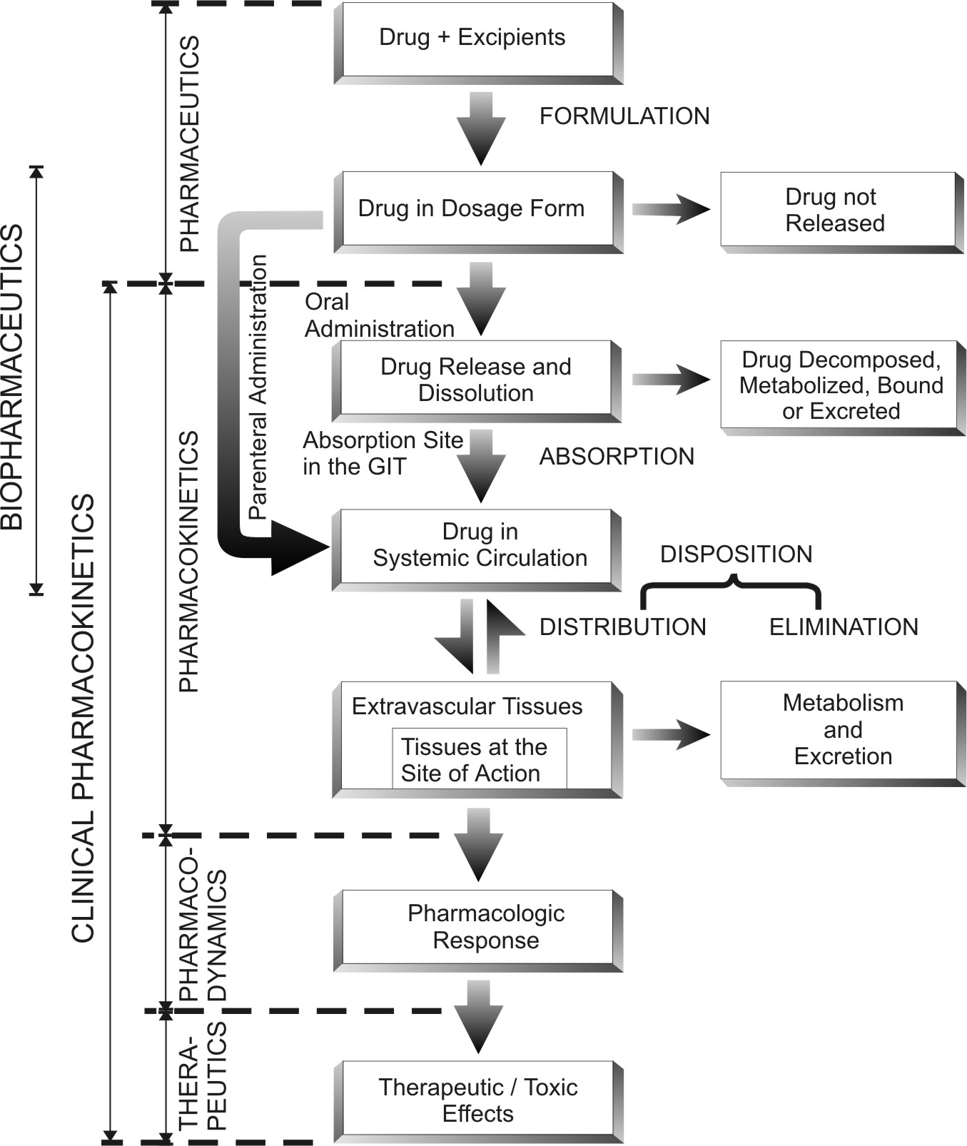
Schematic representation of the processes involved in drug therapeutics

Slide 7
ABSORPTION

Slide 8
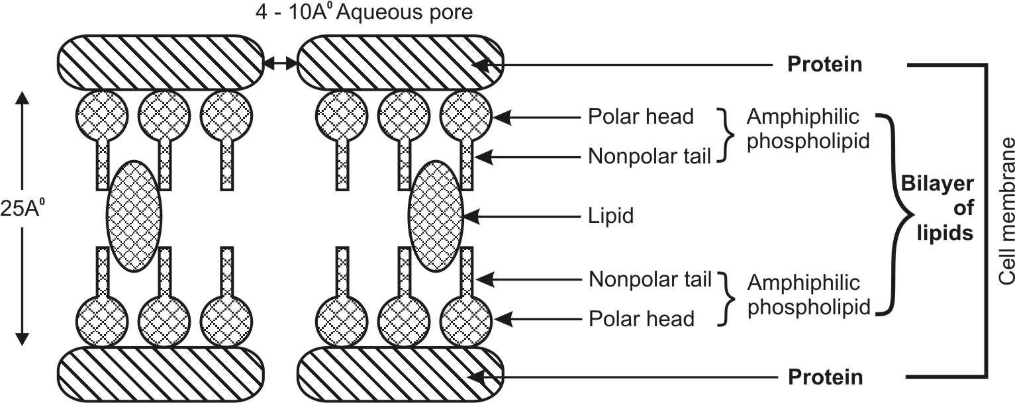
MEMBRANE PHYSIOLOGY
For a drug to be absorbed and distributed into organs and tissues and eliminated from the body, it must pass through one or more biological membranes/barriers at various locations. Such a movement of drug across the membrane is called as drug transport.
Basic structure of functional cell membrane

Slide 9
The cellular membrane consists of a double layer of amphiphilic phospholipid molecules, their hydrocarbon chains are oriented inwards to form the hydrophobic or lipophilic phase and their polar heads oriented to form inner hydrophilic boundaries of the cellular membrane that face the surrounding aqueous environment.
Bimolecular layer of lipids is contained between two parallel monomolecular layers of proteins.
The hydrophobic core of the membrane is responsible for the relative impermeability of polar molecules.
Aqueous filled pores or perforations of 4 to 10 Å in diameter are also present in which, the inorganic ions and small organic water-soluble molecules like urea can pass.

Slide 10
Dose response curve
TOXIC LEVEL
MSC
THERAPEUTIC LEVEL
POTENTIAL
Plasma drug Concentration (mg)
MEC
SUBTHERAPEUTIC LEVEL
Time (Min)

Slide 11
Mechanisms of Drug Absorption
The three broad categories are
Transcellular/intracellular transport : is defined as the passage of drugs across the GI epithelium. 3 steps involved
  Permeation of GI epithelial cell membrane
  Movement across the intracellular space (cytosol).
  Permeation of the lateral or basolateral membrane.
The various transcellular transport processes involved in drug absorption are –
A. Passive Transport Processes – These transport processes do not require energy other than that of molecular motion (Brownian motion) to pass through the lipid bilayer. Passive transport processes can be further classified into following types –
  Passive diffusion.
  Pore transport.
  Ion-pair transport.
  Facilitated- or mediated-diffusion.

Slide 12
Passive Diffusion
Also called non-ionic diffusion, it is the major process for absorption of more than 90% of the drugs. The driving force is concentration or electrochemical gradient. It is defined as the difference in the drug concentration on either side of the membrane
Passive diffusion is best expressed by Fick’s first law of diffusion, which states that the drug molecules diffuse from a region of higher concentration to one of lower concentration until equilibrium is attained and that the rate of diffusion is directly proportional to the concentration gradient across the membrane.
dQ/dt = rate of drug diffusion
D = diffusion coefficient of the drug
A = surface area of the absorbing membrane
Km/w = partition coefficient of the drug between membrane and the aqueous phase
(CGIT – C) = difference in the concentration of drug in GI fluid & the plasma
h = thickness of the membrane (length)

Slide 13
Pore Transport
It is also called as convective transport, bulk flow or filtration.
The driving force is hydrostatic pressure or the osmotic differences across the membrane.
The process is important in the absorption of low molecular weight (less than 100), generally water-soluble drugs through narrow, aqueous-filled channels ex: urea, water and sugars.
Chain-like or linear compounds of molecular weight up to 400 Daltons can be absorbed by filtration.
Drug permeation through water-filled channels is importance in renal excretion, removal of drug from the cerebrospinal fluid and entry of drugs into the liver.

Slide 14
Ion-Pair Transport
Absorption of drugs like quaternary ammonium compounds and sulphonic acids, which ionise under all pH conditions, is ion-pair transport.
Despite their low o/w partition coefficient values, such agents penetrate the membrane by forming reversible neutral complexes with endogenous ions of the GIT like mucin.
Such neutral complexes have both the required lipophilicity as well as aqueous solubility for passive diffusion. Such a phenomenon is called as ion-pair transport.
Propranolol, a basic drug that forms an ion pair with oleic acid, is absorbed by this mechanism.

Slide 15
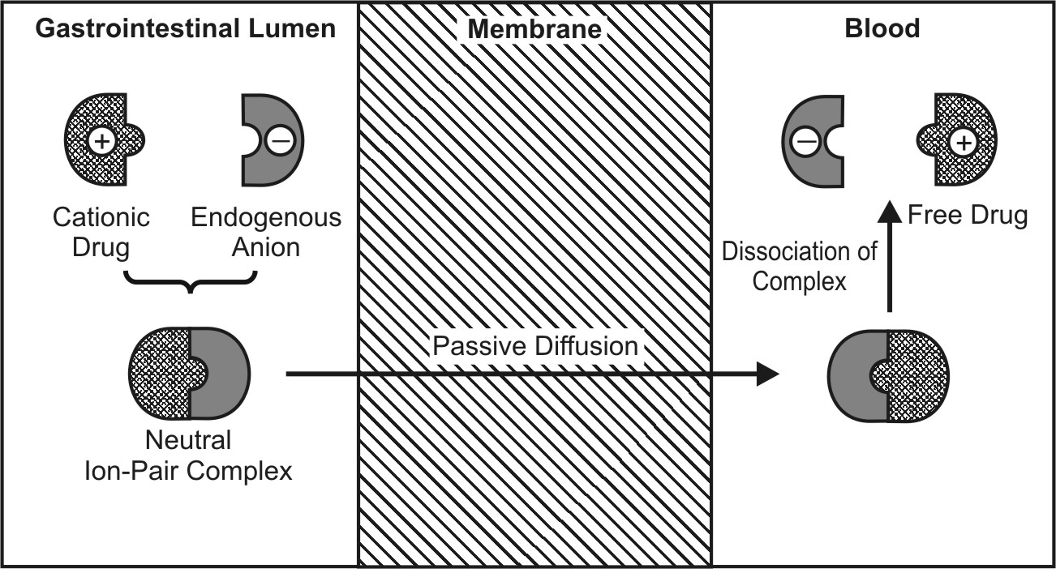
Ion-pair transport of a cationic drug

Slide 16
Carrier-Mediated Transport
Some polar drugs cross the membrane more readily than can be predicted from their concentration gradient and partition coefficient values. Like monosaccharides, amino acids and vitamins will be poorly absorbed.
The mechanism is involved is carrier that binds reversibly or non-covalently with the solute molecules to be transported. This carrier-solute complex traverses across the membrane to the other side where it dissociates and discharges the solute molecule.
The carrier then returns to its original site to complete the cycle by accepting a fresh molecule of solute. Carriers in membranes are proteins (transport proteins) and may be an enzyme or some other component of the membrane.

Slide 17
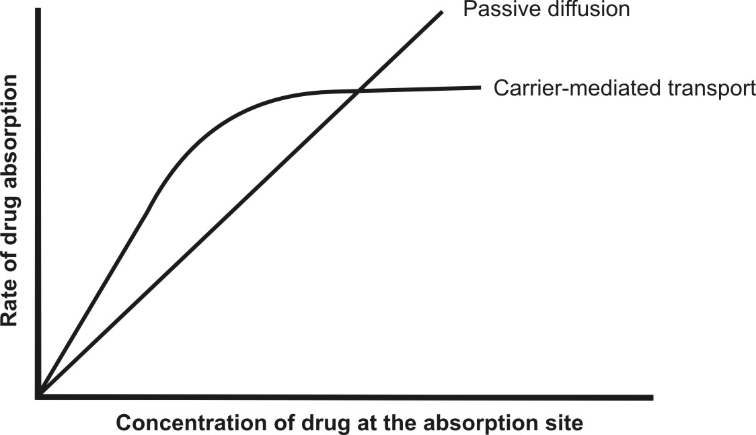
Since the system is structure-specific, drugs having structure similar to essential nutrients, called as false nutrients, are absorbed by the same carrier system.

Slide 18
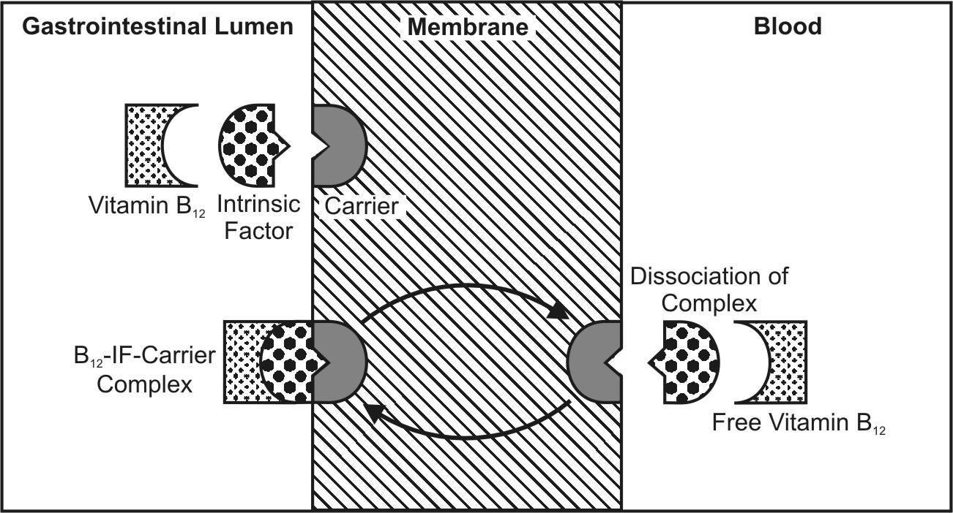
Facilitated Diffusion
It is a carrier-mediated transport system that operates down the concentration gradient (downhill transport) but at a much a faster rate than can be accounted by simple passive diffusion. The driving force is concentration gradient (hence a passive process). Since no energy expenditure is involved, the process is not inhibited by metabolic poisons that interfere with energy production.
Facilitated diffusion of vitamin B12

Slide 19
B. Active Transport Processes – This transport process requires energy from ATP to move drug molecules from extracellular to intracellular milieu. These are of two types –
  Primary active transport.
  Secondary active transport – this process is further subdivided into two –
    Symport (co-transport).
    Antiport (counter-transport).

Slide 20
Active Transport
This transport mechanism requires energy in the form ATP. Active transport mechanisms are further subdivided into -
Primary active transport – In this process, there is direct ATP requirement. Moreover, the process transfers only one ion or molecule and in only one direction, and hence called as uniporter e.g. absorption of glucose.
Secondary active transport – In these processes, there is no direct requirement of ATP i.e. it takes advantage of previously existing concentration gradient. The energy required in transporting an ion aids transport of another ion or molecule (co-transport or coupled transport) either in the same direction or in the opposite direction. Accordingly this process is further subdivided into –
  symport (co-transport) – involves movement of both molecules in the same direction e.g. Na⁺-glucose symporter
  Antiport (counter-transport) – involves movement of molecules in the opposite direction e.g. H⁺ ions using the Na⁺ gradient in the kidneys.

Slide 21
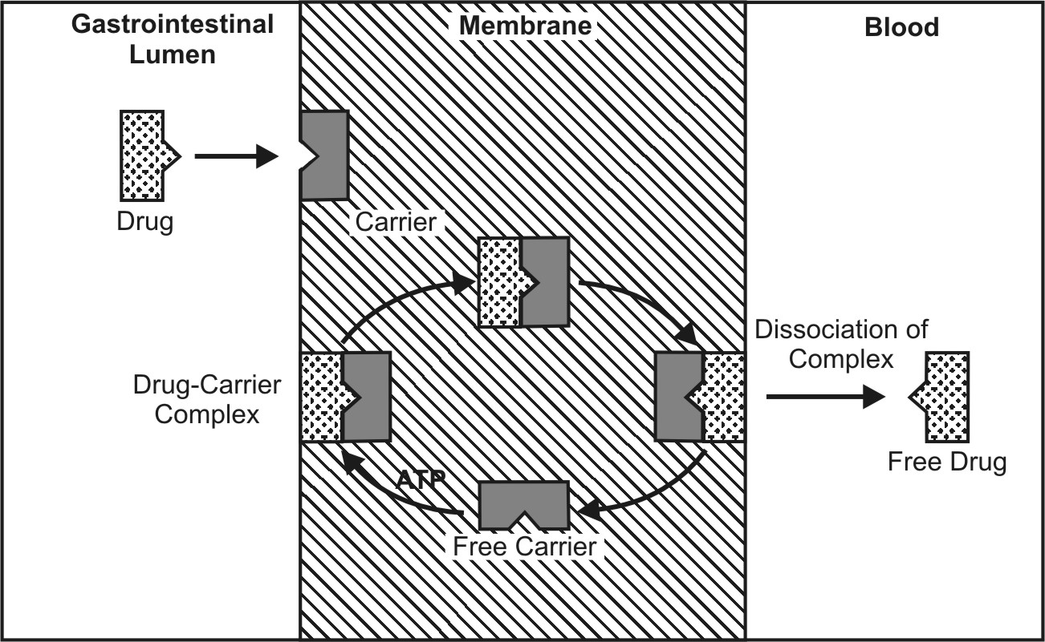

Slide 22
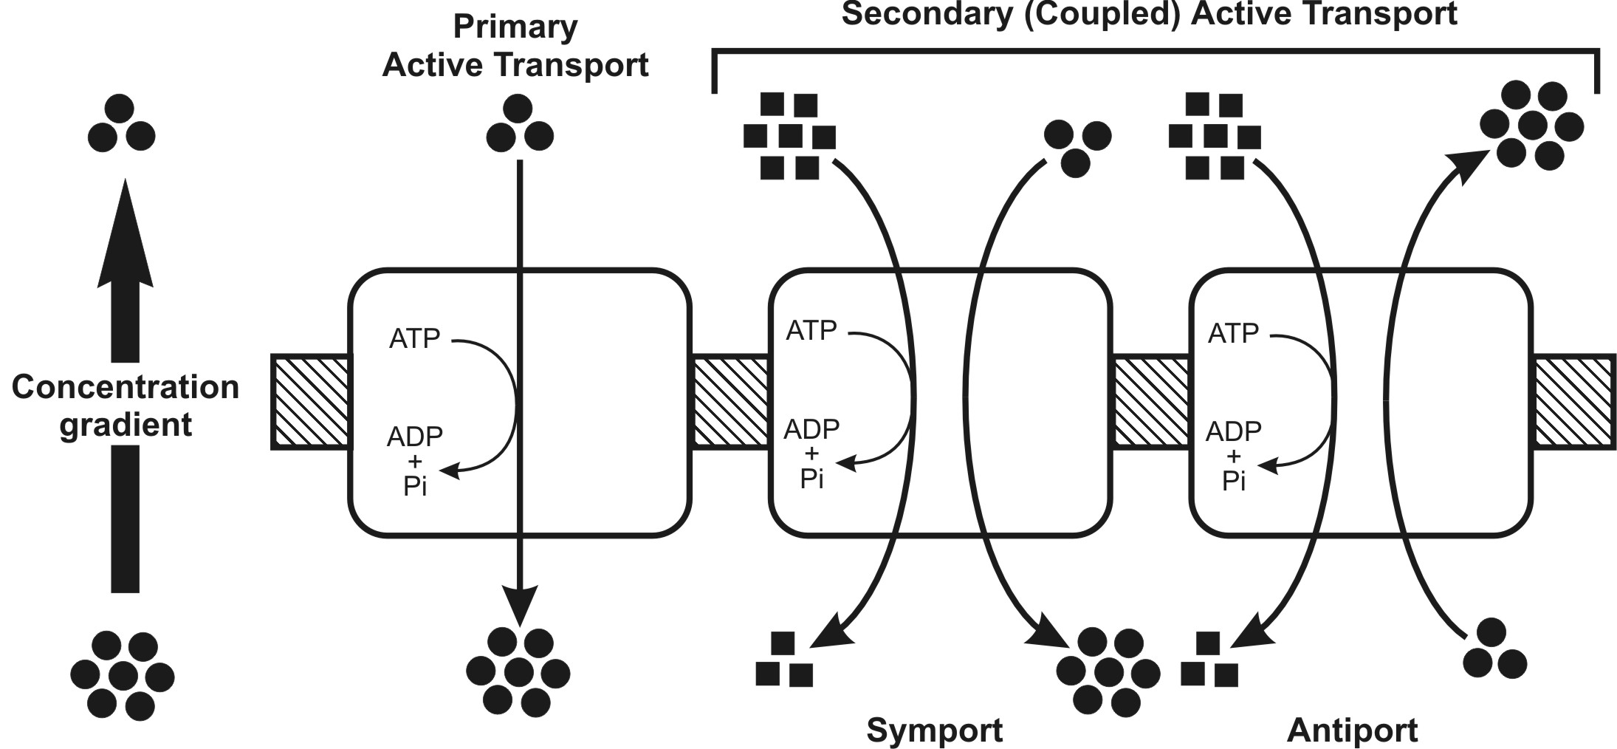

Slide 23
B. Paracellular/Intercellular Transport – is defined as the transport of drugs through the junctions between the GI epithelial cells. This pathway is of minor importance in drug absorption. The two paracellular transport mechanisms involved in drug absorption are –
  Permeation through tight junctions of epithelial cells – this process basically occurs through openings which are little bigger than the aqueous pores. Compounds such as insulin and cardiac glycosides are taken up this mechanism.
  Persorption – is permeation of drug through temporary openings formed by shedding of two neighbouring epithelial cells into the lumen.

Slide 24
C. Vesicular or Corpuscular Transport (Endocytosis) – Like active transport, these are also energy dependent processes but involve transport of substances within vesicles into a cell. Since the mechanism involves transport across the cell membrane, the process can also be classified as transcellular. Vesicular transport of drugs can be classed into two categories –
  Pinocytosis.
  Phagocytosis.

Slide 25
This phenomenon is responsible for the cellular uptake of macromolecular nutrients like fats and starch, oil soluble vitamins like A, D, E and K, water soluble vitamin like B₁₂ and drugs such as insulin. Another significance of such a process is that the drug is absorbed into the lymphatic circulation thereby bypassing first-pass hepatic metabolism.
Endocytosis includes two types of processes:
Phagocytosis (cell eating): adsorptive uptake of solid particulates, and
Pinocytosis (cell drinking): uptake of fluid solute.

Slide 26
