Slide 1

Department of Pharmacy, SVDu
PHARMACEUTICS I
D. Pharm, 1st Year
Title: INTRODUCTION TO PHARMACOPOEIA
Prepared By:
Ms. Mamta Kumari

Slide 2
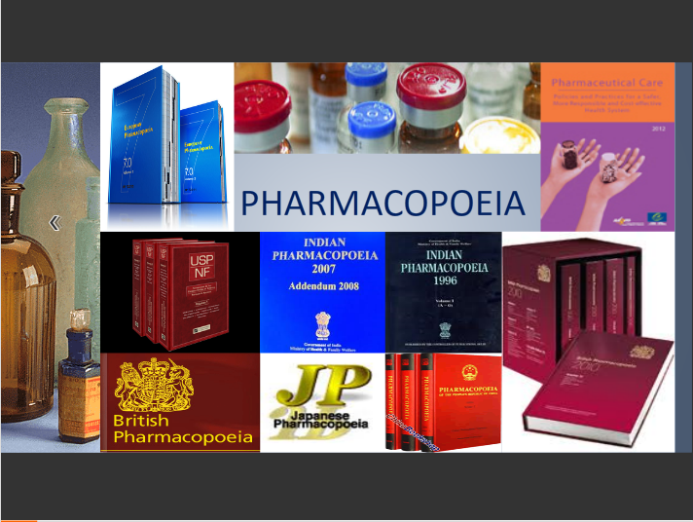

Slide 3
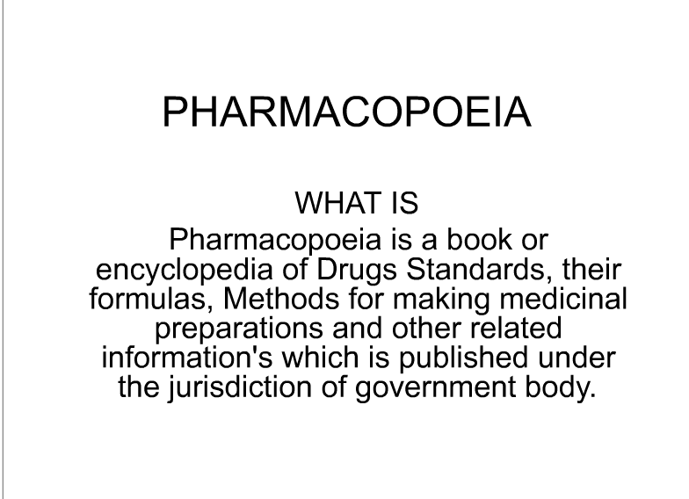

Slide 4
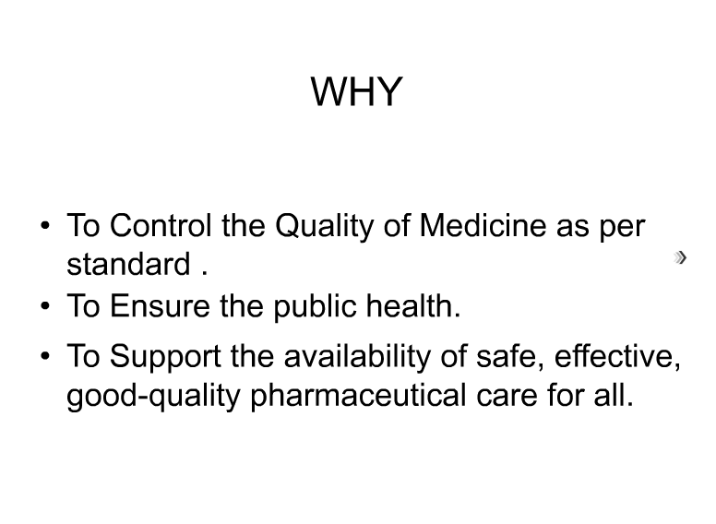

Slide 5
Pharmacopoeia
Derived from Greek word ‘Pharmakon’ means drug and ‘Poiea’
means to make.
It is a legal and official book issued by recognized authorities usually appointed by Government of each country.
It comprises list of pharmaceutical substances, formulae along with
their description and standards.
List of Pharmacopeias:
  Argentine b) Austrian c) Belgian d) Brazilian e) British
f) Chinese g) Egyptian h) European i) French j) German
k) Hungarian l) Indian m) International n) Italian o) Japanese
p) Yugoslavian q) Mexican r) Netherlands s) Nordic t) Polish
u) Portuguese v) Rumanian w) Russian x) Spanish y) Turkish
z) United state.

Slide 6
Indian Pharmacopoeia and its Addendum
 | Indian Pharmacopoeia | Year
1. | First Edition | 1955
2. | Supplement | 1960
3. | Second Edition | 1966
4. | Supplement | 1975
5. | Third Edition | 1985
6. | Addendum | 1989
7. | Addendum | 1991
8. | Fourth Edition | 1996
9. | Addendum | 2000
10. | Veterinary Supplement | 2000
11. | Addendum | 2002
12. | Addendum | 2005
13. | Fifth Edition | 2007
14. | Addendum | 2008
15. | Sixth Edition | 2010
16. | Addendum | 2012
17. | Seventh Edition (Current Edition) | 2014
18. | Addendum | 2015
19. | Addendum | To be Published in Sept. 2016

Slide 7
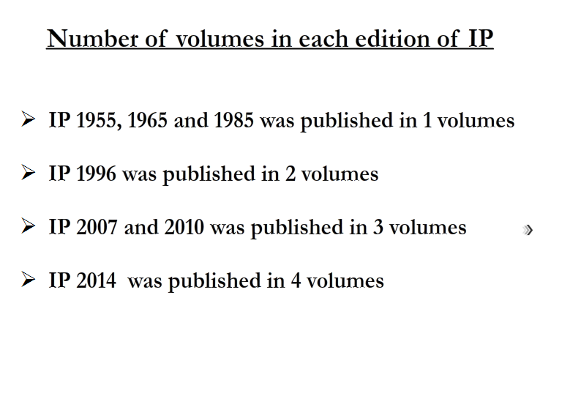

Slide 8
Indian Pharmacopoeia
First official Pharmacopeia of India appeared in 1868 which was edited by Edward John Waring.
In preindependence days, British Pharmacopeia was used in India.
The colonial addendum of BP 1898 was published in 1900
appeared as Government of India edition in 1901.
In 1946 Government of India issued one list known as „The Indian Pharmacopeial list‟
Committee under chairmanship of Sir R. N. Chopra alongwith
other nine members prepared 'The Indian Pharmacopeial list‟
It was prepared by Dept. of Health, Govt. of India, Delhi in 1946.
In 1948 Government of India appointed an Indian Pharmacopeia committee for preparing ‘Pharmacopeia of India'
Tenure of this committee was five years.
Indian Pharmacopeia committee under chairmanship of Dr. B. N. Ghosh Published first edition of IP in 1955.

Slide 9
Indian Pharmacopoeia
It is written in English & official titles of monographs given in
Latin.
It covers 986 monographs.
Supplement to this edition was published in 1960.
Second edition of IP was published in 1966 under the chairmanship of Dr. B. Mukkerji.
Official titles of monographs given in English.
Dose were expressed in Metric system.
For Tablets and Injections “USUAL STRENGTH” have been given.
Formulations of the drugs were given immediately after the
monograph of drugs.
274 monographs from IP 55 & their supplement were deleted.
93 new monographs were added.
Supplement to this edition was published in 1975.
126 new monographs have been included & 250 monographs
have been amended.
Cholera vaccine has been deleted.

Slide 10
Indian Pharmacopoeia
Third edition of IP was published in 1985 with two volumes & nine
appendices.
261 new monographs have been added.
450 monographs were deleted.
Addendum I to IP was published in 1989 were 46 new monographs
added and 126 amended.
Addendum II was published in 1991 were 62 new monographs added and 110 amended.
Fourth edition of IP was published in 1996 under the chairmanship of Dr. Nityanand.
It has been made effective from 1st December 1996.
It covered 1149 monographs and 123 appendices.
It includes 294 new monographs & 110 monographs have been deleted.
Addendum I has been made effective from 31st December 2000
were 42 new monographs have been added.
Addendum II has been made effective from 30th June 2003 were
19 new monographs have been added.
The veterinary supplement to IP 1996 contains 208 monographs &
four appendices.

Slide 11
Indian Pharmacopoeia
Fifth edition of IP was published in 2007 & addendum to this edition was published in 2008.
IP 2007 is presented in Three Volumes.
Volume One contains general notices & general
chapters.
Volume Two & Three contains general monographs on
drug substances , dosage forms & Pharmaceutical aids.

Slide 12
Indian Pharmacopoeia 2010
6th editionof IP is published in 2010.
The 6th edition of the Indian Pharmacopoeia 2010 is published by the Indian Pharmacopoeia Commission (IPC) Ghaziabad in accordance with a plan and completed through the untiring efforts of its members, Secretariat and Laboratory over a period of about two years.
It supersedes the 2007 edition but any monograph of the earlier edition that does not figure in this edition.
This edition would be effective from 1st September, 2010.
The Indian Pharmacopoeia 2010 is presented in three volumes.
Volume I contains the Notices, Preface, the Structure of the IPC, Acknowledgements, Introduction, and the General Chapters.
Volume II contains the General Notice, General Monographs on Dosage Forms and Monographs on drug substances, dosage forms and pharmaceutical aids (A to M).

Slide 13
Indian Pharmacopoeia 2010
Volume III contains Monographs on drug substances, dosage forms and pharmaceutical aids (N to Z).
Followed by Monographs on Vaccines and Immunosera for Human use, Herbs and Herbal products, Blood and blood- related products, Biotechnology products and Veterinary products.
The scope of the Pharmacopoeia has been extended to include products of biotechnology, indigenous herbs and herbal products, veterinary vaccines and additional antiretroviral drugs and formulations, inclusive of commonly used fixed-dose combinations. Standards for new drugs and drugs used under National Health Programmes are added and the drugs as well as their formulations not in use now a day are omitted from this edition.

Slide 14
Indian Pharmacopoeia 2010
The number of monographs of Excipients, Anticancer drugs, Herbal products and antiretroviral drugs has been increased in this edition.
Monographs of Vaccines and Immunosera are also upgraded in view of development of latest technology in the field.
A new chapter on Liposomal products and a monograph of Liposomal Amphotericin B injection is an added advantage in view of latest technology adopted for drug delivery.
A chapter on NMR is incorporated in Appendices.
The chapter on microbial contamination is also updated to a great extent to harmonise with prevailing international requirements.

Slide 15
Seventh Edition of IP (2014)
The seventh edition of the Indian Pharmacopoeia (IP 2014) is published by the Indian Pharmacopoeia Commission (IPC) on behalf of the Government of India, Ministry of Health & Family Welfare.
The Indian Pharmacopoeia 2014 is presented in four volumes. The scope of the Pharmacopoeia has been extended to include additional anticancer drugs & antiretroviral drugs and formulations, products of biotechnology, indigenous herbs and herbal products, veterinary vaccines.
The IP 2014 incorporates 2550 monographs of drugs out of which 577 are new monographs consisting of APIs, excipients, dosage forms and herbal products etc.

Slide 16
Seventh Edition of IP (2014)
A list of 577 New Monographs not included in IP-2010 and its Addendum-2012 but added in this edition containing 313 New Monographs on drug substances, Dosage forms & Pharmaceutical aids (A to Z), 43 New Drugs Substances Monographs, 10 Antibiotic Monographs, 31 Herbal Monographs, 05 Vaccines & immunosera for human use, 06 Insulin Products, 07 Biotechnology Products etc. along with the 19 new General Chapters.
19 New Radiopharmaceutical Monographs & 1 General chapter is first time being included in this edition.
This edition of Indian Pharmacopoeia-2014 is available since Sept.2013, before three months of its effective date, i.e. 1st Jan. 2014.

Slide 17
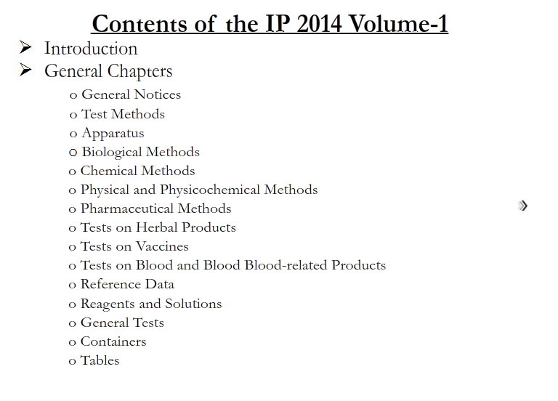

Slide 18
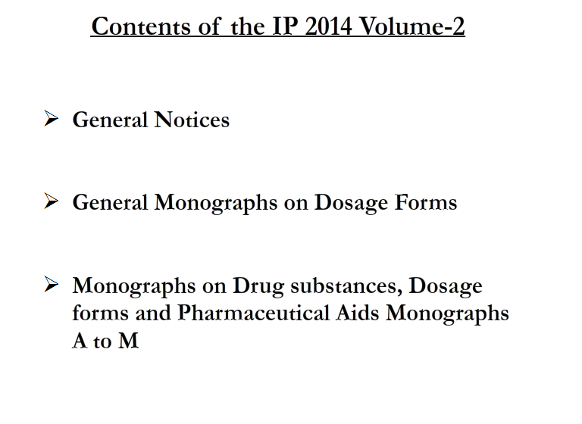

Slide 19
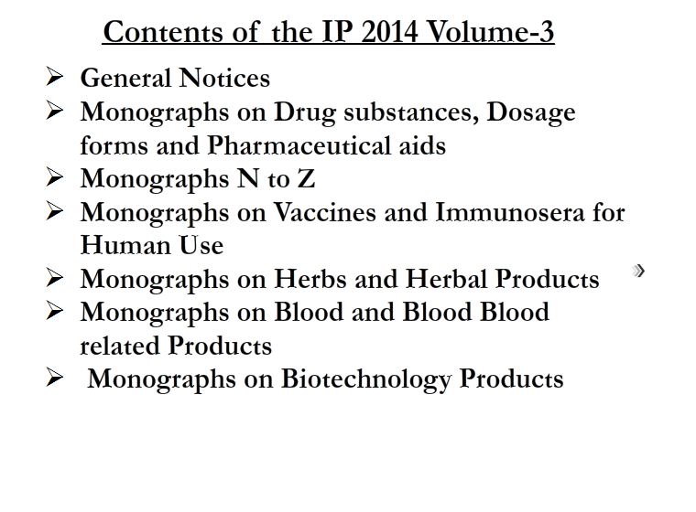

Slide 20
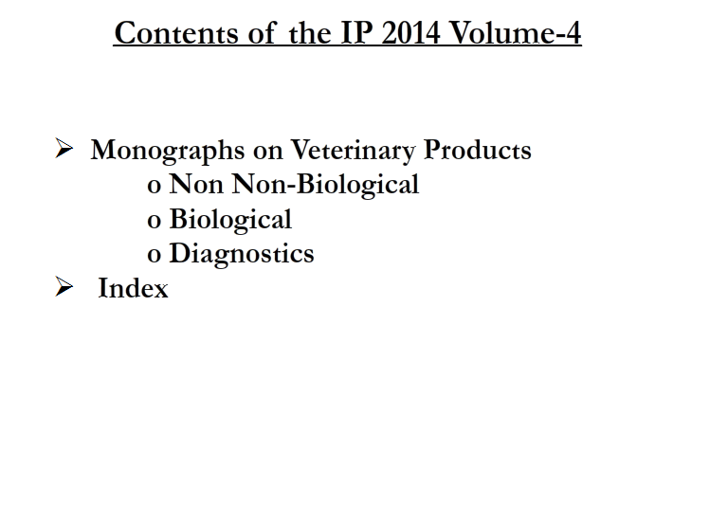

Slide 21
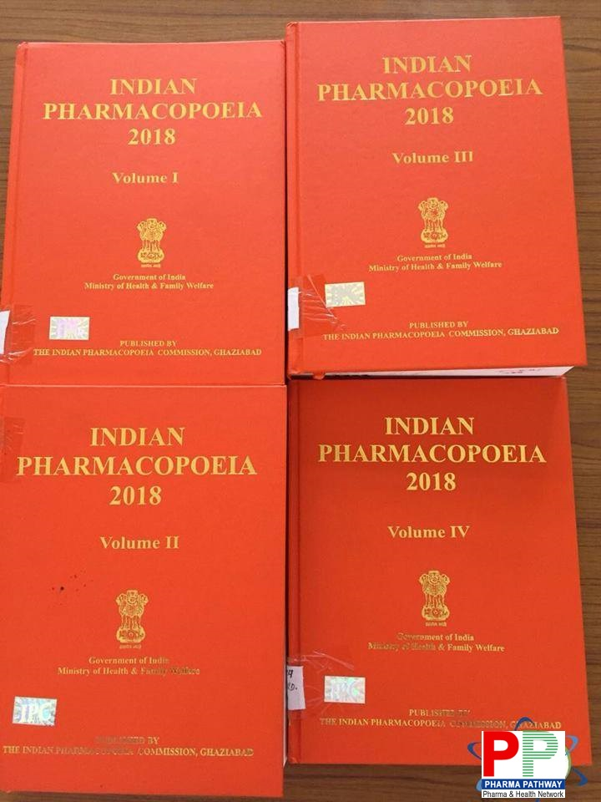

Slide 22
Updates in IP 2018
IP-2018 has been brought out in 4 Volumes incorporating 220 new monographs
Chemical Monographs (170),
Herbal Monographs (15),
Blood and Blood related products (10),
Vaccines and Immunosera for Human use monographs (02),
Radiopharmaceutical monographs (03),
Biotechnology Derived Therapeutic Products (06),
Veterinary monographs (14)),
366 revised monographs and 7 omissions.

Slide 23
Updates in IP 2018
Salient Features of IP-2018 Keeping in view the essential requirement for harmonization of analytical methods with those accepted internationally, steps have been taken for monitoring drug standards.
General Chemical tests & Thin Layer Chromatography (TLC) for identification of an article have been almost eliminated and more specific infrared, ultraviolet spectrophotometer and HPLC tests have been given emphasis.
The concept of relying on published infrared spectra as a basis for identification has been continued.
The use of chromatographic methods has been greatly extended to cope with the need for more specificity in assays and in particular, in assessing the nature and extent of impurities in ingredients and products.
Most of the existing Assays and Related Substances Test methods are upgraded by liquid chromatographic in view to harmonize with other International Pharmacopoeia
Source: http://ipc.nic.in

Slide 24
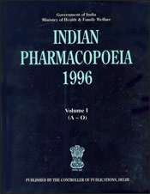
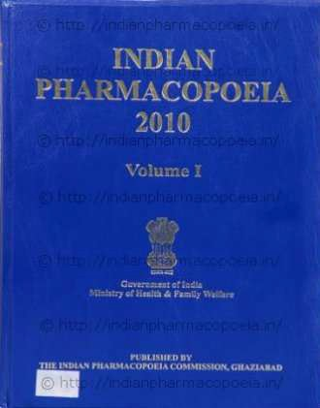
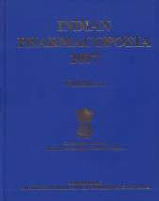
Indian Pharmacopoeia

Slide 25
BRITISH Pharmacopoeia
First edition of BP was published in 1864.
It consist of two sections
Part I:- Materia Medica & Part II:- Preparation & compounds.
Second edition of BP was published in 1867.
Fourth edition of BP was published in 1898.
Fifth edition of BP was published in 1914.
Eighth edition of BP was published in 1953.
In this edition titles of drugs & preparations were in English
instead of Latin and metric system.
It has been published annually.
In BP 2007 monographs has been introduced for material specifically used in preparation of Traditional Chinese medicines.
Term „Prolonged release‟ has been replaced the term „Slow‟ and the term „Gastro-resistant‟ has been replaced with „Enteric coated‟ in number of monographs.

Slide 26
BRITISH Pharmacopoeia
BP 2008 contains approximately 3100 monographs for substances, preparations and articles used in practice.
It has been made effective from 1st January 2008.
BP 2007 -2009 were given in Six Volumes i.e. Volume I to Volume VI.
Volume I & II contains medicinal substances.
Volume III contains formulated preparations, blood related products, immunological products, radiopharmaceutical preparations, surgical materials & homoeopathic preparations.
Volume IV contains supplementary chapters, IR spectra etc.
Volume V contains veterinary.
Volume VI contains CD ROM version.

Slide 27
THE BRITISH PHARMACOPOEIA 2010
TSO (The Stationery Office), on behalf of the British Pharmacopoeia Secretariat, part of the Medicines and Healthcare products Regulatory Agency (MHRA), has recently published the British Pharmacopoeia (BP) 2010.
The British Pharmacopoeia (BP) is the official collection of standards for UK medicinal products and pharmaceutical substances. Published annually, the BP contains monographs for pharmaceutical substances, formulated preparations and other articles used in the practice of medicine. The standards in the BP 2010 are legally effective in the UK from 1 January 2010.
The BP has been providing authoritative, official standards for pharmaceutical substances and medicinal products since 1864. Today, it is used in almost 100 countries worldwide and remains an essential reference for any individual or organisation working within pharmaceutical research and development, manufacturing and testing across the globe.

Slide 28
New to the BP 2010 are 40 monographs for formulated
preparations, including additional standards for
veterinary medicines and widely used unlicensed
formulations. All European Pharmacopoeia 6th edition
material up to and including
Supplement 6.5 is
integrated into the text of the BP 2010. In addition to the
expanding formulated
number products,
of monographs the BP supports of herbal and
for licensed the regulatory
work in the fields
medicines by providing
complementary
additional new and revised medicinal products and for
monographs for herbal
homeopathic stocks and mother tinctures.
The print edition of the BP 2010 comprises four volumes of the BP 2010 and a single volume of the BP (Veterinary) 2010.

Slide 29
THE BRITISH PHARMACOPOEIA (BP) 2013
The BP 2013 package includes:
Six volume printed edition including the BP (Veterinary) 2013
New for 2013:
41 new BP monographs
40 new European Pharmacopoeia monographs 619 amended monographs
6 new and 1 amended Infrared Reference Spectra

Slide 30
THE BRITISH PHARMACOPOEIA 2014
The only official source of British pharmaceutical standards
Produced by the British Pharmacopoeia Commission Secretariat of the Medicines and Healthcare Products Regulatory Agency, and updated annually, the British
Pharmacopoeia (BP) is the official, authoritative collection of standards for UK
medicinal substances for human and veterinary use.
The 2014 edition includes almost 3500 monographs which are legally enforced by the Human Medicines Regulations 2012.
Global standards
Now used in over 100 countries, the BP remains an essential reference for all individuals and organisations working within pharmaceutical research and
development, manufacture and testing around the globe.

Slide 31
Flexible access options
The BP 2014 package comprises five volumes of the British Pharmacopoeia 2014 and a single volume of the British Pharmacopoeia (Veterinary) 2014, along with a fully searchable CD-ROM and online access to provide you with flexible resources.
New for 2014
Legally effective from 1 January 2014 40 new BP monographs
272 amended monographs
Three new Supplementary Chapters Four new BP (Vet) monographs
One new BP (Vet) Supplementary Chapter
Current edition of BP 2019 is in process.

Slide 32
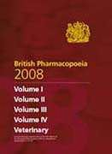
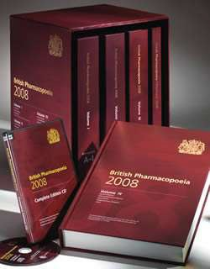
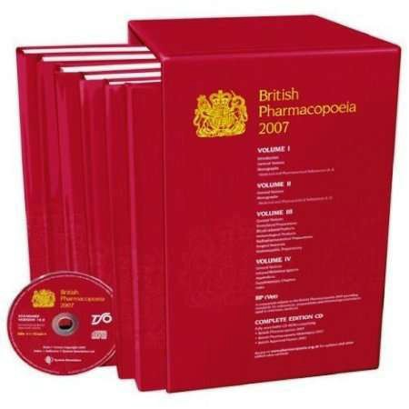
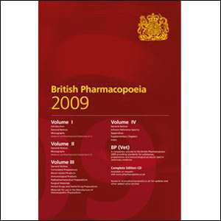
BRITISH Pharmacopoeia

Slide 33
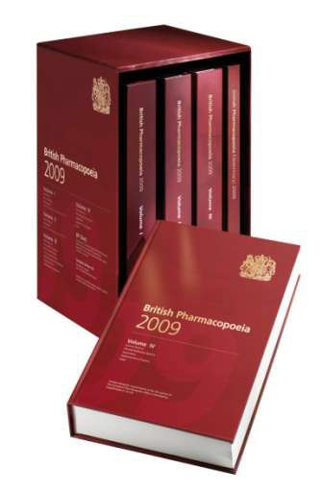


BRITISH Pharmacopoeia

Slide 34
UNITED STATE Pharmacopoeia
First edition of United state Pharmacopeia was published on 15th
December 1820 in both Latin & English.
From 1820 to 1942 it was published at Ten years intervals.
From 1942 to 2000 it was published at Five years intervals.
From 2002 it was published annually.
First National Formulary of the united state appeared in 1888.
USP21-NF16 have eight supplements.
First appeared in January 1985 & last in November 1988.
USP22-NF17, 1990 is the third revision that consolidates USP & NF into a single volume.
Electronic version of USP-NF on floppy disks was introduced in
1992.
USP23-NF18, was published in Mumbai as an Asian edition at the end of 1994.

Slide 35
UNITED STATE Pharmacopoeia
USP23 has ten supplements.
First supplement was published in January 1995 & Last in May 1999.
USP24-NF19, appeared from first January 2000.
USP30-NF25, appeared from May 2007.
It contains Scientific standards for drugs, dietary substances, biological products & Excipients used in dosage forms.
It contains 4,100 monographs and 200 general chapters.
It has been printed in three volume set.
Volume I contains general chapters & Volume II & III contains monographs.
First supplement to USP30-NF25, appeared from August 2007 & second supplement from November 2007 which will be considered official from May 2008.
From 2006, Spanish edition of USP is also being published.
Current edition of USP 2014 is in process.

Slide 36
UNITED STATES PHARMACOPOEIA 30 – NATIONAL
FORMULARY 25
Highlights include:
New heavier paper stock
Complete table of contents and index in each volume
Special 'Using the New USP-NF Print' tutorial CD
Convenient slipcase for easy access and storage (English edition only).
UNITED STATES PHARMACOPOEIA 31 - NATIONAL
FORMULARY 26
The USP-NF is a single-volume combination of two official compendia, the United States Pharmacopeia (USP) and the National Formulary (NF). Monographs for drug substances and preparations are featured in the USP, with monographs for dietary supplements and ingredients appearing in a separate section of the USP. Excipient monographs are included in the NF.

Slide 37
UNITED STATES PHARMACOPOEIA 32 - NATIONAL
FORMULARY 27
The USP 32-NF 27 Contains :
More than 4,200 monographs
Includes over 200 general chapters, covering general tests and assays
Displays helpful guides and charts that make it easy to find focus-specific information
Includes information on emerging areas of science and medicine
Helps ensure compliance with official standards
Enables validation of test results against proven benchmarks
Creates in-house standards for operating procedures and
specifications
Expedites new product development and approvals.

Slide 38
UNITED STATES PHARMACOPOEIA 33 - NATIONAL
FORMULARY 28:
The USP 33-NF 28 Contains:
More than 4,400 monographs
Over 200 general chapters covering general tests and assays
A new, easy-to-read format and monograph layout
Helpful guides and charts that make it easy to find focus-specific information
Ensures compliance with official standards
Establishes in-house standard operating procedures and specifications
Facilitates new product development and approval.

Slide 39
UNITED STATES PHARMACOPEIA 34 - NATIONAL
FORMULARY 29:
USP 34-NF 29 features more than 4,500 monographs for drug substances, dosage forms, excipients, biologics, dietary supplements, and other therapeutics. USP 34-NF 29 also offers harmonized material and more than 230 General Chapters with current guidelines for the full range of laboratory tests and established processes for validating methods.
UNITED STATES PHARMACOPEIA 35 - NATIONAL FORMULARY 30:
The 'United States Pharmacopeia 35 - National Formulary 30' (USP-NF) is a combination of two official compendia: the 'United States Pharmacopeia (USP)' and the 'National Formulary (NF)' and is officially applicable from 1 May, 2012 to 30 April, 2013.

Slide 40


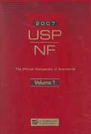
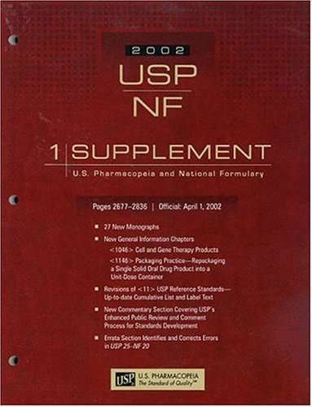

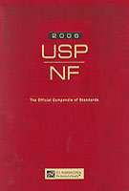
UNITED STATE Pharmacopoeia

Slide 41
European Pharmacopeia
European pharmacopeia commission started working since 1964 to prepare EP
Editions
1st edition: published 1967
2nd edition: published 1980
3rd edition: published 1997
4th edition: published 2001, valid from 1 January 2002
5th edition: published 15 June 2004, valid from 1 January 2005
6th edition: published 16 July 2007, valid from 1 January
2008
7th edition: published June 2010, valid from 1 January 2011
8th edition: published June 2013, valid from 1 January 2014

Slide 42
Since its 5th edition, the pharmacopoeia is published in 2 volumes. Volume 1 contains general chapters and monographs (e.g. on dosage forms, methods of analysis, reagents), volume 2 contains all substance monographs. During runtime of current edition several supplements are published. Electronic versions are also available (CD-ROM, USB stick and online version).

Slide 43
EUROPEAN PHARMACOPOEIA 8TH EDITION
PUBLISHED ON JUNE 2013
The European Pharmacopoeia (Ph. Eur.) defines requirements for the qualitative and quantitative composition of medicines, the tests to be carried out on medicines and on substances and materials used in their production.
It covers active substances, excipients and preparations of chemical, animal, human or herbal origin, homoeopathic preparations and homoeopathic stocks, antibiotics, as well as dosage forms and containers. It also includes texts on biologicals, blood and plasma derivatives, vaccines and radiopharmaceutical preparations. The European Pharmacopoeia and its requirements are legally binding in the member states of the European Pharmacopoeia Convention and the European Union.

Slide 44
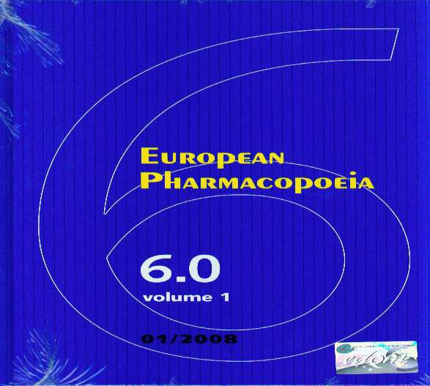
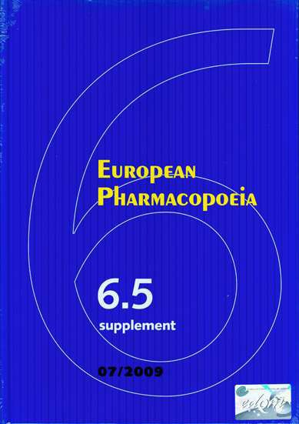
European Pharmacopeia

Slide 45
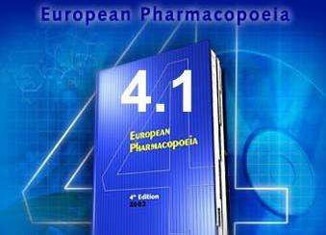
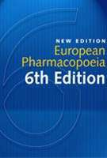
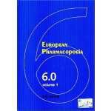
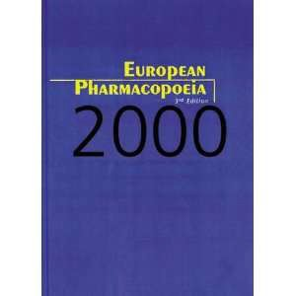
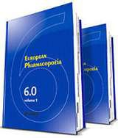

European Pharmacopeia

Slide 46
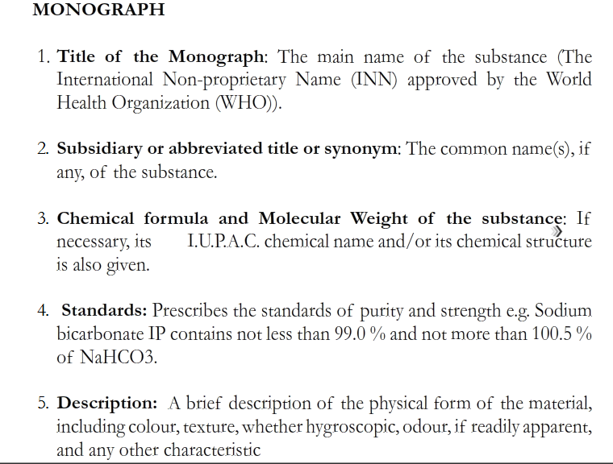

Slide 48
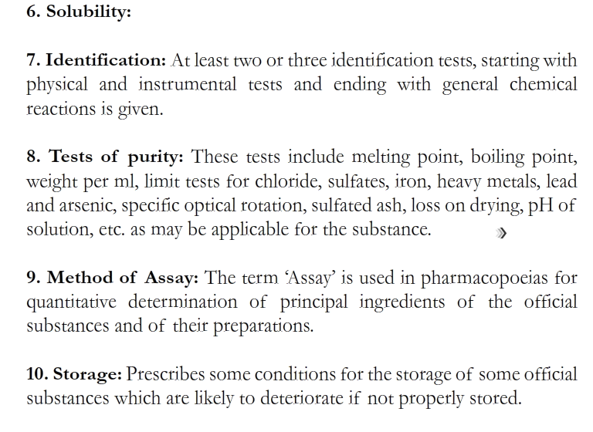

Slide 49
List of Pharmacopeias
a) Argentine
b) Austrian
c) Belgian
d) Brazilian
e) British
f) Chinese
g) Egyptian
h) European
i) French
j) German
k) Hungarian
l) Indian
m) International
n) Italian
o) Japanese
p) Yugoslavian
q) Mexican
r) Netherlands
s) Nordic
t) Polish
u) Portuguese
v) Rumanian
w) Russian
x) Spanish
y) Turkish
z) United state.

Slide 50
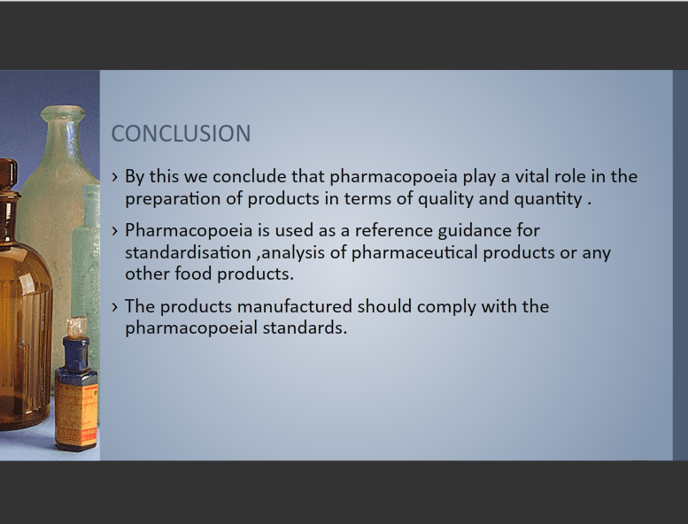

Slide 51
EVIDENCE BASED REFERENCE
Title/ Journal | Author name | Question | Methodology | Result | conclusion
“Pliny’s pharmacopoeia or the Roman treat” Neth Heart J. 2007 March; 15(3): 118–120 | C. van Tellingen | To explore Pliny’s pharmacopoeia | Reviewing the literature | reductionistic approach to single active components is more than likely lacking efficaciousness and activity in highly complex living systems | humans with an internal ecosystem of diverse microbiota and parasites that have interactive metabolic processes, the notion of synergy in drug action could well be the only road to success in the time to come.

Slide 52
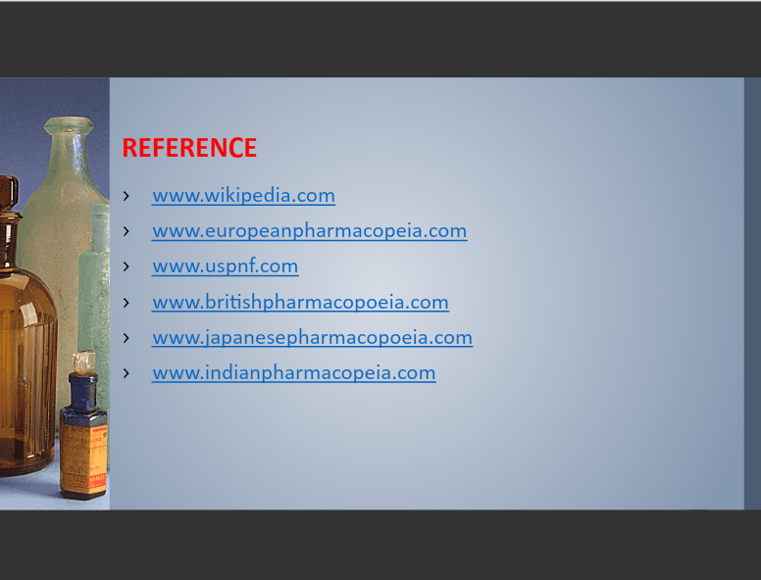

Slide 53


