Slide 1
Plant Tissue Culture
4th sem B.pharm(Pharmacognosy)
Prepaired By
Sunil Baile
(Assistant Professor))

Slide 2
Content
Background
Introduction
Plant Cell Culture Media
Types of Culture Media
Application
Terminology

Slide 3
Plant tissue culture is the science of growing plant cells, tissues or organs isolated from the mother plant, on artificial media.

Slide 4
Some of the landmark discovery in field of Plant Tissue Culture

Slide 5
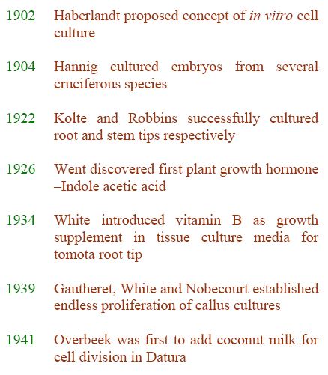
http://nsdl.niscair.res.in/bitstream/123456789/668/1/revised+introduction+to+plant+biotechnology.pdf

Slide 6
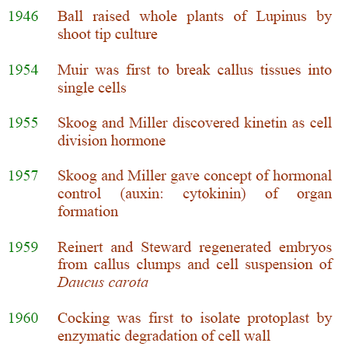
http://nsdl.niscair.res.in/bitstream/123456789/668/1/revised+introduction+to+plant+biotechnology.pdf

Slide 7
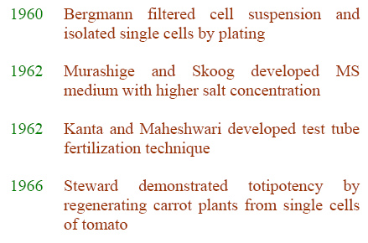
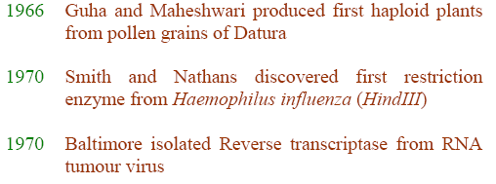
Department of Pharmacy, SV
http://nsdl.niscair.res.in/bitstream/123456789/668/1/revised+introduction+to+plant+biotechnology.pdf

Slide 8
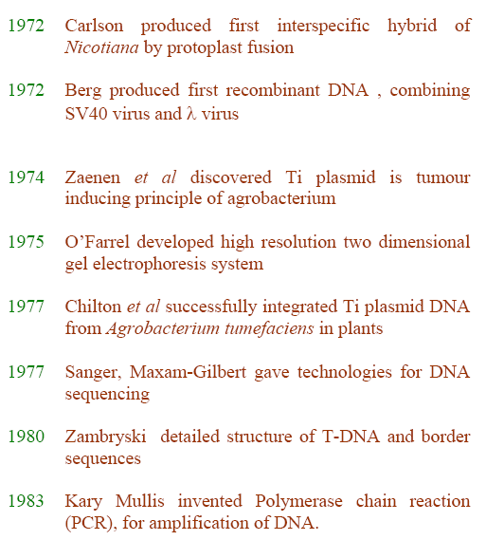
http://nsdl.niscair.res.in/bitstream/123456789/668/1/revised+introduction+to+plant+biotechnology.pdf

Slide 9
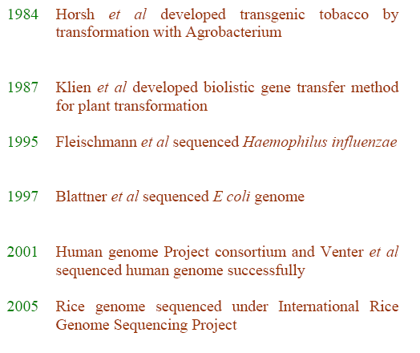
http://nsdl.niscair.res.in/bitstream/123456789/668/1/revised+introduction+to+plant+biotechnology.pdf

Slide 10
Introduction
Plant tissue culture is a practice used to propagate plants under sterile conditions, often to produce clones of a plant.
It relies on maintaining plant cells in aseptic conditions on a suitable nutrient medium.
The culture can be sustained as a mass of undifferentiated cells for an extended period of time, or regenerated into whole plants.
http://en.wikipedia.org/wiki/Plant_tissue_culture
http://www.liv.ac.uk/~sd21/tisscult/introduction.htm

Slide 12
Different techniques in plant tissue culture may offer certain advantages over traditional methods of propagation, including
The production of exact copies of plants that produce particularly good flowers, fruits, or have other desirable traits.
To quickly produce mature plants.
http://en.wikipedia.org/wiki/Plant_tissue_culture

Slide 13
The production of multiples of plants in the absence of seeds or necessary pollinators to produce seeds.
The regeneration of whole plants from plant cells that have been genetically modified.
The production of plants in sterile containers that allows them to be moved with greatly reduced chances of transmitting diseases, pests, and pathogens.
http://en.wikipedia.org/wiki/Plant_tissue_culture

Slide 14
The production of plants from seeds that otherwise have very low chances of germinating and growing, i.e.: orchids and nepenthes.
To clean particular plant of viral and other infections and to quickly multiply these plants as 'cleaned stock' for horticulture and agriculture.
http://en.wikipedia.org/wiki/Plant_tissue_culture

Slide 15
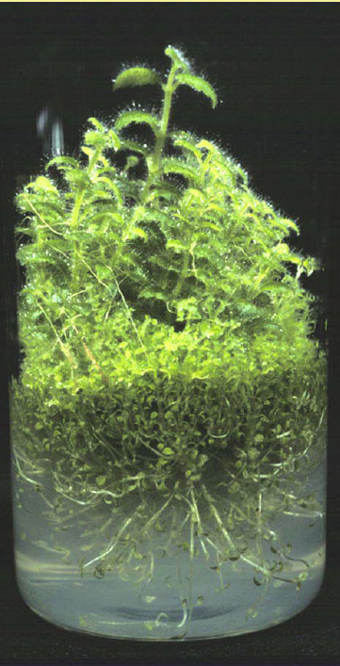
Plant tissue culture relies on the fact that many plant cells have the ability to regenerate a whole plant (totipotency).
http://en.wikipedia.org/wiki/Plant_tissue_culture

Slide 16
Single cells, plant cells without cell walls (protoplasts), pieces of leaves, or (less commonly) roots can often be used to generate a new plant on culture media given the required nutrients and plant hormones

Slide 17
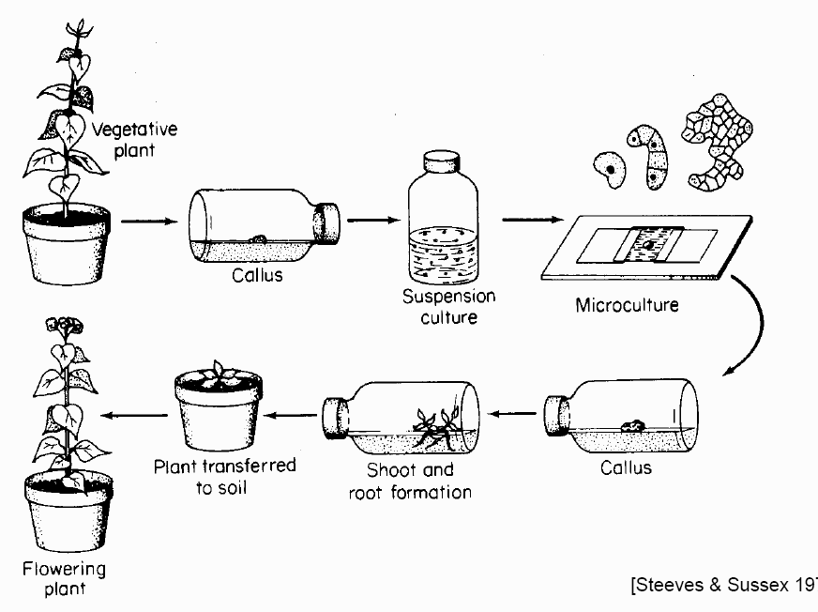

Slide 18
Plant Tissue Culture refers to the technique of growing plant cells, tissues, organs, seeds or other plant parts in a sterile environment on a nutrient medium.
This technique relies on the following conditions:
    Explant
    Aseptic environment
    Nutrient media
http://www.titanbiotechltd.com/plant-tissue-culture-media.asp

Slide 19
Explants:
A small tissue excised from any part of the plant is called explant which is the starting point.
It can be initiated from any part of plant- root, stem, petiole, leaf or flower, choice of explant varies with species. Meristems are more responsive and give better success as they are actively dividing.
http://nsdl.niscair.res.in/bitstream/123456789/668/1/revised+introduction+to+plant+biotechnology.pdf

Slide 20
The physiological state of the plant also has an influence on its response to initiate tissue culture. Therefore, the parent plant must be healthy and free from obvious signs of disease or decay.

Slide 21
Aseptic environment :
Aseptic environment during culture is required to avoid contamination from microorganisms.
Since plant cell division is slower compared to the growth of bacteria, fungi and even minor contaminants can easily overgrow the plant tissue culture. Therefore, all the materials like glassware, instruments, medium, explant etc to be used in culture work must be free of microbes using several techniques available:
http://nsdl.niscair.res.in/bitstream/123456789/668/1/revised+introduction+to+plant+biotechnology.pdf

Slide 22
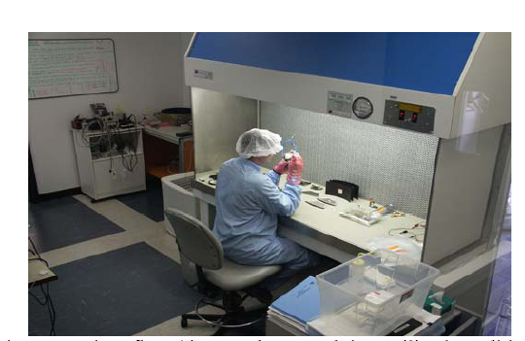
Laminar flow is a mandatory prerequisite for any tissue culture laboratory for contamination free work.
http://nsdl.niscair.res.in/bitstream/123456789/668/1/revised+introduction+to+plant+biotechnology.pdf

Slide 23
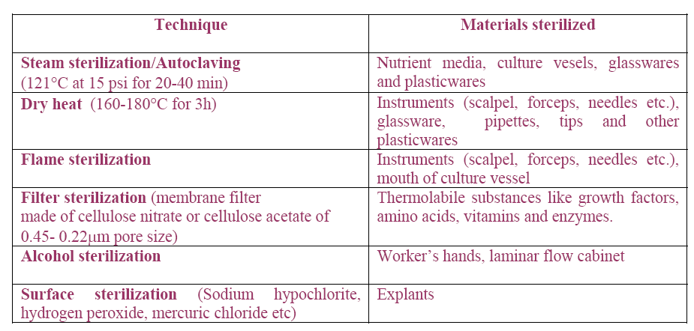
Sterilization Techniques used in plant tissue culture
http://nsdl.niscair.res.in/bitstream/123456789/668/1/revised+introduction+to+plant+biotechnology.pdf

Slide 24
Nutrient Media

Slide 25
Nutrient media used for in vitro cultivation of plant cells are composed of following basic components:
Inorganic salts containing essential elements, or mineral ions, supplied as a complex mixture of salts;
Organic supplement supplying vitamins and/or amino acids
Carbon source; usually supplied as the sugar sucrose.
Gelling agents
Plant Growth Regulators
pH
http://www.titanbiotechltd.com/plant-tissue-culture-media.asp
www.oup.com/uk/orc/bin/0199254680/ch02.pdf

Slide 26
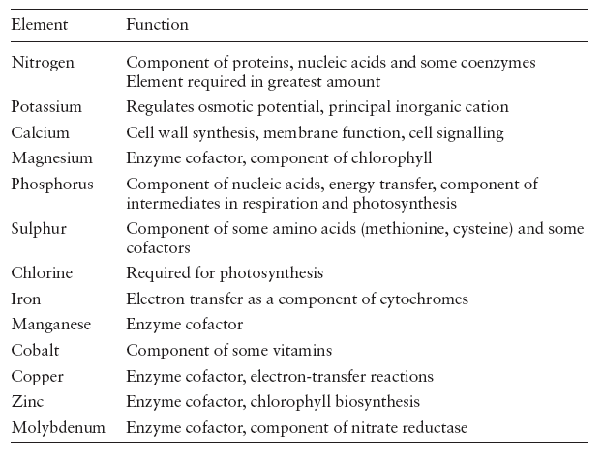
www.oup.com/uk/orc/bin/0199254680/ch02.pdf

Slide 27
Inorganic salts
These include essential elements or mineral ions important for plant nutrition and their physiological function. The essential elements can further be divided into the following categories:
Macroelements (or macronutrients)
Microelements (or micronutrients)
Iron source
http://www.titanbiotechltd.com/plant-tissue-culture-media.asp

Slide 28
Macroelements:
  required in large amounts for plant growth and development.
  Nitrogen, phosphorus, potassium, magnesium, calcium and sulphur (and carbon, which is added separately) are regarded as macroelements.
  These elements comprise at least 0.1% of the dry weight of plants.
http://www.titanbiotechltd.com/plant-tissue-culture-media.asp

Slide 29
Microelements:
  These elements are required in trace amounts for plant growth and development.
  Manganese, iodine, copper, cobalt, boron, molybdenum, iron and zinc are regarded as microelements, although other elements like aluminium and nickel are frequently found in some formulations.
http://www.titanbiotechltd.com/plant-tissue-culture-media.asp

Slide 30
Iron Source:
  Iron is usually added in the medium as iron sulphate, although iron citrate can also be used.
  Ethylenediaminetetraacetic acid (EDTA) is usually used in conjunction with the iron sulphate.
  The EDTA complexes with the iron so as to allow the slow and continuous release of iron into the medium.
  Uncomplexed iron can precipitate out of the medium as ferric oxide.
http://www.titanbiotechltd.com/plant-tissue-culture-media.asp

Slide 31
Organic supplements
These include vitamins and amino acids. Two vitamins, i.e., thiamine (vitamin B1) and myoinositol (a vitamin B) are essential for the culture of plant cells in vitro. However, other vitamins are often added to for historical reasons.
The most commonly used amino acid is glycine.
http://www.titanbiotechltd.com/plant-tissue-culture-media.asp

Slide 32
However, arginine, asparagine, aspartic acid, alanine, glutamic acid, glutamine and proline are also used.
Amino acids provide a source of reduced nitrogen and, like ammonium ions, uptake causes acidification of the medium.
Casein hydrolysate can be used as a source of a mixture of amino acids.
http://www.titanbiotechltd.com/plant-tissue-culture-media.asp

Slide 33
Carbon source:
  The most commonly used carbon source is sucrose.
  It is readily assimilated and relatively stable.
  Other carbohydrates like glucose, maltose, galactose and sorbitol can also be used and may prove better than sucrose in specialized circumstances.
http://www.titanbiotechltd.com/plant-tissue-culture-media.asp

Slide 34
Gelling agents:
  Plant tissue culture media can be used in either liquid or ‘solid’ forms, depending on the type of culture being grown.
  Agar, produced from seaweed, is the most common type of gelling agent, and is ideal for routine applications.
  For more demanding applications, a range of purer gelling agents are available.
  Purified agar or agarose can be used, as can a variety of gellan gums.
http://www.titanbiotechltd.com/plant-tissue-culture-media.asp

Slide 35
Plant growth regulators
  Specific media manipulations can be used to direct the development of plant cells in culture due to plasticity and totipotency.
  Plant growth regulators are the critical media components in determining the developmental pathway of the plant cells.
http://www.titanbiotechltd.com/plant-tissue-culture-media.asp

Slide 36
  There are five main classes of plant growth regulator used in plant cell culture, namely:
    Auxins
    Cytokinins
    Gibberellins
    Abscisic acid
    Ethylene

Slide 37
Auxins:
  Auxins promote both cell division, cytodifferentiation, organogenic and embryogenic differentiation.
  Generally, auxin at low concentration favours root initiation, whereas at higher concentration induces callus formation
  IAA (indole-3-acetic acid) is the most important naturally occurring auxin but its use in plant tissue culture media is limited because it is unstable to both heat and light.
  2,4-Dichlorophenoxyacetic acid (2,4-D) is the most commonly used auxin and is extremely effective in most circumstances.
http://www.titanbiotechltd.com/plant-tissue-culture-media.asp

Slide 38
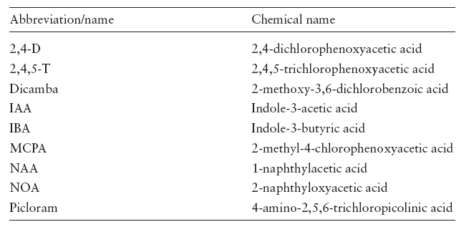
www.oup.com/uk/orc/bin/0199254680/ch02.pdf

Slide 39
Cytokinins:
  Cytokinins promote cell division.
  Of the naturally occurring cytokinins, only zeatin and 2iP (2-isopentyl adenine have some use in plant tissue culture media.
  The synthetic analogues, kinetin and BAP (benzylaminopurine), are used more frequently.
  Non-purine-based chemicals, such as substituted phenylureas, are also used as cytokinins in plant tissue culture media.
http://www.titanbiotechltd.com/plant-tissue-culture-media.asp

Slide 40
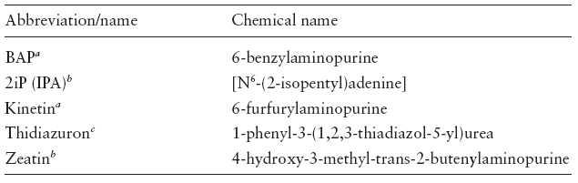
a Synthetic analogues.
b Naturally occurring cytokinins.
c A substituted phenylurea-type cytokinin.
www.oup.com/uk/orc/bin/0199254680/ch02.pdf

Slide 41
Gibberellins:
  Gibberellins are involved in regulating cell elongation, in determining plant height and fruit-set.
  Only a few of the gibberellins like GA3 are used in plant tissue culture media.
http://www.titanbiotechltd.com/plant-tissue-culture-media.asp

Slide 42
Abscisic acid:
  It is used in plant tissue culture to promote distinct developmental pathways such as somatic embryogenesis.
  Abscisic acid (ABA) inhibits cell division.
http://www.titanbiotechltd.com/plant-tissue-culture-media.asp

Slide 43
Ethylene:
  Ethylene is associated with controlling fruit ripening in climacteric fruits, and its use in plant tissue culture is not widespread.
  Some plant cell cultures produce ethylene, which, if it builds up sufficiently, can inhibit the growth and development of the culture.
http://www.titanbiotechltd.com/plant-tissue-culture-media.asp

Slide 44
pH
  pH affects absorption of ions and also solidification of gelling agent.
  Optimum pH for culture media is 5.8 before sterilization.
  Values of pH lower than 4.5 or higher than 7.0 greatly inhibit growth and development in vitro.
http://nsdl.niscair.res.in/bitstream/123456789/668/1/revised+introduction+to+plant+biotechnology.pdf

Slide 45
The pH of culture media generally drops by 0.3 to 0.5 units after autoclaving and keeps changing through the period of culture due to oxidation and also differential uptake and secretion of substances by growing tissue.

Slide 46
Preparation of Media
  This is a very crucial step for the experiment to be successful.
  There are two possible ways to prepare medium.
  One method is to weigh and dissolve the required quantities of the ingredients separately and mix them every time a medium is to be prepared. But this is a cumbersome method and chances of committing error are more.
http://nsdl.niscair.res.in/bitstream/123456789/668/1/revised+introduction+to+plant+biotechnology.pdf

Slide 47
A more convenient and widely practiced method is to prepare, in advance, a series of concentrated stock solutions and store them in a refrigerator.
Whenever a medium is to be prepared, the required amounts are drawn from the stock solutions and mixed.
For example, to prepare MS, four stock solutions are prepared

Slide 48
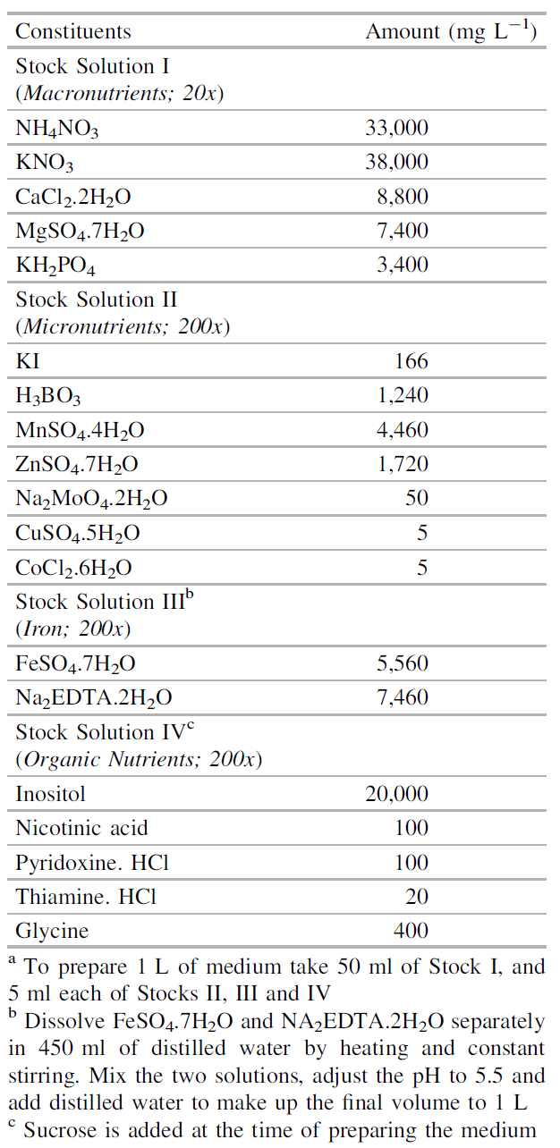
  Preferably, following four stock solutions are prepared:
    Major salts
    (20X concentration)
    Minor salts
    (200X concentration)
    Iron
    (200X concentration)
    Organic nutrients
    (200X concentration)

Slide 49
Each salt should be separately dissolved to the last particle and then mixed with the others.
In order to avoid any precipitation, the preferred method is to group the compounds by the ions they contain, such as nitrate, sulphate, phosphate and halide, and to first mix the dissolved components of each group and then mixing all the solutions.

Slide 50
The stocks of major and minor salts are kept separately.
For making stock solution of iron, the required quantities of FeSO₄.7H₂O and NA₂EDTA.2H2O are weighed and dissolved separately in 450 ml of distilled water by heating and constant stirring and then the two are mixed.
The pH is adjusted to 5.5, and distilled water is added to make up the final volume to one litre.
The final stock solution should be deep golden yellow.

Slide 51
Separate stock solution for each growth regulator is prepared.
Appropriate quantities are taken from stocks and mixed to constitute basal medium.
Required quantity of agar, sucrose and organic supplements if needed are added separately.
http://nsdl.niscair.res.in/bitstream/123456789/668/1/revised+introduction+to+plant+biotechnology.pdf

Slide 52
Types of culture

Slide 53
Cultures are generally initiated from sterile pieces of a whole plant.
These pieces are termed ‘explants’, and may consist of pieces of organs, such as leaves or roots, or may be specific cell types, such as pollen or endosperm.
http://nsdl.niscair.res.in/bitstream/123456789/668/1/revised+introduction+to+plant+biotechnology.pdf

Slide 54
For growth, the cells need to divide, whereas, the cells breaking up from explant are mature, nondividing.
Therefore, the differentiated tissue undergoes modifications to become meristematic. This phenomenon of a mature cell reverting back to meristematic state to form undifferentiated callus tissue is called dedifferentiation.

Slide 55
There are three types of culture
  Organized (root cultures, shoot tip cultures, embryo cultures etc.).
  Unorganized (callus and suspension cultures)
  Single cell

Slide 56
Organized culture
Organised growth contributes towards the creation or maintenance of a defined structure.
It occurs when plant organs such as the growing points of shoots or roots (apical meristems), leaf initials, young flower buds or small fruits, are transferred to culture and continue to grow with their structure preserved.

Slide 57
Growth that is coherently organised also occurs when organs are induced.
This may occur in vitro either directly upon an organ or upon a piece of tissue placed in culture (an explant), or during the culture of previously unorganised tissues.
The process of de novo organ formation is called organogenesis or morphogenesis (the development of form)

Slide 58
Differentiated plant organs can usually be grown in culture without loss of integrity.
They can be of two types:
  Determinate organs which are destined to have nonly a defined size and shape (e.g. leaves, flowers and fruits);
  Indeterminate organs, where growth is potentially unlimited (apical meristems of roots and nonflowering shoots).

Slide 59
Root cultures
Root cultures can be established in vitro from explants of the root tip of either primary or lateral roots and can be cultured on fairly simple media.

Slide 60
The growth of roots in vitro is potentially unlimited, as roots are indeterminate organs.

Slide 61
Shoot tip and meristem culture
The tips of shoots (which contain the shoot apical meristem) can be cultured in vitro, producing clumps of shoots from either axillary or adventitious buds.

Slide 62
This method can be used for clonal propagation. Shoot meristem cultures are potential alternatives to the more commonly used methods for cereal regeneration (see the Case study below) as they are less genotype-dependent and more efficient (seedlings can be used as donor material).

Slide 63
Embryo culture
Embryos can be used as explants to generate callus cultures or somatic embryos.
Both immature and mature embryos can be used as explants.
Immature, embryo-derived embryogenic callus is the most popular method of monocot plant regeneration.

Slide 64
Unorganized culture
The growth of higher plants depends on the organised allocation of functions to organs which in consequence become differentiated, that is to say, modified and specialised to enable them undertake their essential roles.
Unorganised growth is seldom found in nature, but occurs fairly frequently when pieces of whole plants are cultured in vitro.

Slide 65
The cell aggregates, which are then formed, typically lack any recognisable structure and contain only a limited number of the many kinds of specialised and differentiated cells found in an intact plant

Slide 66
A differentiated cell is one that has developed a specialised form (morphology) and/or function (physiology).
A differentiated tissue (e.g. xylem or epidermis) is an aggregation of differentiated cells.
So far, the formation of differentiated cell types can only be controlled to a limited extent in culture.

Slide 67
It is not possible, for example, to maintain and multiply a culture composed entirely of epidermal cells.
By contrast, unorganised tissues can be increased in volume by subculture and can be maintained on semisolid or liquid media for long periods. They can often also be used to commence cell suspension cultures.
Differentiation is also used botanically to describe the formation of distinct organs through morphogenesis.

Slide 68
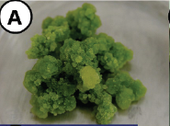
(I) Callus culture
After the transfer of freshly cut explants into growth-promoting conditions, usually on the cut surface cell division is initiated, and as a form of wound healing, unorganized growth occurs—a callus will be formed.
Following a supplement of growth hormones to the nutrient medium, this initial cell division activity will continue, and this unorganized growth will be maintained without morphological recognizable differentiation.

Slide 69
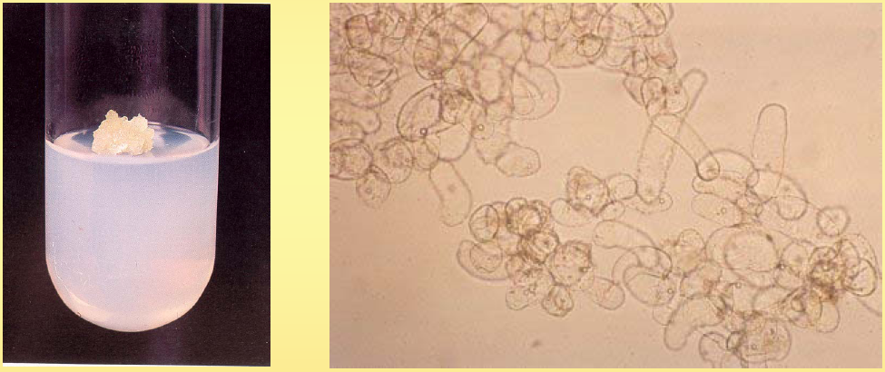
The culture of undifferentiated mass of cell on agar media produced from an explant of a seedling or other plant part is called callus culture.
For callus formation, auxin and cytokinins, both are required.

Slide 70
It is often induced in or upon parts of an intact plant by wounding, by the presence of insects or microorganisms, or as a result of stress
Callus can be initiated in vitro by placing small pieces of the whole plant (explants) onto a growth-supporting medium under sterile conditions

Slide 71
Under the stimulus of endogenous growth regulators or growth regulating chemicals added to the medium, the metabolism of cells, which were in a quiescent state, is changed, and they begin active division.
During this process, cell differentiation and specialisation, which may have been occurring in the intact plant, are reversed, and the explant gives rise to new tissue, which is composed of meristematic and unspecialised cell types.

Slide 72
Callus can be subcultured indefinitely by transferring a small piece of the same to fresh agar medium.
Subculturing needs to be done every 3-5 weeks in view of cell growth, nutrient depletion and medium drying.
The callus formed on an original explant is called ‘primary callus’. Secondary callus cultures are initiated from pieces of tissue dissected from primary callus

Slide 73
Because of low degree of uniformity among cells in callus, slower growth rate and development of nutrient gradients, the usefulness of callus in experimental system is limited.
The main use of callus culture is for purposes of maintaining cell lines and for morphogenesis.

Slide 74
Callus tissue itself is not generally used to produce chemicals or conduct basic investigations on secondary metabolism, but rather as a source material to establish cell suspension cultures.

Slide 75
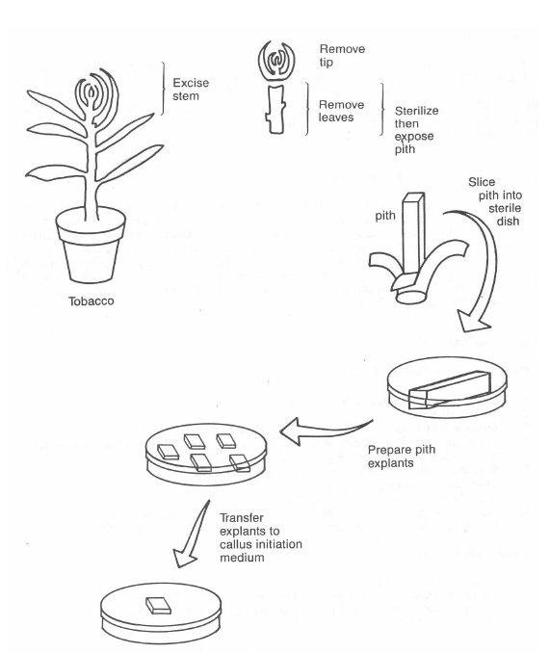

Slide 76
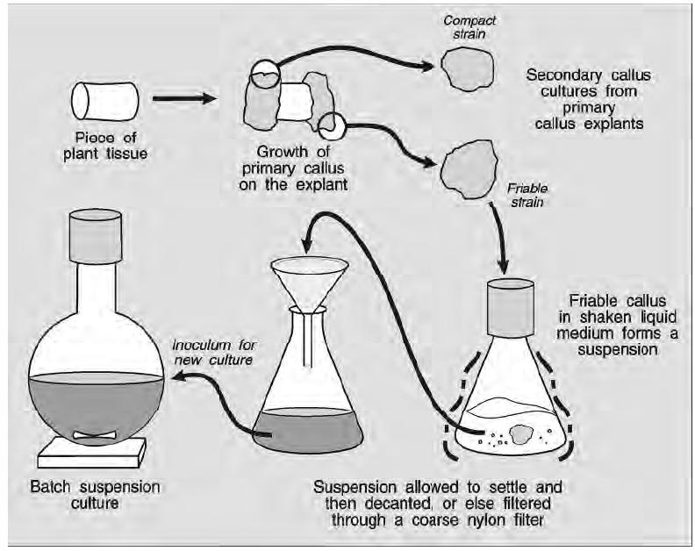

Slide 77
Callus tissue is not of one single kind. Strains of callus differing in appearance, colour, degree of compaction and morphogenetic potential commonly arise from a single explant.
Sometimes the type of callus obtained, its degree of cellular differentiation and its capacity to regenerate new plants, depend upon the origin and age of the tissue chosen as an explant.
Loosely packed or ‘friable’ callus is usually selected for initiating suspension cultures.

Slide 78
Friability of callus can also be induced by modifying the growth regulator composition of the medium.

Slide 79
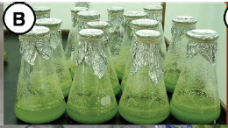
(II) Cell suspension culture:
The culture of tissues and cells cultured in a liquid nutrient medium produce a suspension of single cells and cell clumps, this is called suspension culture.
http://nsdl.niscair.res.in/bitstream/123456789/668/1/revised+introduction+to+plant+biotechnology.pdf

Slide 80
A callus mass friable in texture is transferred to liquid medium and vessel is incubated on shaker to facilitate aeration and dissociation of cell clumps into smaller pieces.
Agitation of the medium exerts a mild pressure on the tissue, breaking it into smaller cell aggregates and single cells. It also maintains uniform distribution of cells and cell clumps in the medium, and helps gaseous exchange between the culture medium and the air inside the culture vial (aeration of the cells).

Slide 81
Gradually, over several weeks by subculturing, cells of callus dissociate and a liquid suspension culture is obtained.
Cell suspensions are also maintained by subculturing of cells in early stationary phase to a fresh medium.
Their growth is much faster than callus cultures and hence need to be subcultured more frequently (3-14days).

Slide 82
Cell suspension cultures when fully established consist of a nearly homogeneous population.
A much higher rate of cell division may be exhibited by cells in suspension cultures than in callus cultures on agar medium. However, cell doubling time in suspension cultures varies with the system: Nicotiana tabacum, 48 h, Acer pseudoplatanus, 40 h, Rosa sp., 36 h, and Haplopappus gracilis, 22 h.
This system has an advantage that the nutrients can be continually adjusted and hence it is the only system which can be scaled up for large scale production of cells and even somatic embryos.
http://nsdl.niscair.res.in/bitstream/123456789/668/1/revised+introduction+to+plant+biotechnology.pdf

Slide 83
The suspension cultures are broadly classified as:
  Batch culture in which cells are nurtured in a fixed volume of medium until growth ceases
  Continuous culture in which cell growth is maintained by continuous replenishment o sterile nutrient media
http://nsdl.niscair.res.in/bitstream/123456789/668/1/revised+introduction+to+plant+biotechnology.pdf

Slide 84
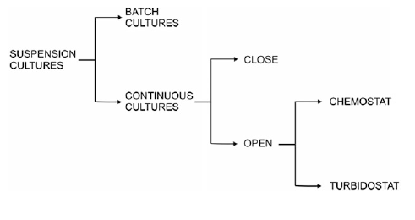

Slide 85
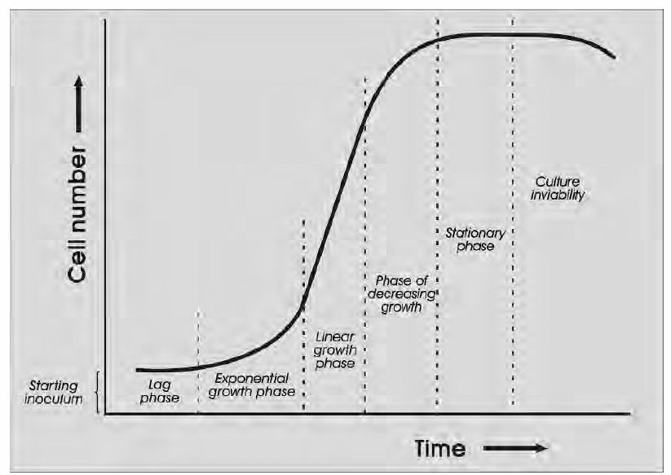

Slide 86
Batch culture:
The culture medium and the cells produced are retained in the culture flask
These cultures are maintained continuously by subculturing i.e. by transferring a small aliquot of inoculum from the grown culture to fresh medium at regular intervals.
The biomass or cell number of a batch culture follows a typical sigmoidal curve, where to start with the culture passes through lag phase during which cell number is constant, followed by brief exponential or log phase where there is a rapid increase in cell number because of culture cell division.

Slide 87
Initially, the cultures pass through a lag phase where cells prepare to divide.
It is followed by a short exponential phase during which the rate of cell divisions is the highest.
After a few cell generations cell divisions slow down and cell expansion increases (linear growth phase).
Thereafter, the cultures enter the deceleration phase during which cell divisions and expansion decline.

Slide 88
Finally, the cultures enter the stationary phase in which the number and size of the cells remain constant. The cells stop dividing due to depletion of nutrients and accumulation of cellular wastes.
Cultures can be maintained continuously in exponential phase by frequent (every 2–3 days) subcultures.
Addition of ‘conditioned medium’ (in which cell cultures have been grown before) reduces the lag phase dramatically.

Slide 89
Batch cultures undergo a constant change in cell density and metabolism and hence, not used for studies related to aspects of cell behaviour.
But batch cultures are convenient to maintain, hence used for initiation of cell suspension and scaling up for continuous cultures.

Slide 90
Continuous culture:
Periodic addition of fresh medium and draining out the used medium ensures maintenance of suspension cultures under steady state of growth for long periods. Such cultures are called continuous suspension cultures.
Continuous culture are further classified into two types:
  Closed
  Open

Slide 91
  Closed type
    In this system, the addition of fresh medium is balanced by out flow of the old medium.
    However, the cells from the out flowing medium are mechanically separated and added back to the culture.
    Thus, cell biomass continues to increase with age of the culture.

Slide 92
  In open type, both cells and used medium are replaced with fresh medium thus maintaining culture at constant and submaximal growth rate.
  There are further two types of open continuous suspension culture:
    turbidostat
    chemostat.

Slide 93
In chemostat cultures, a steady state of cell growth is maintained by a constant inflow of fresh medium in which the concentration of chosen nutrient (nitrogen, phosphorus or glucose) is adjusted so as to be growth limiting while othe constituents are at a concentration higher than that required for desired rate of cell growth.

Slide 94
Any increase or decrease in the growth limiting factor is reflected by an increase or decrease in the growth rate of cells.
Chemostats are useful for the determination of effects of individual nutrients on cell growth and metabolism

Slide 95
In turbidostat cultures, the inflow of fresh medium is controlled by an increase in the turbidity (decided on the basis of optical density) of the culture due to cell growth.
A desired biomass density is maintained by flushing out cells.

Slide 96
Synchronization of suspension cultures:
Cell suspension is mostly asynchronous, different cells of different size, shape, DNA, nuclear content and also in different stages of cell cycle (G1, S, G2, M).
This is not desirable in cell metabolism studies.
Hence, it is essential to obtain synchrony in suspension cultures and can be achieved by :

Slide 97
For studying cell cycle or cell metabolism in suspension cultures, it is desirable to use synchronous or partially synchronous cultures.
A cell culture in which the majority of cells proceed through each cell cycle phase (G1, S, G2 and M) simultaneously is regarded as synchronous.
Synchronization in cell suspension cultures could be achieved by starvation or inhibition.

Slide 98
  Starvation: Cells are starved of a nutrient like a growth regulator which is necessary for cell division resulting in arrest of cell growth during G1 or G2. After some time, when the nutrient is supplied, all arrested cells enter divisions synchronously.
  Inhibition: Using a biochemical inhibitor of DNA synthesis like 5 aminouracil, cells are arrested at G1 so that removal of inhibitor leads to synchreonous division of cells.
  Mitotic arrest: Colchicine is widely used to arrest cells at metaphase but only for short duration as longer colchicine treatment may induce anormal mitosis and chromosome stickiness

Slide 99
Determination of Growth in Suspension Cultures
Growth in plant cell suspension cultures is commonly measured by cell counting, determination of total cell volume (packed cell volume), and fresh and dry-weight increase of cells and cell colonies

Slide 100
Cell viability test:
The objective of cell suspension culture is to achieve rapid growth rates and uniform cells with all cells being viable.
The viability of cells can be determined by following approaches:

Slide 101
  Phase contrast microscopy: Live cells having a well defined healthy nucleus and streaming cytoplasm are easily observed under phase contrast microscope

Slide 102
  Reduction of tetrazolium salts: When cell masses are stained with 1-2% solution of 2,3,5-triphenyl teterazolium chloride (TTC). The living cells reduce TTC to red coloured formazon which can be extracted and measured spectrophotometrically for quantification of viability. This approach is not used for single cells.

Slide 103
  Fluorescein diacetate (FDA): Esterase present in live cells cleaves FDA to produce fluorescein which fluoresces under UV so that live cells appear green under UV.
  Evan’s Blue staining: This is the only dye which is taken up by dead cells. Therefore, evan’s blue is used usually to complement FDA.

Slide 104
Cultures of single cell origin
Free cells isolated from plant organs or cell suspensions when grown as single cells under in vitro conditions thus producing a clone of identical cells is called single cell culture.
Protoplasts are plant cells with the cell wall removed. Protoplasts are most commonly isolated from either leaf mesophyll cells or cell suspensions
http://nsdl.niscair.res.in/bitstream/123456789/668/1/revised+introduction+to+plant+biotechnology.pdf

Slide 105
Isolation of single cell from plant organs:
Single cells could be isolated from intact plant organs (usually leaf) or fine suspension cultures.
However, invariably the single cell systems used in basic and applied research are isolated from cultured tissues as it offers several advantages

Slide 106
Single cells from leaf tissue can be isolated mechanically or by enzymatic degradation of middle lamella.

Slide 108
Mechanical:
Small pieces of leaves are cut and macerated in mortar and pestle in a grinding buffer.
This homogenate is filtered through muslin cloth followed by centrifugation to finally pellet down the cells.

Slide 109
Enzymatic:
Leaves are cut into moderate pieces after peeling the lower epidermis off.
Cut pieces are then incubated with macerozyme or pectinase which degrade the middle lamella and cell wall of parenchymatous tissue.

Slide 110
A suitable osmoticum like 0.3M mannitol is added to the culture which provides protection to cell wall from any damage to cells by enzymatic action.

Slide 111
Culture of single cell

Slide 112
Filter paper raft-nurse technique
This method was developed by Muir et al. (1954) to culture single cells from suspension cultures and friable calli of tobacco and marigold

Slide 113
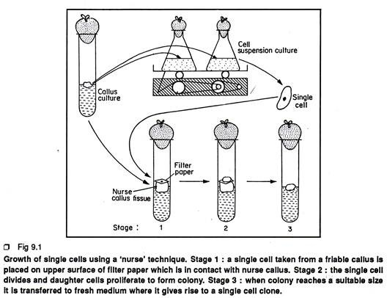

Slide 114
Individual cells were isolated from suspension cultures or a friable callus with the aid of a micropipette.
Several days before cell isolation, a sterile 8 x 8 mm square of filter paper is placed aseptically on the top of the established callus of the same or a different species.

Slide 115
The filter paper is wetted with liquid and nutrients from the nurse tissue.
An isolated single cell is placed on the wet filter paper raft.
The whole culture system is incubated under 16 hrs. cool white light (3,000 lux) or under continuous darkness at 25° C

Slide 116
The single cell divides and re-divides and ultimately forms a small cell colony. When the cell colony reaches a suitable size, it is transferred to fresh medium where it gives rise to the callus tissue.

Slide 117
The callus tissue, on which the single cell is growing, is called the nurse tissue.
Actually the callus tissue supplies the cell with not only the nutrients from the culture medium but some­thing more that is critical for cell division.
The single cell absorbs nutrients through filter paper.

Slide 118
The nutrients actually diffuse upward from culture medium through callus tissue and filter paper to the single cell.
A callus tissue originating from a single cell is known as a single cell clone.

Slide 119
The Petri Dish Plating Technique
A suspension of purely single cells is prepared aseptically from the stock cell suspension culture by filtering and centrifugation requisite cell density in the single cell suspension is adjusted by adding or reducing the liquid medium.

Slide 120
The solid medium (1.6% ‘Difco’ agar added) is melted in water bath
In front of laminar air flow, the tight lid of falcon plastic petri dish is opened With the help of sterilized Pasteur pipette 1 5 ml of single cell suspension is put an equal amount of melted agar medium when it cools down at 35°C, is added in the single cell suspension

Slide 121
The lid is quickly replaced and the whole dish is swirled gently to disperse the cell and medium mixture uniformly throughout the lower half of the petri dish.
The medium is allowed to solidify and the petri dish is kept at the inverted position.

Slide 122
The cultures are incubated under 16hrs light (3,000 lux, cool white) or under con­tinuous dark at 25°C.
The petri dishes are observed at regular in­tervals under inverted microscope to see whether the cells have divided or not.
After certain days of incubation, when the cells start to divide, a grid is drawn on the undersurface of the petri dish to facilitate counting the number of dividing cells.

Slide 123
The dividing cells ultimately form pin-head shaped cell colonies within 21 days of incu­bation.
The plating efficiency (PE) can be calculated from the counting of cell colonies by the following formula:
PE = Number of colonies per plate/Number of total cell per plate x 100

Slide 124
Pin-head shaped colonies, when they reach a suitable size, are transferred to fresh me­dium for further growth.

Slide 125
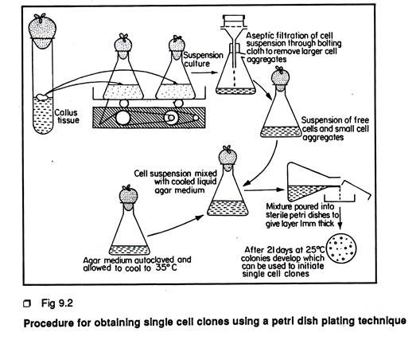

Slide 126
Microchamber technique.
In this technique, devised by Jones et al. (1960), the nurse tissue is replaced by a conditioned medium, and single cells are grown in a microchamber.
A drop of the medium carrying a single cell is isolated from suspension cultures, placed on a sterile microscope slide and ringed with sterile mineral oil.

Slide 127
A drop of oil is placed on either side of the culture drop and a cover glass placed on each drop.
A third cover glass is placed on the culture drop bridging the two cover glasses and forming a microchamber to enclose the single cell aseptically within the mineral oil.
The oil prevents water loss

Slide 128
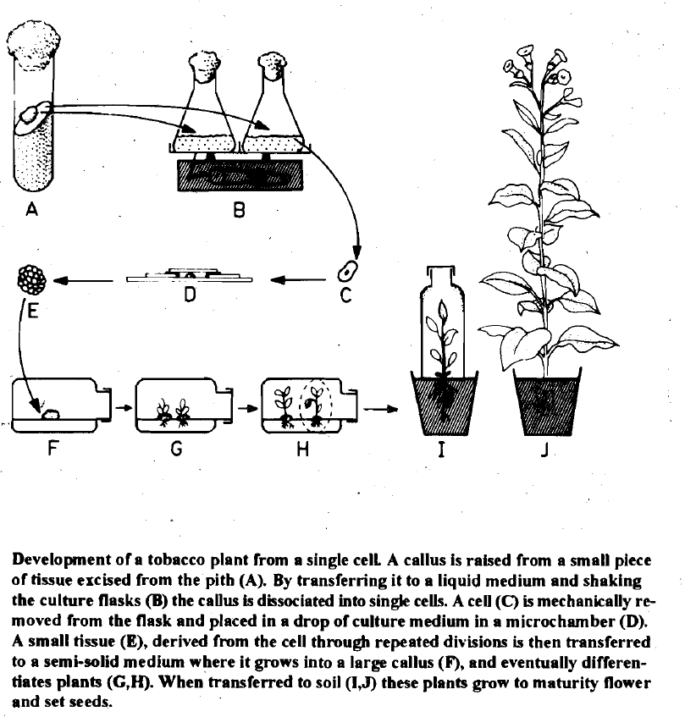

Slide 129
The Nurse Callus Technique:
This method is actually a modification of petridish plating method and the paper raft nur­se culture method. In this method, single cells are plated on to agar medium in a petridish as described ear­lier Two or three callus masses (Nurse tissue) derived from the same plant tissue are also em­bedded directly along with the single cells in the same medium

Slide 130
Here the paper barrier between single cells and the nurse tissue is re­moved.
Cells first begin to divide in the regions near the nurse callus indicating that the single cells closer to nurse callus in the solid medium gets the essential growth factors that are lib­erated from the callus mass.
The developing colonies growing near to nurse callus also stim­ulate the division and colony formation of other cells.

Slide 131
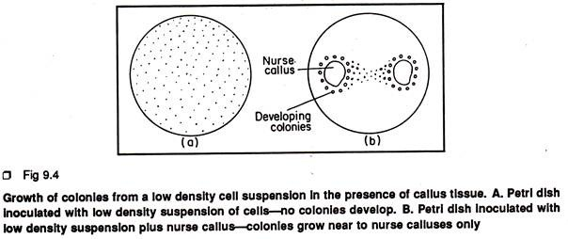

Slide 132
Bergmann’s cell plating technique
This is the most popular technique for single cell culture developed by Bergmann, in 1960.
Free cells are suspended in a liquid medium at a density twice the finally desired plating cell density.

Slide 133
The optimum plating density may vary with the species but cells generally fail to divide below a certain critical cell density.
In another vial molten agar (0.6–1 %) containing medium of otherwise the same composition as the liquid medium, is cooled and maintained at 40⁰ C in a water bath

Slide 134
Equal volumes of the two media are mixed and rapidly spread out in Petri dishes in such a manner that the cells are evenly distributed and fixed in a thin layer (approximately 1 mm thick) of the medium after it has cooled and solidified.

Slide 135
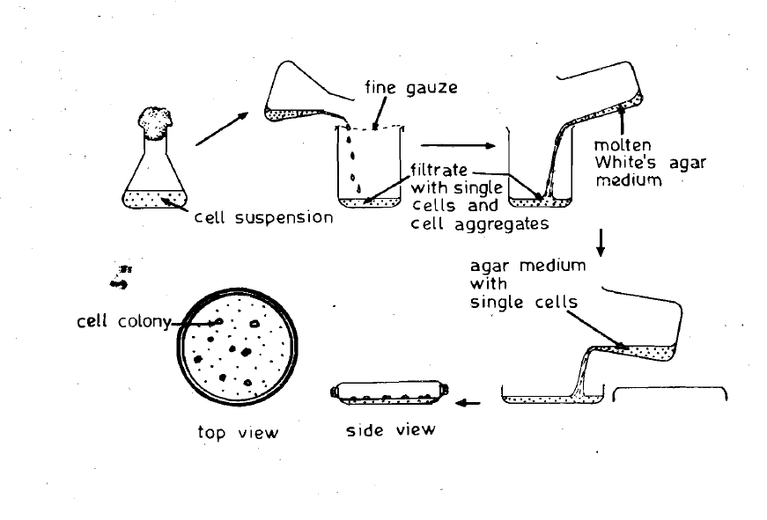
Bergmann's method of Cell Plating

Slide 136
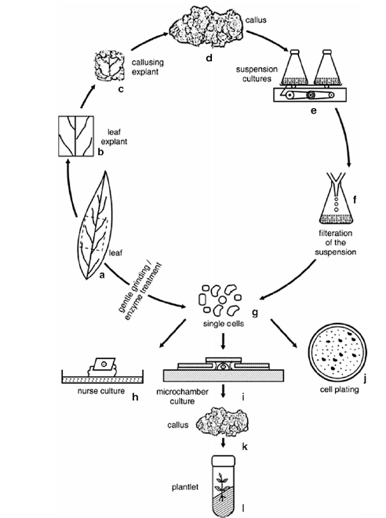

Slide 137
The Petri dishes are sealed with Parafilm.
Filtration of cell suspension through a sieve should allow exclusion of large cell aggregates and plating of only single cells and small cell aggregates (of 3–4 cells).
The plates may be observed on an inverted microscope and single cells marked on outside of the plate by a fine marker to ensure the isolation of pure single cell clones.
The culture plates are incubated at 25 C in the dark.

Slide 138
The Micro-droplet Technique
In this method, single cells are cultured in special Cuprak dishes which have two chambers—a small outer chamber and a lar­ge inner chamber. The large chamber car­ries numerous numbered wells each with a capacity of 0.25-25µl of nutrient medium..

Slide 139
Each well of the inner chamber is filled with a micro-drop of liquid medium containing isolated single cell.
The outer chamber is filled with sterile distilled water to maintain the humidity inside the dish

Slide 140
fter covering the dish with lid, the dish is sealed with paraffin.
The dish is incubated under 16hrs cool light (3,000 lux) at 25°C.
The cell colony derived from the single cell is transferred on to fresh solid or semisolid medium in a culture tube for further growth

Slide 141
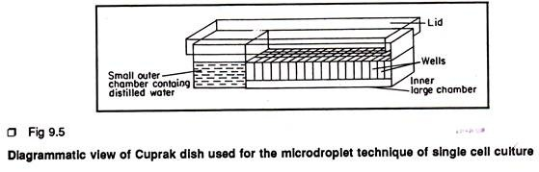

Slide 142
Micropropagation

Slide 143
In vitro propagation of plants vegetatively by tissue culture to produce genetically similar copies of a cultivar is referred to as micropropagation or clonal propagation.

Slide 144
Here in this method a multiple number of miniatures of vegetative shoots are produced from a clone within a short time and space.
Use of tissue culture for micro-propagation was initiated by G. Morel (1960) who found this as the only commercially viable approach for orchid propagation.

Slide 145
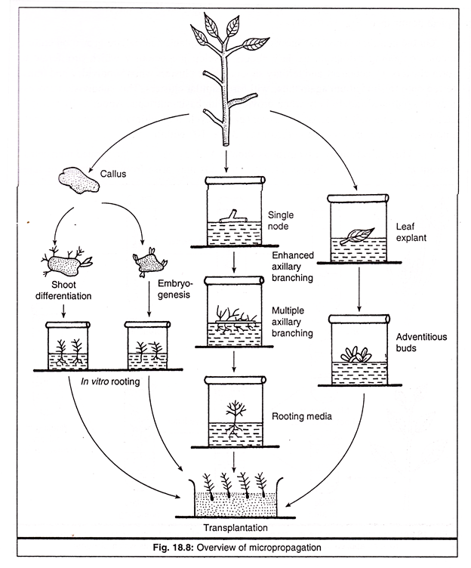

Slide 146
Sexually propagated plants (through generation of seeds) demonstrate a high amount of heterogeneity whereas asexual reproduction (by multiplication of vegetative parts) gives rise to genetically identical copies of parent plant.
Thus, it permits perpetuation of the parental characters of the cultivars among the plants resulting from micropropagation.

Slide 147
General Micropropagation
Technique
Micropropagation is a well-defined multistep process.
It comprises of five steps, each with its specific requirements and problems
  Stage 0: It is the preparatory stage to provide quality explants
  Stage 1: Initiation of aseptic cultures
  Stage 2: Multiplication
  Stage 3: Rooting of in vitro formed shoots
  Stage 4: Transfer of plants to greenhouse or field conditions (transplantation).

Slide 148
Stage 0:
This is the initial step in micro- propagation, and involves the selection and growth of stock plants for about 3 months under controlled conditions.

Slide 149
Stage I:
In this stage, the initiation and establishment of culture in a suitable medium is achieved. Selection of appropriate explants is important.
The most commonly used explants are organs, shoot tips and axillary buds.
The chosen explant is surface sterilized and washed before use.

Slide 150
II:
It is in this stage, the major activity of micro propagation occurs in a defined culture medium.
Stage II mainly involves multiplication of shoots or rapid embryo formation from the explant.

Slide 151
Stage III:
This stage involves the transfer of shoots to a medium for rapid development into shoots. Sometimes, the shoots are directly planted in soil to develop roots.
In vitro rooting of shoots is preferred while simultaneously handling a large number of species.

Slide 152
Stage IV:
This stage involves the establishment of plantlets in soil.
This is done by transferring the plantlets of stage III from the laboratory to the environment of greenhouse.
For some plant species, stage III is skipped, and un-rooted stage II shoots are planted in pots or in suitable compost mixture.

Slide 153
The different stages described above for micro propagation are particularly useful for comparison between two or more plant systems, besides better understanding. It may however, be noted that not all plant species need to be propagated in vitro through all the five stages referred above.

Slide 154
Micropropagation proves useful for propagation of:
  Sexually sterile species like triploids, aneuploids which cannot be perpetuated by seeds.
  Seedless plants like banana
  Cross bred perennials where heterozygosity is to be maintained
  Mutant lines like auxotrophs which cannot be propagated in vivo
  Disease free planting material of fruit trees and ornamentals

Slide 155
Advantages of micropropagation over conventional propagation methods
Genotype constitution maintained as there is lesser variation in somatic embryo
Easier transport and storage is facilitated by small size propagules and their ability to grow in soil less medium.
Control over growing conditions as the production of planting material is completely under artificial control in vitro

Slide 156
Reduced growth cycle and rapid multiplication as shoot multiplication has short cycle and each cycle results in exponential increase in number of shoots
Selective multiplication can be done for e.g. auxotrophs, aneuploids, selected sex in dioecious species
Virus free plants can be raised and maintained through meristem culture which is the only method available for this

Slide 157
Disadvantages
Involves high cost
Somaclonal variation- any variation if occurs during multiplication may go unnoticed
Recalcitrancy of species/ genotype- many tree sp like mango etc do not respond to in vitro growth.

Slide 158
Application of micropropagation:
Commercial production of secondary metabolites
Production of synthetic seeds
Raising somaclonal variants
Production of disease free plants

Slide 159
Methods of Micro-Propagation
Multiplication by axillary buds/apical shoots.
Multiplication by adventitious shoots.
Besides the above two approaches, the plant regeneration processes namely organogenesis and somatic embryogenesis may also be treated as micro propagation.

Slide 160
Organogenesis: The formation of individual organs such as shoots, roots, directly from an explant (lacking preformed meristem) or from the callus and cell culture induced from the explant.
Somatic embryogenesis: The regeneration of embryos from somatic cells, tissues or organs.

Slide 161
Multiplication by Axillary Buds and Apical Shoots:
Quiescent or actively dividing meristems are present at the axillary and apical shoots (shoot tips).
The axillary buds located in the axils of leaves are capable of developing into shoots.

Slide 162
Axillary and apical shoots contain quiescent or active meristems depending on the physiological state of the plant. When these shoot tips are cultured on a basal medium containing no growth regulators, these typically develop into single seedling like shoots with strong apical dominance

Slide 163
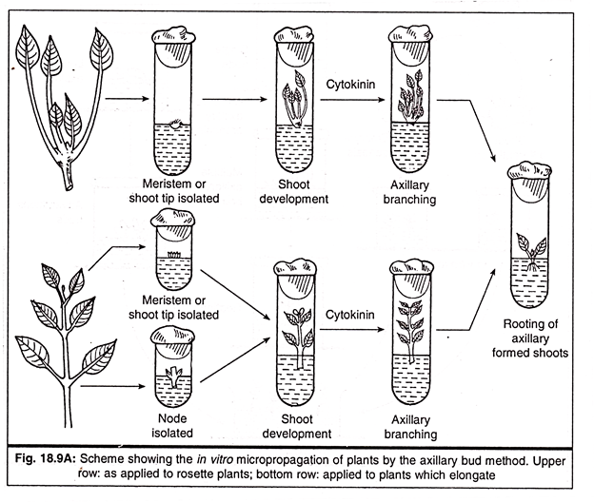

Slide 164
On the contrary, when the shoots of the same explant material are grown on culture media containing cytokinin, axillary shoots develop precociously which proliferate to form clusters of secondary and tertiary shoots.
These clusters when subdivided and transferred onto fresh medium again these will form similar clusters.

Slide 165
This subdivision process may be continued indefinitely when provided with basic nutrients.
About 5-10 multipli­cation rates on 4-8 weeks of micro-propagation cycle may ultimately lead to extremely impressive clonal propagation range of 0.1-3.0 x 10⁶ within a year

Slide 166
Multip lication by Adventitious Shoots:
Axillary buds are “preformed meristems” present at the leaf axils, whereas adventitious buds may arise from any plant structures and this regeneration is often dependent on the presence of organised plant tissue.
The explants may be stems, internodes, leaf blades, cotyledons, root elongation zone, bulb, corms, tubers, rhizomes, etc.

Slide 167
If these explants are induced by using appropriate level of growth regulators in the medium they will form the meristematic zone which regenerates multiple shoots on a suitable culture medium.
High number of adventitious shoots may arise only from a single epidermal cell.

Slide 168
Continuous propagation by adventitious shoot proliferation from bulbs and corms can be achieved by cultivating two vertically split piece of shoot bases.
Clusters of shoots may develop from the abaxial surfaces of developing leave and scales.
Trimming of the shoot apices is a good approach which has been found to ensure continuously productive cultures of different hybrid plants for indefinite period.

Slide 169
Organogenesis & Embryogenesis
Whole plant regeneration from cultured cells may occur in one of the two pathways:
  shoot bud differentiation, (organogenesis)
  embryo formation (Embryogenesis).
The Embryos are bipolar structures with no organic connection with the parent tissue and can germinate directly into a complete plant.

Slide 170
On the other hand, shoots are monopolar. They need to be removed from the parent tissue and rooted to establish a plantlet.
Often the same tissue can be induced to form shoots or embryos by manipulating the components of the culture conditions.

Slide 171
Organogenesis
Organogenesis refers to the differentiation of organs such as roots, shoots or flowers.
Shoot bud differentiation may occur directly from the explant or from the callus.
The stimulus for organogenesis may come from the medium, from the endogenous compounds produced by the cultured tissue or substances carried over from the original explant.

Slide 172
Organogenesis is chemically controlled by growth regulators.
Skoog while working with tobacco pith callus, observed that the addition of an auxin Indole Acetic Acid (IAA) enhanced formation of roots and suppressed shoot differentiation.
He further observed that adenine sulphate, (Cytokinin) reversed the inhibition of auxin and promoted the formation of shoots.

Slide 173
Auxins and cytokinins are the most widely used plant growth regulators in plant tissue culture and are usually used together, the ratio of the auxin to the cytokinin determining the type of culture established or regenerated
www.oup.com/uk/orc/bin/0199254680/ch02.pdf

Slide 174
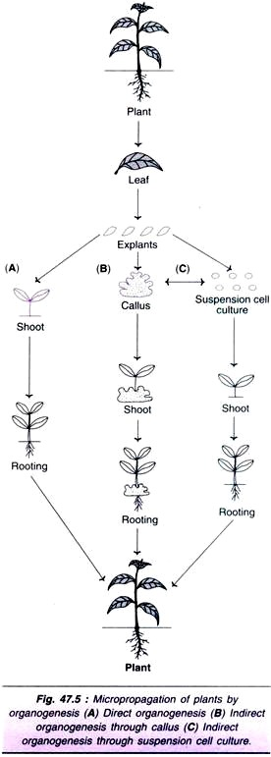

Slide 175
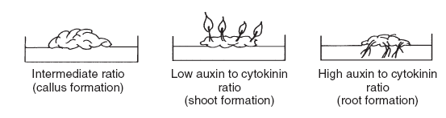
www.oup.com/uk/orc/bin/0199254680/ch02.pdf

Slide 176
Two Hormones Affect Plant Differentiation:
Auxin: Stimulates Root Development
Cytokinin: Stimulates Shoot Development
Generally, the ratio of these two hormones can determine plant development:
↑ Auxin ↓Cytokinin = Root Development
↑ Cytokinin ↓Auxin = Shoot Development
Auxin = Cytokinin = Callus Development

Slide 177
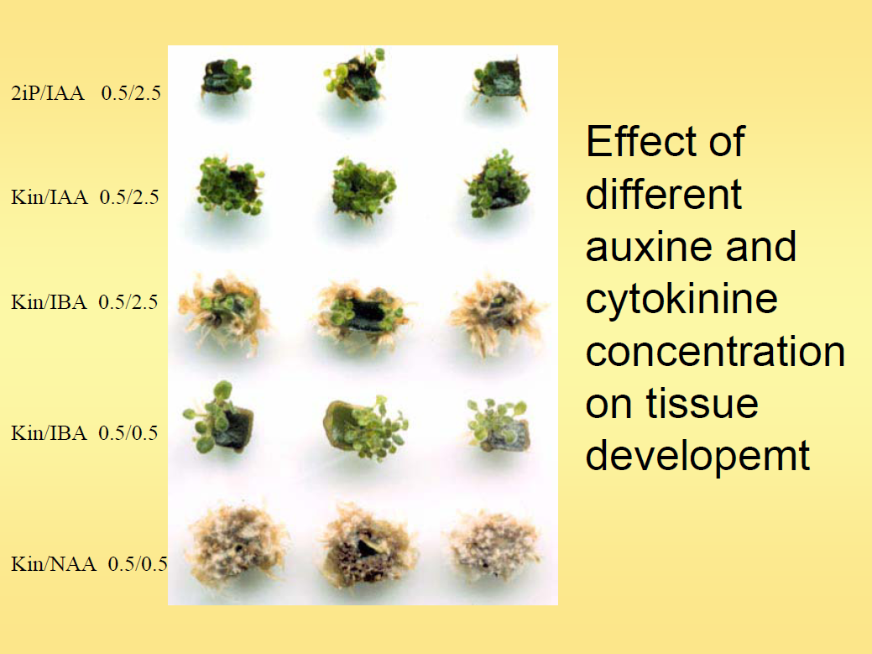

Slide 178
Other factors affecting organnogenesis are size and souce of the explant.
  The larger the explant (containing parenchyma, cambium and vascular tissue), more is likelihood of shoot bud formation.
Also, genotype of explant affects shoot regeneration as explant taken from different plant varieties of same species show different frequencies of shoot bud differentiation.

Slide 179
Light has been shown to have inhibitory effect. Even the quality of light has effect as blue light has been shown to induce shoot formation and root by red light in tobacco.
The optimum temperature required may vary with plant species.

Slide 180
Somatic Embryogenesis
The process of embryo development is called embryogenesis.
It is not the monopoly of the egg to form an embryo. Any cell of the female gametophyte (Embryo sac) may give rise to an embryo.

Slide 181
Somatic embryogenesis may result in non-zygotic embryos or somatic embryos (directly formed from somatic organs), parthogenetic embryos (formed from unfertilized egg) and androgenic embryos (formed from male gametophyte).
Thus we can say that 'The phenomenon of embryogenesis is not necessarily confined to the reproductive cycle".

Slide 182
It is a process involving redifferentiation of meristematic cells into nonzygotic somatic embryo which are capable of germinating to form complete plants.
While developing into somatic embryo, the mersitematic cells break any cytoplasmic or vascular connections with other cells around it and become isolated.
Therefore, unlike shoot bud, the somatic embryos are easily separable from explants.

Slide 183
Somatic embryogenesis involves three distinct steps which are absent in organogenesis:
  Induction: is the initiative phase where cells of callus are induced to divide and differentiate into groups of meristematic cells called embryogenic clumps (ECs). These ECs develop into initial stages of somatic embryo i.e. globular stage.

Slide 184
  Maturation: In this phase somatic embryos develop into mature embryos by differentiating from globular to heart shaped, torpedo to cotyledonary stages. The mature embryo here undergoes biochemical changes to acquire hardiness.
  Conversion: Embryos germinate to produce seedlings.

Slide 185
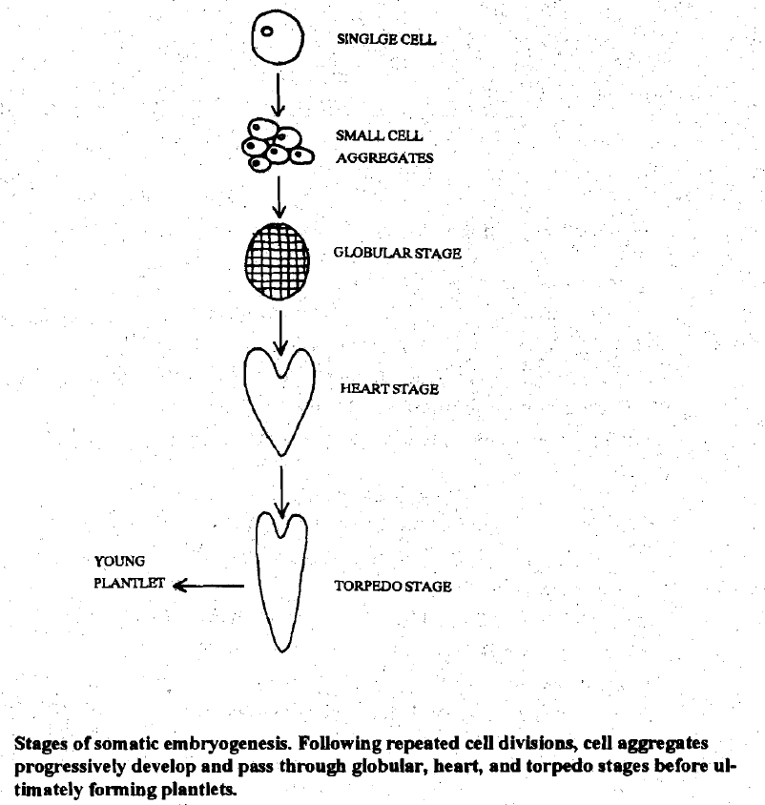

Slide 186
Somatic embryogenesis is influenced by following factors:
  Growth regulators:
    The presence of auxin (generally 2,4-D) in the medium is essential for induction phase.
    2,4-D induces dedifferentiation of explant cells to form ECs.
    When auxin is removed or its concentration is reduced, ECs convert to somatic embryos. Once induced, cells don’t need PGRs. Still some doses of CK at maturation and conversion make better plants.

Slide 187
    Maturation is achieved by culturing somatic embryos on high sucrose medium.
    Also, ABA is added as it gives hardening due to water loss which is important for embryo maturation.
    Ethylene inhibits both somatic embryogenesis and organogenesis. Therefore, silver nitrate is added to the medium as inhibitor of ethylene for plant regeneration.

Slide 188
  Nitrogen source: NH4+ form of nitrogen is essential for induction of somatic embryogenesis while NO3- form is required during maturation phase.
  Other factors:
    Like shoot bud differentiation, explant genotype has influence on somatic embryogenesis also.
    In cereals, use of maltose as carbohydrate source promotes both somatic embryo induction and maturation.

Slide 189
References
www.oup.com/uk/orc/bin/0199254680/ch02.pdf
http://en.wikipedia.org/wiki/Plant_tissue_culture
http://www.liv.ac.uk/~sd21/tisscult/introduction.htm
http://www.liv.ac.uk/~sd21/tisscult/what.htm
http://www.titanbiotechltd.com/plant-tissue-culture-media.asp
http://www.phytotechlab.com/pdf/PlantTissueCultureTerminology.pdf
http://nsdl.niscair.res.in/bitstream/123456789/668/1/revised+introduction+to+plant+biotechnology.pdf

