Slide 1
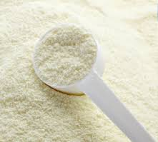
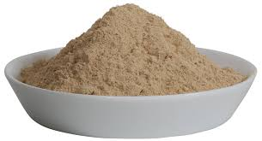
SOLID DOSAGE FORMS
POWDERS
Prepared by: Mr. Nirmal Shah

Slide 2
SOLID DOSAGE FORMS
POWDERS :-
powders are the solid dosage forms, supplied either in bulk or as an individual doses in the fine state of drug with or without the diluent.
Bulk powders – external use
Individual powders – Internal use
Advantages:-
Most versatile and convenient to prescribe, compound and administer
More stable than liquid dosage forms.
Very less chance of chemical reaction among the drugs present in it.
Drug available in fine state so they show rapid rate of dissolution and hence rapid rate of absorption.
Easy to carry than liquid.
Disadvantages:-
Bitter, unpalatable or sensitive to atmospheric condition drugs are not suitable candidates for dispensing in powder form.
Drugs which are hygroscopic, deliquescent, effervescent & volatile in nature may arise problems in dispensing processes.

Slide 3
General method for preparation of Powders
(" http://www.pharmpedia.com/GATE:Pharmaceutical_Powders")
Following steps are involved in preparation:
(A) Size reduction
(i) Trituration
(ii) Pulverization by intervention
(iii) Levigation (Wet grinding)
(B) Mixing of powders
(i) Spatulation
(ii) Trituration
(iii) Geometric dilution
(iv) Sifting
(v) Tumbling
(C) Dividing powder mixtures
(i) Estimation
(ii) Blocking & dividing
(iii) Powder measures
(iv) Weighing each powder
(D) Packing (Enclosing of powders)
(i) Vegetable parchment
(ii) Paraffin paper
(iii) Light weight bond paper

Slide 4
Classification of different types of Powders:-
("http://www.pharmpedia.com/GATE:Pharmaceutical_Powders")
(a) Powders for internal use
(b) Powders for external use
(c) Special powders
(a) Powders for internal use :-
(i) Divided powders:--
1. Simple powders
2. Compound powders
3. Powders enclosed in cachets & capsules
4. Tablet triturates
(ii) Bulk powders:-- Antacids, Electrolyte replinishers, laxatives
(b) Powders for External use :-
(i) Medicated dusting powders:--
(ii) Surgical dusting powders:--
1. Insufflations
2. Snuffs
(iii) Dentifrices:--

Slide 5
(b) Special powders:-
(i) Eutectic mixtures
(ii) Effervescent powders or Granules
(iii) Powders to be reconstituted
(iv) Hygroscopic and Deliquescent powders
(a) Powders for internal use:-
(i) Divided powders:-- Supplied individually as a single dose in separate packets
1. Simple powders:
• Contain one ingredient either in crystalline or amorphous form
• Supplied in a single dose & packed separately
• Wrapped singled or doubled according to the properties of drugs.
Ex: Aspirin Powder
Rx
Aspirin – gr v
Mitte tales decim
Signa : Unam Somni nocte sumenda

Slide 6
2. Compound powders:
• Contain two or more ingredients
• Supplied in a single dose & packed separately
Ex:
Rx
Phenacetini – gr iv
Caffinae – gr i
Fiat pulvis Mitte tales Decem
Signetur : Capiat unum dolore urgente
3. Powders enclosed in cachets & capsules:
(i) Catches :-
(www.rpsgb.org.uk/pdfs/mussheet 08.pdf)
• Unit dosage form, in which drug is enclosed in a tasteless sheet formed by pouring a mixture of rice flour & water between two hot polished revolving cylinders. Water evaporates and sheet of wafer formed is called Cachets.
Advantages:-
• Very simple to make
• Suitable for giving larger doses of the drugs.
• Disintegrate quickly in the stomach.

Slide 7
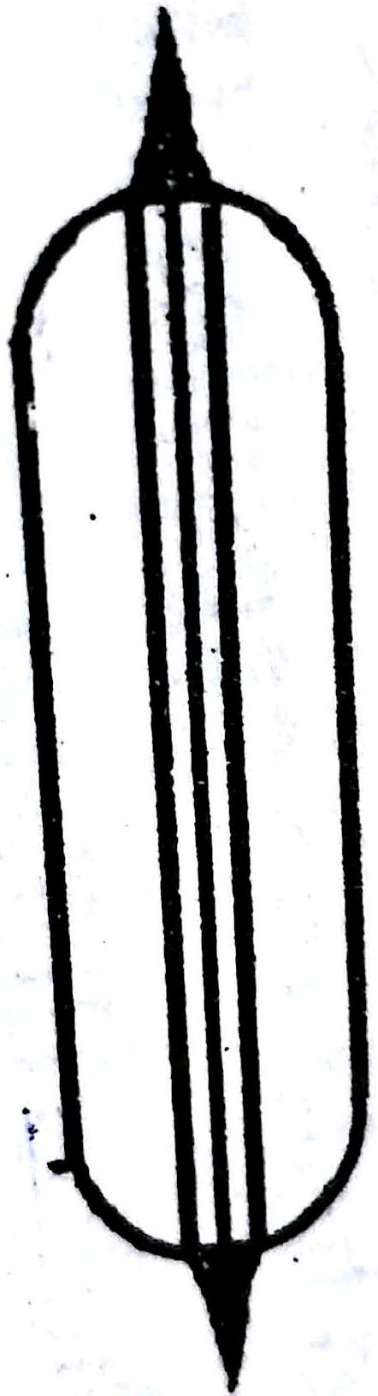
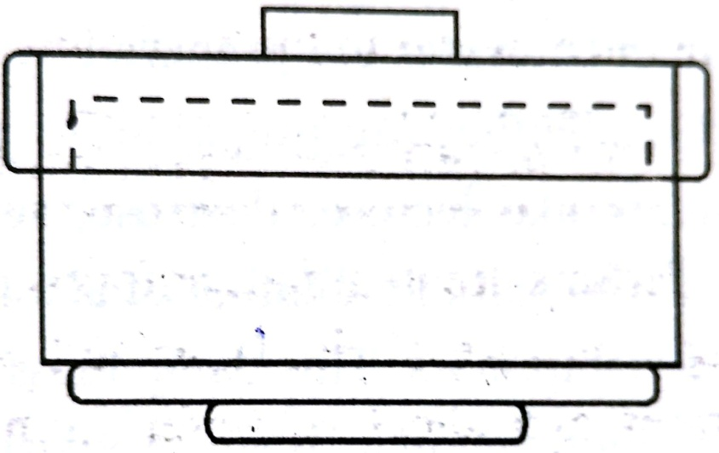
Disadvantages:-
• Easily damaged as they are not firm.
• Provide poor protection to the drugs from light & moisture
• Fragile in nature so not suitable to be filled on automated machines.
Cachets are of two types:-
(1) Wet seal cachets
(2) Dry seal cachets

Slide 8
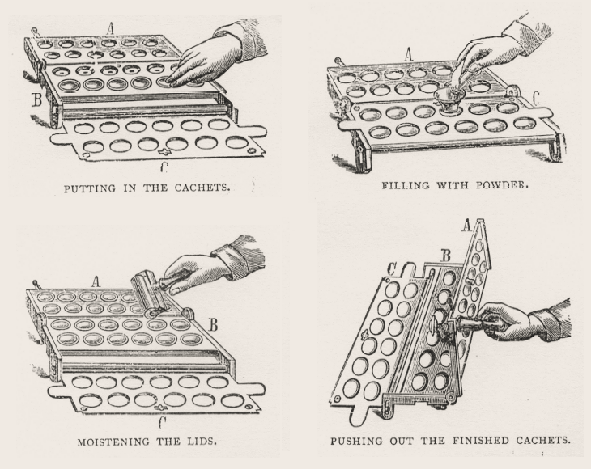
Wet seal cachets

Slide 9
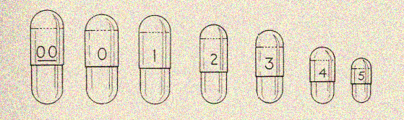
(ii) Capsules:-
(www.rpsgb.org.uk/pdfs/mussheet 09.pdf)
( US Patent 7622137 )
• Small boxes or shell made up of mainly gelatin
• Available in various sizes
• Made up of two halves…
lower part -- Body
Upper part -- Cap
Various sizes of capsule
Filling of powder can be done by two ways :
Heap method
By using simple wooden apparatus

Slide 10
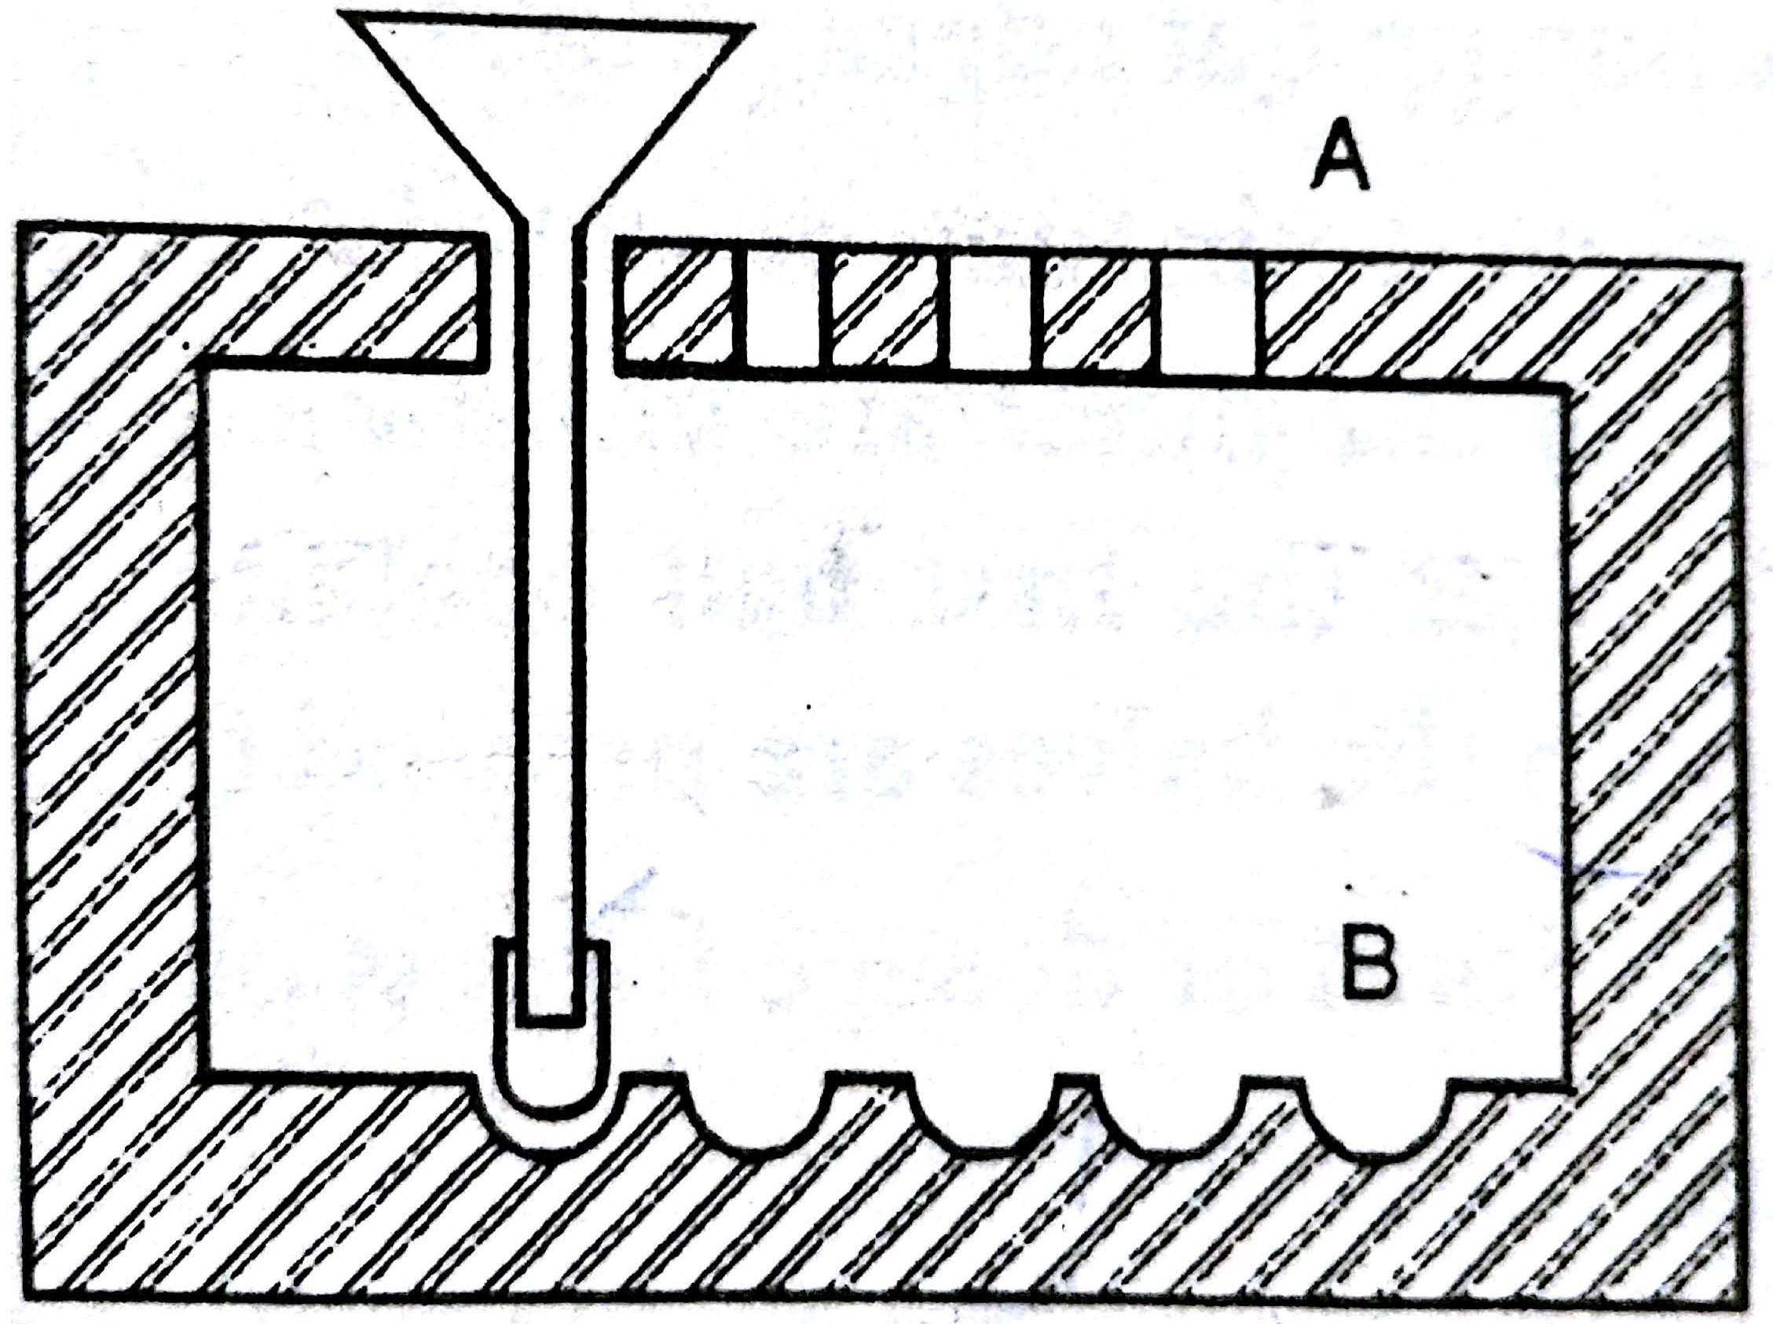
Simple wooden apparatus

Slide 11
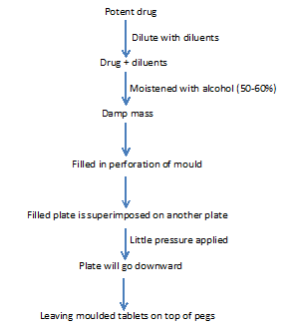
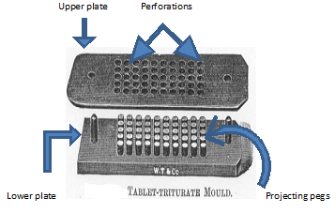
4. Tablet triturates:
(www.rpsgb.org.uk/pdfs/mussheet 09.pdf)
(US Patent 6036974 ) (US Patent 4004036 )
• They are flat and circular disk shaped.
• Prepared by moulding powder into tablets, usually for potent medicaments and higher toxic drugs by diluting with diluents.

Slide 12
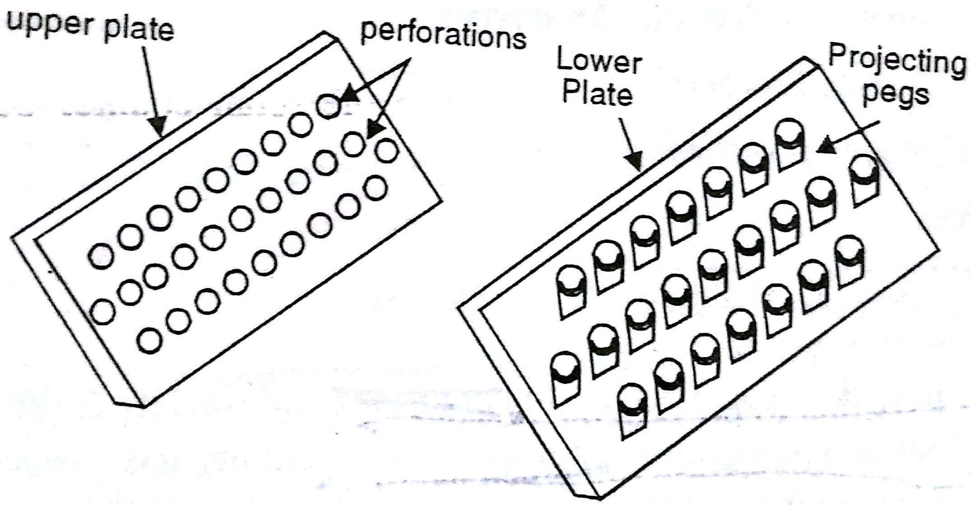

Slide 13
REFERENCES
Pharmaceutics – II, Dr. A. K. Seth, S. Vikas & co. publication, Jalandhar, 1st edition, reprinted 2008, p.n. 109-137.
Pharmaceutics- II, Dr. G.K. Jani, B.S. Shah prakashan, 4th edition- 2003-2004. p.n. 106-140.
Dispensing pharmacy, R.M. Mehta, Vallabh prakashan publication, p.n. 108-142.
www.pharmpedia.com/GATE:Pharmaceutical_Powders, Author: Prof. Jayanti Vijaya Ratna
powder and cachets, Information sheet : 8, Royal pharmaceutical society of Great Britain, (www.rpsgb.org.uk/pdfs/mussheet 08.pdf).
Capsules and tablets, Information sheet : 9, Royal pharmaceutical society of Great Britain, (www.rpsgb.org.uk/pdfs/mussheet 09.pdf).
Dosage forms contained within a capsule or sachet, US Patent 7622137, Issued on November 24, 2009,(www.Patentstorm.com).
Method and apparatus for preparation of molded tablet and thereby prepared molded tablet, US Patent 6036974 Issued on March 14, 2000, (www.Patentstorm.com).
Effervescent molded triturate tablets, US Patent 4004036 Issued on January 18, 1977,(www.Patentstorm.com).

Slide 14

THANK YOU

