Slide 1
Non-aqueous titrations
Subject- PD 105 Pharmaceutical Inorganic Chemistry
Class- First Pharm D
Prepared by- Dr. Dhanya B Sen.

Slide 2
Non aqueous titration
Non aqueous titration is the titration of substances dissolved in solvents other than water.
It is the most common titrimetric procedure used in pharmacopoeial assays and serves a double purpose:
It is suitable for the titration of very weak acids and very weak bases and
It provides a solvent in which organic substances are soluble.
Most of the drugs are water insoluble
Non- aqueous titration is mainly carried out for weak acids and weak bases.
Weak acids and weak bases cannot be titrated in aqueous solutions because water is an amphiprotic solvent and it will interfere with the reaction.
Types of solvents
Protogenic Solvents
Acidic substances which generate protons are called as protogenic solvents.
Eg: sulphuric acid.

Slide 3
Protophilic solvents
They are basic in nature and react with acids to form solvated protons
Eg: Sodium Hydroxide.
Amphiprotic solvents
Solvents which have both protophilic and protogenic properties are known as amphiprotic solvents.
Eg: water, glacial acetic acid
Aprotic solvents
Aprotic solvents are neutral. Chemically inert substances , they have a low dielectric constant, do not react with either acids or bases and therefore, do not favor ionisation.
Eg: Toluene, chloroform.
Precautions to be taken while carrying out NA titration.
Water should not be present in any of the glass apparatus used. All glasswares should be dried properly before use.
Perchloric acid should be prepared 24 hours before its use so that any water molecule present will react with acetic anhydride and will get converted into acetic acid.

Slide 4
3. Non aqueous solvents in general, have greater coefficients of expansion than water, so that temperature differences can cause significant errors . So standardisation and titration should be carried out as far as possible at the same temperature. A correction factor can also be used after experiment.
Vc = V[1+0.0011 (t1 –t2)]
Where Vc= corrected volume of titrant
V=Volume of titrant measured
t1= temperature at which titrant was standardised
t2=temperature at which titration was carried out
4. The perchloric acid must be well diluted with acetic acid before adding the acetic anhydride. Failure to observe this precaution leads to formation of the explosive acetyl-perchlorate.
Levelling effect.
If a very strong acid such as perchloric acid is dissolved in glacial acetic acid, the latter can function as a base because of its amphiprotic property and combine with protons donated by the perchloric acid to form an onium ion.
When a weak base, such as pyridine, is dissolved in acetic acid, the acetic acid exerts its levelling effect and enhances the basic properties of the pyridine. It is possible therefore to titrate a solution of a weak base in acetic acid with perchloric acid to obtain a sharp endpoint.

Slide 5
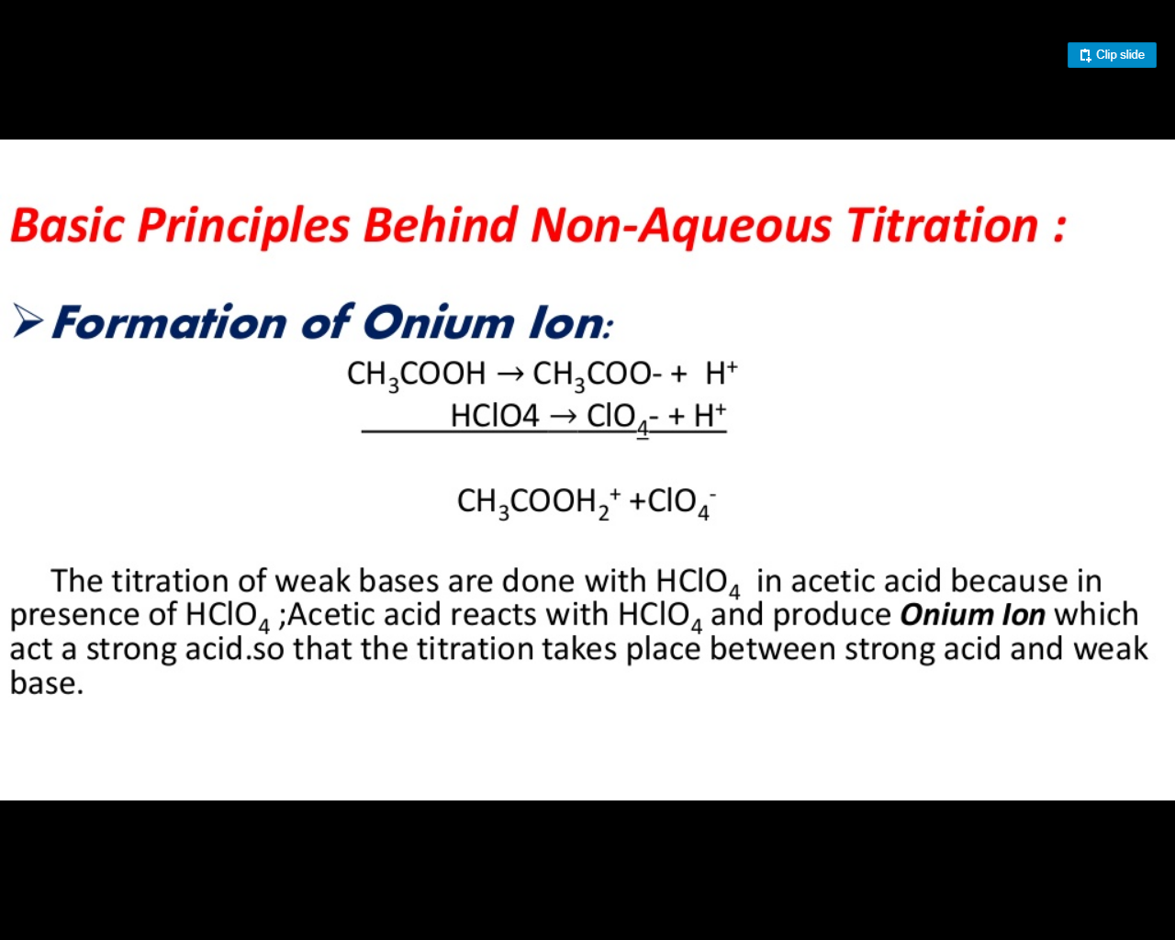

Slide 6
Titrants used in non aqueous titration
Acidic titrants: Perchloric acid
p- Toluenesulfonic acid,
2,4-Dinitrobenzenesulfonic acid
Basic titrants : Tetrabutylammonium hydroxide
Potassium methoxide
Sodium methoxide
Preparation of 0.1 M Perchloric acid
Mix 8.5 ml of perchloric acid with 500 ml of anhydrous glacial acetic acid and 25 ml of acetic anhydride, cool and add anhydrous glacial acetic acid to produce 1000 ml. Allow the prepared solution to stand for one day before use.
Standardisation of 0.1 M Perchloric acid.
Weigh accurately about 0.35 g of potassium hydrogen phthalate , previously powdered lightly and dried at 120 degree for 2 hours and dissolve it in 50 ml anhydrous glacial acetic acid. Add 0.1 ml crystal violet solution and titrate with the perchloric acid solution until the violet colour changes to emerald green. Perform a blank determination and make any necessary correction.
Each ml of 0.1 m perchloric acid is equivalent to 0.02042 g of C8H5KO4.

Slide 7
Estimation of Sodium Benzoate
Assay Procedure: Weigh accurately about 0.25 g of Sodium Benzoate, dissolve in 20 ml of anhydrous glacial acetic acid, warming to 50º if necessary, cool. Titrate with 0.1 M perchloric acid, using 0.05 ml of 1 naphtholbenzein solution as indicator. Carry out a blank titration. Equivalent factor or I.P factor : 1 ml of 0.1 M perchloric acid is equivalent to 0.01441 g .
Preparation of 0.1 M tetrabutylammonium hydroxide in toluene-methanol
Dissolve tetrabutylammonium iodide (40 g ) in absolute methnol (90 ml), add finely powdered purified silver oxide (20 g) and shake vigorously for 1h. Centrifuge a few ml of the mixture and test the supernatant liquid for iodide. If a positive reaction is obtained, add an additional 2 g of silver oxide and shake for a further 30 min. Repeat this procedure until the liquid is free from iodide, filter the mixture through a fine sintered glass filter and rinse the reaction vessel with 3 portions, each of 50 ml, of dry toluene. Add the washings to the filtrate and dilute to 1000 ml with toluene. Flush the solution with carbon dioxide free nitrogen for 5 min and protect from carbon dioxide and moisture during storage.

Slide 8
Standardisation of 0.1 m tetrabutyl ammonium hydroxide
Accurately weigh about 60 mg of benzoic acid into 10 ml dimethyl formamide previously neutralized to the full blue colour of thymol blue by titration with 0.1 m TBAH . Allow the benzoic acid to dissolve and titrate in an atmosphere of carbon-dioxide free nitrogen with 0.1 M tetrabutyl ammonium hydroxide.
Preparation Of 0.1 M Sodium Methoxide
Cool 150 ml of anhydrous methanol in ice water and add, in small portions about 2.5 g of freshly cut sodium. When the metal has dissolved add sufficient toluene previuosly dried over sodium wire to produce 1000 ml. standardize the solution in the following manner immediately before use.
Weigh accurately about 0.4 g of benzoic acid dissolved in 80 ml of dimethyl formamide add 0.15 ml of thymolphthalein solution and titrate with sodium methoxide solution to a blue endpoint. Protect the solution from atmospheric carbon di oxide through out the titration. Perform a blank determination and make any necessary corrections.
1 ml of 0.1 M sodium methoxide is equivalent to 0.01221 g of C7H6O2

Slide 9
Method A of Non aqueous titration : In this method, substance under examination is dissolved in appropriate solvent and titrated with perchloric acid or sodium methoxide.
Method B of Non aqueous titration : The halide ions chloride, bromide and iodide are too weakly basic to react quantitatively with acetous perchloric acid. Addition of mercuric acetate (which is undissociated in acetic acid solution) to a halide salt replaces the halide ion by an equivalent quantity of acetate ion, which is a strong base in acetic acid.
Indicator | Basic | Acidic
Crystal Violet | violet | Yellowish green
1-Naphtholbenzein | blue | Dark green
Thymol blue | blue | yellow
Thymolphthalein | blue | colourless

