Slide 1
SEDATIVE AND HYPNOTICS
Mrs Kinjal Patel
Assistant Professor
Pharmacology department

Slide 2
SEDATIVE:
A drug that reduces excitement, calms the patient (without inducing sleep)
Sedative in therapeutic doses are anxiolytic agents
Most sedatives in larger doses produce hypnosis(trans like stage in which subject become passive and highly suggestible)
Site of action is on limbic system which regulates thought and mental function.

Slide 3
HYPNOTIC
A drug which produces sleep resembling natural sleep
They are used for initiation and/or maintenance of sleep.
Hypnotics in higher doses produce general anaesthesia.
Site of action is on the midbrain and ascending RAS which maintain wakefulness.

Slide 4
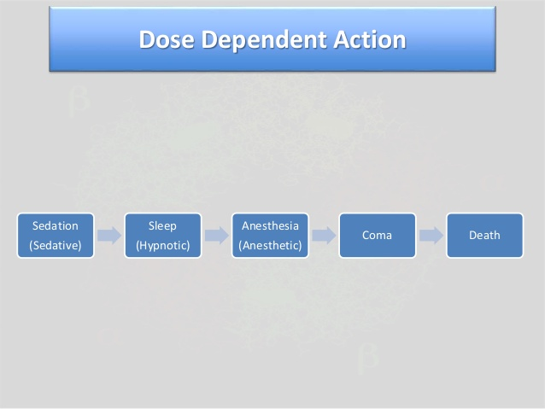

Slide 5

SLEEP
BASICS:
Sleep is a naturally recurring state characterized by
1.Reduced or absent consciousness
2.Relatively suspended sensory activity
3. Decreased ability to react to stimuli
4.Easily reversible
5.Inactivity of nearly all voluntary muscles

Slide 6
FUNCTIONS OF SLEEP
Energy Conservation :decrease in metabolic rate and body temperature
Restoration and Recovery : increased anabolic hormones, decreased catabolic hormone
Ecological Hypotheses of predator avoidance
Memory Reinforcement and consolidation
Synaptic and Neuronal Network Integrity

Slide 7
The sleep-wake cycle, is regulated by two separate biological mechanisms in the body, which interact together and balance each other.
1)Circadian rhythm(Process C)
2)Sleep-wake homeostasis(Process S)

Slide 8
1)Circadian rhythm (Process C)
Process C regulates the body’s internal processes and alertness levels , which is governed by the internal biological or circadian clock.
The body’s built-in circadian clock, which is centred in the hypothalamus organ in the brain, is the main mechanism that controls the timing of sleep, and is independent of the amount of preceding sleep or wakefulness
This internal clock is coordinated with the day-night / light-dark cycle over a 24-hour period, and regulates the
Body’s sleep patterns
Feeding patterns
Core body temperature
Brain wave activity
Cell regeneration
Hormone production

Slide 9
2)Sleep-wake homeostasis(Process S)
sleep-wake homeostasis, or Process S, the accumulation of hypnogenic (sleep-inducing) substances in the brain, which generates a homeostatic sleep drive
Sleep-wake homeostasis is an internal biochemical system that operates as a kind of timer or counter, generating a homeostatic sleep drive or pressure to sleep and regulating sleep intensity.
It effectively reminds the body that it needs to sleep after a certain time, and it works quite intuitively:

Slide 10
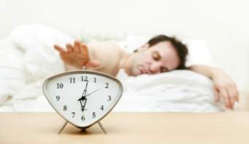
STAGES OF SLEEP
The human body goes through stages of sleep when we lay down to rest, and interference with the sleep cycle can cause tiredness and irritability the following day.
Science has discovered two distinct types of sleep, known as
1. Rapid eye movement (REM) sleep
2. Non-REM sleep.

Slide 11
STAGES OF SLEEP
The human body goes through stages of sleep when we lay down to rest, and interference with the sleep cycle can cause tiredness and irritability the following day.
Science has discovered two distinct types of sleep, known as
1. Rapid eye movement (REM) sleep
2. Non-REM sleep.

Slide 12
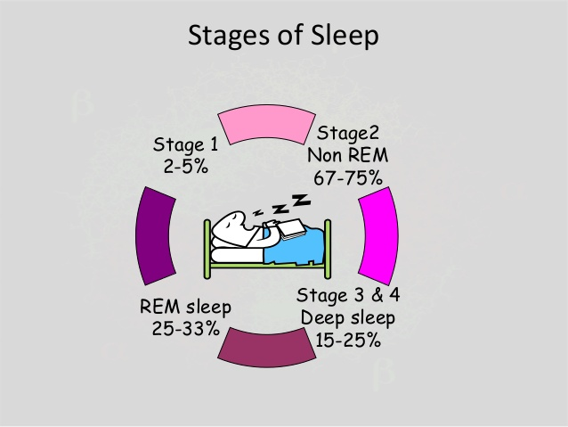

Slide 13
5 STAGES OF SLEEP
Stage 1( non-REM sleep)
This sleep occurs in the first moments after you have laid your head down on your pillow and closed your eyes. The eyes move slowly and muscle movement ceases.
Sleeper can be easily awakened by noise or other disturbances as she drifts in and out of sleep.
Stage 2( non-REM sleep)
In this stage of sleep, the person is actually asleep and the sleeper is not aware of surroundings.
Body temperature drops, breathing and heart rate are regular, and eye movements decrease significantly or are non-existent.
Brain waves slow down, though there may be bursts of activity.

Slide 14
Stage 3 (non-REM sleep)
This is deep sleep, characterized by even slower brain waves and less sporadic bursts of brain wave activity.
Breathing slows and muscles relax.
Sleepers are hard to awaken during this stage. Children sometimes wet the bed during this stage of sleep.

Slide 15
Stage 4 (non-REM sleep)
This is the deepest sleep and is characterized by very slow brain waves and no sporadic bursts of brain wave activity.
As with Stage 3 non-REM sleep, sleepers are hard to wake up.
tissue repair takes place during this stage of sleep.
Hormones will be released to assist with growth and development.
Once the sleeper reaches stage four (about an hour after sleep begins) they then travel back up through stages three, two and one.

Slide 16
Stage 5 ( REM sleep)
The REM stage is the sleep during which we dream. It is characterized by rapid eye movements even though the eyes are closed.
Breathing is rapid, irregular, and shallow.
Heart rate and blood pressure increase.
Arms and leg muscles experience a type of paralysis that keeps people from acting out their dreams.
some may talk or walk during REM sleep.

Slide 17
SLEEP HORMONES
Sleep brain hormones are:
Serotonin---which is produced during the day
Melatonin---which is produced at night.
If you are happy during the day and sleep soundly at night, then your brain hormones are well balanced.
SEROTONIN:
Serotonin (“happy hormone” )is secreted in the central nervous system.
Function of serotonin:
Regulating moods, appetite, sleep

Slide 18
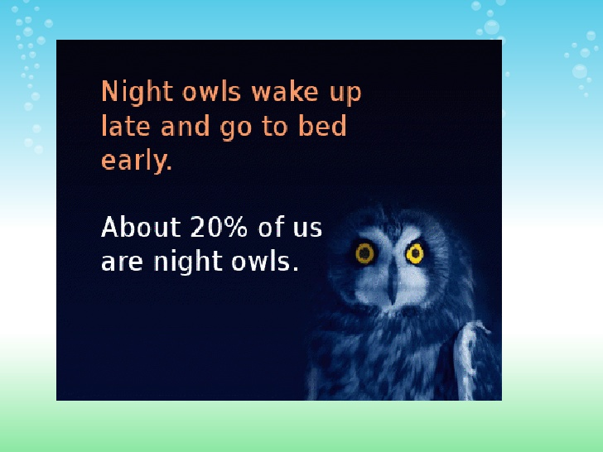
The lack of Serotonin causes
Anxiety
depression
insomnia
irritability

Slide 19
MELATONINE:
Melatonin is produced from Serotonin during low light conditions and is produced naturally when darkness falls.
Melatonin is secreted by the Pineal Gland.
Function of Melatonin
1.Synchronization of the biological clock
2. As an antioxidant.
3. It increases Killer T cells of the immune system.

Slide 20
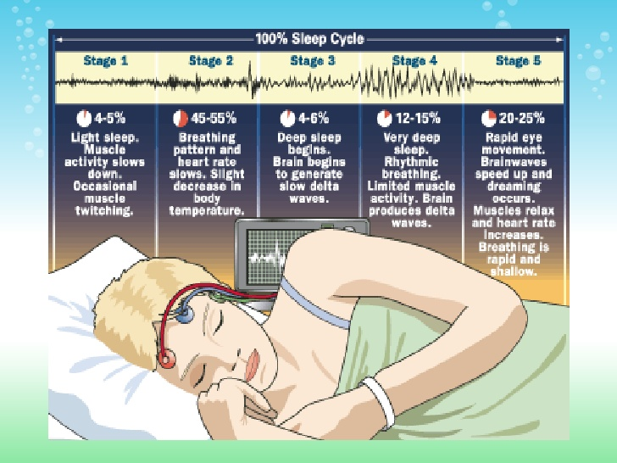

Slide 21
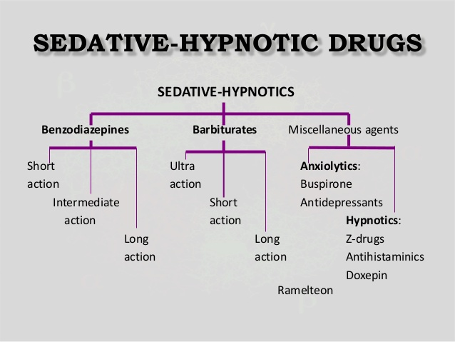

Slide 22
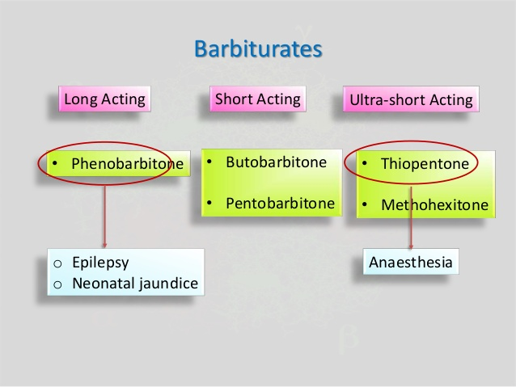

Slide 23
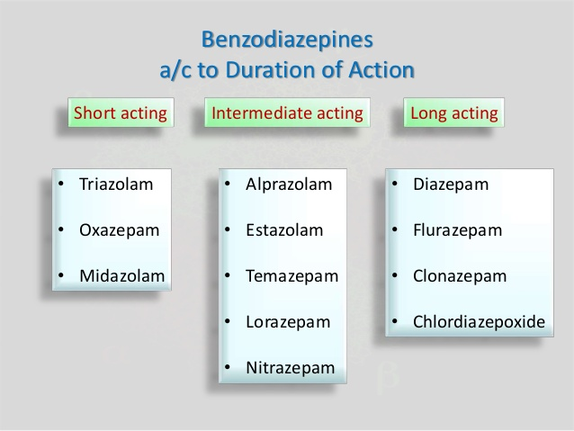

Slide 24
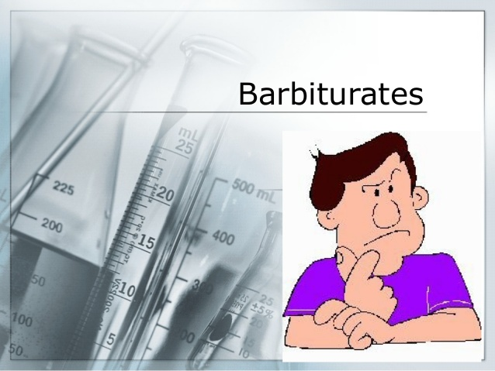

Slide 25
BARBITURATES
All derivatives of Barbituric acid.
Depressants of the central nervous system (CNS) that impair or reduce the activity of the brain by acting as a Gamma Amino Butyric Acid (GABA) potentiators
Categorized as hypnotics and also called “downers”
Produce alcohol like symptoms such as impaired motor control (ataxia), dizziness, and slower breathing and heart rate.

Slide 26
HISTORY
Barbituric acid was first created in 1864 by a German scientist named Adolf von Baeyer. It was a combination of urea from animals and malonic acid from apples.
Its first derivative utilized as medicine was used to put dogs to sleep but was soon produced by Bayer as a sleep aid in 1903 called Veronal.
Prescribed as sedatives, anesthetics, anxiolytics, and anti-convulsant.
Also popular and abused in pop culture because of their alcohol like effects.

Slide 27
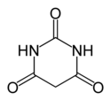

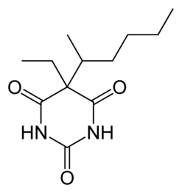
TYPES
Barbituric Acid
Amobarbital
Phenobarbital
Pentobarbital

Slide 28

SYNTHESIS
Malonic Acid Urea Barbituric Acid
Barbituric acid is synthesized by a condensation reaction that results in the release of H2O (dehydration) and the heterocyclic pyrimidine

Slide 29
MECHANISM OF ACTION
Barbiturates potentiate the effect of GABA by binding to the GABA-A receptor at a nearby site and increasing the chloride flow through the channel.
Glutamate performs the opposite effect from GABA restricting ion flow and increasing the transmembrane action potential of the neuron.
By blocking this action Barbiturates serve to increase the duration of the receptor response to GABA and extend the depressed condition of the cell.

Slide 30
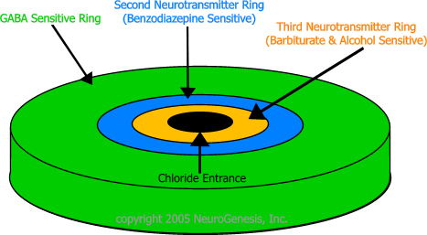

Slide 31
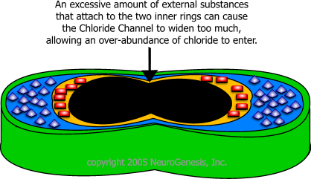

Slide 32
MECHANISM OF ACTION:

Slide 33
PHARMACOLOGICAL ACTION OF BARBITURATES
On CNS
Mild degree of sedation to general anaesthesia.
Anticonvulsant effect
Respiratory centre depression
On CVS
Hypotension
Decrease heart rate
Circulatory collapse

Slide 34
On Liver:
Enzyme induction,so increase metabolism of itself and other drugs.
Stimulation of glucouronyl transferase.
On Kidney
Antidiuretc efffect (increase ADH)
Decrease urinary output by depressing GFR

Slide 35
On Eye
No effect (normal dose)
Miosis(Toxic effect)
On GIT
Constipation (on prolong use)

Slide 36
USES:
Barbiturates have been use in the past to treat a variety of symptoms from insomnia and dementia to neonatal jaundice
They have largely been replaced with drugs such as benzodiazepine due to their propensity for addiction and reduced effect over extended use
Still widely used to treat most seizures including neonatal seizures
Used when benzo class drugs fail or in underdeveloped countries
Cannot be used for treatment of absence seizures

Slide 37
THERAPEUTIC USES
ANESTHESIA (THIOPENTAL, METHOHEXITAL)
Selection of a barbiturate is strongly influenced by the desired duration of action.
The ultrashort-acting barbiturates, such as thiopental, are used intravenously to induce anesthesia.
ANXIETY
Barbiturates have been used as mild sedatives to relieve anxiety, nervous tension, and insomnia.
When used as hypnotics, they suppress REM sleep more than other stages. However, most have been replaced by the benzodiazepines.

Slide 38
THERAPEUTIC USES
ANTICONVULSANT: (PHENOBARBITAL, MEPHOBARBITAL)
Phenobarbital is used in long-term management of tonic-clonic seizures, status epilepticus, and eclampsia.
Phenobarbital has been regarded as the drug of choice for treatment of young children with recurrent febrile seizures.
Phenobarbital can depress cognitive performance in children, and the drug should be used cautiously.
Phenobarbital has specific anticonvulsant activity that is distinguished from the nonspecific CNS depression.

Slide 39
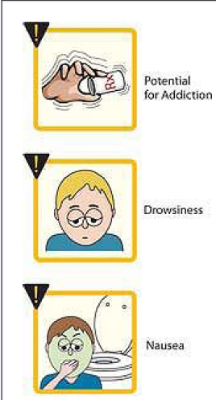
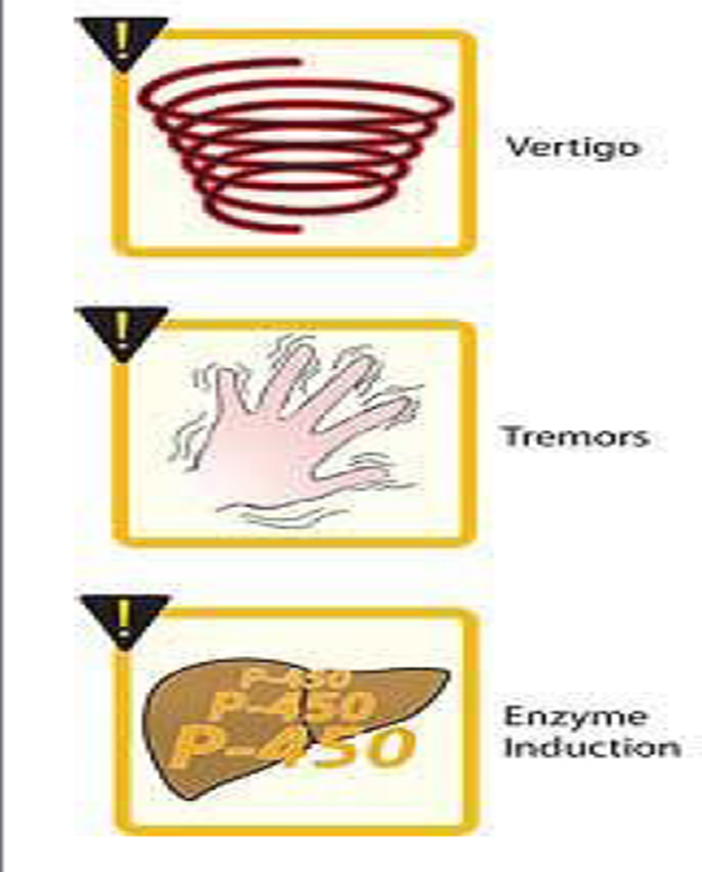
ADVERSE EFFECTS

Slide 40
Tolerance:
Repeated administration of Barbiturates.
The tolerance is due to increase in its own metabolism, as well as adaptation of the cells in CNS.
Tolerance with barbiturates develops for all effect except that for anticonvulsant action.
Drug Dependence
Development of addiction is also common after repeated use of barbiturates.
Withdrawal syndrome occurs after 12- 16 hrs and is characterized by anxiety, restlessness, tremors, nausea, vomiting .
Drug is withdraw mostly trough the tappering method.

Slide 41
SYMPTOMS OF WITHDRAWAL
Tremors
Difficulty in sleeping
Agitation
Hallucinations
High temperature
Seizures.

Slide 42
SIDE EFFECTS
Drowsiness
Confusion
Dizziness
Trembling
Impaired coordination
Vision problems
Grogginess( strong desire of sleep)
Feelings of depression
Headache

Slide 43
BENZODIAZEPINE

Slide 44
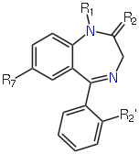
Benzodiazepine

Slide 45
GENERAL PROPERTIES OF BENZODIAZEPINES
Benzodiazepines are compounds with sedative, anxiolytic and anticonvulsant properties.
As the dose is increased the effects observed are first anxiolytic, followed by sedation, then hypnosis and finally unconsciousness with respiratory depression.
First clinically useful benzodiazepine, chlordiazepoxide hydrochloride, was discovered in 1957.
History
The first benzodiazepine, chlordiazepoxide (Librium), was synthesized in 1955 by Leo Sternbach while working at Hoffmann–La Roche on the development of tranquilizers.

Slide 46
SYNTHESIS :-
The 2- amino aryl ketone is condensed with a bifunctional, two carbon fragment to give 1,4-benzodiazepin-2-ones.
46

Slide 47
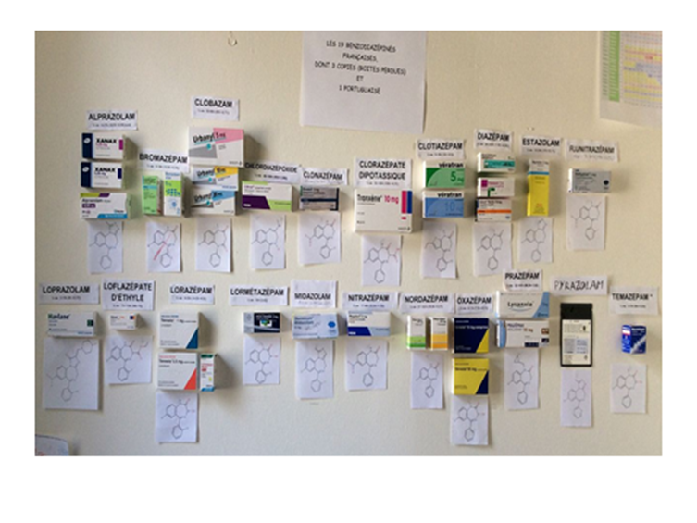
CLASSIFICATION
Short acting drugs (t_{1/2}=6hrs):
triazolam
midazolam
brotizolam
Medium acting drugs (t1/2=6-12hrs):
temazepam,
lometazepam,
loprazolam
Long acting drugs (t1/2=more than12hrs):
nitrazepam
flurazepam
flunitrazepam

Slide 48
MECHANISM OF ACTION
Benzodiazepines act as GABA (aminobutyric acid) potentiators.
They bind to BZ receptors on the GABA-BZ receptor complex, which allows them to allosterically modulate and enhance the activity of GABA.
This results in increased hyperpolarization at target neurons, making them less responsive to excitatory stimuli.

Slide 49
Mechanism of Action

Slide 50
PHARMACOKINETICS
Oral route peak plasma concentration (1-3) hours
Extensive protein binding
Lipophilic, readily cross blood-brain barrier
Distributed widely though out body
Hepatic metabolism
Many have active metabolites
Biotransformation affected by liver disease, age,
individual variation

Slide 51
PHARMACOLOGICAL ACTION
Reduction in anxiety and agression
BZD are useful in anxiety because of low risk of drug interactions, based on enzyme induction, high therapeutic index, slow elimination rate and a low risk of drug dependence.
BZD in general, produce additive CNS depression when administered with other CNS depressant drug including ethanol.
Alprazolam is specifically useful as an anxiolytic agent.
Sedation and induction of sleep
They induce sleep which is almost identical to normal sleep as the REM component is not suppressed.

Slide 52
Reduction in muscle tone and co-ordination
All BZD produce decrease in spontaneous motor activity in animals
BZD exert inhibitory effect on polysynaptic reflexes and interneurones transmission and at high dose suppress transmission at the skeletal muscles.
These effects are centrally mediated and are independent of sedative effect.
Anticonvulsion effect
Diazepam, Nitrazepam and Clonazepam possess antiepileptic activity of which diazepam is specifically useful in status epilepticus.

Slide 53
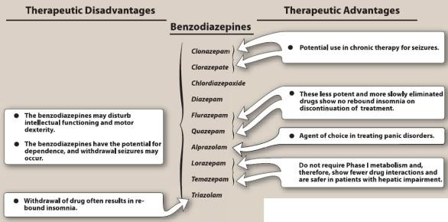
v

Slide 54
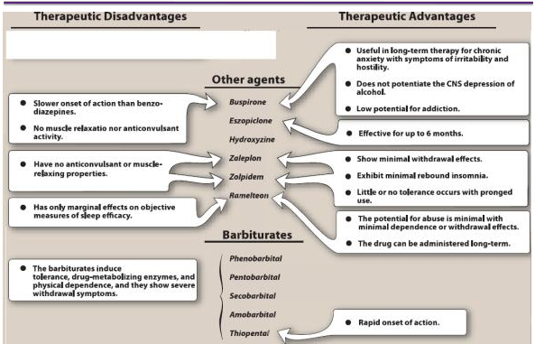

Slide 55
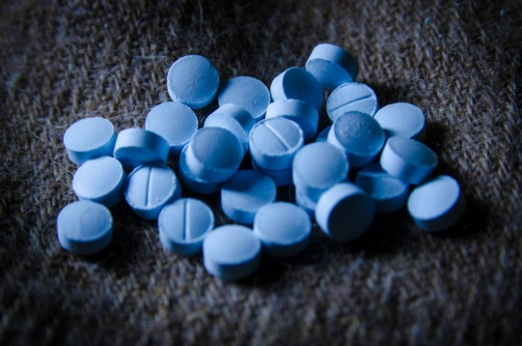
USES:
Anxiety and panic
Seizures (convulsions)
Insomnia or trouble sleeping.
General anesthesia
Sedation prior to surgery or diagnostic procedures
Muscle relaxation
Acohol withdrawal
Nausea and vomiting
Depression
Panic attacks

Slide 56

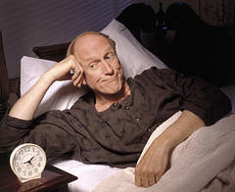

SIDE EFFECT
Feeling of depression
Loss of orientation
Headache
Sleep disturbance
Confusion
Irritability
Aggression
Excitement
Memory impairment

Slide 57

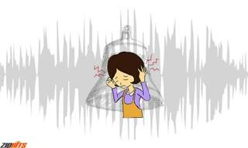
WITHDRAWAL SYMPTOMS
Anxiety
Trouble sleeping
Restlessness
Muscle tension
Nausea
Blurred vision
Sweating,
Nightmares
Depression,
Muscle coordination problems
Muscle twitching
Hallucinations
Delusions
Ringing in the ears

Slide 58
CONTRAINDICATION
The FDA classifies benzodiazepines as pregnancy categoryD, which means that benzodiazepines can potentially cause fetal harm if administered to pregnant women.
Benzodiazepines enter breast milk and can cause lethargy and weight loss in the newborn.. Therefore, they should not be used in nursing mothers.

Slide 59
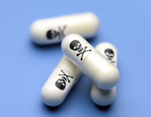
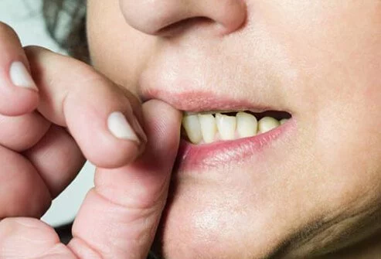
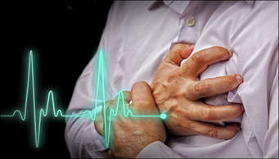
OVERDOSE SYMPTOMS
Confusion
Slurred speech
Loss of muscle control
Trouble thinking or talking
Unconsciousness
Low blood pressure
Slow or shallow breathing
Seizure
Cardiac arrest

Slide 60
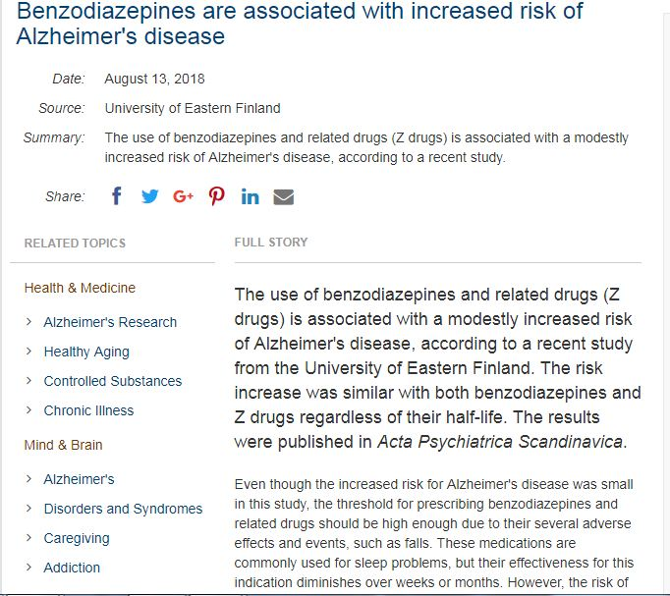
RESEARCH TOPICS
The use of benzodiazepines and related drugs (Z drugs) is associated with a modestly increased risk of Alzheimer's disease, according to a recent study from the University of Eastern Finland.

Slide 61
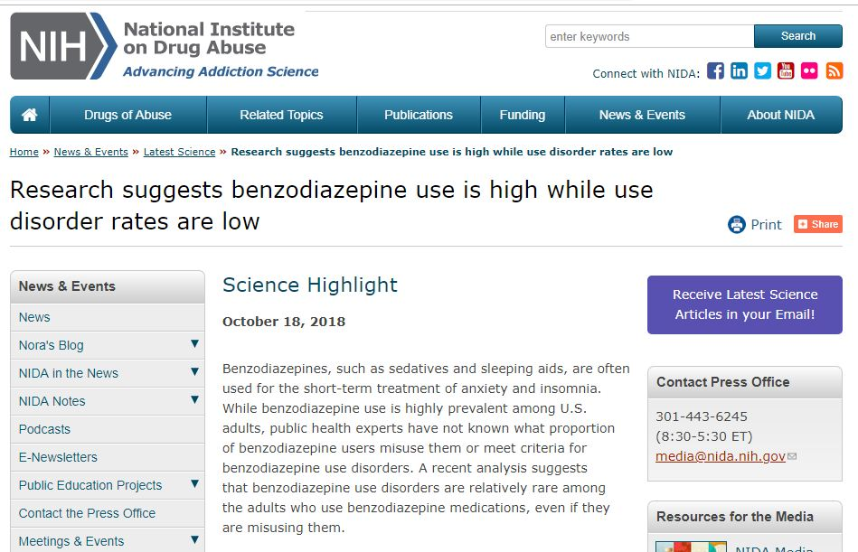

Slide 62
REFERENCE
Agulnik A, Kelly DP, Bruccoleri R, Yuskaitis C, Ebrahimi-Fakhari D, Sahin M, Burns MM, Kohane DS. Combination Clearance Therapy and Barbiturate Coma for Severe Carbamazepine Overdose. Pediatrics. 2017 May;139(5) [PubMed]
Ashton, H. (2002), ‘Benzodiazepine abuse’, in Caan, W. and De Belleroche, J. (editors), Drink, drugs and dependence: from science to clinical practice, Routledge, London.
American Society of Anesthesiologists. (2011, January 21). ASA Statement on Sodium Thiopental’s Removal From the Market [Press release]. Retrieved from https://www.asahq.org/about-asa/newsroom/news-releases/2011/01/asa-statement-on-thiopental-removal-from-the-market
Barbiturates drug profile. (2015, January 8). Retrieved from http://www.emcdda.europa.eu/publications/drug-profiles/barbiturates
Barbiturates. (n.d.). Retrieved from http://www.ginad.org/en/drugs/drugs/222/barbiturates-
Blanco, et al. Prevalence and Correlates of Benzodiazepine Use, Misuse, and Use Disorders Among Adults in the United States. Journal of Clinical Psychiatry. ​

Slide 63
Bramness, J., Skurtveit, S. and Morland, J. (2002), 'Clinical impairment of benzodiazepines–relation between benzodiazepine concentrations and impairment in apprehended drivers', Drug and Alcohol Dependence, Volume 68, No 2, pp. 131–41.
Briggs GG, Freeman RK, Yaffe SJ (2008): Drugs in Pregnacy and Lactation. 8th Edition. Lippincott Williams & Wilkins. pp 1750-1751
Cordato, D.J., Herkes, G.K, Mather, L.E., & Morgan, M.K. (2003, May). Barbiturates for acute neurological and neurosurgical emergencies--do they still have a role? [Abstract]. Journal of Clinical Neuroscience, 10(3), 283-8. Retrieved from http://www.jocn-journal.com/article/S0967-5868(03)00034-1/abstract
Drugs and Lactation Database (LactMed) [Internet]. National Library of Medicine (US); Bethesda (MD): 2006. Phenobarbital.
Drugsof abuse. (2017). Retrieved from https://www.dea.gov/pr/multimedia-library/publications/drug_of_abuse.pdf

Slide 64
https://www.slideshare.net/duttamonasen/9-sleep-and-stay-healthy
https://www.tuck.com/stages/
International Narcotics Control Board (2007), Psychotropic Substances, Statistics for 2006: Assessments of Annual Medical and Scientific Requirements for Substances in Schedules II, III and IV of the Convention on Psychotropic Substances of 1971, United Nations Publications, New York.
López-Muñoz, F., Ucha-Udabe, R., & Alamo, C. (2005, December). The history of barbiturates a century after their clinical introduction. Neuropsychiatric Disease and Treatment, 1(4), 329-343. Retrieved from http://www.ncbi.nlm.nih.gov/pmc/articles/PMC2424120/
Ramakrishnan, K., & Scheid, D.C. (2007, August 15). Treatment options for insomnia. American Family Physician, 76(4), 517-26. Retrieved from http://www.aafp.org/afp/2007/0815/p517.html

Slide 65
Standard antiepileptic drugs (phenobarbital, phenytoin, carbamazepine, valproic acid) for management of convulsive epilepsy in adults and children. (2012). Retrieved from http://www.who.int/mental_health/mhgap/evidence/epilepsy/q7/en/
Tapiainen, H. Taipale, A. Tanskanen, J. Tiihonen, S. Hartikainen, A.-M. Tolppanen. The risk of Alzheimer's disease associated with benzodiazepines and related drugs: a nested case-control study. Acta Psychiatrica Scandinavica, 2018; 138 (2): 91 DOI: 10.1111/acps.12909
Yasiry, Z., & Shorvon, S.D. (2012, December 3). How phenobarbital revolutionized epilepsy therapy: the story of phenobarbital therapy in epilepsy in the last 100 years. Epilepsia, 53(Suppl. 8), 26-39. Retrieved from http://onlinelibrary.wiley.com/doi/10.1111/epi.12026/full

Slide 66

THANK YOU

