Slide 1
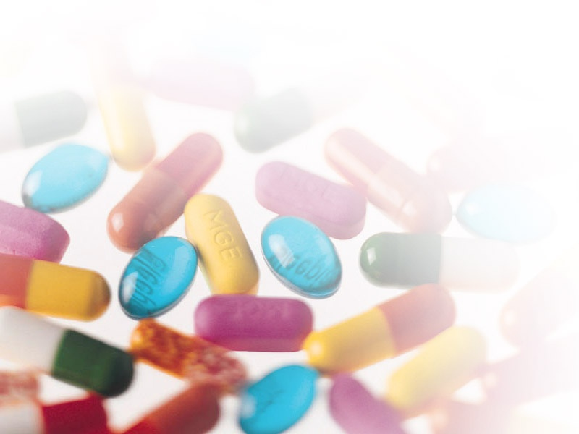
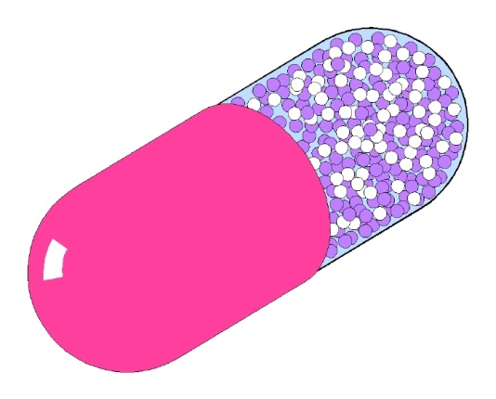
Raw Materials for capsules
By: Dr. Chintan Aundhia

Slide 2
Capsules are primarily (but not exclusively) manufactured using gelatin; however, the suitability of other materials, e.g. HPMC and starch, have been investigated as suitable replacements.

Slide 3
Formulation ingredients of Capsules
1.Gelatin
2.Colourants
3.Process aids

Slide 4
1. Gelatin

Slide 5
Gelatin is a mixture of proteins that is extracted from animal collagen (derived from animal skins, sinews and/or bovine bones) by either partial acid or partial alkaline hydrolysis.
Major component of the capsules.
Raw material of choice because it gels to form a solid just above ambient temperature.
This enables a homogeneous film to be formed rapidly on a mould pin.

Slide 6
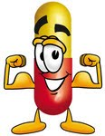
Gelatin is a translucent brittle solid substance, colorless or slightly yellow, nearly tasteless and odorless, which is created by prolonged boiling of animal skin connective tissue or bones.

Slide 7
Basic Properties of Gelatin
It is non-toxic, widely used in foodstuffs and acceptable for use worldwide.
It is readily soluble in biological fluids at body temperature.
It is good film-forming material, producing a strong flexible film
The gelatin films are homogeneous in structure, which gives them strength.

Slide 8
Types of Gelatin
Type A gelatin is derived from an acid-treated precursor and exhibits an isoelectric point in the region of pH 9. It is produced by acid treatment of Pig skin
Type B gelatin is from an alkali-treated precursor and has its isoelectric zone in the region of pH 4.7. It is produced by alkaline treatment of demineralised bones.

Slide 9
Physical Properties of Gelatin
The natural molecular bonds between individual collagen strands are broken down into a form that rearranges more easily.
Gelatin melts when heated and solidifies when cooled again. Together with water it forms a semi-solid colloidal gel.

Slide 10
Production of Gelatin

Slide 11
Gelatin is made from by-products of the meat and leather industry, mainly pork skins, pork and cattle bones, or split cattle hides
The raw materials are prepared by different curing, acid, and alkali processes which are employed to extract the dried collagen hydrolysate.

Slide 12
Dry Bone
5% HCl. 10-15days
Lime 10% 4-8 weeks
Lime Removal
pH Adjustment
Bone Meal
Dicalcium Phosphate
Calf Skin
Wash
Lime 10% 6-12 weeks
Water Wash 10-30 hours
Acid
1- 5 % HCl 10-30 hours
Acid
Removal
Pork Skin
Wash
Hot Water Extraction
Filter
Vacuum Concentration
Cool to solidify
Air Dry
Mill to size
Manufacturing process of Gelatin used in Capsules

Slide 13
Grades of Gelatin
Gelatin is available in various grades form higher to lower grade.
The grade depends upon the strength of gelatin.
Higher grade of gelatin has higher strength and vice versa.
The grade of gelatin is defined by BLOOM STRENGTH

Slide 14
BLOOM STRENGTH
It is a measure of the cohesive strength of the cross linking that occurs between the gelatin molecules.
It is proportional to the molecular weight of gelatin.
It is defined as the weight of gelatin(g) required to move a plastic plunger that is 0.5 inches in diameter 4 mm into a 6²/3% gelatin gel that has been held at 10^{O}C for 17 hours

Slide 15
2. Colourants

Slide 16
The colorants that can be used in capsules are of two types: water soluble dyes or insoluble pigments.
Three most commonly used dyes are erythrosine, indigo carmine and quinolone yellow.
The two types of pigments used are iron oxides- black, red and yellow and titanium dioxide which are white and used to make the capsule opaque.
Capsules are colored by the addition of colorants to the gelatin solution during the manufacturing stage.

Slide 17
3. Process Aids

Slide 18
Preservatives and surfactants are added to the gelatin solution during capsule manufacture to aid in processing.
Gelatin solutions are an ideal medium for bacterial growth at temperatures below 55○ C.
Preservatives are added to the gelatin and colorant solutions to reduce the growth of microorganisms until the moisture content of the gelatin film is below 16% w/v.

Slide 19
The materials used as preservatives include:
Sulfur dioxide which is added as the sodium salts bisulfate or metabisulfite
Sorbic acid or the methyl propyl esters of para hydroxy-benzoic acid
Organic acids, benzoic and propanoic acids.

Slide 20
Some hard gelatin capsules may contain 0.15 % w/w of sodium lauryl sulphate which functions as wetting agent, to ensure that the lubricated metal moulds are uniformly covered when dipped into the gelatin solution.

Slide 21
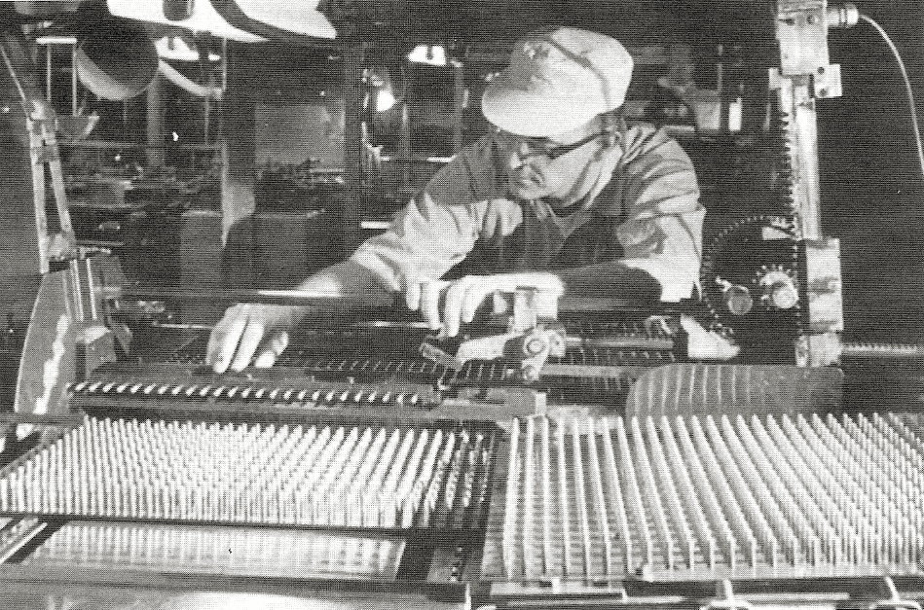
Manufacture of Hard Gelatin Capsules

Slide 22
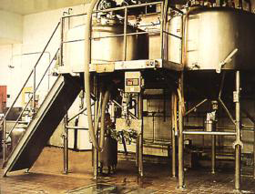
1)Once raw materials have been received and released by Quality Control, the gelatin and hot demineralized water are mixed under vacuum in Stainless Steel Gelatin Melting System.

Slide 23
2) After aging in stainless steel receiving tanks, the gelatin solution is transferred to stainless steel feed tanks.

Slide 24
3 Dyes, opacifants, and any needed water are added to the gelatin in the feed tanks to complete the gelatin preparation procedure. The feed tanks are then used to gravity-feed gelatin into the Capsule Machine

Slide 25
4. From the feed tank, the gelatin is gravity fed to Dipper section. Here, the capsules are molded onto stainless steel Pin Bars which are dipped into the gelatin solution

Slide 26
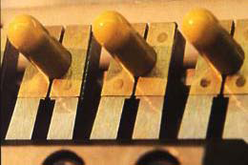
6. The Pin Bars pass through the upper and lower kilns of Capsule Machine Drying System. Here gently moving air which is precisely controlled for volume, temperature, and humidity, removes the exact amount of moisture from the capsule halves

Slide 27
7. Once drying is complete, the Pin Bars enter the Table section which positions the capsule halves for stripping from the Pins in the Automatic section.

Slide 28
8. In the Automatic section, capsule halves are individually stripped from the Pins.

Slide 29
9. The cap and body lengths are precisely trimmed to a ±0.15 mm tolerance.

Slide 30
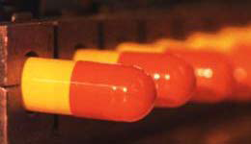
10. The capsule bodies and caps are joined automatically in the joiner blocks.

Slide 31
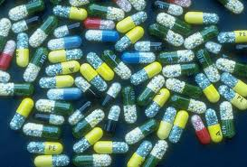
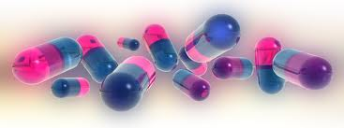
11. Finished capsules are pushed onto a conveyer belt which carries them out to a container.

Slide 32
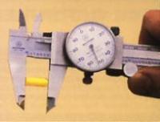
12. Capsule quality is monitored throughout the production process including size, moisture content, single wall thickness, and color

Slide 33
13. Capsules are sorted and visually inspected on specially designed Inspection Stations

Slide 34
Properties of Capsule
Empty capsules contain a significant amount of water that acts as a plasticizer for the gelatin film and is essential for their function.
The standard moisture content specification for hard gelatin capsules is between 13 % w/w and 16 % w/w.
This value can vary depending upon the conditions to which they are exposed that is at low humidity’s they will lose moisture and become brittle, and at high humidity’s they will gain moisture and soften.

Slide 35
The moisture content can be maintained within the correct specification by storing them in sealed containers at an even temperature.
Capsules are readily soluble in water at 37○ C. When the temperature falls below this, their rate of solubility decreases.
At below about 30○ C they are insoluble and simply absorb water, swell and distort.
This is an important factor to take into account during disintegration and dissolution testing.
Because of this most Pharmacopoeia have set a limit of 37○ C ± 1○ C for the media for carrying out these tests.

Slide 36
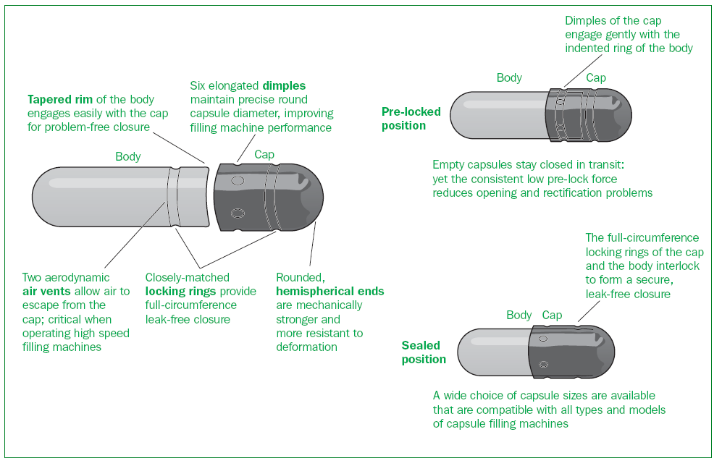
Parts of Hard Gelatin Capsule

Slide 37
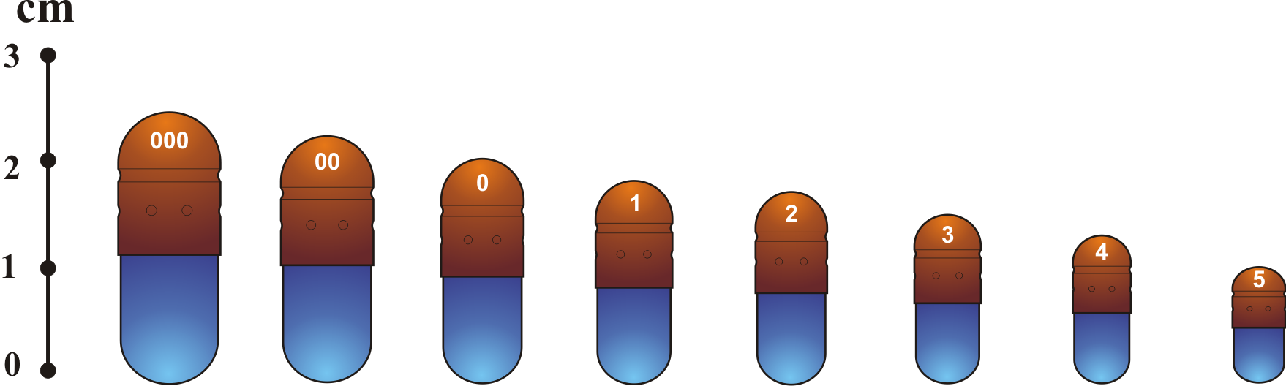
Capsule Sizes
For human use, empty capsules ranging in size from 000 (the largest) to 5 (the smallest) are commercially available

Slide 38
Capsule Sizes
Size | Outer Diameter (mm) | Height or Locked Length (mm) | Actual Volume (ml) | Typical Fill Weights (mg) 0.70 Powder Density
000 | 9.91 | 26.14 | 1.37 | 960
00 | 8.53 | 23.30 | 0.95 | 665
0 | 7.65 | 21.70 | .075 | 475
1 | 6.91 | 19.40 | 0.55 | 350
2 | 6.35 | 18.00 | 0.4 | 260
3 | 5.82 | 15.90 | 0.3 | 210
4 | 5.31 | 14.30 | 0.25 | 145
5 | 4.91 | 11.10 | 0.15 | 190

Slide 39
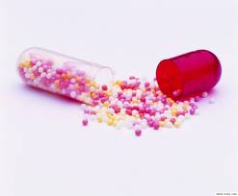
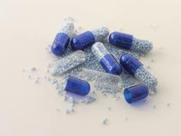
Filling operation of hard gelatin capsules

Slide 40
Basic Steps are:
Rectification
Separating the caps from empty capsules
Filling the bodies
Scraping the excess powder
Replacing the caps
Sealing the capsules
Cleaning the surface of the filled capsules

Slide 41
It is of 2 types
1.Manual
2.Automatic/ Semi Automatic

Slide 42
Manual Methods

Slide 43
1.Punch Method
Powder is placed on a sheet of a clean paper or porcelain plate
Using spatula - formed into a cake having a depth of approximately one-fourth to one-third the length of the capsule body
Then empty capsule body is held between the thumb and forefinger and punched vertically into the powder cake repeatedly until filled

Slide 44
2. Hand operated hard gelatin capsule filling machines
Various parts are as follows:
A bed with 200-300 holes.
A capsule loading tray
A powder tray
A pin plate having 200 or 300 pins corresponding to the number of holes in the bed and capsule loading tray.
A lever
A handle
A plate fitted with rubber top.

Slide 45
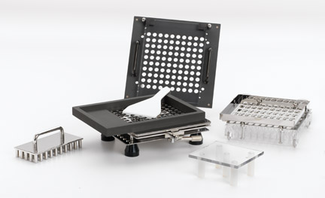
Hand operated hard gelatin capsule filling machine

Slide 46
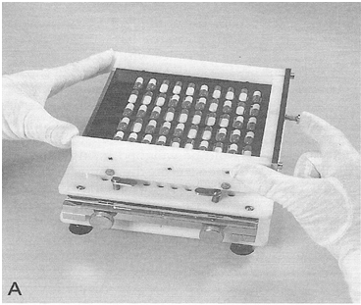
Working of hand operated filling machine
STEP 1:
The empty capsules are filled into the loading tray which is then placed over the bed.

Slide 47
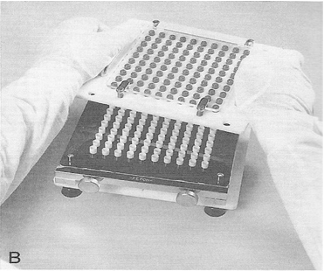
Working of hand operated filling machine
STEP 2:
By opening the handle, the bodies of the capsules are locked and caps separated in the loading tray itself which is then removed by operating the lever.

Slide 48
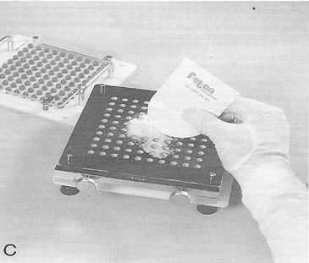
Working of hand operated filling machine
STEP 3:
The weighed amount of the drug to be filled in the capsules is placed in powder tray already kept in position over the bed. The powder is spread with the help of a powder spreader so as to fill the bodies of the capsules uniformly.

Slide 49
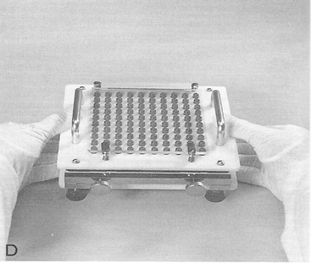
Working of hand operated filling machine
STEP 4:
The pin plate is lowered and is moved downward so as to press the powder in the bodies. The powder tray is removed and the tray holding the caps in position is placed. the caps are pressed with the help of plate and the lever is operated to lock the cap and body of the capsules.

Slide 50
Automatic/
Semi Automatic Methods

Slide 51
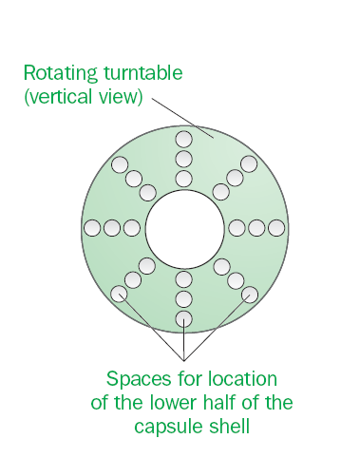
Dependent method (dosing system).
In this method the lower half of the capsule is placed into slots that are located within a revolving turntable. The upper part of the capsule is also housed in a similar turntable. The turntable containing the lower half of the capsule (which may be rotated at a range of speeds) is rotated under a hopper that contains the powder formulation and, as a result, the powder falls into the capsule.

Slide 52
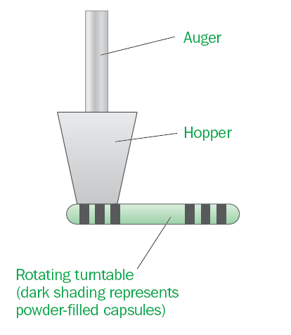
The flow of the powder through the hopper and the homogeneity of the powder mix are maintained by the circular movement of an auger. At the end of the operation the two capsule halves are brought together to form the finished dosage form

Slide 53
The mass of powder that is dispensed into each capsule is dependent on the length of time that the hopper spends above the capsule
At the end of the filling process the filled capsules are removed from the turntable.

Slide 54
Independent method (dosing system).
The independent method of capsule-filling involves the physical transfer of a plug of powder from the mixed powder into the capsule.
In this method a tube, which contains a spring-loaded piston, is depressed into a powder bed enabling a volume (plug) of powder to enter the tube.
The settings of the spring-loaded piston control the volume of powder that enters the tube.
If required, the bonding between the particles within the plug may be enhanced by the application of a compression pressure.

Slide 55
The tube (containing the plug of powder) is then elevated out of the powder bed, rotated and located above the lower half of the capsule and the plug of powder is dispensed into the capsule by the depression of the piston.

Slide 56
Formulation of the fill of hard gelatin capsules

Slide 57
Types of materials for filling into hard gelatin capsules:
Dry solids – Powders, pellets, granules or tablets
Semisolids – Suspensions or pastes
Liquids – Non-aqueous liquids

Slide 58
1. Dry solids – Powders, pellets, granules or tablets
Excipients used:
Diluents
Lubricants
Surface Active Agents
Disintegrants

Slide 59
2. Semisolids & Liquids
(a)Lipophilic liquids/oils containing dissolved or dispersedtherapeutic agent.
Eg:
Vegetable oils (e.g. sunflower, arachis, olive)
Fatty acid esters (e.g. glyceryl monostearate).
(b)Water-miscible liquids containing dissolved/dispersed therapeutic agent.
Eg:
Polyethylene glycols (PEGs) that are solid at room temperature but will liquefy upon heating (e.g. higher molecular-weight PEGs)
Liquid polyoxyethylene-polyoxypropylene block co-polymers (Pluronics).

Slide 60
A major concern in the choice and hence formulation of solvents for liquid fill formulations is the effect of the formulation on the stability of the capsule.
As stated previously, the equilibrium moisture content of hard gelatin capsules should be 13–16% to ensure that the capsule exhibits the optimal mechanical properties.
Solvents that are hygroscopic when filled into hard gelatin capsules will enhance moisture uptake into and result in splitting of the capsule shell.
The moisture uptake of lipophilic solvents, solid PEGs and Pluronics is low and therefore these solvents are preferred for liquid fill formulations for hard gelatin capsules.

Slide 61
To stabilize the liquid fill formulations for hard gelatin capsules, other excipients are used which are as follows:
(c)Surface-active agents. These are included in liquid fills for hard gelatin capsules to:
Solubilise the therapeutic agent within the solvent
Stabilise the suspended therapeutic agent
Enhance the dissolution of poorly water-soluble therapeutic agents within the gastrointestinal tract.

Slide 62
d) Viscosity-modifying agents. These are included in liquid fills for hard gelatin capsules to:
stabilise the suspended therapeutic agent
modify the viscosity of the formulation to optimise filling of the capsule.
(e)Stabilisers (e.g. antioxidants, colours)

