Slide 1
General Principles of Cancer Chemotherapy
Dr. Hadia Rajesh Assistant Professor, Department of Pharmacy Practice, Sumandeep Vidyapeeth Deemed to be University, Vadodara.

Slide 2
Presentation Outlines:
Introduction, Epidemiology
Pathogenesis, Tumor growth & Cell cycle
Principles for Cancer chemotherapy, surgery, Radiation
Evaluation of benefits
Anticancer drugs & Common toxicities
Routes of administration
Conclusion

Slide 3
Introduction
The practice of cancer medicine has changed dramatically in the past four decades, as curative treatments have been identified for a number of previously fatal malignancies.
New drugs are available to treat clinical conditions those were previously either untreatable or amenable only to local therapies such as surgery and irradiation.

Slide 4
Epidemiology
Cancer is a group of more than 100 different diseases.
It is second only to cardiovascular disease as a cause of mortality in Americans.
More than 1.3 million cases of cancer are diagnosed annually, and cancer claims an estimated 5,70,280 lives in the United States each year.

Slide 5
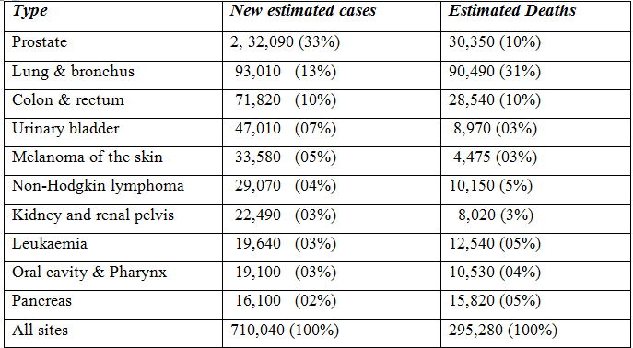
American Cancer Society Survey

Slide 6
Epidemiology
The four most common cancers are prostate, breast, lung, and colorectal cancer.
The most common cause of cancer-related deaths in the United States is lung cancer, which accounts for about 1,60,000 deaths each year.

Slide 7
Pathogenesis
Cancer
Epigenetic factors Genetic Mutation
Acquired Inherited
Chemicals , Virus , Radiation Autosomal

Slide 8
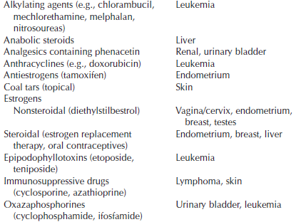

Slide 9
Pathogenesis
Genetic changes
Proto-oncogenes Inactivation of
Tumor Suppresser
Oncogenes Genes
(Myc family) (P 53, DNA repair , RTB)

Slide 10
Pathogenesis
Cancer develops through four steps.
uncontrolled proliferation
dedifferentiation and loss of function
invasiveness
metastasis

Slide 11
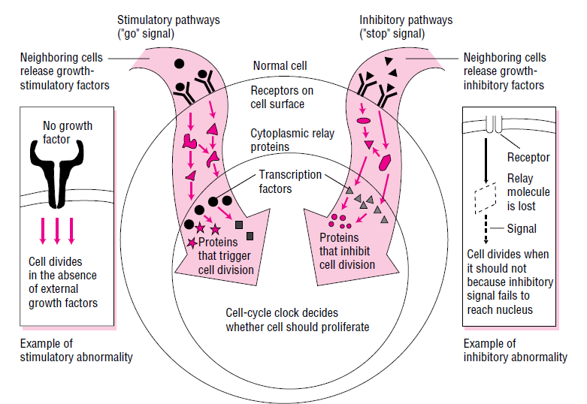

Slide 12
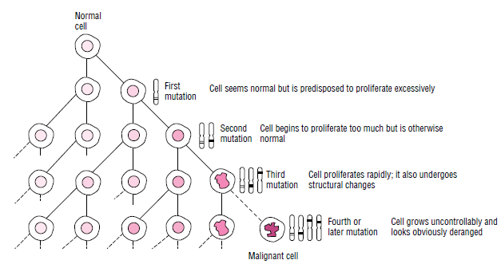

Slide 13
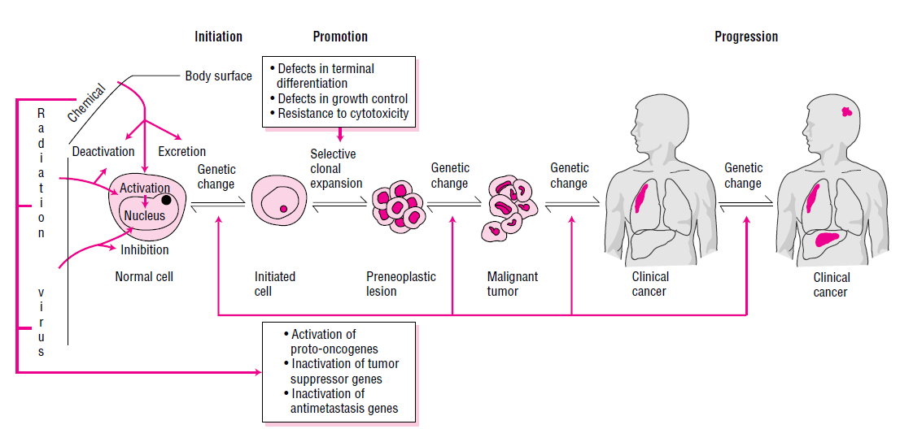
Multistage model of Carcinogenesis

Slide 14
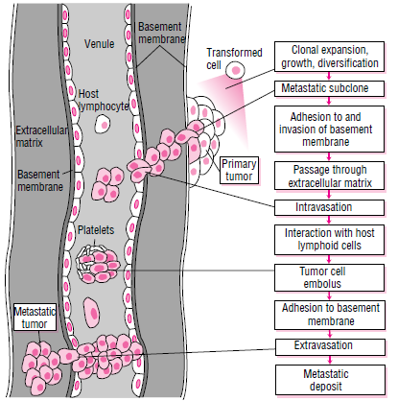
Invasion & Metastasis

Slide 15
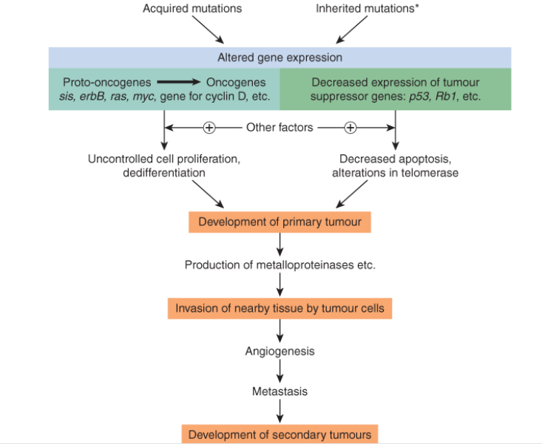

Slide 16
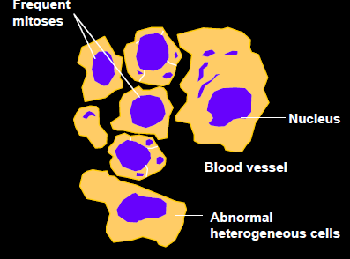
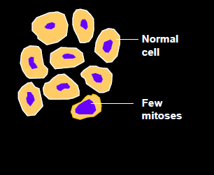
Characteristics of Cancer & Normal Cells
Cancer Cell
Normal cell

Slide 17
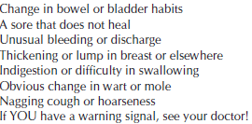
Seven Warnings Signs of Cancer

Slide 18
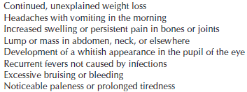
Seven Warning Signs for Child Cancer

Slide 19
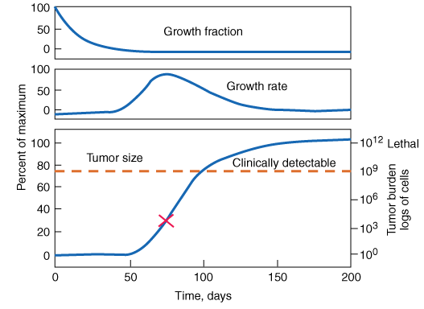
Principle of Tumor growth

Slide 20
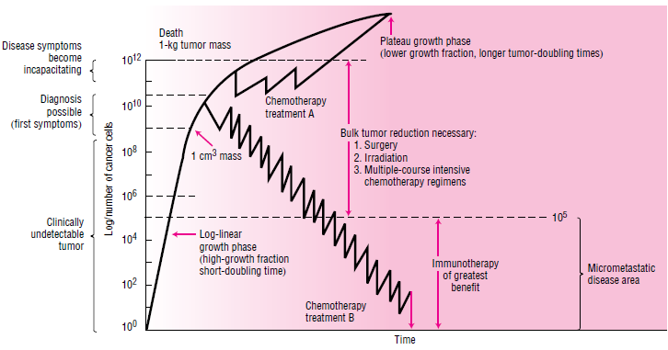
Gompertzian tumour growth

Slide 21
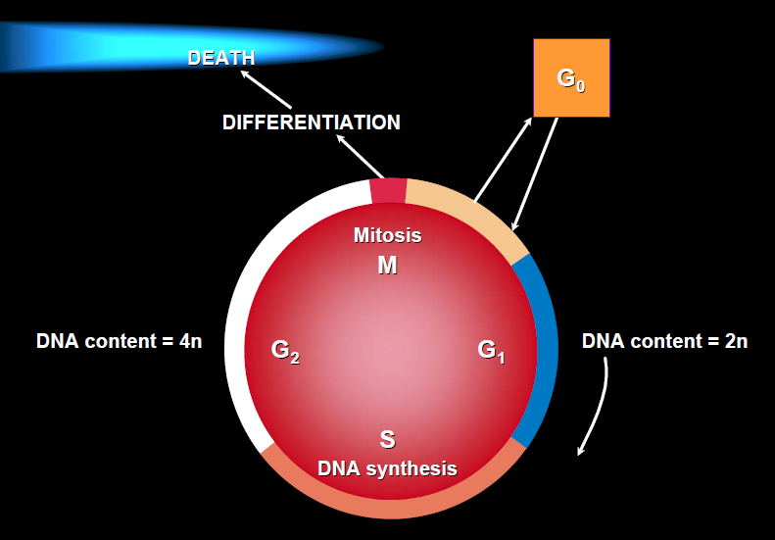
Cell Cycle

Slide 22
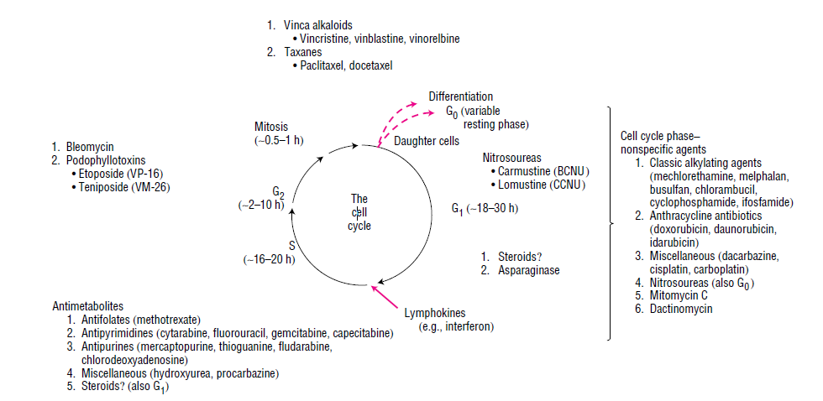

Slide 23
Antitumor drugs may be placed into one of three classes based on the relationship of the effect to the mitotic cycle of the cell:
1. Cell cycle active, phase specific
2. Cell cycle active, phase non-specific
3. Non-cell cycle active

Slide 24
Cancer Chemotherapy

Slide 25
Goals of Cancer Chemotherapy
Cure
Control
Palliation

Slide 26
Cancer Chemotherapy
Primary
Palliative
Adjuvant
Neo-adjuvant

Slide 27
Response Criteria
Cure
Complete response
Partial response
Stable disease
Progression

Slide 28
Factors affecting response to Chemotherapy
Tumour burden
Tumour-cell heterogeneity
Drug resistance
Dose intensity
Patient-specific factors

Slide 29
Drug Resistance
Inherited/ Natural Resistance
Acquired drug resistance
Inherited Resistance:
E.g. Loss of p 53 gene,
bcl-2 gene over expression

Slide 30
Acquired drug resistance (Mechanisms)
Defective transport
Decrease in activating enzyme
Increased drug inactivation
Gene amplification of target enzyme
Expression of an altered gene product

Slide 31
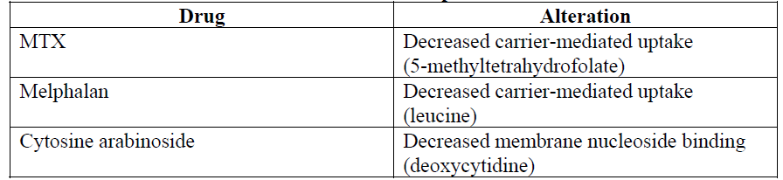
Defective Transport

Slide 32
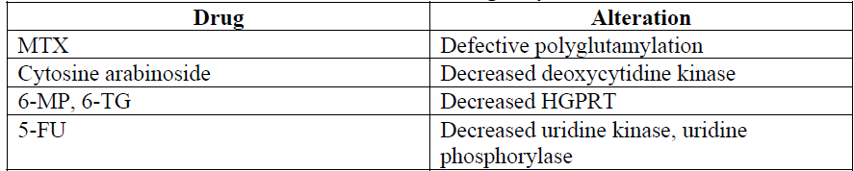
Decrease in activating enzyme

Slide 33
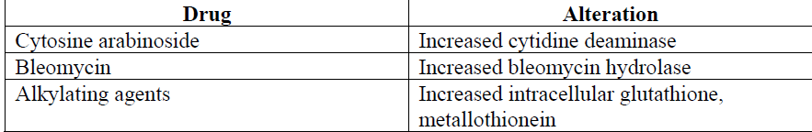
Increased Drug Inactivation

Slide 34
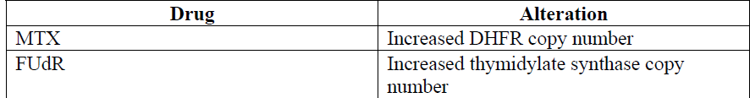
Gene amplification of target enzyme

Slide 35
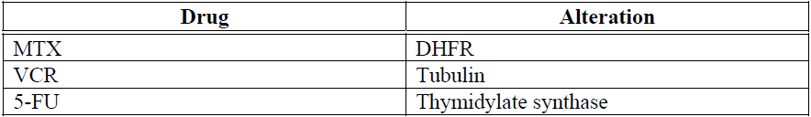
Expression of an altered gene

Slide 36
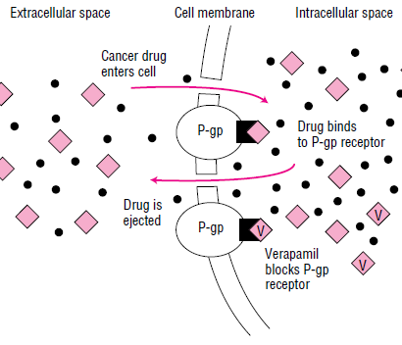
Multi-Drug Resistance
Vinka alkaloids
Anthracyclines
Etoposides
Mitomycin
Taxanes

Slide 37
Dose intensity
Dose intensity is defined as the dose delivered to the patient over a specified period of time.
The three main variables that determine delivered dose intensity are the dose per course, the interval between doses, and the total cumulative dose.
So, there is a advancement in approach to therapy E.g. use of G-CSF, GM-CSF

Slide 38
Patient Specific Factors
Presence of other co-morbidities
Pathway of genetic mutation
For example, breast cancers that overexpress the HER-2 oncogene are often refractory to regimens like CMF (cyclophosphamide, methotrexate, and 5 fluorouracil), but sensitive to anthracycline-based regimens.
Inter-individual variation ( ADME) of patient

Slide 39
Patient Specific Factors
Pharmacogenomics
In oncology, several clinically relevant genetic polymorphisms, or variations, have been identified that can affect drug pharmacokinetics and pharmacodynamics.
dihydropyrimidine dehydrogenase (responsible for 5-fluorouracil metabolism),
thiopurine S-methyltransferase
(responsible for thiopurine metabolism),
uridine diphosphateglucuronosyltransferase 1A1 (responsible for irinotecan metabolism).

Slide 40
Oncologist’s next approach
Patient Specific factor
Tumor specific factor
Goals of therapy

Slide 41
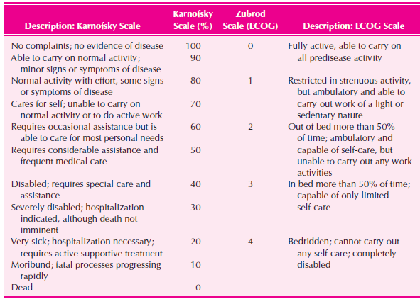

Slide 42
Combination Therapy

Slide 43
Combination Therapy
It is employed to target as many types of cells in the tumour as possible.
Selection of agents for combination chemotherapy regimens involves consideration of drug-specific factors such as mechanism of action, antitumor activity, and toxicity profile.

Slide 44
Combination Therapy
Drugs that possess minimally overlapping mechanisms of action and toxicities are combined, when possible.
Myelosuppressive combinations are sometimes alternated with nonmyelosuppressive combinations to allow bone marrow recovery, while gaining additive antitumor effects.

Slide 45
Combination Therapy
The selected agents should each have significant activity against the tumour that is to be treated.
If a synergistic reaction is known to exist for two agents, they may be combined in various treatment regimens.
Development of more specifically targeted agents may decrease the need for combining multiple agents.

Slide 46
Combination Therapy
Benefits:
• Each drug is given at full dose.
• The rate of cell kill increases.
• The chance of emergence of a drug-resistant clone decreases .

Slide 47
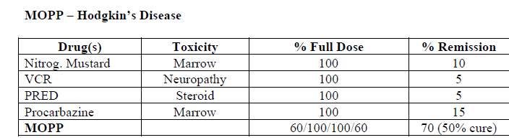

Slide 48
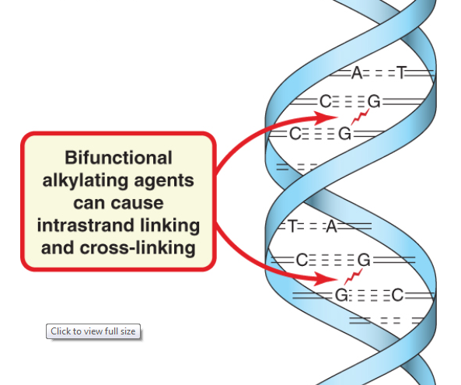
Alkylating Agents
Nitrogen mustard
Melphalan
Cyclophosphamide
Ifosfamide
Chlorambucil
Busulfan
Thiotepa

Slide 49
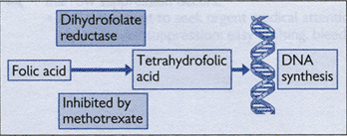
Antimetabolites
Antifolates: Methotrexate
Purine antagonists:
Mercaptopurine
Azathioprine
Fludarabine
Pyrimidine antagonists:
5-Flurouracil
Cytarabine

Slide 50
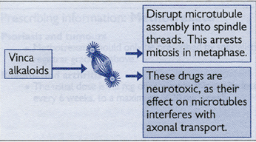
Vinca Alkaloids
Vincristine
Vinblastine
Vindesine
Vinorelbine

Slide 51
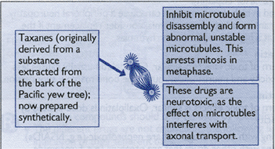
Taxanes
Paclitaxel
Docetaxel

Slide 52
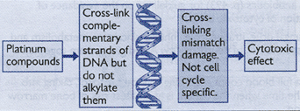
Heavy Metals
Cisplatin
Carboplatin
Oxaliplatin

Slide 53
Anthracycline Antibiotics
Daunorubicine
Doxorubicine
Epirubicine
Idarubicine
They are topoisomerase inhibitors
Etoposides
Tinoposides

Slide 54
Miscellaneous agents
Arsenic trioxide
Aspraginase
Bleomycin
Mitomycin
Dactinomycin
Hydroxy urea

Slide 55
General toxicities of Chemotherapy
Bone-marrow suppression
Lympho-reticular tissue damage
Opportunistic infections
Oral complications
Gastric disturbances
Dermatological manifestations
Sexual dysfunctions
Abnormal Pregnancy
Secondary tumors
Hyperuricaemia

Slide 56
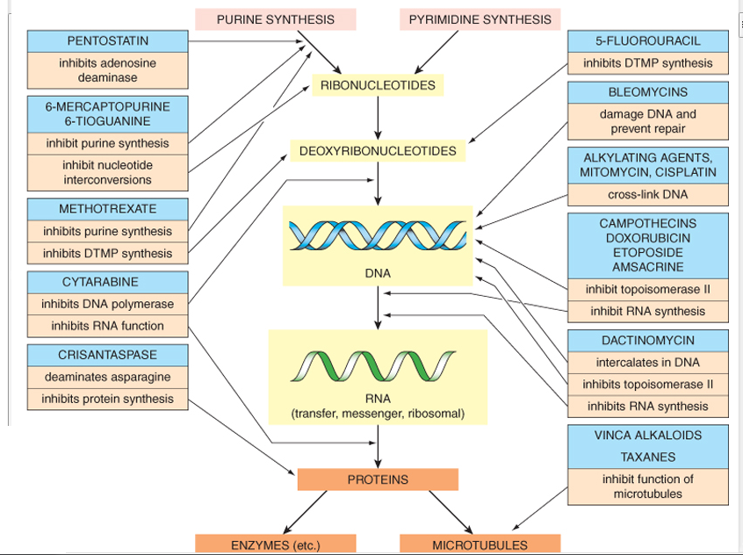

Slide 57
Immune Therapy
Active therapy Passive therapy
Interferons Alemtuzumab
Intraleukins-2 Rituximab
Monitoring Parameters:
Flu-like syndrome, renal hypoperfusion,
hypotension, chest-X-ray
Suggested indication: Cell counts< 10⁴

Slide 58
Hormonal therapy
Hormones do not work in the same ways as standard chemotherapy drugs, but rather by preventing the cancer cell from using the hormone it needs to grow, or by preventing the body from making the hormones.
Mainly used for Breast, prostate, and uterus
cancer

Slide 59
Hormonal Therapy
Disease | Hormone agent | Mechanism of action
Breast cancer | Tamoxifen, Fulvestrant | Antiestrogen
 | Aminoglutethimide | Steroidogenesis inhibitor
Prostate cancer | Leuprolide, Abarelix | LHRH antagonist
 | Flutamide | Antiandrogen
Endometrial cancer | Medroxyprogesterone | Progestin
Lymphomas | Glucocorticoid | Lymphocytolytic
LHRH, Luteinizing hormone-releasing hormone.

Slide 60
Other Therapies
Angiogenesis inhibitors: Bevacizumab
Biologically directed therapy: Transzumab
Tyrosine-kinase inhibitors: Imatinib ,Gefitinib
Retinoids: tretinoin , Vitamin A

Slide 61
Commonly Used Combination Chemotherapy Regimens
Disease | Regimen
Breast cancer | Cyclophosphamide, methotrexate, 5-FU (CMF)
 | Cyclophosphamide, doxorubicin (Adriamycin), 5-FU (CAF)
Lung cancer | Cisplatin, etoposide
Colorectal cancer | 5-FU, leucovorin
Non-Hodgkin's | Cyclophosphamide, doxorubicin, vincristine, prednisone (CHOP)
Hodgkin's | Nitrogen mustard, vincristine, procarbazine, prednisone (MOPP)
 | Doxorubicin, bleomycin, vinblastine, dacarbazine (ABVD)
Bladder cancer | Methotrexate, vinblastine, doxorubicin, cisplatin (MVAC)
Testicular cancer | Cisplatin, etoposide, bleomycin (PEB)

Slide 62
Routes of Administration
Oral
Topical
Intravenous
Intramuscular
Subcutaneous
Intra-arterial
Intrathecal
Intrapleural
Intraperitoneal
Intravesical
Intralesional/intratumoral

Slide 63
Principles of Cancer Surgery
Surgery is used in Cancer prevention, Diagnosis, Staging, Treatment (for both localized and metastatic disease), Palliation, and Rehabilitation.

Slide 64
Cancer Prevention (Prophylaxis)
Cancer can be prevented by surgery in people who have premalignant lesions resected and in those who are at increased risk of cancer from either an underlying disease , the presence of genetic lesions , or a developmental anomaly .
In some cases, prophylactic surgery is more radical than the surgical procedures used to treat the cancer after it develops.

Slide 65
Diagnosis
The underlying principle in cancer diagnosis is to obtain as much tissue as safely possible.
Microscopy & Morphology helps in differential diagnosis.
Valuable in searching for genetic abnormalities and protein expression patterns, that may aid in differential diagnosis or provide information about prognosis or likely response to treatment.

Slide 66
Staging
Surgical procedure is also used to categorize the stage of tumour so that appropriate therapy may be initiated accordingly.

Slide 67
Treatment
Surgery is the most effective means of treating cancer.
Up to 40% of Cancer can be treated by surgery except Metastatic diseases.
The removal of tumour can obtain important benefits, including local control of tumour, preservation of organ function, debulking that permits subsequent therapy to work better, and staging information, even if disease is not curable.

Slide 68
Palliation
Insertion of central venous catheters, stabilization of cancer-weakened weight-bearing bones, control of haemorrhage,
Surgical bypass of gastrointestinal, urinary tract, or biliary tree obstruction can alleviate symptoms and prolong survival.
For, relief of intractable pain or reverse neurologic dysfunction .
Splenectomy ,Intrathecal therapy. or intrahepatic
Surgery may correct other treatment-related toxicities such as adhesions or strictures.

Slide 69
Rehabilitation
Orthopaedic procedures, Breast reconstruction can make an enormous impact on the patient's perception of successful therapy. Plastic and reconstructive surgery can correct the effects of disfiguring primary treatment.

Slide 70
Principles of Radiation Therapy
Radiation is a physical form of treatment that damages any tissue in its path; its selectivity for cancer cells may be due to defects in a cancer cell's ability to repair sublethal DNA and other damage.
Radiation causes breaks in DNA and generates free radicals from cell water that may damage cell membranes, proteins and organelles.

Slide 71
Principles of Radiation Therapy
The factors that influence tumour cell killing include,
the dose required to deliver an average of one lethal hit to all the cells in a population, hypoxia, tumour mass, growth fraction, and cell cycle time and phase (cells in late G₁ and S are more resistant).

Slide 72
Principles of Radiation Therapy
Most radiation-induced cell damage is due to the formation of hydroxyl radicals:
Ionizing radiation + H₂O H₂O⁺ + e–
H₂O⁺ + H₂O H₃O⁺ + OH˙,
OH˙ Cell damage
Telegraphy, Brachytherapy, Systemic therapy

Slide 73
Conclusion
To practice proper chemotherapy, one must analyze tumor size, type of tumor cells, tumor stage, and patient related factors.
Combination therapy is preferred to overcome drug resistance.
Management of toxicities during course of treatment and QOL is very important to maintain.

Slide 74
Thank You

