Slide 1



AUTONOMIC NERVOUS SYSTEM
EBES DOCUMENT
Dr J M Harsoda Ph.D
PROF AND HEAD
DEPARTMEN OF PHYSIOLOGY
SBKSMI AND RC SUMANDEEP VIDYAPEETH

Slide 2

CLAUDE BERNARD
MEDICINE IS SCIENCE OF SICKNESS WHILE
PHYSIOLOGY IS SCIENCE OF LIFE

Slide 3
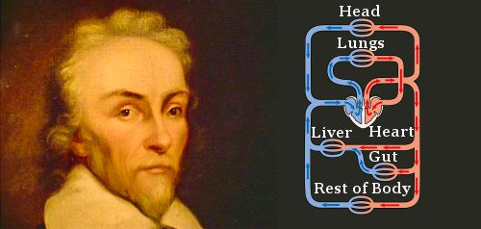

William Harvey (1578 – 1657)
William Harvey (1 April 1578 – 3 June 1657) was an English physician who was the first person to describe completely and in detail the systemic circulation and properties of blood being pumped to the body by the heart.

Slide 4

AUTONOMIC NERVOUS SYSTEM
INTRODUCTION
PHYSIOLOGIC ANATOMY OF ANS
SYMPATHETIC DIVISION
PARASYMPATHETIC DIVISION
CHEMICAL DIVISION OF ANS
PRINCIPAL NEUROTRANSMITTERS
OF ANS AND THEIR ACTIONS
PHARMACOLOGY OF ANS

Slide 5
PHYSIOLOGIC ANATOMY SYMPATHETIC DIVISION
VIA:- 1 WHITE RAMI COMMUNICANTS
2 GRAY RAMY COMMUNICANTS
3 SUPERIOR,MIDDLE AND INFERIOR
CERVICAL GANGLION
4 COLLATERAL GANGLION [ Celiac plexus, Sup. & Inf. mesentric ganglion]
5 SHORT NOR ADRENERGIC NEURONS
6 INTRINSIC CARDIAC ADRENERGIC
CELLS [ ICA CELLS ] IN RATS
W F Ganong ( 2005) Review of Medical Physiology International 22nd Ed.

Slide 6

PHYSIOLOGIC ANATOMY PARASYMPATHETIC DIVISION
1 CRANIAL OUTFLOW:-
VIA:- III, VII, IX AND X CRANIAL NERVES
III Occulomotor
VII FACIAL
IX Glossopharyngeal
X Vagus
2 SACRAL OUTFLOW
VIA:- SPINAL NERVES:- S2 , S3 AND S4

Slide 7
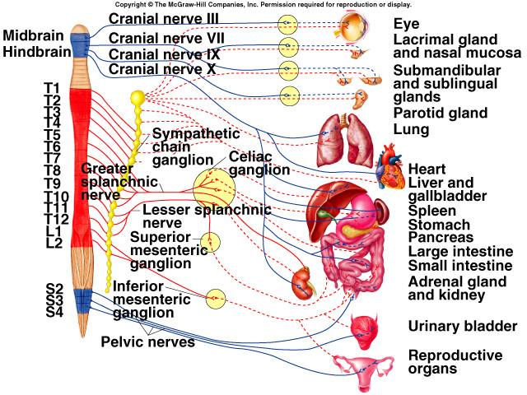
PHYSIOLOGIC ANATOMY OF SYMPATHETIC AND PARASYMPATHETIC DIVISION

Slide 8
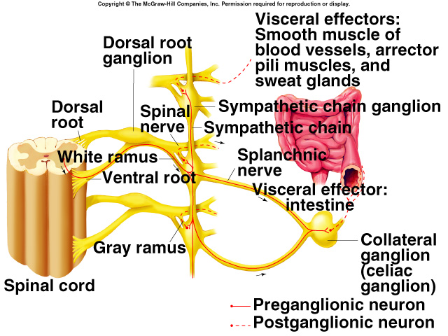
PHYSIOLOGIC ANATOMY OF SYMPATHETIC DIVISION

Slide 9

CHEMICAL DIVISION OF ANS
1 CHOLINERGIC NEURONS
2 NOR ADRENERGIC NEURONS
3 ADRENERGIC NEURONS

Slide 10
CHEMICAL DIVISION OF ANS
CHOLINERGIC NEURONES :-All preganglionic neurons are cholinergic in both the sympathetic and the parasympathetic nervous systems.
Either all or almost all of the postganglionic neurons of the parasympathetic system are also cholinergic.
However, the postganglionic sympathetic nerve fibers to the sweat glands, to the piloerector muscles of the hairs, and to a very few blood vessels are cholinergic.
NOR ADRENERGIC NEURONES:-Conversely, most of the postganglionic sympathetic neurons are nor adrenergic or adrenergic (ICA cells).
Guyton and Hall (2006) Text book of medical physiology 11th Ed.
W F Ganong ( 2005) Review of Medical Physiology International 22nd Ed.

Slide 11
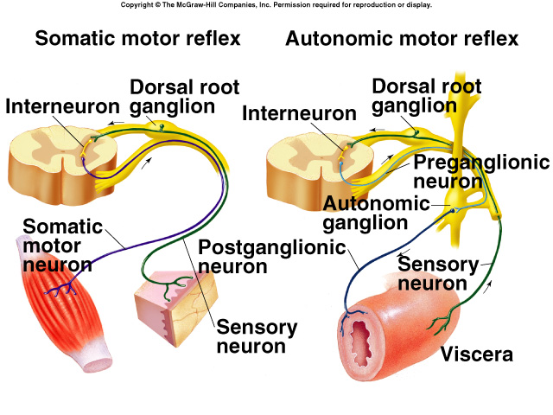
Autonomic Neurons

Slide 12
TYPICAL NEURONES OF ANS Ref. J M Harsoda (2011) EBES DOCUMENT,ANS;SV.
Parasympathetic . N Sympathetic . N
PRE. GANG. N.
Ach
Ach SYNAPSE
POST. GANG.N.
Ach Nor Adrenaline
EFFECTOR ORG.

Slide 13
MOST COMMON NEUROTRANSMITTERS OF ANS
ACETYL CHOLINE
ADRENALINE (EPINEPHRENE)
NOR ADRENALINE (NOR EPINEPHRENE)
DOPA (DIHYDROXY PHENYL ALANINE)
DOPAMINE (DIHYDROXY PHENYL ETHYL AMINE)

Slide 14
MCQ TEST AFTER END OF LECTURE
1 Pre ganglionic fibers are very short and post
ganglionic fibers are very long in:
A Sympathetic system
B Parasympathetic system
C Both
D None of above
2 Following are neurotransmitters of ANS EXCEPT:
A Acetyl choline
B Adrenaline
C Histamine
D Nor adrenaline

Slide 15
3 Parasympathetic division of SACRAL OUT FLOW VIA SPINAL NERVES:-
A C2, C3 AND C4
B S2 , S3 AND S4
C BOTH
D NONE OF ABOVE
4 Parotid glands get nerve supply by parasympathetic division via cranial nerve:
A Occulomotor
B Facial
C Glossopharyngial
D Vagus

Slide 16
MECHANISM OF ACTION OF NEUROTRANSMITTERS OF ANS
ACETYLCHOLINE:- ACh can have either an
excitatory or inhibitory effect depending on
the postsynaptic ‘ M ’ [Muscarinic] receptor that
is activated.
EXCITATORY EFFECT OF ACETYLCHOLINE :-
[ e.g. GI Tract, Bladder and Bronchi ]
I Depolarization of the cells of smooth muscles
II Increase ca++ conductance
III Activation of ‘G’ protein
Michael B Wang (1984) NMS physiology 3rd Ed.

Slide 17
INHIBITORY EFFECT OF ACETYLCHOLINE
Inhibitory effect of Ach are produced on
heart :-
I Hyperpolarization of cardiac cells.
II Ach acts directly to inhibit the pace maker
channel , slowing the rate of spotaneous
depolarization.
Michael B Wang (1984) NMS physiology 3rd Ed.

Slide 18
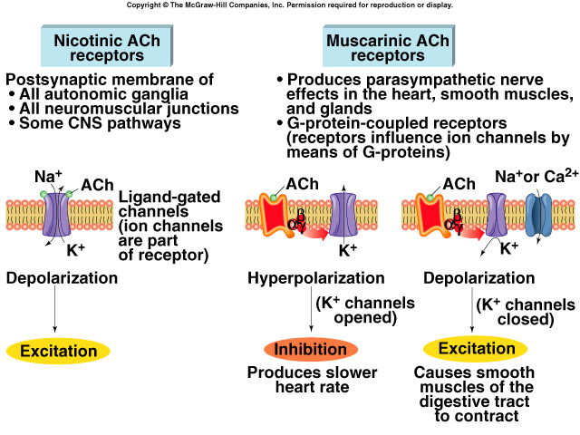
ACTION OF ACHETYL CHOLINE ON NICOTINIC AND MUSCARINIC RECEPTORS

Slide 19
MECHANISM OF ACTION OF NOR ADRENALINE
Nor adrenaline can have an excitatory or
inhibitory effect depending on the type and
location of the receptor activated.
Nor adrenaline receptors are either ‘Beta’ (β)
or ‘Alpha’ (α) adrenergic receptors.
Michael B Wang (1984) NMS physiology 3rd Ed.

Slide 20
EXCITATORY EFFECTS OF NOR ADRENALINE
When nor adrenaline binds to the
‘Beta’receptors (β), it activates ‘ G ’ protien the
activated ‘ G ’ protien activates a different
membrane bound protien ‘Adenylate cyclase’
Adenylate cyclase stimulates formation of
cyclic AMP from ATP. The ’ G ’ protien that
stimulates the formation of cyclic AMP is
called the ‘ Gs ’ protien.
Michael B Wang (1984) NMS physiology 3rd Ed.

Slide 21
EXCITATORY EFFECTS OF NOR ADRENALINE
Cyclic AMP activates the cytoplasmic enzymes Protien kinase A which turn produces a variety of physiological responses by phosphorylating the aminoacids serine and thronine.
Action on heart by :-
1 Phosphorylation of the ca++ channels in cardiac ventricular muscle cells by protien kinase A .Increases force of contraction
2 Phosphorylation of phospholamban in sarcoplasmic reticulum (SR) by protien kinase A. enhances the activity of the SR Ca++ pump. Reducing the duration of contraction
3 Phosphorylation of membrane channel protein. Increases rate of pacemaker depolarization and shortens the duration of the action potential by activiting K+ channels, thus increasing heart rate.
Action on lungs by :-
1 Phosphorylation of phospholamban in bronchiole smooth muscle cells by protien kinase A. Relaxes the bronchiole smooth muscle.
Michael B Wang and Johan Bullock (1984) NMS physiology 3rd Ed.

Slide 22
EXCITATORY EFFECTS OF NOR ADRENALINE
When nor adrenaline binds to the Alpha-1 (α1) receptors it activates a ‘ G ’ protien that similar to its action at muscarinic receptors results in the formation of IP3 and diacylglycerorl [DAG].
Activation of the Alpha-1 (α1) receptor by sympathetic nerve activity causes constricton of vascular smooth muscle.
Michael B Wang and Johan Bullock (1984) NMS physiology 3rd Ed.

Slide 23
INHIBITORY EFFECTS OF NOR ADRENALINE
When nor adrenaline binds to the Alpha-2 (α2)
receptor it activates a ‘ G ’ protien that
inhibits adenylate cyclase thus reducing the
cyclic AMP in the cells . The ‘ G ’protien that
inhibits the formation of cyclic AMP is called
‘ GI ’ protien.
Michael B Wang , Johan Bullock and Joseph Boyle III (1984) NMS physiology 3rd Ed.

Slide 24

PHARMACOLOGY OF ANS
SYMPATHOMIMETIC DRUGS. Nor adrenaline and Adrenaline
SYMPATHOLYTIC DRUGS . Phenoxybezamine and Propranolol.
PARASYMPATHOMIMETIC DRUGS. Acetyl choline and Pilocarpine
PARASYMPATHOLYTIC DRUGS. Atropine
GANGLION BLOCKING AGENTS. Nicotine,Hexamethonium and Curare ( NMJ )

Slide 25
EBES LEARNING
ASSESSMENT OF AUTONOMIC FUNCTIONS

Slide 26
ASSESSMENT OF AUTONOMIC FUNCTIONS
REFERENCES | INTERVENTION | SUBJECT | OUT COME | RESULT
M P Jayarajan et al (1991). Altered parasympathetic tone in chronic energy deficient human subjects. Ind.J. of physiol & pharmacol Vol.35:5 (supplement) 78. | 29 healthy young adult male subjects were studied in two separate protocols designed to assess parasympathetic tone. They were divided in to two groups, well nourished (W N) with BMI > 20.0 & chronic energy deficient (CED) with BMI < 18.0. | The WN subjects had a daily energy intake >10 MJ/day, while CED subjects consumed <8 MJ/day. | These result indicate a greater parasympathetic tone in CED in human subjects. | In the first protocol the CED subject (n=7) showed a significantly higher absolute HR response to vagal blockade with I.V atropine (124±12.8 beat/m ) than WN controls (n=8, 110±13.3 beats/m (p<0.05) In the second protocol CED subjects 31.o± 8.8 beats/m vs WN 18.9± 7.5 beats/m p<0.05.

Slide 27
ASSESSMENT OF AUTONOMIC FUNCTIONS
REFERENCES | INTERVENTION | SUBJECT | OUT COME | RESULT
2 K P Kochhar et al (1991). Does basal respiratory rate influence heart rate variations during slow breathing test to assess autonomic function ? Ind.J. of physiol & pharmacol. Vol.35:5 (supplement) 160. | 25 normal subjects (mean age 26.96±8.56) underwent slow breathing test (6/min for 2 min) to study of their basal RR (19.4±3.61/min) on two response variables viz maximum HR (99.8± 12.4) minimum HR (65±8.72) difference in HRs (37.73±8.16) & E:I ratio (1.6±15). | The subjects were sorted in to two groups according to their RR (16.5± 1.65 n=12 vs 21.84± 3.18 n=13. p<0.01) The basal HRs were not significantly different in these two groups (17.75± 9.27 vs 84.18± 10.49 ns). | The result indicate possible operation of differential adjustments of HR variation in either direction to achieve comparable ANS responsivity & influence of basal RR on autonomic function. | To analyze further regression curves were plotted to assess the dependence of response variable in this test on the lowered frequency of breathing in the two groups (% drop 63.93 vs 72.06 p<o.o1) The maximum HR & minimum HR were well co related with RR.

Slide 28
ASSESSMENT OF AUTONOMIC FUNCTIONS
REFERENCES | INTERVENTION | SUBJECT | OUT COME | RESULT
Maria Terasa La Rovere et al (1992 Autonomic nervous system adaptation to short term exercise training. CHEST, Vol. 101:5: 299S. | We tested the hypothesis that physical training would be effective in improving the autonomic balance by studying 22 patients with a first & recent myocardial infarction who were randamly assigned to enter on not enter a 4 weeks in hospital physical training programme. | Spectral indices of HR variability were analyzed at rest & during 70 head up tilt before & after the index training , not training period. | Our data suggest that in post myocardial infarction patients 4 weeks of physical training may induce an improvement in the autonomic balance with a restoration toward normal in the reflex activity of system. | As expected physical training induced a significant increase in exercise duration (13.7±0.8 vs 17.1±0.1min p<0.01) & in the anaerobic threshold (9.5±0.7 vs 12.0±1.0 min p<0.02) in train patients while no changes were observed in the untrained group.

Slide 29
CONCLUSION
Heart rate variation in either direction to achieve comparable ANS responsivity & influence of basal respiratory rate on autonomic function.
Exercise training may induce an improvement in the autonomic balance with a restoration toward normal ANS reflex activity.
Greater parasympathetic tone in chronic energy deficient (CED) in human subjects.

Slide 30
REFERENCES
1 M P Jayarajan et al (1991). Altered parasympathetic tone
in chronic energy deficient human subjects.
Ind.J. of physiol & pharmacol , Vol.35:5(supplement) 78.
2 K P Kochhar et al (1991).Does basal respiratory rate influence heart rate
variations during slow breathing test to assess autonomic function ?
Ind.J. of physiol & pharmacol. Vol.35:5(supplement) 160.
3 Maria Terasa La Rovere et al (1992). Autonomic nervous system
adaptation to short term exercise training. CHEST, Vol. 101:5: 299S.
4 Francois peronnet et al (1981). Plasma nor epinephrene response to
exercise before and after training in human.
J of appl physiol,Vol. 51:4:812-815.

Slide 31
MCQ TEST AFTER END OF LECTURE
1 The postganglionic fibers of sympathetic fibers secrete acetylcholine at:
A Gastric glands
B Sweat glands
C Salivary glands
D Endometrial glands
2 It is a action of acetyl choline:
A Increases heart rate
B Increases blood pressure
C Decreases heart rate
D Decreases secretion of gastric juice

Slide 32
3 It is a example of parasympatholytic drug:
A Nor adrenaline
B Hexamethonium
C Atropine
D Acetyl choline
4 Nor adrenaline binds to the:
A Muscarinic receptors
B Beta’ (β) adrenergic receptors
C Nicotinic receptors
D Non of above

Slide 33


