Slide 1



EARLY CLINICAL EXPOSURE
PHYSIOLOGY OF DIABETES MELLITUS
    Dr. J. M. Harsoda
    Professor & Head
    DEPARTMENT OF PHYSIOLOGY

Slide 2


Slide 3
DIABETES MELLITUS
INTRODUCTION:-
The incidence of diabetes mellitus in the human population has reached epidemic proportion worldwide, increasing at a rapid rate.
In 2020, there were an estimated 463 million cases in the word, and these number is projected to increase 700 million by 2045.
Ninety percent of present cases are type-II diabetes.

Slide 4

CONTD….. DIABETES MELLITUS
Complication of diabetes mellitus:
Polyuria.
Polydipsia.
Polyphagia.
Hyperglycemia.
Glycosuria
Metabolic ketoacidosis and coma.
Kussumaul breathing
Diabetic retinopathy.
Diabetic nephropathy.
Diabetic neuropathy.

Slide 5
KUSSUMAUL’S BREATHING
RAPID DEEP BREATHING
Kussmaul’ breathing is rapid deep breathing often seen in patients suffering from diabetic ketoacidosis. It occurs as the body tries to compensate for metabolic acidosis by increasing rate of co2 excretion.

Slide 6
CONTD….. DIABETES MELLITUS
Intracellular hyperglycemia activates enzyme aldose reductase. This increases the formation of sorbitol in cells, which in turn reduces cellular Na+ - K+ ATPase.
Intra cellular glucose can be converted to so called advanced glycosylation end products (AGEs), which cross link. This damages blood vessels.
Types of diabetes mellitus:
Type-I or Insulin-dependent diabetes mellitus (IDDM) Is due to insulin deficiency caused by autoimmune destruction of the B cells in islets of Langerhans.

Slide 7
CONTD….. DIABETES MELLITUS
Type-II or non insulin-dependent diabetes (NDDM)
Is characterised by insulin resistance and impaired insulin secretion.
Secondary diabetes mellitus is due to some other diseases or conditions such as :
Chronic pancreatitis.
Total pancreatectomy.
Cushing’s syndrome.
Acromegaly.
Grave’s disease.

Slide 8
CONTD….. DIABETES MELLITUS
Juvenile diabetes: Type-I diabetes usually develop before the age of 40 and hence is called juvenile diabetes.
Patients with juvenile diabetes are not obese, and they have a high incidence of ketosis and acidosis.
The genetic abnomality is in the majar histocompatibility complex on chromosome 6.

Slide 9


Slide 10
FUNCTIONAL ANATOMY OF ISLETS OF LANGERHANS
CELL STRUCTURE:
There are four types of cells in islets.
A or α cells secrete glucagon.
B or β cells secrete insulin.
D or δ cells secrete somatostatin.
F or PP cells secrete pancreatic polypeptide.

Slide 11
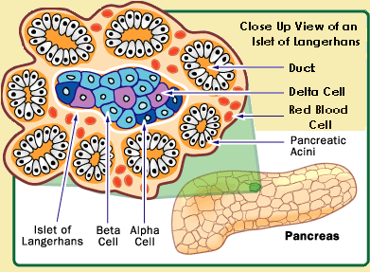
CELLS IN ISLETS OF LANGERHANS

Slide 12
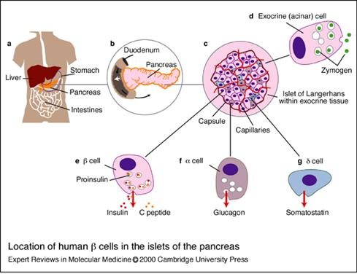

Slide 13

INSULIN
SITE OF FORMATION
CHEMISTRY
MECHANISM OF SECRETION
FATE OF SECRETED INSULIN
SITES OF ACTION
MECHANISM OF ACTION
PHYSIOLOGICAL EFFECTS
REGULATION OF INSULIN
ENDOCRINOPATHIES

Slide 14
CONTD….. INSULIN
SITE OF FORMATION: B or Beta cells constitute about 60% of the islets cells and associated with insulin synthesis and release.
CHEMISTRY:
Preproinsulin consisting of 108 amino acids with a molecular weight of 11,500.
Proinsulin having 86 amino acids and molecular weight of 9000.
C-peptide is the connecting peptide remaining after cleavage of proinsulin. In human, it consists of 31 amino acid residues.
Insulin having two polypeptide chains. A chain consisting of 21 amino acids and B chain consisting of 30 amino acids and molecular weight of 5808.

Slide 15
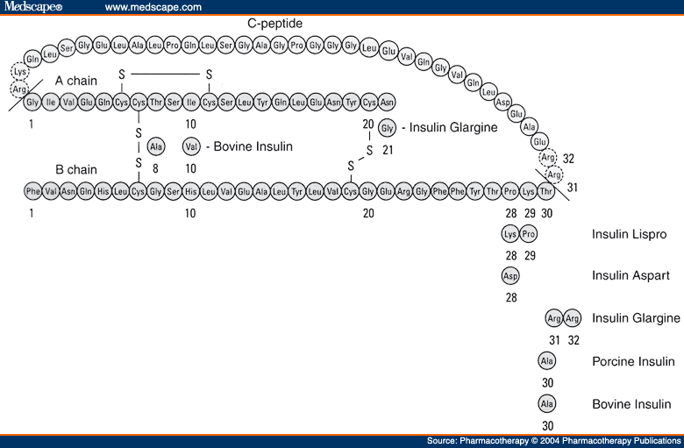
STRUCTURE OF AN INSULIN

Slide 16
MECHANISMS OF INSULIN SECRETION
BY BLOOD GLUCOSE:
Glucose diffuse into the B cells by binding with the GLUT-2 receptors (4 specific transporter) on B cell membrane.
BY GLUCAGON:
Glucagon mediates insulin releasing effect by stimulator G protein via cyclic AMP.
BY ACETYLCHOLINE:
Acetylcholine stimulate insulin release via phospholipase-C second messenger system.

Slide 17
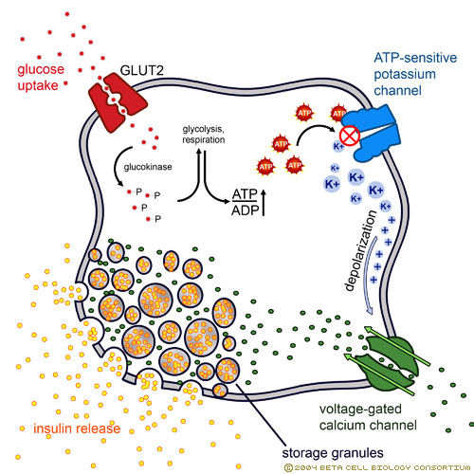
MECHANISM OF INSULIN SECRETION BY BLOOD GLUCOSE

Slide 18
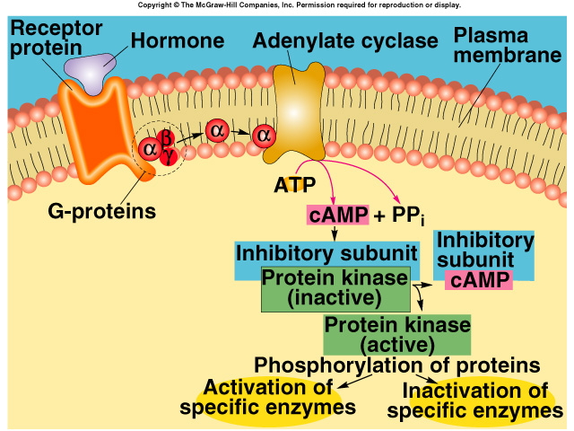
Cyclic AMP mediated hormone activity

Slide 19
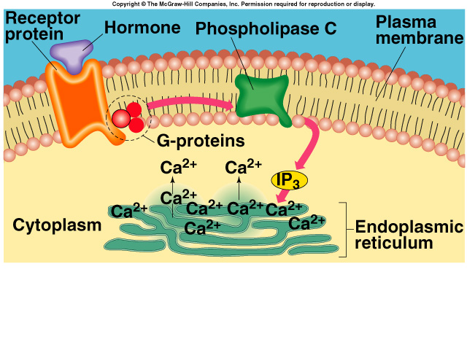
PHOSPHOLIPASE C SECOND MESSENGER SYSTEM

Slide 20
FATE OF SECRETED INSULIN
NSILA (NON SUPPRESSIBLE INSULIN-LIKE ACTIVITY):
The activity that is not suppressed by antiinsulin antibodies has been called NSILA.
INSULIN LIKE GROWTH FACTORS (IGF-I AND IGF-II)
Most, if not all, of this activity persist after pancreatectomy and due to the IGE-I and IGF-II.

Slide 21
SITES OF INSULIN ACTION
ADIPOSE TISSUE
MUSCLE
LIVER
GENERAL: INCREASED CELL GROWTH

Slide 22
MECHANISM OF INSULIN ACTION
INSULIN RECEPTOR, which has a molecular weight of approximately 340,000, is a tetramer made up of two α and two β glycoprotein subunits.
Transport of insulin through the capillary wall to the target tissues.
Insulin binds with the insulin receptor. Binding of insulin to the α chains activates the tyrosine kinase activity of the β chains. The activated tyrosine kinase then autophosphorylations β chains.
The phosphorylated receptor then phosphorylates tyrosine residues on insulin receptor substrates (IRS).
Notes:
then phop

Slide 23
CONTD…. MECHANISM OF INSULIN ACTION
The IRS tyrosine phosphorylation produce following effects:
Glucose synthesis
Fat synthesis
Protein synthesis
Glucose transport
Growth and gene expression
The growth-promoting protein anabolic effects of insulin are mediated via phosphoinositol 3-kinase (PI3K).

Slide 24
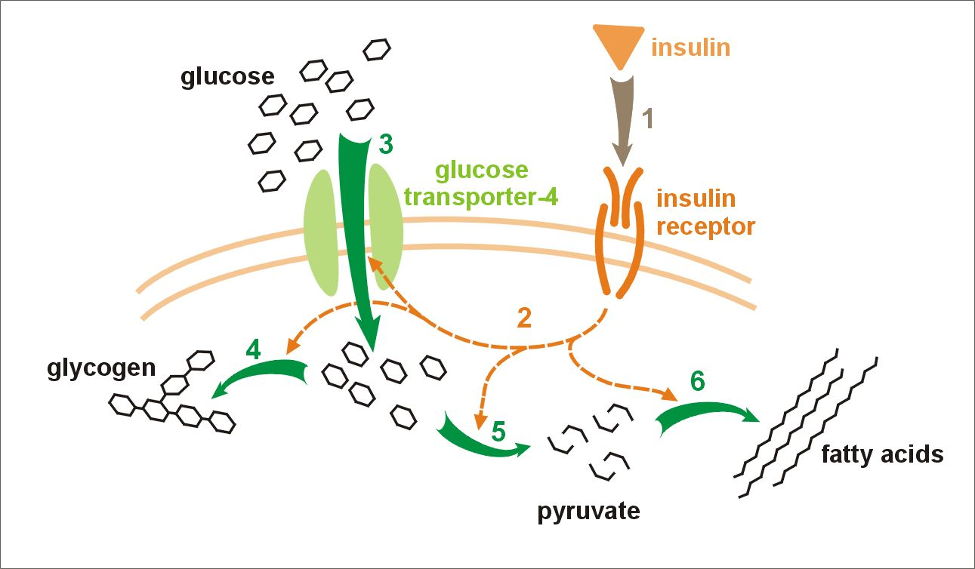
MECHANISM OF INSULIN ACTION

Slide 25
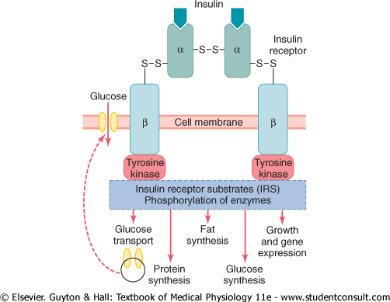
MECHANISM OF INSULIN ACTION

Slide 26
PHYSIOLOGICAL EFFECTS OF INSULIN
EFFECTS ON ADIPOSE TISSUE:
Increased glucose entry
Increased fatty acids synthesis
Increased glycerol phosphate synthesis
Increased triglyceride deposition
Activation of lipoprotein lipase
Inhibition of hormone sensitive lipase
Increased K+ uptake

Slide 27
CONTD……PHYSIOLOGICAL EFFECTS OF INSULIN
EFFECTS ON MUSCLE:
Increased glucose entry
Increased glycogen synthesis
Increased amino acid uptake
Increased protein synthesis in ribosomes
Decreased protein catabolism
Decreased release of glyconeogenic amino acids
Increased ketone uptake
Increased K+ uptake

Slide 28
CONTD……PHYSIOLOGICAL EFFECTS OF INSULIN
EFFECTS ON LIVER:
Decreased ketogenesis
Increased protein synthesis
Increased fat synthesis
Decreased glucose output due to:
Decreased gluconeogenesis
Increased glycogen synthesis
Decreased glucogenesis
Decreased glycogenolysis
GENERAL: Increased cell growth

Slide 29


Slide 30
MCQ TEST AFTER END OF LECTURE
1 One of the complication of diabetes mellitus is :
A Hypocalcaemia
B Carotenemia
C Dilution syndrome
D Metabolic ketoacidosis
2 Insulin-dependent diabetes mellitus (IDDM) Is :
A Type-I
B Type-II
C Secondary diabetes mellitus
D None of above

Slide 31
MCQ TEST AFTER END OF LECTURE
3 The activity that is not suppressed by antiinsulin antibodies has been called :
A IGE-I
B IGF-II
C NSILA.
D Phosphoinositol 3-kinase
4 Type-I diabetes usually develop before the age of 40 and hence is called :
A Secondary diabetes mellitus
B juvenile diabetes.
C Diabetes insipidus
D None of above

Slide 32
MCQ TEST AFTER END OF LECTURE
5 Glucagon mediates insulin releasing effect by stimulator:
A Phospholipase-C second messenger system.
B G protein via cyclic AMP system.
C Transcription and translation effects.
D Non of above.

Slide 33
EBES LEARNING
DIABETES MELLITUS

Slide 34
DIABETES MELLITUS
REFERENCES | PATIENT/ SUBJECT | INTERVENTION | CONCLUSION | OUT COME/ RESULT
Chiasson JL et al (2002). Acarbose for prevention of type 2 diabetes mellitus: the STOP-NIDDM randomised trial. Lancet [2002, 359(9323):2072-2077] | We randomly allocated 714 patients with impaired glucose tolerance to acarbose and 715 to placebo. The worldwide increase in type 2 diabetes mellitus is becoming a major health concern. | In a multicentre, placebo-controlled randomised trial, we randomly allocated patients with impaired glucose tolerance to 100 mg acarbose or placebo three times daily. The primary endpoint was development of diabetes on the basis of a yearly oral glucose tolerance test (OGTT). Analyses were by intention to treat. | Acarbose could be used, either as an alternative or in addition to changes in lifestyle, to delay development of type 2 diabetes in patients with impaired glucose tolerance. | 221 (32%) patients randomised to acarbose and 285 (42%) randomised to placebo developed diabetes (relative hazard 0.75 [95% CI 0.63-0.90]; p=0.0015). Furthermore, acarbose significantly increased reversion of impaired glucose tolerance to normal glucose tolerance (p<0.0001).

Slide 35
DIABETES MELLITUS
REFERENCES | PATIENT/ SUBJECT | INTERVENTION | CONCLUSION | OUT COME/ RESULT
Graham A. Colditz et al (1995) . Weight Gain as a Risk Factor for Clinical Diabetes Mellitus in Women Ann Intern Med. 1995;122(7):481-486. | 114 281 female registered nurses aged 30 to 55 years who did not have diagnosed diabetes mellitus, coronary heart disease, stroke, or cancer in 1976. | To examine the relation between adult weight change and the risk for clinical diabetes mellitus among middle-aged women. Prospective cohort study with follow-up from 1976 to 1990 | These findings support the importance of maintaining a constant body weight throughout adult life and suggest that the 1990 U.S. Department of Agriculture guidelines that allow a substantial weight gain after 35 years of age are misleading. | The corresponding relative risk for women who gained 8.0 to 10.9 kg was 2.7 (CI, 2.1 to 3.3). In contrast, women who lost more than 5.0 kg reduced their risk for diabetes mellitus by 50% or more. These results were independent of family history of diabetes.

Slide 36
DIABETES MELLITUS
REFERENCES | PATIENT/ SUBJECT | INTERVENTION | CONCLUSION | OUT COME/ RESULT
Ralph A. DeFronzo et al (1999). Pharmacologic Therapy for Type 2 Diabetes Mellitus Ann Intern Med. 1999;131(4):281-303. | Type 2 diabetes mellitus is a chronic metabolic disorder that results from defects in both insulin secretion and insulin action. An elevated rate of basal hepatic glucose production in the presence of hyperinsulinemia is the primary cause of fasting hyperglycemia | In the United States, five classes of oral agents, each of which works through a different mechanism of action, are currently available to improve glycemic control in patients with type 2 diabetes. | This review examines the goals of antihyperglycemic therapy and reviews the mechanism of action, efficacy, nonglycemic benefits, cost, and safety profile of each of the five approved classes of oral agents. A rationale for the use of these oral agents as monotherapy, | The recently completed United Kingdom Prospective Diabetes Study (UKPDS) has shown that type 2 diabetes mellitus is a progressive disorder that can be treated initially with oral agent monotherapy but will eventually require the addition of other oral agents,

Slide 37
CONCLUSION
Acarbose could be used, either as an alternative or in addition to changes in lifestyle, to delay development of type 2 diabetes in patients with impaired glucose tolerance.
These findings support the importance of maintaining a constant body weight throughout adult life and suggest that the 1990 U.S. Department of Agriculture guidelines that allow a substantial weight gain after 35 years of age are misleading.
This review examines the goals of antihyperglycemic therapy and reviews the mechanism of action, efficacy, nonglycemic benefits, cost, and safety profile of each of the five approved classes of oral agents. A rationale for the use of these oral agents as monotherapy.

Slide 38
REFERENCES
Chiasson JL et al (2002). Acarbose for prevention of type 2 diabetes mellitus: the STOP-NIDDM randomised trial.Lancet [2002, 359(9323):2072-2077]
Graham A. Colditz et al (1995) .Weight Gain as a Risk Factor for Clinical Diabetes Mellitus in Women.
Ann Intern Med. 1995;122(7):481-486.
Ralph A. DeFronzo et al (1999).Pharmacologic Therapy for Type 2 Diabetes Mellitus .Ann Intern Med. 1999;131(4):281-303.

Slide 39
The End

Slide 40


