Slide 1
Color Vision
Dr. Hemendra Suthar
(M.B.B.S., M.D. Physiology)
Assistant Professor
Department of Physiology
Smt. B. K. Shah Medical Institute & Research Centre
Sumandeep Vidyapeeth

Slide 2
Photopic Vision
It is day light vision.
Operates at high intensity of light above 1 milliambert(mA)
The cones have a much ‘higher threshold’ but has a much ‘greater’ acuity this responsible for vision in bright light and for colour vision.
Scotopic Vision
Dim light vision
Operates at low intensity of light below 0.01 mA
Function of rods, as it have much ‘lower’ threshold and are extremely sensitive to light.

Slide 3
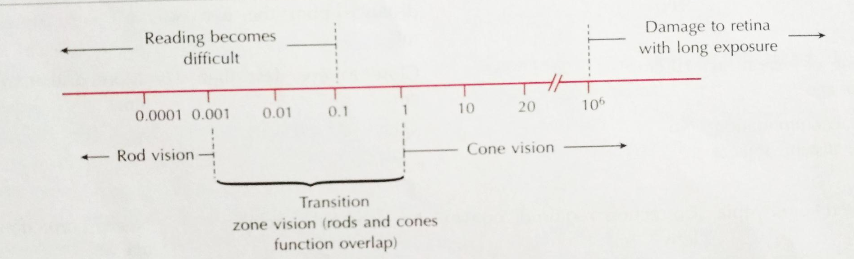
Mesopic Vision
Full moon ight vision with brightness level 0.01 mA
Below 0.1 mA intensity of brightness reading becomes difficult.
Between 0.01 to 1.0 mA is transition zone of vision because function of cones overlap the rods.

Slide 4
Visual Perceptions
Sensations from stimulation of retina by light.
Four types:
Light sense - Faculty to perceive light in all gradations of intensity.
2. Form sense - to perceive the shape of object in outer
world. Max at fovea/ cones
3. Contrast sense- ability to perceive changes in luminance
between regions not separated by sharp borders.
4. Color sense -ability to distinguish between different colors as
excited by lights of different wavelengths

Slide 5
VISION
Shifting of sensitivity of eye from photopic to scotopic vision i.e. from rod vision to cone vision is known as Purkinje Shift or Purkinje phenomenon. This is seen towards evening.
Thus, there are two kinds of inputs to the brain from the eye, input from the rods and input from the cones. The existence of these two kinds of inputs, each working maximally under different condition of illumination is called Duplicity theory of vision.

Slide 6
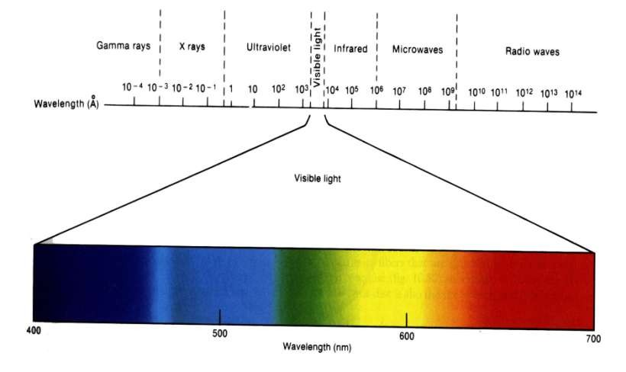
Visible spectrum
(397nm- 723nm)

Slide 7

The Artist Point of View
Hue - The color we see (red, green, purple)
Saturation - How far is the color from gray (pink is less saturated than red, sky blue is less saturated than royal blue)
Brightness/Lightness (Luminance) - How bright is the color
white

Slide 8
Colour vision
Basics of colour vision in humans:-
  Human eyes perceive about 150 colours with different Hue (wavelength 400 nm to 700 nm), Intensity & saturation.
< 400 nm (ultraviolet rays) get absorbed by choroids
> 750 nm (infrared light) get absorbed by cones.
So this are not stimulating to rods and cone. And human eye could not see it.
  Spectral colours- VIBGYOR (wave length 400 to 700)
  Extra spectral colours- colours not in the spectrum (e.g. Pink)

Slide 9
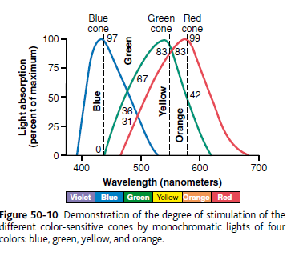
Visibility or Sensibility Curve
Wavelength of spectral colour:
VIBGYOR
Violet : 400
Indigo (blue) : 450
Bluish green (500) : 500
Green: 550
Greenish yellow : 560
Orange : 600
Red : 650-750
Ultra violet / sensibility range of vision/ infrared

Slide 10
Photochemistry of Color Vision by the Cones
The color-sensitive pigments of the cones same as rods
Retenene1 or 11- cis retinal
Protein portions, or the opsins → photopsins (different from scotopsin)

Slide 11
Theories of colour vision

Slide 12
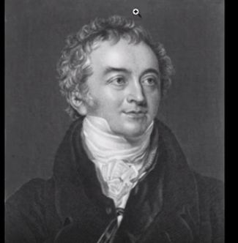
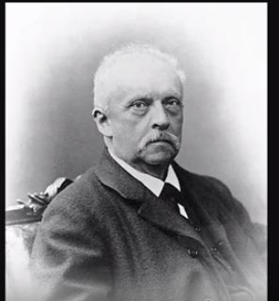
Trichromatic Theory
  Given by Thomas Young and Von Helmholtz According to this theory, there are three groups of cones in retina which are sensitive to three types of primary colours (i.e. blue, green and red) having different wavelengths.
  Sensation of different colours is appreciated when different wavelengths strikes the retina and registered in visual cortex.
  The sensation of many colours is produced by combined stimulation of three types of receptors in different intensities.

Slide 13
Perception of White Light
  Primary colours- blue, green & red and Cones are selectively sensitive to these colors: Blue, Green, Red
  Equal stimulation of all the red, green, and blue cones gives one the sensation of seeing white
Colour Pigments are called………
Blue-sensitive pigment (Cyanopsin)
Green-sensitive pigment (Iodopsin)
Red-sensitive pigment (Porphyropsin)

Slide 14
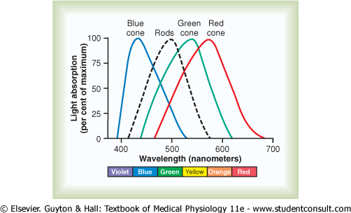
Pigment | peak absorbence @ light wavelengths
Cyanopsin | 445 nm
Iodopsin | 535 nm
Porphyropsin | 570 nm
Rod | 505 nm

Slide 15
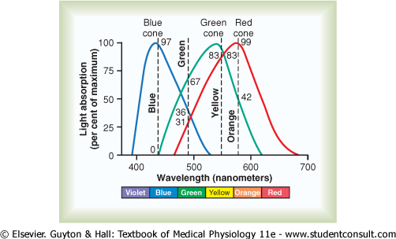
Spectral Sensitivities of the Three Types of Cones
Thomas Young and Von Helmholt’s theory
Almost same as the light absorption curves for the three types of pigment

Slide 16
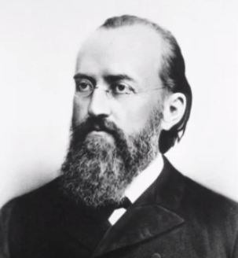
Hering’s Opponent color theory
Color vision is trichromatic at photoreceptor level
Color opponency at ganglion cell onward
Two main type of color opponent ganglion cells:-
(1) Red-Green opponent color cells:- use signals from red and green cones to detect red/green contrast within their receptive field
Ganglion cells are excited by only one color type of cone but inhibited by a second type(red causing excitation & green causing inhibition)
(2) Blue-Yellow opponent colour cells:- a yellow signal from the summed output of red and green cones, which is contrasted with the output from blue cones

Slide 17
Opponent Colour theory
+
black-white
+
blue-yellow
-
+
red-green
-
-

Slide 18
Theories of colour perception
According to Young-Helmholtz ttheory there are three types of cones for three fundamental colours: cones for red colour contain erythrolab; cones for green colour contain chlorolab; cones for blue colour contain cyanolab.
Do not explain why dichromats s e e yellow.
Do not explain complementary colour after images.

Slide 19
According to Hering theory there are couples of
opponent colours:
Spectrally opponents viz Green – red; yellow – blue.
Spectrally non opponent white – black.
Subcortical neurons perceive it due to on- and off-
centers mechanism.
Both theories combined explain the colour vision system. Trichromatic operates at receptor level and the signals are recorded into the opponent process form by higher level neural system of colour vision processing.

Slide 20
3. Muller’s Doctrine of specific nerve energy
Positive after image
Negative after image
4. Granit’s Theory
Dominator receptors
Modulator receptors

Slide 21
Interpretation of Color in the Nervous System
An ORANGE monochromatic light wavelength of 580 nm stimulates……
The stimulation value
The red cones : 99
The green cones : 42
The blue cones : 0
The ratios of stimulation → 99:42:0
The nervous system interprets this set of ratios as the sensation of ORANGE color.

Slide 22
a monochromatic BLUE wavelength of 450 nm stimulates……
The red cones : 0
The green cones : 0
The blue cones : 97
Ratio 0:0:97 → interpreted as BLUE Color

Slide 23
White colour sensation is produced when all the three receptors are stimulated equally.
Eg.:-
Orange= 99:42:0
Blue= 0:0:97
Yellow= 83:83:0
Green=31:67:36
Black= 0:0:0
White= all equally

Slide 24
Colour blindness
  Total loss of colour vision is called Achromatopsia.
  Partial loss is called colour blindness in which there is inability to distinguish certain colours.
  It effects 8% males & 0.4% females

Slide 25
Based on John Dalton’s theory of color blindness
Trichromates
all 3 cones
individuals with normal colour vision
one may be weak ‘protaanomaly’ or deuteromanomaly’ or ‘tritanomaly’
Dichromates
individuals with only two cones present
either protanopia, deuteranopia or tritanopia
Examples of physiological ‘Dichromatic vision’ :- fovea centralis where only blue and red cones are present
Monochromates :
only one cone system (rare)

Slide 26
Suffix:
Anomaly :- colour weakness
Anopia :- colour blindness
Prefix:
Prot → Red cone system
Deuter → Green cone system
Trit → Blue cone system
Protanopia → inability to appreciate red colour
Protoanomaly → weakness (less sensitive to) red colour
common defects of colour blindness (in order of occurance)
Deuteranomaly
Deuternopia
Tritanomaly

Slide 27
Nomenclature:-
  Trichromate: Person with normal colour vision
  Dichromates: Person with normal working 2 of 3 cone pigments.
  Monochromates: Person with only one normal working cone pigment.
  Use of prefix: prot, deuter & trit used for red, green & blue cone system defects respectively
  Loss of cone: ---anopia (e.g. loss of red cone = protanopia)
  Weakness of cone:-anomaly (e.g. weakness of green cone = deuteranomaly)
  Colour blindness is rare & colour weakness is more common especially red green colour weakness.

Slide 28
Red-Green Color Blindness
green, yellow, orange, and red colors, between the wavelengths 525 - 675 nm
distinguished from one another by the red and green cones.
If either of these two cones is missing, the person cannot use this mechanism for distinguishing these four colors
unable to distinguish red from green → red-green color blindness

Slide 29
Causes:-
  These abnormalities are inherited as recessive and X-linked characteristics.
  Colour blindness is present in males if the X chromosome has the abnormal gene.
  Females show a defect only when both X chromosomes contain the abnormal gene.
  However, female children of a male with X-linked colour blindness are carriers of the colour blindness and pass the defect on to half of their sons.
  Therefore, X-linked colour blindness skips generations and appears in males of every second generation.

Slide 30
Protanope : visual spectrum is shortened at the long wavelength end
Deuteranope : have normal visual spectral width because red cones are available to detect the long wavelength red color

Slide 31
Blue Weakness
Rare
blue cones missing
genetically inherited

Slide 32
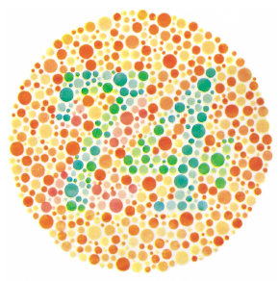
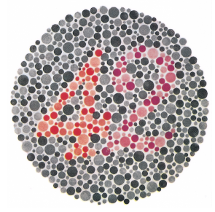
Tests for colour vision
Ishihara’s chart test
Eldridge-green lantern test
Holmgren’s wool matching test

Slide 33
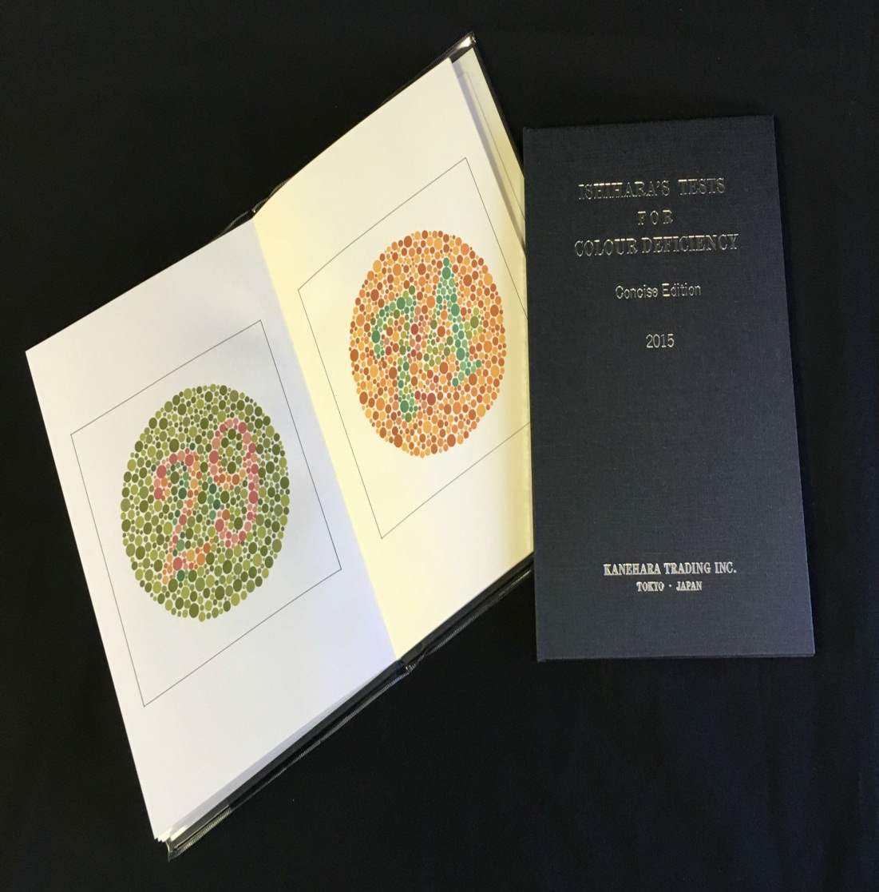
Ishhihira charts:-
rapid method
based on the use of spot charts
arranged with a confusion of spots of several different colors

Slide 34
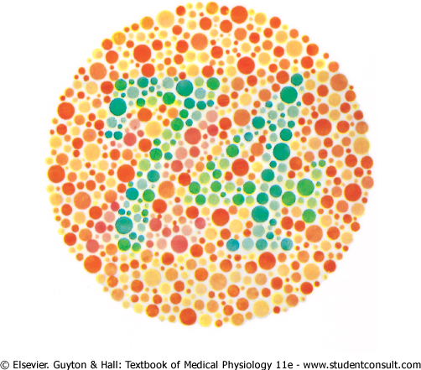
the person with normal color vision reads "74," whereas the red-green color-blind person reads "21"

Slide 35
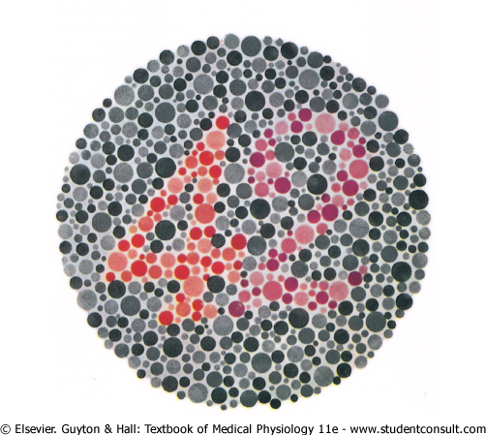
the person with normal color vision reads "42," whereas the red-blind person reads "2," and the green-blind person reads "4"

Slide 36
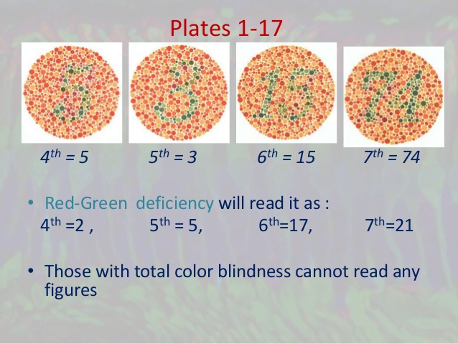

Slide 37
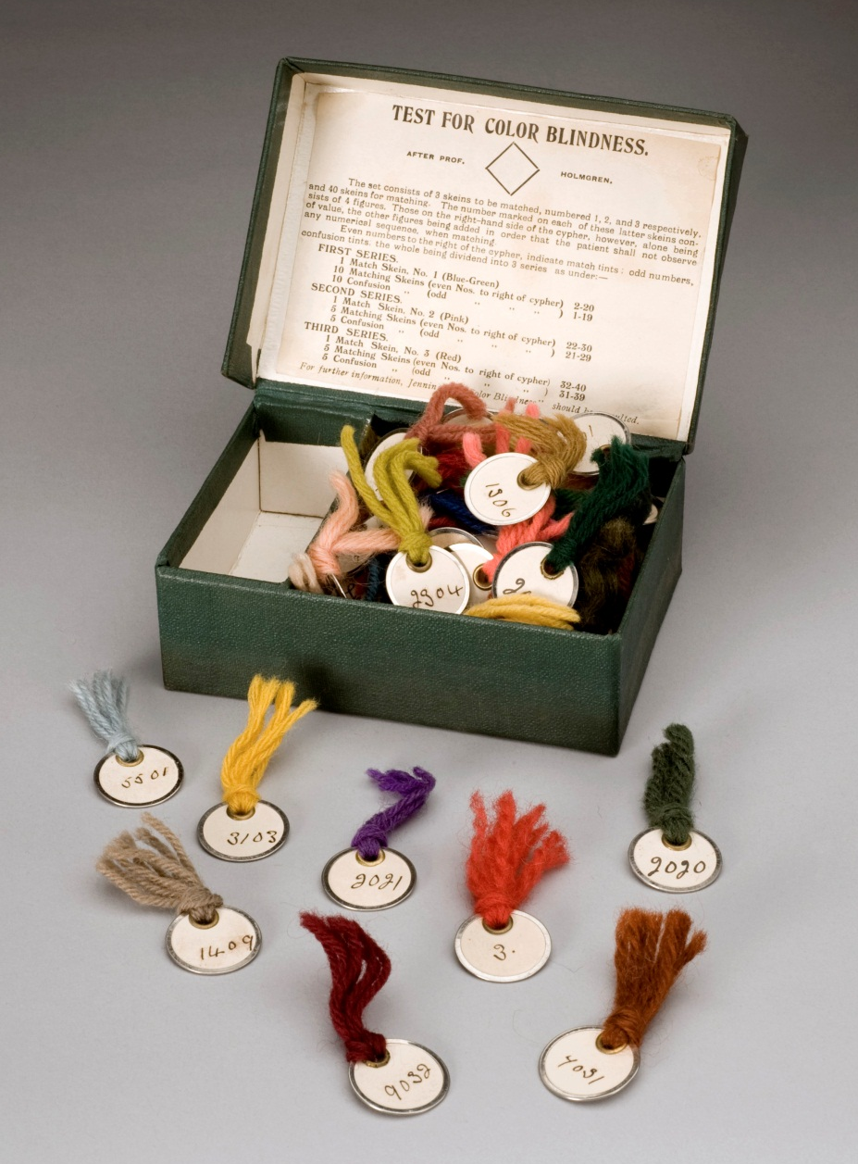
Holmgren’s wool matching test:-
  Subject is asked to match the color and to pile in same pile.
  If he is red-green blind, he will keep yellow, green, orange, red colored pieces in the same pile because he would recognize them of same color.

Slide 38
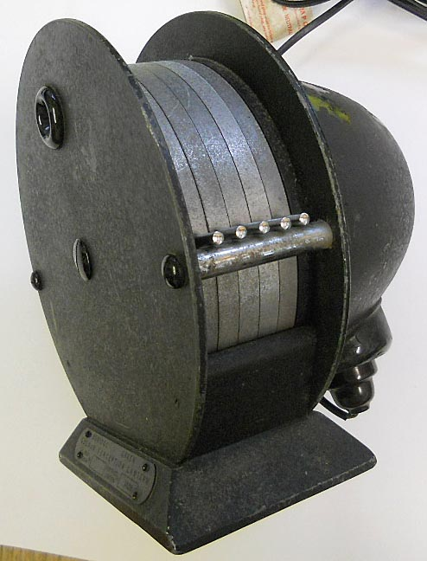
Edridge Green lantern:-
Subject has to identify the colour of the small illuminated area, size of which can be varied. This test is done during selection of engineee or lorry drivers for the colour defective vision.

Slide 39
NEUROPHYSIOLOGY OF VISION
Genesis of visual impulse in photoreceptors
Processing and transmission in retina
Processing and transmission in visual pathway
Analysis in visual cortex

Slide 40
Electrotonic conduction
In the rods and cones → hyperpolarization in outer segment → same conducted by direct electric current flow in the cytoplasm to the synaptic body to other cells.
Transmission of Signals Occurs in the Retinal Neurons by Electrotonic Conduction and not by action potential
EXCEPT GANGLION CELLS

Slide 41
Advantage of Ele. Cond.
allows graded conduction of signal strength
Does not follow not all or none (AP)
for the rods and cones
strength of the hyperpolarizing output signal α the intensity of illumination

Slide 42
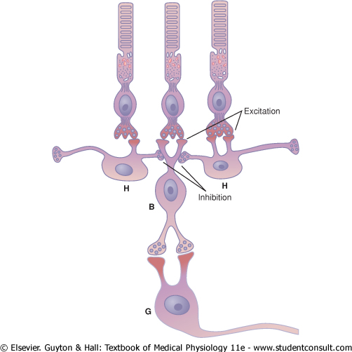
Bipolar Cells
Two types
(1) depolarizing bipolar cell
(2) hyperpolarizing bipolar cell
Importance of two bipolar cells
allows half the bipolar cells to transmit +ve signals and the other half to transmit -ve signals. Provide opposing excitatory and inhibitory signals in the visual pathway
a second additional mechanism for lateral inhibition

Slide 43
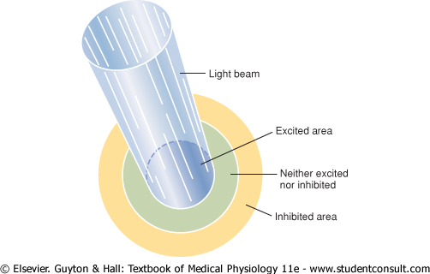
Horizontal cells & Amacrine cells
providing lateral inhibition in the surrounding areas
allow high visual accuracy in transmitting contrast borders in the visual image

Slide 44
Types of Ganglion Cells
3 types
W cells
X cells
Y cells

Slide 45
Cell | The W Cells | The X Cells | The Y Cells
Number | 40 % | 55 % | 5 %
Diameter | < 10 µm | 10-15 µm | 35 µm
Velocity | 8 m/sec | 14 m/sec | > 50 m/sec
Retinal area | broad dendritic fields → more retinal area covered | Dendrites don’t spread widely → their signals represent discrete retinal locations | broad dendritic fields → more area covered
Receiving information | Receive excitation from rods | receives input from at least one cone | -
Function | detecting directional movement in the field of vision Responsible for crude rod vision under dark conditions | the fine details of the visual image probably responsible for all color vision | respond to rapid changes in the visual image → either rapid movement or rapid change in light intensity

Slide 46
Spontaneous, Continuous AP
ganglion cells → the long fibers of the optic nerve → the brain
Because of long distance → the electrotonic conduction not appropriate
AT REST….when unstimulated → transmit continuous impulses
5 - 40 / sec.
Different varieties of responses obtained from ganglion cells

Slide 47
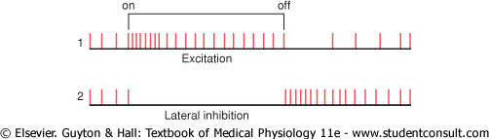
Excited by Changes in Light Intensity-The On - Off Response
light on → increase rate of impulses for a fraction of a second → next fraction of a second → decreasing rapidity (even if the light is on)
ganglion cell lateral to the spot of light;
light on → inhibited, because of lateral inhibition

Slide 48
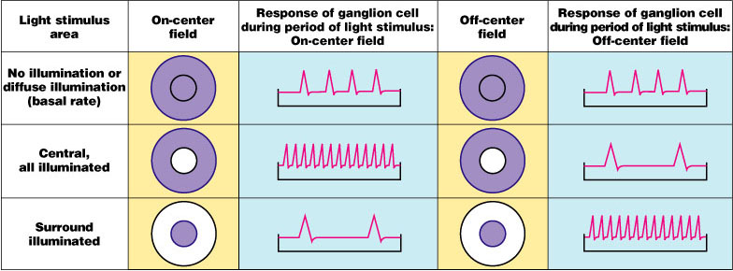
Retinal Processing: Receptive Fields of Ganglion Cells
Figure 15.24

Slide 49
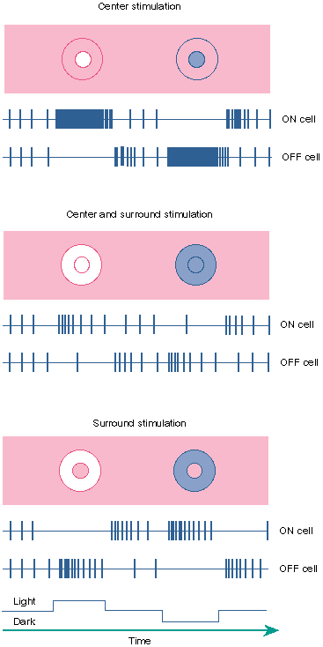
Visual fields explained?
Centre Stimulation
Light On
Light Off
Light on centre excites centre on ganglion cell but inhibits centre off ganglion cell
On cell
On cell
Off cell
Light off centre excites centre off ganglion cell but inhibits centre on ganglion cell
Off cell
Centre & Surround Stimulation
Light on centre & surround weakly excites centre on ganglion cell and weakly inhibits centre off ganglion cell
Light On
Light Off
Note the presence of the “off” response when the stimulus is reversed
On cell
Off cell
Light off centre & surround weakly inhibits centre on ganglion cell and weakly excites centre off ganglion cell
Surround Stimulation
Light On
Light Off
Light on surround inhibits centre on ganglion cell but excites centre off ganglion cell
On cell
Off cell
Light off surround excites centre on ganglion cell but inhibits centre off ganglion cell
NB -the light stimulus increases or decreases in intensity

Slide 50
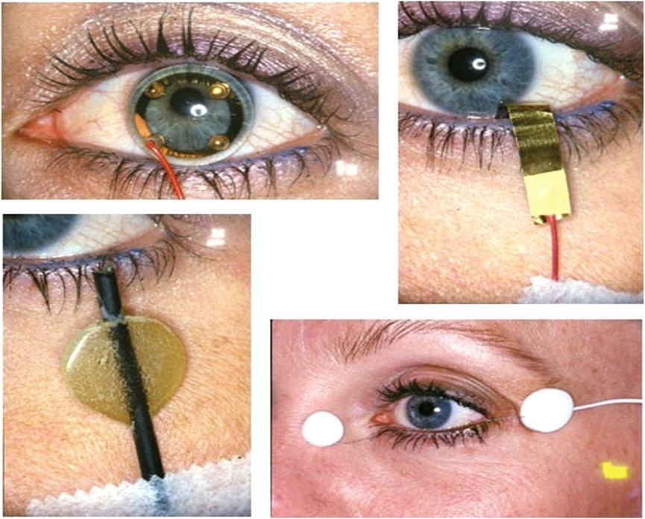
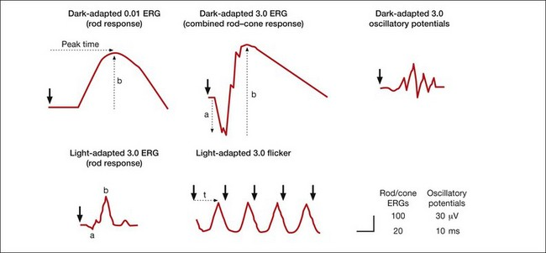
Electroretinogram
recording of electrical activity of retina
used to investigate retinal physiology and its disorders

Slide 51
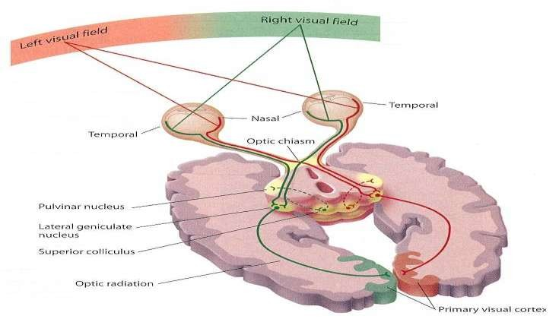
Transmission of vision
◆ Impulses from retina pass to optic nerve – optic chiasma (fibers from nasal halves of retina cross to opposite side) – optic tracts – synapse in lateral genicular body – geniculocalcarine fibers – pass through optic radiation or geniculocalcarine tract – primary visual cortex in calcarine fissure or medial aspect of occipital lobe.

Slide 52
CCES

Slide 53
“Trichromatic Theory” of color vision given by
Thomas and Helmholtz
John Dalton
Ewald Hering
Jan Purkinje

Slide 54
2. Function of “X type” of ganglionic cells
Detecting directional movement
Detecting color sense
Detecting Light Intensity
Lateral Inhibition

Slide 55
Red green color blindness is
Autosomal Dominant
Autosomal Recessive
X- linked Dominant
X- linked Recessive

Slide 56
4. Person with Deuternopia have following
symptom
Red color blindness
Green color blindness
Yellow color blindness
Blue color blindness

Slide 57
5. Human eye is able to see the ____ wavelength of
light
320 nm
450 nm
780 nm
850 nm

