Slide 1
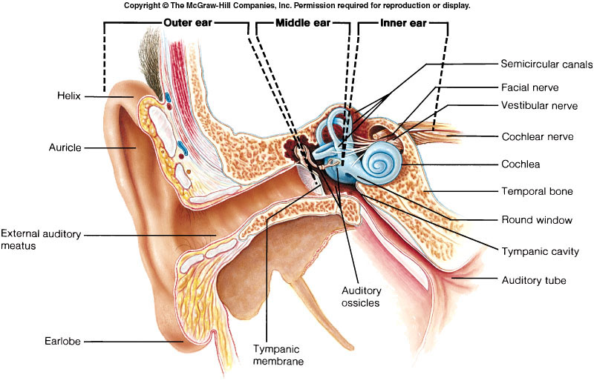
EAR
organ for heARING AND EQUILLIBRIUM
Dr. Hemendra Suthar
(M.B.B.S., M.D. Physiology)
Assistant Professor
Department of Physiology
Smt. B. K. Shah Medical Institute & Research Centre
Sumandeep Vidyapeeth

Slide 2
PHYSILOGICAL ANATOMY
It is divided in to THREE parts.
External ear
Middle ear
Internal ear.

Slide 3
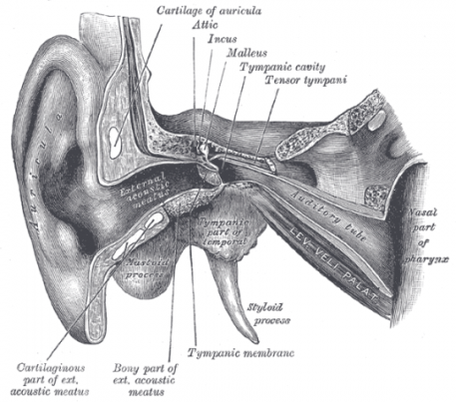
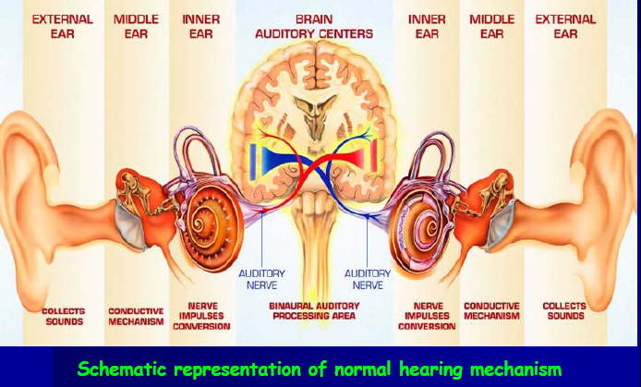
EAR AS A TRANSDUCER
SOUNDENERGY
MECHANICAL ENERGY
ELECTRICAL ENERGY

Slide 4
Sound is a form of energy that propagates in the form of waves
The speed of sound depend on the medium through which the wave pass
The sound frequencies audible to humans range from about 20 to a maximum of 20,000 Hz
The loudness can be measured in decibel: 20-90 db

Slide 6
THE EXTERNAL EAR
The external ear or the outer ear includes the PINNA and EXTERNAL AUDITORY CANAL.
THE PINNA :- it is fibrocartilaginous expanded portion covered with skin projecting from the side of the head.
It helps to COLLECT SOUND WAVES and TO LOCALIZE THE SOURCE OF SOUND.

Slide 7
THE EXTERNAL EAR
The EXTERNAL AUDITORY CANAL OR OUTER EAR CANAL.
It is 2.5 cm long runs forwards and inwards (medially) and helps in TRANSPORTING THE SOUND WAVES TO THE MIDDLE EAR.

Slide 8
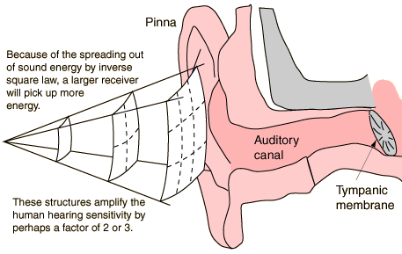
Role of external ear
Pinna- concha system catches sound over large area and concentrate it to smaller area of ext. auditory meatus and increases the total energy available to the tympanic membrane
Sound localization

Slide 9
EXTERNAL AUDITORY CANAL OR OUTER EAR CANAL.
It is lined with skin which secret ear wax from CERUMINOUS GLANDS.
And oil from sebaceous gland which by TRAPPING THE FOREIGN BODIES KEEP THE EAR CANAL CLEAR.

Slide 10
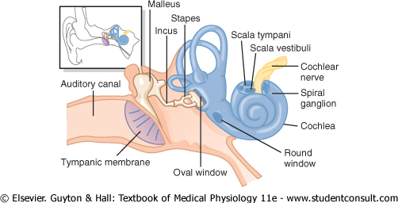

Slide 11
THE MIDDLE EAR
It is a air filled chamber and consists of the following parts:-
1) Tympanic membrane
2) Ear ossicles
3)Phayngotympanic tube or Eustachian tube

Slide 12
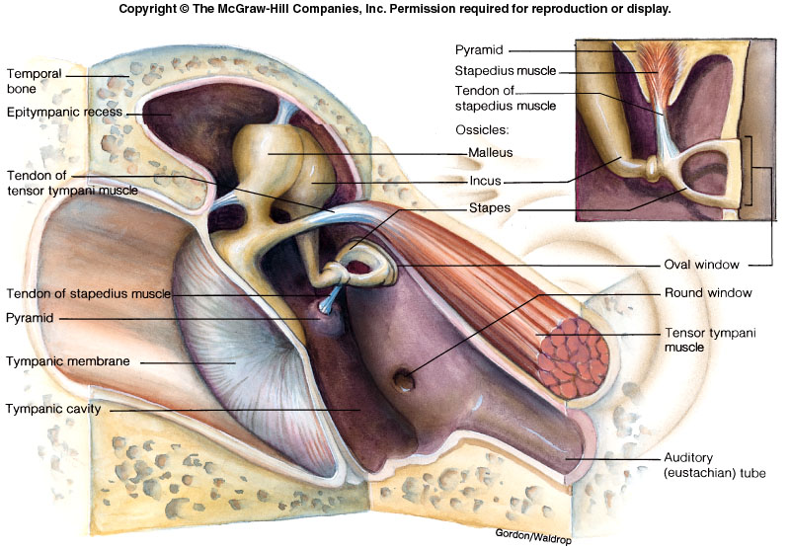

Slide 13
Tympanic membrane
It consists of connective tissue covered with skin on the outside and mucous membrane on the inside.
It has the shape of a swallow funnel with centre (UMBO) pointing inwards and is kept in this position by the handle of the malleus.

Slide 14
It acts as a resonator
i.e. it starts vibrating (in and out movement) when the sound waves strike.
It critically dampens ( stops the vibrations of ) the sound waves i.e. as soon as the sound waves will stop stretching the tympanic membrane its vibrations are stopped almost immediately.

Slide 15
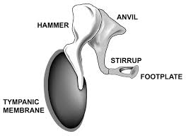
Ear ossicles
There are three minute bony (ear) ossicles
Malleus (hammer)
Incus (anvil)
Stapes (stirrup)
They extend across the cavity from the tympanic membrane to the oval window.

Slide 16
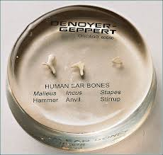
Ear ossicles
FUNCTIONS :-
It acts as pressure receiver i.e. it is extremely sensitive to pressure changes produced by sound waves on its external surface. Ossicles has main role in impedance matching.

Slide 17
EUSTACHIAN TUBE
It is 4-5cm in length and connects the middle ear cavity with the pharynx.
It serves to equalize the pressure on the two sides of the tympanic membrane when atmospheric pressure decrease (high altitude) or increase ( deep sea diving).
In common cold impairment causes the temporary hearing defects

Slide 18
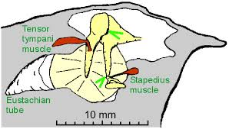
Middle Ear Muscles

Slide 19
TWO SKELETAL MUSCLES
TENSOR TYMPANI :- it is attached to the neck of malleus. Supplied by V CN. It attach with tympanic mem through malleus.
Its contraction increases the tension of tympanic membrane thus it keeps the tympanic membrane firmly attached. Paralysis can cause hearing defects.

Slide 20
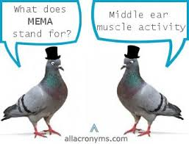
STAPEDIUS:- It is attached to the neck of the stapes. Supplied by VII CN.
On contraction it pulls the foot plate of the stapes out from the oval window. Prevents excess movement of stapes. Paralysis can cause
hyperacusis

Slide 21
FUNCTIONS OF MIDDLE EAR
IMPEDENCE MATCHING
ATTENUATION
PHASE DIFFERENCIAL EFFECT

Slide 22
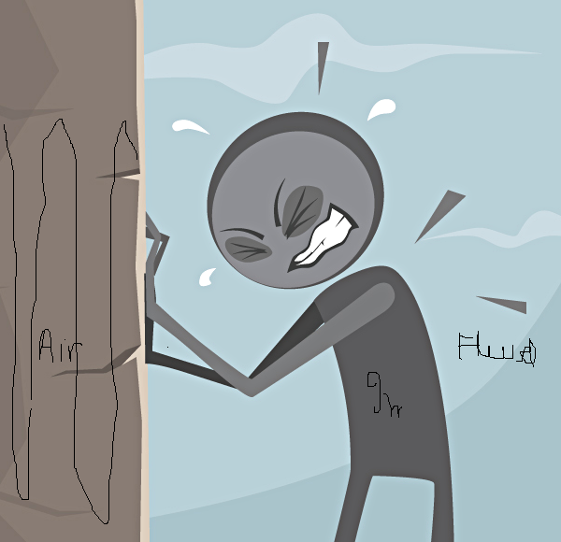
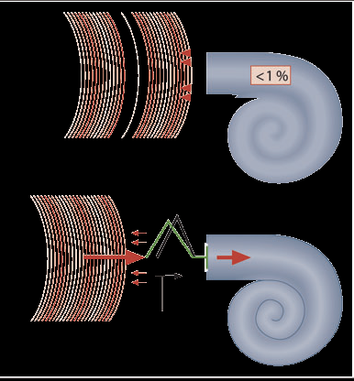
Impedence mismatch
IF THERE WAS NO MIDDLE EAR SYSTEM ,99% OF SOUND WAVES WOULD HAVE REFLECTED BACK FROM OVAL WINDOW
MIDDLE EAR BY ITS IMPEDENCE MATCHING PROPERTY ALLOWS 60% OF SOUND ENERGY TO DISSIPATE IN INNER EAR

Slide 23
“Impedance Matching” by the middle ear System
Area of tympanic membrane relative to oval window
55 mm² is of tympanic membrane
3.2 mm² is of oval window
The lever action of middle ear ossicles
All osscicles combindly Act like a handle of the door
The shape of tympanic membrane
UMBO condense the sound waves to the osscicles

Slide 24
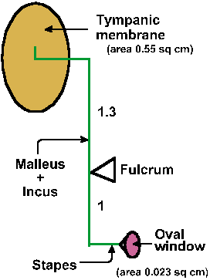
HYDRAULIC ACTION OF TYMPANIC
MEMBRANE
Total area of tympanic membrane 55mm²
Area of stapes footplate is 3.2mm²
Effective areal ratio is 17:1
Thus by focusing sound pressure from large area of tympanic membrane to small area of oval window the effectiveness of energy transfer is increased

Slide 25
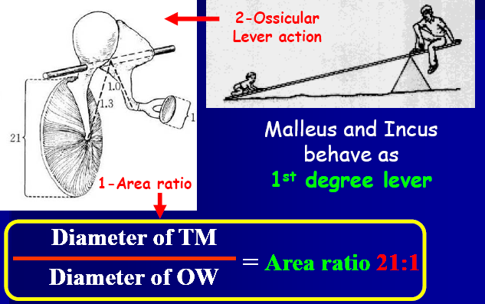
Lever action of ossicles
Handle of malleus is 1.3 times longer than long process of incus
Overall this produces a lever action that converts low pressure with a long lever action to high pressure with a short lever action

Slide 26
Attenuation reflex- Attenuation is a general term that refers to any reduction in the strength of a signal
When loud sounds are transmitted through the ossicular system
The tensor tympani muscle pulls the handle of the malleus inward while the stapedius muscle pulls the stapes outward.
These two forces cause the entire ossicular system to develop increased rigidity, thus greatly reducing the ossicular conduction of loud sound
This is k/as Attenuation reflex.
This occurs after a latent period of only 40 to 80 ms to cause contraction of the middle ear muscles. Sudden loud sound like gut shot, bomb explosion can not protect the ear and causes deafness

Slide 27
Function of attenuation reflex
To protect the cochlea from damaging vibrations caused by excessively loud sound.
To mask low-frequency sounds in loud environments. This usually removes a major share of the background noise
To decrease a person’s hearing sensitivity to his or her own speech

Slide 28
CCES

Slide 29
Stimulation of Parasympathetic pathway to eye leads to
Miosis
Mydriasis
Ptosis
Enophthalmos

Slide 30
2. Absence of Light reflex and presence of
Accomodation reflex is known as
Marcus Gun Pupil
Hutchison’s Pupil
Argyll Robertson pupil
Home Adies Pupil

Slide 31
3. Middle ear infection may follow a throat infection because:
A) Auditory (Eustachian) tube opens into the base of the inner ear
B) Pharyngeal (throat) mucosa is continuous with the mucosa of the middle ear
C) Sphenoid sinus opens into the tympanic cavity of the middle ear
D) Vestibulo cochlear nerve passes through the tympanic cavity

Slide 32
4. The oval window is closed by:
A) Tympanic membrane
B) Handle of Malleus
C) Body of Incus
D) Footplate of Stapes

Slide 33
5. Impedance matching is the function of :
A) Middle ear
B) External Ear
C) Inner ear
D) Ear whole

Slide 34
Thank you

