Slide 1
ELECTRON TRANSPORT CHAIN
&
OXIDATIVE PHOSPHORYLATION

Slide 2
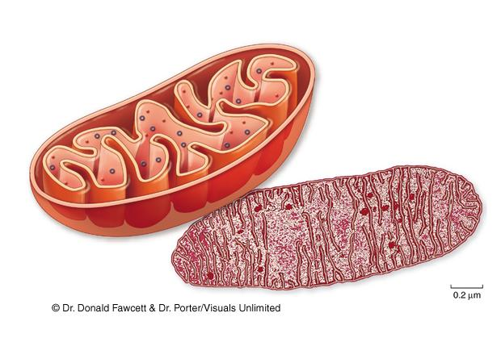
How Cells Harvest Energy
Cellular respiration

Slide 3
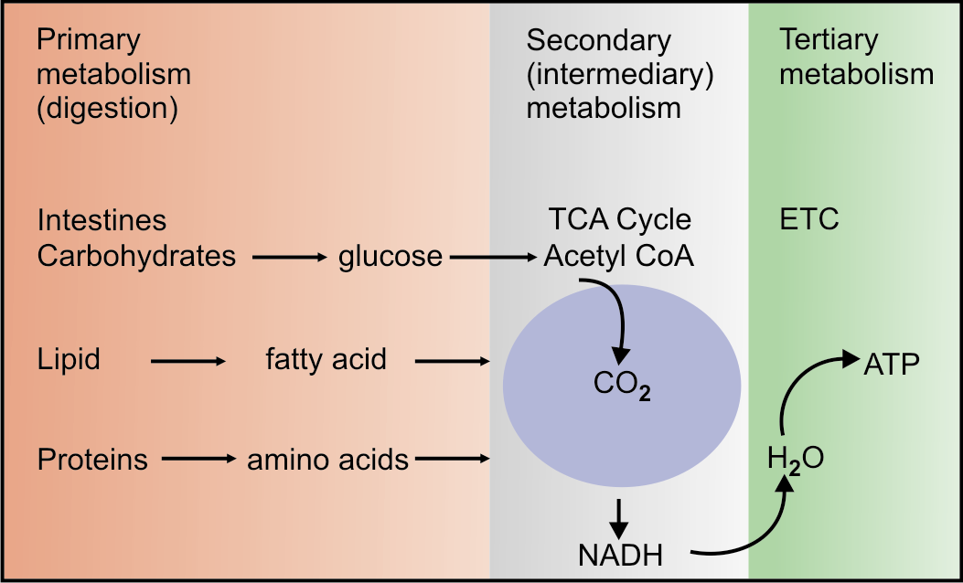

Slide 4
Redox Potentials
Redox potential of a system is the electron transfer potential E₀’.
Oxidation is defined as the loss of electrons.
Reduction is the gain in electrons.
When a substance exists both in the reduced state and in the oxidized state, the pair is called a Redox Couple.

Slide 5
Redox Potentials
Redox pairs | Eo
NAD⁺/NADH | -0.32
FMN/FMNH₂ | -0.22
Cytochrome c Fe³⁺/Fe²⁺ | +0.07
½O₂/H₂O | +0.82

Slide 6
Respiration
During respiration, electrons are shuttled through electron carriers to a final electron acceptor.
aerobic respiration: final electron acceptor is oxygen (O₂)
anaerobic respiration: final electron acceptor is an inorganic molecule (not O₂)
fermentation: final electron acceptor is an organic molecule

Slide 7
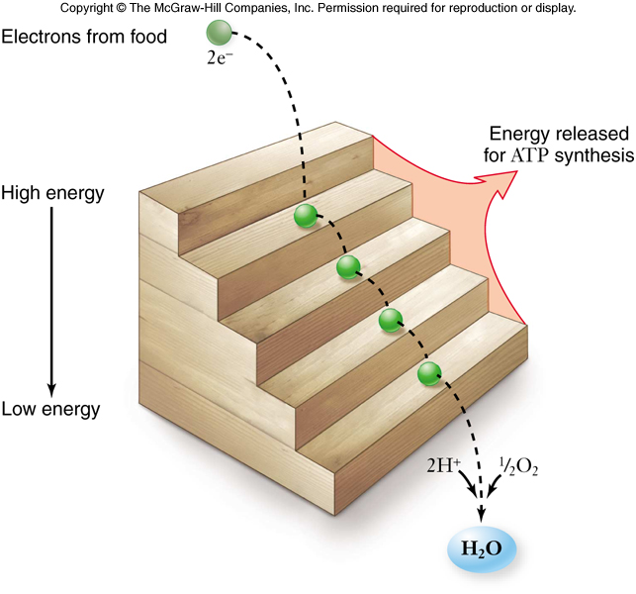

Slide 8
Respiration
The goal of respiration is to produce ATP.
-energy is released from oxidation reaction in the form of electrons
-electrons are shuttled by electron carriers (e.g. NAD⁺) to an electron transport chain
-electron energy is converted to ATP during phosphorylation

Slide 9
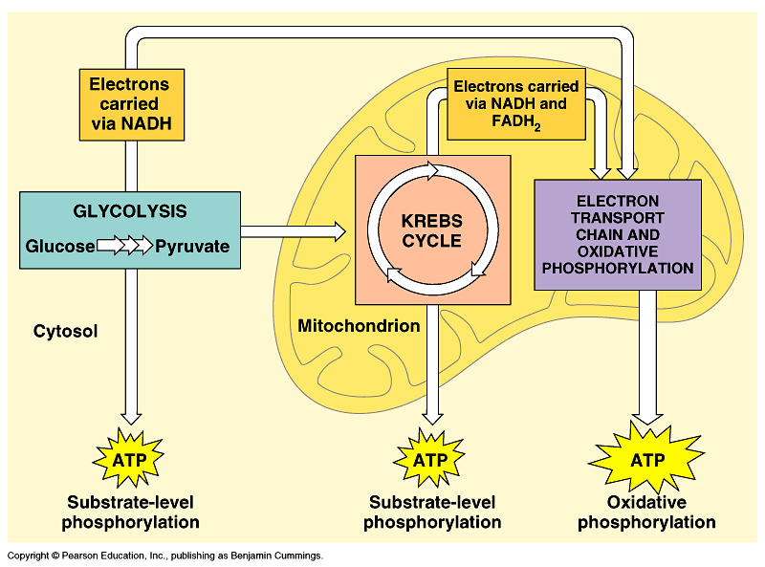

Slide 10
BIOLOGICAL OXIDATION
The transfer of electrons from the reduced coenzymes through the respiratory chain to oxygen is known as biological oxidation.
Energy released during this process is trapped as ATP. This coupling of oxidation with phosphorylation is called Oxidative phosphorylation.
In the body, this oxidation is carried out by successive steps of oxidoreductases.

Slide 11
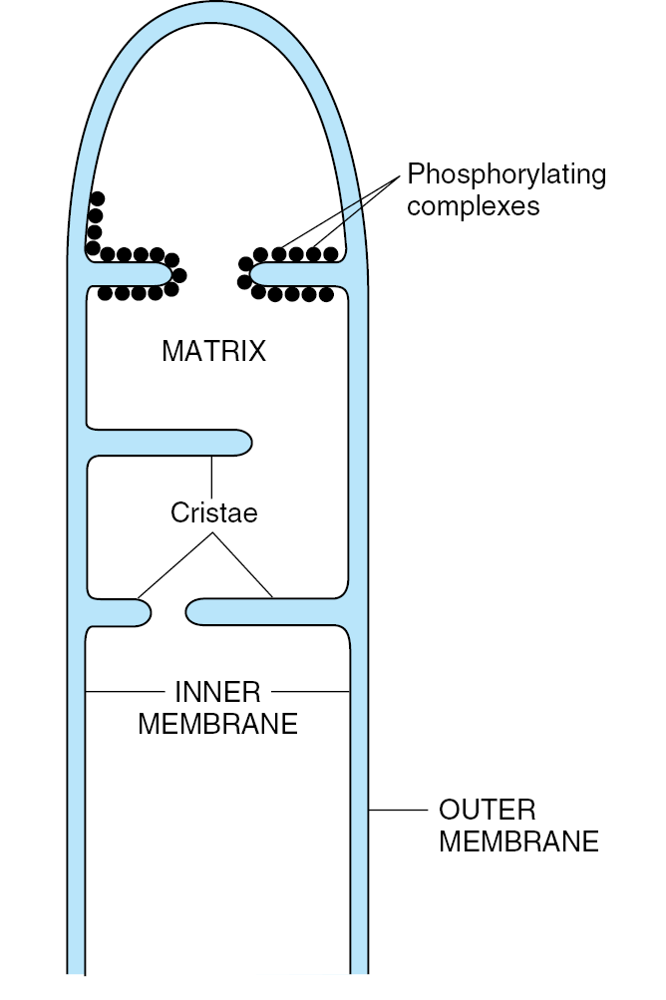

Slide 12
Organization of ET Chain
All the components of ETC are located in the inner membrane of mitochondria.
There are 4 multi-protein complexes; these are named as Complex-I, II, III and IV. These are connected by two mobile carriers, coenzyme Q and cytochrome c.

Slide 13
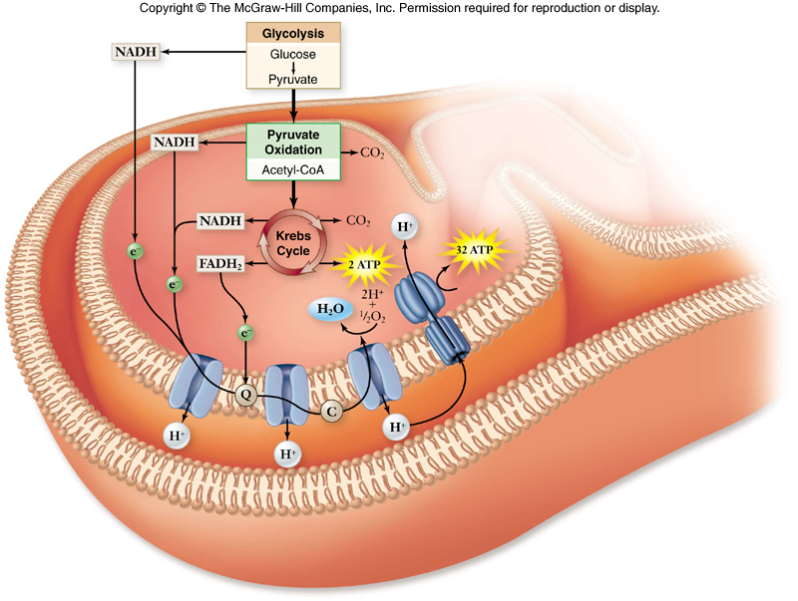
How NADH enters in Mitochondrion?

Slide 14
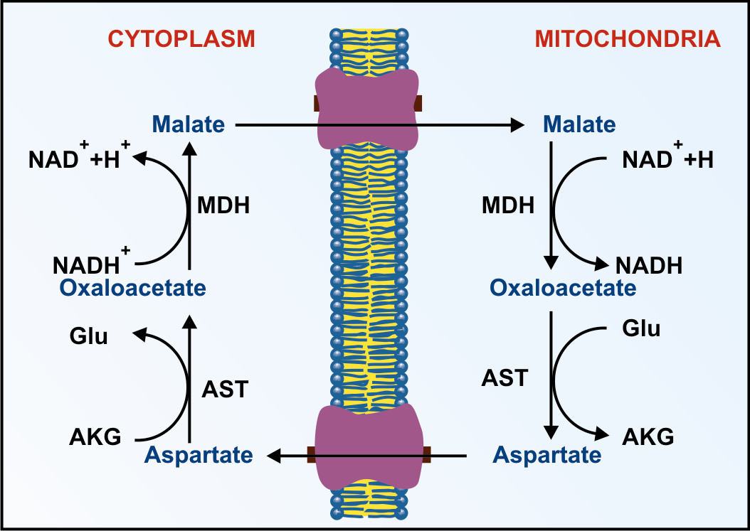
NADH transport
Malate aspartate shuttle (in heart & liver) :

Slide 15
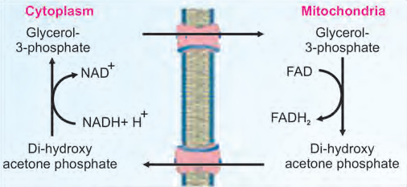
2. Glycerol-3-phosphate shuttle
(skeletal muscle and brain) :

Slide 16
COMPLEX – I
NADH- CoQ reductase
NADH dehydrogenase

Slide 17
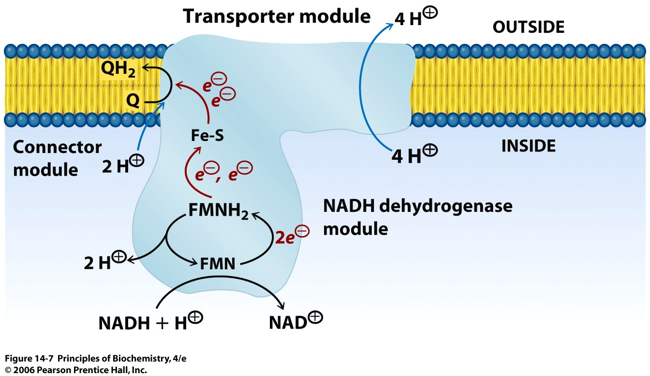
Notes:
Figure 14.7
Electron transfer and proton flow in complex I. Electrons are passed from NADH to Q via FMN and a series of Fe–S clusters. The reduction of Q to QH₂ requires two protons taken up from the inside compartment. In addition, four protons are translocated across the membrane for each pair of electrons transferred.

Slide 18
COMPLEX – II
Succinate-Q-reductase

Slide 19
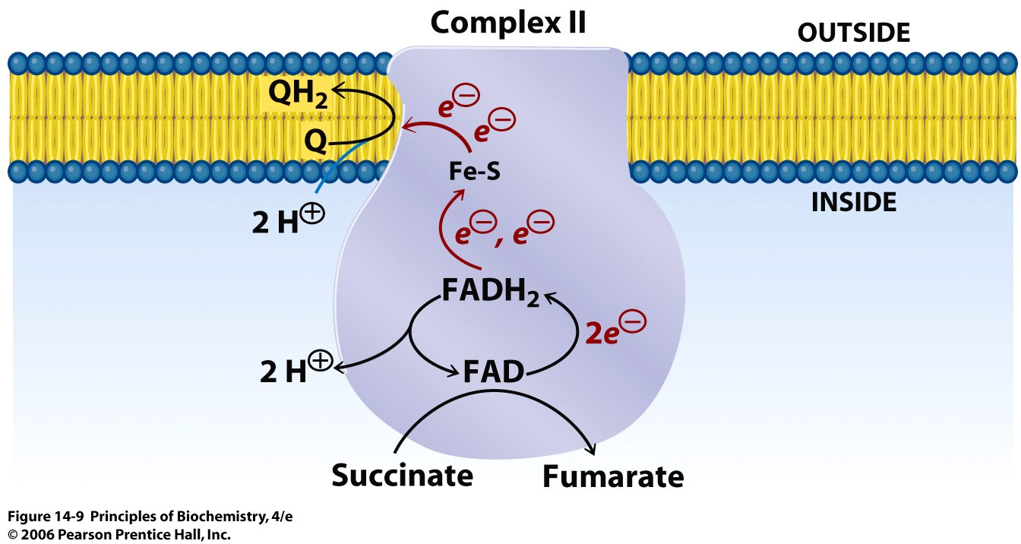

Slide 20
COMPLEX- III
Cytochrome (bc₁) Reductase

Slide 21
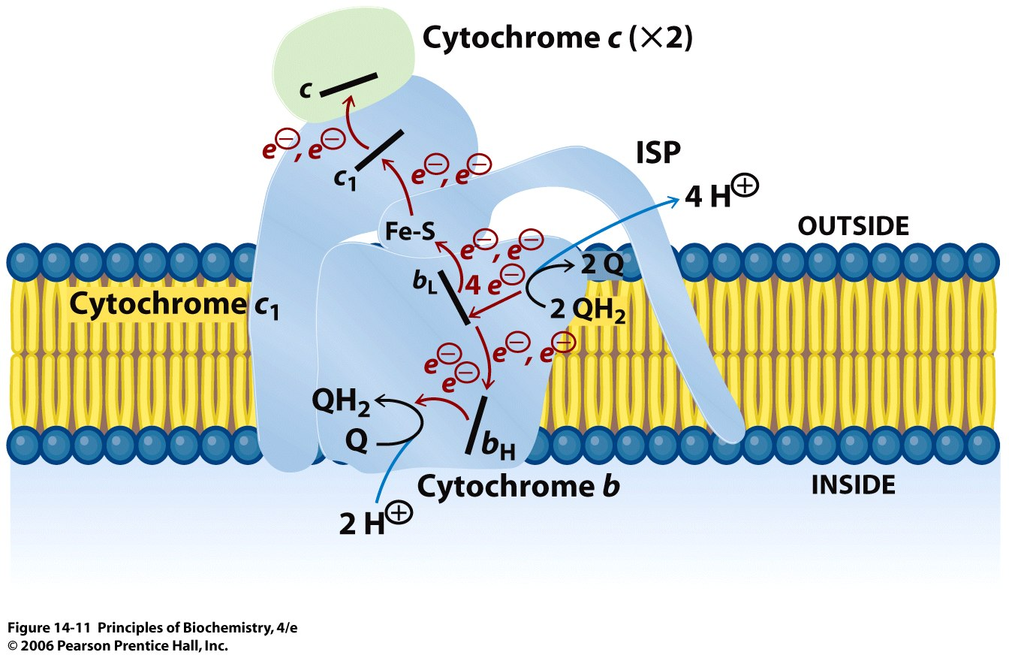
Electron transfer and proton flow in Complex III
Ubiquinol:cytochrome c oxidoreductase
Notes:
Figure 14.11
Electron transfer and proton flow in Complex III. Two pair of electrons are passed separately from two molecules of QH₂ to heme b_{L} (Q₀ site). Each pair of electrons is split so that individual electrons follow separate pathways. One electron is transferred to an Fe-S cluster, cytochrome c1, and finally to cytochrome c - the terminal electron acceptor. The other electron of each pair is transferred to heme b_{H} (Q₁ site) and then to Q. A total of four protons are translocated across the membrane: two from the inside compartment and two from QH₂.

Slide 22
COMPLEX –IV
Cytochrome (aa₃) Oxidase

Slide 23
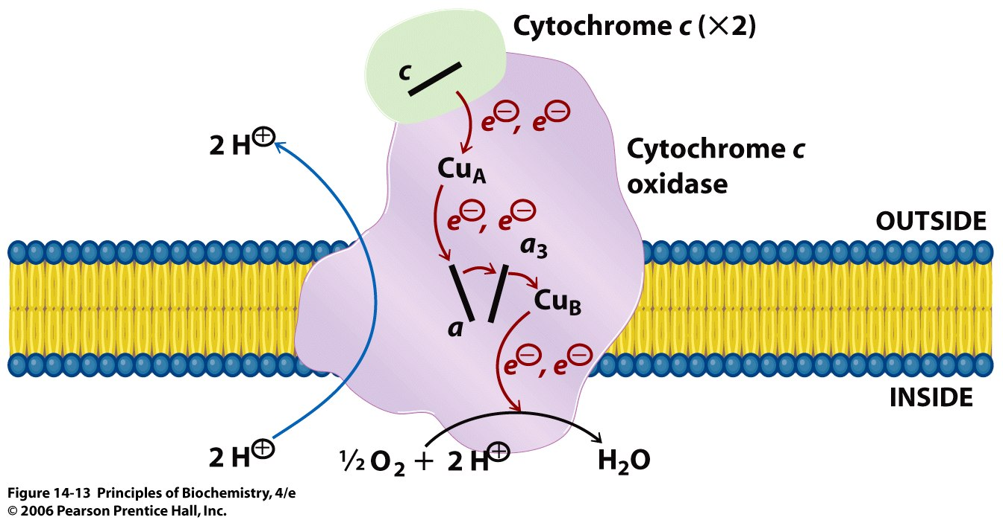

Slide 24
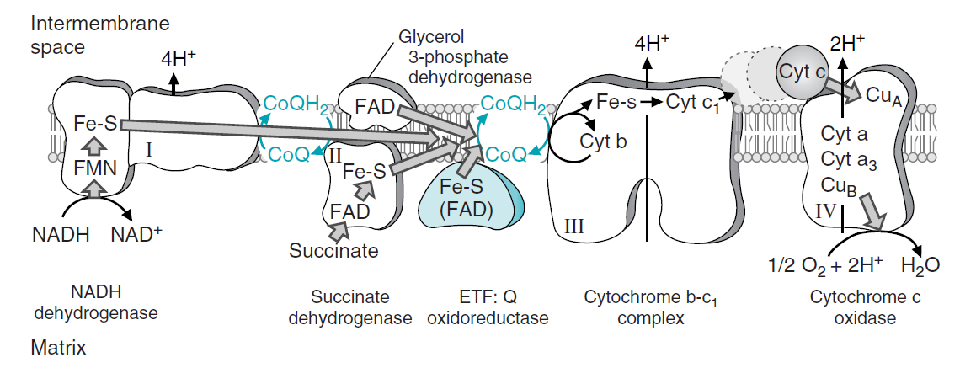
Summary

Slide 25
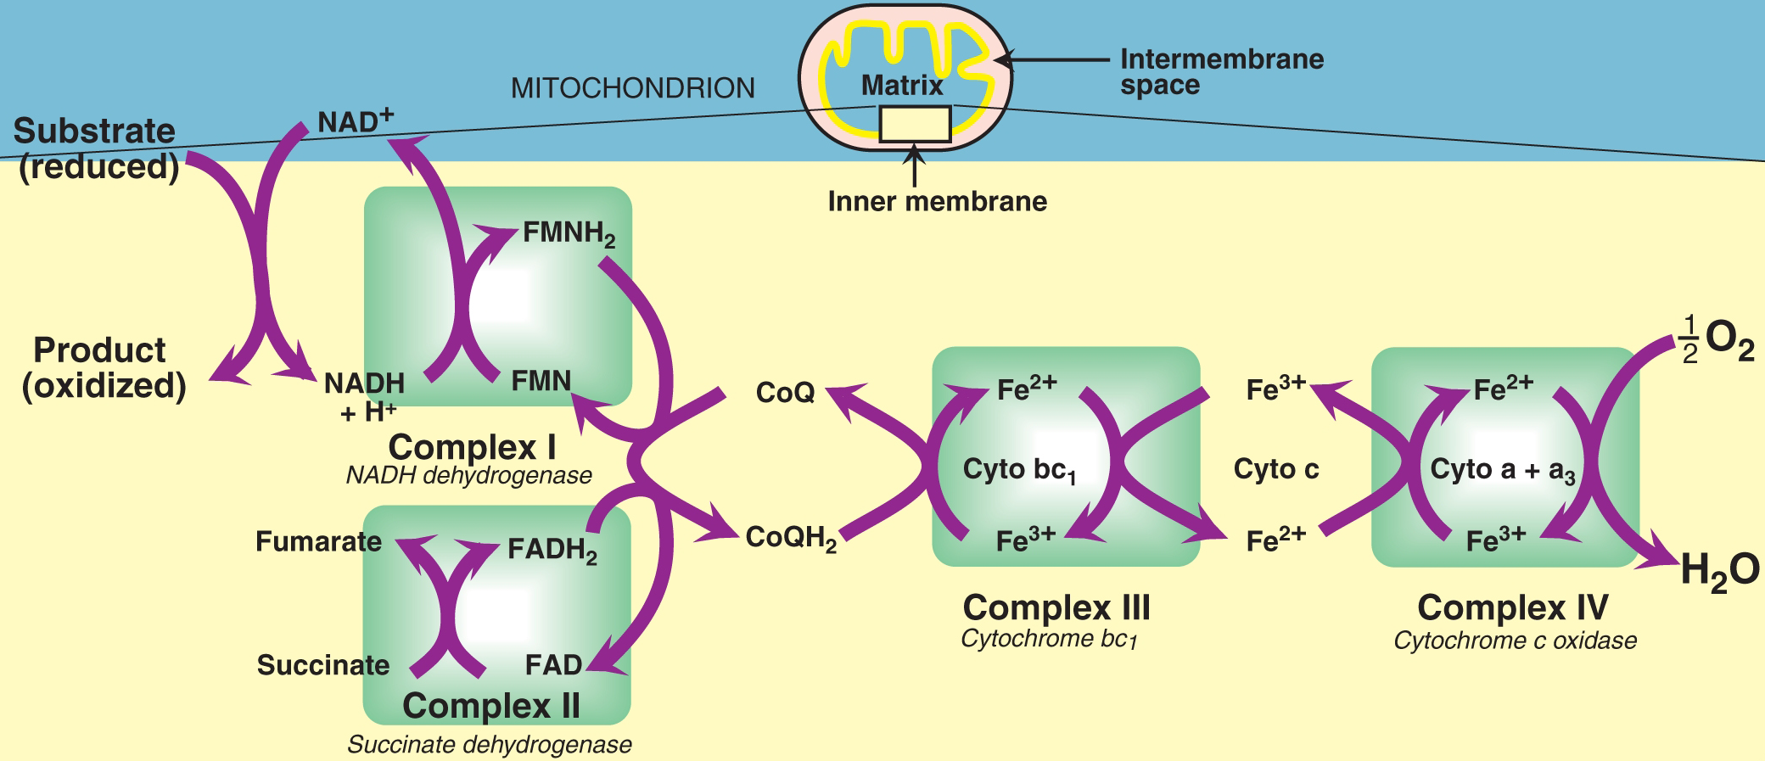
Summary

Slide 26
Oxidative phosphorylation

Slide 27
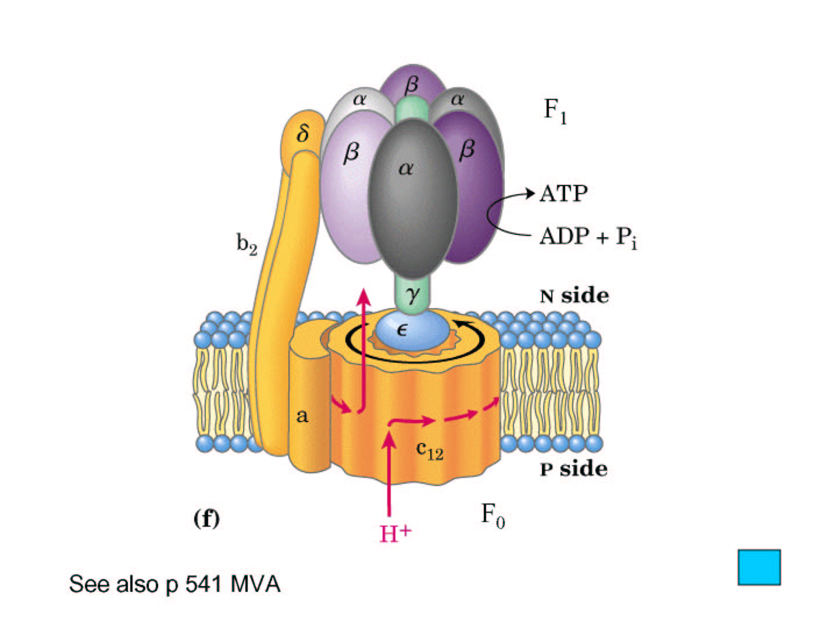
ATP synthase ( Complex V)

Slide 28
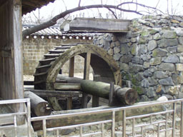
Chemiosmotic hypothesis

Slide 29
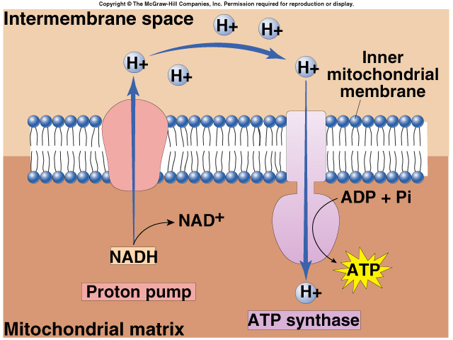
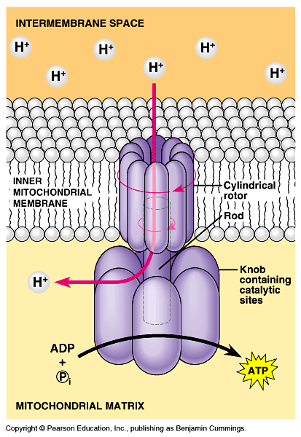
ATP synthesis
Chemiosmosis couples ETC to ATP synthesis
  build up of H+ gradient just so H+ could flow through ATP synthase enzyme to build ATP

Slide 30
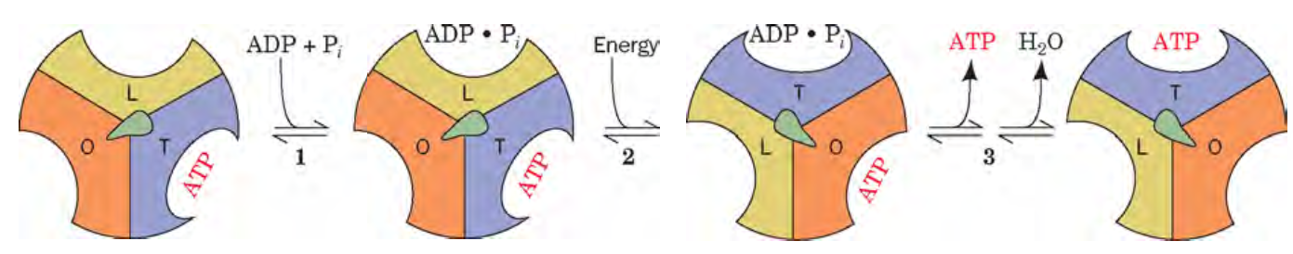
Binding change – mechanism

Slide 31
Energetics of ATP synthesis

Slide 32
ATP generation by oxidation | Traditional value | New value
NADH | 3 | 2.5
FADH₂ | 2 | 1.5
GLUCOSE | 38 | 32
Acetyl Co A | 12 | 10
Palmitate | 129 | 106

Slide 33
Regulation of ATP Synthesis
The availability of ADP regulates the process.
When ATP level is low and ADP level is high, oxidative phosphorylation proceeds at the rate. This is called respiratory control or acceptor control.
The major source of NADH and FADH2 is the citric acid cycle, the rate of which is regulated by the energy charge of the cell.

Slide 34
Most mitochondria are said to be tightly coupled.
That is , there is no electron flow without phosphorylation and no phosphorylation without electron flow.
The reduced substrates, ADP and Pi and O₂ are all necessary for oxidative phosphorylation.

Slide 35
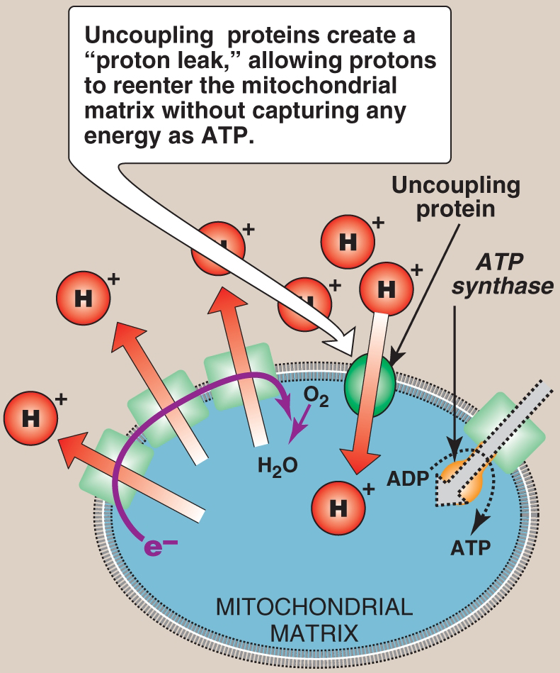
Inhibitors
Uncouplers

Slide 36
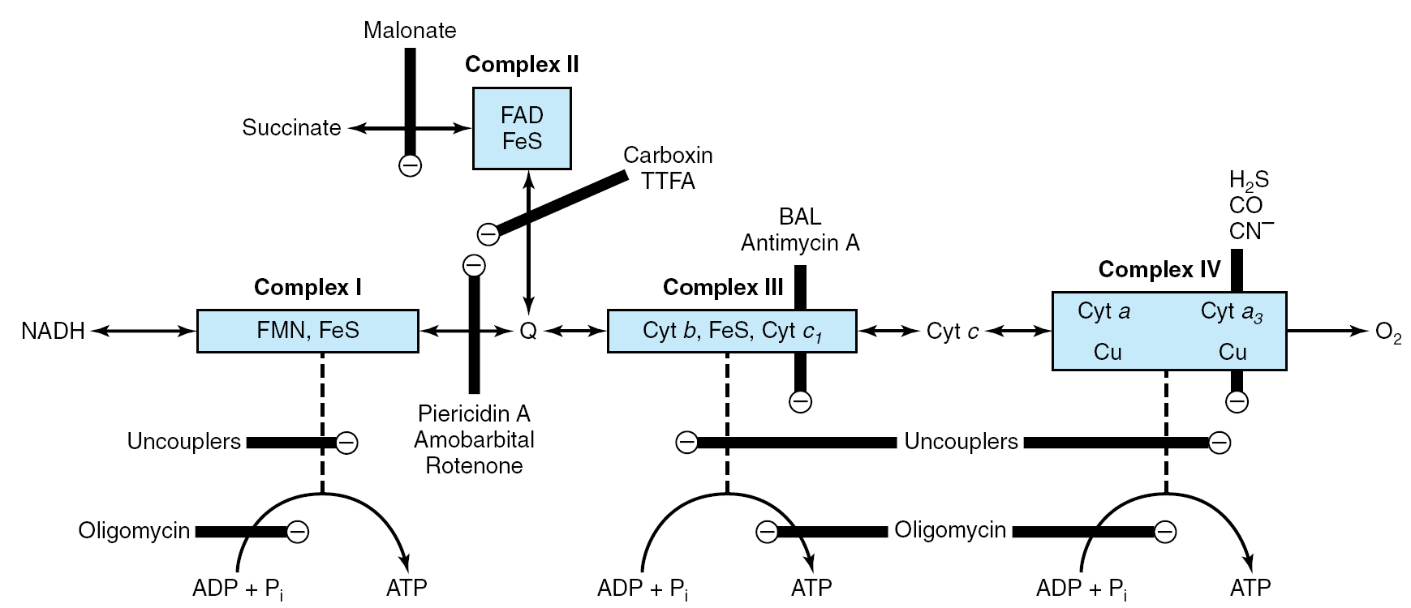

Slide 37
MCQ test (CCES)

Slide 38
………..have the highest affinity for electrons
NAD+/NADH
FAD/FADH2
O2/H2O
Q/QH2

Slide 39
2. Oxidative phosphorylation is carried out by which class of enzymes
Transferases
Isomerases
Hydrolases
Oxido-reductases

Slide 40
3. ETC complexes are located at
Mitochondrial outer membrane
Mitochondrial inner membrane
Inter membrane space
Mitochondrial matrix

Slide 41
4. The following are complexes of ETC except
Cytochrome C
NADH-CoQ reductase
Succinate-CoQ reductase
Cytochrome oxidase

Slide 42
5. All are reduced equivalent except
QH2
NADH + H⁺
FADH2
½O2

Slide 43
6. P:O ratio for NADH is………….
3
3.5
2.5
2

Slide 44
7. Chemiosmotic theory is based on……
Proton motive force
Van der Walls force
Electro-motive force
None of the above

Slide 45
8. Availability of ……………regulates ATP synthesis
GDP
CDP
ADP
ADP+Pi

Slide 46
9. Uncoupler is…………
Thermogenin
Oligomycin
Valinomycin
Atractyloside

Slide 47
10. Cyanide inhibits ………..complex of ETC
Complex I
Complex II
Complex III
Complex IV

