Slide 1
HEME:
Synthesis and Breakdown

Slide 2
Structure of Heme
Heme is a derivative of Porphyrin.
Porphyrins are cyclic compounds formed by fusion of 4 pyrrole rings linked by methenyl (=CH-) bridges.
Since an atom of iron is present, heme is a ferroprotoporphyrin.

Slide 3
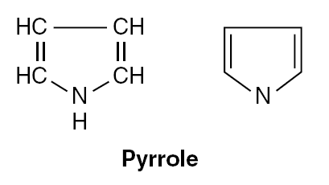

Slide 4
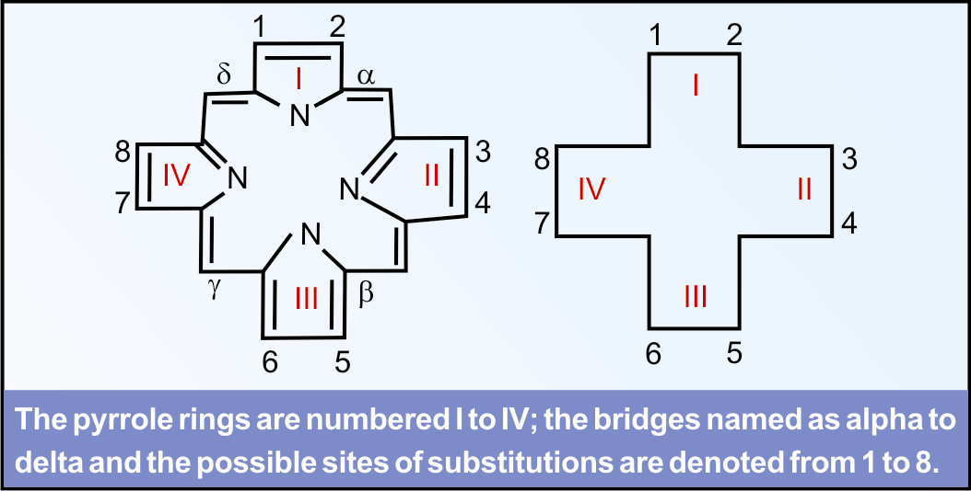

Slide 5
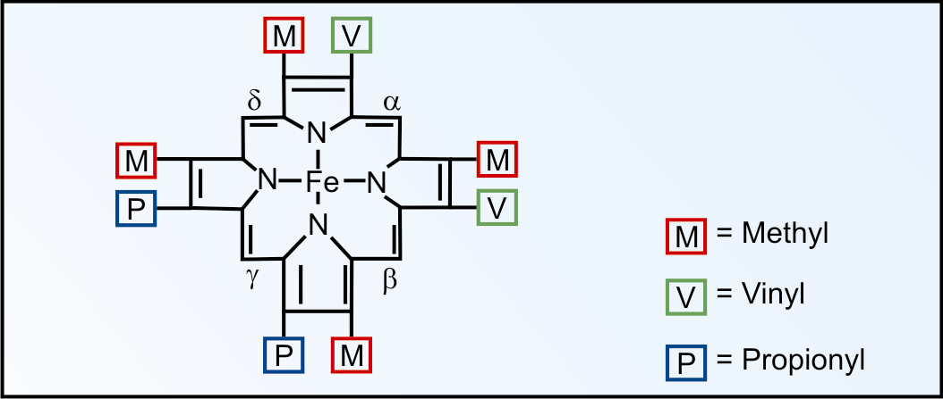

Slide 6
BIOSYNTHESIS OF HEME
Site: Erythroid precursor cells (Bone marrow) and Liver.
Heme is synthesised in the normoblasts, but not in the matured ones.
The pathway is partly cytoplasmic and partly mitochondrial.

Slide 7
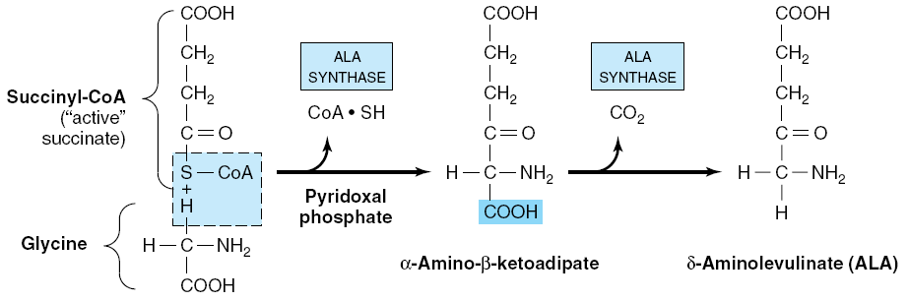
Step 1: ALA synthesis (mitochondria)
Mitochondria
Rate-limiting enzyme
Anemia may be manifested in pyridoxal deficiency.

Slide 8
ALA Synthase
Humans express two isozymes of ALA synthase.
ALAS1 is ubiquitously expressed throughout the body
ALAS2 is expressed in erythrocyte precursor cells.

Slide 9
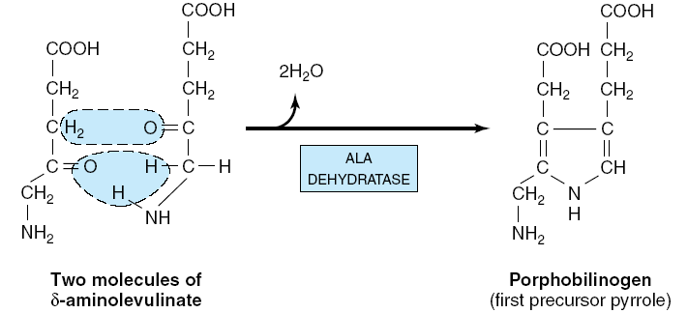
Step 2: Formation of Porphobilinogen (PBG)
(cytoplasm)
Lead Inhibits
Monopyrrole

Slide 10
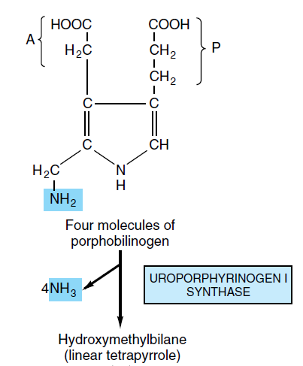
Step 3: Formation of Uroporphyrinogen (UPG)
(Cytoplasm)
PBG deaminase or HMB synthase

Slide 11
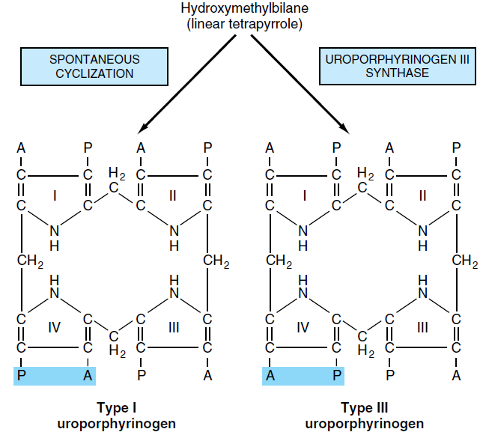
Step 3: Formation of Uroporphyrinogen (UPG)
(Cytoplasm)

Slide 12
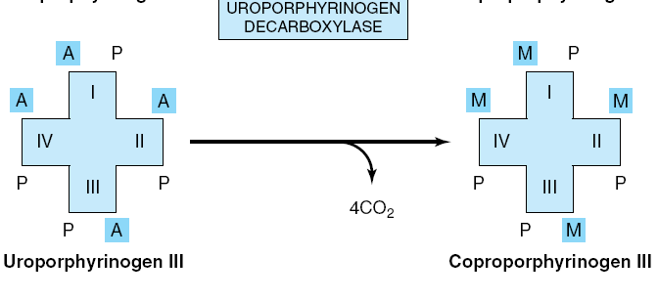
Step 4: Synthesis of Coproporphyrinogen
CPG (Cytoplasm)
Acetyl → Methyl

Slide 13
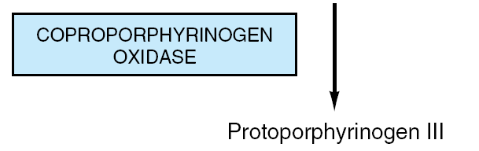
Coproporphyrinogen-III
Step 5: Synthesis of Protoporphyrinogen
PPG (mitochondria)
NADP
NADPH + H+
O2
Two propionyl side chains are oxidatively decarboxylated to vinyl group.
CO2

Slide 14
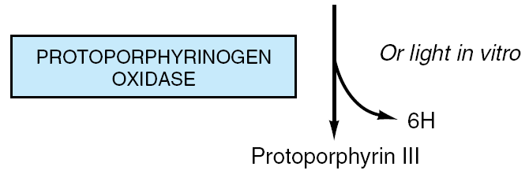
Protoporphyrinogen-III
Step 6: Generation of PP (Mitochondria)
Molecular O2
The methylene bridges (-CH2) are oxidized to methenyl bridges (-CH=) and coloured porphyrins are formed.

Slide 15
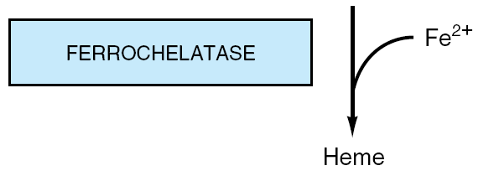
Protoporphyrin-III
Step 7: Generation of Heme (Mitochondria)

Slide 16
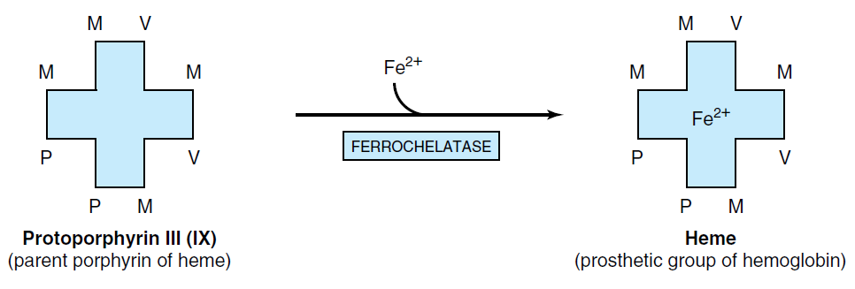

Slide 17
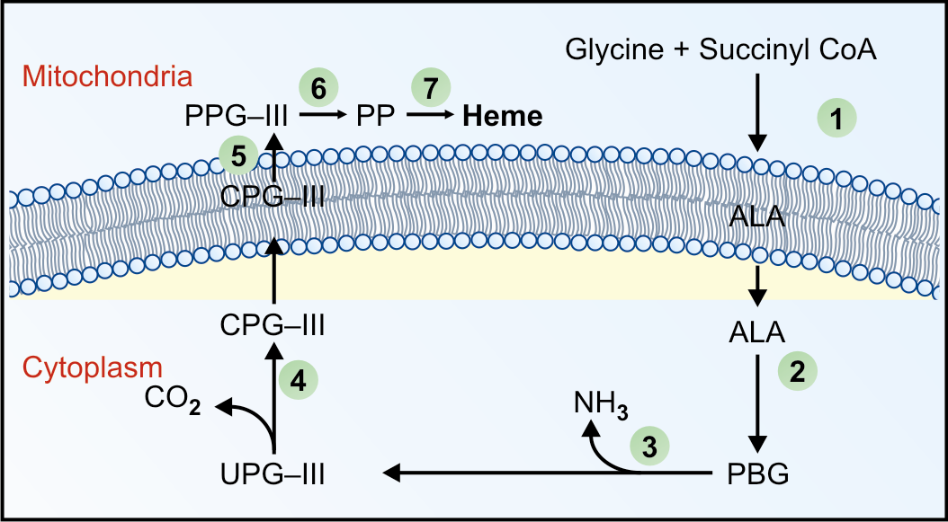

Slide 18
Regulation of Heme Synthesis

Slide 19
Porphyrinogens vs Porphyrins

Slide 20
The porphyrinogens are reduced porphyrins.
They are not coloured because their pyrrole rings are connected by methylene (–CH2) bridges, and the double bonds are not conjugated over the whole system.
The porphyrinogens are the actual intermediates in the haem biosynthetic pathway.
Porphyrinogens can be converted to the corresponding coloured porphyrins on exposure to light, when they lose hydrogen atoms.

Slide 21
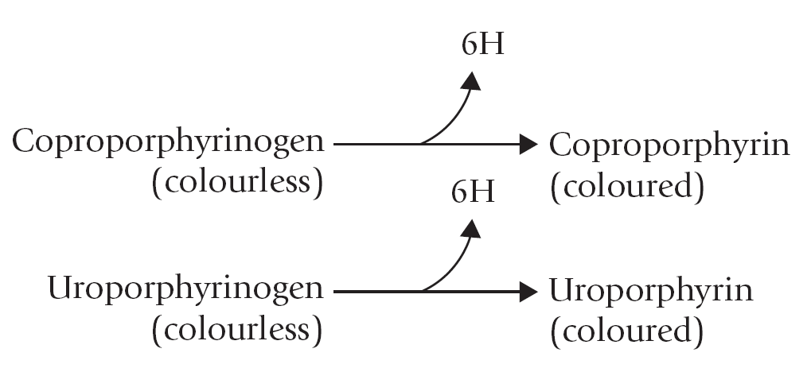

Slide 22
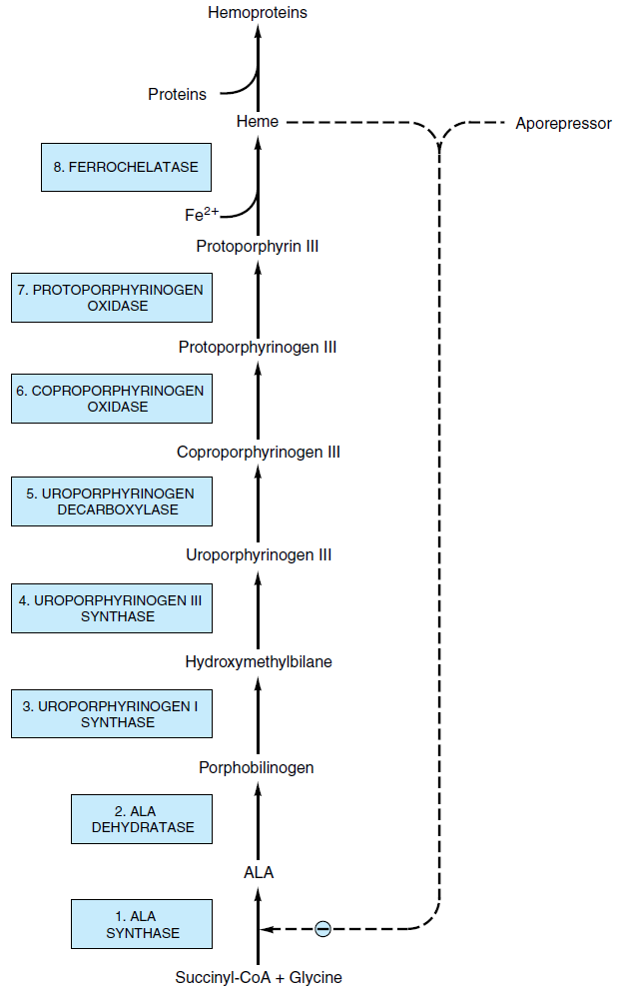
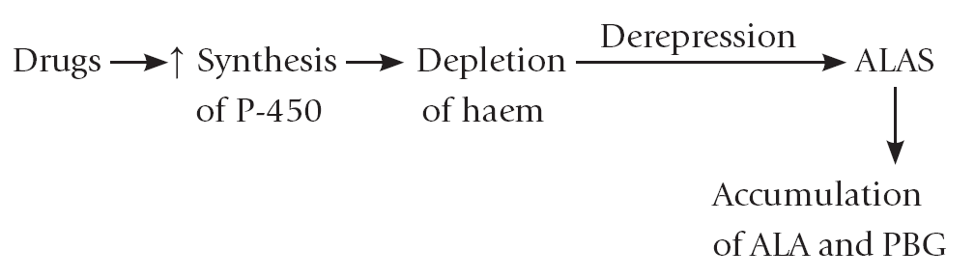
Heme inhibits the synthesis of ALA synthase by acting as a co-repressor.
ALA synthase is also allosterically inhibited by Hematin.
Compartmentalization of the enzymes
Drugs like barbiturates induce heme synthesis. Barbiturates require the heme containing cytochrome p450 for their metabolism.
Steps catalysed by ferrochelatase and ALA dehydratase are inhibited by Lead.
INH( Isonicotinic acid hydrazide)
High cellular concentration of glucose prevents induction of ALA synthase.

