Slide 1
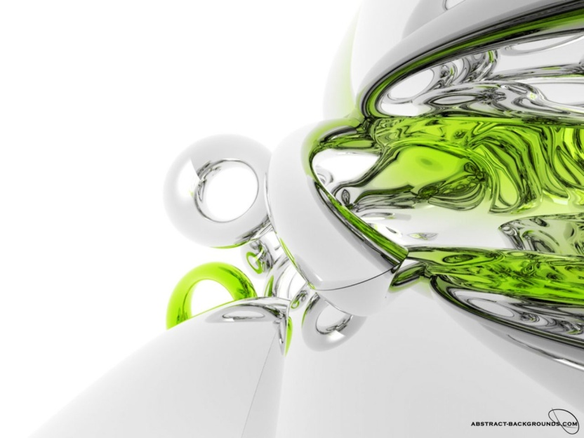
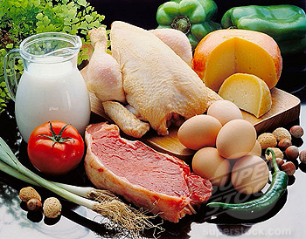
Protein Rich-Foods
Beans
Eggs
Dairy Products
Soyabean
Beef

Slide 2
CLASSIFICATION OF PROTEINS
Functional classification of proteins
Composition and solubility
Based on Nutritional Value
Based on shape

Slide 3
Classification Based on Functions
1. Catalytic proteins, e.g. enzymes
2. Structural proteins, e.g. collagen, elastin
3. Contractile proteins, e.g. myosin, actin.
4. Transport proteins, e.g. haemoglobin, myoglobin, albumin, transferrin
5. Regulatory proteins or hormones, e.g. ACTH, insulin, growth hormone
6. Genetic proteins, e.g. histones
7. Protective proteins, e.g. immunoglobulins, interferons, clotting factors.

Slide 4
2.2.2 Classification based on Composition and Solubility
Simple
Conjugated
Derived
Globular
Scleroproteins
Nucleoproteins
Primary
Secondary
Glycoproteins
Coagulated
Proteoses
Albumins
Collagen
Globulins
Lipoproteins
Peptones
Proteans
Elastins
Glutelins
Phosphoproteins
Metaproteins
Poly-
peptides
Keratins
Prolamines
Chromoproteins
Histones
Peptides
Metalloproteins
Globines
Protamines

Slide 5
Classification Based on Shape
Globular Proteins
They are spherical or oval in shape.
They are easily soluble,
e.g. albumins, globulins and protamines

Slide 6
Fibrous Proteins
The molecules are elongated or needle shaped.
Their solubility is minimum.
They resist digestion.
Collagen, elastin and keratins are examples.

Slide 7
Classification Based on Nutritional Value
1.Nutritionally Rich Proteins.
They are also called as complete proteins or first class proteins.
They contain all the essential amino acids in the required proportion.
On supplying these proteins in the diet, children will grow satisfactorily.
A good example is casein of milk.

Slide 8
2.Incomplete Proteins
They lack one essential amino acid.
They cannot promote body growth in children; but may be able to sustain the body weight in adults.
Proteins from pulses are deficient in methionine, while proteins of cereals lack in lysine.
If both of them are combined in the diet, adequate growth may be obtained.

Slide 9
3.Poor Proteins
They lack in many essential amino acids and a diet based on these proteins will not even sustain the original body weight.
Zein from corn lacks tryptophan and lysine.

Slide 10
PHYSICAL PROPERTIES OF PROTEINS
1.Colour and Taste
Proteins are colourless and usually tasteless. These are homogeneous and crystalline in nature.

Slide 11
2.Molecular weights of some of the proteins are:
Insulin (5,700);
Hemoglobin (68,000);
Albumin (69,000); Immunoglobulins (1,50,000);
Rabbit Papilloma Virus Protein (4,70,00,000).

Slide 12
3.Shape of the proteins also vary.
Thus, Insulin is globular,
Albumin is oval in shape, while
Fibrinogen molecule is elongated. Bigger and elongated molecules will increase the viscosity of the solution.

Slide 13
4. Solubility
Proteins are soluble in water, form colloidal due to their high molecular weight.
Protein solutions exhibit colloidal properties and therefore scatter light and exert osmotic pressure. Osmotic pressure of plasma proteins is clinically important.

Slide 14
5.PRECIPITATION REACTIONS OF PROTEINS
Any factor, which neutralizes the charge or removes water of hydration will therefore cause precipitation of proteins. The following procedures are used for protein precipitation:

Slide 15
Salting Out
When a neutral salt, such as ammonium sulphate or sodium sulphate is added to protein solution, the shell of hydration is removed and the protein is precipitated.
This is called salting out. As a general rule, higher the molecular weight of a protein, the salt required for precipitation is lesser.
Thus globulins are precipitated at half saturation
of ammonium sulphate; but albumin will need full saturation of ammonium sulphate.

Slide 16
Different Method
Isoelectric Precipitation
Precipitation by Organic Solvents
Precipitation by Heavy Metal Ions
Precipitation by Alkaloidal Reagents

Slide 17
Precipitation by Heavy Metal Ions
Heavy metals like cu,zn, cd, mercury are toxic, because they tend to precipitate normal proteins of GIT wall.
Metal ions + Proteins = Metal proteinates.
Clinical application
Raw egg is given orally as an antidote in mercury poisoning. Albumin of egg precipitate the mercury salt to form mercury proteinates there by delay and prevent the absorption of mercury

Slide 18
Precipitation by Organic Solvents
Clinical aspect
Use of surgical spirit during surgery and during blood collection act as a disinfectant based on property of precipitating proteins

Slide 19
Precipitation by Alkaloidal Reagents
Eg tungstic acid ,phsphotungstic acid ,picric acid ,sulphosalicylic acid ,Tannic acid
Uses:
Estimation of proteins
Leather processing from animal skin

Slide 20
6.Denaturation of proteins
There will be nonspecific alterations in secondary, tertiary and quaternary structures of protein molecules. Primary structure is not altered during denaturation.
2.Mild heating, treating with urea, salicylate, X-ray, ultraviolet rays, high pressure, vigorous shaking and such other physicochemical agents produce denaturation.

Slide 21
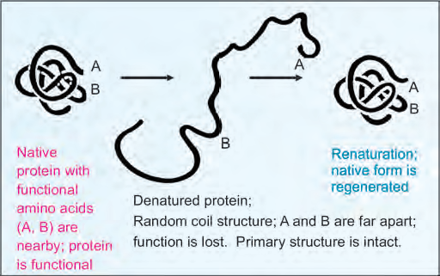
Denaturation of proteins

Slide 22
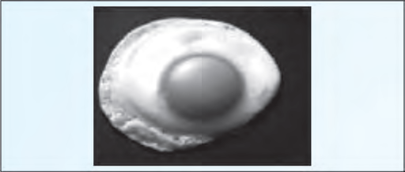
Heat Coagulation

Slide 23
QUESTIONS ????
1) Example of Transport Protein
A) Albumin B) Keratin C) Casein D) all
2) Which protein is present in arteries and tendons
A) Collagen B) elastin C) keratin D) all
3)Example of Nutritionally rich protein
A) Collagen B) Casein C) both D) none
4)All the bonds are non-covalent, except
a) hydrogen b) electrostatic c) hydrophobic d) disulphide
Hemoglobin is ______ proteins
A) conjugated B) simple C) derived D) none

Slide 24
Structural organisation of Proteins

Slide 25
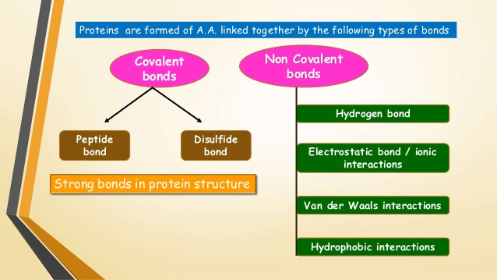

Slide 26
Primary structure
Denotes the number and sequence of amino acids in the protein.
The higher levels of organization are decided by the primary structure.
Each polypeptide chain has a unique amino acid sequence decided by the genes.
The primary structure is maintained by the covalent bonds of the peptide linkages.

Slide 27
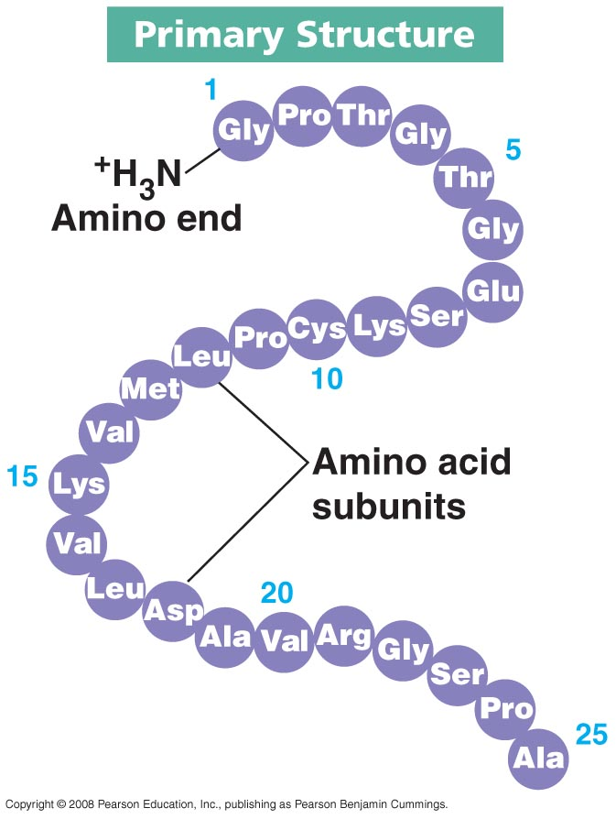
“sequence”. See the following example:
Gly - Ala - Val (1)
Gly - Val - Ala (2)

Slide 28
Characteristics of a Peptide Bond
The peptide bond is a partial double bond.
The distance is 1.32Å which is midway between single bond (1.49Å) and double bond (1.27Å).
The side chains are free to rotate on either side of the peptide bond.

Slide 29
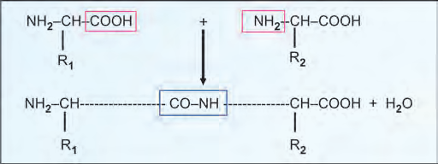
In a polypeptide chain, at one end there will be one free alpha amino group. This end is called the amino terminal (N-terminal) end
The other end of the polypeptide chain is the carboxy terminal end (C-terminal)

Slide 30
Usually the N-terminal amino acid is written on the left hand side when the sequence of the protein is denoted.
Incidentally, the biosynthesis of the protein also starts from the amino terminal end.

Slide 31
The other end of the polypeptide chain is the carboxy terminal end (C-terminal), where there is a free alpha carboxyl group which is contributed by the last amino acid

Slide 32
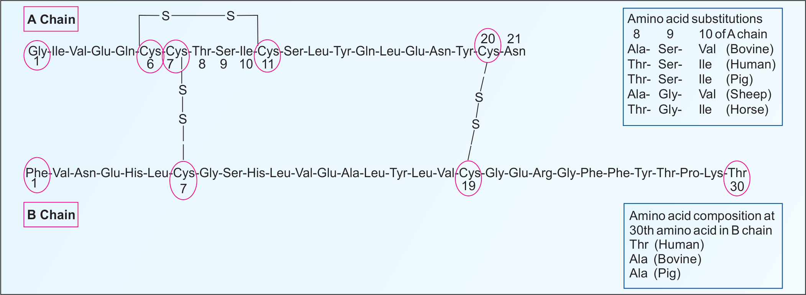
Insulin

Slide 33
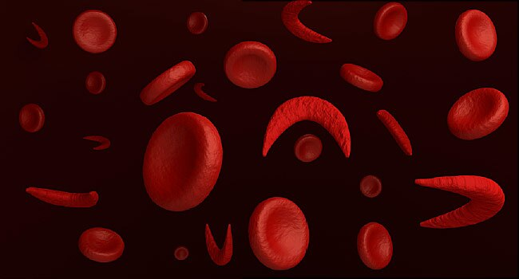
IMPORTANCE OF PRIMARY STRUCTURE
Many genetic diseases result from abnormal amino acid sequences.
E.g sickle cell anemia
To understand the molecular mechanism of action of proteins.

Slide 34
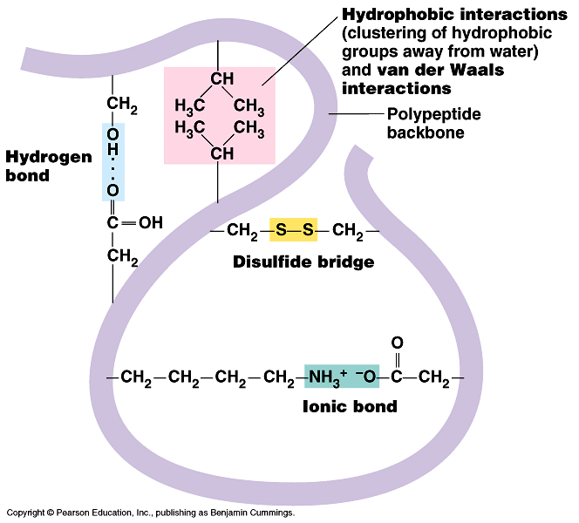

Slide 35
Secondary Structure:
When linear polypeptide chain is fold and two amino acid is joined by hydrogen bond is called as secondary structure
Secondary and tertiary levels of protein structure are preserved by non covalent forces or bonds like hydrogen bonds, electrostatic bonds, hydrophobic interactions and van der Waals forces.

Slide 36
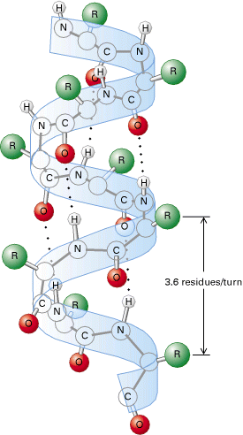

Slide 37
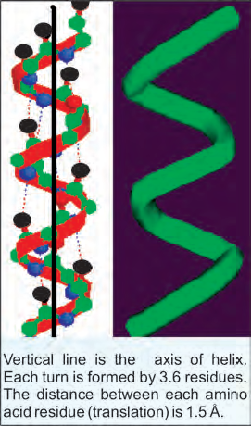
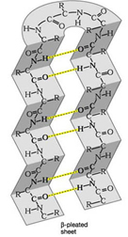
1. Alpha Helix
2. Beta Pleated Sheet

Slide 38
The alpha helix is the most common and stable conformation for a polypeptide chain.
In proteins like haemoglobin and myoglobin, the alpha helix is abundant, whereas it is virtually absent in chymotrypsin.
The alpha helix is a spiral structure
The polypeptide bonds form the back-bone and the side chains of amino acids extend outward.

Slide 39
The structure is stabilized by hydrogen bonds between NH and C=O groups of the main chain.
Each turn is formed by 3.6 residues.
The distance between each amino acid residue (translation) is 1.5 Å.
The alpha helix is generally right handed.

Slide 41
Beta-Pleated Sheet
The polypeptide chains in beta-pleated sheet is almost fully extended.
The distance between adjacent amino acids is 3.5Å.
They are stabilized by H bond b/w N-H and carbonyl groups of adjacent chains

Slide 43
Clinical Part
Prions Diseases
Defect: The basic defect involves alteration of α-helical structure into β-pleated sheet.
Fatal neurodegenerative diseases in animals and humans

Slide 44
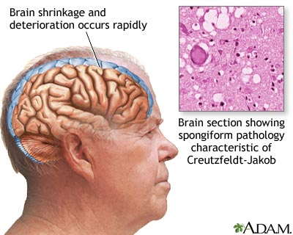
Creutzfeldt–Jakob disease (CJD)

Slide 45
A prion disease is a type of disease of structurally abnormal folding of proteins.
Creutzfeldt–Jakob disease (CJD)
fatal familial insomnia (FFI)
They characterize several fatal and transmissible neurodegenerative diseases in humans and many other animals.

Slide 46
TERTIARY STRUCTURE
The three dimensional structure of a protein.
The tertiary structure defines the steric relationship of amino acids which are far apart from each other in the linear sequence, but are close in the three dimensional aspect.

Slide 47
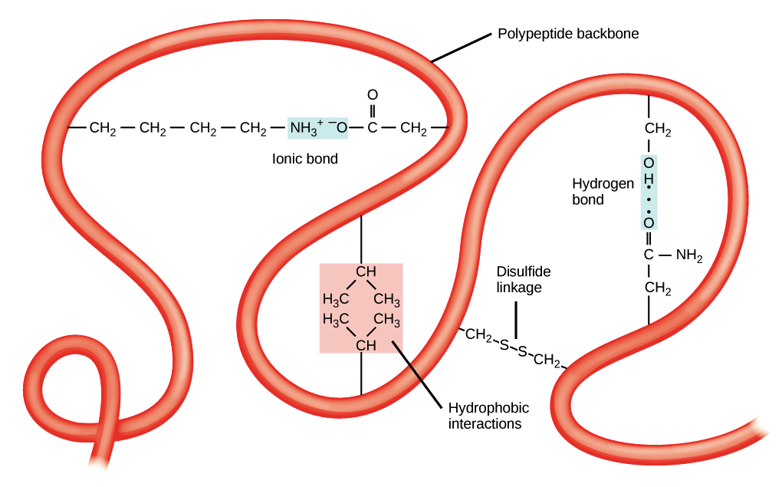

Slide 48
The tertiary structure is maintained by noncovalent interactions such as
hydrophobic bonds,
electrostatic bonds
van der Waals forces.

Slide 49
QUATERNARY STRUCTURE
When one or more polypeptides will aggregate and form one functional protein referred to as the quaternary structure.
The forces that keep the quaternary structure are hydrogen bonds, electrostatic bonds, hydrophobic bonds and van der Waals forces.

Slide 50
Depending on the number of polypeptide chain, the protein may be termed as monomer (1 chain), dimer(2 chains), tetramer (4 chains ) and so on. Each polypep- tide chain is termed as subunit or monomer.
For example, 2 alpha-chains and 2 beta-chains form the hemoglobin molecule

Slide 51
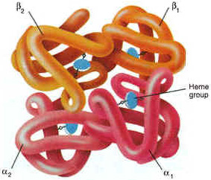
E.g 2 alpha-chains and 2 beta-chains form the haemoglobin molecule.

Slide 52
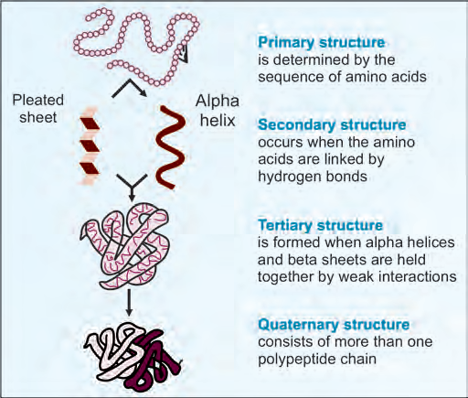

Slide 53


Slide 54
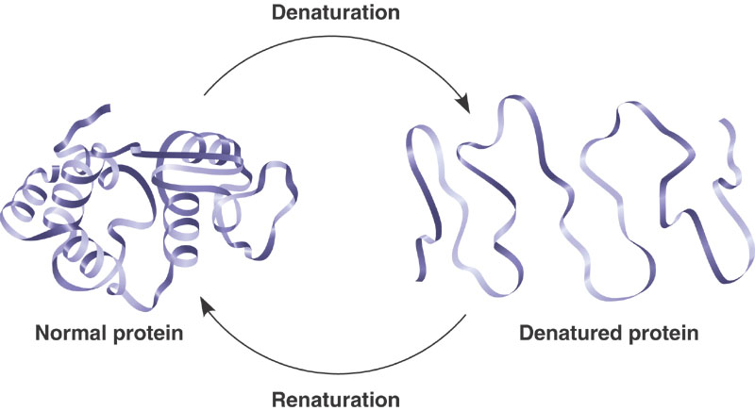
Protein denaturation

Slide 55
RECENT DEVELOPMENTS
A team of scientists at The Scripps Research Institute and the National Institutes of Health (NIH) has discovered the structure of a protein – dynamin, that pinches off tiny pouches from cell’s outer membranes.
Scientists at the Institute of Structural and Molecular Biology have revealed the structure of a complex protein called FimD that acts as an assembly platform for the pili of cystitis bacteria.
Researchers from the Walter and Eliza Hall Institute have found a structural surprise in a type of protein, Bcl-w ,that encourages cell survival, raising interesting questions about how the proteins function to influence programmed cell death.

Slide 56
QUESTIONS ????
1. Example of Quaternary Structure
a) Albumin b) Globulin c) Hemoglobin d) none
2. Alpha helices found in proteins are mostly___ handed
a) Right b) left c) both d) none
3. Peptide bond is _____ character
a) single b) double c) triple d) partial
4. All the bonds are non-covalent, except
a) hydrogen b) electrostatic c) hydrophobic d) disulphide
5)Distance between each amino acid in alpha helix
A) 2.5 A B) 1.5 A C) both D) none

Slide 57


Slide 58
THANK YOU: REFERENCES

