Slide 1
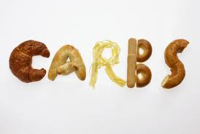
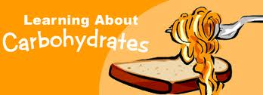
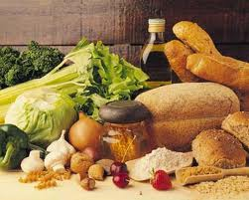
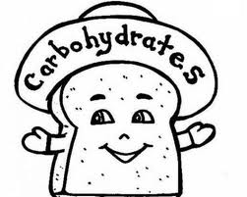

Slide 2
CARBOHYDRATE CHEMISTRY
Definition, classification, biological importance.
Monosaccharides- structure, classification & properties.
Disaccharides,
Polysaccharides- homo & heteropolysaccharides, their structure & function.

Slide 3
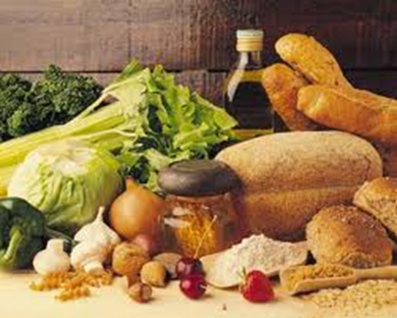
Biomedical importance
Diseases associated with carbohydrates:-
  diabetes mellitus
  Galactosemia
  glycogen storage diseases
  lactose intolerance.

Slide 4


Slide 5
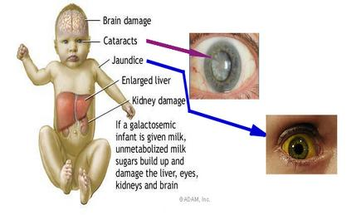
Galactosemia

Slide 6
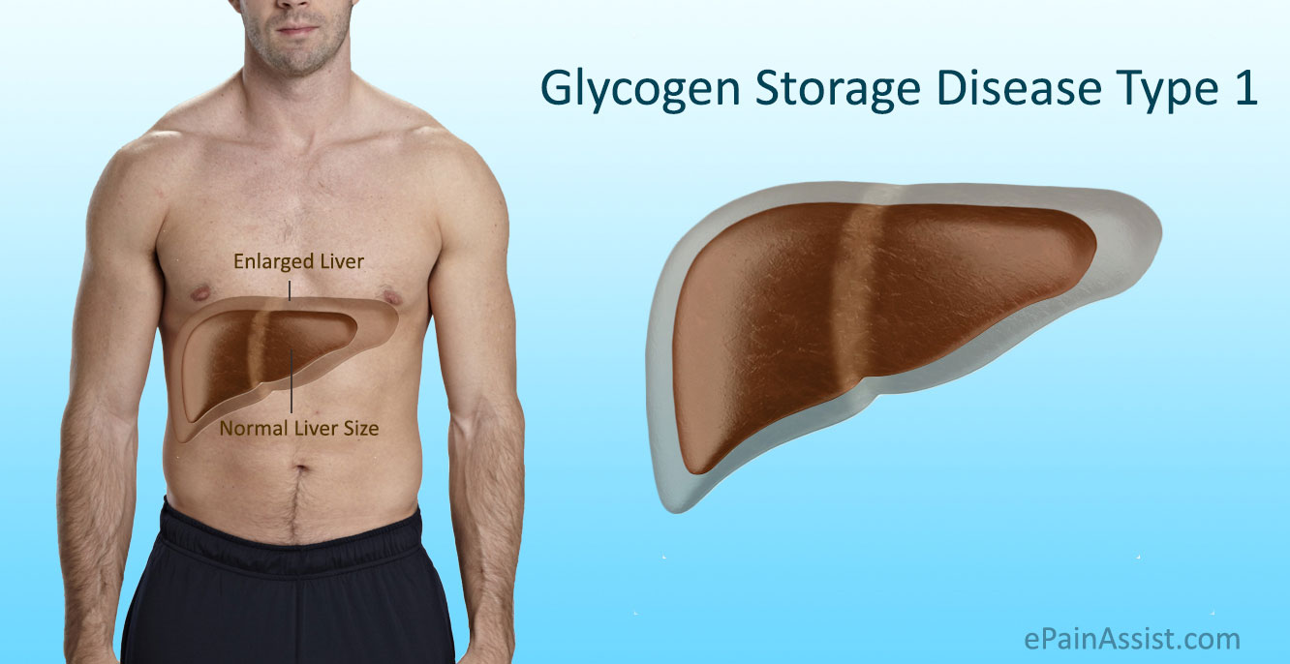

Slide 7
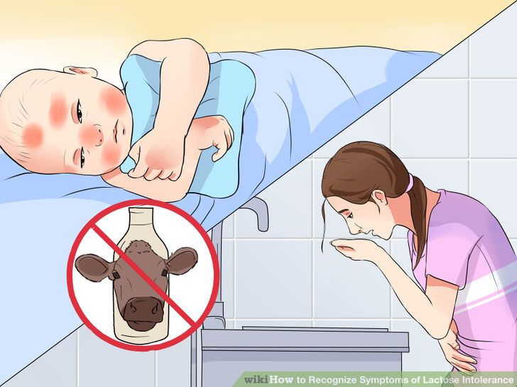
Lactose Intolerance

Slide 8
What is Carbohydrates???
It is a Polyhydroxy aldose and Ketose and their derivative

Slide 9
Biomedical importance
Glucose is the major fuel for the tissues.
Glycogen for storage;
Ribose in nucleic acid
Galactose in lactose of milk;
in certain complex lipids & in combination with protein in glycoproteins & proteoglycans.
Non digestible carbohydrates serve as dietary fibres like cellollose

Slide 10
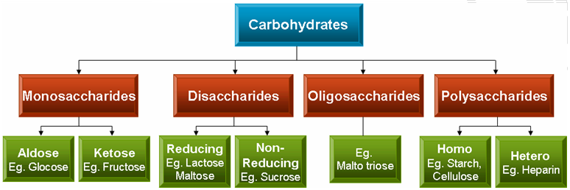
CLASSIFICATION

Slide 11
Monosaccharides
Contains only one sugar group (mono-one, saccharin-sugar).
Cannot be hydrolyzed to simpler form.
Depending on the no. of C-atoms, may be triose, tetrose, pentose etc.
Depending on whether aldehyde or ketone group is present, may be ALDOSE Or KETOSE.

Slide 12
COMMON MONOSACCHARIDES
No. Of Carbon atoms | Generic name | ALDOSES | KETOSES
3 | TRIOSE | GLYCERALDEHYDE | DIHYDROXY ACETONE PHOSPHATE
4 | TETROSE | ERYTHROSE | ERYTHRULOSE
5 | PENTOSE | RIBOSE | RIBULOSE
6 | HEXOSE | GLUCOSE | FRUCTOSE
7 | HEPTOSE | GLUCOHEPTOSE | SEDOHEPTULOSE

Slide 13
Disaccharides
Formed when two monosaccharides combine together by a glycosidic linkage with the elimination of molecule of water.
i.e., DISACCHARIDES , ON HYDROLYSIS YIELD TWO MOLECULES OF MONOSACCHARIDES.

Slide 14
Examples of Disaccharides:-
ON HYDROLYSIS
LACTOSE:- Glucose +Galctose
MALTOSE :- yields two molecules of glucose.
SUCROSE:- Fructose +Glucose

Slide 15
polysaccharides
Yield more than 10 molecules of monosaccharides on hydrolysis(poly-many).
Homopolysaccharides yield only one type of monosaccharide units.
Heteropolysaccharides yield more than one type of monosaccharides on hydrolysis.

Slide 16
Homopolysaccharides
Eg
Starch
Cellulose
Glycogen

Slide 17
Hetropolysaccharides
E.g.
Hyluronic acid
Dermatan sulpate
Keratan sulphate
Chodrotin sulphate

Slide 18


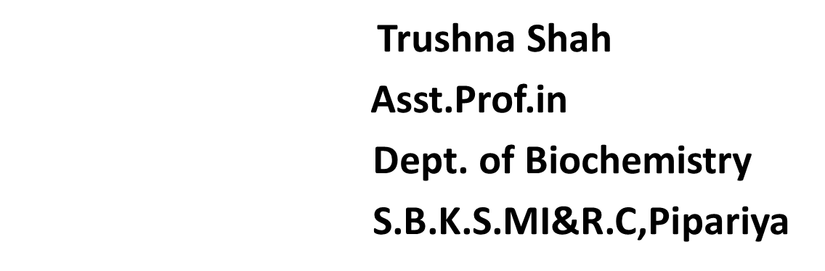
MCQ

Slide 19

1Example of monosaccharide
Maltose
Lactose
Glucose
Starch

Slide 20
2. Example of Disaccharide
Sucrose
Glycogen
Glucose
Starch

Slide 21
3. Example of Polysaccharide
Maltose
Lactose
Glucose
Starch

Slide 22
4 Example of Triose
Ribose
Erythrose
Glucose
None of above

Slide 23
5. Example of Homopolysaccharide
Maltose
Lactose
Glucose
Starch

Slide 24
PROPERTIES OF MONOSACCHARIDES
Stereo-isomerism
D-L ISOMERISM
PYRANOSE-FURANOSE ISOMERISM
ANOMERS
EPIMERS
OPTICAL – ISOMERISM
MUTAROTATION

Slide 25
01 stereo-isomerism
Stereo-isomers have same structural formula but different spatial configuration.
Mirror images of each other.
No. of possible isomers of a compound is 2n where ‘n’ is the no. of asymmetric carbon atoms.

Slide 26
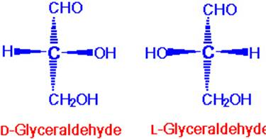

Slide 27
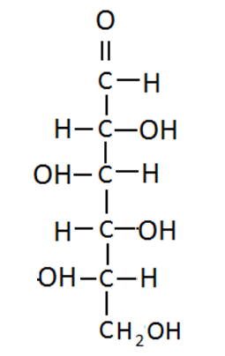
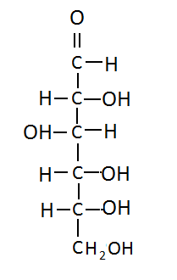
02 D-L ISOMERISM
BASED ON POSITION OF –OH ON REFERENCE CARBON : PENULTIMATE CARBON
If –OH group on right side is called D and if it is left is called L isomer
C-5 IN HEXOSES, c-4 in pentose, ….

Slide 28
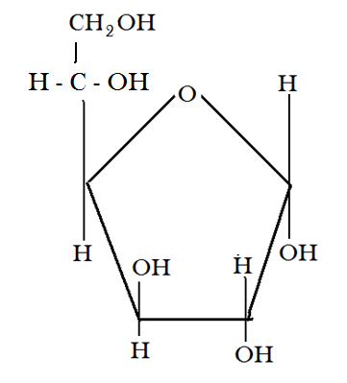
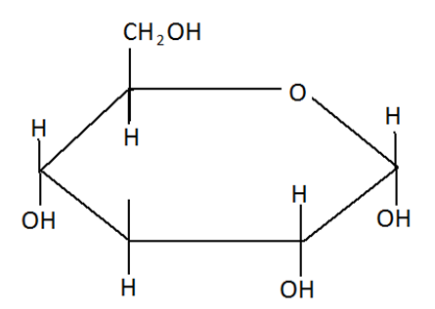
03 PYRANOSE-FURANOSE ISOMERISM

Slide 29
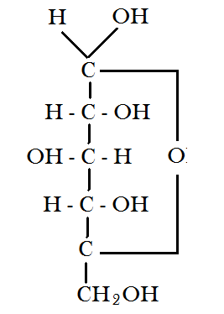
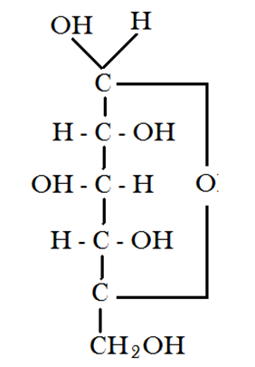
04 - ANOMERS
POSITION OF -OH GROUP ON ANOMERIC CARBON IN RELATION TO PRIMARY ALCOHOL GROUP

Slide 30
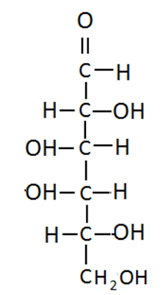
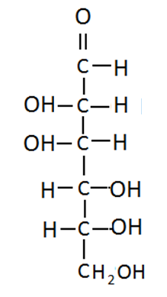
05 - EPIMERS
DIFFERS IN POSITION OF -OH GROUP AROUND A SINGLE CARBON ATOM OTHER THAN PENULTIMATE CARBON
GLU & GAL ARE C-4 EPIMERS WHILE GLU & MANNOSE ARE C2 EPIMERS
GALACTOSE
GLUCOSE
MANNOSE

Slide 31
06 - OPTICAL - ISOMERISM
BASED ON ROTATION OF PLANE POLARISED LIGHT WHEN IT PASSES THROUGH A SOLUTION OF A CARBOHYDRATE.
CALLED ‘d’ OR (+) WHEN plane of light TURNS RIGHT or clockwise (dextrorotatory)
CALLED ‘l’ OR (-) WHEN plane of light TURNS LEFT or counter-clockwise (levorotatory)

Slide 32
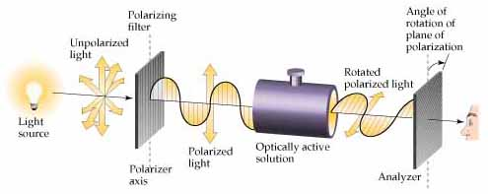

Slide 33
07- MUTAROTATION
ROTATION OF α- ANOMER +112.2° & OF β-ANOMER 18.7°
IN SOLUTION, INTERCONVERSION OF α & β-ANOMERS OCCURS.
AT EQUILIBRIUM, OPTICAL ROTATION STABILISES AT 52.7 °.
AT EQUILIBRIUM 63 % ARE β-ANOMERS, 36% ARE α- ANOMERS WHILE 1% ARE IN STRAIGHT CHAIN.

Slide 34
DISACCHARIDES :
Reducing
Maltose- Glu+Glu
Lactose- Glu+Gal
Non-Reducing
Sucrose Glu+Fruc

Slide 35
1. Maltose:-
  It is known as malt sugar.
  Sources: Germinating grains, sweet potatoes, and various fruits -- including kiwis, dates, cherries contain maltose. Malt, an ingredient in beer, contains maltose.
Chemistry:
Contains 2 glucose molecules linked by α-1,4 glycosidic bond.
A reducing disaccharide.

Slide 36
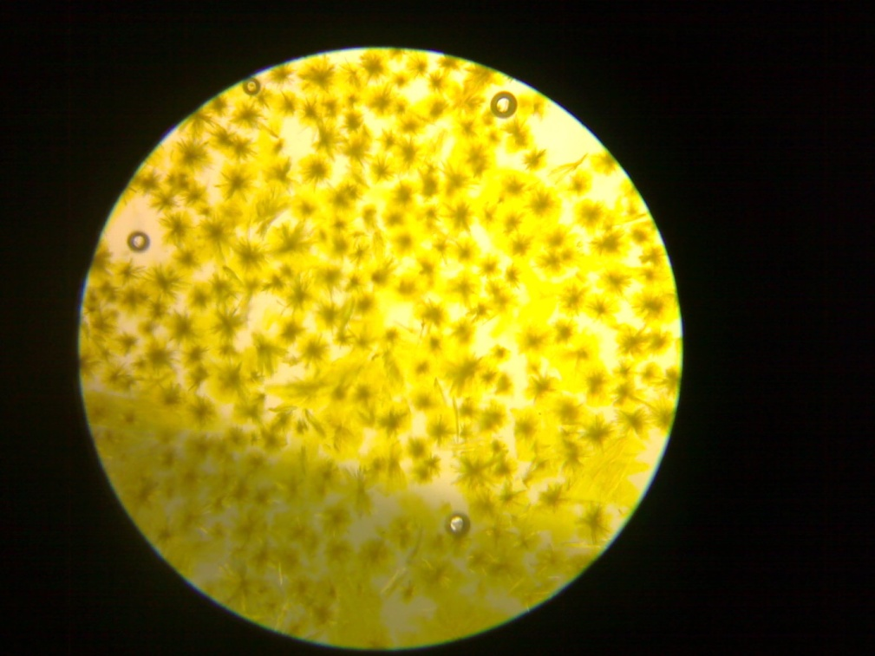
Identification by Osazone Test
It forms characteristics ‘petals of sunflower shaped crystals’.

Slide 37
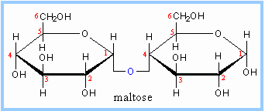
Linkage

Slide 38
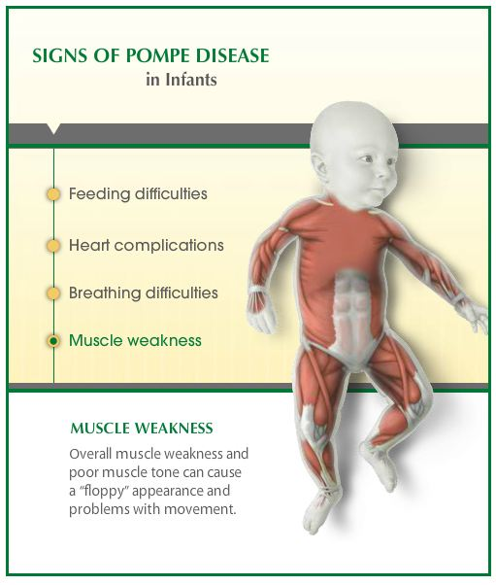
Pompe’s Diseases

Slide 39
Lactose:- (Milk Sugar)
Sources:
Milk and Milk products
Chemistry:
major carbohydrate found in milk.
Contains one molecule of β-D galactose & one molecule of β-D glucose linked by β-1,4 glycosidic linkage.

Slide 40
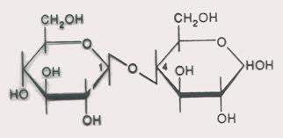
Linkage.

Slide 41
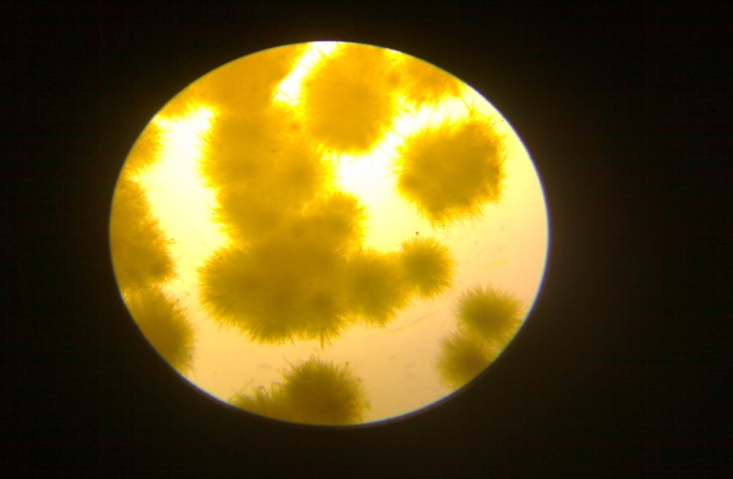
Identification
By OSAZONE
Powder puff
Flower of ‘
touch me not plant like’

Slide 42


Slide 43
Case study
Jason, a seventeen year-old high school student, had been experiencing occasional discomfort like bloating, abdominal pain and diarrheoa after taking milk and milk products.
1. What is the diagnosis?
2. Which enzyme is deficient?

Slide 44
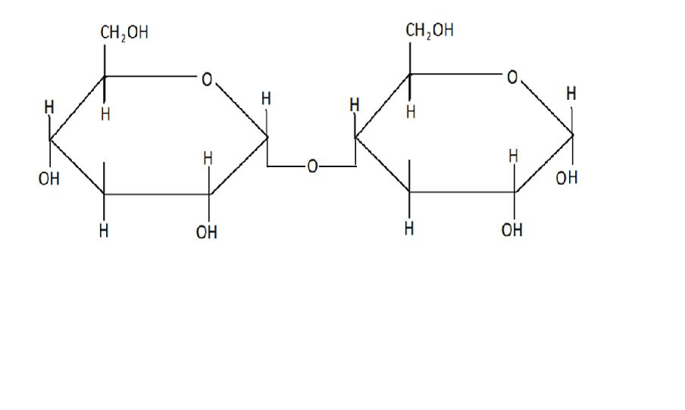
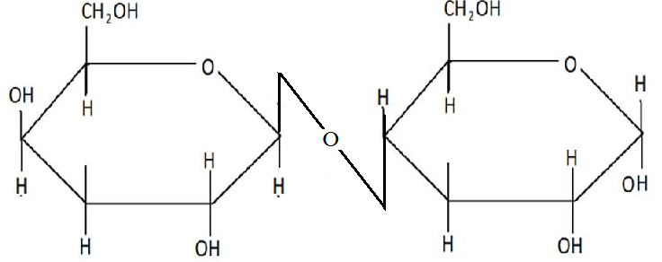
STRUCTURE OF MALTOSE
oh
STRUCTURE OF LACTOSE

Slide 45
SUCROSE(COMMON TABLE SUGAR):-
Sources:
Widely present in plants, Sugar cane ,sugar beet.
Chemistry :
Disaccharide of glucose & fructose.
α- 1,2 glycosidic bond.
Non –reducing sugar due to absence of free anomeric carbon atom which are involved in the glycosidic bond.
Hydrolysed by enzyme sucrase(invertase).

Slide 46
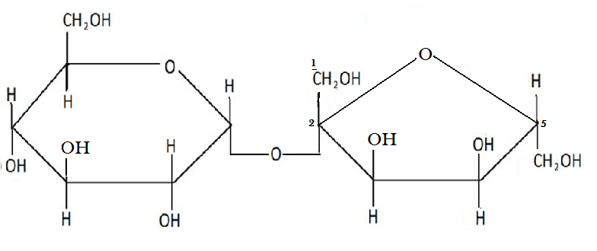
STRUCTURE OF SUCROSE

Slide 47
CLINICALLY IMPORTANT CARBOHYDRATES
NAME OF CARBOHYDRATE | ASSOCIATED DISORDER
D-Glucose | Diabetes mellitus
D-Fructose | Hereditary Fructose Intolerance
D-Galactose | Galactosemia & Cataract
D-Lactose | Lactose Intolerance
L-Xylulose | Essential Pentosuria
Sucrose | Sucrase deficiency
Glycogen | Glycogen Storage Disorder

Slide 48
MCQ

Slide 49
1Example of epimer
Maltose
Galactose
Glucose
Starch

Slide 50
2. Example of Anomers
α Anomer
γ Anomer
δ Anomer
ε Anomer

Slide 51
3. Galactose is the epimer of glucose
2 nd epimer
4 th epimer
3 epimer
5 epimer

Slide 52
4 Shape of maltose osazone
Flower of touch me not plant like
Petals of sunflower
Needles shape
Broom shaped

Slide 53
5. Linkage present in maltose
α-1,6 glycosidic bond.
β-1,4 glycosidic bond.
β-1,6 glycosidic bond
α-1,4 glycosidic bond.

Slide 54



Slide 55
Polysaccharides
Homopolysaccharides (Homoglycans):-
Starch
Glycogen
Cellulose
Inulin
Dextran

Slide 56
STARCH:-
Sources: Potatoes, Rice, Major plant polysaccharide.
It is a Homopolysaccharide composed of Glucose units linked by α-1-4 glycosidic bonds.
Two types of structural components- Amylose(10-20%):- unbranched, water-soluble, α-1,4 linkages.
Amylopectin(80-90%):- highly branched, water-insoluble, α-1,6 linkages at the branch points.
STARCH FORMS BLUE COLOURED COMPLEX WITH IODINE WHICH DISAPPEARS ON HEATING & REAPPEARS ON COOLING

Slide 57
Hydrolysis of Starch By Amylase
Iodine Non-Reducing
Purple
Red
No colour
No colour
Starch
Amylo dextrin
Erythro -dextrin
Achro-Dextrin
Maltose
Glucose

Slide 58

Types OF Amylase
Amyalse
α-Amyalse
$β$ amylase

Slide 59
GLYCOGEN
Excess carbohydrate is converted in to the glycogen and stored in the liver.
MAJOR ANIMAL POLYSACCHARIDE
HOMOPOLYSACCHARIDE COMPOSED OF GLUCOSE UNITS LINKED BY α-1,4 LINKAGE
α-1,6 LINKAGES AT THE BRANCH POINTS
STORED IN MUSCLES & LIVER
5% OF THE LIVER WEIGHT IS DUE TO ITS GLYCOGEN CONTENT
GIVES RED-BROWN OR BROWN-VIOLET COLOUR WITH IODINE

Slide 60
CELLULOSE:-
PLANT POLYSACCHARIDE
CONTAINS GLUCOSE UNITS LINKED BY β- GLYCOSIDIC LINKAGE
CANNOT BE DIGESTED IN HUMAN DUE LACK OF ENZYME “cellobiase” HYDROLYSING β- GLYCOSIDIC BOND

Slide 61
INULIN:-
HOMOPOLYSACCHARIDE COMPOSED OF FRUCTOSE UNITS
OCCURS IN Tubers and bulb of GARLIC, ONION & OTHER TUBERS
WATER SOLUBLE, LOW MOL.WT., USED TO MEASURE GLOMERULAR FILTRATION RATE(TO ASSESS KIDNEY FUNCTION)

Slide 62
DEXTRANS:-
Homopolymer of glucose
Highly branched have linkage of 1-6,1-4,1-3
It is formed by microorganisms
It is used as a Plasma expander in Hypovolemic shock

Slide 63
Chitin
Homopolysaccharide of n-acetyl glucosamine
Structural polysaccharide of invertebrates

Slide 64
MUCOPOLYSACCHARIDES:
Heteropolysaccharides composed of sugar derivatives viz., amino sugars & uronic acids as a charge groups.
Also called GLYCOSAMINOGLYCANS(GAG)
Form viscous solutions in contact with water.
The amino sugar usually is acetylated.

Slide 65
MUCOPOLYSACCHARIDES:-
Heteropolysaccharides composed of sugar derivatives viz., amino sugars & uronic acids as a charge groups.
Also called GLYCOSAMINOGLYCANS(GAG)
Form viscous solutions in contact with water.
The amino sugar usually is acetylated.

Slide 66
CLASSIFICATION:
Acidic :
a) sulphur containing : 1) Keratan sulphate
2) Dermatan sulphate
3) Chodrotin sulphate
b) Non sulphur containing: Hyaluronic acid.
Neutral: Blood group substances

Slide 67
Non sulphur containing:
HYALURONIC ACID:-
Chemistry:
contains N-acetyl glucoseamine & glucuronic acid.
Linkage is β -(1-4) linkage.
Present in connective tissue, tendons, synovial fluid, vitreous humour of eye.
Acts as a lubricant and shock absorbant in joints.

Slide 68
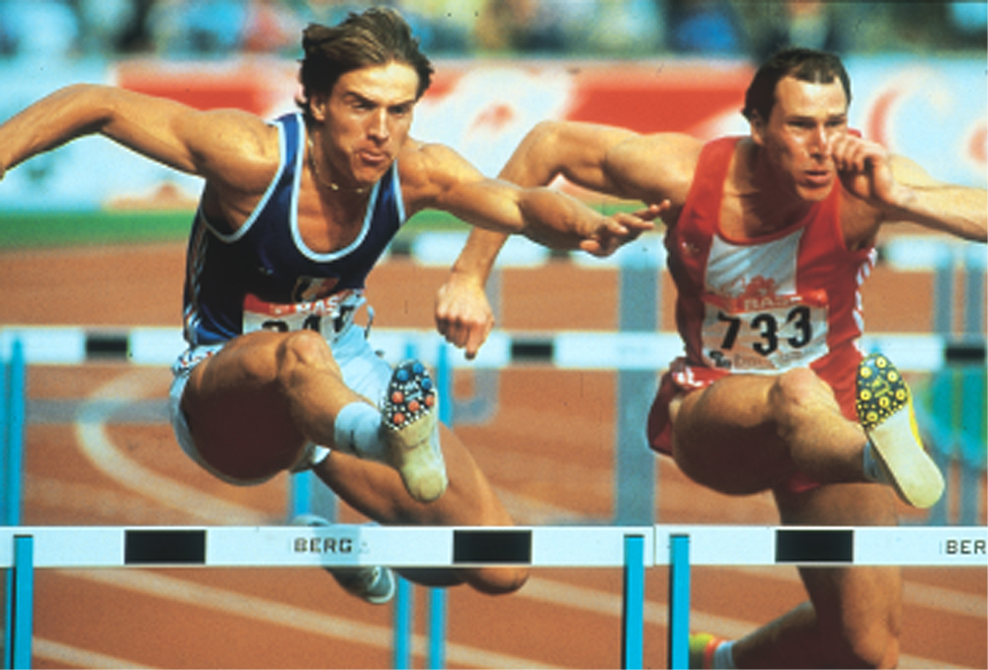
Acidic polysaccharides associated with the connective tissue. It gives joint lubrication

Slide 69
Hyaluronic Acid Benefits
Hyaluronic acid provides a cushion effect between the joints. You are able to move easier and feel less pain.
Hyaluronic acid provides a "reservoir of water" within the skin. Elasticity of skin is maintained by it
Hyaluronic acid reduces bacterial infections. Hyaluronic Acid has been found to raise the white cell count in your bloodstream.

Slide 70
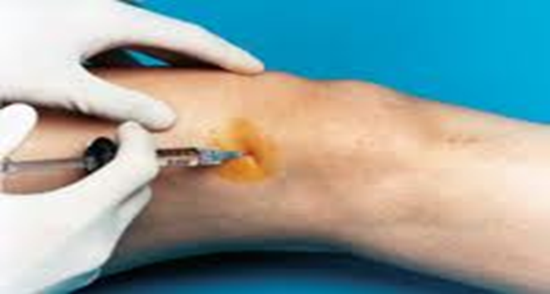
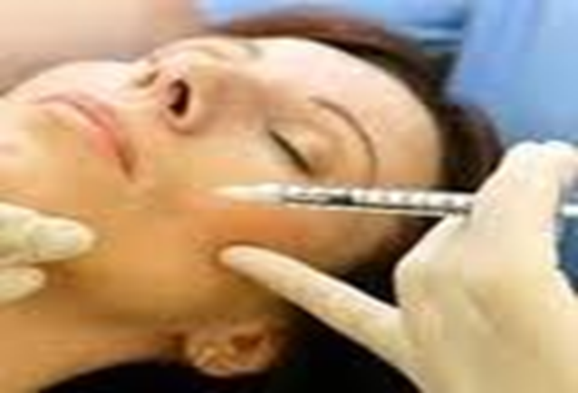

Slide 71
HEPARIN:-
composed of sulphated glucosamine & sulphated iduronic acid.
Linkage: α-(1-4)
occurs in lung, liver, spleen.
It is an anticoagulant used both in vitro & in vivo
Uses: Present in liver, lung, spleen etc. it is an anticoagulant used both in vitro & in vivo

Slide 72
2. CHONDROITIN SULPHATE:-
Composed of sulphated glucuronic acid & sulphated N-acetyl galactoseamine
Linkage: β -(1-4)
major constituent of connective tissue.
Occurs widely in bones, tendons & cartilages.

Slide 73
3. KERATAN SULPHATE:-
only GAG which does not contain uronic acid. Instead of uronic acid there is Galactose.
composed of galactose & N- acetyl gucoseamine.
occurs in cornea & tendons.

Slide 74
4. DERMATAN SULPHATE:-
composed of iduronic acid & N-acetyl galactosamine.
occurs in skin, blood vessels & heart valves.

Slide 75
 | Uronic acid | Amino sugar
Hyluronic acid
Heparin
Keratan sulphate
Dermatan sulphate
Chondroitin sulphate

Slide 76
MCQ

Slide 77
1.The glycosaminoglycan which does not contain uronic acid is
(A) Dermatan sulphate
(B) Chondroitin sulphate
(C) Keratan sulphate
(D) Heparan sulphate

Slide 78
2. N–Acetylglucosamnine is present in
(A) Hyaluronic acid
(B) Chondroitin sulphate
(C) Heparin
(D) All of these

Slide 79
3. The constituent unit of inulin is
(A) Glucose (B) Fructose
(C) Mannose (D) Galactose

Slide 80
4. Keratan sulphate is found in abundance in
(A) Heart muscle
(B) Liver
(C) Adrenal cortex
(D) Cornea

Slide 81
5.The polysaccharide used in assessing the glomerular fittration rate (GFR) is
(A) Glycogen (B) Agar
(C) Inulin (D) Hyaluronic acid

Slide 83
3. Cellulose is not digested by human being
(A) Lactase Deficiency
(B) Cellulose Deficiency
(C) Maltase Deficiency
(D) None of above

Slide 84
4 Linkages present in Glycogen
(A) 1-4 and 1-6
(B) 1-2
(C) 1-3
(D) All of these

Slide 85
5. Amylose is a constituent of
(A) Starch (B) Cellulose
(C) Glycogen (D) None of these

