Slide 1
Nutrition

Slide 2
Energy Requirement
Energy Requirement is predicted to maintain an energy balance in a healthy adult accordingly
  Age
  Gender
  Level of physical activity.
  Differences in the genetics.
  Body composition, metabolism, and behavior of individuals
For example,
  Sedentary adults = 30 kcal/kg/day to maintain body weight
  Moderately active adults = 35 kcal/kg/day.
  Very active adults = 40 kcal/kg/day.

Slide 3
Energy Content of Food: calorific value
The energy content of food is measured in calories.
It is calculated from the heat released by the total combustion of food in a calorimeter.
Expressed in kilocalories (kcal, or Cal).
For uniformity, many scientists are promoting the use of joules (J), rather than calories
1 Cal = 4.128 J.
The calorific value (energy density) of nutrients is energy yield per unit weight of food.

Slide 4
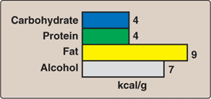
Average energy available from the major food components

Slide 5
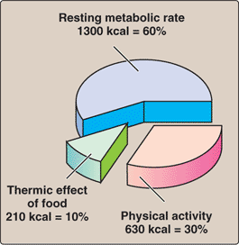
How energy is used in the body

Slide 6


Basal metabolic Rate
(BMR)

Slide 7
Definition
Energy required by an awake individual during physical, emotional and digestive rest.
It is the minimum amount of energy required to maintain life or sustain vital factions, respiration, etc.
The metabolic rate is less during sleep.

Slide 8
Factors affecting BMR.
Age: During the period of active growth BMR is high. It reaches maximum at the age of 5 yrs. In old age is lowered.
Sex: Males have higher BMR than Females.
Temperature : COLD- increases
Fever: 12% increases in BMR is noticed per degree centigrade rise in temperature.
Thyroid Hormones: Hyperthyroidism increases.

Slide 9
Normal Value
ADULT MEN -34-37 Kcal/sq.m/hour
ADULT FEMALE – 30-35 Kcal/sq.m/hour.

Slide 10
Specific Dynamic Action (SDA): Thermic effect of food
It refers to the increased heat production or increased metabolic rate following intake of food.
SDA can be considered as activation energy needed for chemical reaction.
250 gms of carbohydrates produce 250*4=1000 kcal., but before this energy is trapped 10% energy is drawn from the reserve of the body. Net generation is 1000-100=900 kcal.
Values for SDA: proteins 30%, lipids 15% and carbohydrates 5%.

Slide 11
MAJOR NUTRIENTS
Carbohydrates
Proteins
Fats
Vitamins
Minerals
Water

Slide 12
Carbohydrates’ Functions
Readily available source & supply most of the body’s energy needs
Antiketogenic
Structure of cells
Store calories as glycogen
Convert to fat
Amino acid synthesis
Cellulose as roughage

Slide 13
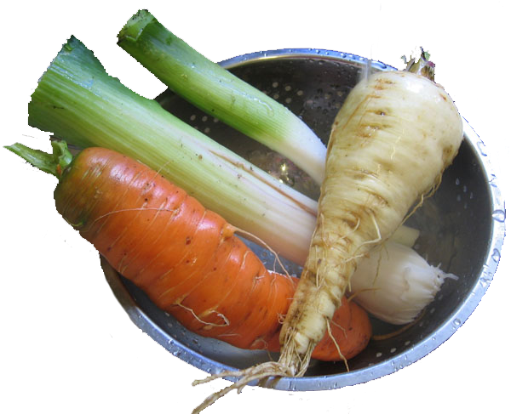
Dietary Fibers
Dietary fiber is defined as the nondigestible carbohydrates.
Soluble fiber = form a viscous gel when mixed with a liquid.
Insoluble fiber passes through the digestive track largely intact.
The recommended daily fiber intake (AI) is 25 g/day for women and 38 g/day for men.
E.g.: Cellulose, Hemi-cellulose, Lignin, Pectins.

Slide 14
Fibers: beneficial effects
  Adds bulk to the diet .
  Absorb 10–15 times its own weight in water, drawing fluid into the lumen of the intestine and increasing bowel motility.
  Delays gastric emptying and result in a sensation of fullness.
  This delayed emptying also results in reduced peaks of blood glucose following a meal.
  Consumption of soluble fiber decreases LDL cholesterol levels by increasing fecal bile acid excretion and interfering with bile acid reabsorption.

Slide 15
FIBRES
Fiber | Chemical nature | Physiological effect
Cellulose | Polymer of glucose | Retains water in feces, promotes peristalsis, and increases bowel action.
Hemi-cellulose | Pentoses , hexoses | Retains water in feces, increases bile acid and uronic acid excretion.
Lignin | Aromatic alcohols | Antioxidant, increases bile acid excretion, hypocholesterolemic.
Pectins | Partially esterified rhamno-galacturans | Absorbs water, slows gastric emptying, binds bile acids, increases their excretion.
Notes:
Fiber
Chemical nature
Physiological effect
Cellulose
Polymer of glucose
Retains water in feces, promotes peristalsis, and increases bowel action.
Hemi-cellulose
Pentoses , hexoses
Retains water in feces, increases bile acid and uronic acid excretion.
Lignin
Aromatic alcohols
Antioxidant, increases bile acid excretion, hypocholesterolemic.
Pectins
Partially esterified rhamno-galacturans
Absorbs water, slows gastric emptying, binds bile acids, increases their excretion.

Slide 16
Glycemic Index (GI)
Glycemic index is a number. It gives you an idea about how fast your body converts the carbohydrates in a food into glucose.

Slide 17
Foods low on the glycemic index (GI) scale tend to release glucose slowly and steadily.
Foods high on the glycemic index release glucose rapidly.
55 or less = Low (good)
56- 69 = Medium
70 or higher = High (bad)

Slide 18
FOOD | Glycemic index (glucose = 100)
HIGH-CARBOHYDRATE FOODS
White wheat bread* | 75 ± 2
Whole wheat/whole meal bread | 74 ± 2
Specialty grain bread | 53 ± 2
Unleavened wheat bread | 70 ± 5
Wheat roti | 62 ± 3
Chapatti | 52 ± 4

Slide 19
VEGETABLES
Potato, boiled | 78 ± 4
Potato, instant mash | 87 ± 3
Potato, french fries | 63 ± 5
Carrots, boiled | 39 ± 4
Sweet potato, boiled | 63 ± 6
Pumpkin, boiled | 64 ± 7
Plantain/green banana | 55 ± 6
Taro, boiled | 53 ± 2
Vegetable soup | 48 ± 5

Slide 20
FRUIT AND FRUIT PRODUCTS
Apple, raw† | 36 ± 2
Orange, raw† | 43 ± 3
Banana, raw† | 51 ± 3
Pineapple, raw | 59 ± 8
Mango, raw† | 51 ± 5
Watermelon, raw | 76 ± 4
Dates, raw | 42 ± 4
Peaches, canned† | 43 ± 5
Strawberry jam/jelly | 49 ± 3
Apple juice | 41 ± 2
Orange juice | 50 ± 2

Slide 21
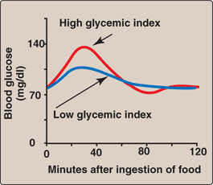
Glucose concentrations following ingestion of food with low or high Glycemic index.

Slide 22
Simple carbohydrates such as glucose or sucrose will have high GI. But the same quantity of complex carbohydrate will not increase the blood sugar.
The GI of carbohydrate is lowered if it is combined with protein, fat or fiber.
Although ice cream contains sugar, it has low glycemic index, because it contains lot of fat which prevent absorption.

Slide 23
GI OF FOOD ITEMS
ITEM OF FOOD | GLYCEMIC INDEX
POTATO CHIPS | 80-90
BREAD | 70-79
WHITE RICE ( POLISHED ) | 70-79
PARBOILED RICE | 60-69
BANANA | 60-69
MILK | 35-40
ICE CREAM | 35-40

Slide 24
Fats’ Functions
A concentrated & reserve source of energy
Physical protection for vessels, nerves, organs
Insulate against changes in temperature
Structure of body tissues, cell membranes & nuclei
Carry the fat-soluble vitamins (A, D, E, K)
Give appetite appeal
Aid satiety (delay emptying time of the stomach)
Spare protein
Supply linoleic acid, the essential fatty acid

Slide 25
Dietary Fats
The incidence of a number of chronic diseases is significantly influenced by the kinds and amounts of nutrients consumed.
Dietary fats most strongly influence the incidence of coronary heart disease (CHD).
Research now indicates that the type of fat is more important than the total amount of fat consumed.

Slide 26
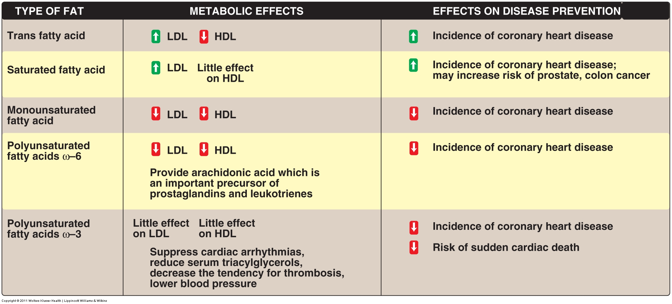

Slide 27
Proteins’ Functions
Supply amino acids for growth & repair of body tissues
Supply ions in acid-base balance
Part of hemoglobin, nucleoproteins, glycoproteins & lipoproteins
As enzymes, hormones, antibodies & cellular respiratory substance
Protective structure (nails & hair)
Source of energy when there is shortage of fats & carbohydrates

Slide 28


Protein-Energy Malnutrition
(PEM)

Slide 29
Protein-Energy Malnutrition
PEM most often affects children
  500 million children are malnourished
  Live in poverty
Adults may also be affected
  At greatest risk are:
    Those living in poverty
    Elderly living alone
    Addicts
    Those with eating-disorders
    Those with long-term illness

Slide 30
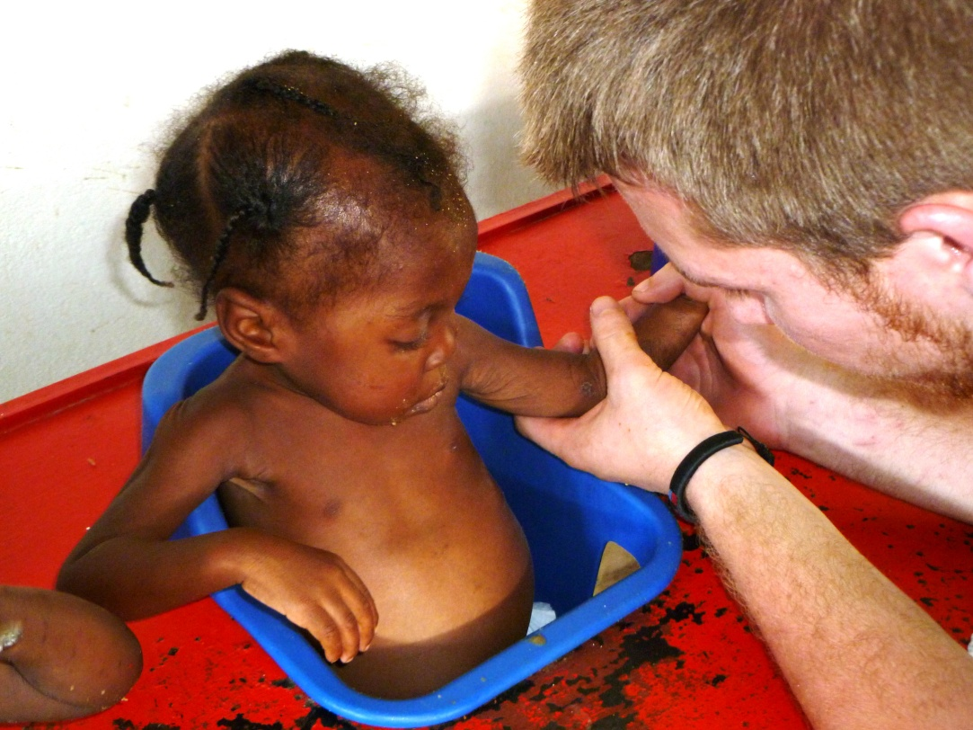
Protein-Energy Malnutrition
Most common is Africa, Central America, South America, Middle East, SE/E Asia
Also see in US
  Homeless
  inner-city
  rural poverty

Slide 31
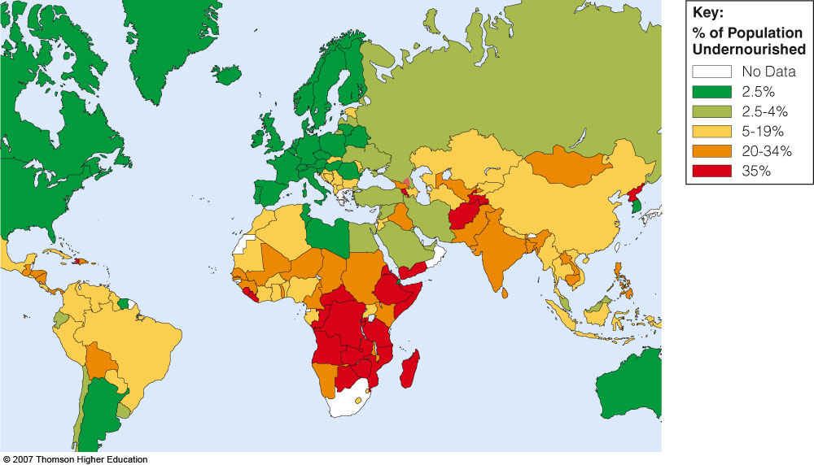

Slide 32
Types of PEM
Protein-Energy Malnutrition (PEM)
  also called protein-kcalorie malnutrition (PCM)
Classifying PEM –
Maramus –
Kwashiorkor –

Slide 33
 | Marasmus | kwashiorkor
Age of onset | Below one year | 1 to 5 yr
Deficiency of | Calorie and protein | protein
Growth retardation | Marked | present
Attitude | Irritable | Lethargic and apathetic
Appearance | No edema | always edema
Skin and hair | Dry and atrophic, hypo pigmented | Cracking, dermatitis
Serum albumin | 2 to 3 gm% | Less than 2gm%

Slide 34

Kwashiorkor – always edema
  Rapid onset, inadequate protein intake often after illness
  Older infants and young children, 18 months to 2 years of age
  Edema and fatty liver
  Apathy, irritability, sadness
  Loss of appetite
  Infections, is more common
  Some muscle wasting
  Loss of hair and skin pigments
  Skin scaly, cracked
Notes:
Often develops when mother stops breast feeding and child switches from high quality breast milk to cereal/starchy diet. Also seen after illness or infection…measles a common contributing factor. Not enough protein to make: antibodies, carriers for lipids, hemoglobin (Iron carrier(…free iron circulates and promotes bacterial growth)

Slide 35
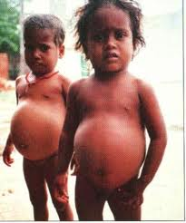
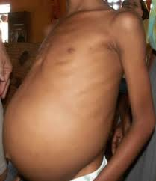

Slide 36
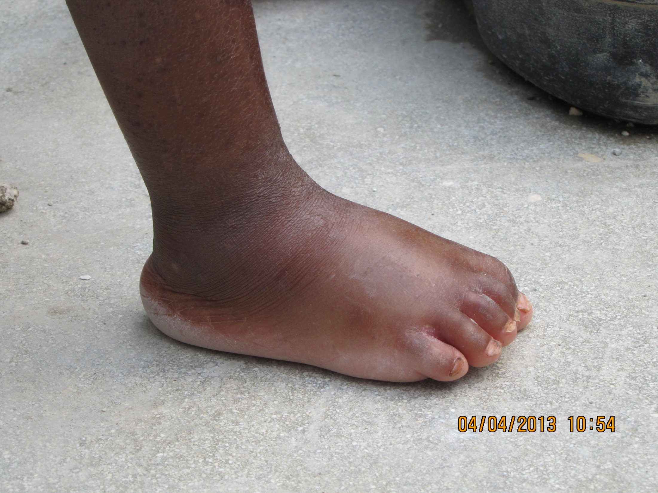

Slide 37
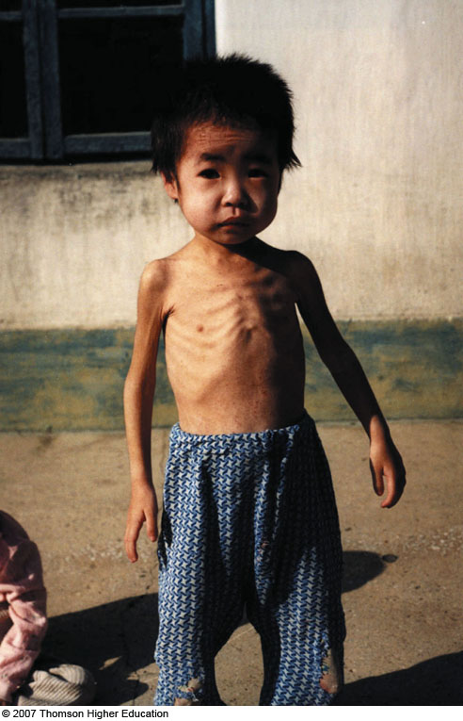
Marasmus – Chronic PEM
  Infancy, 6 to 18 months of age
  Diet inadequate to meet needs for calories, protein, essential FA….watery cereal is primary food
  Severe weight loss and muscle wasting, including the heart
  Anxiety and apathy
  Cold, no energy
  Hair and skin problems as in Kwashiorkor
  No edema or fatty liver

Slide 38
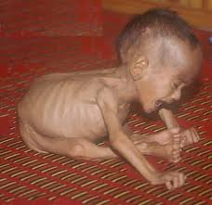
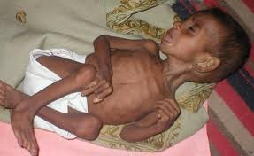

Slide 39
Biochemical alteration
Hypo albuminemia specially in Kwashiorkor
Level of Retinol Binding protein is also low.
IgG is increases due to associated infection.
Fatty liver may be in some cases of Kwashiorkor, but not in marasmus.
Hypoglycemia in marasmus children.
Hypomagnesaemia is usual findings

Slide 40
Treatment
Optimal response is observed with diet providing 150-200kcal/kg body weight and 3-4 gm of protein /kg body wieght.
A mixture of three parts of vegetable proteins and one part of milk protein is very effective.
Monitoring :
Disappearance of edema
Rise in serum albumin
Gain in weight.

Slide 41


Slide 42


Slide 43
Health Effects and Recommended Intakes of Protein
PEM - Infections lead to death in many cases
    Lack of antibodies to fight infections
    Fever
    Fluid imbalances and dysentery - contributes to kwashiorkor developing, weakens immune system even more
    Anemia – due to lack of hemoglobin
    Heart failure and possible death – due to all of the above
  Rehabilitation
    Nutrition intervention must be cautious, slowly increasing protein.
    Programs involving local people work better.

Slide 44
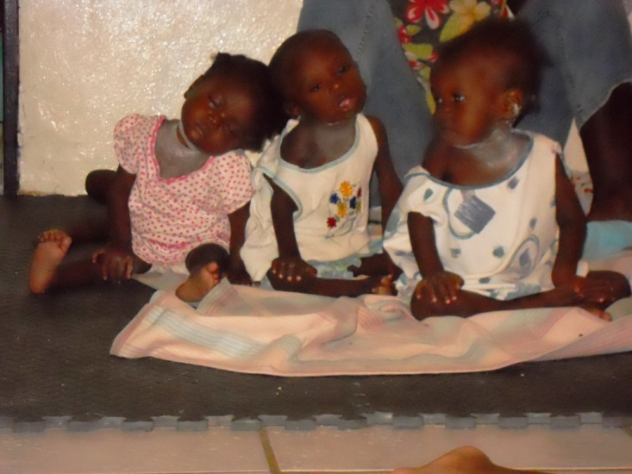
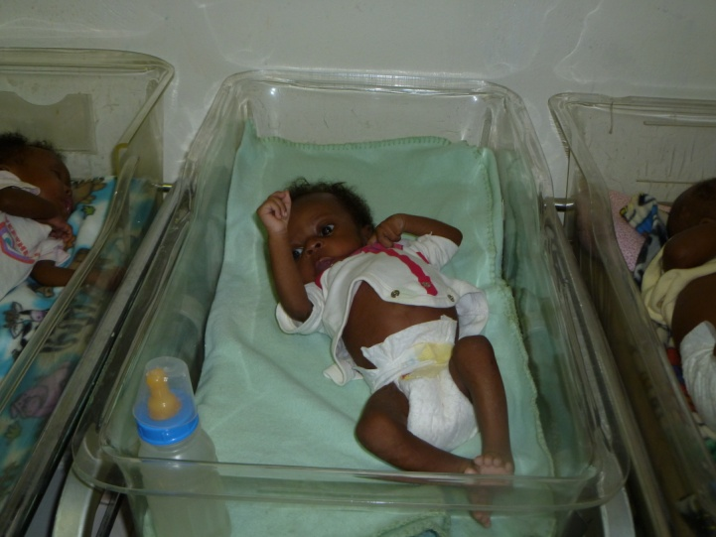

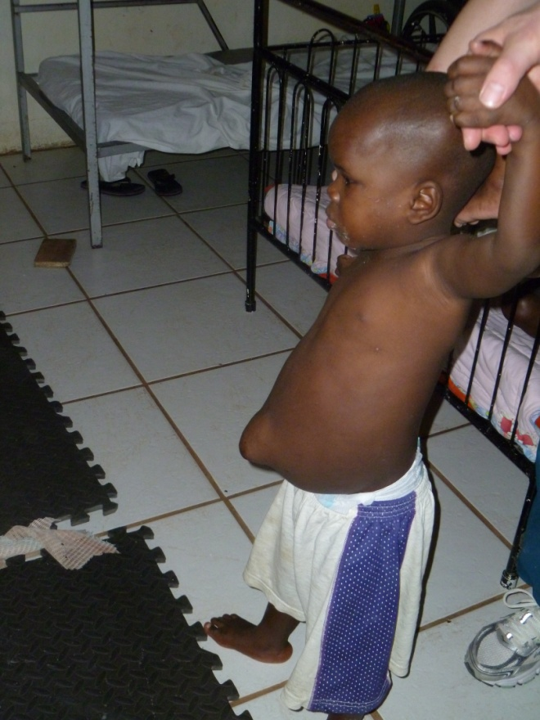
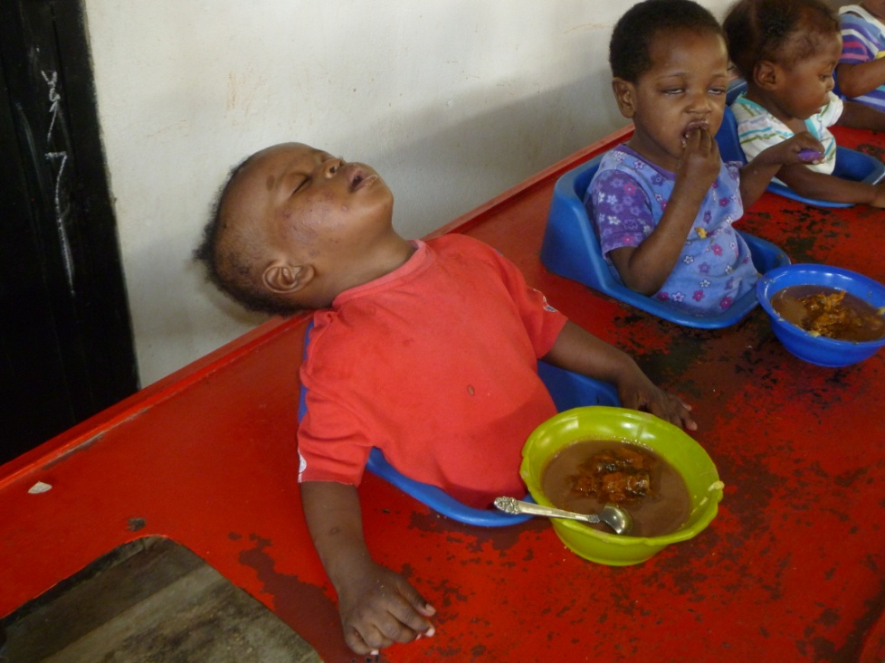
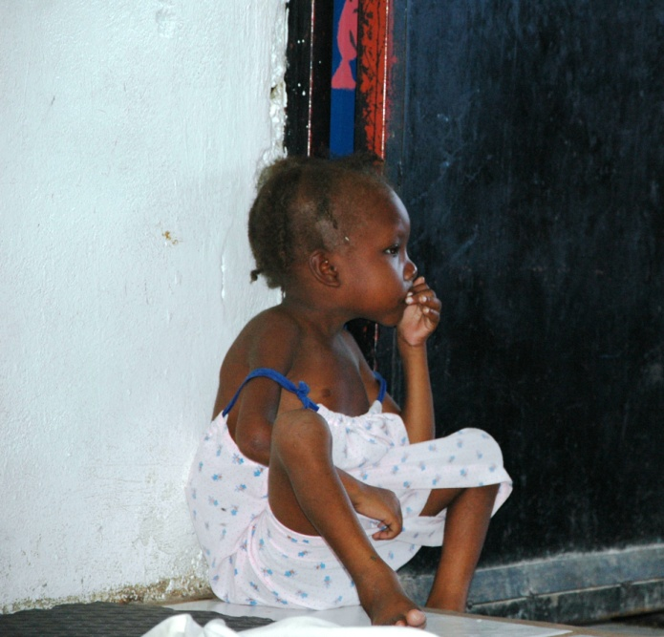
PEM in Haiti

Slide 45
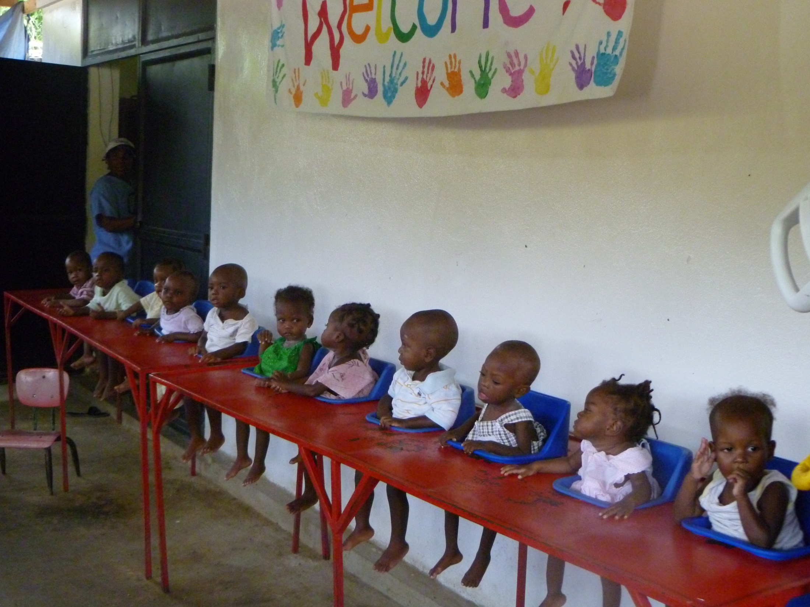

Slide 46



MCQ

Slide 47

1. Kwashiorkor is due to deficiency of
Lipids
calories
Proteins
Both

Slide 48
2. Marasmus is due to deficiency of
Lipids
calories
Proteins
Both

Slide 49
3. Edema found in
Kwashiorkar
Marasmus
Both
None of above

Slide 50
4. BMR Increases in
Fever
Hyperthyroidism
Growing children
All of above

Slide 51
5. Unit of Measurement of BMR IS
Milligram
Kcal/sq.m/hour.
Gram
International unit

